Slide 1

Common Application
Notes:
Welcome to the Brockton Public Schools' Guidance Department's presentation on the Common Application! My name is Andrew Papile and I am a guidance counselor at the Keith Center. I will be taking you through the first few slides of this presentation. The best way to view this presentation is through the desktop app. If you have not already done so, please click “Open in Desktop App” located near the top of your screen. This session is intended for Seniors and will cover the many features of the Common Application's online tool for first time users.

Slide 2
Getting to know the Common App
Notes:
If you are a college bound senior, the chances of working with the Common Application are very high. Many colleges and universities use the Common Application as part of the process to apply for admission. In the next slide, we will begin to introduce the many features that the Application offers and help you learn to navigate through it.

Slide 3
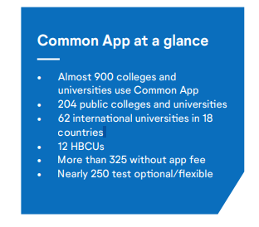

What is the Common App?
Most 4 year colleges and universities require the Common App.
Common App is a free college application tool, but most colleges still require an application fee*.
With Common App you only need to use one system to apply to multiple colleges & universities.
https://www.commonapp.org
* Please speak with your school counselor to discuss if you are eligible for a fee waiver.
Notes:
What exactly is the Common App.? Common App is a place for you to learn about the college admissions process, understand how to plan and apply to college, and discover all that different colleges have to offer. It’s a hub of information that can guide you through each step of the application journey. It’s a resource that connects you with financial aid and scholarship opportunities.
The Application is used by a majority of 4-year colleges in the United States and allows students to complete one application that can be sent out to any school that uses it.
While the Common Application is a free tool to use, many colleges do still require a fee to apply for admission. Brockton Public Schools does, however, offer fee waivers for some college applications. Any of the following indicators of economic need can qualify you for a Common App fee waiver:
• You have received or are eligible to receive an ACT or SAT testing fee waiver
• You are enrolled in or eligible to participate in the federal free or reduced price lunch program (FRPL)
• Your annual family income falls within the Income eligibility guidelines set by the USDA Food and Nutrition Service
• You are enrolled in a federal, state, or local program that aids students from low-income families (e.g., TRIO programs such as Upward Bound)
• Your family receives public assistance
• You live in a federally subsidized public housing, a foster home or are homeless
• You are a ward of the state or an orphan
• You can provide a supporting statement from a school official, college access counselor, financial aid officer, or community leader
Please speak with your School Counselor to discuss your eligibility for a fee waiver. Your counselor will be asked to complete a fee waiver form to affirm your request.

Slide 4
2
There are main parts to complete:
A set of common application questions
Each college’s own specific questions
The best part is you only need to fill out the common questions one time!
Notes:
As you begin to fill out the Common Application for the first time, please note that there are two main parts to consider.
1. There are Common-App. questions which are general and shared by all schools using the App. These questions ask about your demographics, contact information, languages and citizenship.
2. Colleges may also present their own set of questions specific to their school. Later, you will hear more about these types of questions.
When you complete all parts and hit submit, the Common App combines all your responses into one form.

Slide 5
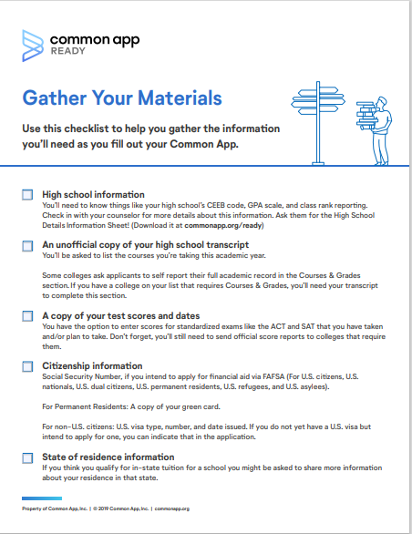
Gather Materials
Gather this information, BEFORE you start!
Get an unofficial transcript from your school/guidance counselor
Make a list of activities, work, and family responsibilities
SAT/ACT test scores, if needed
Parent/Guardian information
Academic honors & achievements
Complete the senior college interview with your counselor
Click image
Notes:
It is important to focus on gathering all of the materials that you need to complete the App. before you get started working on it. The items that you will need include:
- An unofficial transcript which can be obtained directly from your counselor
- A list of activities, work and family responsibilities which can be used to create a resume
- Any SAT or ACT scores, if required by the schools you plan to apply to
- Contact information for your parents or guardians
- Any academic honors you have achieved
- A completed senior interview with your counselor
You may click the image on the right side of the screen to access a material checklist which can help you stay organized as you begin working on the Common App.

Slide 6
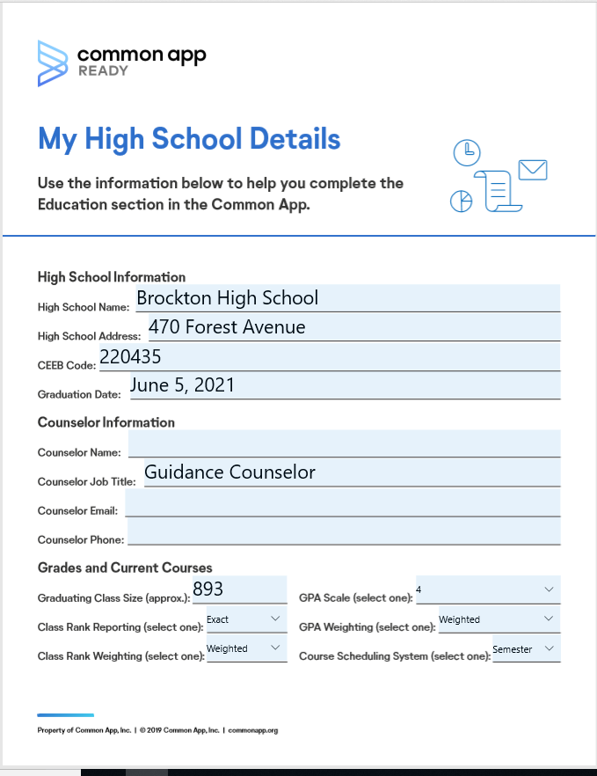
Example
High School Details
Notes:
HI, my name is Heather Arrighi and I am school counselor in the green building at BHS. In the Common App, all students need to answer several questions about their high school and counselor. This sheet will help your answer those questions. You guidance counselor will provide you with a completed version of this form.

Slide 7
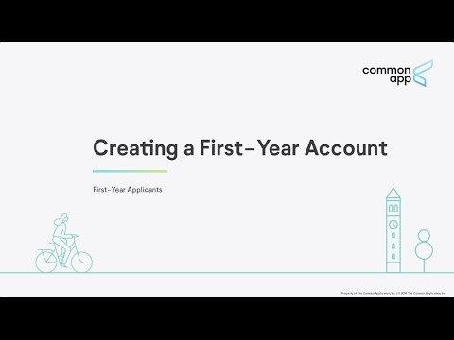

Creating an account
FYI: Common App can ONLY be access through Google Chrome!
Notes:
Once you have gathered all the necessary information, it is time to create an account. Watch this video to learn how to create a first year account in the Common App. Please note that the Common App can ONLY be accessed through Google Chrome.

Slide 8

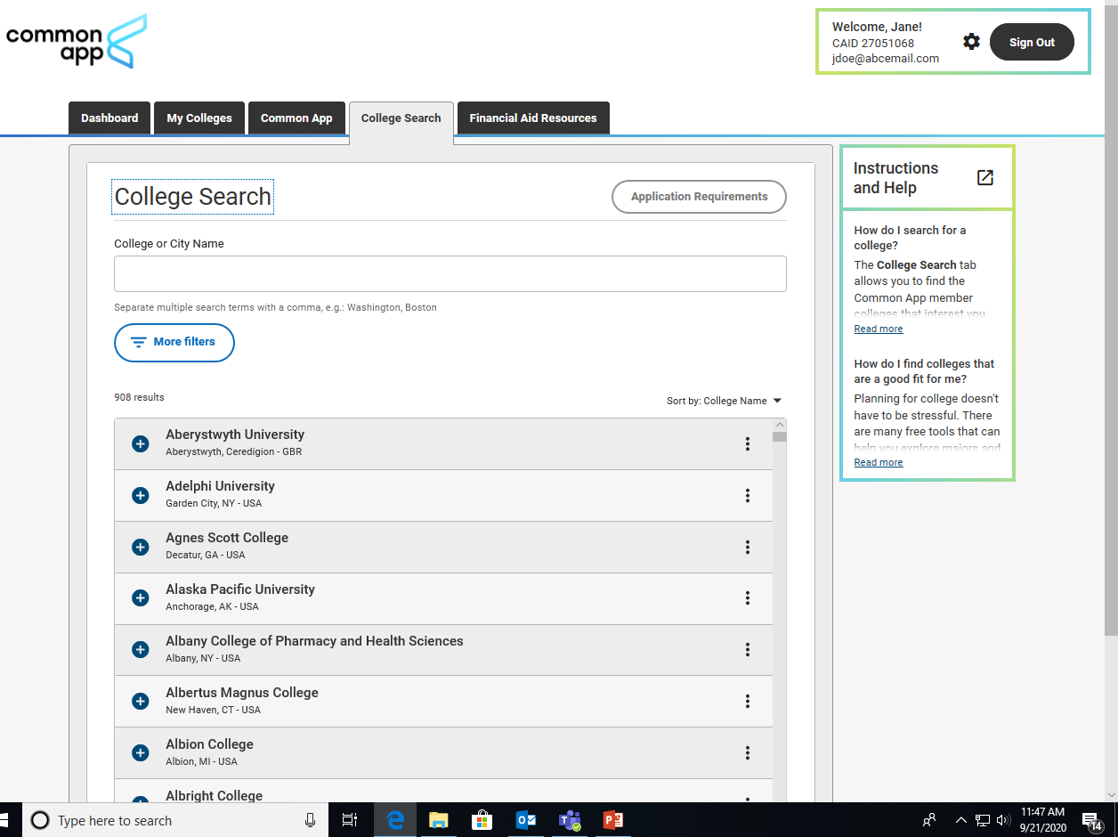
Exploring Colleges
The College Search tab is where you will search for and add the colleges you want to apply to.
If you have a school in mind you can search by name.
If you want to explore, you can use the more filters button. Some filters include:
State or country
Application deadline
Writing requirements
Standardized testing policy
Recommendation requirement
Notes:
After creating an account, you are going to want to start exploring different colleges and universities. If you already know the schools you want, you can search for them by name. If you want to explore colleges, try using the filter button to narrow down your results. You can filter by State, Application deadline, testing requirements, and more.

Slide 9
Adding a college is easy
You may add a college using the add button in the search results list.
You can also select a college and add them using the "Add to My Colleges" button from their info screen.
You may only add up to 20 colleges, but can adjust your list at any time.
Notes:
After exploring or if you know your college choices already, you will want to add the college to your Common App account. You can do this by using the add button in the search results list or you can select a college and add them using the “Add to My Colleges” button from their info screen. Remember, you can only add up to 20 colleges, but can make changes to the list at any time.

Slide 10


Types of Colleges to Add
Probable
A probable school is a school where the chance for admission is strong, and might include a 2-year community college.
Apply to 1-2 probably schools.
Target
A target school is looking for a candidate similar to you in terms of your GPA, SAT scores, and extra-curricular activities.
Apply to at least 3-4 target schools.
Reach
Reach schools are colleges requiring high GPA’s and SAT scores that are very competitive and selective.
Apply to 1-2 reach schools.
Notes:
As you may remember from the Senior presentation, you want to make certain you are applying to appropriate schools according to your academic background. Therefore, you should choose between 4 to 6 schools which include:
1 or 2 reach schools
Reach schools are colleges requiring high GPA’s and SAT scores that are very competitive and selective. These are schools where your chances of admission are less than 50%.
3 or 4 target schools
Target schools are schools that are looking for a candidate similar to you in terms of your GPA, SAT scores, and extra-curricular activities. These are schools where the chances of admission are 50/50.
1 or 2 probable schools
Probable schools are schools where the chances for admission are strong and might include 2-year community colleges just in case you don’t meet the eligibility requirements of other schools you applied to. You can always transfer to another 2-year program once you complete your associate’s degree.
Remember to carefully consider finances when making these decisions.

Slide 11

Engage your supporters
Notes:
My name is Donna Neary and I am a Guidance/School Counselor in the yellow building at BHS. I will be reviewing the next few slides with you.

Slide 12
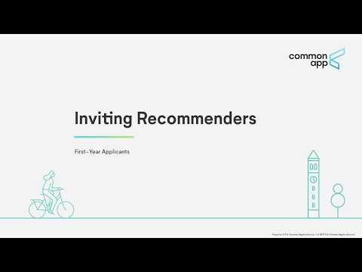

The FERPA release authorization asks you 2 questions. First, you must grant Brockton High School permission to release ALL requested records sent to colleges on your behalf. Second, you will be asked to waive your right to review recommendations.
Please note: Some teachers may not be willing to write a recommendation unless you waive this right.
Notes:
It is time to ask 2 teachers for your College Recommendations. If you need help selecting your recommenders, ask your Counselor for help. If your teachers agree to write a recommendation, you will need to have their email to invite them to the Common App. Follow the same procedure for your Guidance/School Counselor.
Watch the video to learn the process for inviting recommenders.

Slide 13

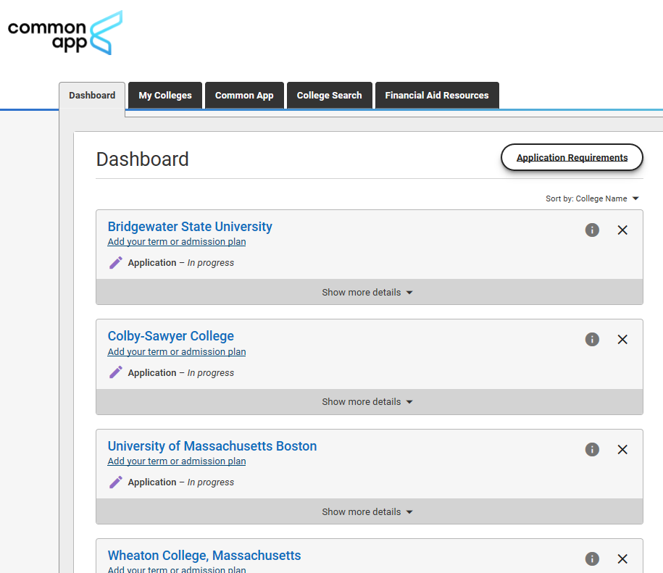
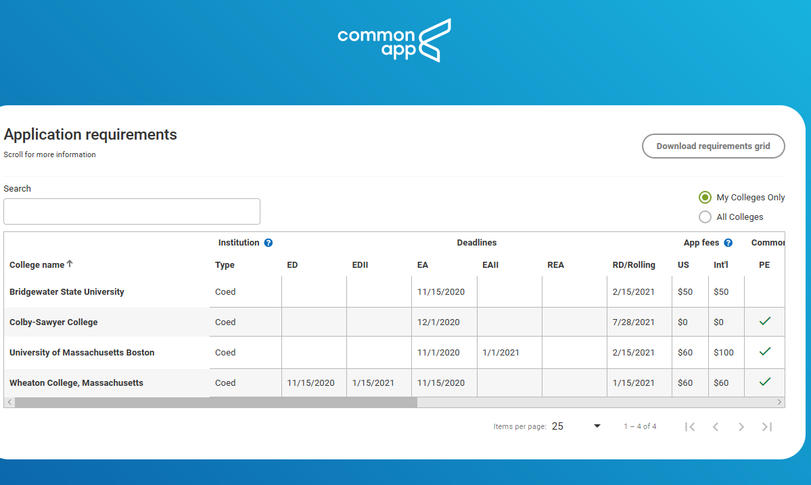
Understanding requirements
The requirements grid is a useful listing of every college that accepts the Common App. It displays key information about these colleges in a concise format, such as the deadlines, application fees, writing requirements, & more.
Notes:
Every college that you put on your DASHBOARD will lead you to the college applications. But what is required from you, to complete each individual applications? The Common App knows that applying to college can be confusing and overwhelming., so on the upper right hand corner of the screen there is a button labeled APPLICATION REQUIREMENTS. By clicking this button, you will see a grid with all the important information for all of your schools that are on your dashboard.
It is important to remember that if you miss an application deadline, then you will not be able to apply to that school.

Slide 14
check requirements with the college directly
ALWAYS
Due to COVID-19, college admission requirements may have changed. Visit the school’s website or call their admissions office to double check requirements.
Notes:
Now that you have researched your college requirements and have looked at your application grid, It is time to contact the colleges by phone. Because of COVID-19, Schools may have on-line or limited tours, some of the requirements may have changed and some schools may have moved their application deadlines. Other schools have gone to SAT/ACT optional or may have completely waived the testing. Unfortunately, the Common App may not have reflected these changes in their information, so it is up to you to stay informed

Slide 15
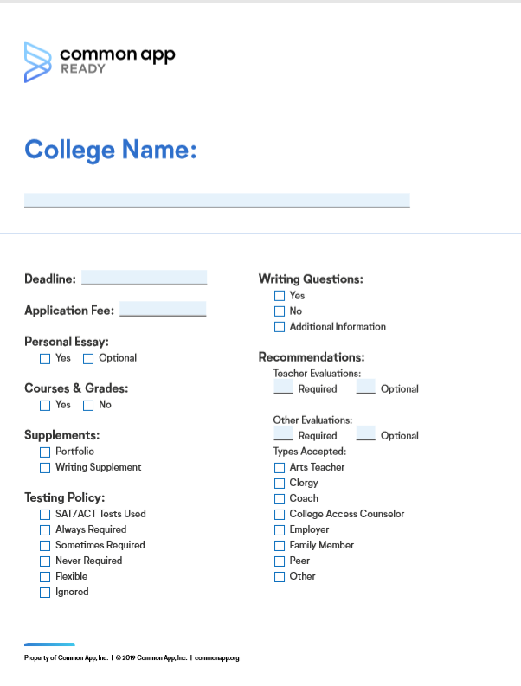
Organize Yourself
Notes:
It is important, for every college that you are considering, that you stay organized. You should fill out this college sheet for each of your schools, this will help you to stay focused and on track.

Slide 16

Plan your Essay
Notes:
It is Heather Arrighi again and I will be walking you through the last few slides. The Common App essay provides you the opportunity to tell the readers of your application about yourself apart from courses, grades, and test scores. The best essays help you to stand out in a crowd and reveal who you are and how you think. Sure, you can write a good essay about anything, but an essay often has the most impact if it highlights something that is unique or unusual about you.

Slide 17

As you work on your applications you can find essays or short answer questions in three sections:
Common App Personal Essay
College Specific
Writing Supplement
Colleges can either make the personal essay optional or required.
Many colleges include short answer questions or essay prompts within this section.
Some, not all, colleges use a separate writing supplement. Some colleges only request this supplement based on how you answer other questions.
** Special COVID-19 section**
Notes:
In the Common App, there are questions in three section – the personal essay, college specific For the common app personal essay, there are 7 prompts but endless possibilities to tell your story. One example of a prompt reads like this: The lessons we take from obstacles we encounter can be fundamental to later success. Recount a time when you faced a challenge, setback, or failure. How did it affect you, and what did you learn from the experience? There are many ways to answer this question. You obstacle could be big or small, personal or societal. Hardships faced by family and friends can also impact you. Perhaps it is an unresolved challenge that you are still struggling with. However you decide to answer, make sure to use your own voice, be honest and concise.
For the Common App, your answer must be completed using between 250 - 650 words. Remember, a well written essay can push a borderline applicant into the "Admit" column.
Many schools will ask you specific questions. College specific questions are usually shorter and may ask you things like describe a leader you admire and why did you choose this college. Remember to watch for word limits and read all instructions carefully.
Some schools will ask for a SEPARATE writing supplement. It may only be requested based on how you answer other questions. An example of a writing supplement question is "How will you contribute to the college community?"
Finally, this year, the Common App is including a special 250-word section allowing students to describe the impacts of COVID-19 on their lives. This is an optional question and you are not required to answer it. However, it you feel as though you need to address your COVID-19 experience in your college application, then you should elaborate on the impact of the pandemic, both personally and academically. It is recommended that you explain this experience here and NOT in other writing sections of the Common App.

Slide 18

5 steps to writing a college essay
Not only is the college essay a place to showcase writing skills, it's one of the only parts of a college application where a student's voice can shine through.
Explore essay prompts & select a topic.
Start an outline BEFORE jumping in.
Write the essay & leave time for multiple drafts.
Edit & proofread your essay.
Submit your essay.
Talk to your English Teacher. S/he may be willing to read your essay and offer suggestions.
Notes:
Remember, the essay will be yet another image of yourself, therefore, you want to send in an essay that, not only reflects you personally, but that is well written and void of mistakes and typographical errors. Once you submit the essay, you cannot go back and change anything!! Look at all the prompts before selecting a topic. Don't just pick the first one you see. Make an outline before you start writing. This will help organize your answer. Next, start writing your essay. Don't wait to write your essay. Any good piece of writing take multiple drafts. You'll want to edit and proofread your essay to make sure you've used proper spelling, grammar and punctuation. Get feedback from others. Ask your friends, family and even your English teacher to read your essay and tell you what they think. Be open to suggestions and ways to improve it, even if this means going back to the drawing board. When you've read and re-read your essay and made all your edits, you can finally submit. Please remember that once you submit your essay you CANNOT go back and make changes.

Slide 19
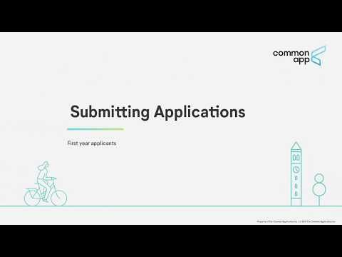
Submit Your Applications
Submission is a 3 step process:
1) Reviewing your application.
2) Paying the application fee.*
3) Submitting your application.
Notes:
You've done all the hard work and now it is time to submit your application. Submission is a 3 step process. Watch this video from the Common App to learn more about this final step.

Slide 20

Let’s review the steps
1. Gather Materials
Attend a senior college meeting with your school/guidance counselor
4. Engage Supporters
Every college gets to choose their own recommendation requirements. You will need to invite and assign recommenders.
7. Review & Submit
1. Review your application
2. Pay the fee
3. Submit
2. Create a Common App Account
It is free and easy to do! Make sure to use a email address you use often. Also, be sure to use your legal name.
5. Plan Essays
This can feel overwhelming. But, with a little bit of planning, organizing and drafting, you can get the job done.
😉
3. Explore & Add Colleges
You can add up to 20 Colleges. Be sure to have a mix of probable, target and reach schools
6. Understanding Requirements
It is important to stay organized as you work on your application. Each college can have unique requirements
Notes:
Let's review the steps to Common App. First, gather all necessary materials. Some of these you will receive during the senior interview with your guidance counselor. Next, create a common app account. Make sure to provide them with an email account you check often and to use your legal name. The third step is to explore and add colleges to your dashboard. You can add up to 20 schools. Next, engage your supports. These are the people who will give you recommendations. After you've added recommenders, you going to plan your essay. This can be overwhelming so start ASAP and plan on creating multiple drafts. The sixth step is to understand each college's admission requirements. You should check with each college individually to ensure you understand their specific requirements. Finally, you are going to review your application and submit. Sit back and take a deep breath. You have completed the Common App. Be sure to check your email account frequently for any updates or additional questions from the colleges you applied to.

Slide 21

Got questions?
Contact your School Counselor
Notes:
Still confused, or need more help? Contact your School Guidance Counselor. He or she will be able to answer your questions and offer additional support throughout this process. On behalf of the Brockton Public Schools’ Guidance Department, we want to thank you for watching this presentation. We look forward to helping you reach your post-secondary goals.

