Slide 1
Financial Aid
Plan, apply, and pay for college
Better job?
Personal Growth?
Discover your passion?
M. Clarke Paine
Director of Financial Aid
Franklin & Marshall College

Slide 2
What Will Be Presented
What to Do Now
Role of the Financial Aid Office
How to Apply for Financial Aid
Types of Financial Aid
Your Questions

Slide 3


Slide 4

Discuss College Finances Now
Family
The Hun School Professional Staff
College Admission Office
Financial Aid Office
Others

Slide 5


Slide 6
Net Price Calculator (NPC)
(Web-based Tool to Use Now!)
When cost is a factor, use the Net Price Calculator
Each school is required to have one – many use a similar tool, so you may only have to enter data one time
This will help you in determining the “net price” of the school. Don’t let “sticker price” scare you. You may be eligible for more financial aid than you think and what you need to be concerned about is what the “net price” will cost.
Be very careful when inputting the data – the output data your receive will only be as accurate as your input. If you put wrong information in, it may give you misleading output. Read the questions very carefully.

Slide 7
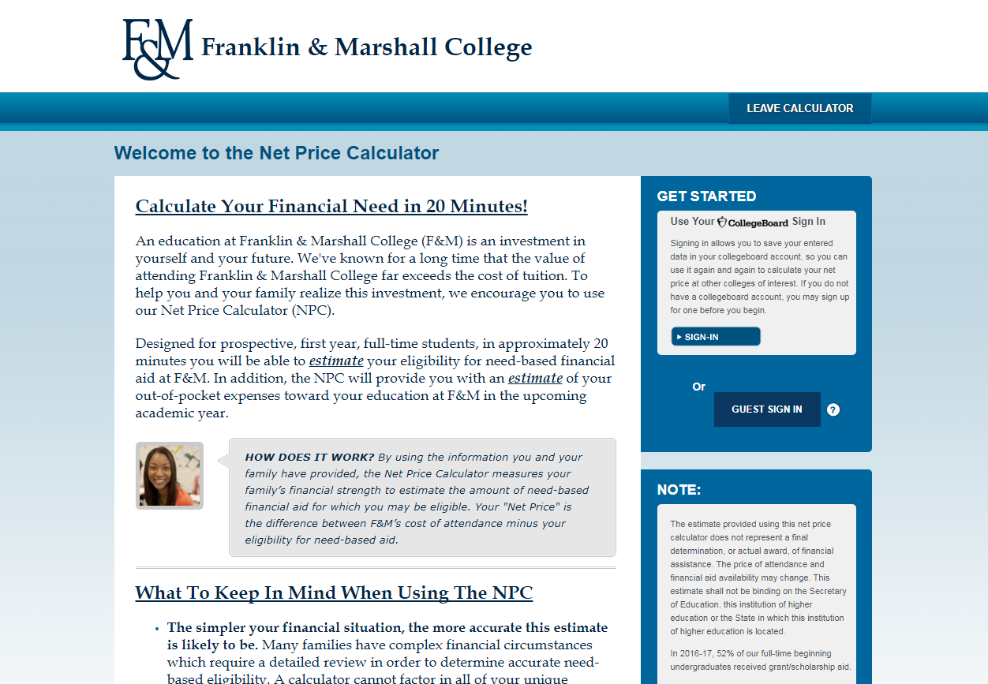
Net Price Calculator

Slide 8
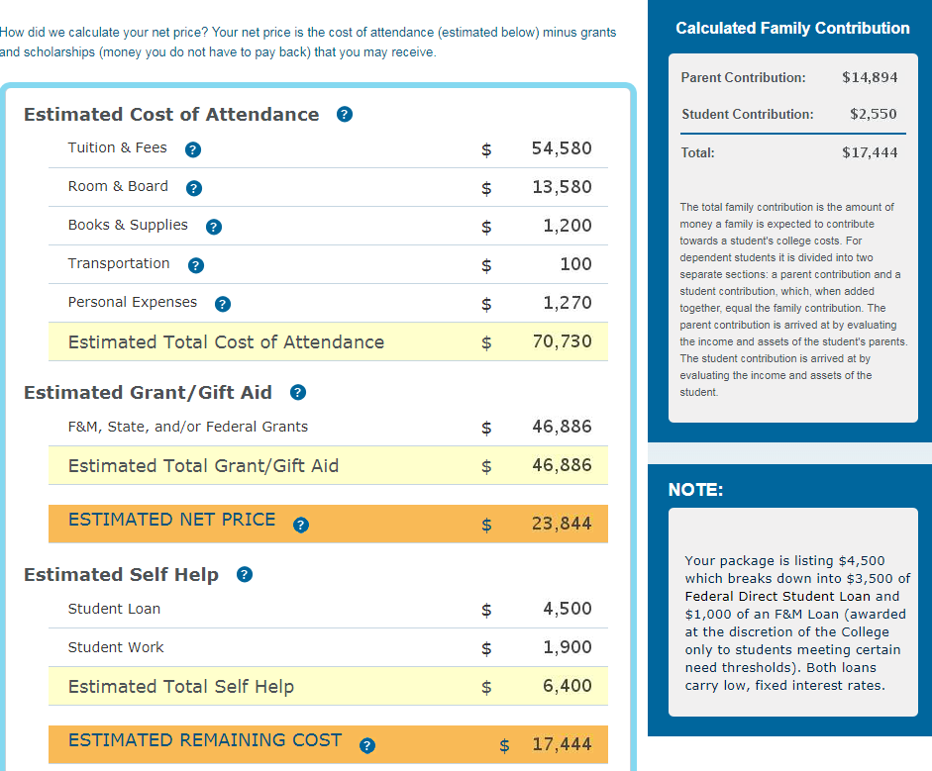



Slide 9
Role of the Financial Aid Office
Assist families throughout the financial aid process.
Assist in the recruitment and retention of students.
Determine final eligibility for need-based aid
Package aid
Notify student of aid, which detail:
  Type(s) and amount of aid
  Disbursement procedure
  Conditions of aid programs
Assist families throughout the financial aid process!!!

Slide 10
Principals of Financial Aid
Student and parent(s) have primary responsibility for funding postsecondary education to the extent they are able.
Families will be treated equitably and consistently by the need-analysis formula.

Slide 11
You Can be Considered . . .
for these types of financial aid when you electronically file the
FAFSA
and
CSS/PROFILE
Both applications available beginning October 1st of Senior Year

Slide 12

Purpose of Each Application
FAFSA - Determines your eligibility for need-based aid from the Federal & some State Governments.
CSS/PROFILE - Determines your eligibility for need-based aid for some colleges institutional funds.

Slide 13
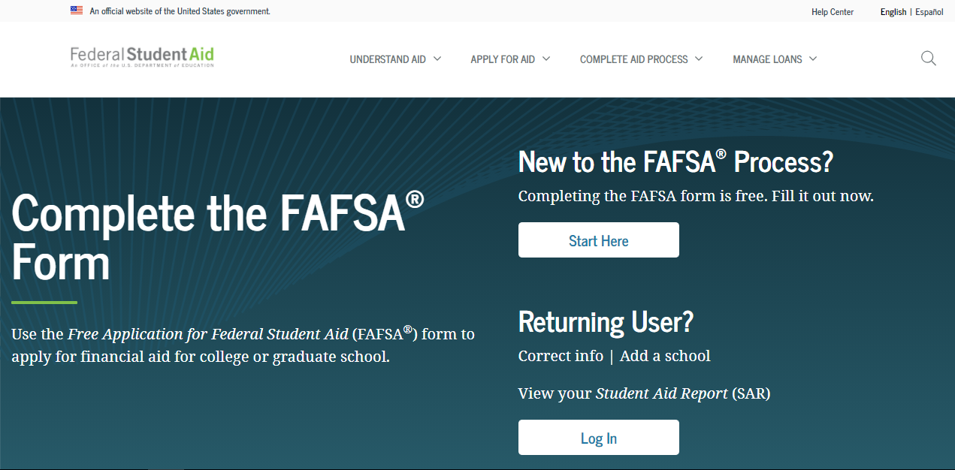
For the FAFSA, start here . . .
  Make a correction
  Providing Signatures
  Continuing a Saved FAFSA
  Viewing your Student Aid Report (SAR), etc.
  New Mobile App!

Slide 14
How To Begin To Apply
Students and parents will need to create an FSA ID which is comprised of a username and password. Your FSA ID can be used to:
  Electronically sign Federal Student Aid documents,
  Access your personal records, and
  Make binding legal obligations.
  If you are a parent and need to electronically sign your child’s FAFSA, you need your own FSA ID. If you have more than one child attending college, you can use the same FSA ID to sign their applications.
  If you do not already have an FSA ID and would like to apply for one, select the Create an FSA ID tab on the FSA ID log-in page.
For more information, see Federal Student Aid Online at: https://fsaid.ed.gov/npas/pub/faq.htm

Slide 15
Be Prepared to Submit 2019 Federal Tax Documents
Federal Tax Documents
  Tax Return (1040, 1040A, 1040EZ)
  Tax Schedules
  Business Tax Returns
  W-2s
  Parent and Student
  Supplemental documents

Slide 16

How Is My Financial Aid Determined?
  Colleges determine your financial aid based on the following equation. Also known as “Need Analysis.”
Cost of Attendance (COA)
Expected Family Contribution (EFC)
Financial NEED (Financial Aid Eligibility)
Notes:
16

Slide 17

What is the Expected Family Contribution (EFC)?
A figure derived from the information that you/your parents submitted on the FAFSA and CSS/PROFILE.
The EFC is used to determine the types and amounts of need-based aid you may receive.
Notes:
17

Slide 18

What is the Cost of Attendance COA)?
Also known as the Student Budget, includes most everything related to college expenses for one academic year which is nine (9) months.
Tuition and fees
Room and meal plan
Books and supplies
Transportation
Miscellaneous educational expenses
Notes:
18

Slide 19
Sources of Aid
Federal
State
Institutional
Private

Slide 20
Types of Financial Aid
Gift Aid – Free Money
Student Loans – Must Be Repaid
Student Employment – Spending Money

Slide 21

Federal Financial Aid Programs
Pell Grant
  Federal EFC of 5500 or lower
  Maximum = $6,345/year
SEOG
    Priority to Pell Grant recipients
    Maximum = $4,000/year
Federal Work Study (FWS)
    Job on campus or in community
    Minimum wage or higher

Slide 22
Federal Direct Student Loan Program
Subsidized Loans – Current Rate 2.75%
  Must have financial need to qualify
  No interest accrues until while student is enrolled in school
Unsubsidized Loans – Current Rate 2.75%
  Not based on financial need
Variable-Fixed Interest Rate – rate changes July 1 each year, but whatever the rate is at the time the loan is disbursed, it will be fixed for the life of the loan.
Loan fees of 1.057% are assessed at disbursement.
Interest rates are based on 10-year Treasury Bill plus a percentage add-ons. To view chart of historical interest rates:
http://www.direct.ed.gov/calc.html

Slide 23
Federal Direct Loan Limits
Year in College | Base Limit Subsidized or Unsubsidized Loan | Extra Unsubsidized Federal Stafford Loan² | Total Guaranteed and Awarded Amount for Academic Year | Additional Unsubsidized Loan | Total Potential Academic Year Limit
1st year | $3,500 | $2,000 | $5,500 | $4,000¹ | $9,500
2nd year | $4,500 | $2,000 | $6,500 | $4,000¹ | $10,500
3rd year | $5,500 | $2,000 | $7,500 | $5,000¹ | $12,500
4th year | $5,500 | $2,000 | $7,500 | $5,000¹ | $12,500
Must be a Dependent Student whose Parents were denied the PLUS Loan Student may need to request the additional amount by contacting the Office of Financial Aid

Slide 24
Federal Direct Student Loan Program
REPAYMENT
Begins 6 months after the student leaves school (graduates, withdraws, leave of absence)
Lender is the U.S. Department of Education

Slide 25
Institutional Aid
May be grants, scholarships, loans, employment
May require institutional application and/or other supplemental financial aid forms
Deadline dates are very important
Each institution varies in resources available for awards, percentage of need met, & what formula they use
Contact the Admissions or Financial Aid Office at each institution being considered

Slide 26

Professional Judgment
Reduction in income
Extraordinary medical or dental expenses
Unreimbursed child care expenses
Disability expenses
Tuition for elementary or secondary school
Documentation/Forms will likely be required.
Contact the Financial Aid Office(s) of the school(s) for more information.
*** 2020 OR 2021 income compared to 2019 income on FAFSA

Slide 27
Alternatives for Meeting Need
Institutional or private 10 month payment plans
Federal PLUS loan
  Loan in parent’s name (biological, adoptive, or step-parent)
  Based on credit
  Lender is the U.S. Department of Education
  Payments for principle can be deferred each year for up to 4 years (provided the student is enrolled at least half-time)
    Current rate: 5.30%
    Loan fees of 4.236% are assessed at disbursement
  To see a chart of historical interest rates: http://www.direct.ed.gov/calc.html
Alternative loans
  Loan in student’s name, but usually requires a credible co-signer
  Money from private banks
    Variable interest rates and terms
    Check with aid office for a listing
  Payments for principle are deferred generally until 6 months after student graduates or drops below half-time status (continue to pay interest on loan)

Slide 28
What Can You Do Now if You are Not a Senior?
FAFSA4caster.ed.gov
  This allows you to find out your eligibility for federal student aid by estimating your eligibility early in order to help you get better insight when making college choices.
  This is not just for high school juniors.
  Parents can use this tool to receive early estimates, create scenarios based on future earnings, and then establish college savings strategies.
  When finished you can see your estimated federal student aid eligibility information based on the answers provided in FAFSA4caster.
LOOK FOR SCHOLARSHIPS!!!
  Apply for any you can now – pay attention to deadlines!
  Be prepared for those you can apply for when it is time (generally your senior year of high school is the earliest you can apply for most).

Slide 29

Higher Education Tax Benefits
Education Credits
American Opportunity Credit
Student loan interest deductibility
Tuition and Fees Deduction
Coverdell Education Savings Accounts (ESA), previously referred to as Education IRAs
529 Plans

Slide 30
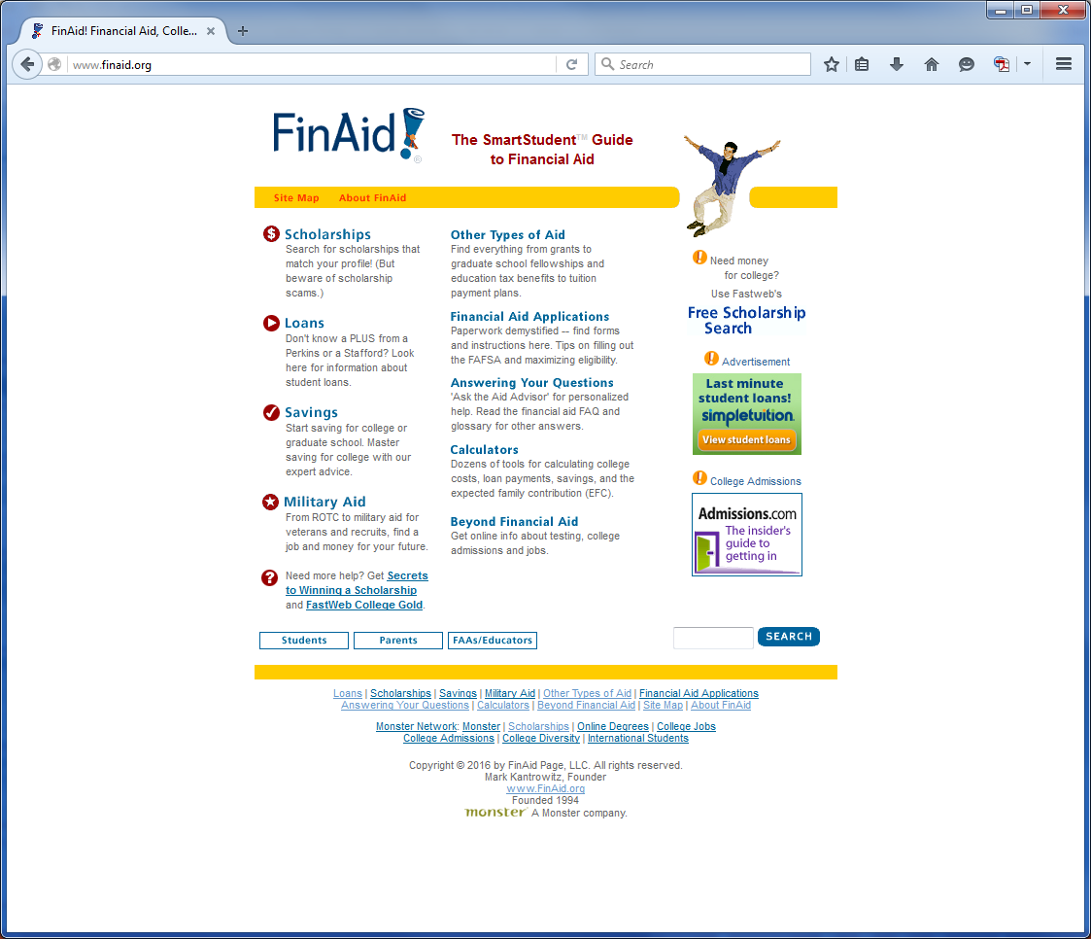
Online Financial Aid Resources
finaid.org

Slide 31

Informational Sources
How accurate is the data & How do I interpret the data?
College Board Big Futures
Campus Explorer
The Princeton Review
College View
Cappex
College Navigator

Slide 32

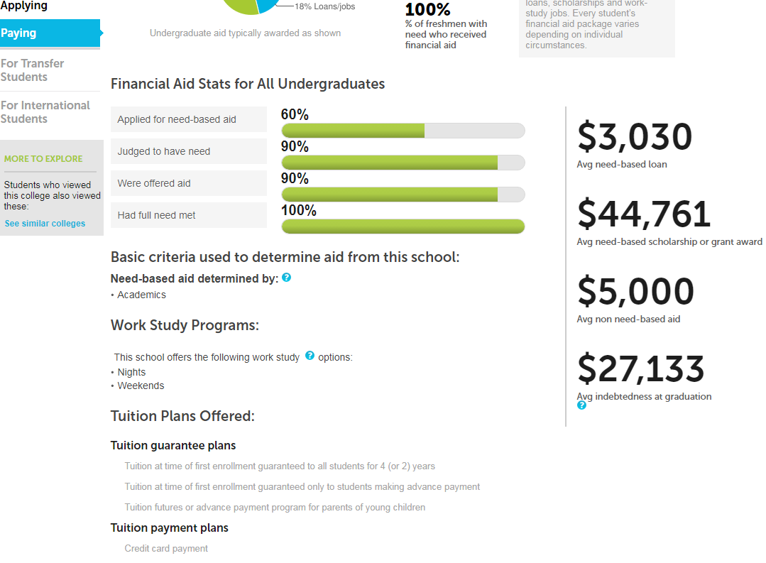
Example - College Board’s Big Future

Slide 33

Financial Aid Tips
Students: Be involved in the financial aid process – this is your education!
Every student should file a FAFSA for his/her first year.
Meet all deadlines and respond promptly to requests for additional information.
Stay organized
Take the time to explore and apply for outside scholarships and other funding sources.

Slide 34
Financial Aid Tips (cont.)
Contact the financial aid office with any unusual financial circumstances.
Don’t forget that you will need to complete new financial aid applications for each academic year.
    HINT: Every year you file taxes, file your FAFSA)
Make certain you know how you are going to pay for your out-of-pocket expenses (books, supplies, personal expenses).
Above all – ASK QUESTIONS!!! This process can seem confusing and overwhelming. Anytime you are uncertain about anything – ASK!!!

Slide 35
M. Clarke Paine
Franklin & Marshall College
Office of Financial Aid
717.358.3991
www.fandm.edu/financialaid
Clarke.paine@fandm.edu

