Slide 1
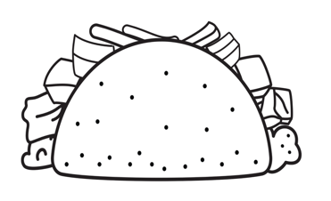
TACO ’BOUT IT WITH YOUR
SCHOOL COUNSELOR
Q
CHEESY
COUNSELOR SUPPORT
ONIONS
STINKY SITUATIONS
M
TOMATOES
SMALL GROUPS
v
R
MEAT
CLASSROOM GUIDANCE LESSONS
LETTUCE
INDIVIDUAL COUNSELING
y
n
SHELL
TO HOLD YOUR SECRETS SAFE

