Slide 1
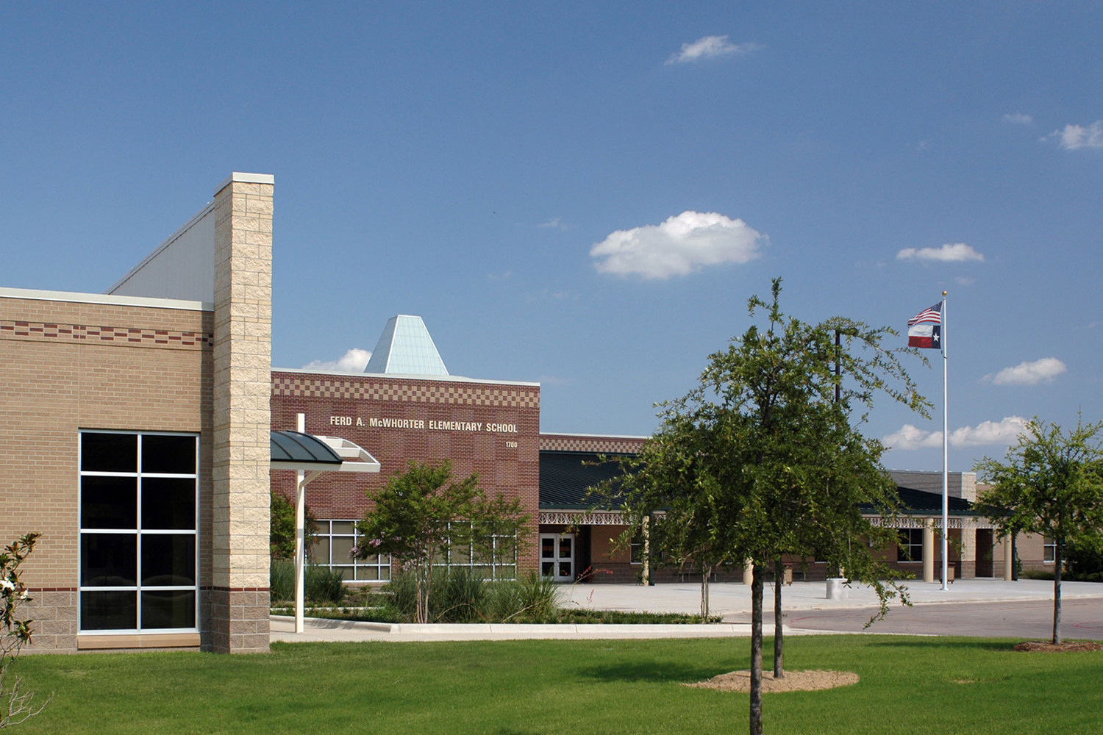
Who’s Who?
People who work at McWhorter who can help!

Slide 2
Mrs. Froning, Principal

Slide 3
Assistant Principals
Ms. Cluff
Mrs. Englert

Slide 4
Mrs. Seleznoff, Testing Coordinator

Slide 5
Nurse Fowler

Slide 6
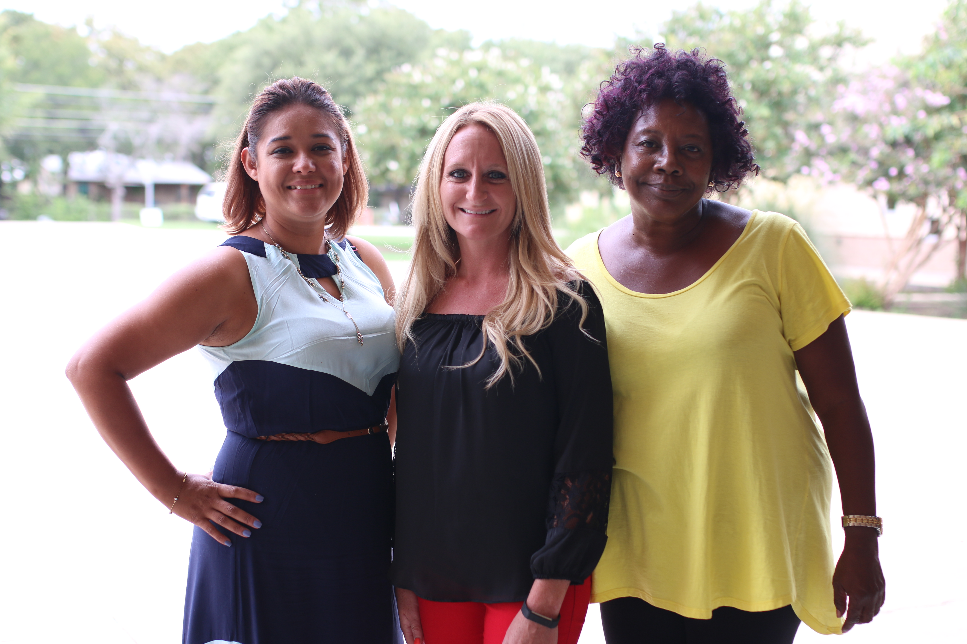
Office Staff
Ms. Tome, Mrs. Carpenter, Ms. Sharon

Slide 7
Dr. Robinson, Counselor

Slide 8
School Counseling Program
What does she do?

Slide 9
What does a counselor do?
Guidance lessons
Meet 1 on 1
Sad, mad, scared, something is bugging you
Talk, activity, art, play, sandtray
Groups
Help teachers and parents

Slide 10
How do I get to see the counselor?
Ask your teacher for a pass! Teacher must sign it!
Let me know what kind of rock it is. You can even write or draw something on the back!
I’ll see you right then, if I can, or call as soon as I’m available. I might even schedule times.

Slide 11
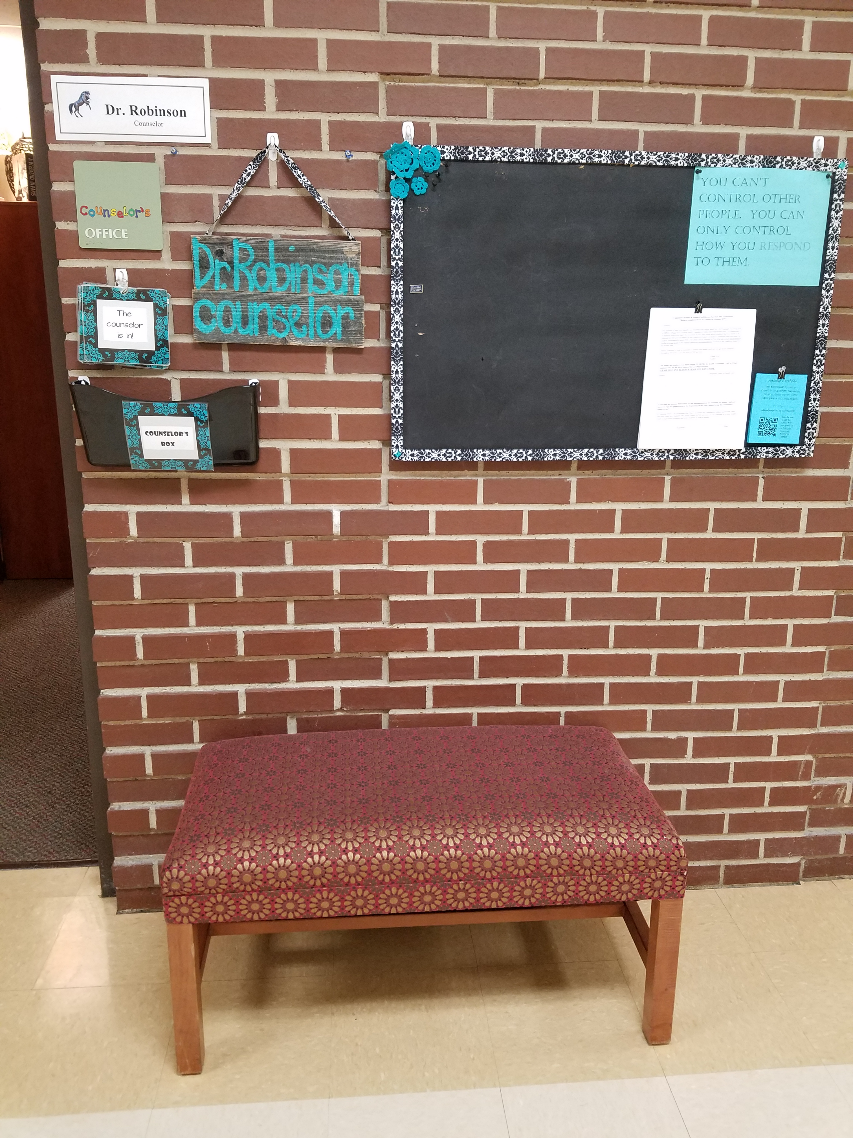
When you come to my office
Door open, off campus, privacy please
Can wait for up to 5 minutes

Slide 12
Don’t knock
Where I am/Schedule

Slide 13
Meeting with the counselor
What you say in here stays in here, unless someone is hurting you, you want to hurt someone, or you want to hurt yourself.

Slide 14
Character Counts
Each 6 weeks we will focus on a different character trait!
You can earn tickets for showing the character trait to be entered into a prize drawing.
You can also get a brag tag for showing the character trait!
We’re focusing on Respect first!

