Slide 1
Schoology for Families

Slide 2
Why ?

Slide 3
Rooted in the Strategic Plan
We believe: In providing instruction that supports the different ways people learn.
Identify and adopt an LMS that would best meet the learning needs of the students across the district and integrate with the SIS.
Strategy 1
Increase student technology use
Integrated PBL facilitation
Vertical alignment facilitation
Strategy 4
Support and facilitate professional learning opportunities-”It’s in Schoology”
Fostering professional collaboration
Support learning anytime, anywhere, by anyone

Slide 5
Access

Slide 6
Does Your Student Have Access?
Access Via the Portal
Student Should Find the Portal Icon
Student Should Authenticate with Google
Students will receive navigation and use training in their advisory course.

Slide 7
Do You Have Access?
www.schoology.com
Schoology parent accounts are created directly from Synergy Parent Vue. If you do not have a Schoology account, your information in Synergy ParentVue Might not be up to date. Call your school site to get your personal email(s) added to Synergy for all district communication!
Do you have an account? Yes!
Can you access it?
Check your email. If you didn’t get an email from Schoology, please call your site to check to see if your email is in Synergy, then wait a few days. If no email comes, email tech.support@rpsmn.org
If you have already accessed it and your children aren’t associated with you, then email tech.support@rpsmn.org
If you forgot your password, use the forgot password button in Schoology.

Slide 8
Navigation

Slide 9
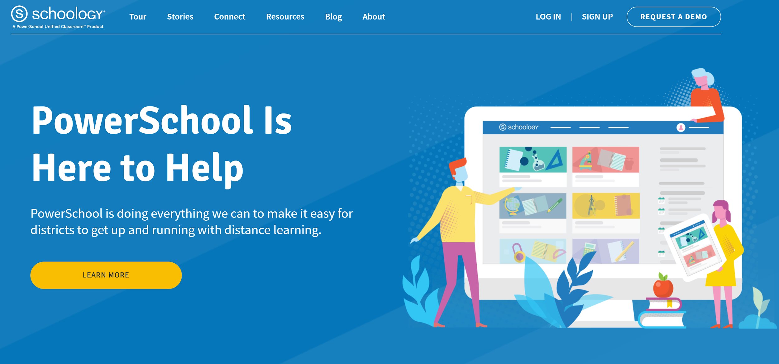

Slide 10
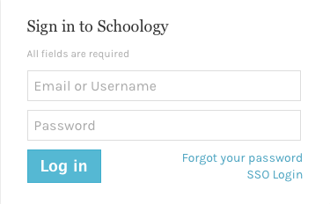
Login
Email Login
Go to app.schoology.com
Click Log In on the top right.
Enter your Email Address and Password.
Click Log in.

Slide 11
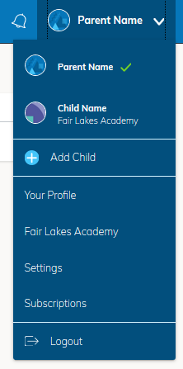
Parent Home Page
Your View vs Student’s Vue
When you log into Schoology, you'll land on your account's Home Page. This home page displays a Recent Activity feed of updates and Upcoming events at the school. This area only displays information pertinent to your account, and does not show any of your child's content.
To view a Summary of your child's activity in Schoology and upcoming items associated with their school, courses, and groups, you may toggle between your account and your child's account.

Slide 12
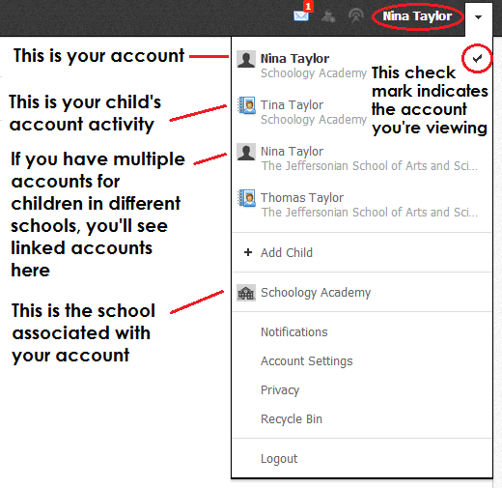
Parent Home Page
Your View vs Student’s Vue
Click on the down facing arrow on the top right of your Schoology account.
Below your name, you'll see the name of the child associated with your account. If you have linked accounts in Schoology, you'll see your linked account and associated children in this dropdown as well.
To view the activity of a particular child, click the child's name from the dropdown menu.
Clicking on the Student name will display their Summary page
When you have multiple children in the same school, clicking on the icon to the right of the student name will take you to their profile.

Slide 13
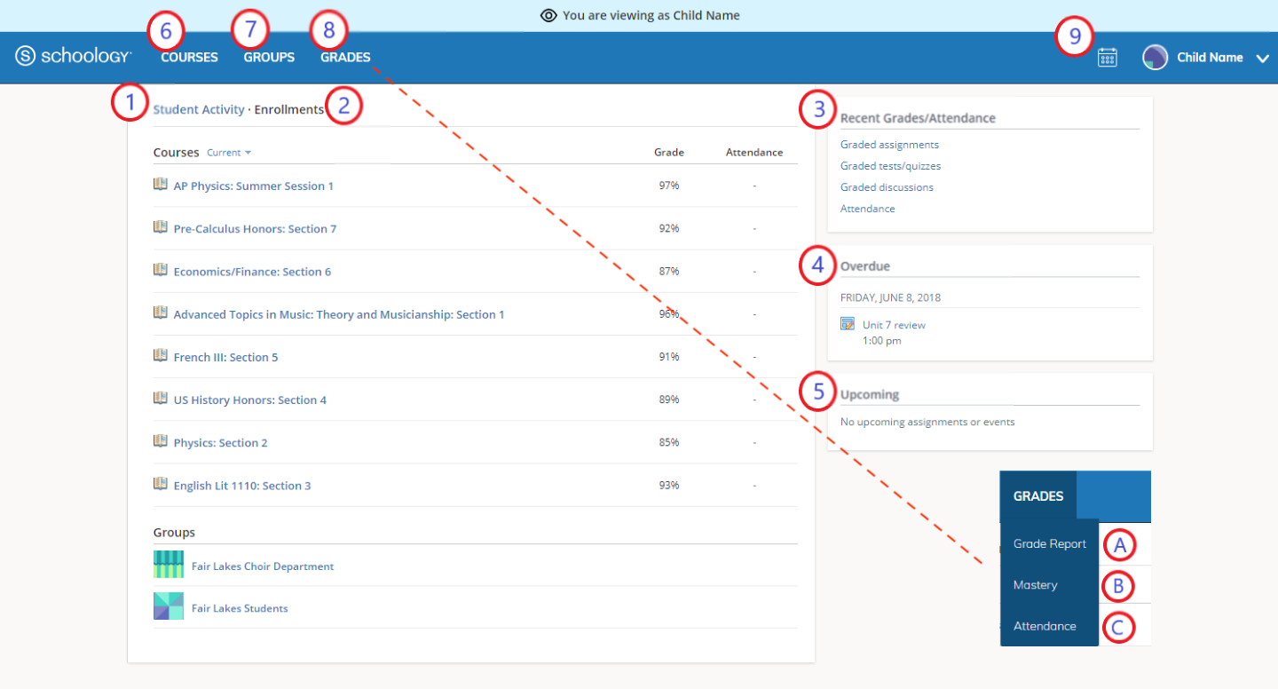
Student Activity View
Summary
The child's Summary area displays the following information for your child's school, courses, and groups:
Student Activity
Enrollments
Recent Grades/Attendance
Overdue
Upcoming
Courses
Groups
Grades
Calendar
The Student Activity area displays the most recent updates, submissions, comments, and grades for a student account. To filter these items, click on the Most Recent toggle to the right of the Student Activity heading.

Slide 14
Enrollments
The Enrollments area displays a list of all of the child's courses and groups.
View course as the student- Clicking on the course name allows you to view the course as your child views the course.
View group as the student- Clicking on the group name allows you to view the group as your child views the course.

Slide 15
Recent Grades and Attendance
On the right column of the Summary page, the Recent Grades/Attendance area lists graded assignments, tests/quizzes, discussions and Attendance marks for the student. To view the graded items and attendance marks, click on the item you'd like to view. NOTE: Official attendance and grades for Richfield Public Schools are in Synergy ParentVue. All assignments are graded in Schoology, but the official gradebook ParentVue. The grades should mirror each other. If not, please inform the classroom teacher.

Slide 16
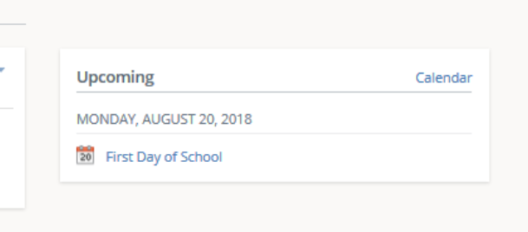
Upcoming
On the right column of the Summary page, the Upcoming area displays a list of upcoming events and graded items in the child's school, courses, and groups. To view more details about the item, click on the name of the item from the list.

Slide 17
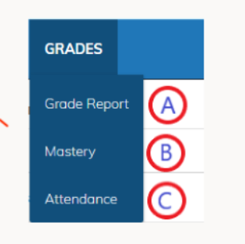
Grades/Attendance (Top Menu)
Grades: Review your child’s grades for all courses.
Mastery: If your child’s school aligns materials to standard and learning objectives, you can check your child’s progress in this area.
Attendance: Review your child’s attendance for all courses.

Slide 18
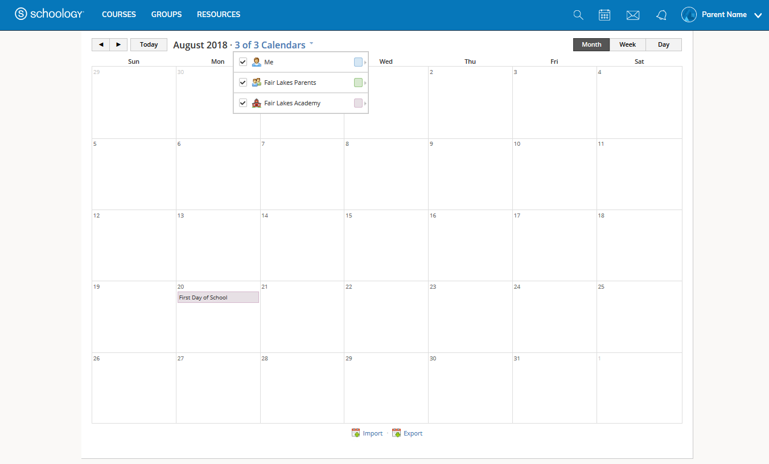
Calendar
Access your personal calendar by clicking the calendar icon in the top navigation of your personal account. Your personal calendar displays personal events you've created for your account, as well as events and assessments for the school, courses, and groups in which you're enrolled.

Slide 19
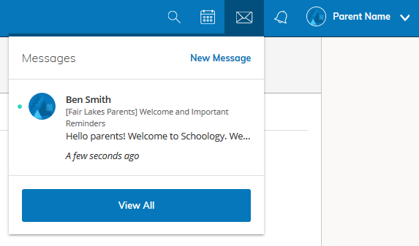
Messages
Messages are a great, and preferred way to communicate with teachers.
Navigate to it on the top right menu.

Slide 20
Messages (Continued)
Check New Messages
When you have a new message in your inbox, the Messages icon on the top menu displays a new number.
Navigate to your Messages area by clicking on the icon in the top menu.
New messages are indicated with a blue dot. Click the message you'd like to read.
To reply to a message, write in the Message area, then click Send.
Check Sent Messages
Navigate to your Messages area by clicking the icon in the top menu and clicking View All.
Click the Sent Messages tab.
To read a message, click a message you've sent in the past.
To send a message, click the +New Message button.
Fill out the form, and click Send to complete.
A recipient name automatically populates when you enter a teacher's name in the To field. If you're not able to send a message to certain users, talk to your teacher for further guidance.

Slide 21
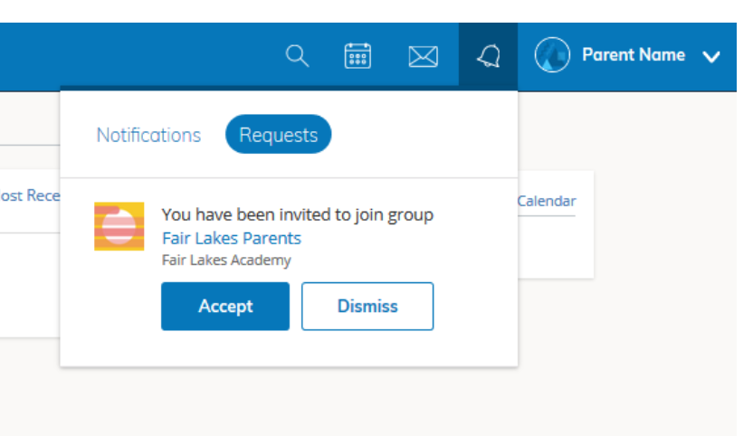
Notifications & Requests
Stay Informed!
On the right side of the header, you have the bell icon that displays Notifications and Requests. Any time someone sends you a message, wants to connect, or does something that pertains to you or your affiliations, it will be made easily accessible in the top right corner of your screen. Everything is chronologically ordered and clickable to make managing them simple.
Right; a parent receives an invitation to a join group:

Slide 22
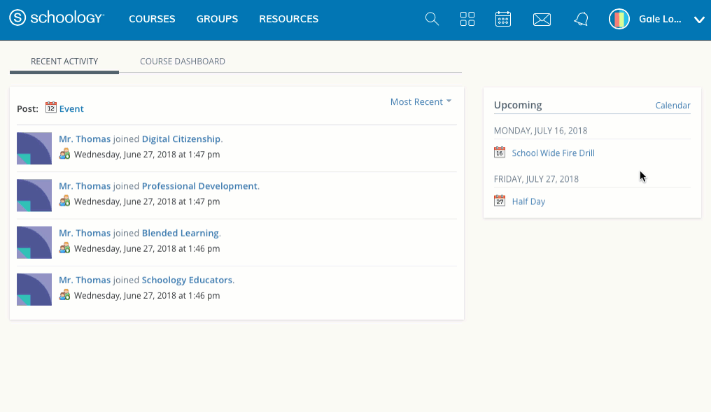
Set Notifications

