Slide 1
Lesson 4
Graphing Data

Slide 2
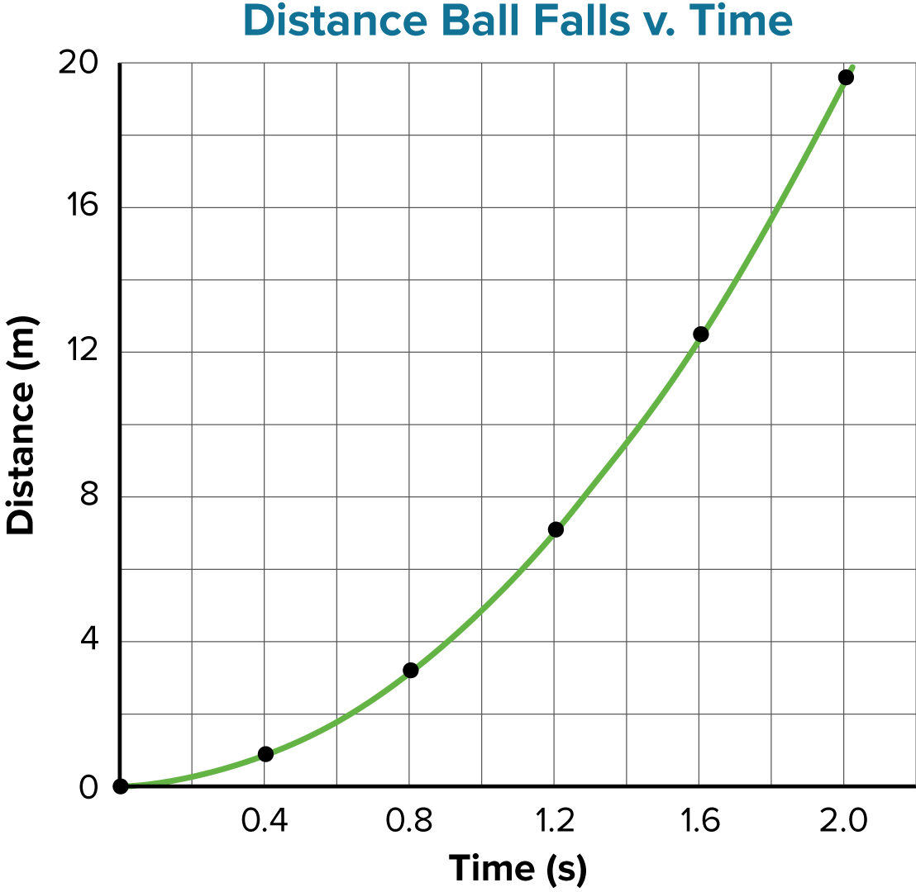
Nonlinear Relationships
When the graph is not a straight line, it means that the relationship between the dependent variable and the independent variable is not linear.
There are many types of nonlinear relationships in science. Two of the most common are the quadratic and inverse relationships.

Slide 3
Nonlinear Relationships
Quadratic Relationships
A quadratic relationship exists when one variable depends on the square of another.
A quadratic relationship can be represented by the following equation:
y = ax² + bx + c

Slide 4
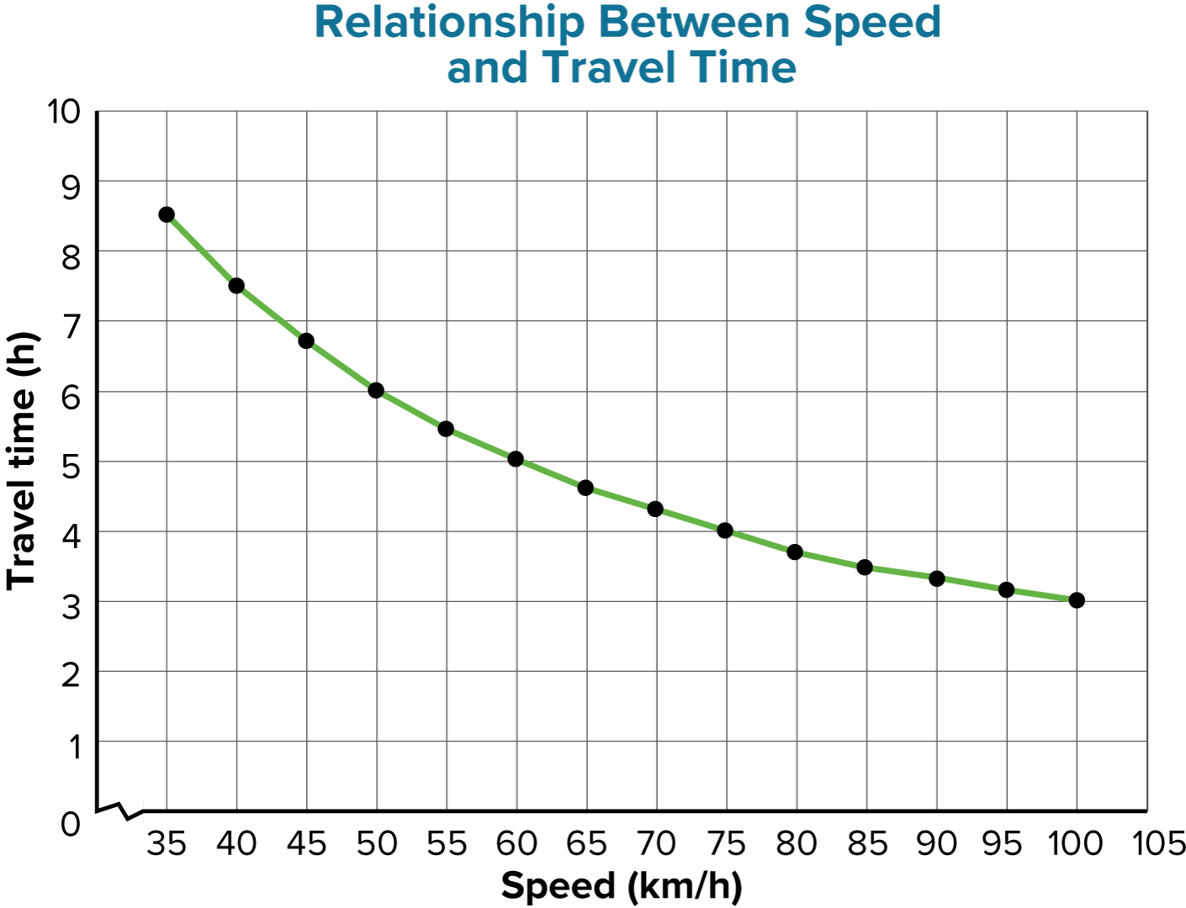
Nonlinear Relationships
Inverse Relationships
In an inverse relationship, a hyperbola results when one variable depends on the inverse of another.
An inverse relationship can be represented by the following equation:
y = a/x

Slide 5
Nonlinear Relationships
There are various mathematical models available apart from the three relationships you have learned. Examples include:
sinusoids (used to model cyclical phenomena)
exponential decay curves (used to model radioactivity)
Combinations of different mathematical models represent even more complex phenomena.

Slide 6
Predicting Values
Relations, either learned as formulas or developed from graphs, can be used to predict values you have not measured directly.
Physicists use models to accurately predict how systems will behave. Examples:
Circumstances that might lead to a solar flare
How changes to a circuit will change the performance of a device
How electromagnetic fields will affect a medical instrument

Slide 7
Quiz
1.
Which is the factor that is intentionally changed or manipulated during an experiment?
A
controlled variable
C
independent variable
CORRECT
B
dependent variable
D
all of the above

Slide 8
Quiz
2.
A length is measured to be 19.57 cm. Which is the uncertain digit in this measurement?
A
1
C
5
B
9
D
7
CORRECT

Slide 9
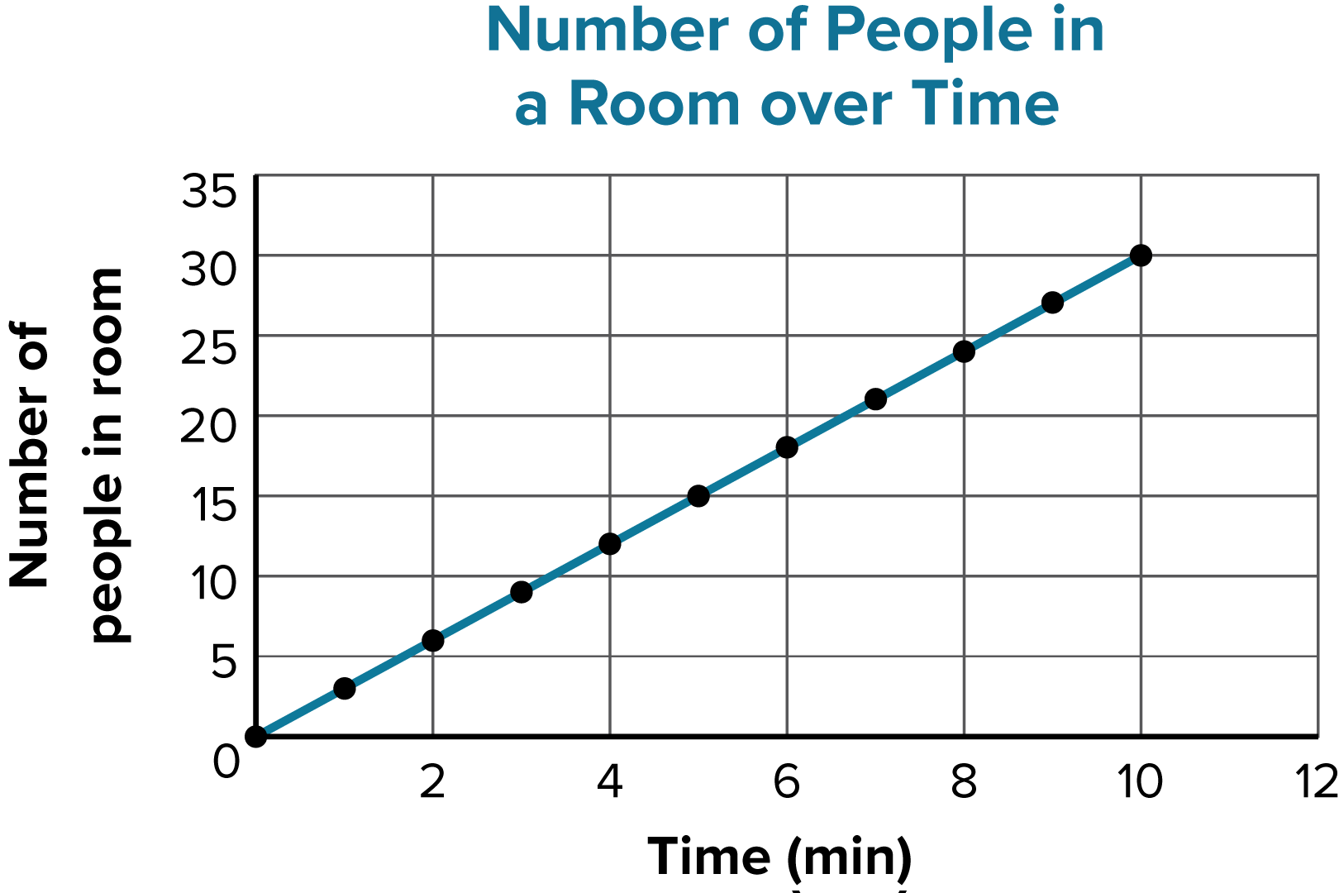
Quiz
3.
What is the numerical value of the slope of the line in this graph?
A
0.3
B
10
3
C
CORRECT
D
30

Slide 10
Quiz
4.
Which is the value of b in the equation y = mx + b that describes this graph?
A
10
B
3
0
C
CORRECT
D
−3

Slide 11
Quiz
5.
Which type of relationship between variables is most likely represented in this graph?
A
linear
C
quadratic
CORRECT
B
inverse
D
sinusoidal

