Slide 1
Lesson 4
How Fast?

Slide 2
Velocity vs Speed
Velocity is a vector, speed a scalar
Average speed – total distance divided by time
Average velocity – total displacement divided by time
Speed and velocity may or may not have the same magnitude

Slide 3
Example
A person walks 70 m (E), then 30 m (W) in 70 sec. Find his
a) speed
b) velocity

Slide 4
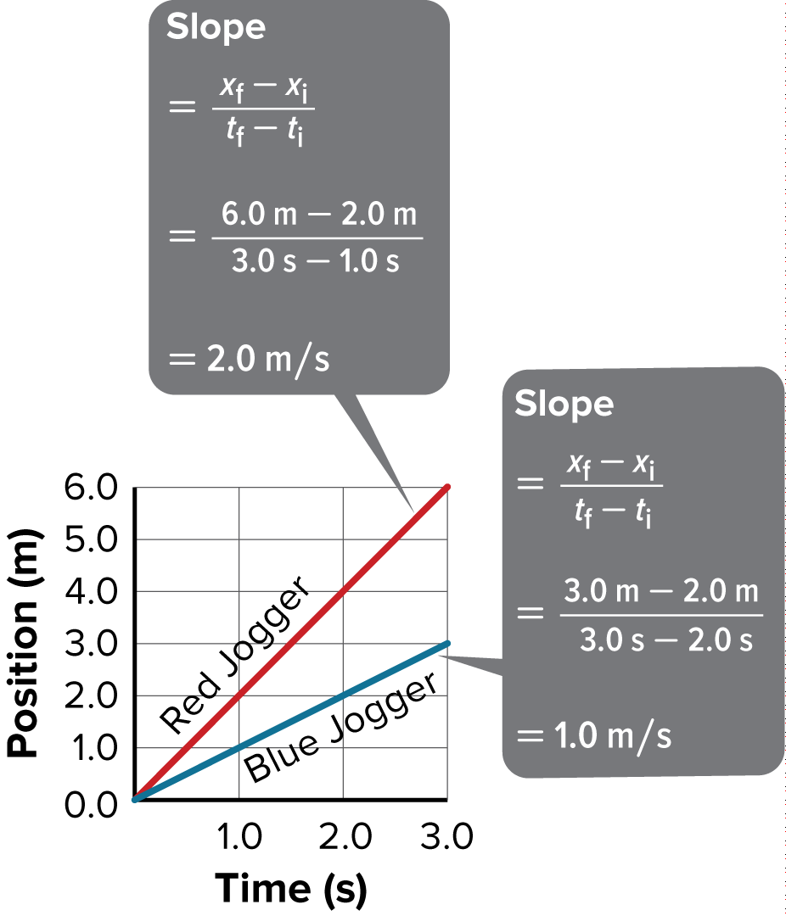
Velocity and Speed
Consider the position-time graph of two joggers.
The slope of a position-time graph for an object is the object’s average velocity, which is represented by the equation:

Slide 5
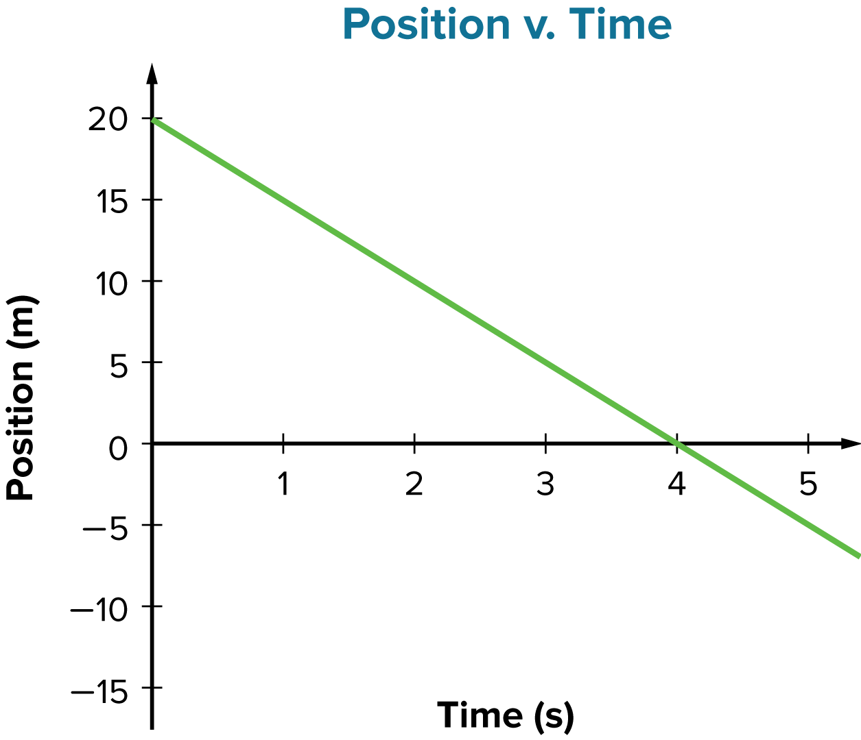
Velocity and Speed
The sign of the slope tells you what direction the object is moving.

Slide 6
Velocity and Speed
The slope’s absolute value is the object’s average speed, which is the distance traveled divided by the time taken to travel that distance.

Slide 7
Velocity and Speed
The speed and direction of an object at a particular instant is called the instantaneous velocity.

Slide 8
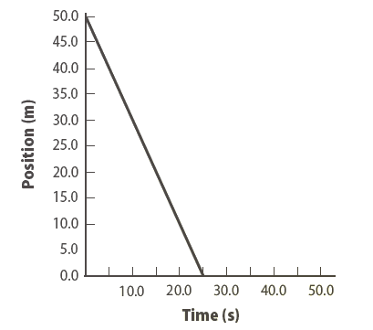
Velocity and Speed
Use with Example Problem 3.
Problem
What is the average velocity of the object whose motion is represented in this graph? What is its average speed?

Slide 9
Equation of Motion
Recall that a straight line can be represented by the equation
y = mx + b
Similarly, a straight line on a position-time graph can be represented with the equation

Slide 10
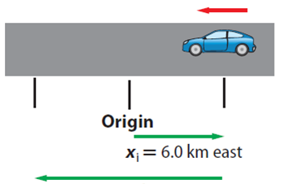
Equation of Motion
Use with Example Problem 4.
Problem
A car is initially 6.0 m east of the origin. It drives west at a speed of 12 m/s. What is its position after 1.2 s?

Slide 11
Quiz
1.
How do you find the average speed of an object from a position-time graph?
A
Find the slope between two points on the line.
C
Find the change in the x values.
B
Find the absolute value of the slope of the line.
D
Find the change in the y values.
CORRECT

Slide 12
Quiz
2.
What is the speed and direction of an object at a particular instant of time?
A
average velocity
B
average speed
C
instantaneous velocity
CORRECT
D
instantaneous speed

Slide 13
Quiz
3.
Which is the total distance traveled divided by the time taken to travel that distance?
A
instantaneous speed
C
average speed
CORRECT
B
instantaneous velocity
D
average velocity

Slide 14
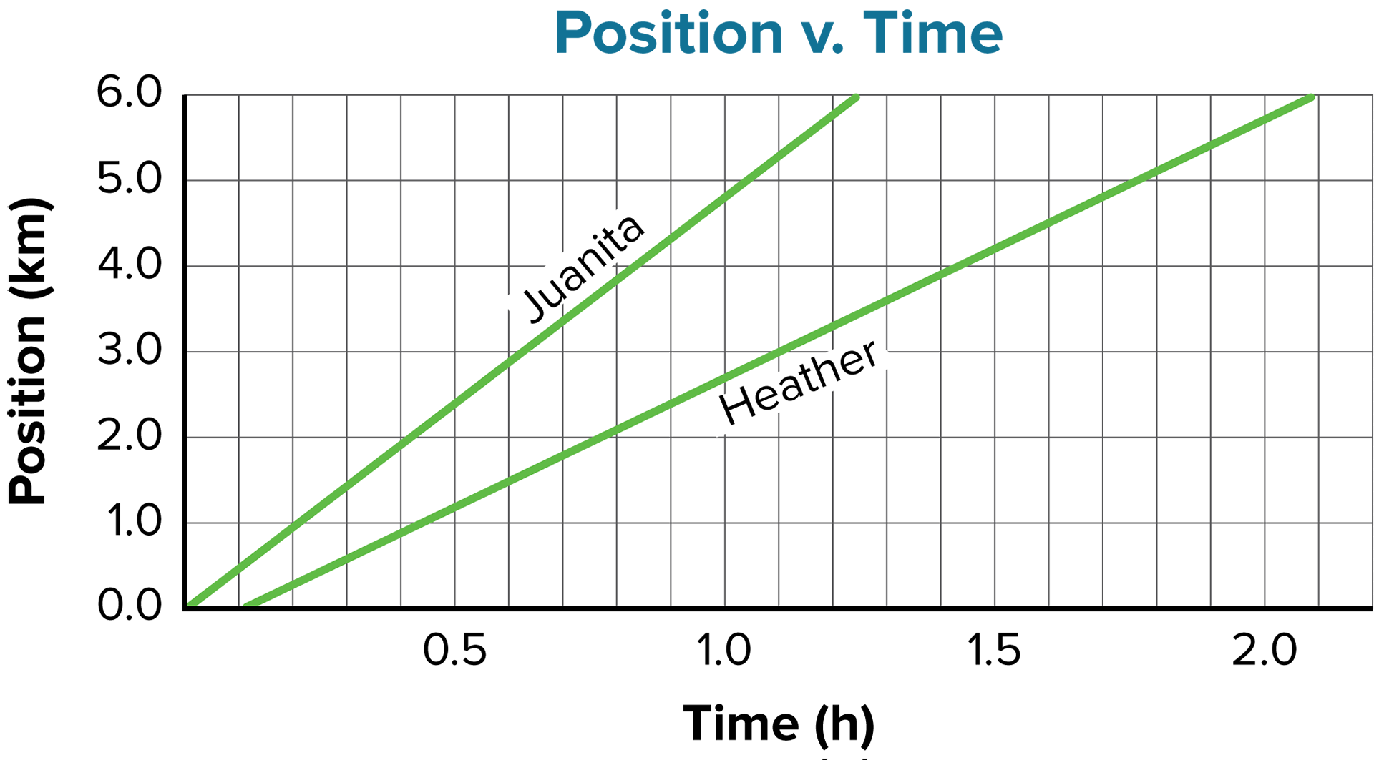
Quiz
4.
Heather and Juanita are traveling east. What is Heather’s average speed?
A
3.0 km/h
C
2.8 km/h
CORRECT
B
4.8 km/h
D
6.0 km/h

Slide 15
Quiz
5.
In a mathematical representation of a straight line on a position-time graph, what quantity is represented by the y-intercept?
A
the time taken
C
the final position
B
the average velocity
D
the initial position
CORRECT

