Slide 1
Limits

Slide 2
Limit Definition
As x becomes sufficiently close to (but not equal to) a, the value of f(x) becomes close to L
Note: x does not equal a so we don’t consider the actual value of f(x) at a, just what it is approaching

Slide 3
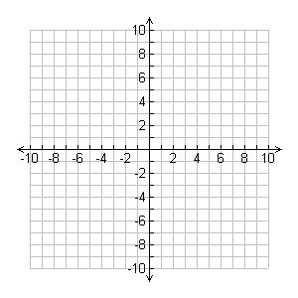
We can “Guess” the limits visually on a graph
Find:

Slide 4
We can “Guess” the value of a limit using a calculator table
Guess the value of:

Slide 5
Guess the value of:

Slide 6
Practice:

Slide 7
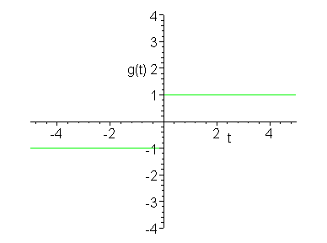
One-Sided limits
The limit of this function as it approaches from the right is not the same as the limit as it approaches from the left (⁻ symbol indicates left and ⁺ symbol indicates right)

Slide 8
Definition
If and only if:
and

Slide 9
Example
Find:
Find:

Slide 10
Infinite Limits
When x approaches a, the value of f(x) becomes arbitrarily large
Example:

Slide 11
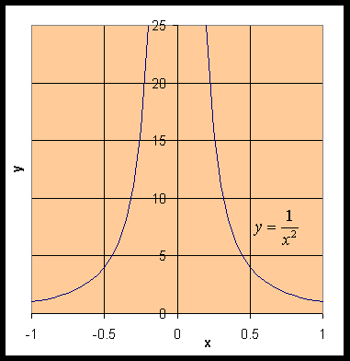
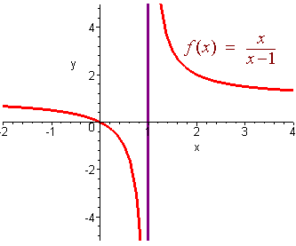

Slide 12
Example:
Find:

Slide 13
Vertical Asymptote
The line of x = a is called a vertical asymptote if at least one of the following is true

Slide 14
Example
Find the asymptotes of
f(x) = tan x

Slide 15
Homework
alternate book pg. 59 # 1-7, 9-12, 15-20, 22

