Slide 1
Algebra Review

Slide 2
Arithmetic Operations

Slide 3
Examples
1)
2)

Slide 4
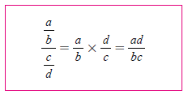
Fractions

Slide 5
Examples
1)
2)

Slide 6
Factoring

Slide 7
Examples
1)
2)
3)
4)

Slide 8
Example

Slide 9
Completing the Square

Slide 10
Quadratic Formula

Slide 11
Radicals

Slide 13
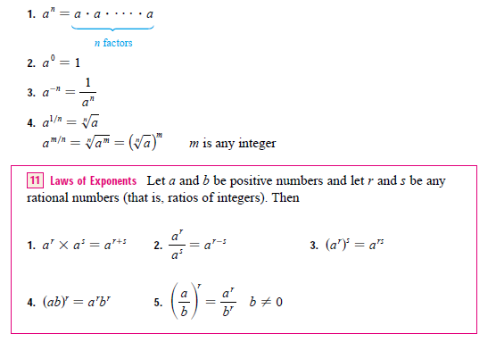
Exponents

Slide 14
Examples
1)
2)
3)
4)

