Slide 1
Intermediate Value Theorem

Slide 2
Removing a Discontinuity
Discontinuity at a point can be removed by making up a value for where it is currently discontinuous so that it will be continuous

Slide 3
Example
Is the function below continuous everywhere? If not what will make it continuous everywhere?

Slide 4
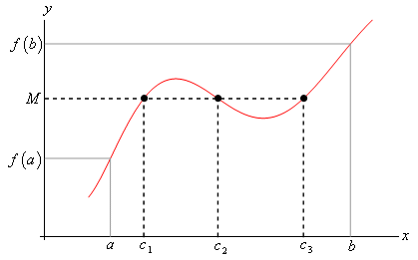
Intermediate Value Theorem
Suppose that f is continuous on the closed interval [a,b] and let M be any number between f(a) and f(b). Then there exists at least number c in [a, b] such that f(c)=M.

Slide 5
Example
Show that there is a root of
on the interval [1,2]

