Slide 1
Tangents

Slide 2
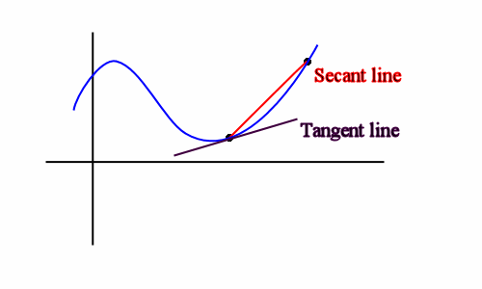
The slope of the secant line is given by
The tangent line’s slope at point a is given by
a
x

Slide 3
Example
Find the equation for the line tangent to the parabola y = x² at the point (1, 1)

Slide 4
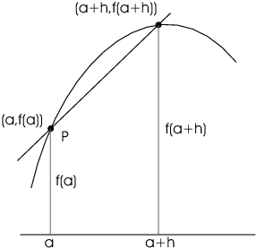
Another Form

Slide 5
Example
Find the equation for the tangent to the hyperbola y = 3/x at the point (3, 1)

Slide 6
Example
Find the slope of the tangent line to the function at a point a
What is the value of this slope at the following points (1,1) , (4, 2) , (9, 3)

Slide 7
Example
Find the slope of the tangent line to the function f(x)= x² + 3x at the point (1, 4) using each definition

