Slide 1
Kinetic Energy and Work

Slide 2
Energy
Loosely defined as the ability to do work
There are many types of energy, but the total energy of a system always remains constant – Law of Conservation of Energy

Slide 3
Kinetic Energy
A moving object has the ability to do work and thus has energy

Slide 4
W = Fd
F = ma
W = mad
v₁² = v₂² + 2ad
W = ½ mv₂² – ½ mv₁²

Slide 5
Translational Kinetic Energy
Work is the change in KE
W = KE₂ – KE₁
W = ½ mv₂² – ½ mv₁²
Therefore,
KE = ½ mv²

Slide 6
The net work done on an object is equal to the change in its kinetic energy
If work done on the object is positive, then it is increasing its kinetic energy
If work done on it is negative, decreasing its kinetic energy

Slide 7
Since work and kinetic energy are related, they are measured in the same unit – Joule (J)
The amount of KE is directly proportional to the mass – mass doubles, KE doubles
The amount of KE is directly prop to square of velocity – v doubles, KE quadruples

Slide 8
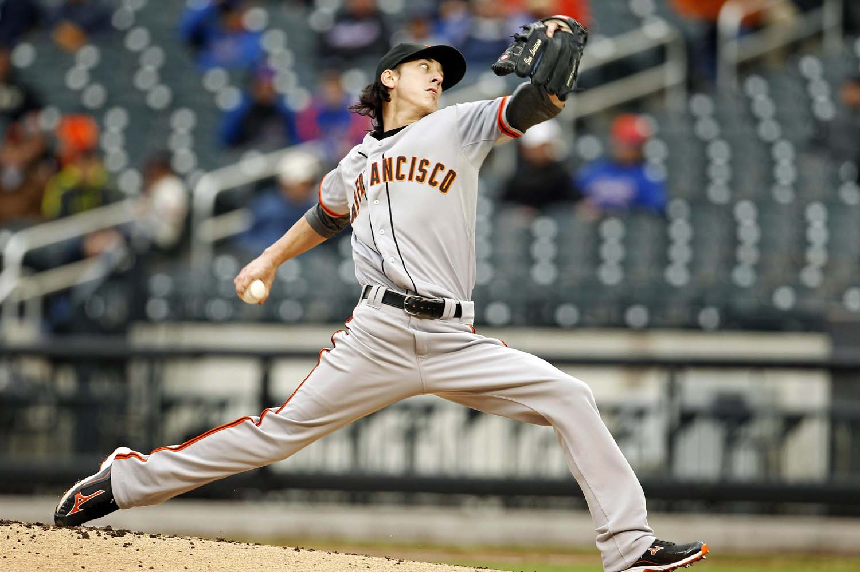
Example 1
A 145 g baseball is thrown with a speed of 25m/s a) what is the KE? B) how much work is done on the ball if it started from rest?

Slide 9
Example 2
How much work is required to accelerate a 1000kg car from 20m/s to 30m/s? If it takes a total of 25m for this acceleration, what is the force supplied by the car’s motor?

Slide 10
Example 3
A car traveling 60km/hr can brake to a stop in a distance of 20m. If the car is going twice as fast, 120km/hr, what is the stopping distance?

