Slide 1
Rotational Kinematics

Slide 2
Angular Motion Equations
Motion equations can be written in terms of angular quantities

Slide 3
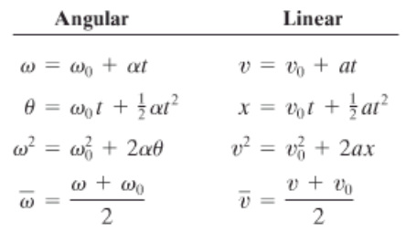
Kinematic Equations

Slide 4
Example
A centrifuge rotor is accelerated from rest to 20000 rpm in 30 s. A) What is the angular acceleration B)Through how many revolutions has the centrifuge rotor turned during its acceleration period?

Slide 5
Example
A bicycle slows down uniformly from 8.40 m/s to rest over a distance of 115 m. The tires have an overall diameter of 68.0 cm. Determine a) the initial angular velocity of the wheels b) the total number of revolutions each wheel rotates before coming to rest c) the angular acceleration of the wheel d) the time it takes to come to a stop

