Slide 1
Newton’s 1st Law
Inertia

Slide 2
Force
Any push or pull acting on an object
Most forces require contact between two objects (Contact Forces)
Ex. Motor lifts an elevator; hammer hits a nail; wind blows a paper
A few forces do not require contact
Ex. Gravity pulls everything on Earth down
If an object is at rest, a force is needed to start it moving
If an object is already moving, a force is needed to speed it up, slow it down, or change its direction

Slide 3
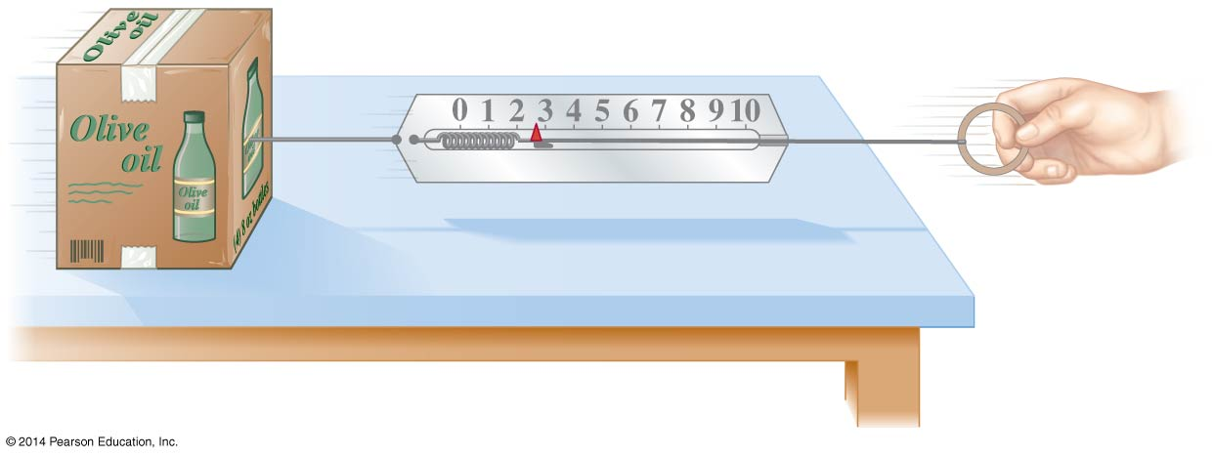
Measuring Force
Forces can be measured with a spring scale
Read in a unit called the Newton (N)

Slide 4
Forces are Vectors
Both magnitude and direction are important
Force exerted in a different direction has a different effect
What would happen if you add more force to the right?
What would happen if you add a force to the left?

Slide 5
Law of Inertia or Newton’s First Law
Object at rest will remain at rest or object in motion will remain in uniform motion in a straight line as long as no net force acts on it

Slide 6
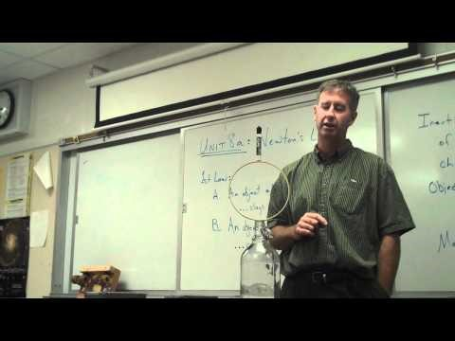

Slide 7
What Is Happening?

Slide 9
Assignment
Watch the video at link below
https://www.youtube.com/watch?v=MmkXfRCmRM4
INDIVIDUALLY brainstorm HOW and WHY the crash happened.
Discuss with another person
Draw a diagram and write an explanation of your idea

