Slide 1
Rotational Inertia

Slide 2
Equation
F = ma
a = rα
F = mrα
Στ = r ΣF = Σmr²α
Moment of Inertia ( I ) – sum of rotational inertia of an object
I = Σmr²
Στ = I α

Slide 3
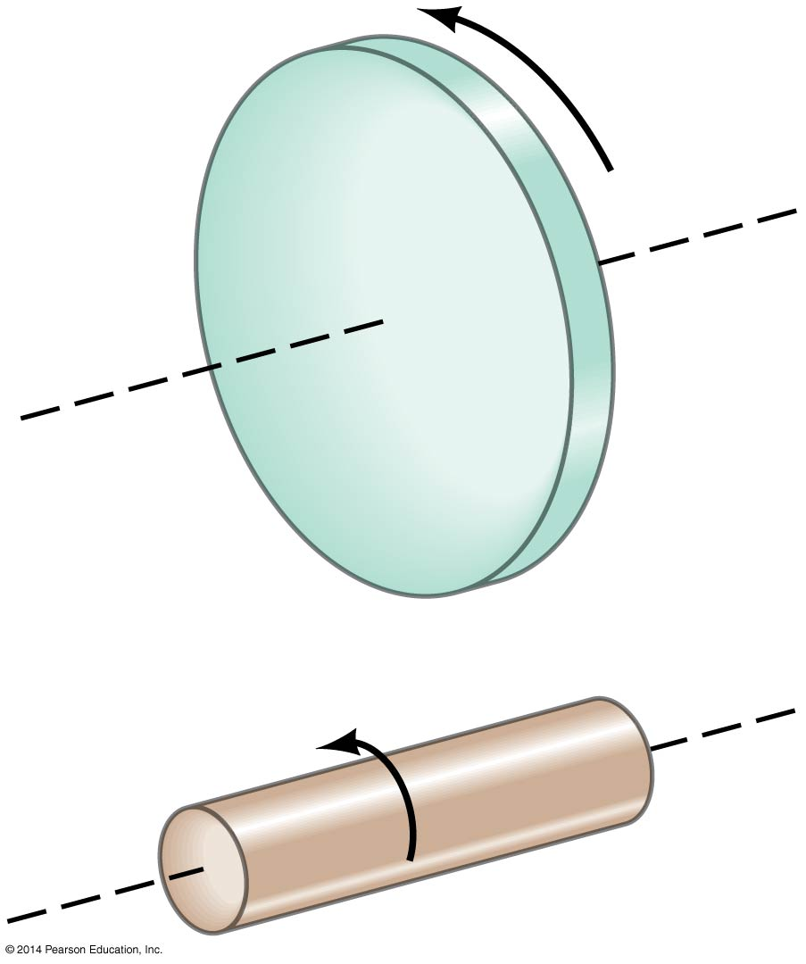
Rotational Dynamics
The distribution of mass matters here—these two objects have the same mass, but the one on the top has a greater rotational inertia, as so much of its mass is far from the axis of rotation.
Top object is harder to start or stop rotating

Slide 4
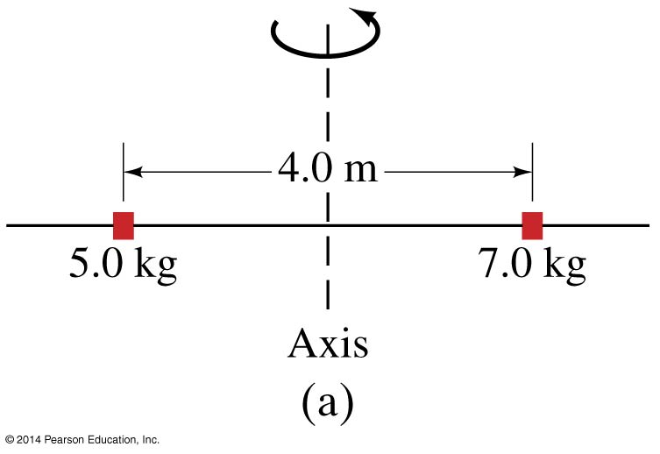
Example
Two small masses of 5.0kg and 7.0kg are mounted 4.0m apart on a light rod. Calculate the moment of inertia when rotated about the axis halfway between the weights.

Slide 5
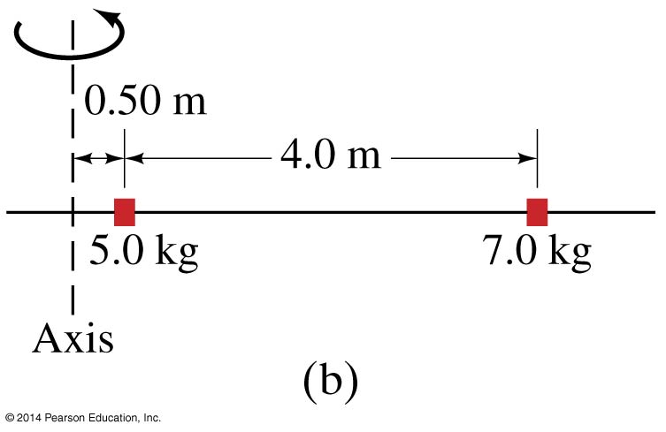
Example
Calculate the moment of inertia when the same two objects are rotated about an axis 0.50m to the left of the 5.0 kg mass.

Slide 6
For most objects, the calculation of the moment of inertia is very difficult
However, for a number of regularly shaped objects, the expressions have already been worked out
Pg. 210 in textbook

Slide 7
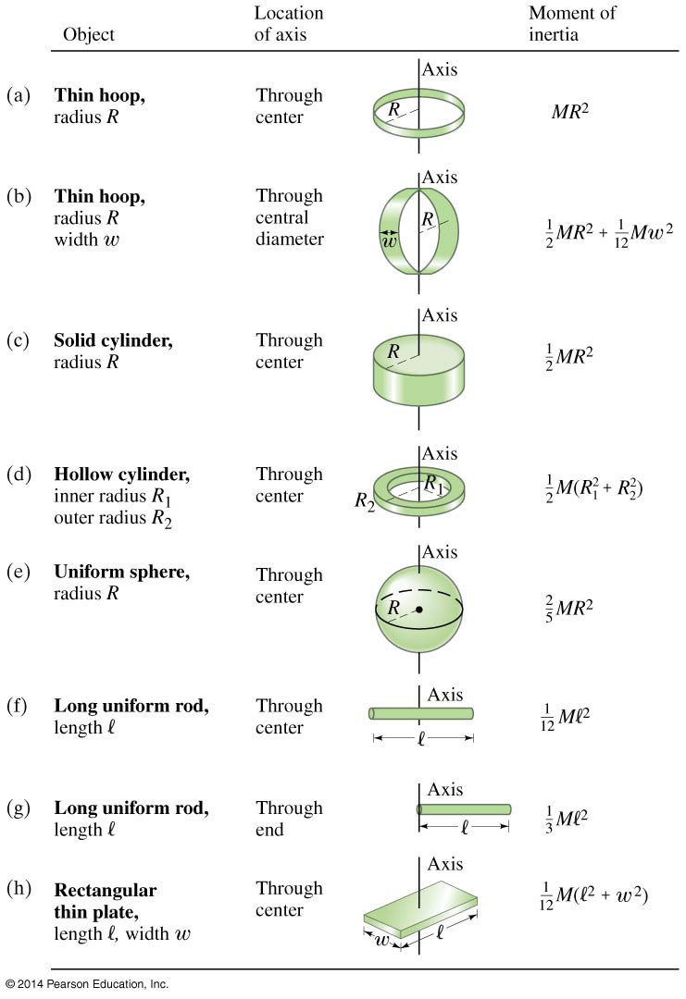

Slide 8
Example
A fixed 0.15kg solid disk pulley with a radius of 0.075m is acted on by a net torque of 6.4N-m. What is the angular acceleration of the pulley?

Slide 9
Example
What torque is needed to give a 20 kg solid ball with a radius of 0.20m an angular acceleration of 2.0 rad/s?

Slide 10
Example
A 2000 kg Ferris wheel accelerates from rest to a angular speed of 2.0 rad/s in 12s. If the radius is 30m, what is the net torque on the wheel?

Slide 11
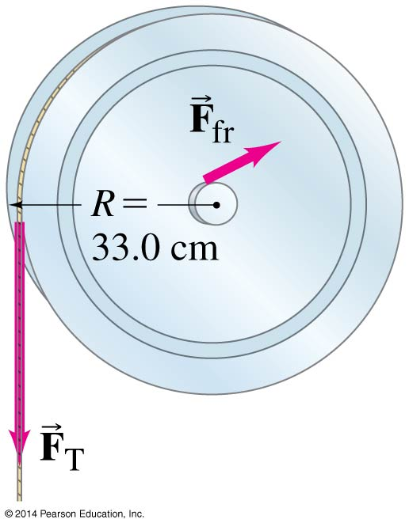
Example
A 15.0N force is applied to a cord wrapped around a pulley of mass 4.00kg and radius 33.0 cm. The pulley accelerates form rest to an angular speed of 30.0 rad/s in 3.00 s. If there is a frictional torque of 1.10 m-N, determine the moment of inertia of the pulley.

