Slide 1
Rotational Kinetic Energy

Slide 2
Kinetic Energy
The kinetic energy of the center of mass of an object moving through a linear distance is called translational kinetic energy
KE = ½ mv²
As an object rotates it experiences a type of kinetic energy known as rotational kinetic energy
Rotational KE = ½ I ω²
If the object is moving as it is rotating, its total kinetic energy is the sum of both its translational and rotational kinetic energies
KE = ½ mv² + ½ I ω²

Slide 3
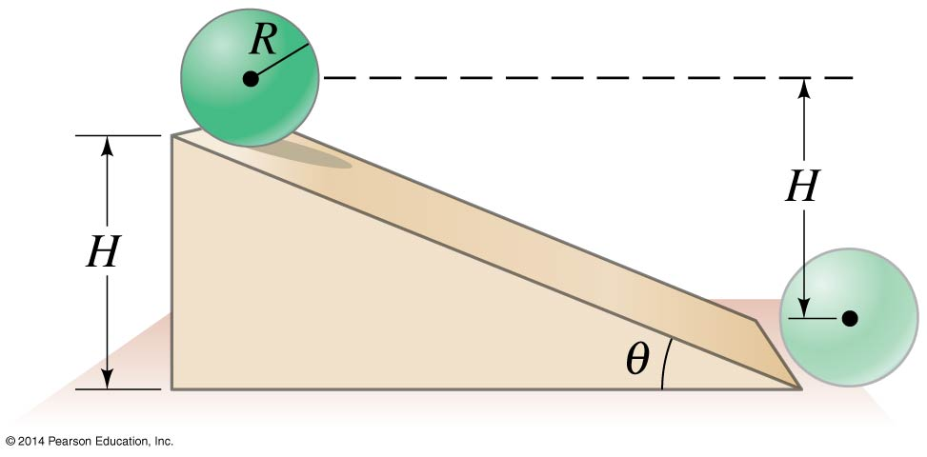
Example
What will be the speed of a solid sphere of mass 1.0 kg and radius 15.0 cm when it reaches the bottom of an incline of height 1.00 m? Assume it starts from rest and rolls without slipping.

Slide 4
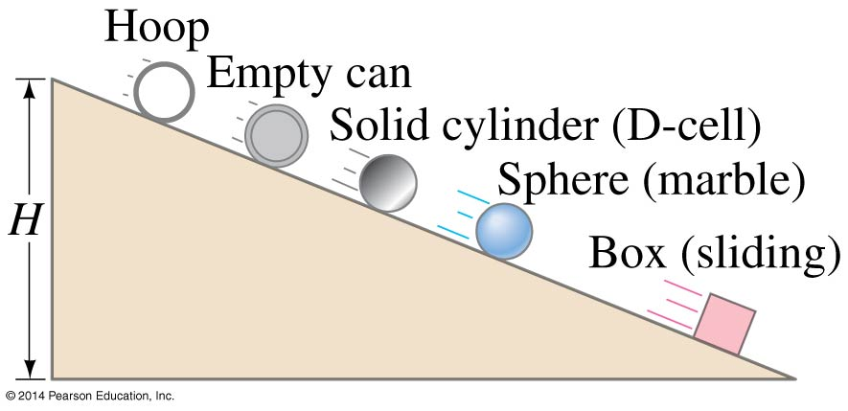
Example
Several objects roll without slipping down an incline of vertical height H, all starting from rest at the same moment. The objects are a thin hoop, a spherical marble, and a solid cylinder. In addition, a greased box slides without friction. In what order will they reach the bottom?

Slide 5
Work
Work done by a rotating object can be calculated
W = τ θ θ = l / r
Rate of work, Power, can also be determined

Slide 6
Example
A constant retarding torque of 12 m-N stops a rolling wheel of diameter 0.80m in a distance of 15m. How much work is done by the torque?

Slide 7
Example
What is the horsepower required to keep a train wheel rotating at a steady speed of 1500 rpm if the engine develops a torque of 200 m-N?

Slide 8
Example
How much work is required to accelerate a solid disc, of mass 1.5 kg and radius 75.0 cm, from rest to 500 rpm?

