Slide 1
Velocity and Speed Graphically

Slide 2
Data for Car

Slide 3
Graphically
Velocity can be shown graphically by plotting position vs time
Slope of a position-time graph is velocity

Slide 4
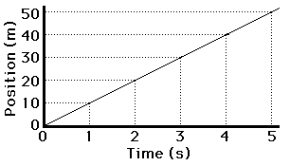
Plot

Slide 5
Velocity is Slope
50m – 0m
V =
= 10m/s
5s – 0s

Slide 7
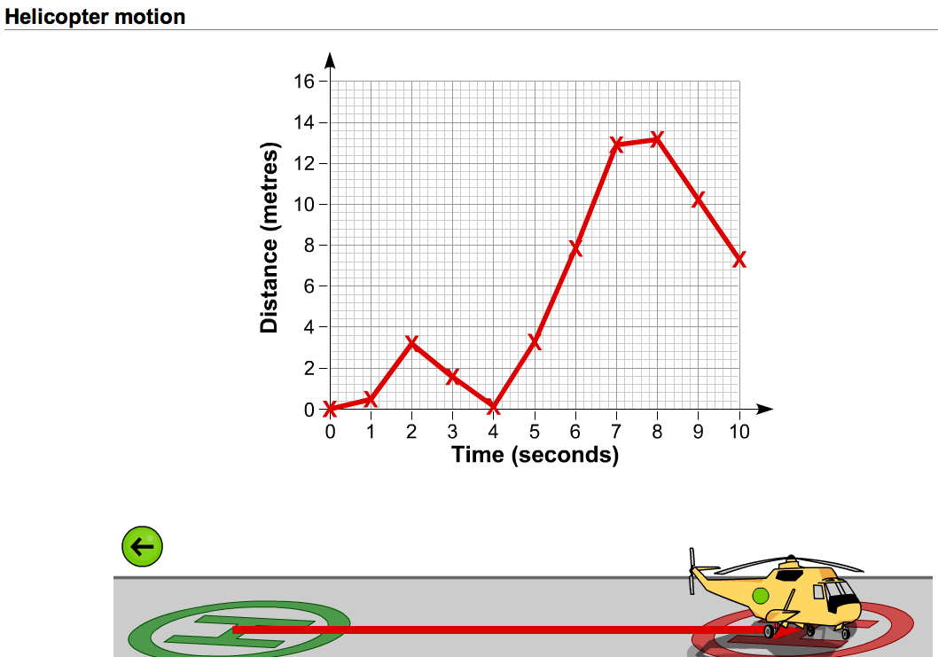
Practice – Describe the motion shown in the graph

Slide 8
Instantaneous Velocity
If the graph is not a straight line, the velocity is constantly changing
You can find the velocity at any specific point
You do this by finding the slope of the line tangent to the curve

Slide 9
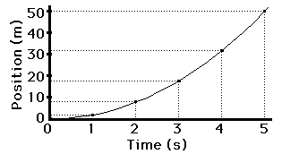
Changing Velocity Plot

Slide 10
What is Velocity at 3 Second?
30m – 5m
v (at 3s) =
= 7.5m/s
4s – 2s

Slide 11
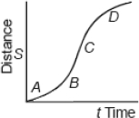
At what point is the object moving the fastest?
At what point is the object moving the slowest?

