Slide 1
Mixtures
Two or more substances together but not bonded

Slide 2
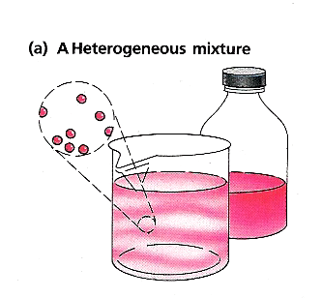
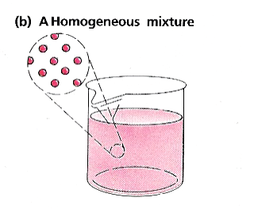
Types of Mixtures
Heterogeneous –
different throughout
Homogeneous- uniform throughout

Slide 3
Heterogeneous Mixtures
Suspension – mixture in which particles are large and separate to the bottom: like dirt and water
Colloid – mixture in which particle size is large enough to see but not large enough to settle out: like milk

Slide 4
Solution
Homogeneous mixture where particles are so small that they can no longer be seen
Particles dissolved – only one phase seen
Particles don’t settle out
Solution is clear or transparent
Particles will not be trapped in filters

Slide 5
Parts of Solution
Solute – substance dissolved
Solvent – what it is dissolved in
The solvent’s phase will be the only one visible
If both substances are originally in the same phase, the one with the least is the solute
Aqueous – solution with water solvent
Tincture – solution with alcohol solvent

Slide 6
Types of Solutions
All phases can form solutions
Gas in gas
Gas in liquid
Liquid in liquid
Solid in liquid
Solid in solid
Alloy – metal and metal solution

Slide 7
Miscible – when substances dissolve in one another
Immiscible – do not dissolve in one another

Slide 8
Solubility
Quantity of solute that can dissolve in a solvent

Slide 9
Factors Effecting Solubility
Type of solute and solvent
- like dissolves like (polar in polar and non-polar in
non-polar)
Temperature
- at higher temperature solvent holds more solute
Pressure
- gases are more soluble at higher pressures
- effervescence is when gas comes out of solution

Slide 10
Solubility Curve
Shows how much solute will dissolve in a given amount of solvent over a range of temperatures
Show the grams of solute that will dissolve per 100g of water
For the solids and liquids, the curve goes up as the temperature goes up
For gases, the curve goes down as temp goes up

Slide 11
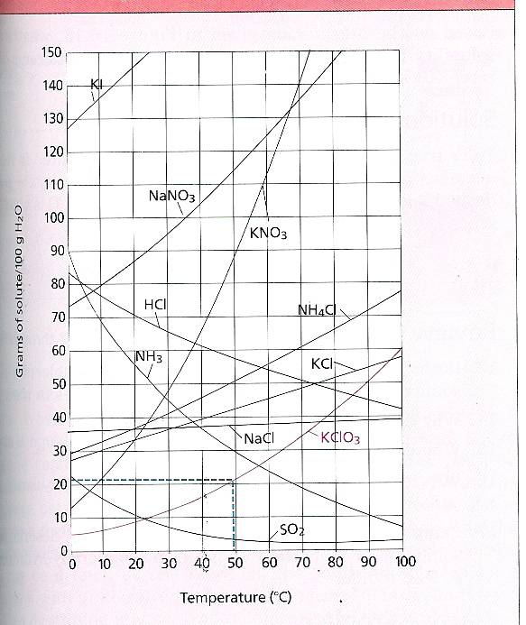

Slide 12
Example
How many grams of KClO₃ will dissolve in 100g of water at 50°C?
How many grams of NaNO₃ will dissolve in 200g of water at 35°C?
At what temperature will 45g of KCl dissolve in 100g of water?
At what temperature will 140g of HCl dissolve in 200g of water?

Slide 13
Factors Effecting Rate
Rate is not how much dissolves but how fast it dissolves
Smaller particles dissolve faster
- more surface area of solute and solvent in contact
Stirring speeds up dissolving
- bring in contact faster
Heating speeds up dissolving
- bring in contact faster

Slide 14
Saturated
A saturated solution is one that has dissolved in it all the solute that it can normally hold at that temperature
If it has less than the max amount of solute possible, it is unsaturated

Slide 15
Supersaturated
Solution hold more solute than is present in their saturated solutions
Produced by creating saturated solution at high temp and allowing it to gradually cool

