Slide 1
Conservation of Mass

Slide 2
Antoine Lavoisier
First experimental chemist
Found that mass of products in a chemical change is always the same as the mass of the reactants
Led to Law of Conservation of Matter
Matter cannot be created or destroyed
True for all chemical reactions but not nuclear reactions

Slide 3
Periodic Table
Organization of elements
Element Symbols - abbreviations for element names
First letter is always a capital letter
Second letter, if there is one, is lower case
Some symbols come from Latin names

Slide 4
Group or Family – vertical column on table
- all members in same group have similar chemical properties
Period – horizontal row

Slide 5
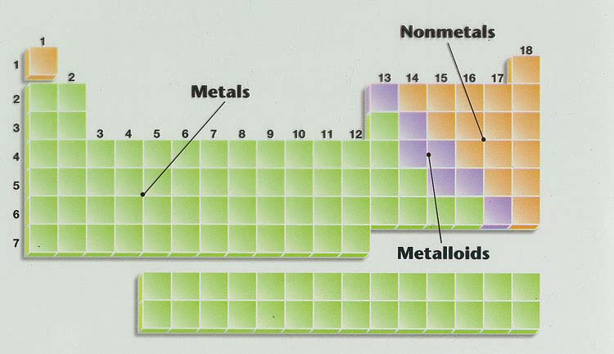

Slide 6
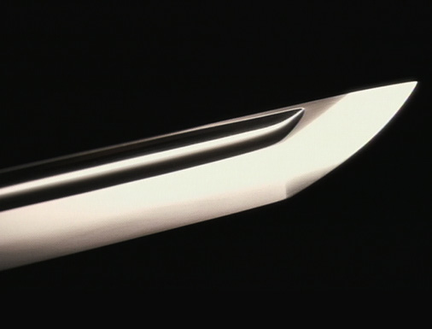
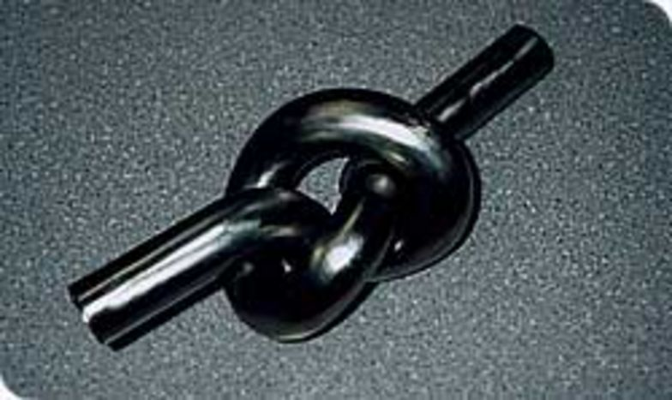
Metals
Left of the stairway on the Table
Lusterous (shiny)
Conduct heat
Conduct electricity
Malleable and ductile (can bend)

Slide 7
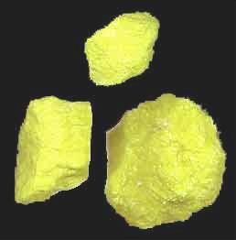
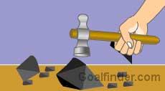
Non-Metals
Right of stairway
Gases or brittle solids
Do not conduct heat or electricity
Noble Gases – Group 18 – very unreactive gases

Slide 8
Metalloids or Semi-metals
Border stairway
Some characteristics of metals and some of non-metals

Slide 9
