Slide 1
Types of Changes

Slide 2

Physical Change
Change in form of a substance that does not result in a change in identity
For example: cutting, grinding, dissolving, freezing, melting, evaporating, condensing, subliming

Slide 3
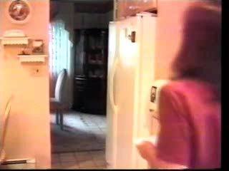

Slide 4
Chemical Change
This is a change that alters the identity of a substance

Slide 5
Chemical Reaction
When one or more substance are converted into different substances with different properties
Reactants – substances that undergo a chemical reaction
Products – substances that are produced by the reaction

Slide 6
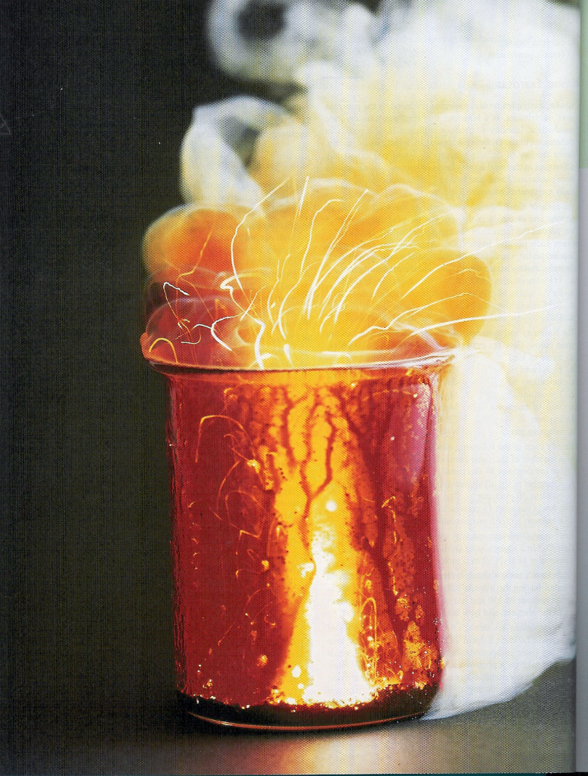
Five Properties of Chemical Change – Recognizing
Light is given off

Slide 7
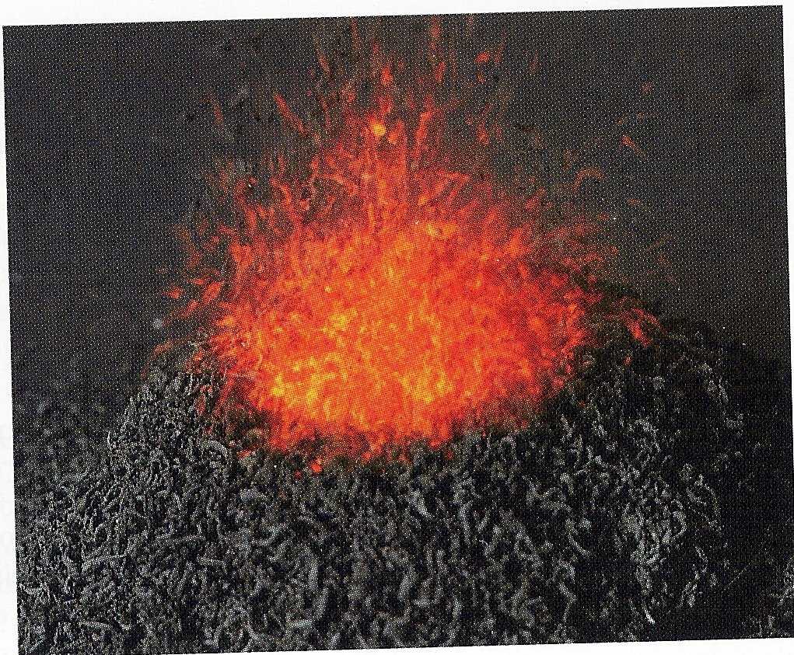
A Change in Temperature Occurs
Either hotter or colder

Slide 8
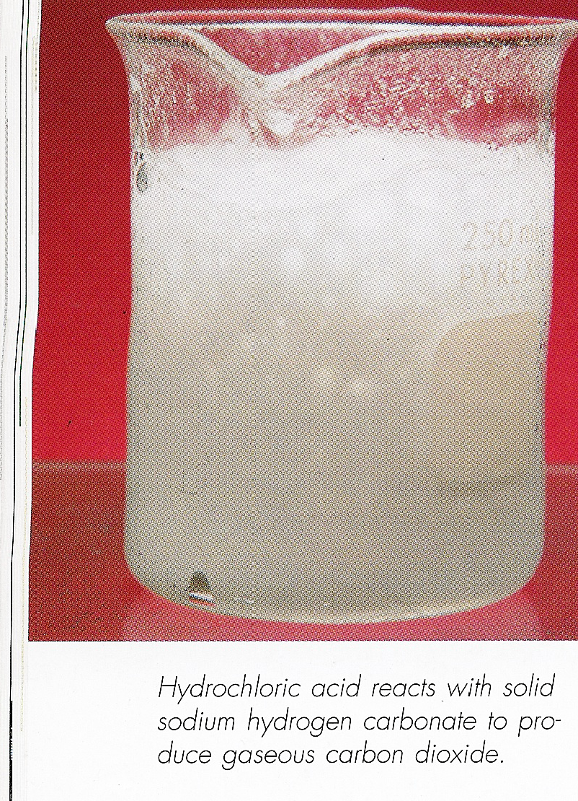
A Gas is Produced
Will appear as bubbling

Slide 9

There is a Change in Color
To totally different color

Slide 10
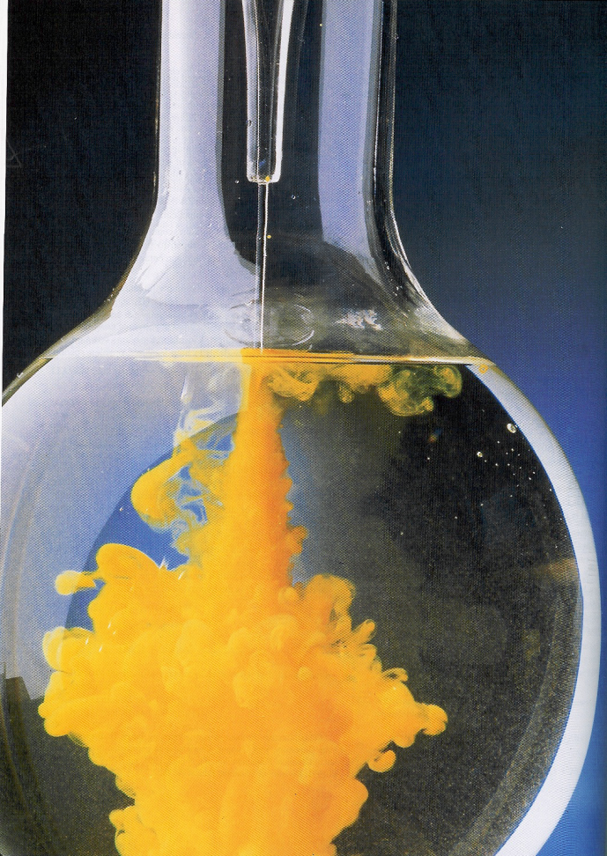
Precipitate Formed
A cloudy appearance is caused by a solid being formed

