Slide 1
TEMPLE CITY UNIFIED SCHOOL DISTRICT 2017-18 Unaudited Actuals Report PRESENTED TO THE BOARD OF EDUCATION September 12, 2018

Slide 2
TEMPLE CITY UNIFIED SCHOOL DISTRICT 2017-18 Unaudited Actuals

Slide 3
TEMPLE CITY UNIFIED SCHOOL DISTRICT 2017-18 Unaudited Actuals Changes since 2nd Interim

Slide 4
TEMPLE CITY UNIFIED SCHOOL DISTRICT 2017-18 Unaudited Actuals - Reserve

Slide 5
TEMPLE CITY UNIFIED SCHOOL DISTRICT 2017-18 - Unaudited Actuals CALSTRS Rate Increase And Cost Analysis
 | 2013-14 | 2014-15 | 2015-16 | 2016-17 | 2017-18 | 2018-19 | 2019-20 | 2020-21 | 2021-22
Employer | 8.25% | 8.88% | 10.73% | 12.58% | 14.43% | 16.28% | 18.13% | 19.10% | 19.10%
District Cost in Thousands of dollars | $1,960 | $2,228 | $2,806 | $3,637 | $4,172 | $4,707 | $5,242 | $5,522 | $5,730

Slide 6
TEMPLE CITY UNIFIED SCHOOL DISTRICT 2017-18 - Second Interim CALPERS Rate Increase And Cost Analysis
 | 2013-14 | 2014-15 | 2015-16 | 2016-17 | 2017-18 | 2018-19 | 2019-20 | 2020-21 | 2021-22
Employer | 11.442% | 11.771% | 11.847% | 13.888% | 15.531% | 18.06% | 20.8% | 23.5% | 24.6%
District Cost in Thousands of dollars | $844 | $944 | $960 | $1,224 | $1,393 | $1,649 | $1,904 | $2,195 | $2,342

Slide 7
Historical Enrollment

Slide 8
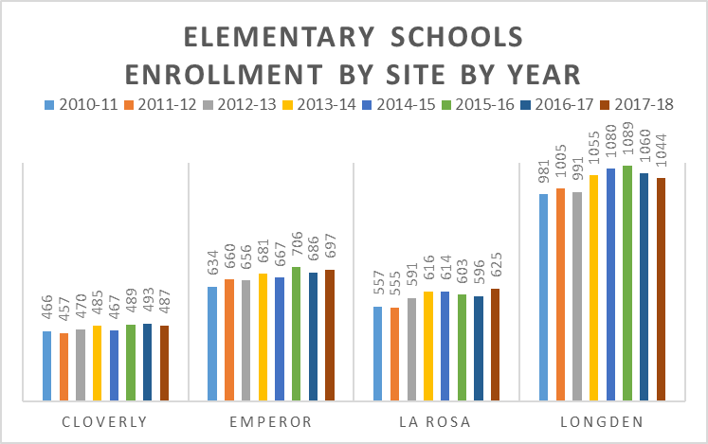

Slide 9
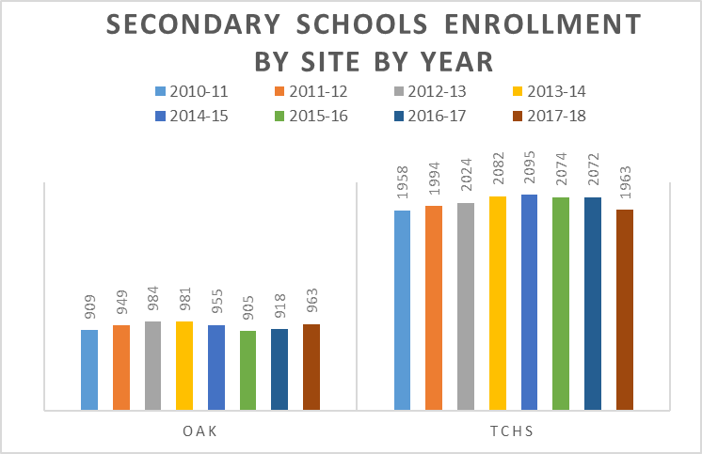

Slide 10
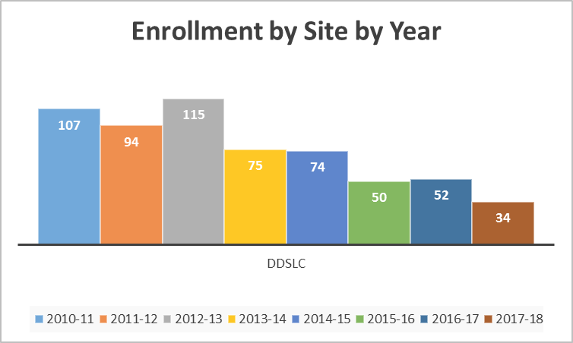

Slide 11
Temple City Unified School District History of Enrollment

