Slide 1

Doing Business with KCPS
(Revised 2-2019)

Slide 2
Contents
Doing Business with KCPS
Formal Sourcing Opportunities
Products and Services
Supplier Diversity Program
1st and 2nd Tier Supplier Diversity Opportunities
Key Elements of a Bid
Supplier Diversity Contacts

Slide 3
Doing business with KCPS
Interested in learning more about doing business with the Kansas City Public Schools, please visit our webpage at:
http://www.kcpublicschools.org/page/211
Here you will find a wealth of information to enable you with the resources to begin or continue to do business with KCPS by locating our quick links section (Bottom Right of the Page)
Quick Links
NIGP Commodity Codes
Supplier Diversity
Forms and Procedures
Bid Advertisement
Online Bidding System

Slide 4
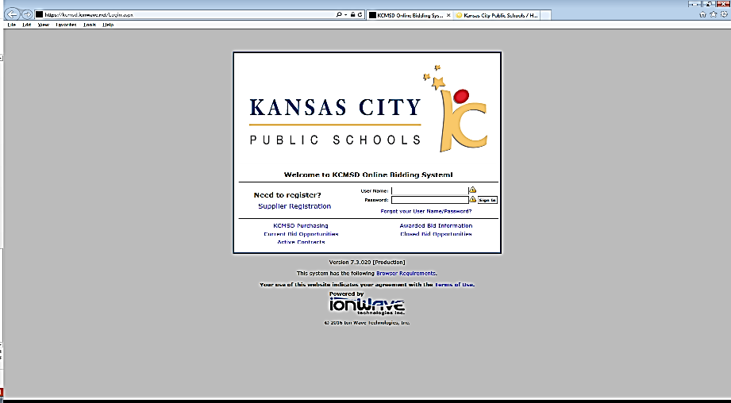
Doing Business with KCPS
https://kcmsd.ionwave.net/Login.aspx
Online Bidding System Access
Follow the Supplier Registration link to register as a new vendor to have access to all KCPS formal bids
Returning Users follow simple login process (forgot your credentials don’t worry- help is a click away or send an email to: purchasing@kcpublicschools.org)
ONCE REGISTERED YOU WILL HAVE ACCESS TO ALL FORMAL BIDS

Slide 5
Formal Sourcing Opportunities
Request for Qualifications (RFQ)
Invitation for Bid (IFB) and Request for Proposal (RFP)
Invitation for Bid (IFB) is most often used as a formal solicitation with an evaluation standard process of lowest and best bids on line item needs and awarded to one or multiple vendors.
Request for Proposal (RFP) is most often used as a formal solicitation with an evaluation process performed by internal KCPS stakeholders. Suppliers will normally provide a formal proposal outlining the project path to completion and cost. RPF’s are evaluated on a standard of lowest and best. Can be awarded to one or multiple vendors.
Used to gather a pool of successful candidates for professional services for further negotiations with one or multiple responders.
Occasionally used to gather qualifications and cost for projects that are over $15,000 for construction related projects and $25,000 for materials, goods and service related projects.

Slide 6
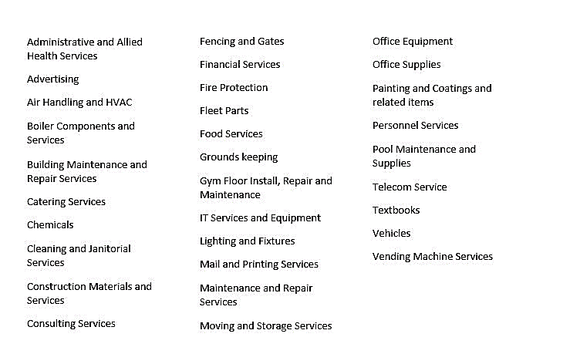
Products and Services

Slide 7
Supplier Diversity Program
KCPS is committed to increasing opportunities for diverse suppliers and enhancing the competitiveness of the supply base.
KCPS is dedicated to increasing opportunities with diverse suppliers.
Minority Business Enterprise (MBE)*
Woman Business Enterprise (WBE)*

Slide 8
1st and 2nd Tier Supplier Diversity Opportunities
1st Tier Diverse Spend opportunities as a Prime Vendor to KCPS
2nd Tier Diverse Spend opportunities with KCPS’s Prime Vendors
  RFP and IFB Requirement - Prime Vendors submit 2nd Tier (subcontracting) opportunities during the bid process on a Supplier Diversity Business Plan
  Contract Requirement - Prime Vendors report 2nd Tier actual diverse spend on a quarterly basis to KCPS

Slide 9
Key Elements of a Bid
Elements of Response to a Request for Proposal (RFP)
Elements of Response to a Invitation for Bid (IFB)
Declaration of Technical capabilities , as well overall Proposal submission identifying how to reach the objective identified by KCPS
Determination of the Project Team
Project Experience of Similar Nature/ References
Response Affidavit
Pricing
Contractor Disclosure
Subcontracting/Diverse Supplier Business Plan
Suppliers Financial Stability
Insurance
References
Certifications
Terms and Conditions
Declaration of Capabilities to meet Scope of Work
Determination of the Project Team
References
Response Affidavit
Pricing
Contractor Disclosure
Insurance
Subcontracting/ Diverse Supplier Business Plan
Certifications
Itemized Response(s)
Term and Conditions

Slide 10
Supplier Diversity Contacts
Ashlea Blue or Kim Mason
Kansas City Public Schools
2901 Troost Avenue
Kansas City, Missouri 64109
supplierdiversity@kcpublicschools.org
(816)418-7300

