Slide 1
2019-2020 B.O.Y.
Discipline Training
August 7, 2019

Slide 2




Introductions
Stephanie Farmer
PEIMS Data Quality Specialist, ext. 2059
Lisa Felton
PEIMS Specialist, ext. 2043
Marisol Munoz
PEIMS Specialist, ext. 2044
Melinda Turner
Director of Information Systems, ext. 2057

Slide 3
Course Overview
Importance of Accurate Discipline Data
Duncanville Discipline PEIMS Procedure Manual
Teacher Referrals to the Office
How to Process a Teacher Referral to the Office
Basic Discipline Reports

Slide 4
Why Your “Discipline” Work Matters
Support Campus Teachers: Strengthens Morale and Builds Campus Culture
Accurate Facts:
A Student’s Story in Duncanville ISD is Accurately Written
Interventions: Builds Student’s Social Emotional and Mental Health
Data: Progress Based Measures, Safe Schools, Office of Civil Rights, Public’s Perception of a School District
Attendance Implications: Student Daily Attendance

Slide 5
Accuracy Matters
Discipline records include a large amount of information in PEIMS coded form.
ALL of the codes have to be correct.
ALL of the actions (consequences) have to be reflected in the student’s attendance record.*
ALL of the discipline records have to be verified by campus administrators.
Inaccurate Data Leads To
*Financial Loss
*Accreditation Status
*Compliance Reprimands
*Attendance*
Elementary & Intermediate: 2nd instructional hour
Middle & High School: every period

Slide 6

PEIMS Discipline Reporting: The Law
It is a 3rd degree felony to tamper with data reported for a school district to TEA through PEIMS (SB 124).

Slide 7

Duncanville PEIMS Discipline Procedure Manual

Slide 8

How Teachers Enter a Teacher Referral through Skyward
Video Training Link to Share with Your Teachers
  Classlinks
  Skyward Training (Gradebook Help)
  Discipline Referrals
Teacher Referral Video Training

Slide 9

A Referral Was Written: Now What?
Discipline Entry by Officer
Discipline Entry by Student
Discipline Entry from Student Profile
  TRO-Teacher Referral to Office Need to be Processed by the Discipline Officer within 2 School Days

Slide 10
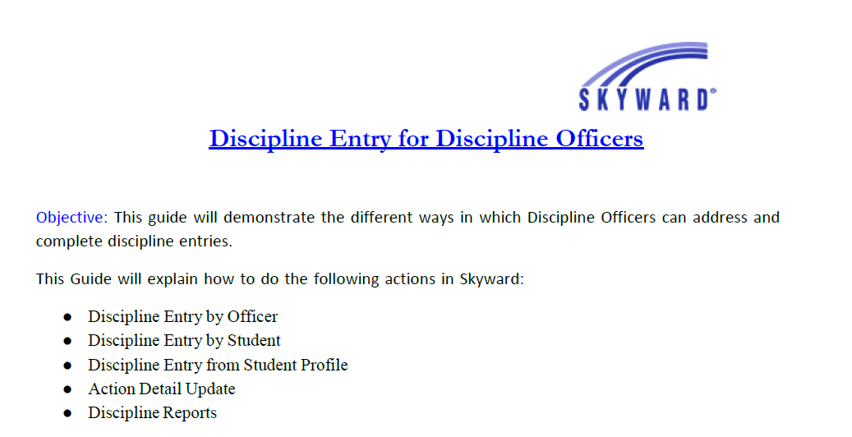
Training Handout

Slide 11
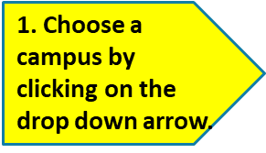
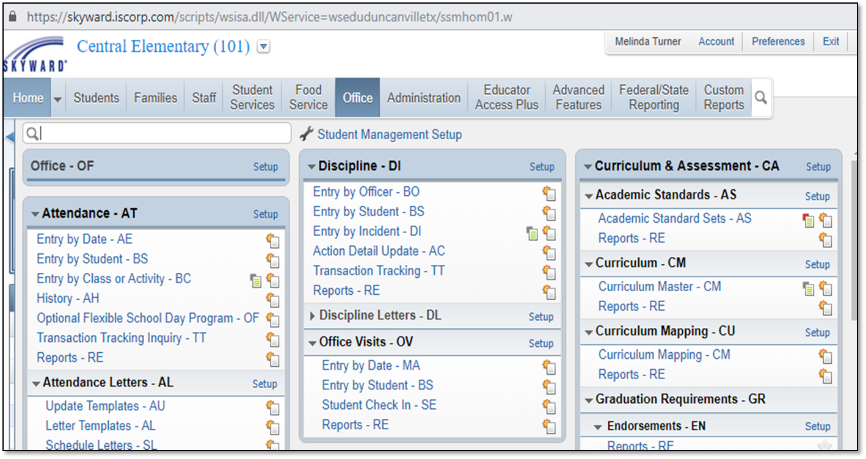


How to Run Discipline
Reports in Skyward

Slide 12
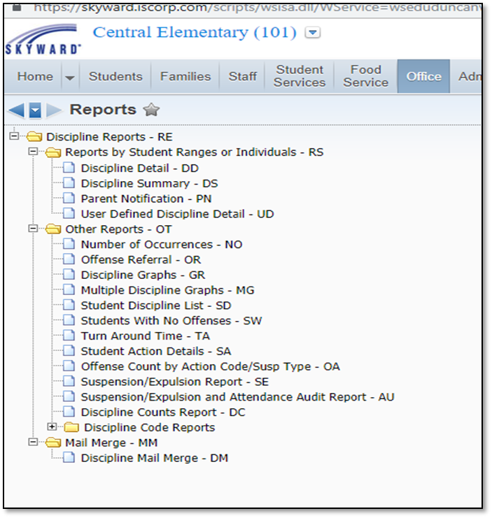

How to Run Discipline
Reports in Skyward
Today, we will look at the following reports:
-Suspensions/Expulsion Report
-Suspension/Expulsion and Attendance Audit Report

Slide 13
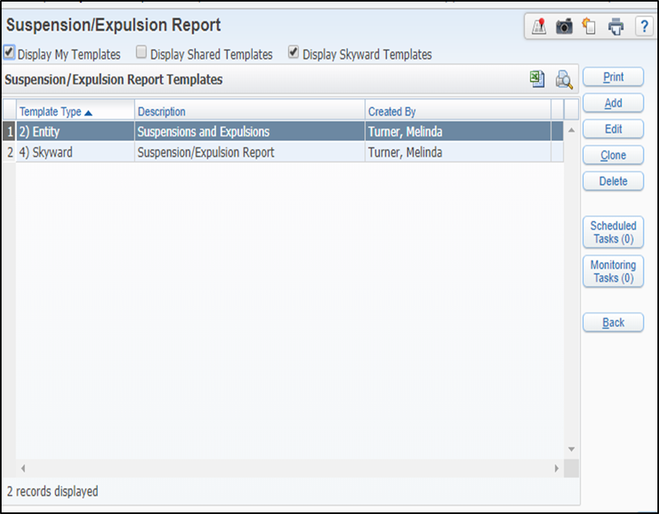
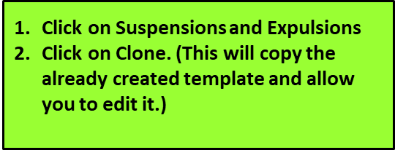

Suspension/Expulsion Report

Slide 14
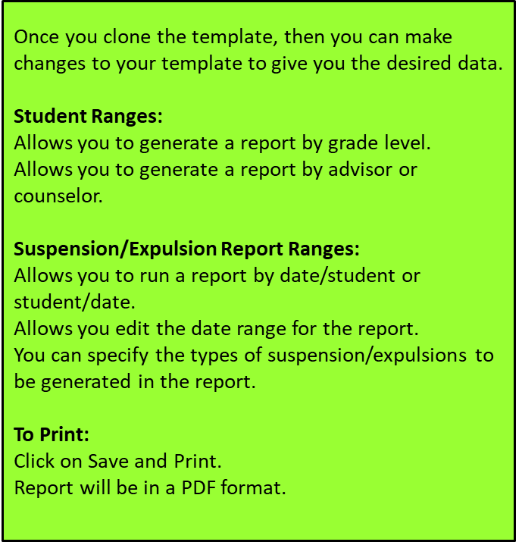
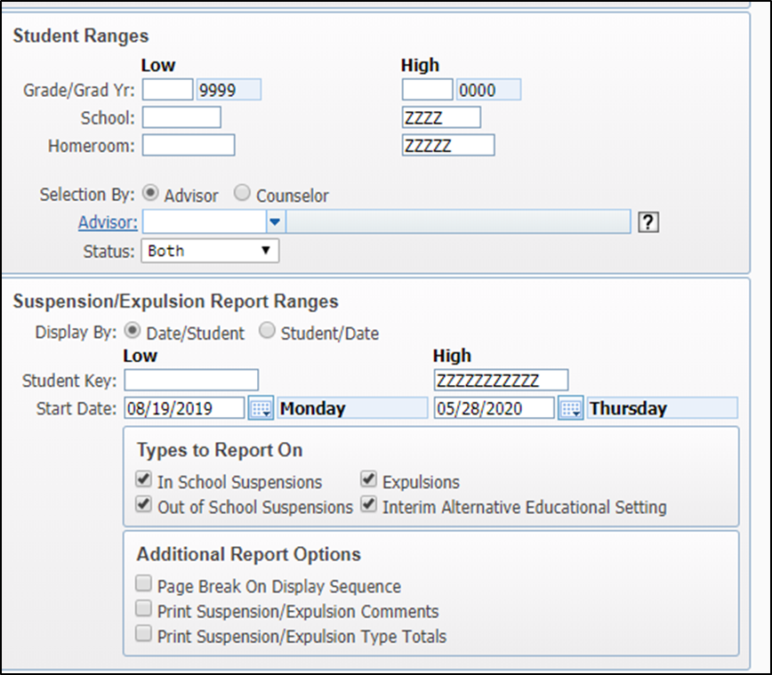
Suspension/Expulsion Template

Slide 15
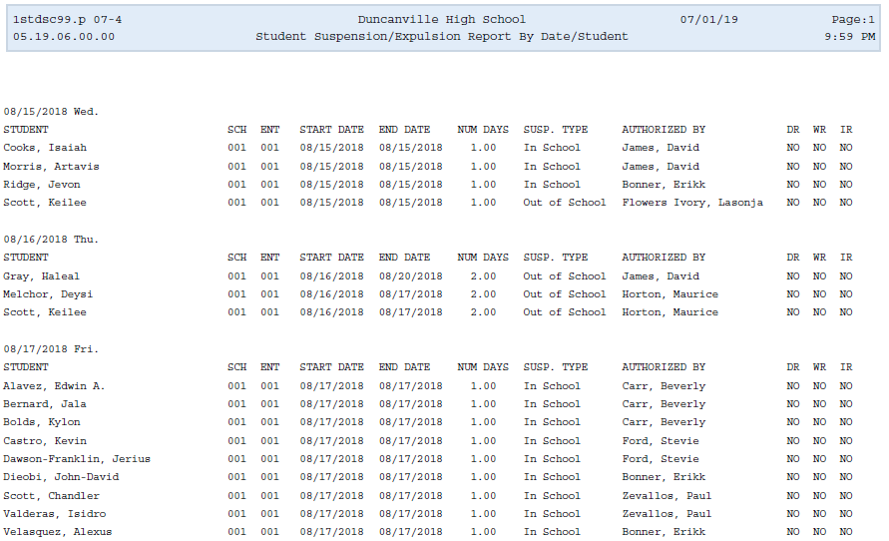
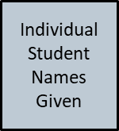
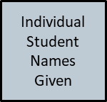
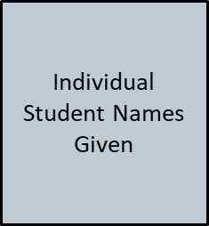
Sample: Suspension/Expulsion Report

Slide 16
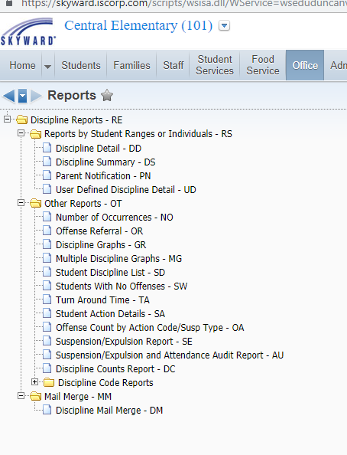
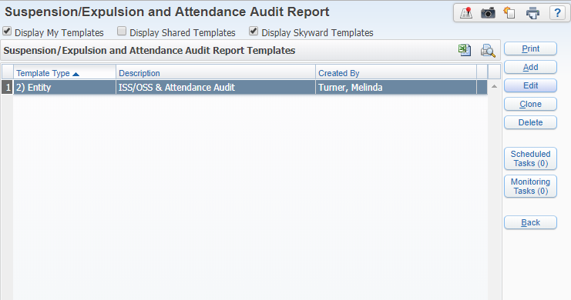
Suspension/Expulsion and Attendance Audit Report
Click on ISS/OSS & Attendance Audit
Click on Clone (This will copy the already created template and allow you to edit it.)
Click on Suspension/Expulsion & Attendance Audit Report

Slide 17
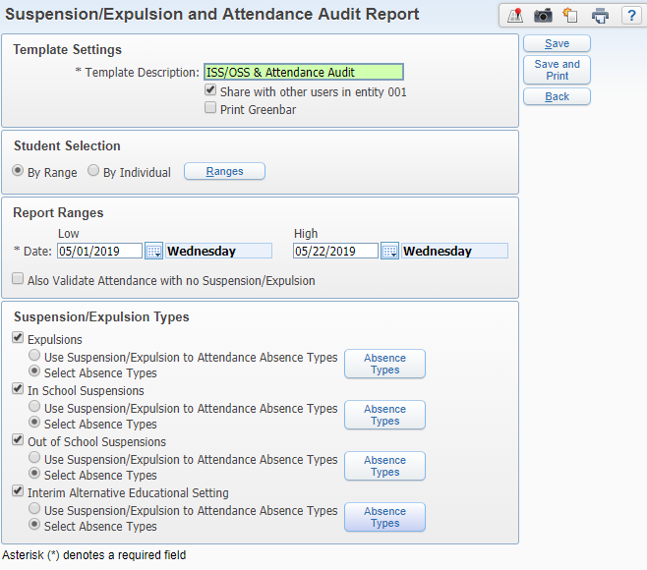
Suspension/Expulsion and Attendance Audit Report
Once you clone the template, then you can make changes to your template to give you the desired data.
Student Selection:
Allows you to print by student name range, grade, counselor, ethnicity.
Report Ranges:
Allows you edit the date range of the report.
To Print:
Click on Save and Print.
Report will be in a PDF format.

Slide 18
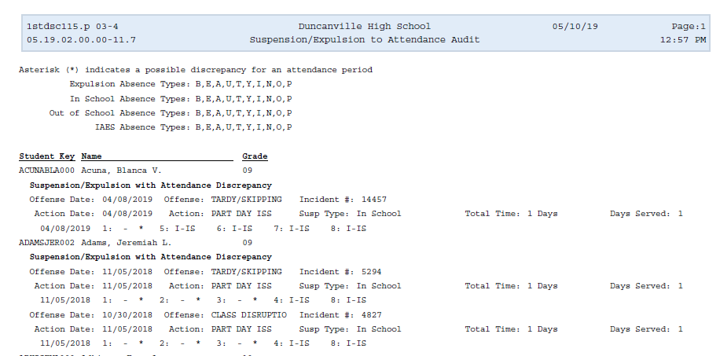
Sample: Suspension/Expulsion Attendance Audit

Slide 19
ISS/OSS BEST PRACTICES
Inform classroom teachers, attendance clerk, and ISS teacher/paraprofessional/administrator the names of students who will attend ISS for the given day.
ISS Log: Create an ongoing ISS daily log with the following components: student’s name, ID number, date, time in/time out.
The ISS Log should be shared with the attendance clerk and discipline officer on a daily basis.
If the student does not show up for ISS, establish a system to determine if the student is in class, wandering the building/skipping, or absent.
Update Skyward discipline records as soon as possible. Do not wait until the end of the 6 or 9 weeks to update the records. Attendance matters each day!

Slide 20
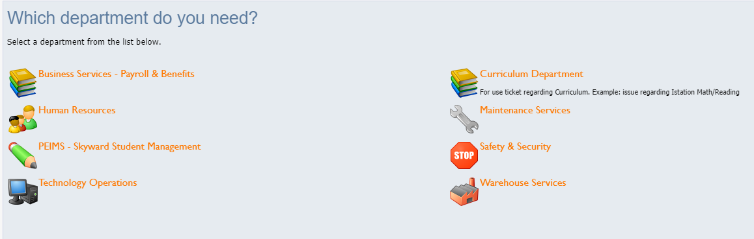
Reference Materials
Training Reference Site: www.duncanvilleisd.org>Staff>Department Sites>PEIMS
Store your training materials in a single location such as a binder or file folder for easy access.
Eduphoria: Help Desk Ticket

Slide 21

Questions

