Slide 1
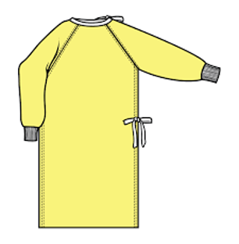
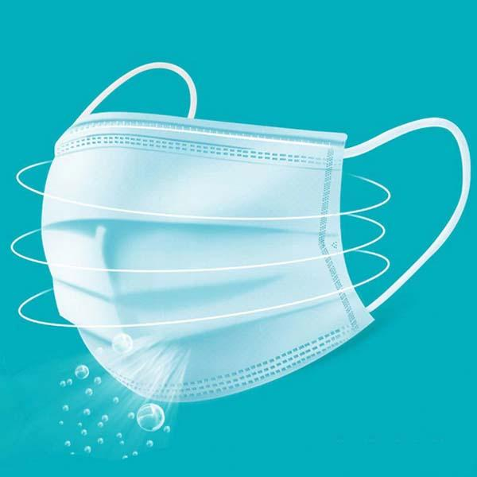
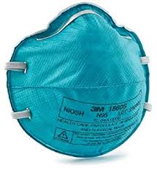
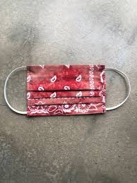
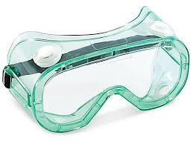
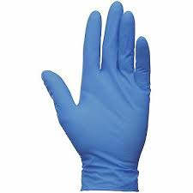
Proper and Safe Use of Personal Protective Equipment
Andrea Ingram, BSN, RN, CSN

Slide 2
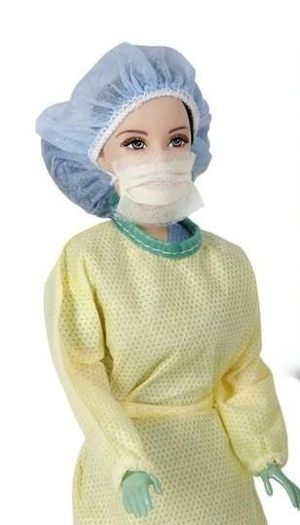
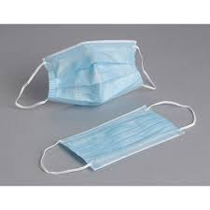
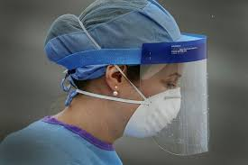
Before We Discuss Personal Protective Equipment, We Must
Understand Mode of Transmission
Pathogens are different sizes, and travel differently.
Specific precautions must be taken,
depending on the organism.

Slide 3
Standard Precautions
Use appropriate PPE when there is
any potential exposure to:
Blood
Body fluids
Mucous membranes
Non-intact skin
Potentially contaminated environmental surfaces or equipment
Gloves, gown, or face protection depending on the exposure.
(Centers for Disease Control and Prevention, 2020).

Slide 4
Contact Precautions
Implemented for pathogens that are transmitted by touching
an infected person directly or touching a contaminated object.
Some pathogens that are transmitted by contact are MRSA, Norovirus, and Clostridium difficile
(Centers for Disease Control and Prevention, 2020).

Slide 5
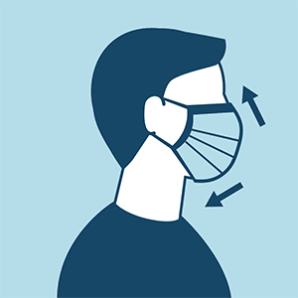
Droplet Precautions
Droplet Precautions are implemented when a caregiver is coming into contact
with infectious pathogens that are generated by coughing or sneezing
In addition to standard precautions, the eyes, nose and mouth are fully covered
Examples of pathogens that are transmitted by droplet are Influenza, rhinoviruses, pertussis,
and diphtheria. These pathogens are too large to remain airborne for long periods
of time, they may travel up to 6 feet, are propelled through the air, and enter the new host’s
system through the eyes, nose, or mouth. These pathogens may linger on surfaces.
(Centers for Disease Control and Prevention, 2020).

Slide 6
Airborne Precautions
These precautions are used to protect against pathogens transmitted by the airborne route
Droplet nuclei or dust particles containing microorganisms can
remain suspended in air for long periods of time.
Airborne transmission allows organisms to enter the upper and lower respiratory tracts.
Use personal protective equipment (PPE) appropriately, including a fit-tested NIOSH-approved
N95 or higher level respirator for healthcare personnel.
(Centers for Disease Control and Prevention, 2020).
(Minnesota Department of Health, 2020).

Slide 7
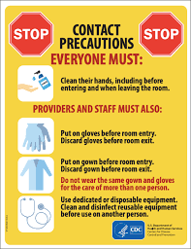
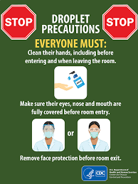
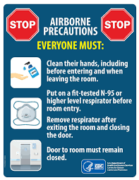
When unsure of which PPE to wear, look up the pathogen in question
to find out its mode of transmission, then choose the appropriate equipment
https://www.cdc.gov/hai/organisms/organisms.html
(Centers for Disease Control and Prevention, 2020).

Slide 8
Surgical Masks, Particulate Respirators, and Cloth Face Coverings

Slide 9
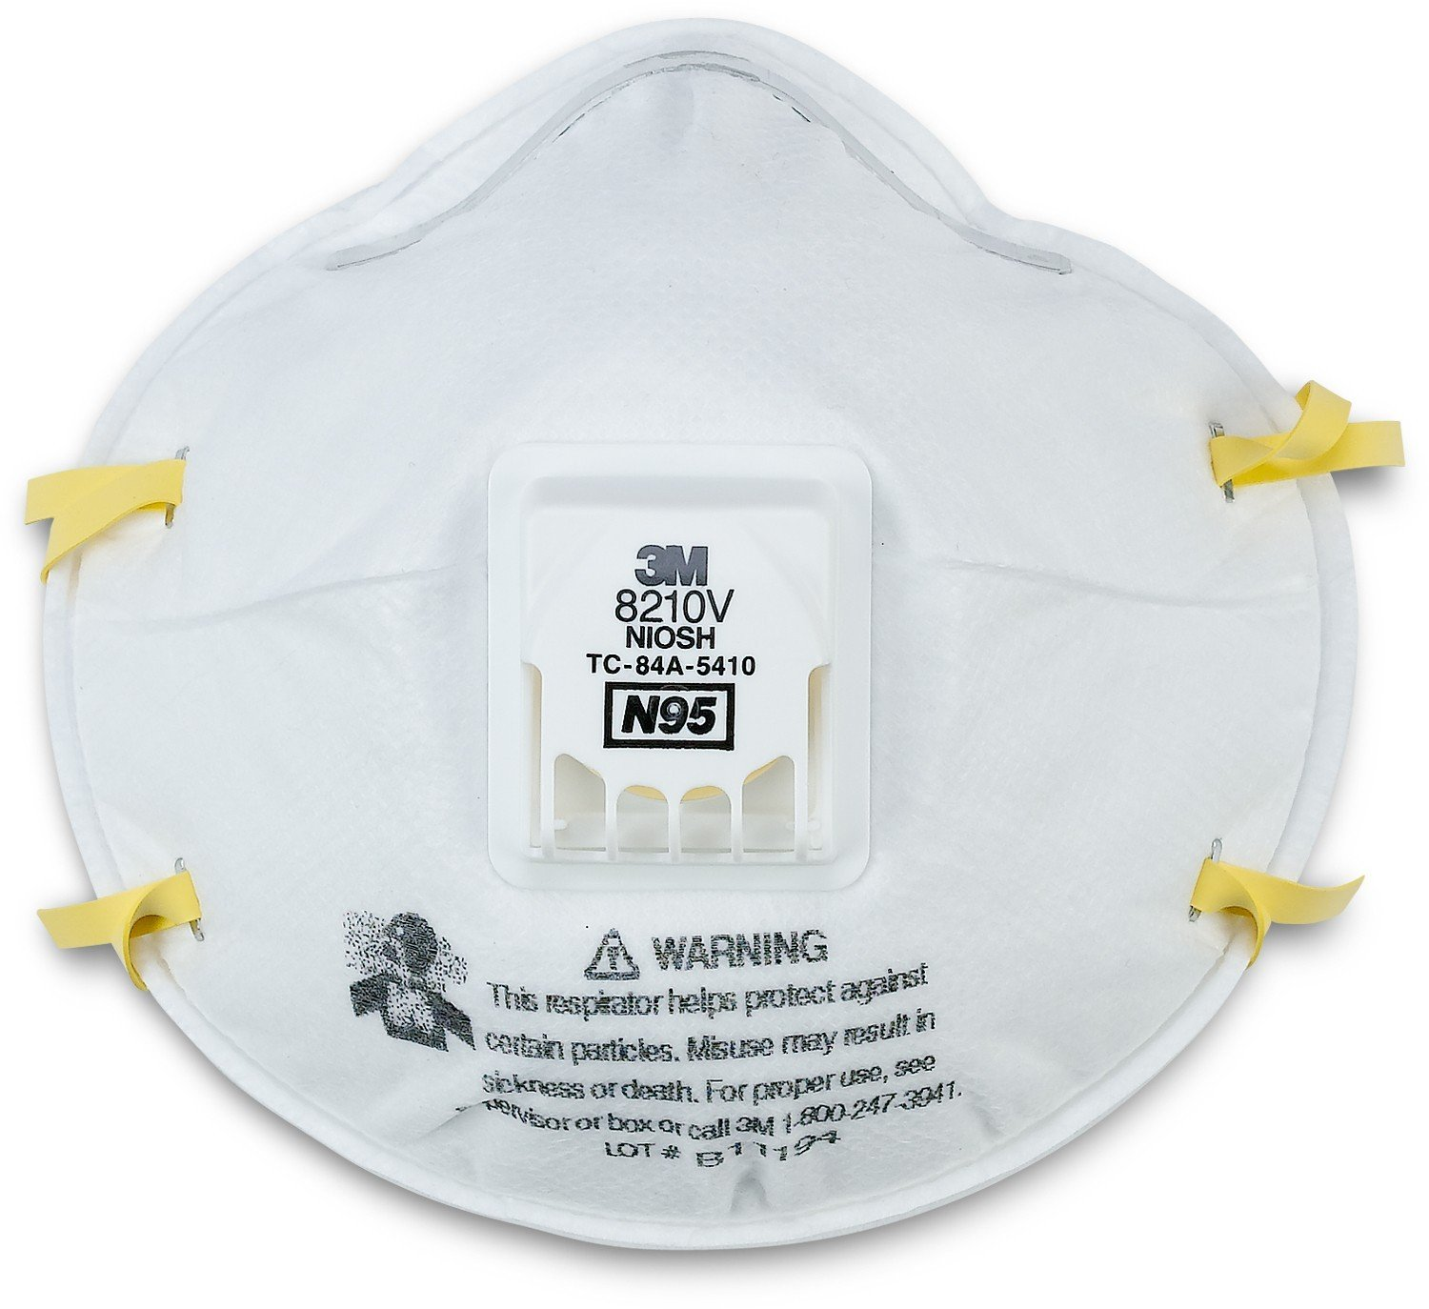
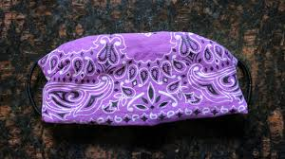
Types of Masks
Surgical Mask
Respirator
Cloth Face Covering

Slide 10
What Kind of Face Covering
does the CDC Recommend
For the General Public?

Slide 11
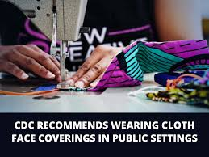
The CDC Recommends the use of Cloth Face Coverings
for the General Public
CDC recommends wearing cloth face coverings
in public settings where other social distancing measure are difficult to maintain
(e.g., grocery stores and pharmacies),
especially in areas of significant community-based transmission
(Centers for Disease Control and Prevention).
(Centers for Disease Control and Prevention, 2020).

Slide 12
The cloth face coverings recommended are not surgical masks or
N-95 respirators. Those are critical supplies that must continue
to be reserved for healthcare workers and other medical first
responders, as recommended by current CDC guidance.
(Centers for Disease Control and Prevention, 2020).

Slide 13
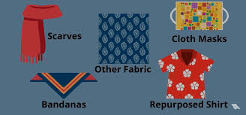
The CDC recommends Cloth Face Coverings for the General Public
But if you still choose to wear a surgical Mask or Respirator,
it is important to understand the differences.

Slide 14
What is a Respirator?
A respirator is a personal protective device that is worn on the face,
covers at least the nose and mouth, and is used to reduce the wearer’s risk of inhaling
hazardous airborne particles (including dust particles and infectious agents), gases, or vapors.
(Centers for Disease Control and Prevention (2020).

Slide 15
Types of Respirators
1. Particulate Respirators filter out airborne particles (N95, N99, N100).
disposable or filtering facepiece respirators
reusable or elastomeric respirators
powered air purifying respirators
2. Gas Masks filter out chemicals and gasses
3. Airline respirators, which use compressed air from a remote source
4. Self-contained breathing apparatus, which include their own air supply.
(Centers for Disease Control and Prevention, 2020).

Slide 16
Comparison of Surgical Mask to N95 Respirator Mask
 | Surgical Mask | N95 Respirator Mask
Testing and Approval | Approved by the *FDA | Approved by *NIOSH
Intended Use | provides the wearer protection against large droplets, splashes, or sprays of bodily or other hazardous fluids. Protects the patient from the wearer’s respiratory emissions. | Reduces wearer’s exposure to particles including small particle aerosols and large droplets (not resistant to oil).
* FDA - U.S. Food and Drug Administration
* NIOSH - The National Institute for Occupational Safety and Health
(Centers for Disease Control and Prevention, 2020).

Slide 17
Comparison of Surgical Mask to N95 Respirator Mask
 | Surgical Mask | N95 Respirator Mask
Face Seal Fit | Loose fit | Tight fit
Fit Test Requirement | No | Yes
User Seal Check Requirement | No | Yes. Required each time the respirator is donned (put on)
(Centers for Disease Control and Prevention, 2020).
(Centers for Disease Control and Prevention, 2020).

Slide 18
Comparison of Surgical Mask to N95 Respirator Mask
 | Surgical Mask | N95 Respirator
Filtration | Does NOT provide the wearer with a reliable level of protection from inhaling smaller airborne particles and is not considered respiratory protection | Filters out at least 95% of airborne particles including large and small particles
Leakage | Leakage occurs around the edge of the mask when user inhales | When properly fitted and donned, minimal leakage occurs around edges of the respirator when user inhales
Use Limitations | Disposable. Discard after each patient encounter. | Ideally should be discarded after each patient encounter and after aerosol generating procedures. It should also be discarded when it becomes damaged or deformed; no longer forms an effective seal to the face; becomes wet or visibly dirty; breathing becomes difficult; or if it becomes contaminated with bodily fluids.
(Centers for Disease Control and Prevention, 2020).

Slide 19
Other NIOSH Approved
Particulate Respirator Masks

Slide 20
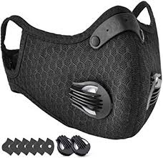
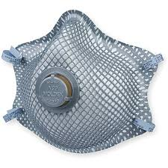
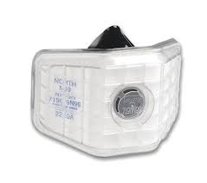
What is an N99 Particulate Filtering Facepiece Respirator?
The N99 particulate filtering facepiece respirator filters at least
99% of airborne particles but is not resistant to oil. N=not resistant to oil
Respirators are rated resistant to oil:
N-Not resistant
R Somewhat Resistant
P-Oil proof
(Centers for Disease Control and Prevention, 2020).

Slide 21
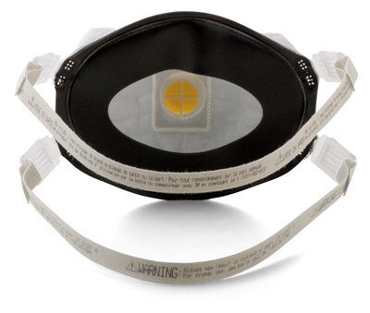
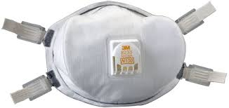
100-rated respirators filter 99.97% of airborne matter but is not resistant to oil. (N= Not resistant to oil)
Respirators are rated resistant to oil:
N-Not resistant
R Somewhat Resistant
P-Oil proof
(Centers for Disease Control and Prevention, 2020).

Slide 22
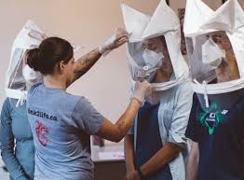
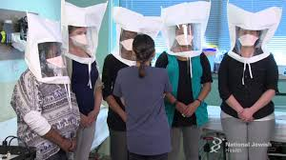
(Respirator use at work: OSHA Training required)
What is a Fit Test?
The Occupational Safety and Health Administration (OSHA)
(29 CFR 1910.134) requires an annual fit test to confirm the
fit of any respirator that forms a tight seal on the wearer’s face
before it is used in the workplace.
(Centers for Disease Control and Prevention, 2020).

Slide 23
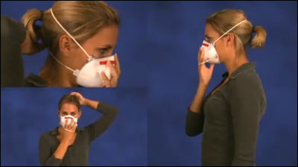
What is a User Seal Check?
Once a fit test has been done
to determine the best respirator model and size for a particular
user, a user seal check should be done every time the respirator
is to be worn to ensure an adequate seal is achieved.
(Centers for Disease Control and Prevention, 2020).

Slide 24
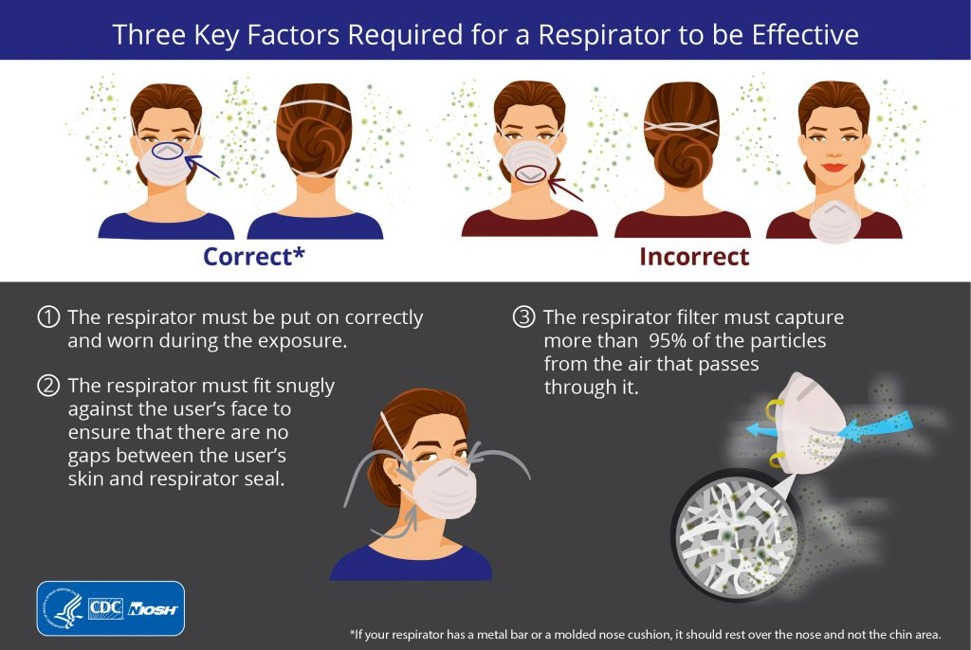
(Centers for Disease Control and Prevention, 2020).

Slide 25
If there is Respirator Use by the General Public
Respirator use by the general public is not subject to the same regulations
required of employers in workplaces.
Wearers will not have the benefits of formal training, fit testing,
or medical evaluation.
Non-NIOSH approved devices such as:
non-NIOSH-approved single-strap dust masks, and loose-fitting
facemasks will not provide the same level of protection as a
properly fitted NIOSH-certified respirator.
(Centers for Disease Control and Prevention, 2020).

Slide 26
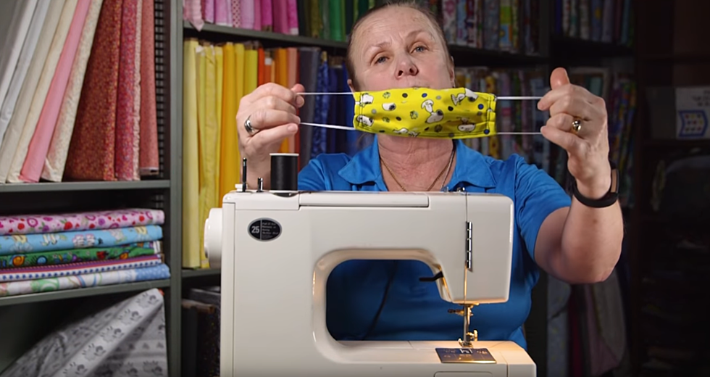
About Cloth Face Coverings

Slide 27
Face coverings should not be placed
on young children under age 2,
anyone who has trouble breathing,
or is unconscious,
incapacitated or otherwise unable to
remove the mask without assistance.
(Centers for Disease Control and Prevention, 2020).

Slide 28
How Can I Make my Own Cloth Face Covering?

Slide 29
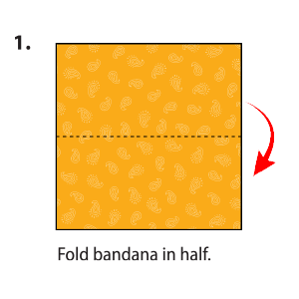
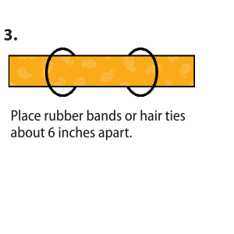
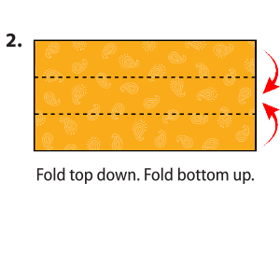
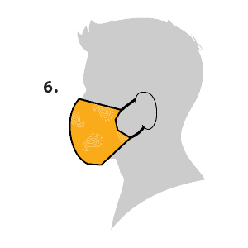
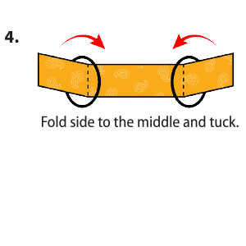
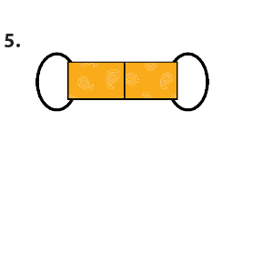
Bandana Face Covering (no sew method)
Materials
Bandana (or square cotton cloth approximately 20”x20”)
Rubber bands (or hair ties)

Slide 30
For more ideas for cloth face covering types, instructions, and instructional videos, go to the Centers for Disease Control and Prevention site https://www.cdc.gov/
Click on Learn More About COVID-19
Then click on How to Protect Yourself
Scroll down to Cover your mouth and nose with a cloth face cover when around others
Click on More details: Cloth Face Covers
Scroll down to Sew and No Sew Instructions for instructions on how to make a sewn cloth face covering, Quick cut T shirt (no sew method) and Bandana (No sew method).
At the bottom of the page, there are links for instructional
videos on how to make cloth face coverings.

Slide 31
How to Wear a Cloth Face Covering
Side view of an individual wearing a cloth face covering, which conceals
their mouth and nose areas and has a string looped behind the visible ear
to hold the covering in place.
The top of the covering is positioned just below the eyes and the bottom
extends down to cover the chin. The visible side of the covering extends
to cover approximately half of the individual’s cheek.
Cloth face coverings should fit snugly but comfortably against the side of the face,
be secured with ties or ear loops include multiple layers
of fabric allow for breathing without restriction, be able to be laundered
and machine dried without damage or change to shape
(Centers for Disease Control and Prevention, 2020).

Slide 32
Should cloth face coverings be washed
or otherwise cleaned regularly?
How regularly?
Yes.
They should be routinely washed depending on the frequency of use.
(Centers for Disease Control and Prevention, 2020).
(Centers for Disease Control and Prevention, 2020).

Slide 33
How does one safely sterilize/clean a cloth face covering?
A washing machine should suffice in properly washing a face covering.
(Centers for Disease Control and Prevention, 2020).

Slide 34
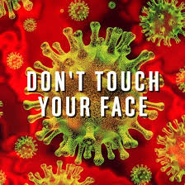
How does one safely remove a used face covering?
“Individuals should be careful not to touch their eyes, nose, and mouth
when removing their face covering and wash hands immediately after removing
(Centers for Disease Control and Prevention, 2020).”
.

Slide 35
Eye protection

Slide 36
Goggles
Appropriately fitted, indirectly-vented goggles with a manufacturer’s anti-fog coating provide
the most reliable practical eye protection from splashes, sprays, and respiratory droplets.
Directly-vented goggles may allow penetration by splashes or sprays;
therefore, indirectly-vented or non-vented goggles are preferred for infection control.
(Centers for Disease Control and Prevention, 2020).

Slide 37
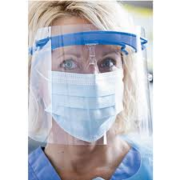
Face Shields
Face shields are commonly used as an infection control alternative to goggles.
Unlike goggles, a face shield can also provide protection to other facial areas.
to provide better face and eye protection from splashes and sprays, a face shield
should wrap around the face to the point of the ear, which
reduces the risk of splash reaching the eyes.
(Centers for Disease Control and Prevention, 2020).

Slide 38
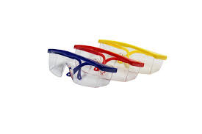
Safety Glasses
Safety glasses provide impact protection but do not provide the same level of
splash or droplet protection as goggles and generally should not
be used for infection control purposes.
(Centers for Disease Control and Prevention, 2020).

Slide 39
Gloves

Slide 40
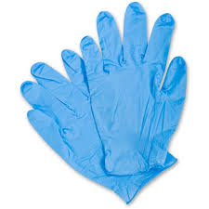
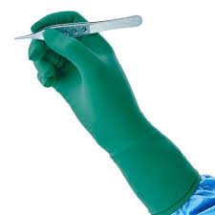
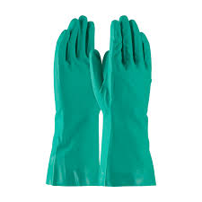
Glove Type Comparison
Non Sterile Exam Gloves
Sterile Gloves
Non Medical Gloves

Slide 41
Glove Type | Indications | Details
Non Sterile Patient Examination Gloves | Patient care examinations, other non-surgical procedures involving contact with mucous membranes and laboratory procedures. | Medical device regulated by the FDA. Non sterile and sterile single use disposable. Single use only for one patient, then dispose of properly.
Sterile Surgical Gloves | Sterile Procedures, surgical procedures | Medical device regulated by the FDA. These gloves are Sterile and single-use, and disposable.
Non Medical Gloves | Housekeeping/cleaning Handling chemicals. Not for use during patient care. | Not regulated by the FDA. Utility/general purpose gloves should be puncture and chemical resistant. Can be sanitized and re used. Not for patient care.
(Centers for Disease Control and Prevention, 2020).

Slide 42
Does the Centers for Disease Control and Prevention recommend
wearing gloves in public?
At this time, the CDC has not posted any information on wearing gloves in public.
Information about glove use in the health care setting is available on the CDC Website:
https://www.cdc.gov

Slide 43
If I choose to wear Gloves in Public,
are there any precautions I should take?

Slide 44
Perform Hand Hygiene Before Donning (putting on)
Clean Exam Gloves
AND
Perform Hand Hygiene After Doffing (removing) your Gloves

Slide 45
Be aware there are pathogens on your gloves.

Slide 46
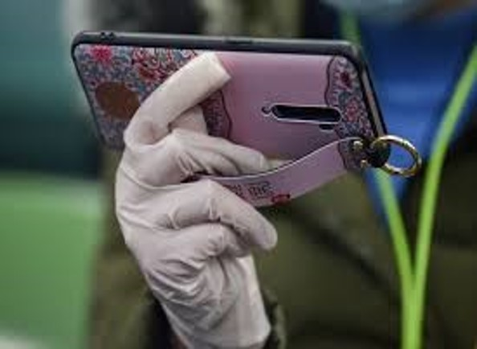
The Outside of your Gloves are Contaminated
Be aware there are pathogens on your gloves.

Slide 47
Preventing Self Contamination
Do not touch your face
Do not handle your keys, phone, or personal with contaminated gloves
Do not reach inside your purse with contaminated gloves
Before handling phone, keys, or put hands inside pockets, wallets, or purses, remove gloves,
dispose of gloves property, and sanitize your hands.
If not wearing gloves, remember to sanitize hands before handling personal items keys,
phone, wallet, or reaching into purse.

Slide 48
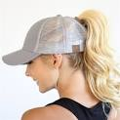
Tie back long hair to prevent hair from touching the face

Slide 49
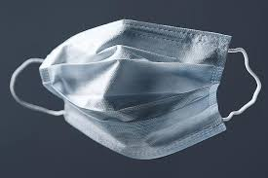
The Proper Sequence of Putting on your Personal Protective Equipment is
1
2
3
4
Face Covering
on
Gown on
Goggles on
Gloves
on
(If not using a piece of equipment, skip that step but keep the same sequence for all other equipment)
(Centers for Disease Control and Prevention, 2020).

Slide 50
Donning PPE
(Putting on)
Before handling equipment, perform hand hygiene
by washing hands with soap and water.

Slide 51
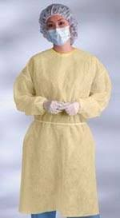
If you are donning a gown, put it on first.

Slide 52
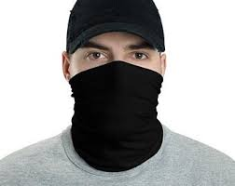
Next, don your mask or face covering

Slide 53
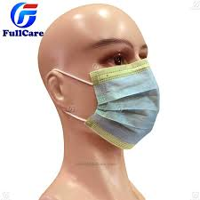
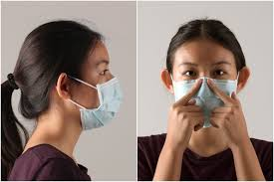
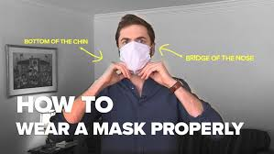
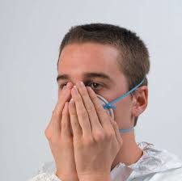
How to Properly Don (put on) a Clean Mask, Respirator, or Face Covering
Using Clean Hands:
Secure ties or elastic bands at middle of head and neck
(or apply ear loops 1A)
2. Fit flexible band to nose bridge
3. Fit snug to face and below chin
4. Fit-check respirator (Fit check not required for a surgical mask)
1A.
2.
4.
1.
3.

Slide 54
The mask or face covering should cover your nose and mouth completely

Slide 55
If you are wearing eye protection, put it on next.

Slide 56
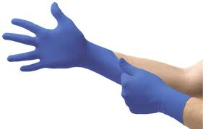
Next, don (put on) your gloves
When Donning Clean Gloves
Hands should be clean and dry
(Centers for Disease Control and Prevention, 2020).

Slide 57
How to Remove Personal Protective Equipment Safely
(without Self-Contamination)

Slide 58
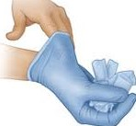
The Proper Sequence for removal of Personal Protective Equipment is
1
2
3
4
Gloves
off
Goggles
off
Gown
off
Face Covering
off
Perform hand hygiene between steps if hands become contaminated AND immediately after removing all PPE
(Centers for Disease Control and Prevention, 2020).

Slide 59
Doffing (removing) Gloves
1. Grasp the outside of one glove at the wrist. Do not touch
your bare skin.
The outside of the gloves are contaminated.
(Centers for Disease Control and Prevention, 2020).

Slide 60
Doffing (removing) Gloves
2. Peel the glove away pulling it inside out
(Centers for Disease Control and Prevention, 2020).

Slide 61
Doffing (removing) Gloves
3. Hold the glove you just removed in your gloved hand
(Centers for Disease Control and Prevention, 2020).

Slide 62
Doffing (removing) Gloves
4. Peel off the second glove by putting your fingers inside
the glove at the top of your wrist.
(Centers for Disease Control and Prevention, 2020).

Slide 63
Doffing (removing) Gloves
5. Turn the second glove inside out while pulling it away from
your body, leaving the first glove inside of the second
(Centers for Disease Control and Prevention, 2020).

Slide 64
Doffing (removing) Gloves
6. Dispose of the gloves properly
(Centers for Disease Control and Prevention, 2020).

Slide 65
Doffing (removing) Gloves
7. Wash your hands again
(Centers for Disease Control and Prevention, 2020).

Slide 66
Removing your Goggles or Face Shield
The outside of the goggles or face shield are contaminated.
• If your hands get contaminated during goggle or face shield removal,
immediately wash your hands or use an alcohol-based hand sanitizer
• Remove goggles or face shield from the back by lifting head band or ear pieces
• If the item is reusable, place in designated receptacle for
reprocessing. Otherwise, discard in a waste container
(Centers for Disease Control and Prevention, 2020).

Slide 67
Removing the Gown
The front of the gown and the sleeves are contaminated
• If your hands get contaminated during gown removal, immediately
wash your hands or use an alcohol-based hand sanitizer
• Unfasten gown ties, taking care that sleeves don’t contact your body
when reaching for ties
• Pull gown away from neck and shoulders, touching inside of gown only
• Turn gown inside out
• Fold or roll into a bundle and discard in a waste container
(Centers for Disease Control and Prevention, 2020).

Slide 68
Removing the Face Covering
Front of mask/respirator is contaminated — DO NOT TOUCH
• If your hands get contaminated during mask/respirator removal,
immediately wash your hands or use an alcohol-based hand sanitizer
• Grasp bottom ties or elastics of the mask/respirator, then the ones at
the top, and remove without touching the front
• Discard disposable face covering in a waste container
If you are removing a reusable cloth face covering, place it in the washing machine for
laundering after use.
(Centers for Disease Control and Prevention, 2020).

Slide 69
For more information and video tutorials visit
CDC.gov

Slide 70
References
Centers for Disease Control and Prevention (2003). Guidelines for Infection Control in Dental Health-Care Settings.
Retrieved from: https://www.cdc.gov/mmwr/PDF/rr/rr5217.pdf
Centers for Disease Control and Prevention (2020). The National Institute for Occupational Safety and Health NIOSH
Retrieved from: https://www.cdc.gov/niosh/index.htm
Centers for Disease Control and Prevention (2020). NIOSH Science Blog. Non-occupational Uses of Respiratory Protection –
What Public Health Organizations and Users Need to Know Retrieved from:
https://blogs.cdc.gov/niosh-science-blog/2018/01/04/respirators-public-use/
Centers for Disease Control and Prevention (2020). Sequence for donning personal protective equipment. Retrieved from:
https://www.cdc.gov/hai/pdfs/ppe/ppeposter148.pdf
Centers for Disease Control and Prevention (2020). Sequence for removing personal protective equipment. Retrieved from:
https://www.cdc.gov/hai/pdfs/ppe/ppeposter148.pdf
Minnesota Department of Health (2020). Airborne Precautions.
Retrieved from: https://www.health.state.mn.us/facilities/patientsafety/infectioncontrol/pre/airborne.html
World Health Organization (2020). Gove Use Information Leaflet.
Retrieved from: https://www.who.int/gpsc/5may/Glove_Use_Information_Leaflet.pdf

