Slide 1
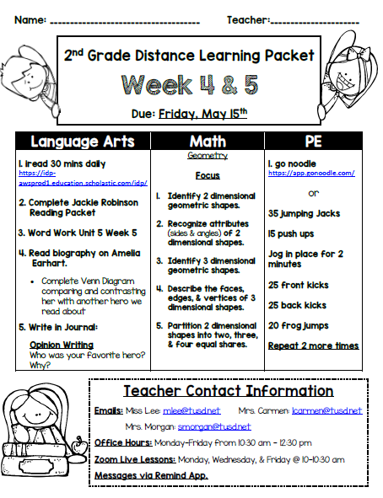
Click here to type
Click here to type

Slide 2
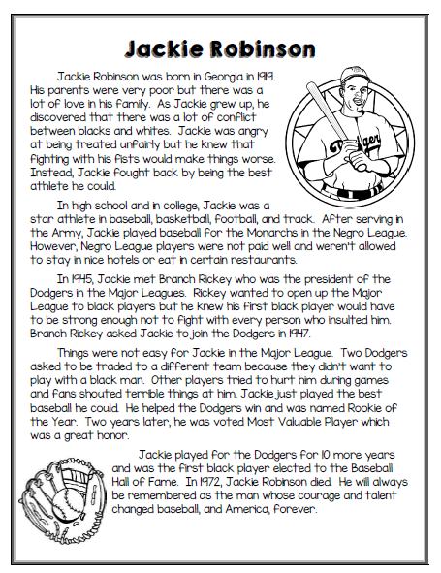

Slide 3
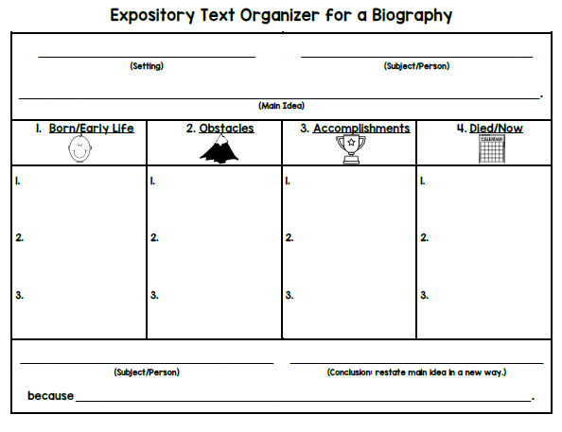
Click here to type
Click here to type
Click here to type
Click here to type
Click here to type
Click here to type
Click here to type
Click here to type
Click here to type
Click here to type
Click here to type
Click here to type
Click here to type
Click here to type
Click here to type
Click here to type
Click here to type
Click here to type

Slide 4

Click here to type

Slide 5
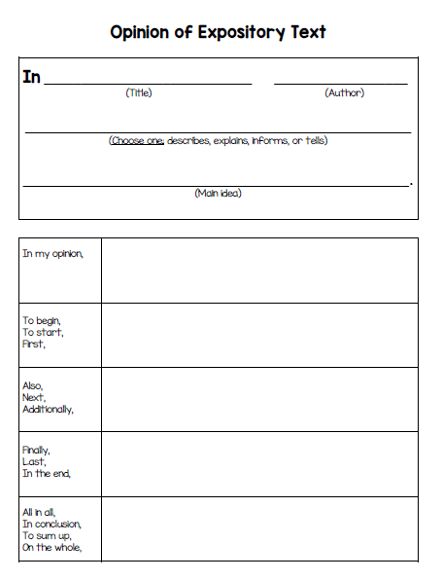
Click here to type
Click here to type
Click here to type
Click here to type
Click here to type
Click here to type
Click here to type
Click here to type
Click here to type

Slide 6
Click here to type

Slide 7
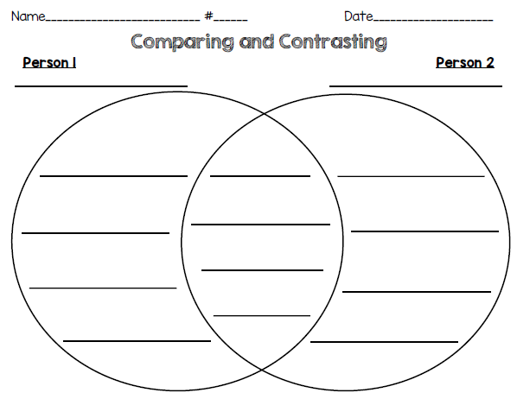
Click here to type
Click here to type
Click here to type
Click here to type
Click here to type
Click here to type
Click here to type
Click here to type
Click here to type
Click here to type
Click here to type
Click here to type
Click here to type
Click here to type
Click here to type
Click here to type

Slide 8
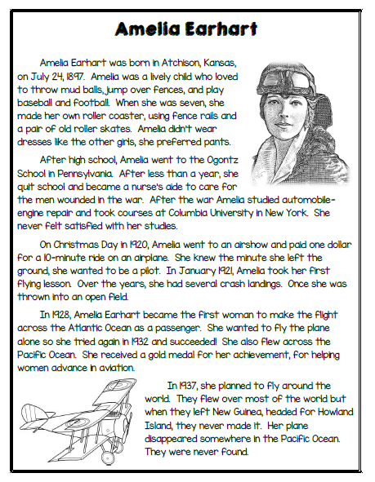

Slide 9
Click here to type
Click here to type
Click here to type
Click here to type
Click here to type
Click here to type
Click here to type
Click here to type
Click here to type
Click here to type
Click here to type
Click here to type
Click here to type
Click here to type
Click here to type
Click here to type

Slide 10
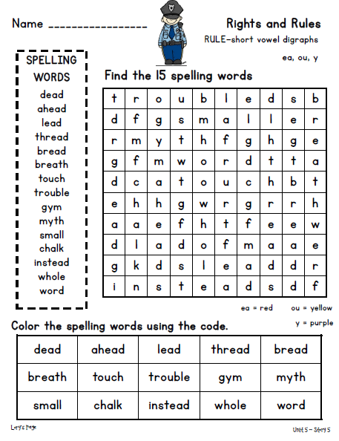
Click here to type

Slide 11
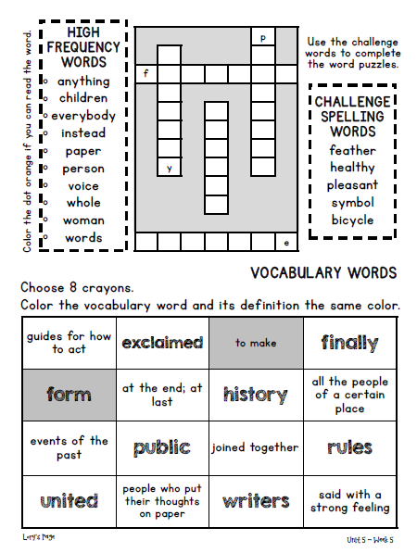

Slide 12

Click here to type

Slide 13
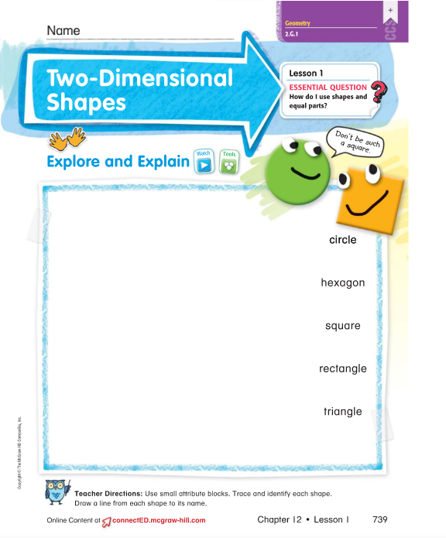
Click here to type
Click here to type

Slide 14
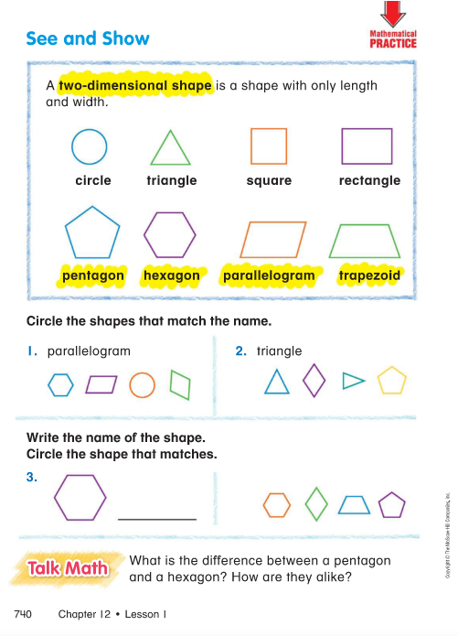
Click to type
Click to type
Click to type
Click to type

Slide 15
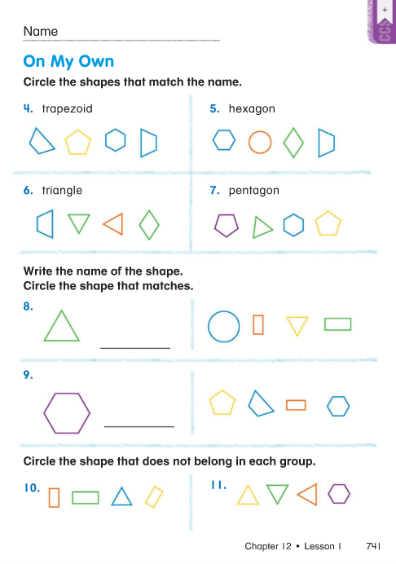
Click here to type
Click here to type
Click here o type
Click here to type
Click here o type
Click here o type
Click here o type
Click here o type
Click here o type
Click here o type
Click here o type

Slide 16
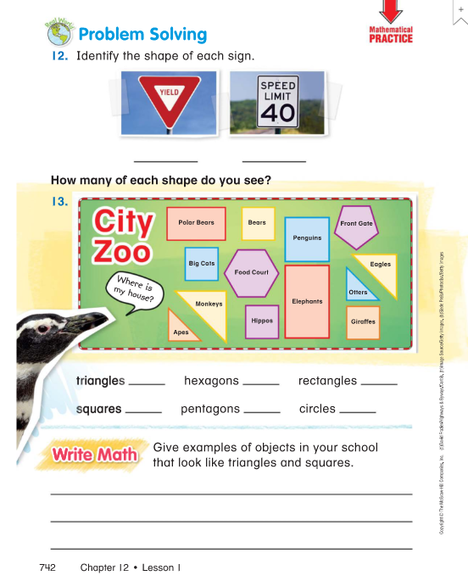
Click here o type
Click here o type
Type here
Type here
Type here
Type here
Type here
Type here
Click here to type

Slide 17
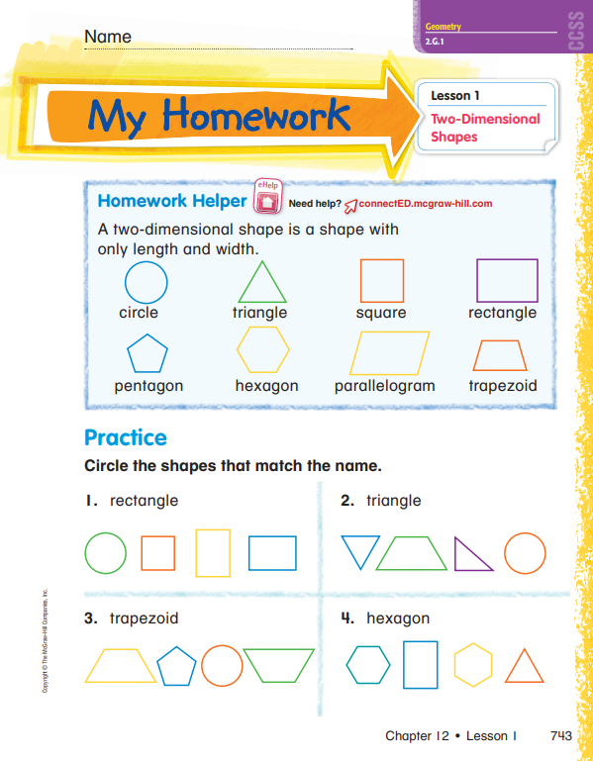
Clck here to type
Click here to type
Click here to type
Click here to type
Click here to type

Slide 18
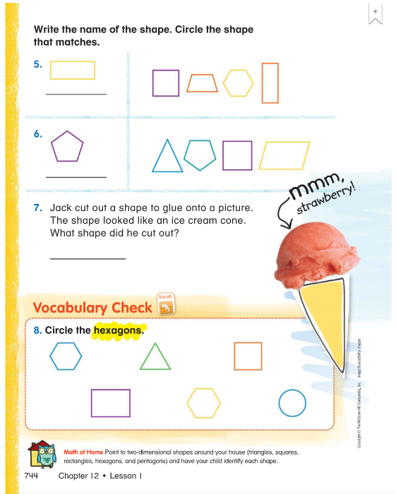
Click here to type
Click here to type
Click here to type
Click here to type
Click here to type
Click here to type

Slide 19
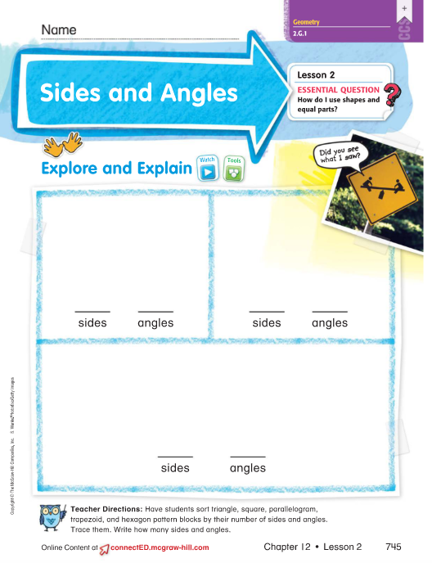
Click here to type
Click here to type
Click here to type
Type
here
Type
here
Type
here
Type
here
Click here to type
Type
here
Type
here

Slide 20
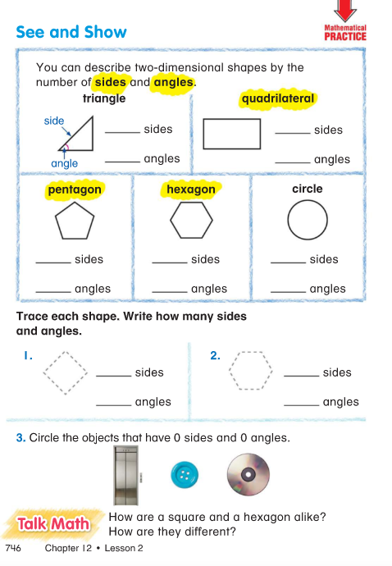
Type here
Type here
Type here
Type here
Type here
Type here
Type here
Type here
Type here
Type here
Type here
Type here
Type here
Type here
Click here
To type

Slide 21
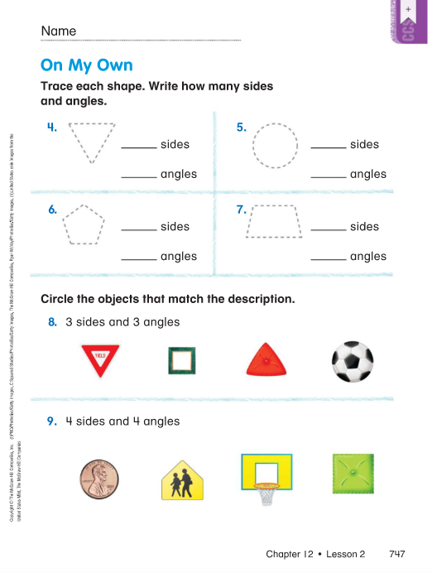
Clck here to type
Type here
Type here
Type here
Type here
Type here
Type here
Type here
Type here
Click here
To type
Click here
To type

Slide 22
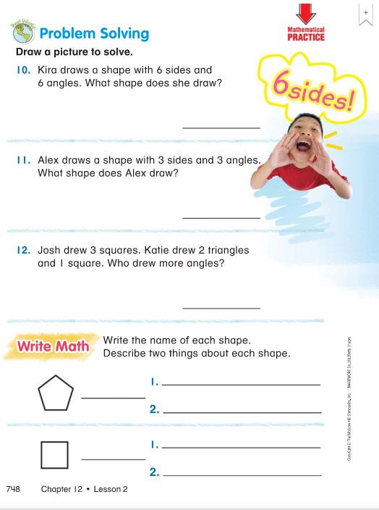
Click here to type
Click here to type
Click here to type
Click here to type
Click here to type
Click here to type
Click here to type
Click here to type
Click here to type
Click here to type

Slide 23
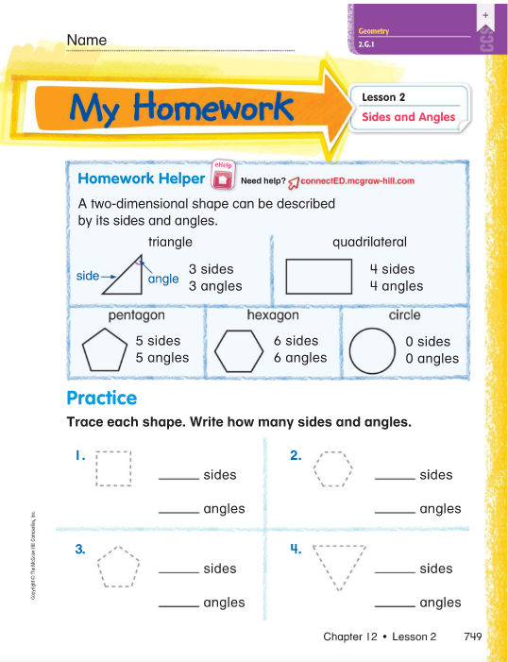
Click here to type
Type here
Type here
Type here
Type here
Type here
Type here
Type here
Type here

Slide 24
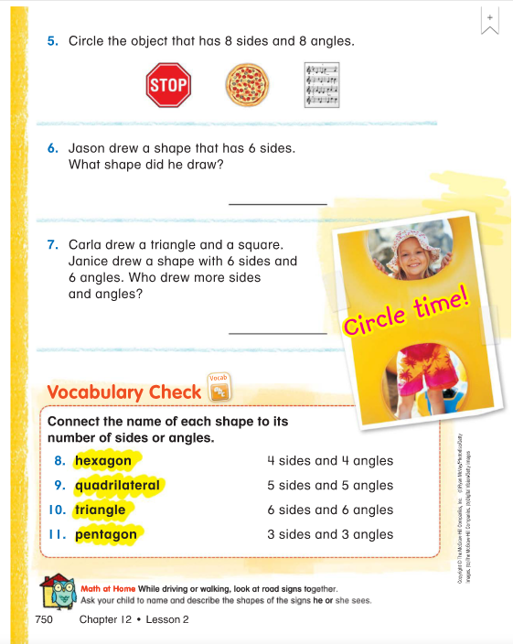
Click here
to type
Click here to type
Click here to type
Click here to type

Slide 25
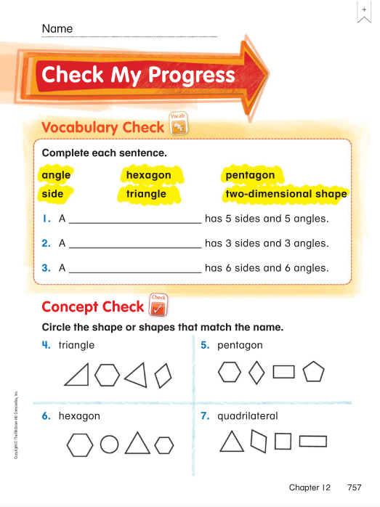
Click here to type
Click here to type
Click here to type
Click here to type
Click here
To type
Click here
To type
Click here
To type
Click here
To type

Slide 26
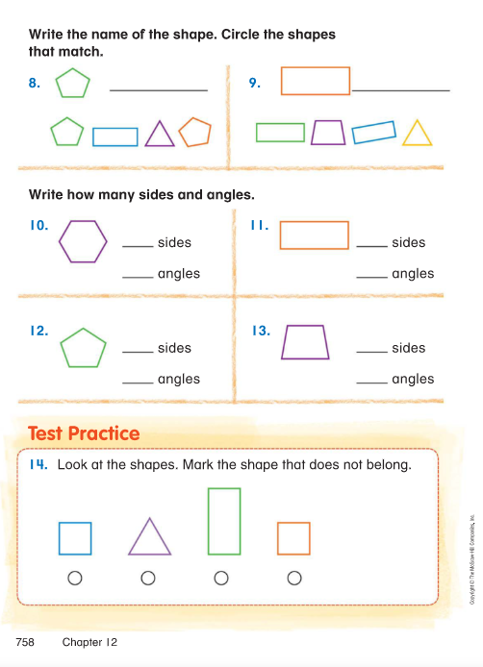
Click here to type
Click here to type
Click here to type
Click here to type
Type
here
Type
here
Type
here
Type
here
Type
here
Type
here
Type
here
Type
here
Click here to type

Slide 27
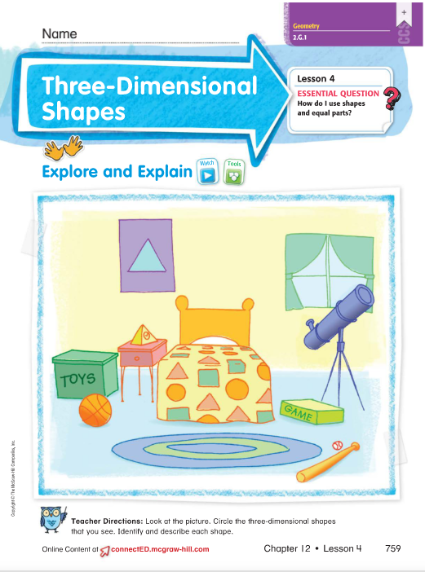
Click here to type
Click here to type

Slide 28
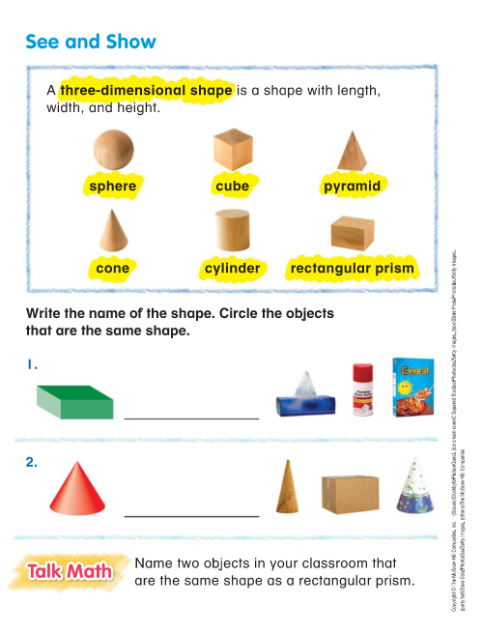
Click here to type
Click here to type
Click here to type
Click here to type

Slide 29
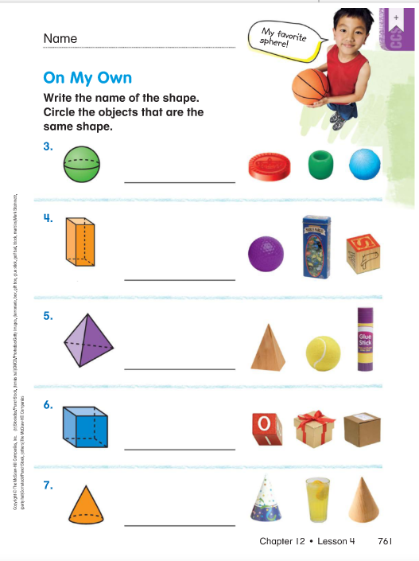
Click here to type
Click here to type
Click here to type
Click here to type
Click here to type
Click here to type
Click here to type
Click here to type
Click here to type
Click here to type
Click here to type

Slide 30
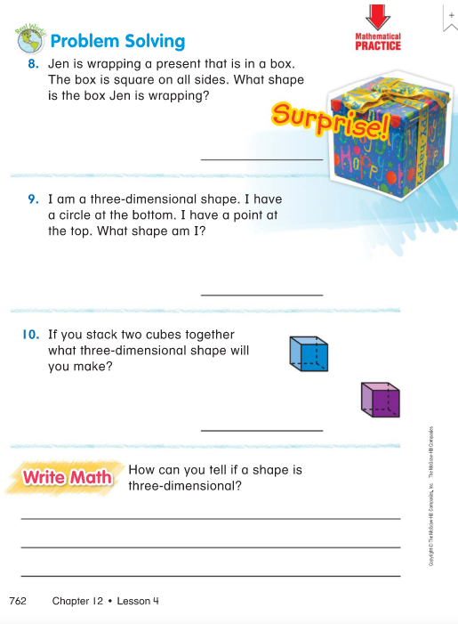
Click here to type
Click here to type
Click here to type
Click here to type

Slide 31
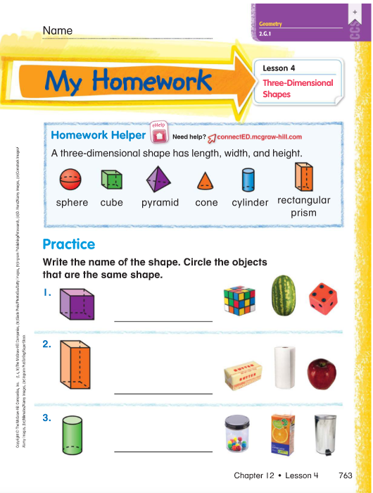
Click here to type
Click here to type
Click here to type
Click here to type
Click here to type
Click here to type
Click here to type

Slide 32
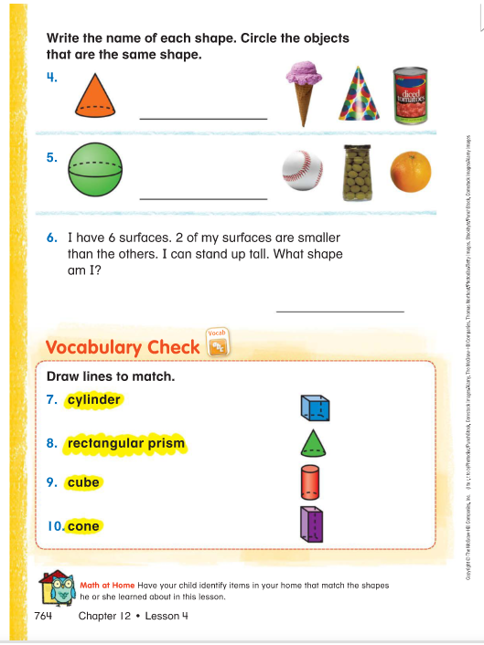
Click here to type
Click here to type
Click here to type
Click here to type
Click here to type
Click here to type

Slide 33
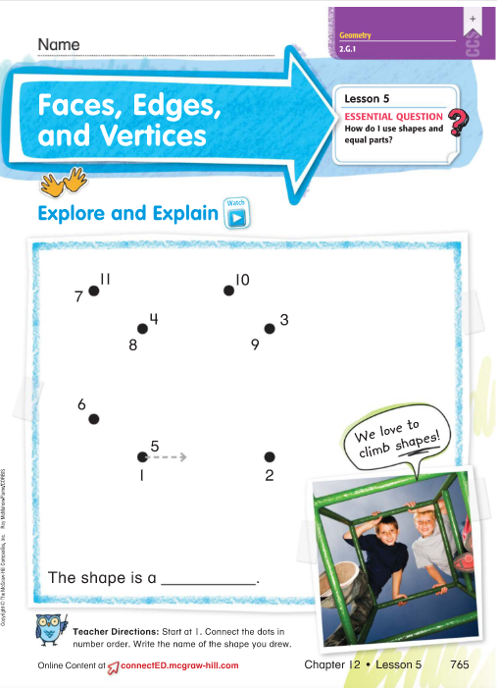
Click here to type
Click here to type
Click here to type

Slide 34
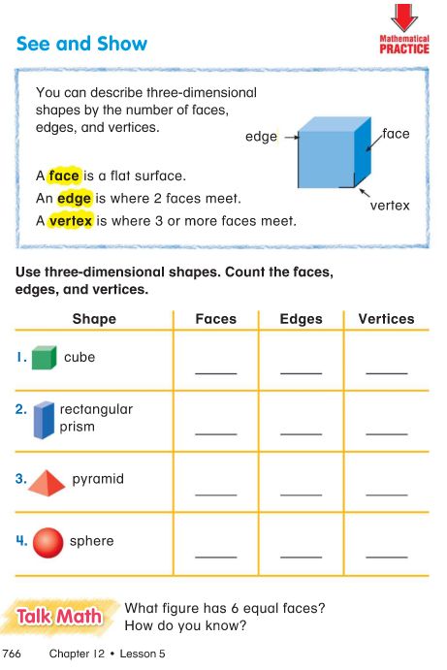
Type here
Type here
Type here
Type here
Type here
Type here
Type here
Type here
Type here
Type here
Type here
Type here

Slide 35
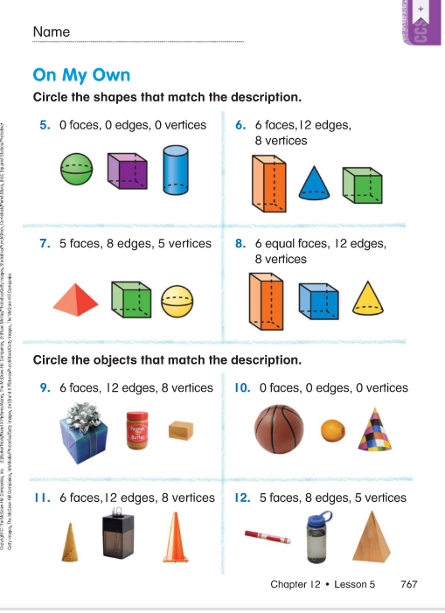
Click here to type
Click here to type
Click here to type
Click here to type
Click here to type
Click here to type
Click here to type
Click here to type
Click here to type

Slide 36
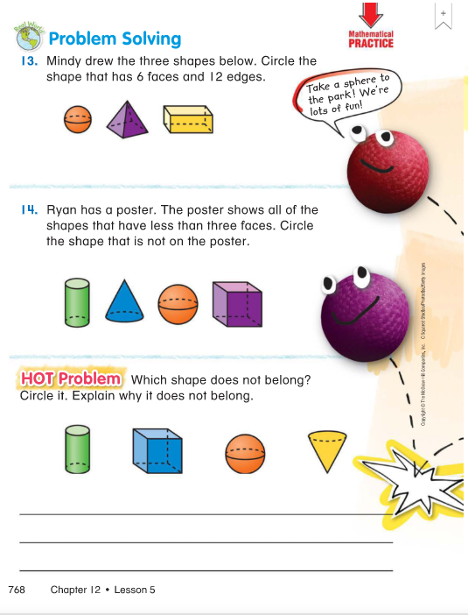
Click here to type
Click here to type
Click here to type

Slide 37
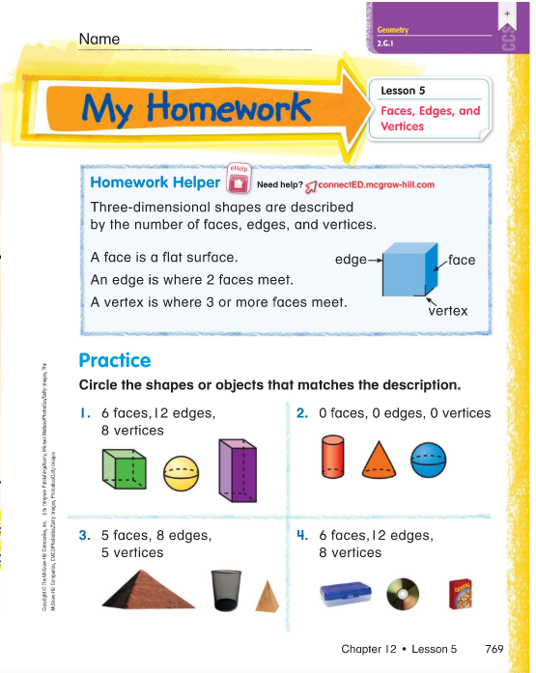
Click here to type
Click here to type
Click here to type
Click here to type
Click here to type

Slide 38
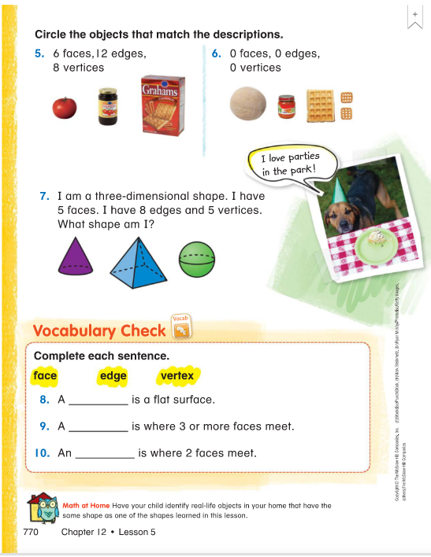
Click here to type
Click here to type
Click here to type
Type here
Type here
Type here

Slide 39
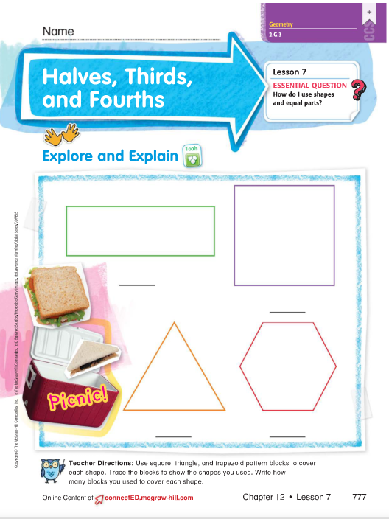
Click here to type
Click here to type
Click here to type
Click here to type
Click here to type
Click here to type
Click here to type
Click here to type
Click here to type

Slide 40
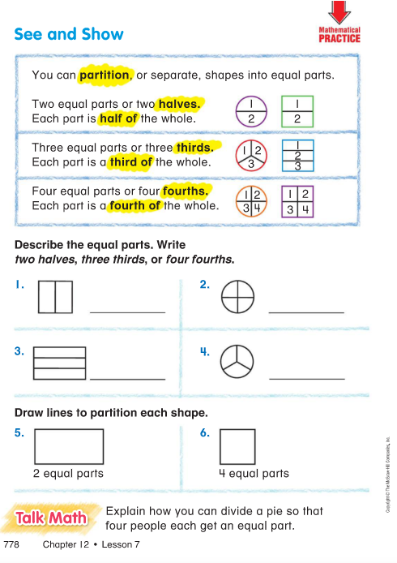
Click here to type
Click here to type
Click here to type
Click here to type
Click here to type
Click here to type

Slide 41
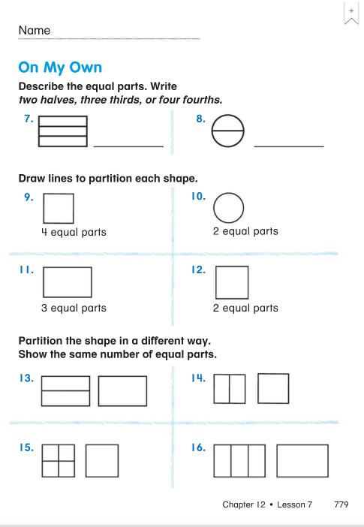
Click here to type
Click here to type
Click here to type
Click here to type
Click here to type
Click here to type
Click here to type
Click here to type
Click here to type
Click here to type
Click here to type

Slide 42
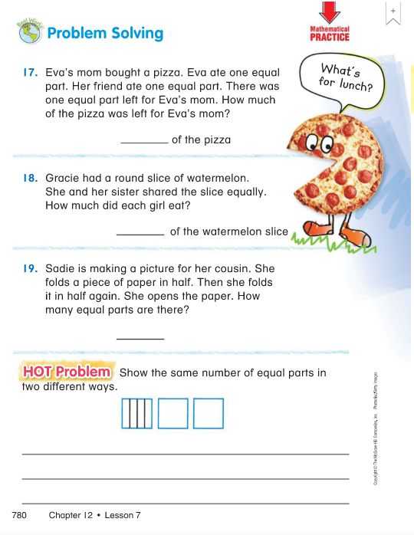
Click here to type
Click here to type
Click here to type
Type here
Type here
Click here to type

Slide 43
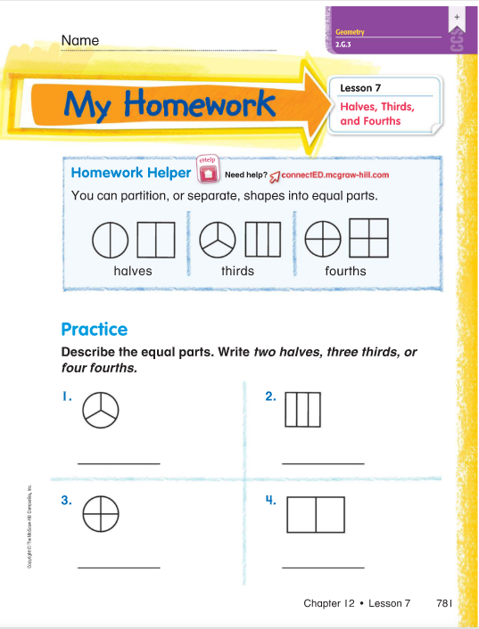
Click here to type
Click here to type
Click here to type
Click here to type
Click here to type

Slide 44
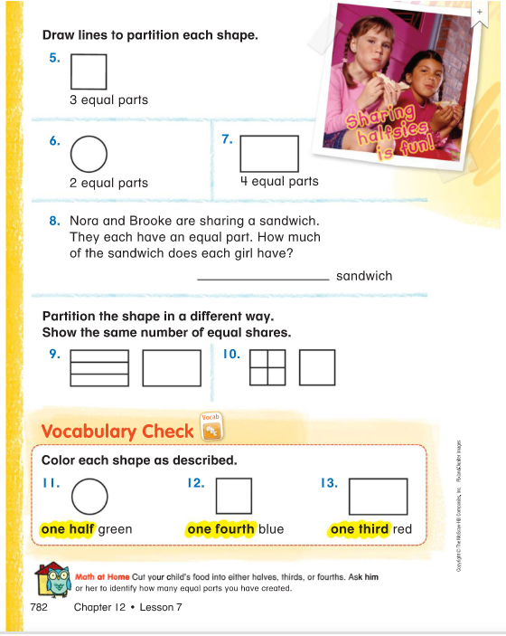
Type here
Type here
Type here
Click here to type
Click here to type
Click here to type
Type here
Type here
Type here

