Slide 1
Click here to type
Click here to type

Slide 3
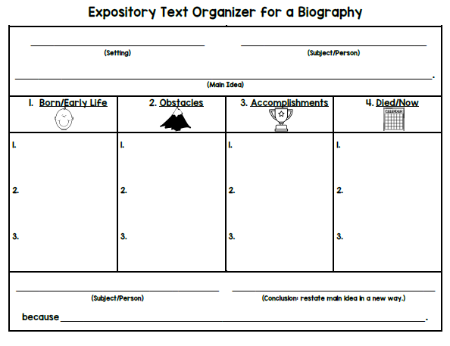
Click here to type
Click here to type
Click here to type
Click here to type
Click here to type
Click here to type
Click here to type
Click here to type
Click here to type
Click here to type
Click here to type
Click here to type
Click here to type
Click here to type
Click here to type
Click here to type
Click here to type
Click here to type

Slide 4
Click here to type

Slide 5
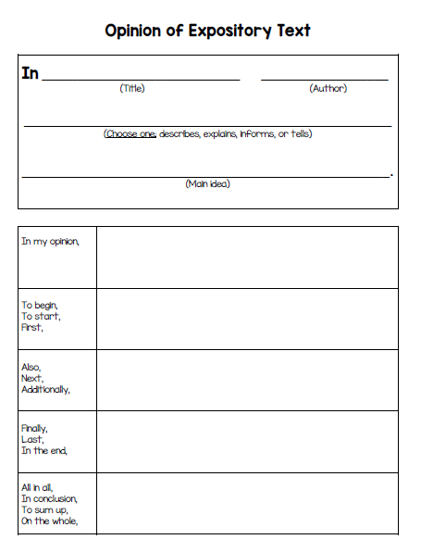
Click here to type
Click here to type
Click here to type
Click here to type
Click here to type
Click here to type
Click here to type
Click here to type
Click here to type

Slide 6
Click here to type

Slide 7
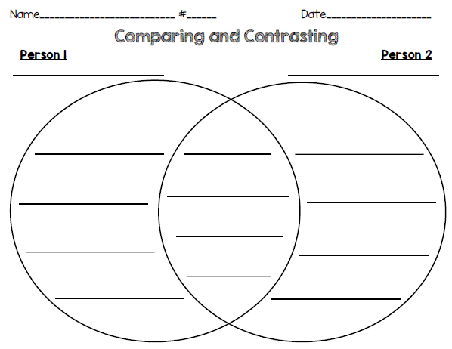
Click here to type
Click here to type
Click here to type
Click here to type
Click here to type
Click here to type
Click here to type
Click here to type
Click here to type
Click here to type
Click here to type
Click here to type
Click here to type
Click here to type
Click here to type
Click here to type

Slide 9
Click here to type
Click here to type
Click here to type
Click here to type
Click here to type
Click here to type
Click here to type
Click here to type
Click here to type
Click here to type
Click here to type
Click here to type
Click here to type
Click here to type
Click here to type
Click here to type
Click here to type
Click here to type

Slide 10
Click here to type

Slide 11
Click here to type
Click here to type
Click here to type
Click here to type
Click here to type
Click here to type
Click here to type
Click here to type
Click here to type

Slide 12
Click here to type

Slide 13
Click here to type
Click here to type
Click here to type
Click here to type
Click here to type
Click here to type
Click here to type
Click here to type
Click here to type
Click here to type
Click here to type
Click here to type
Click here to type
Click here to type
Click here to type
Click here to type

Slide 14
Click here to tye

Slide 16
Click here to type

Slide 17
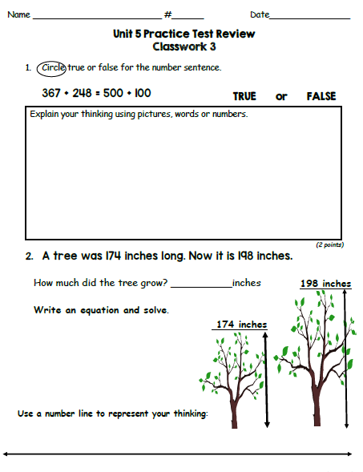
Click here to type
Click here to type
Click here to type
Type here
Click here to type
Click here to type
Click here to type

Slide 18
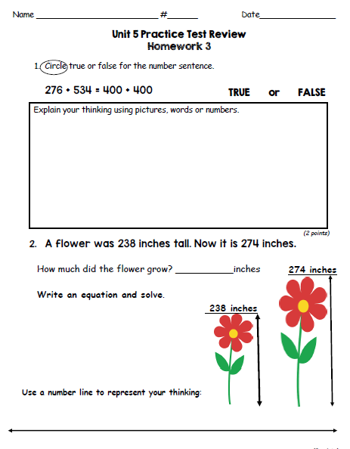
Click here to type
Click here to type
Click here to type
Type here
Click here to type
Click here to type
Click here to type

Slide 19
Click here to type
Click here to type
Click here to type
Type here
Click here to type
Click here to type
Click here to type

Slide 20
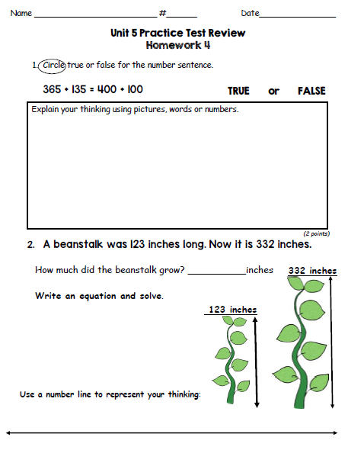
Click here to type
Click here to type
Click here to type
Type here
Click here to type
Click here to type
Click here to type

Slide 21
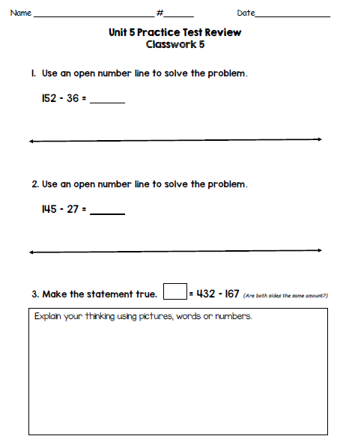
Click here to type
Click here to type
Type here
Click here to type
Click here to type
Type here
Click here to type
Click here to type
type
Click here to type

Slide 22
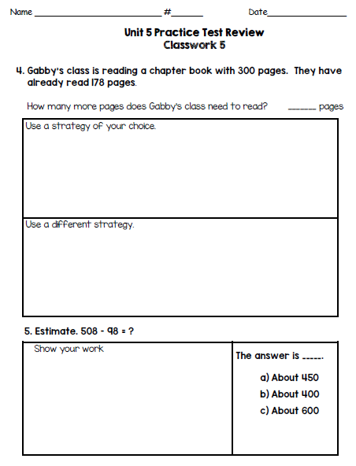
Click here to type
Click here to type
type
Click here to type
Click here to type
type
Click here to type

Slide 23
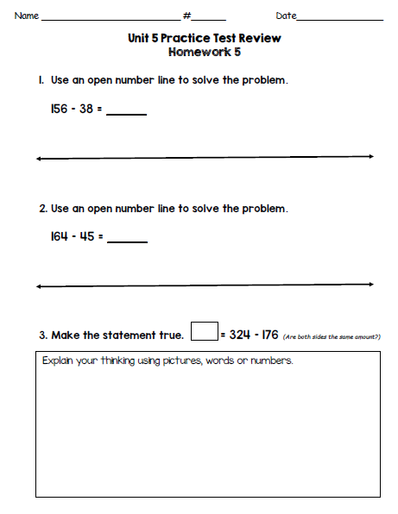
Click here to type
Click here to type
type
Click here to type
Click here to type
Type
Click here to type
Click here to type
type
Click here to type

Slide 24
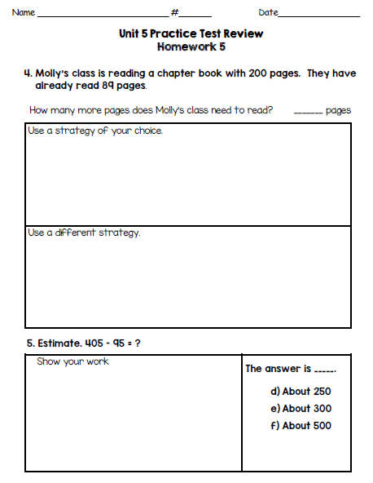
Click here to type
Click here to type
type
Click here to type
Click here to type
Click here to type
type

