Slide 1
Welcome Scientist
Date: 9/8/2018
Have Outs
Pen/Pencil
Tracker
Notebook
DO FIRST: Which car is denser and how do you know?
Agenda
Do First (5 Minutes)
Engage (5 Minutes)
Explore (10 Minutes)
Explain (8 Minutes)
Elaborate (10 Minutes)
Exit Ticket (6 Minutes)
Objective
I can calculate density and identify unknown substances using density.
Homework
None

Slide 2
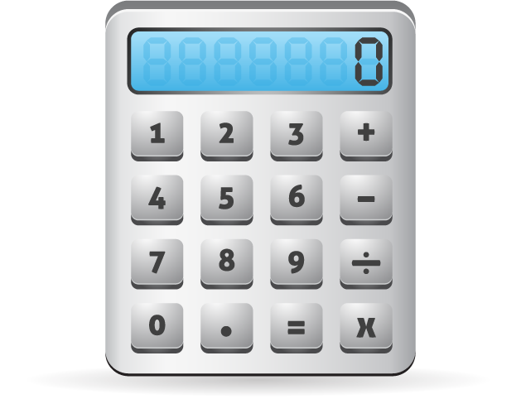
Objective
I can calculate density and identify unknown substances using the property of density.

Slide 3
Engage

Slide 4
Video

Slide 5
Video Questions
A Greek mathematician , inventor, and engineer
To investigate if the goldsmith had cheated the king.
He needed to find the density of pure gold.
By placing it in water.
He needed to find the density of pure gold.

Slide 6
EXPLORE
We can also use math to represent density. The table to the left shows the relationship between mass, volume, and density.
You will have the next 5 minutes to observe the table and answer the questions on your handout.
Based on the observations you make, you will need to come with a equation or formula for density.
Expectations:
Each student needs to write at least 3 patterns or trends that they observe
Students should use sentence stems: “I notice...” “When you look at...” with specific numbers as evidence when talking with peers.
Try your best! We learn from our mistakes.
Mass | Volume | Density
10 | 5 | 2
30 | 6 | 5
100 | 25 | 4
? | 10 | 8
60 | ? | 10
75 | 5 | ?

Slide 7
EXPLAIN
mass
volume
Density is a relationship between a substances' __________ to __________ and is represented by the formula Density = mass / volume. We can use a given mass and volume to solve for density. The unit for density of a solid object is ____________________ and for the density of a liquid is _____________.
g/cm3
g/ml
Formula | Memory Trick
$Density=\frac{mass}{volume}$

Slide 8
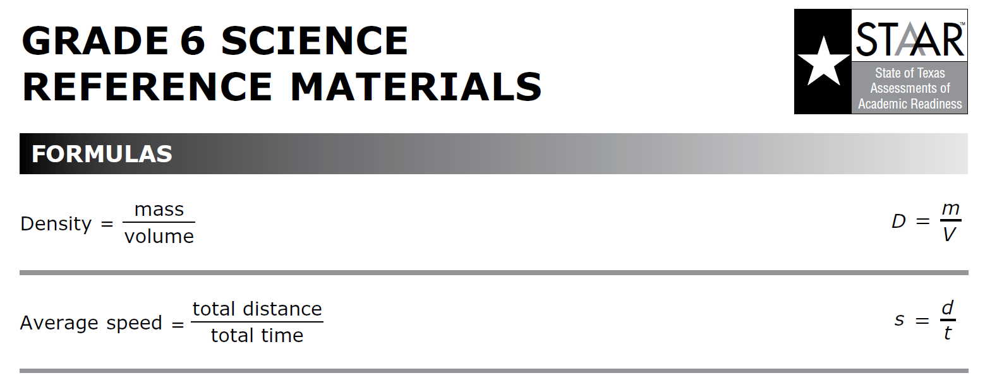
EXPLAIN
This formula will always be given to you on the Science 6 Reference Sheet

Slide 9
Model Problem

Slide 10
EXPLAIN
All substances have their own ____________________ density, allowing density to be used to identify an object.
Two amounts of the same substance, no matter their mass and volume, will have the ____________________ density. Example: A small piece of gold and large piece have the same density.
specific
same
Large gold specimen density: 19g/cm3 | Small gold specimen density: 19g/cm3

Slide 11
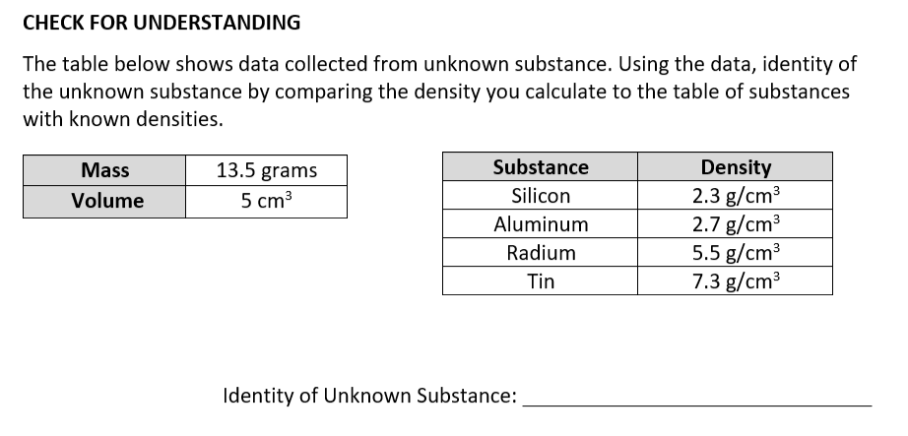
Model Problem

Slide 12
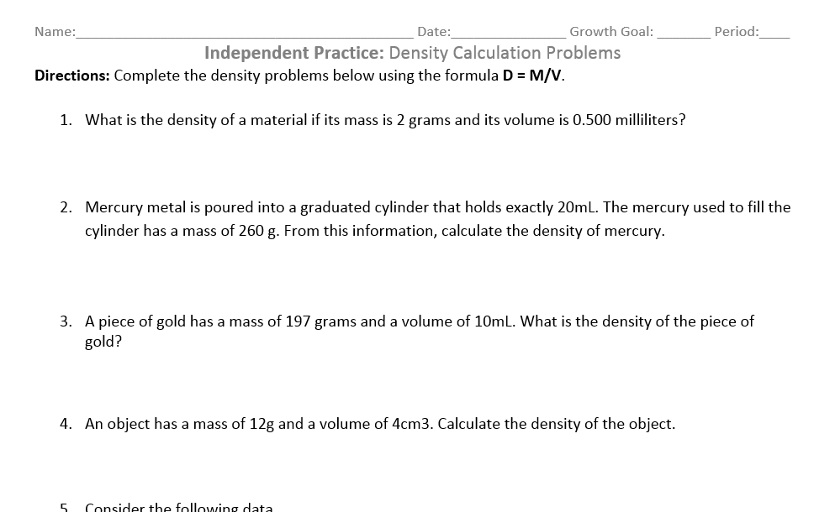
Independent Practice

Slide 13
Exit Ticket

