Slide 1

Push-In Social Skills Instruction
Second Step Social Skills Curriculum
Stuckey Center EDT
Redford Union School District

Slide 2
Redford Union Day Treatment Program
Wayne RESA center-based program that provides a highly structured psycho-educational setting for students, kindergarten through eighth grade, who reside in one of the eight Wayne County Districts. All students are Special Education certified with an Emotional Impairment.
Work toward returning students to their home district in two years or less.
Therapeutic intervention to address social, emotional, and psychiatric conditions in an academic, educational setting.
Therapeutic school environment, to support student progress in general education curriculum benchmarks, and emotional skill development.
Michigan Merit Core Curriculum.
Common Core State Standards.
Participation in State Assessments.

Slide 3
Research based program that teaches
social-emotional skills
Skills for Learning
Emotion management
Problem-solving
Empathy
“Social-emotional learning is so important because our job is to create productive, happy citizens.”
Dedy Fauntleroy, Principal at John Stanford International School in Seattle,WA
https://www.youtube.com/watch?v=WWavPce616Q&feature=youtube

Slide 4
The Second Step
Program Promotes
School success
School connectedness
Safe and respectful school climate

Slide 5

What is included?
22 Lessons
Handouts/homework assignments
3 Unit Cards for teachers
3 Colorful classroom posters
Lesson DVD
Home link activity
Family Letter
Free Online lesson activities

Slide 6
Units
Elementary Sample
1. Empathy and Skills for Learning
  Empathy and Respect
  Listening with Attention
  Being Assertive
  Predicting Feelings
  Taking Others’ Perspectives
  Accepting Differences
  Disagreeing Respectfully
  Responding with Compassion
2. Emotion Management
  Introducing Emotion Management
  Calming Down
  Managing Anxiety
  Managing Frustration
  Resisting Revenge
  Handling Put-downs
  Avoiding Assumptions
3. Problem Solving
  Solving Problems
  Making a plan
  Seeking help
  Dealing with gossip
  Dealing with peer pressure

Slide 7
Units
Middle School Sample
1. Empathy and Communication
  Working in groups
  Disagreeing respectfully
  Negotiating and compromising
  Getting and giving support
2. Bullying Prevention
  Responding to bullying
  Cyber bullying
  Sexual Harassment
3. Emotion Management
  Understanding anger
  Staying in control
  Coping with stress
4. Substance Abuse Prevention
  Myths and facts
  Norms and attitude
  Making good decisions

Slide 8
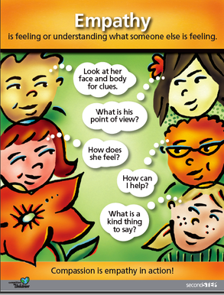

Slide 9

Fourth Grade Video
Seventh Grade Video

Slide 10
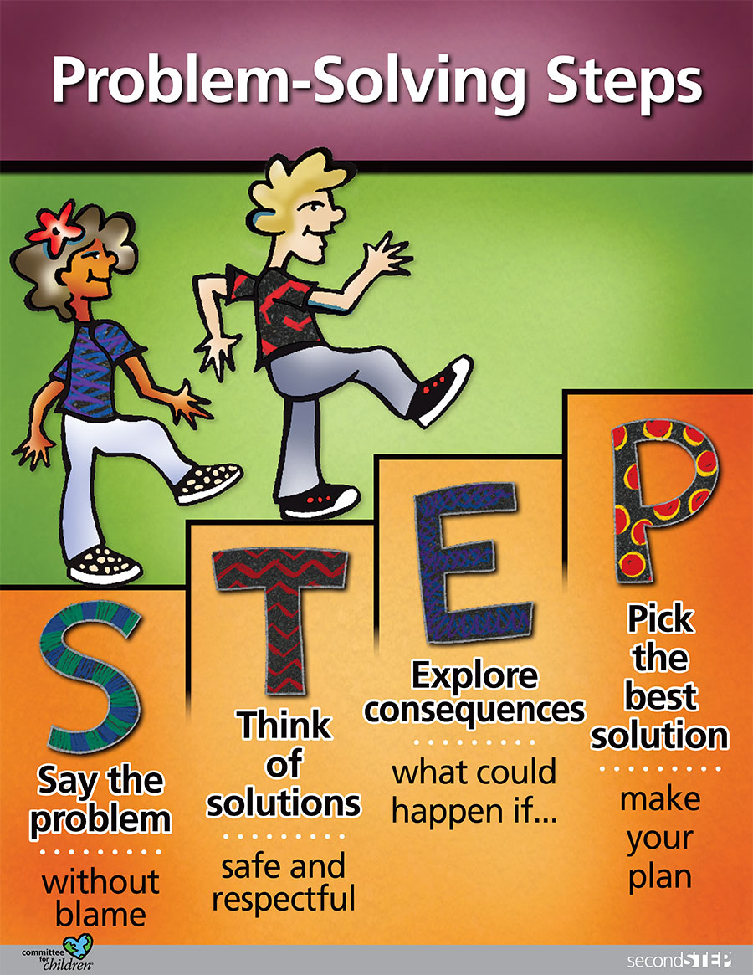

Slide 11
Benefits
Supports positive school environment/reinforces PBIS.
a. Builds relationships between students and staff.
  b. Prevents bullying by encouraging empathy and compassion.
  c. Teaches how to handle strong emotions and improve problem-solving skills.
  d. Normalizes feelings and situations for students.
  e. Gives students the opportunity to listen and learn from their peers
  f. Promotes positive individual change.

Slide 12
Benefits
Provides a foundation for teaching and modeling
social-emotional skills for all staff.
Creates a common language for staff to use throughout the day.
Increases social workers’ awareness of staff perspectives and day to day experiences.
Integrates social skills group work into individual work and vice versa.
Builds relationships between staff and students who would not otherwise have the opportunity.

Slide 13
Benefits
Hands-on approach which provides the opportunity for the social workers to push-in to classroom.
  Observe interactions between students and peers, and students and staff.
  Observe behavior in real time and in the actual environment.
  Allows social workers to assist with behavioral issues as they happen.
  Allows for follow-up with individuals or groups of students in conflict.
  Allows for collaboration with staff and parents.

Slide 15
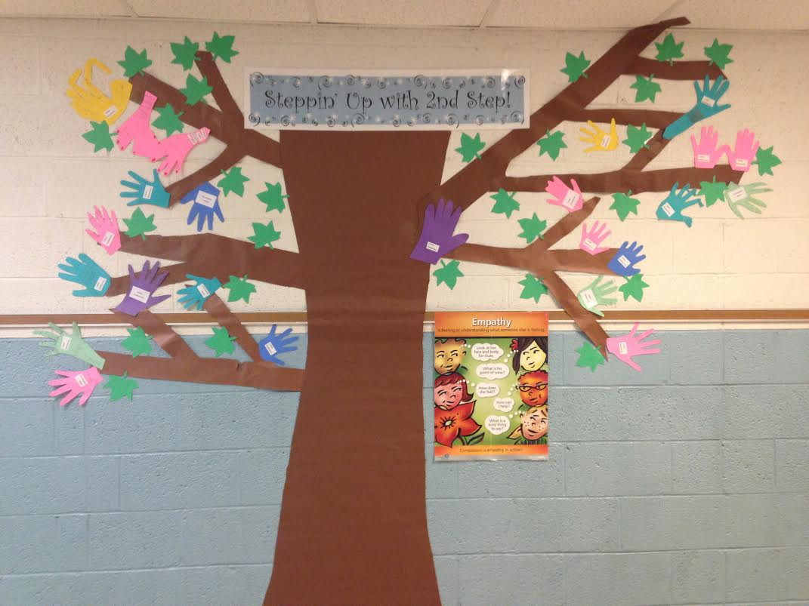
Social Skills Push-In
Social Workers do lessons once a week with teacher support.
Develop group rules incorporating PBIS expectations.
Identify goals.
Ice breakers.
Team Building Activities (Beach ball challenge/ Reindeer challenge/Human knot).
Partner/ group work.
Multimodal learning (Role-play, DVD, movement, dancing,
skill practice, discussion, hands-on activities).
End lessons with small treat.
Supplemental lessons/videos (hygiene/sportsmanship).
Program is flexible depending on the group, day, etc.

Slide 16
Things to think about….
Who will facilitate the lessons?
Planning time.
Technology! Technology! Technology!
Scheduling with classroom.
Adapting to curriculum demands.
How to get staff buy-in.
Adapt the curriculum to the functional ability level of your students.

Slide 17
Teachers’ Feedback
Lessons teachers found most useful in the classrooms:
  All of the team building activities
  Hands-on activities
  Role plays
  Empathy
  Anger Management
  Hygiene
  Dance videos
  Bullying prevention

Slide 18
Teachers’ Feedback
Teachers have observed noticeable changes:
  Students are more cooperative
  Students are developing leadership skills
  Students are working better with a variety of peers
  Students demonstrate improved insight
    “When reminded of second step lessons, they do use what they have learned.”
  Teachers are finding it helpful to have a common language

Slide 19
Students’ Feedback
Students enjoyed
  Group work
  Videos
  Role playing
  Games
  Treats/Rewards
Students learned
  How to problem-solve
  How to respond assertively
  How to be an ally
  Active listening skills
  How to calm down

Slide 20
Success Stories

Slide 21
"Over the years, researchers have made numerous attempts to produce empirical results about which therapeutic modalities create the best therapy outcomes (Lantz, 2004). Again, this area has also been researched extensively in relation to therapeutic outcomes with seemingly limited results. Past research indicates that relationship factors, such as the therapeutic alliance, correlate more highly with success than do specialized treatment techniques or individual therapeutic modalities (Lantz, 2004)."

Slide 22
DANCE!!!!! https://webertube.com/video/18979/calm-it-down-dance
Redford Union Day Treatment
Stuckey Center EDT
26000 Fargo
Redford, MI 48240
313-242-3901

