Slide 1
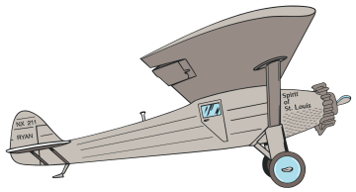
LINDBERGH ELEMENTARY
Dearborn Public Schools
PBIS
Lindbergh Flyers
The Spirit of Success
The Lindbergh Way

Slide 2
LINDBERGH PBIS
Wayne RESA Presenters
Pam DeNeen (Principal)
Sharon Baloga (Music)
Jennifer Knaus (4TH Grade)
Manny Murua (Phys. Ed.)
Carla Stetz (Kindergarten)
Lindbergh Flyers
The Spirit of Success

Slide 3
LINDBERGH DEMOGRAPHICS
Lindbergh Flyers
The Spirit of Success
Years of Data | 2014 - 15 | 2013 - 14 | 2012 - 13
Enrollment | 338 | 323 | 316
No. of Teachers | 15 | 14 | 14
Special Area Teachers | 3.1 | 2.8 | 3.1
Paraprofessionals | 1 | 1 | 1
Intervention FTE’s | 3.2 | 3.5 | 4
No. of ED Students | 102 | 97 | 91
No. of ELL Students | 80 | 72/56 | 68
No. of SE Students | 27 | 25 | 22
% of ED Enrollment | 30 | 30 | 29
% of ELL Enrollment | 24 | 22/17 | 22
% of SE Enrollment | 7 | 8 | 7

Slide 4
IMPLEMENTATION YEARS
First Year
PBIS Committee training, school visitations, Wayne RESA support, PBIS budget.
Staff Manual Development, Matrix, Posters, Rewards, Forms, Clips, Showcase.
PBIS Introduction to teachers and other staff members.
The Lindbergh Way

Slide 5
IMPLEMENTATION YEARS
Second Year
School Implementation, student training, assemblies.
Parent Introduction: Letter and PBIS contract.
Provide teacher and staff support and review.
PBIS Committee continued Tier II and Tier III training, budget.
The Lindbergh Way

Slide 6
IMPLEMENTATION YEARS
Third Year
Leader In Me, The Seven Habits.
Student re-training for first few weeks.
Classroom teachers in charge of assemblies.
Schedule monthly assemblies and rewards.
PBIS Committee continued training.
The Lindbergh Way

Slide 7
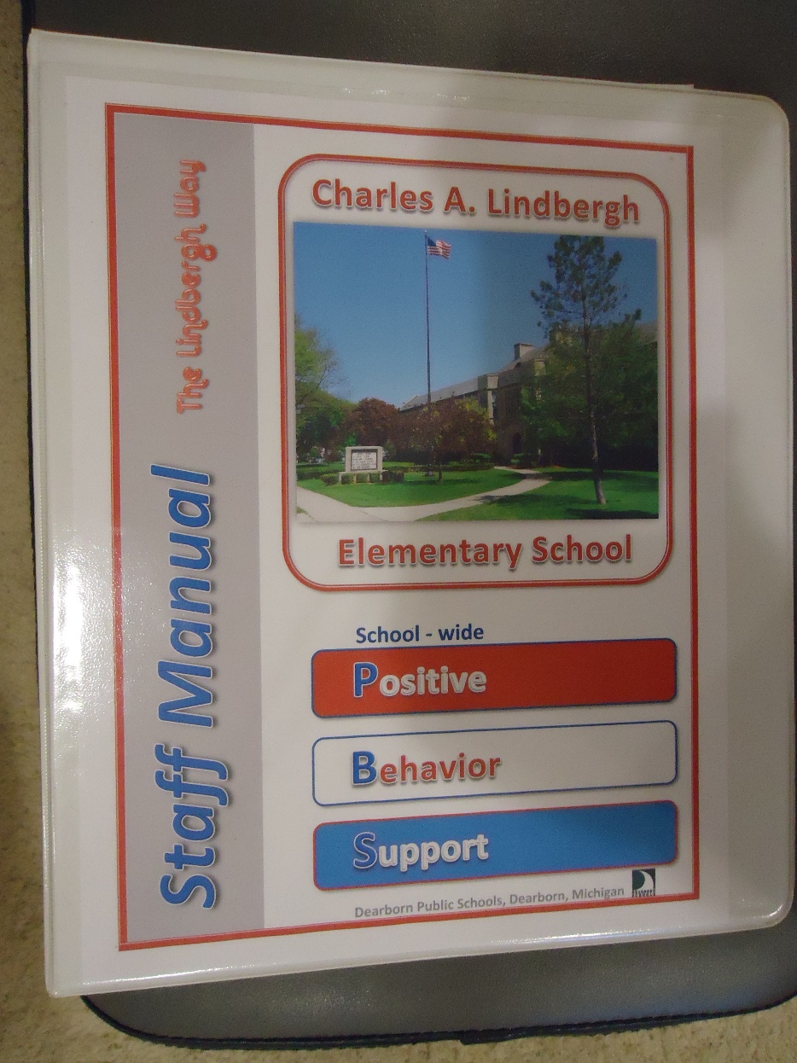
LINDBERGH PBIS STAFF MANUAL

Slide 8
PBIS STAFF MANUAL
The Lindbergh Way
Sections include:
Introduction and Goals of PBIS.
Teaching PBIS Expectations & Matrix.
Acknowledge and Reward Appropriate Behavior.
Consequence for Problem Behavior.
Copies of Forms, Reward Passes, Parent Letter & Contract.

Slide 9
TEACHER BUY IN
Teacher Support:
Training and review during Staff Meetings.
Manual, Lesson Plans, Support Literature.
Re-Teaching Room Planning and Support.
Control Tower and Clips for teachers.
Special Area Teachers.
Noon Hour Supervisors.
The Lindbergh Way

Slide 10
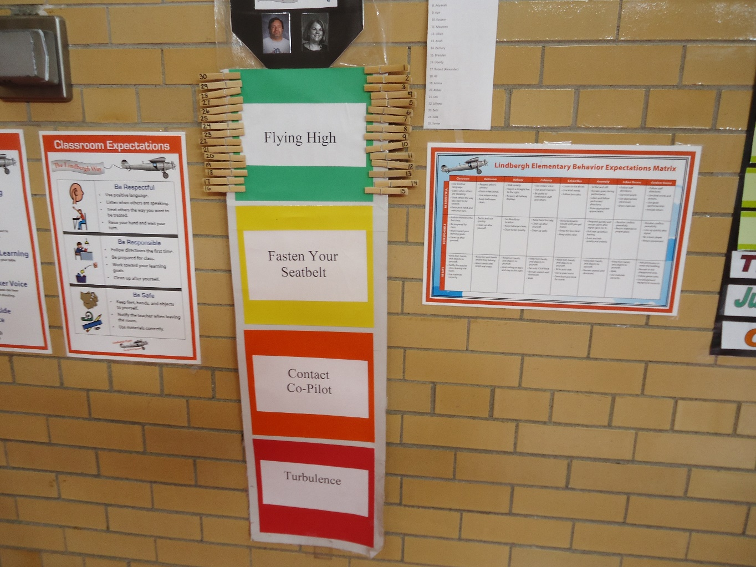
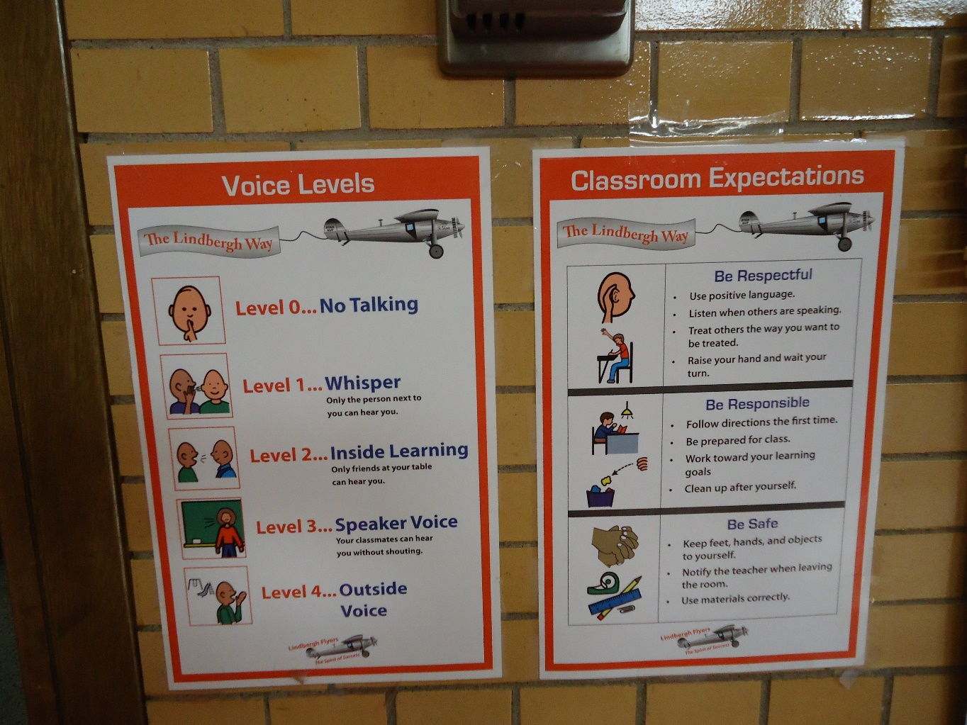
TEACHER BUY IN
Control Tower and Clips & Expectations Posters

Slide 11
TEACHER BUY IN
Notification Sheets
Teachers inform
parents.

Slide 12
STUDENT BUY IN
Staff goal.
Positive Behavior reward is Intrinsic !
Students take pride and ownership in the success
of their behavior.
The Lindbergh Way

Slide 13
STUDENT BUY IN
Build a Team Atmosphere:
Phrases: Be a Lindbergh Flyer !
Ride the Spirit of Success !
Team Spirit Gift.
The Lindbergh Way

Slide 14
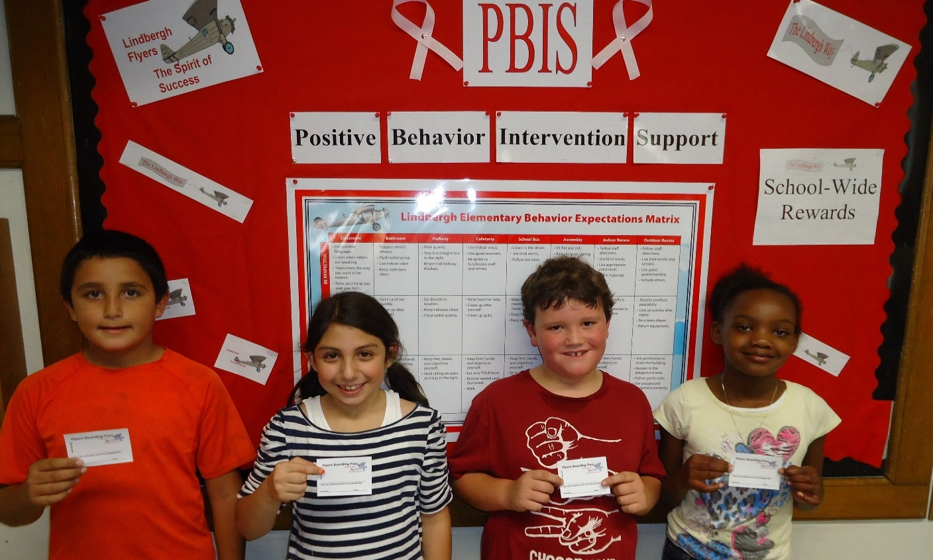
STUDENT BUY IN
Student Pride & Ownership
Boarding Passes
Daily Morning Announcements

Slide 15
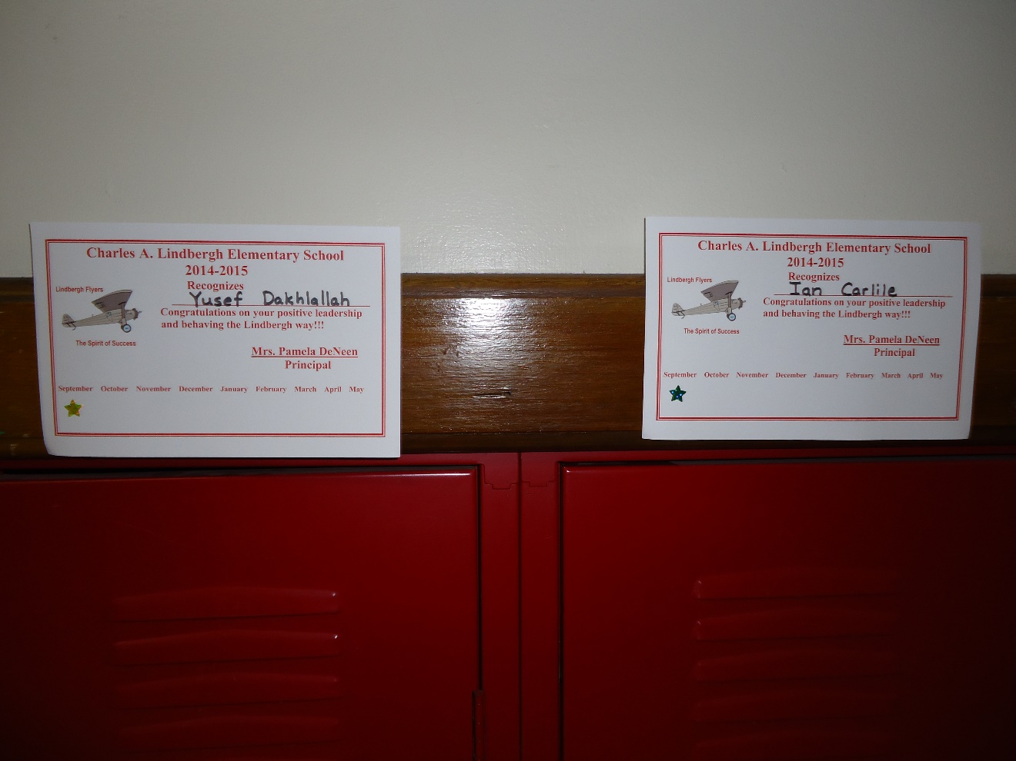
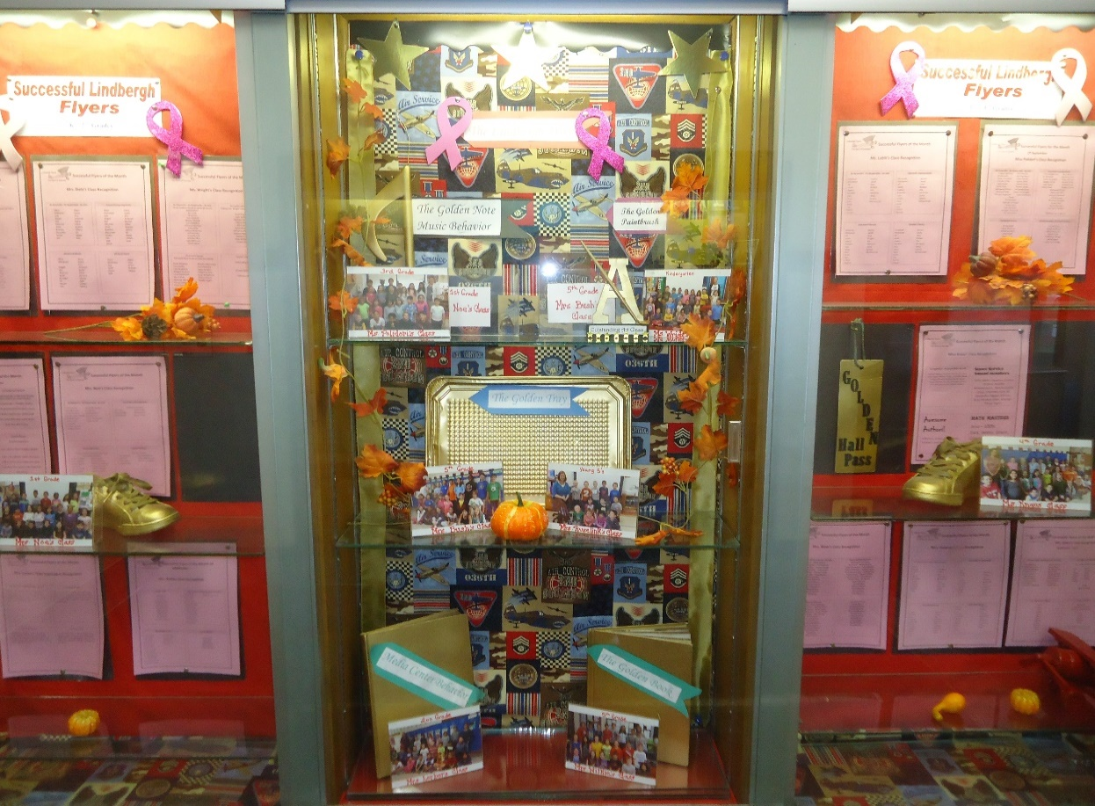
STUDENT BUY IN
Student Pride & Ownership
Locker Passport
Successful Flyers Showcase

Slide 16
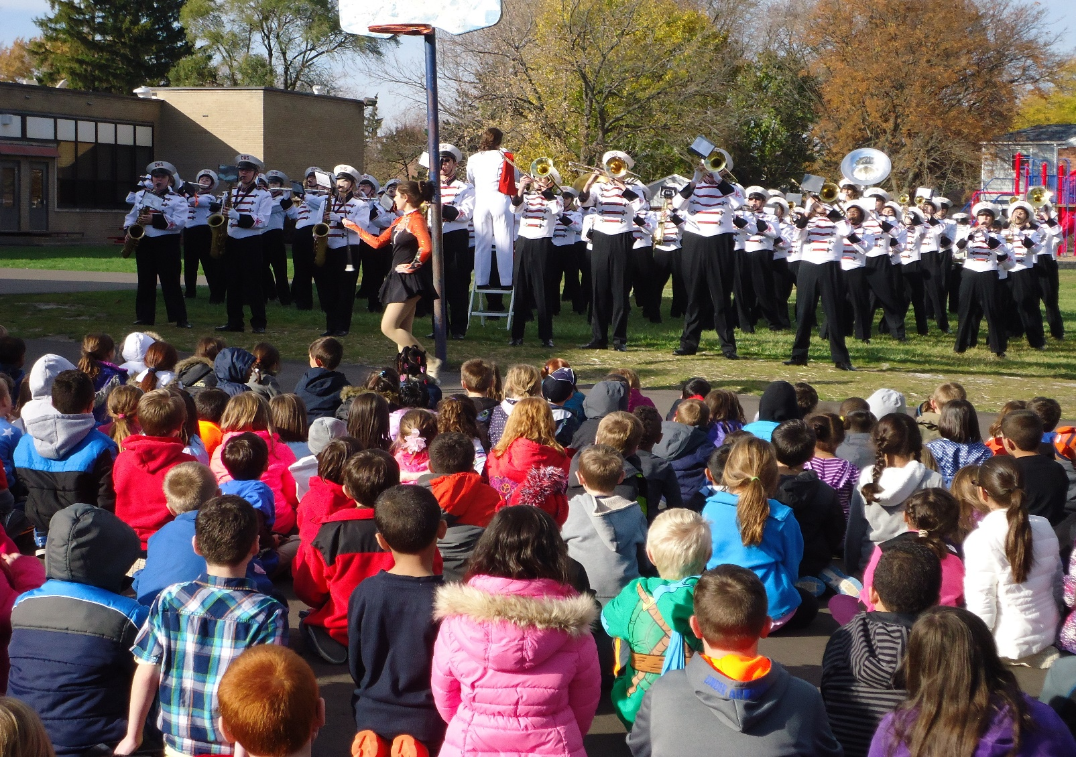
STUDENT BUY IN
Student Pride & Ownership
Reward Event

Slide 17
PARENT BUY IN
PBIS Parent Introduction
Pot Luck & Presentation
Parent Contract
Parent Liaison
PBIS Blog for information.
Teachers inform parents on daily behavior.
The Lindbergh Way

Slide 18
LINDBERGH PBIS DATA
Total Behavior
(Sept) Infractions by School (June)

Slide 19
LINDBERGH PBIS DATA
Percentage of Positive Behavior
(Sept) Indicator by School (June)
(Meeting 80% of the time)

Slide 20
LINDBERGH PBIS DATA
ODR’s & Suspensions Year to Year

Slide 21
Collecting Data at Lindbergh
bathroom hallway cafeteria recess lunch recess auditorium
Bus Kid’s Club Music P.E. Media Art
Boys Girls =
Turbulence Y5 K 1 2 3 4 5 =
ODR Y5 K 1 2 3 4 5 =
Type of Behavior | # | Y5 | K | 1 | 2 | 3 | 4 | 5
Disruption class/independent
Not completing work
Refusal to work/participate
Touching others
Inappropriate language
Teasing/Bullying
Inappropriate use of materials
Damage to property
Cheating
Not being responsible
Not Following directions
Disrespectful

Slide 22
SUCCESS AT LINDBERGH
PBIS
100% Staff Participation
Strong PBIS Team
Supportive Parents
The Lindbergh Way

Slide 23
SUCCESS AT LINDBERGH
Monthly Rewards & Re-teaching Room
Student Driven
Re-teaching Room
Staff Volunteer Facilitator
Lesson Reinforce School-wide Matrix
The Lindbergh Way

Slide 24
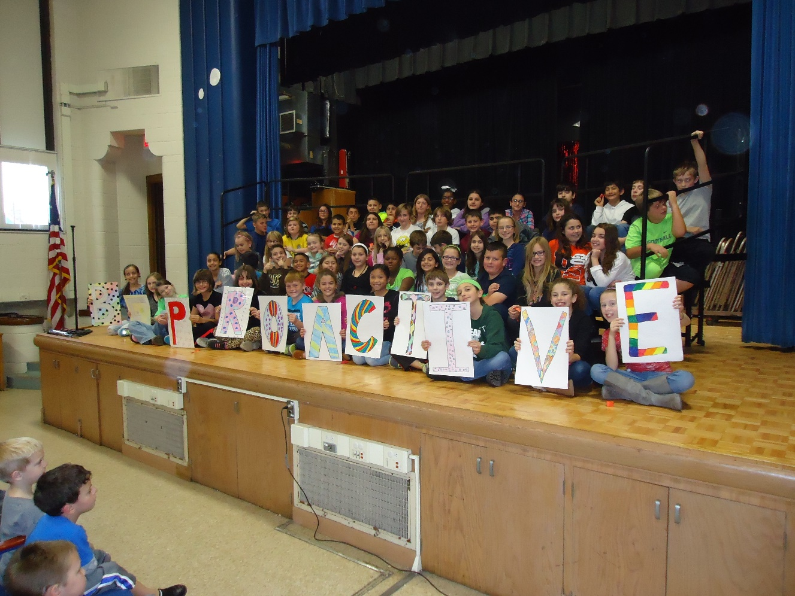
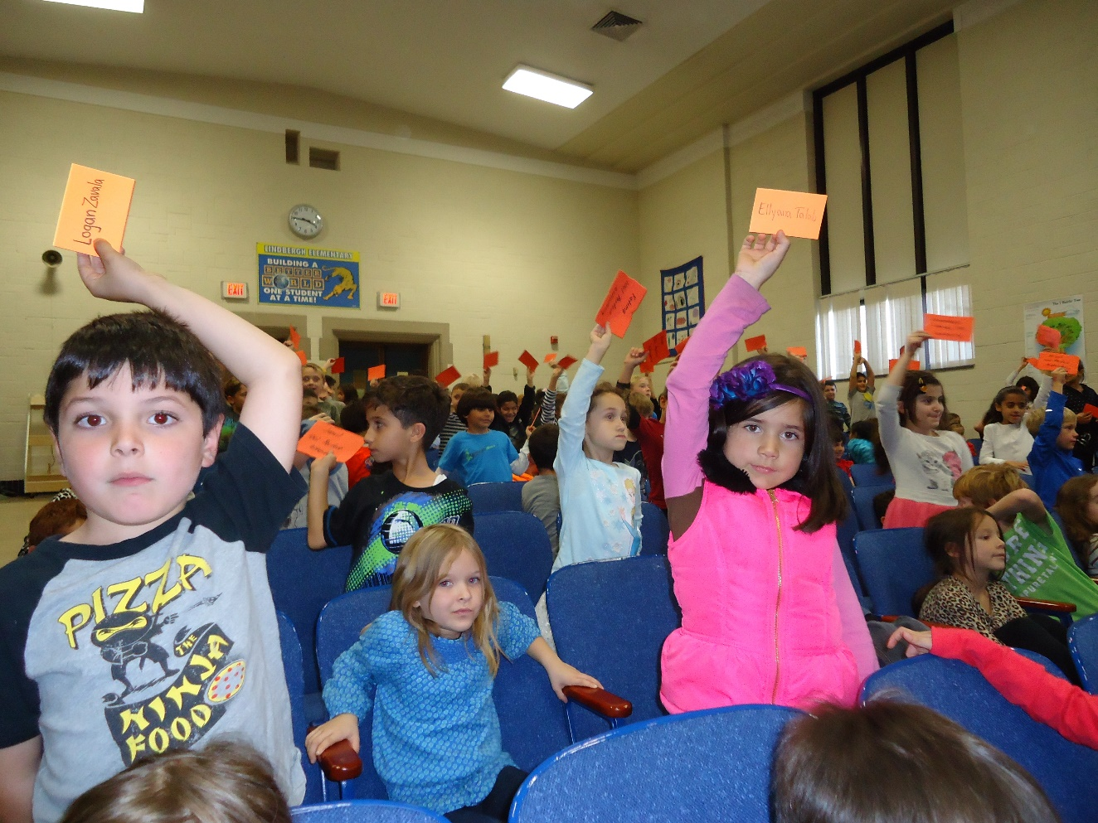
SUCCESS AT LINDBERGH
Monthly Assembly ☺
● Goal Focused ● Grade Level Ownership
● Golden Awards ● Perfect Attendance ● School Song
The Lindbergh Way

Slide 25

PBIS SHOWCASE
Golden Class Awards
PE, Music, Art, Media, Lunch Room, Hallway

Slide 26
LINDBERGH CONTACT INFO
500 N. Waverly, Dearborn, MI 48128
313-827-6300
PBIS
Pam DeNeen deneenp@dearbornschools.org
Sharon Baloga balogas@dearbornschools.org
Jennifer Knaus knausj@dearbornschools.org
Manny Murua muruae@dearbornschools.org
Carla Stetz stetzc@dearbornschools.org
Lindbergh Flyers
The Spirit of Success

