Slide 1
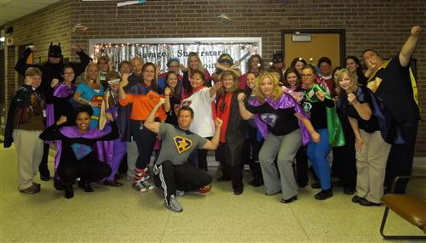
Positive Behavior Interventions and Supports
Savage Elementary School
Home of the SUPERSTARS!
A PBIS School since 2009

Slide 2
This is how we do it…
Who We Are
District boundaries
Population/demographics
Enrollment
Tier I
Daily
Weekly
Monthly
Tier II
Check-In / Check-Out

Slide 3
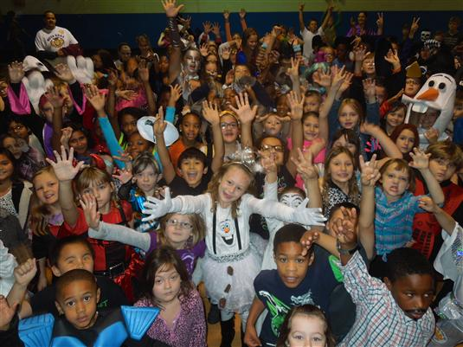
WHO WE ARE
HALLOWEEN 2014

Slide 4
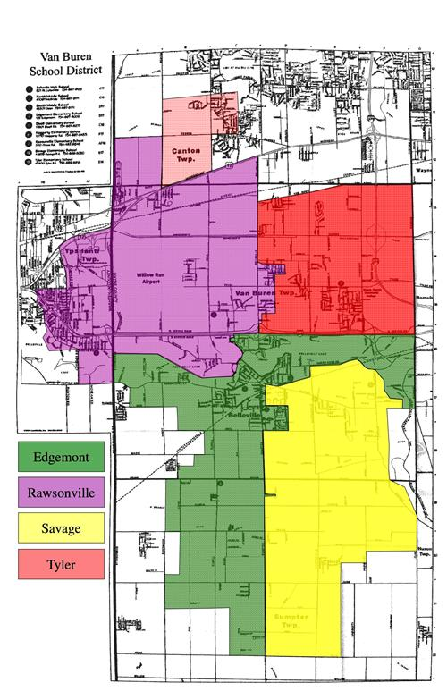
Van Buren Public Schools serves the City of Belleville, Sumpter Township, Van Buren Township, a small section of Washtenaw County and a small section of Canton.

Slide 5
Diversity
5%
30.3%
2.8%
61.9%

Slide 6
Number of Students per Class
Approximately 25

Slide 7
Enrollment Trends

Slide 8
Special Education

Slide 9
ANY QUESTIONS ABOUT WHO WE ARE?

Slide 10
TIER I - Making it Work
It only takes two things…
1. Get the Staff excited and involved
2. Get the Kids excited and involved

Slide 11
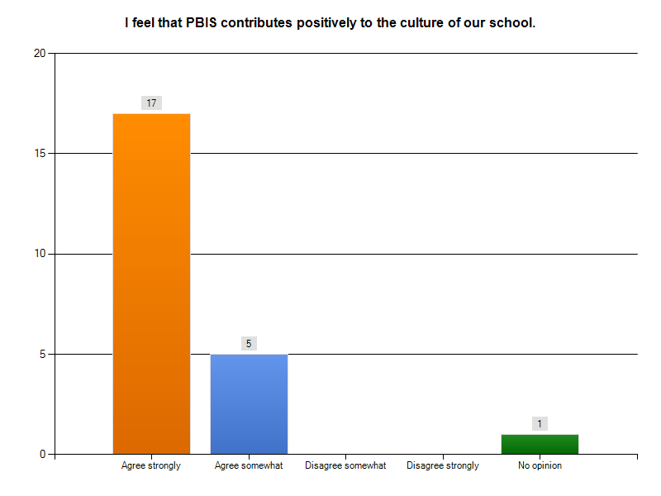
GET THE STAFF EXCITED AND INVOLVED…
Staff shares in planning monthly rewards
Share data with staff frequently
Have a PBIS buddy
Make it easy on them
Celebrate

Slide 12
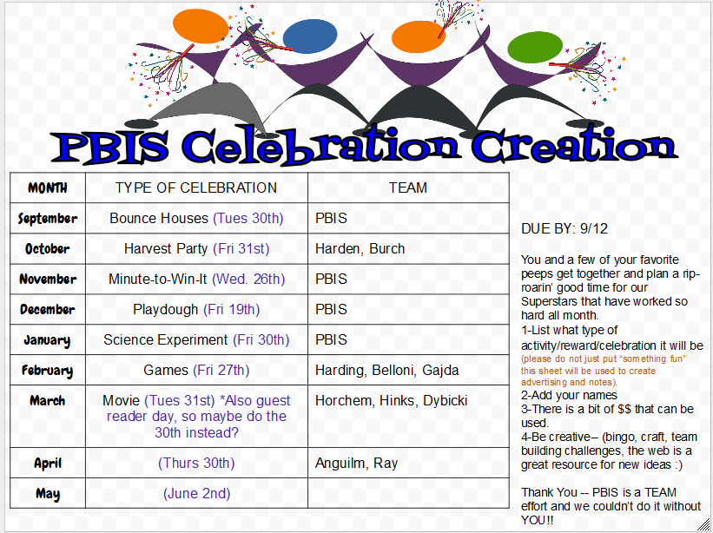
We use a Google Doc for Staff to sign up for a monthly celebration

Slide 13
Share the Data
Data reports are shared via email each month and shared at staff meetings quarterly
“Pause for PBIS” time at each weekly staff meeting
ODR data and celebration attendance data are posted for all to see
Have a PBIS Buddy
A colleague to use for clarification, interventions, ideas and support
Your school is a team and you have to work collaboratively

Slide 14
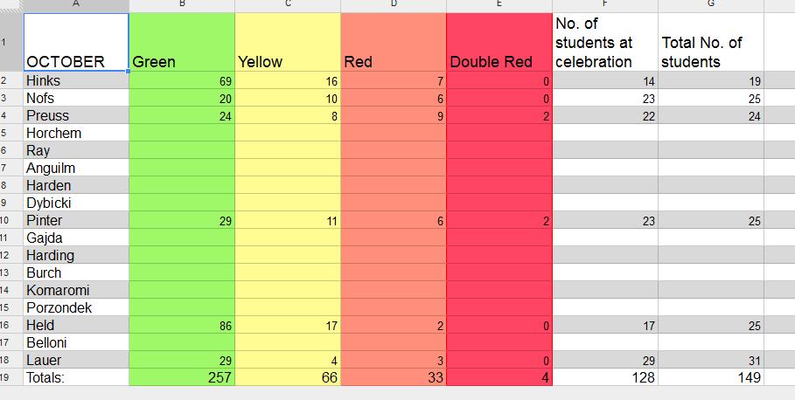
Make it easy on them… We also use a Google Doc to gather data

Slide 15
A “Cheat Sheet”

Slide 16
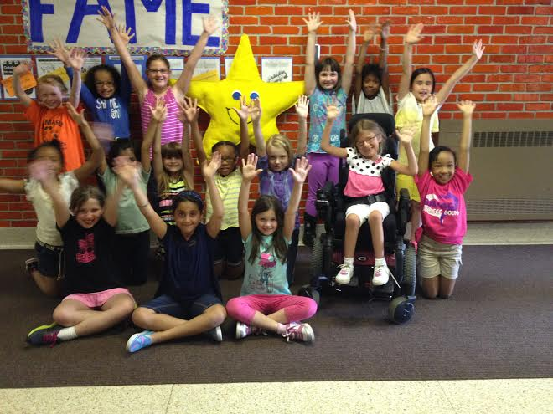
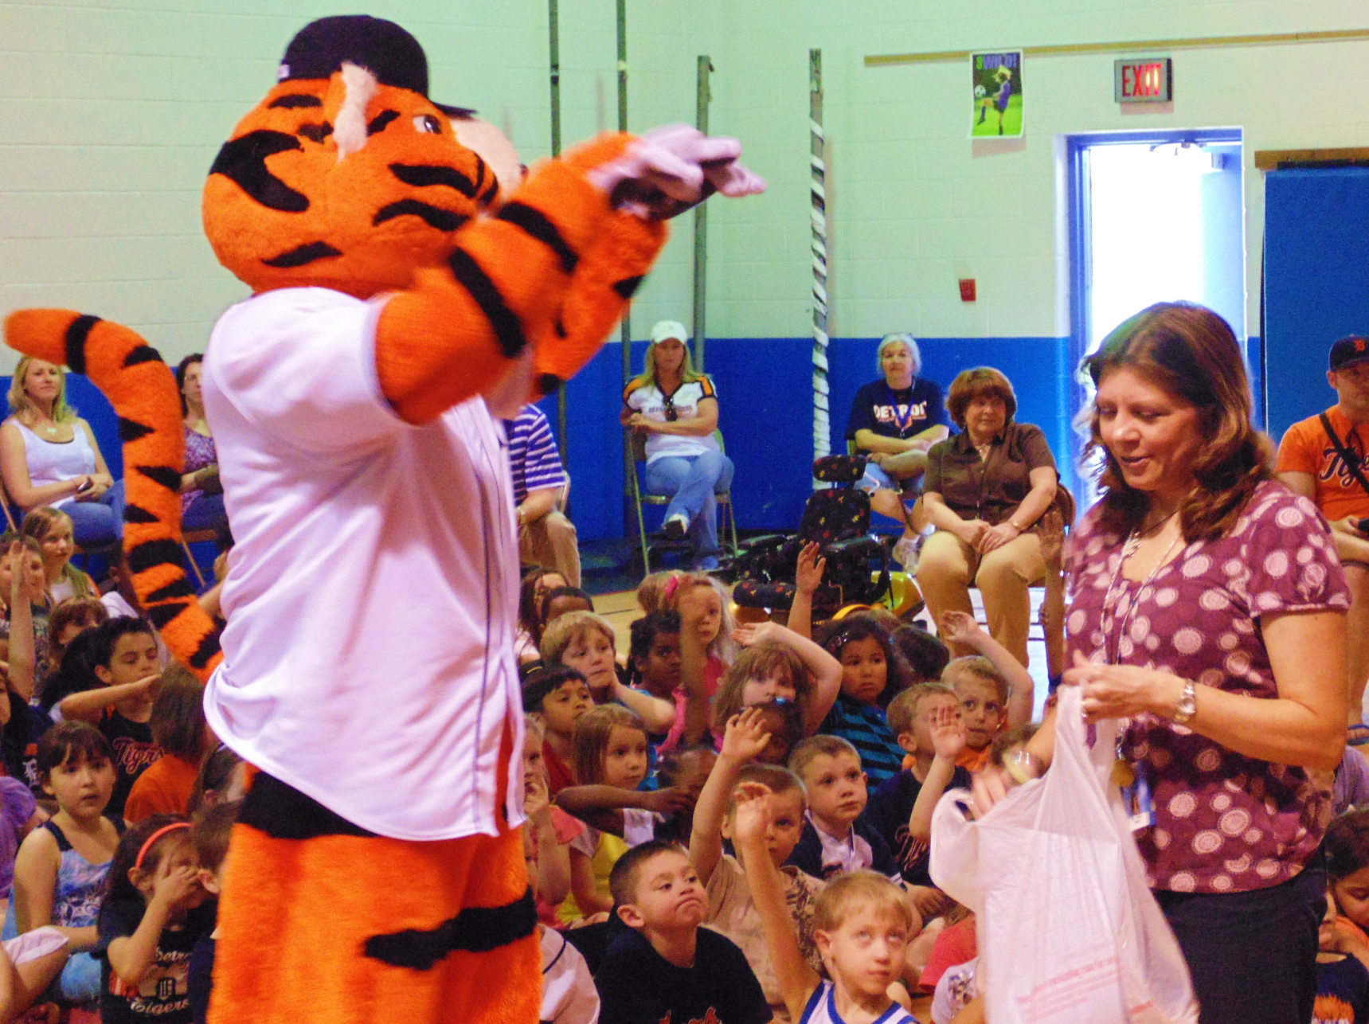
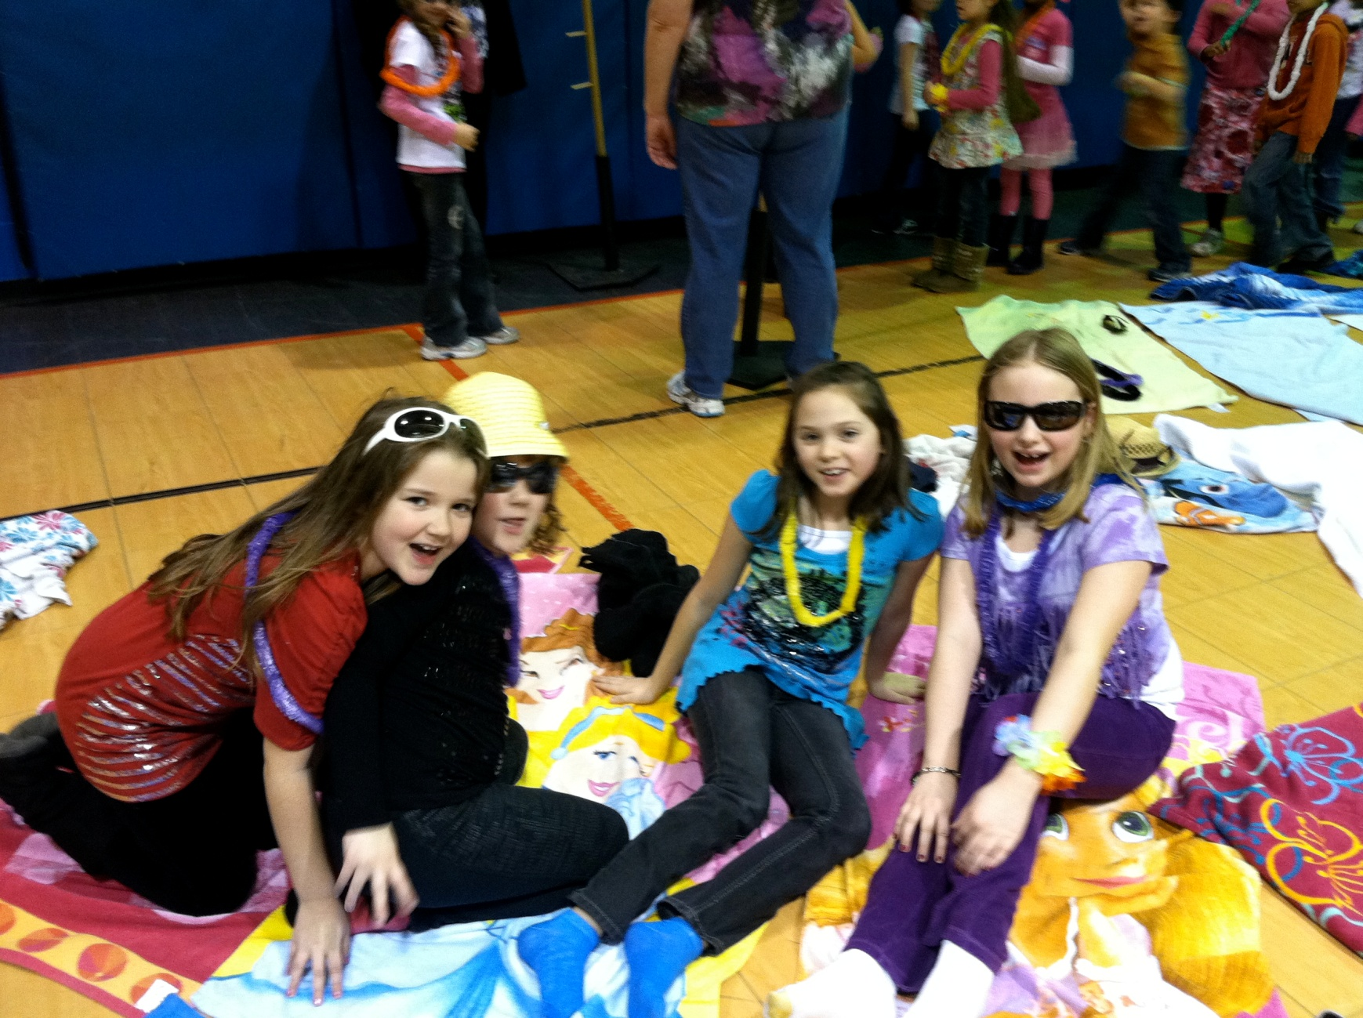
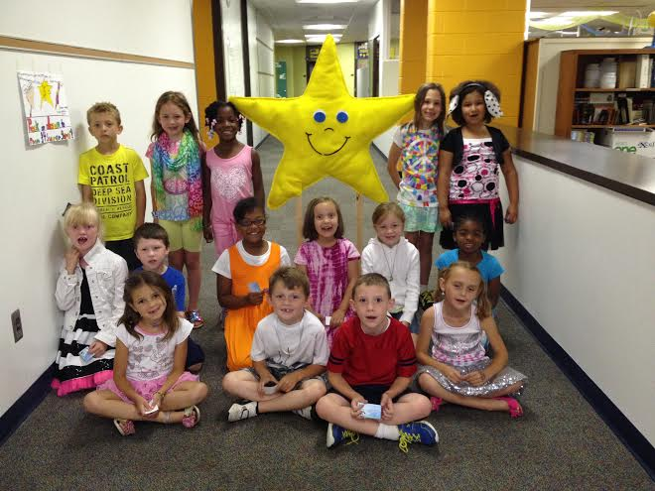
CELEBRATE

Slide 17
GET THE KIDS EXCITED AND INVOLVED
Advertise what celebrations are coming.
Let them vote on what types of rewards they would like
Pump it up at an assembly

Slide 18
ANY QUESTIONS ABOUT GETTING THE STAFF AND STUDENTS EXCITED AND INVOLVED?

Slide 19
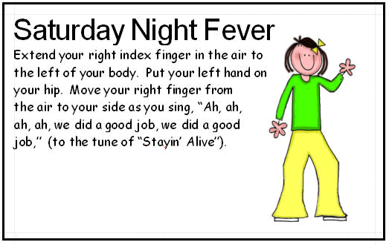
Daily
Daily Reminder
Brain Breaks / Celebrations
Blue Slips
Use Corrective Feedback
Emphasize 4 Positives
Use Common Language
Daily Acknowledgement of All Blue
www.drjean.org
search: celebrations

Slide 20
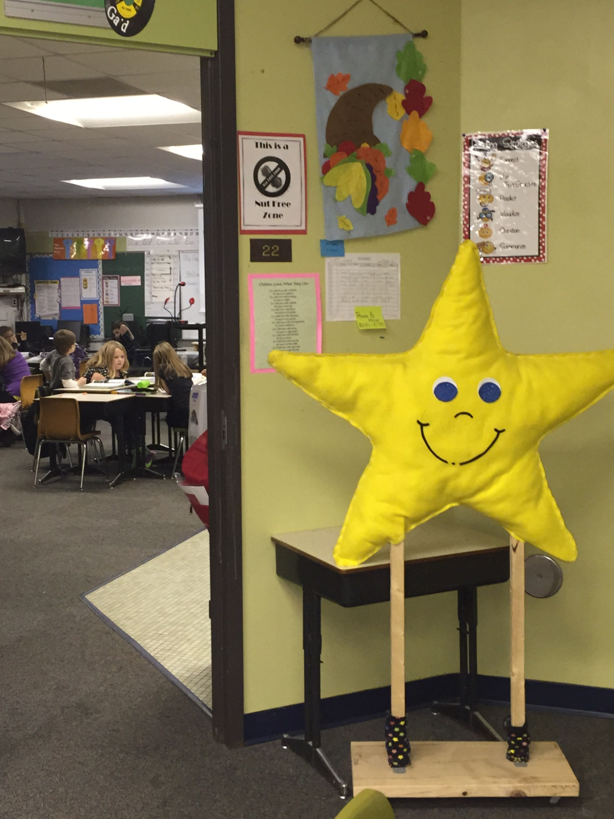
WEEKLY
Blue Slip Pulls
Woo-Hoo for all Blue the “Stella” Behavior Award

Slide 21
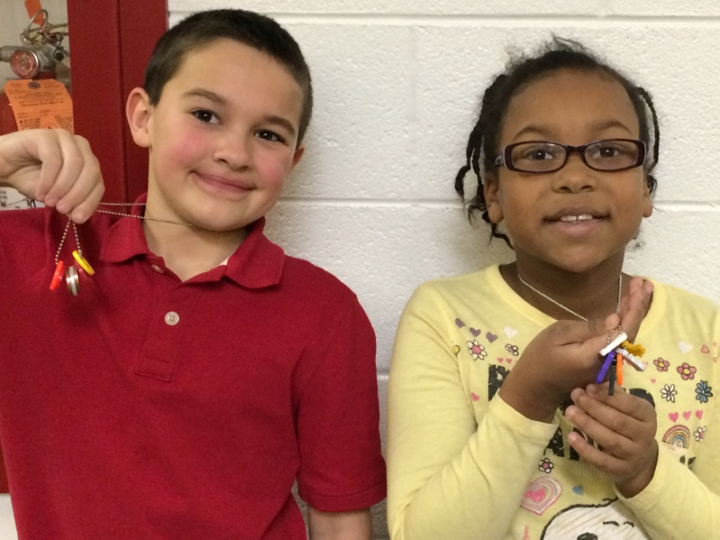
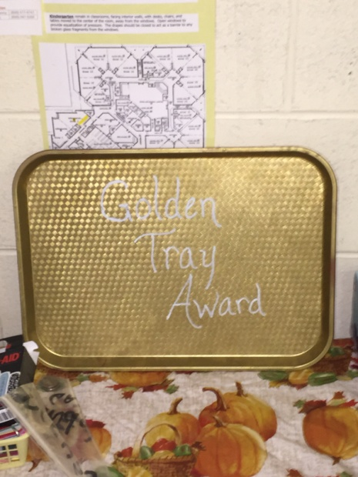
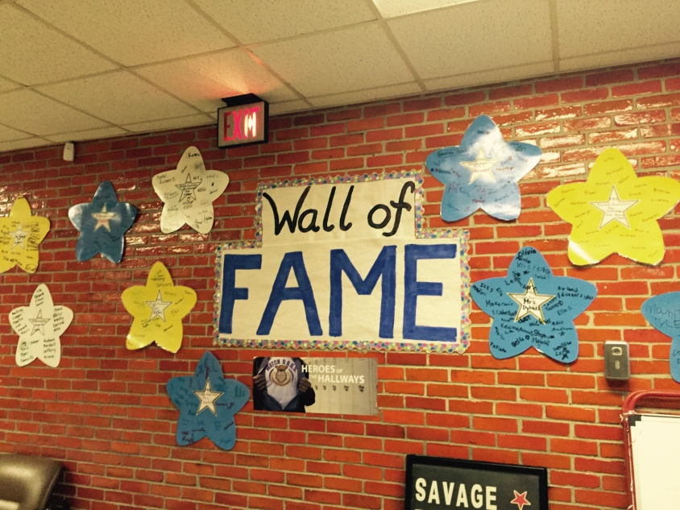
MONTHLY
Charm necklace
Town Hall meeting
Reward Celebration
Targeted Social Skills

Slide 22
ANY QUESTIONS ABOUT TIER I

Slide 23
TIER II Going to the Next Level
Who Qualifies
Interventions
Implementing

Slide 24
Who Qualifies
Teacher Recommendation
Parent Request
Number of ODRs
Interventions
Mentoring
Check-In / Check-Out
Take a Break

Slide 25
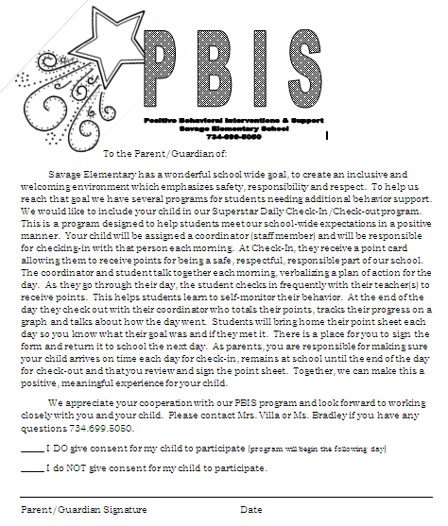
Check-In / Check-out
After being recommended, the parent permission letter is sent home.

Slide 26
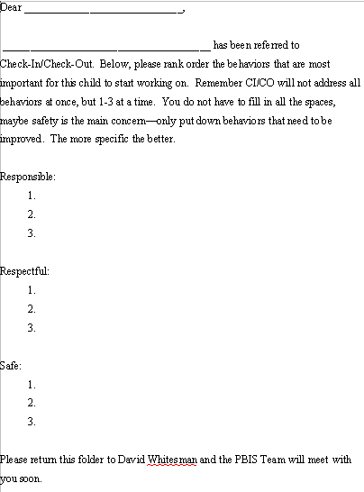
Check-In / Check-Out
Teacher is Notified and a List of Goals for the Student is Generated.

Slide 27
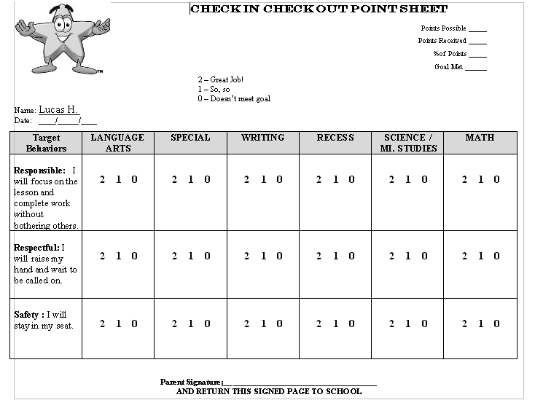
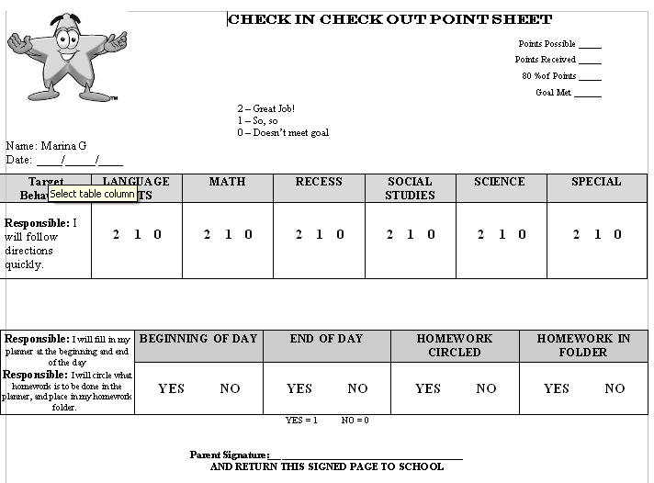
Check-In / Check-out
Create the Check-In / Check-out Point Sheet:
Put copy of point sheet here
Meet with the student to get them excited and familiarized with the procedure.

Slide 28
Check-In / Check-out
Check-In:
Teacher and student connect with each other to fill in the point sheet as the day progresses. Ultimately this is the students responsibility to make sure it is filled in.

Slide 29
Check-In / Check-out
Check-Out:
The point sheet goes home each night for a parent signature.

Slide 30
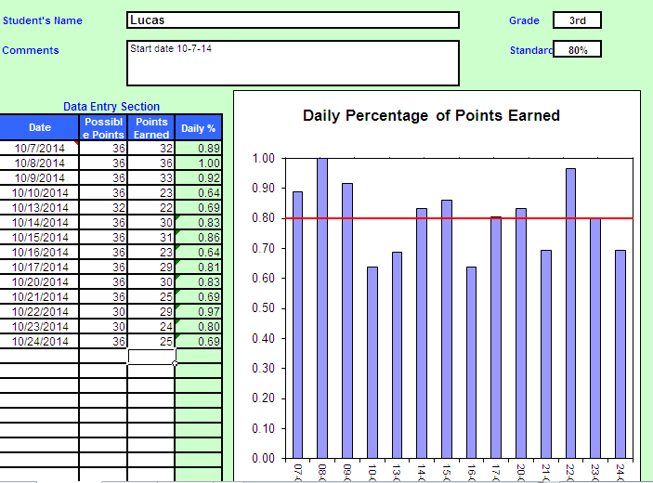
Chart and Report the Data Monthly:
A hard copy of the cart is sent home with the students each month along with a recommendation letter.

Slide 32
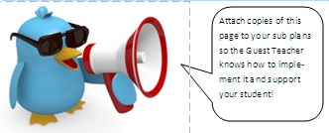
Using the monthly data and teacher input make changes to the goals as necessary.
Provide support to Guest Teachers

Slide 33
ANY QUESTIONS ABOUT
CHECK-IN / CHECK-OUT?

Slide 34
These kids are OUR future, so we are all in this together! If we can ever be of any help to you or you have something awesome to share, PLEASE contact us ☺
Savage Elementary School
42975 Savage Road
Belleville, MI 4811
734-699-5050
Becky Tennis
rtennis@vanburenschools.net
Pam Bradley
pbradley@vanburenschools.net

