Slide 1
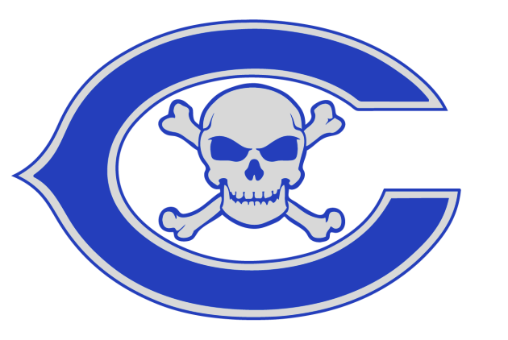
PBIS HIGH SCHOOL FORUM
CARLSON HIGH SCHOOL
November 13, 2014

Slide 2
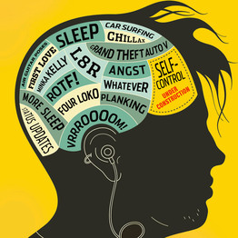
Why PBIS?
Teen brain’s ‘CEO’ is not fully developed Dr. Giedd found that the prefrontal cortex, the part of the brain right behind the forehead that is involved in planning, working memory, organization and modulating mood -- often referred to as the CEO of the brain -- continues to grow and change throughout puberty. It is the last area of the brain to develop, which means that while teens become highly functional in other areas, they cannot reason as well as adults. In a separate study, Dr. Yurgelun-Todd at McLean Hospital in Belmont, Mass., studied how teenage brains understood the emotions of others around them. While looking at pictures of adults with shocked faces, the teens mostly used the amygdala, a small region that guides instinctual reactions, while the adults relied on the frontal cortex. Beginning in the early 20s, the center of activity shifted more toward the frontal cortex and away from the cruder response of the amygdala.

Slide 3
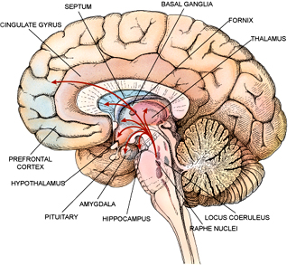
Why PBIS?
Prefrontal Cortex
Organize Multiple tasks
Inhibits specific impulses
Maintain self Control
Set goals and priorities
Empathize with others
Initiate appropriate behavior
Make sound judgments
Plan ahead
Form strategies
Adjust behavior on changing situation
Stop an activity upon completion

Slide 4
Carlson High School Demographics
As of this October:
1173 total students
346 Freshmen
294 Sophomores
272 Juniors
261 Seniors
21% of students receive free or reduced lunch
985 Caucasian (84%)
88 African American
61 Hispanic/Latino
22 Asian American
17 other ethnicities

Slide 5
Where we started….
Back in 2009-2010 school year we had some issues…..
Total ODRs - 1976.
Total Suspensions - 983.
With those numbers we decided to plan the PBIS system in 2010-11 and implemented it in the 2011-12 school year

Slide 6
Where we are now….
At the end of the 2013-2014 school year our numbers have dropped….
Total ODR’s – 927
A 53% drop
Total Suspensions – 407
A 59% drop
We still have some trouble areas and are working to dropping these numbers even more.

Slide 7
PBIS Program Overview
Tier 1
PBIS Posters
Weekly Rock Stars
School wide events
Student of the Month
Weekly Perfect Attendance Rewards
Tier 2
Peer Mentors – Marauder Captains
Freshmen Orientation
CI/CO
Tier 3
Take a Break Cards

Slide 8
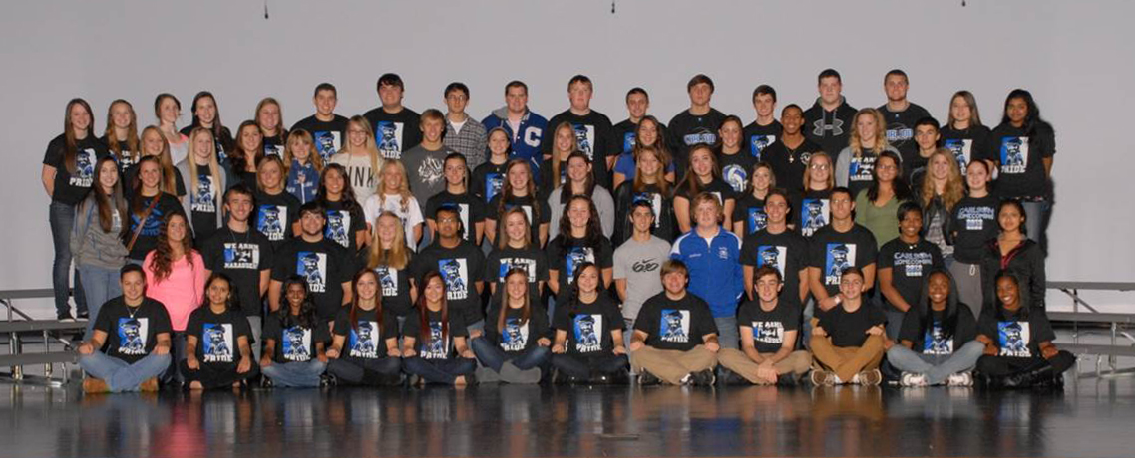
Marauder Captain’s Mentoring Program
87 upper classmen
Total number of Captains and the number of Girls verses Boys are based on the size of the incoming freshmen class.
4-5 freshmen per Captain

Slide 9
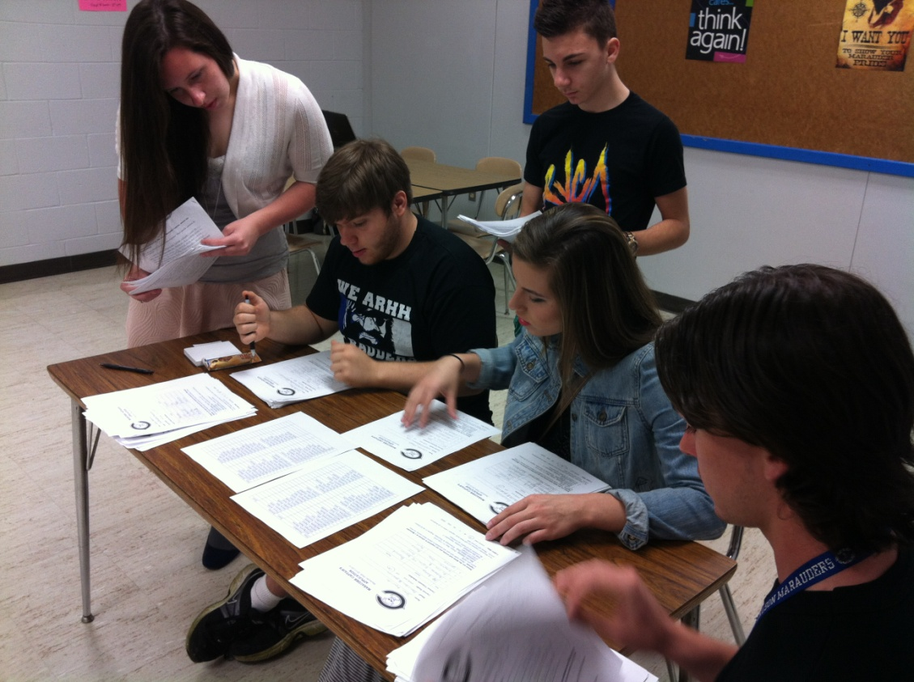
Marauder Captain’s Mentoring Program
The Application Process
Recommendation / Referral by staff before & after being selected
Each prospective student fills out an application

Slide 10
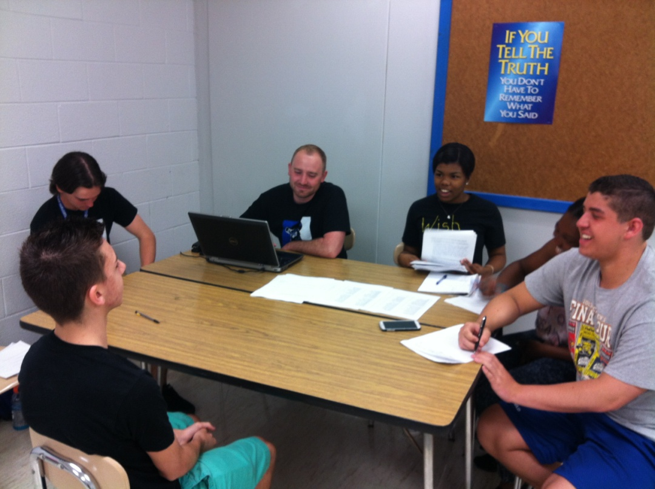
Marauder Captain’s Mentoring Program
Must go through an interview with a panel of their peers and Captain advisors
Must have no behavior issues, outgoing, friendly.
Grades are not a major factor. This is not NHS.

Slide 11
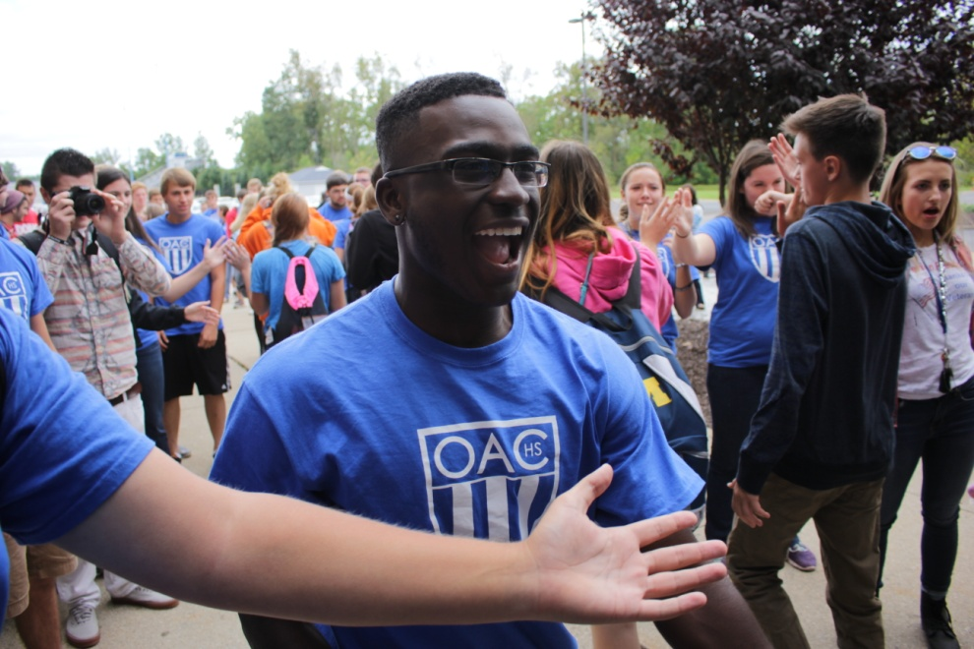
What do the Captains do?
They meet with their Freshmen & New Students
Weekly 1st tri, bi-weekly 2nd tri and monthly 3rd tri
During announcements
Freshmen & New Student Events
Freshmen Orientation
Freshmen Prep days
Freshmen Tailgate
Freshmen Study Tables
School - Wide Events
Tug-of-War competition, Dodge ball, lunch time games, Spring Egg hunt, Spirit Week Activities

Slide 12
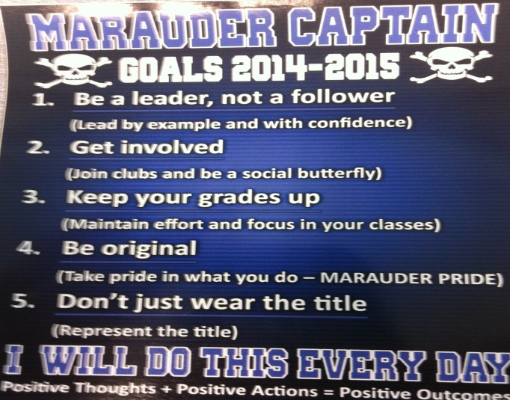
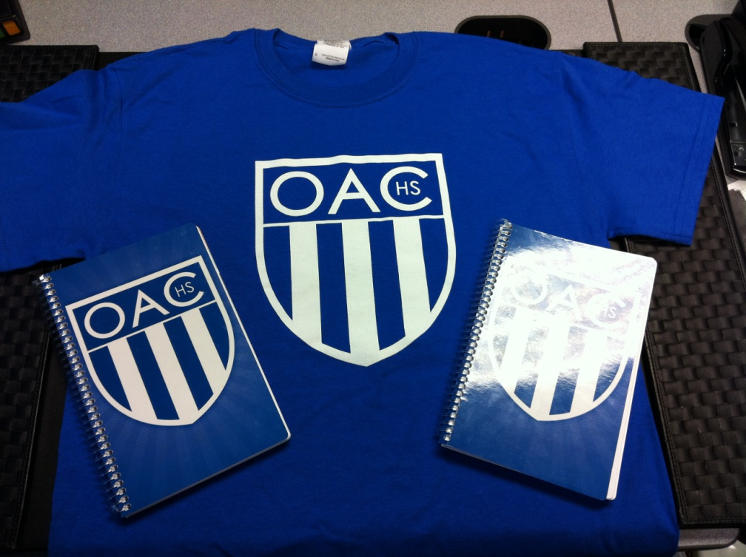
Captains stand out among students:

Slide 13
Who runs the Captains?
The Captains program is starting to become more student driven.
Executive panel consisting of 13 captains plus 2 advisors
They break down each month and are in charge of monthly events. As advisors we are just here to oversee and help them.

Slide 14
Captain Training
May Day Training
After all the Captains have been chosen, we hold a training day.
Why Captains exist, rules, goals, lots of leadership and teamwork based games
Prep-Day Training
In August before school starts
Prepare Captains for what they will do the following day with the freshmen on their own prep-day.

Slide 15
Problems we had….
How to match the freshmen with the Captains
Pairing them up effectively
Meeting with their freshmen
When to meet; where to meet
Communication
Captains to freshmen and advisors to captains.
Picking the right kids for the job
Staff buy-in

Slide 16
How we fixed the problem…
How do we pair 300+ freshmen and new students with the captains that we have picked?
We tried spreading the high and low kids amongst the captains.
Alphabetical order
Matched personality tests
This year we randomized it using playing cards
Next year we are thinking of trying to match kids up using some basic interests.

Slide 17
How we fixed the problem…
Meeting with their freshmen
At first we told the Captains to meet with their mentees throughout the week, once a week. This did not work, Captains were not always doing it and the mentees seemed freaked out that this upper classmen was randomly asking them how things were going each week.
Now we have told the mentees that once a week, each Tuesday, their Captain will come and talk to them to see how things are going. We do it during a set time (announcement period) each week so not to interrupt the class.

Slide 18
How we fixed the problem…
Communication
Captains to freshmen
We have them exchange numbers and class schedules. Having the set time for them to meet has helped with their communication as well.
Advisors to Captains
We tried Facebook and Twitter
Not everyone had it and Facebook was “not cool” anymore
We now sign them all up on the Remind101 text service. It works well once they are all signed up for it.

Slide 19
How we fixed the problem…
Picking the right kids for the job
At first the PBIS team picked them
Too many did not want to do it that we picked
Many wanted to do it that we did not pick
Some did it for the wrong reasons (resume builder)
Then tried to do just an application and Teacher recommendation
We had too many applications and it was hard to decide between them all.
Now we do an application and an interview process
Gives them real life experiences
You have to trust the core group in the interviews
We still check with teachers before and after the interview for their opinion.

Slide 20
How we fixed the problem…
Teacher Buy-in
We had trouble with teacher buy-in because people do not like change.
We tried teaching them PBIS, games, speakers
The only thing that seemed to work with the majority of the staff was RESULTS. When our numbers started to go down, buy-in started to go up.

Slide 21
Contact Info:
Ron Jacobs
jacobsr@gibdist.net
Ryan Donaldson
donaldr@gibdist.net
Dennis Schooley
schoold@gibdist.net
A special thank you for our Marauder Captains that came with us this morning.
Amanda Potter, Lauren Poslaiko, Jordan Payne

