Slide 1
Crestwood High School
PBIS Program
Alternative Consequences and Rewards

Slide 2
High School Information
We have 1315 kids (up from 1200 in 2009)
We have been implementing PBIS for 4 years, it started at the end of 2010.
We are solidly at Tier III

Slide 3
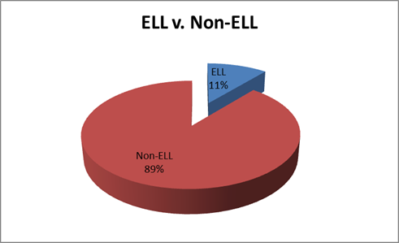
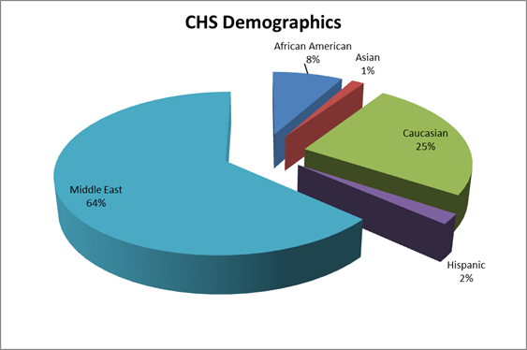
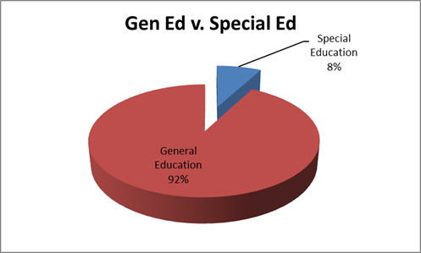
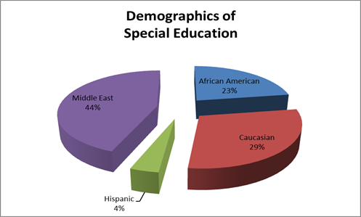
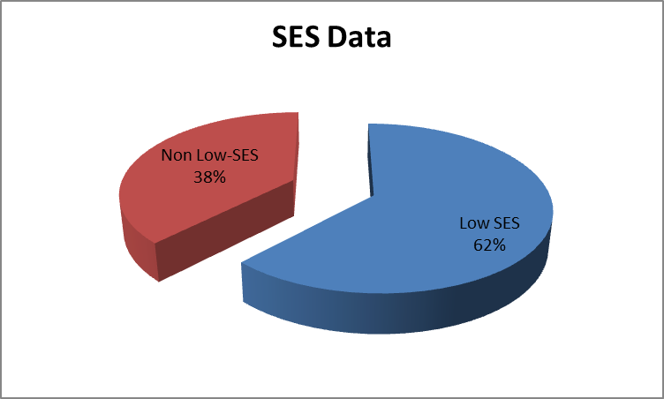
Demographics

Slide 4
Initial Issues
Too many suspensions
Too many absences
Too much paperwork
Too many tardies
Too many students missing class for superficial issues
Not enough time in the day
Misrepresentation of low SES and minority students
Academically underachieving- high failure rate, low test scores

Slide 5
Issues, cont.
Lack of staff buy in
Perception that students had no school spirit
Us/Them mentality
Ignoring social and emotional issues masked by behavior
Students giving up on classes due to missing work and falling behind
Social tracking was prevalent- caste system, segregation, separation from positive peer influence
Lack of connection between staff and (many) students
Lack of dignity for many students in the halls of Crestwood
90-95% of our kids wanted to attend college, few were getting the experience and preparation to be successful in their 13th year.
Under-representation of minorities and special education students in AP Classes

Slide 6
Is There a Solution?
Without dignity, there cannot be self-esteem, and without esteem, there can be no pride.
We had to restore dignity to all kids
Not just rich
Not just political
All kids deserve access to a rigorous college preparatory education

Slide 7
Change in Mindset
We needed to provide staff and students with the time and tools to shift from punitive to proactive teaching. Required action and cooperation from superintendent to newest teacher
Major/Minor Offense Activity
(41 offenses → 15 offenses)
SST
Connections
Social worker
Counseling shift
To ensure staff buy-in we used a super majority on many decisions (cell phones & dress code)

Slide 8
Mindset, cont.
At Crestwood, like many high schools, kids don’t respond to smencils, slap bracelets, and stickers
They may enjoy them, but not enough to create a change in behavior.
We also do not require students to wear their IDs, so lanyards were out too. IDs don’t keep schools safe, knowing and valuing each and every child does
Our kids responded to time, space, and freedom
Works for us since reward budget has been eliminated

Slide 9
Connections
A few years ago as a staff, we made the decision that every student at Crestwood needs to be known and valued by at least one adult and have a positive peer group. We worked through several different iterations of what is now called "Connections.“ Connections meets every Thursday for 20 minutes. We feel that it has a "grounding effect" for students. So many of our kids come to school each day and there is no way to ensure that they have positive interactions. Connections works to form strong relationships between students, peers, and adults.
Connections provides a safe area for all students to appropriately engage in meaningful conversations. It also gives us the opportunity to get to know each student outside of the classroom, in a non-academic setting. Too many schools miss the personal, social, and emotional aspects of student life.
As an example, we had a student who struggled greatly though the summer, and had a difficult time returning to school. She was warmly welcomed by her Connections group providing her with positive relationships to build on for the school year. It may have been awkward for her to return but with a strong group of students, she has a more positive outlook on school.
It also encourages conversations about post secondary plans and provides students with a more diverse understanding of opportunities. The teachers are able to share their unique college experiences in an arena that offers time for questions and more in-depth conversations without competing with academic standards. The teachers are in a unique position as facilitator rather than leader, and this opens up the opportunity for students to then take a leadership role.

Slide 10
Student Support Time
Time set aside 1 day a week for teacher PLC and 1-1 or small group student assistance
½ the staff is on PLC, ½ the staff works with kids
Students are assigned to a teacher if they have below a 2.0 and MUST attend, or can sign up to see one on their own
SST data is used during Meeting Mechanics and other data driven decisions
It is DURING the regular school day
Students not attending SST have the option to socialize (in designated areas), volunteer (which MANY do), or sleep in
Meeting Mechanics are held during this time

Slide 11
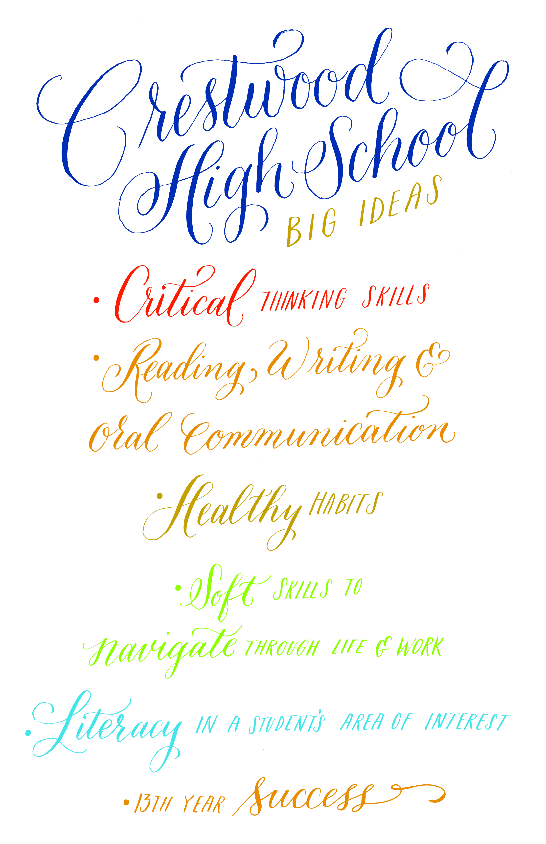
What do We Actually do Here?

Slide 12
Alternatives to Suspension
SRC
Community Service & Detentions
Counselor meetings
Social work support
Tier II Check in /Check Out
Tier II Staff/Student Mentoring

Slide 13
Alternatives to Suspension, cont.
Crestwood Transitions Program
Meeting Mechanics/Risk Assessment/Psych Evaluation
Process
Staff contacts counselor/social worker→ CA60 Review→ Meeting Mechanics with ALL involved staff→ Action Plan
Done prior to Tier II or special education evaluation

Slide 14
Examples
Parking lot
Days off (Senior attendance incentive)
Worked for 3 years, not so much anymore…
SST
Cell phones
AP Incentive
Drop a quiz/test for no tardies
Alternative assessment for poor attendance and lack of participation
Eligibility to take assessment

Slide 15
Charger Awards
Given for on-time arrival (at random)
“Caught being good”
Teacher discretion
Partnership with cafeteria for Charger Awards
Spiritwear
Engaging CI classroom in process as well
Gift cards (self-funded)
Access to courtyard

Slide 16
Results
Pre & Post PBIS Implementation

Slide 17
Hours Suspended (we are up 60+ kids since 2010)

Slide 18
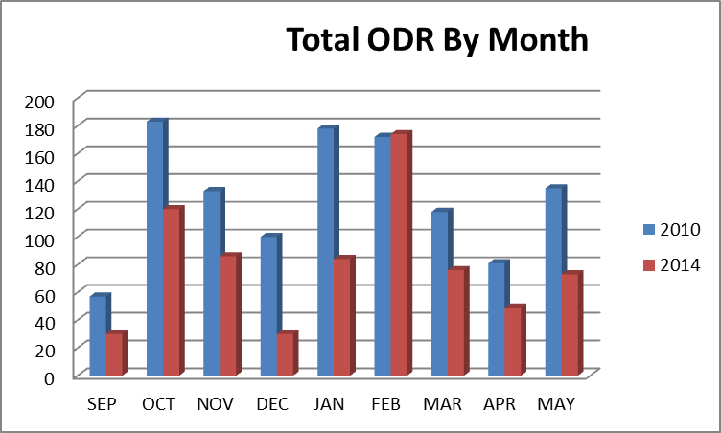
Number of Infractions per Month

Slide 19
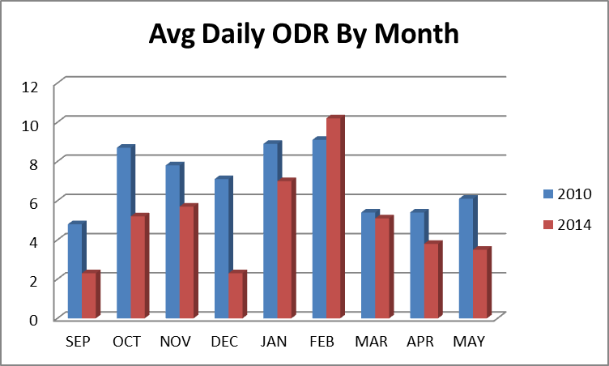
Infractions, cont.

Slide 20
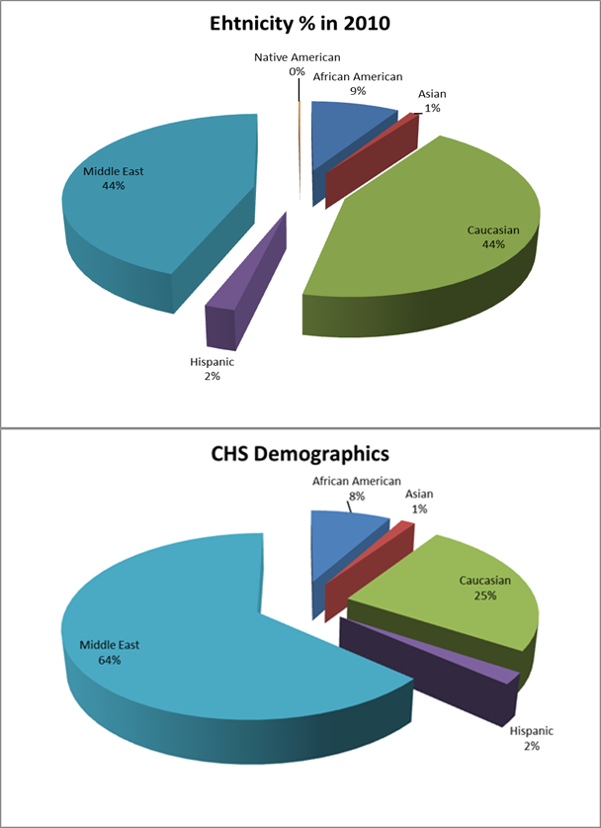
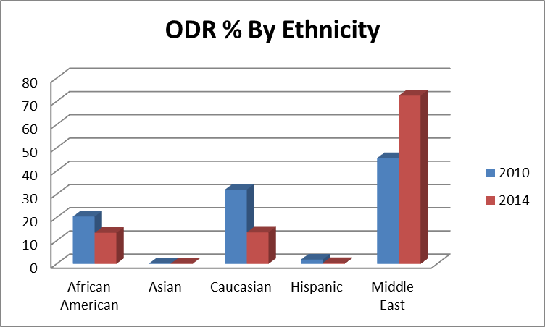
Infractions, cont.

Slide 21
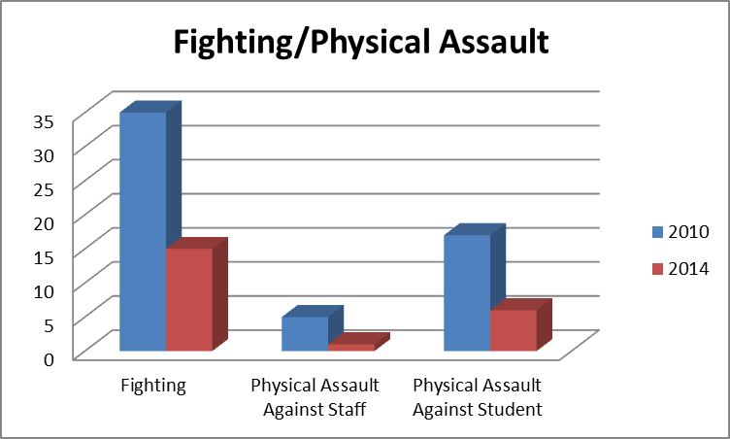
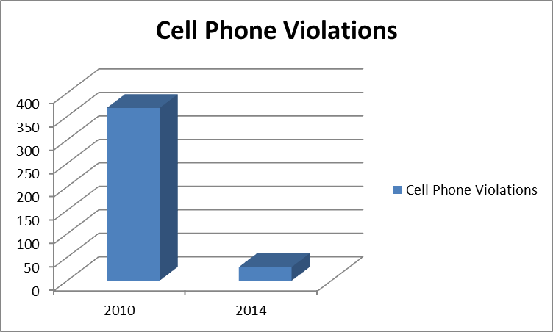
Specific Offenses

Slide 22
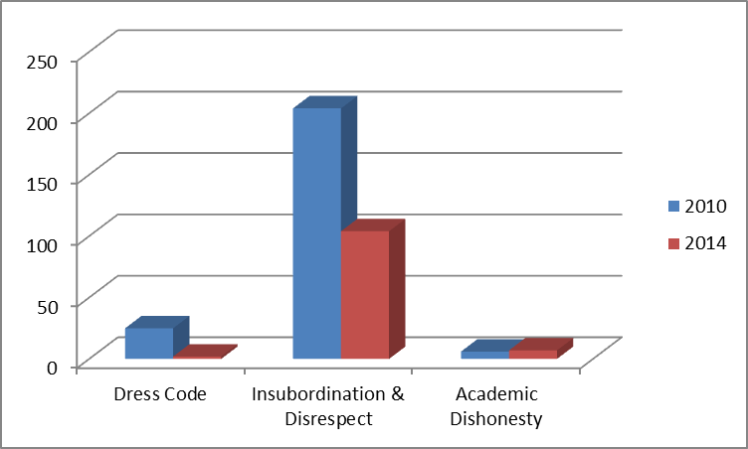
Cellphones = Hell in a Handbasket (not really)

Slide 23
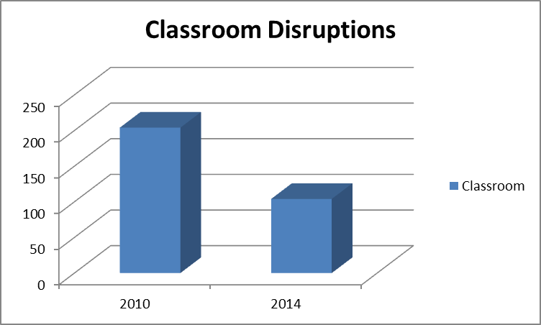
Referrals by Location

Slide 24
Results
(Academic)

Slide 25
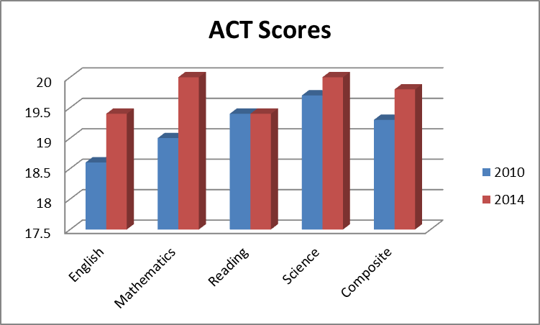
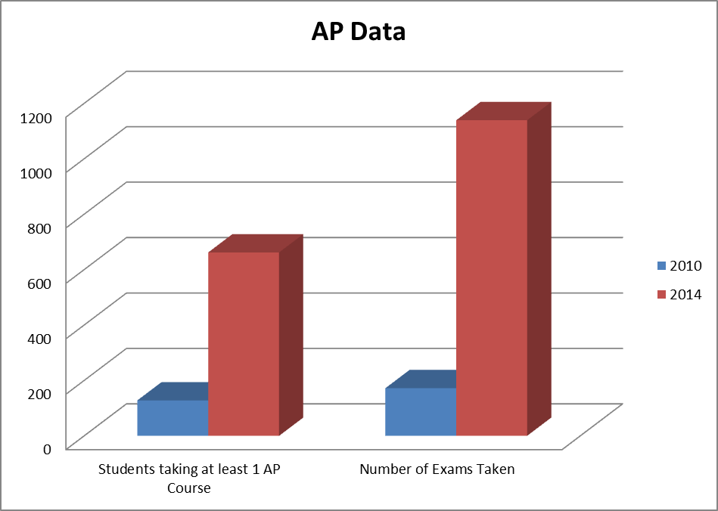
External Data

Slide 26
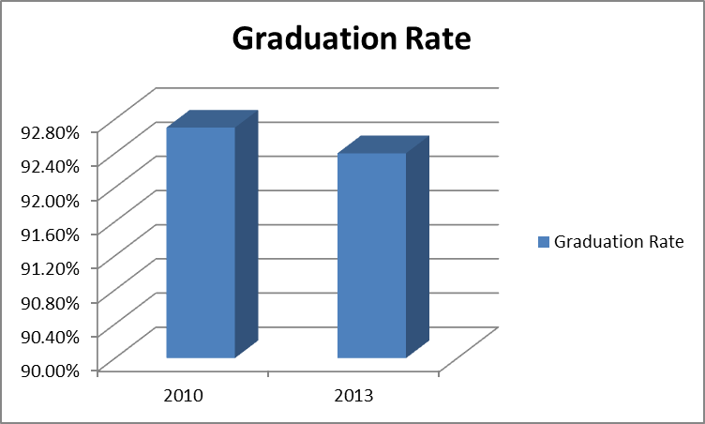
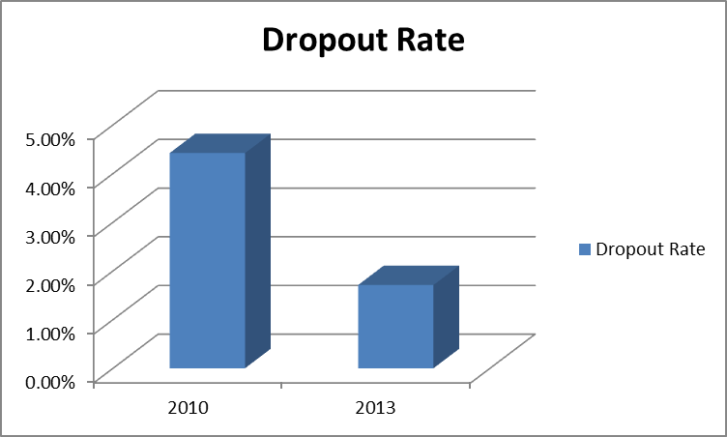
Graduation Rate

Slide 27
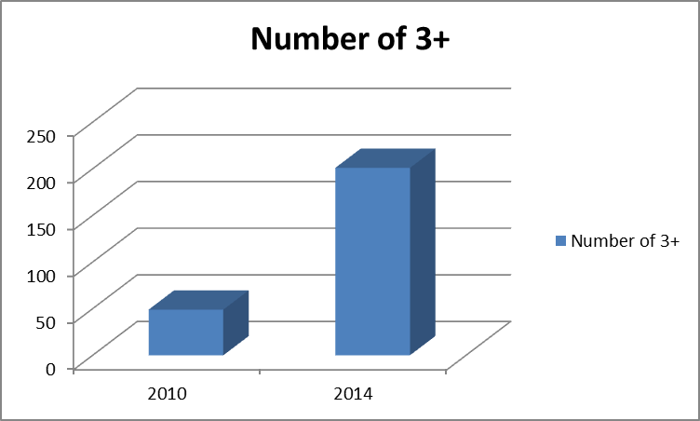
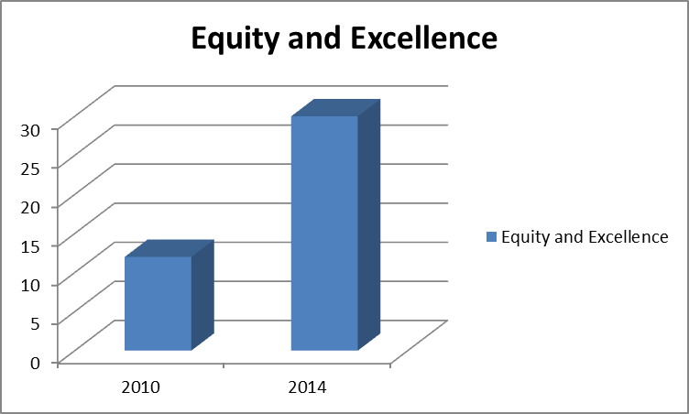
Achievement, cont.

Slide 28
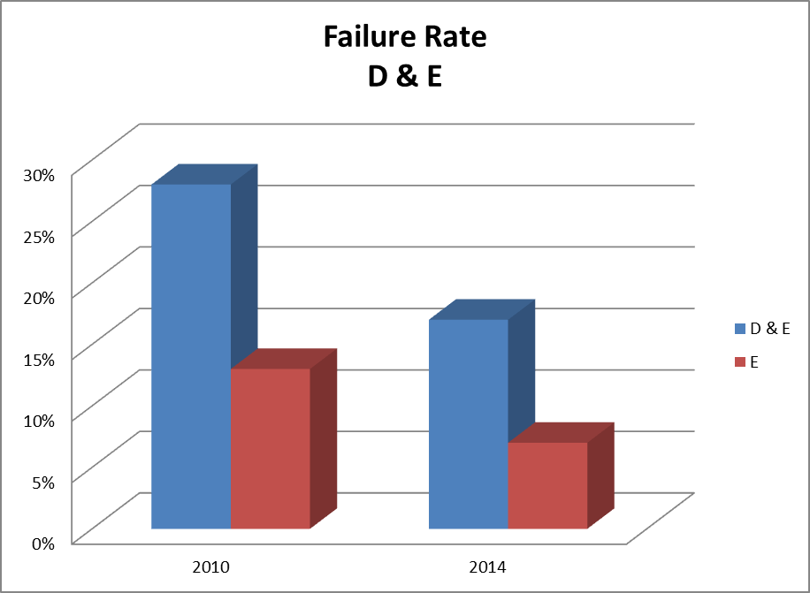
Internal Failure Data (progress report data too)

Slide 29
College Admissions and Scholarships
2010
U of M Dearborn
Wayne State
HFCC
Schoolcraft
The Art Institute
Madonna
Marygrove
EMU
Lawrence Tech
U of D Mercy
Oakland University
2014
U of M Dearborn
Wayne State
HFCC
Schoolcraft
The Art Institute
Madonna
Marygrove
EMU
Lawrence Tech
U of D Mercy
Oakland University
GVSU
Western
Michigan Tech
Ferris
Michigan State
U of M AA
Adrian
Albion
Davenport
University of Toledo
Central

Slide 30
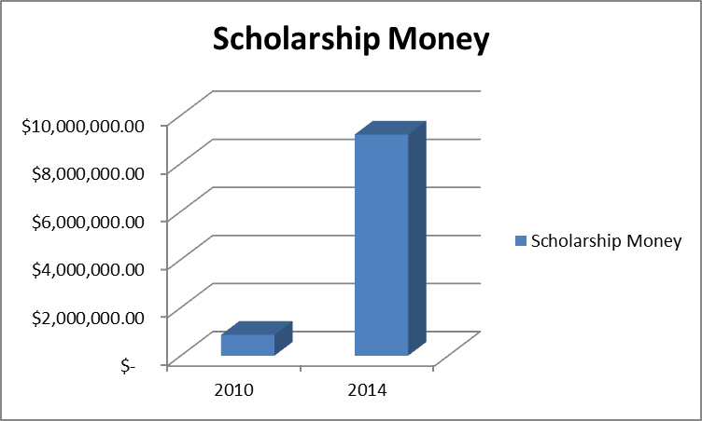
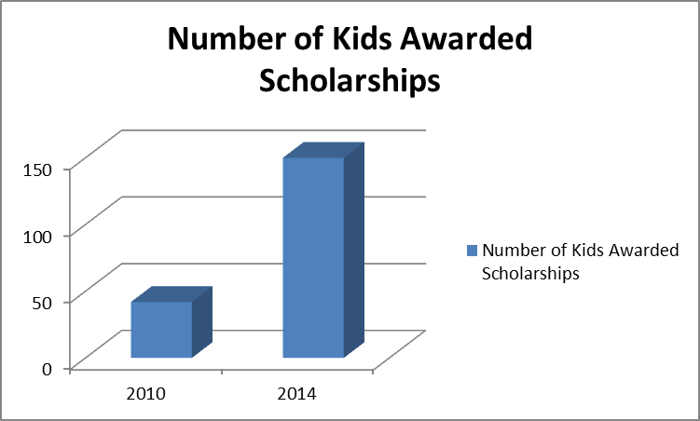
Scholarships Awarded

Slide 31
Why Does it Matter? (Data according to Gates Foundation and payscale.com)
College Completion
U of M AA- 90% (72%)
MSU- 77% (49%)
Wayne- 31% (10%)
Community college matriculation rate?
Lifetime Earnings
U of M
$50,000 x 10 = $500,000
$90,000 x 20 = $1,800,000
Wayne State
$41,000 x 10 = $410,000
$78,000 x 20 = $1,560,000
Difference of $300k+

Slide 32
10% ideas
Assemblies or time off for no ODR
90/90/90/None= No final
Off campus lunch

Slide 33
Left to Do
Tardies and overall attendance are still a problem
Build stronger relationships
Getting total buy in. There is no need to sweat the small stuff
More meaningful SRC experiences
More productive SST
More student input on incentives
Increased school involvement
This is on us…

Slide 34
Contact Information
John J. Tafelski
Principal
jtafelski@csdm.k12.mi.us
(313) 278-7475
Chris Meussner
Social Worker
cmeussner@csdm.k12.mi.us
(313) 278-0902

