Slide 1
East Middle School
PBIS Presentation
October 3, 2014

Slide 2
Who Are We?
Contact List
Scott Burek – Principal scott.burek@pccsk12.com
Chris Marek – Assistant Principal christopher.marek@pccsk12.com
Christianne Abbott – Counselor christianne.abbott@pccsk12.com
Sarah Macheske – Teacher Consultant sarah.macheske@pccsk12.com
Lisa Diebel – Teacher lisa.diebel@pccsk12.com

Slide 3
Who Are We?
Race

Slide 4
Who Are We?
Socio-Economics

Slide 5
Who Are We?
Talented & Gifted

Slide 6
Who Are We?
Fourth Year PBIS School
  Year One & Two
    PBIS approach was to use data to punish more students.
    Students were excluded from rewards for any and all discipline.
    Remarkable Rockets had no value.
    No PBIS kickoff or re-teaching of the matrix.

Slide 7
Who Are We?
Fourth Year PBIS School
  Year Three to Present:
    Separation of discipline from PBIS incentives.
    PBIS kickoff, calendar, & re-teaching of matrix.
    New PBIS leadership promoted positive interaction.
    Weekly & Quarterly rewards ALL students can buy their way in to.
    Remarkable Rockets regained value.
    School store & business partnerships raised money.

Slide 8
Separation of PBIS & Discipline
Focus Card

Slide 9
Separation of PBIS & Discipline
Focus Card

Slide 10
Separation of PBIS & Discipline
Detention Referral

Slide 11
Separation of
PBIS & Discipline
Reflection Sheet

Slide 12
Separation of PBIS
& Discipline Office
Discipline Referral

Slide 13
Separation of
PBIS & Discipline
Consequences

Slide 14

Separation of PBIS & Discipline
Fixation on Discipline Data in Years 1 & 2
  Led to overemphasis on catching students being bad.
  Led to students, parents, & staff to view PBIS negatively.
  Led to school wide incentives to become worthless.
  Had no effect on decreasing discipline issues.

Slide 15

Separation of PBIS & Discipline
Focus on Promoting Positive Behavior Year 3
  Led to catching students doing the right things.
  Led to students, parents, & staff to viewing PBIS in a positive light.
  Led to incentives to be highly valued.
  Decreased overall discipline issues building wide.

Slide 16
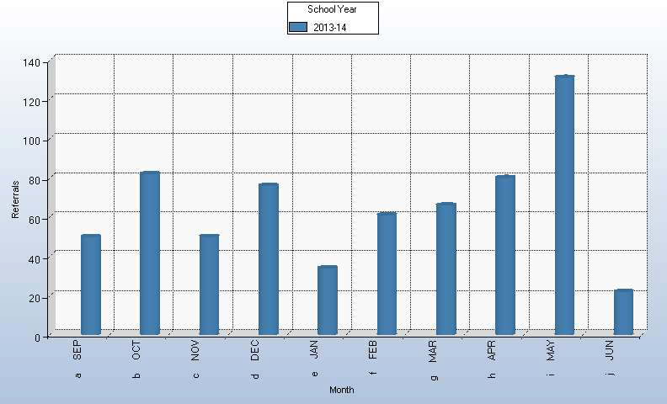
Separation of PBIS & Discipline
Total ODRs 13-14

Slide 17
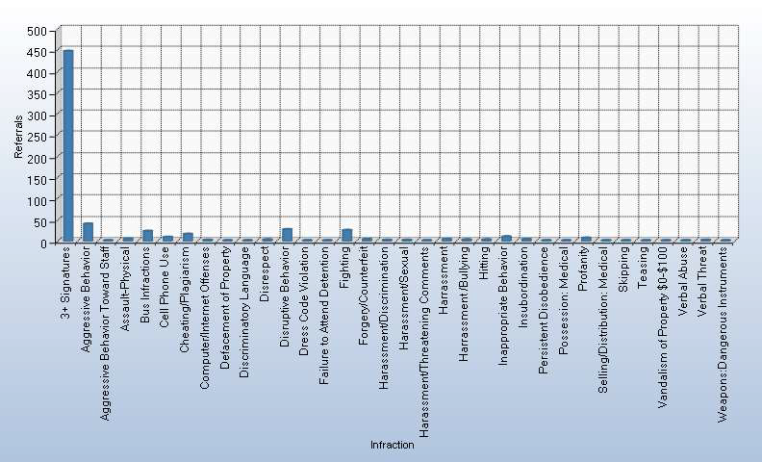
Separation of PBIS & Discipline
Behavior Infractions 13-14

Slide 18
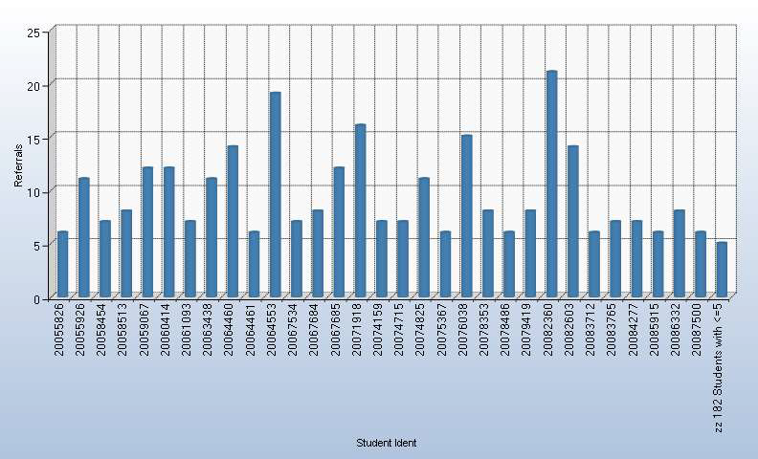
Separation of PBIS & Discipline
Number of Referrals by Student

Slide 19
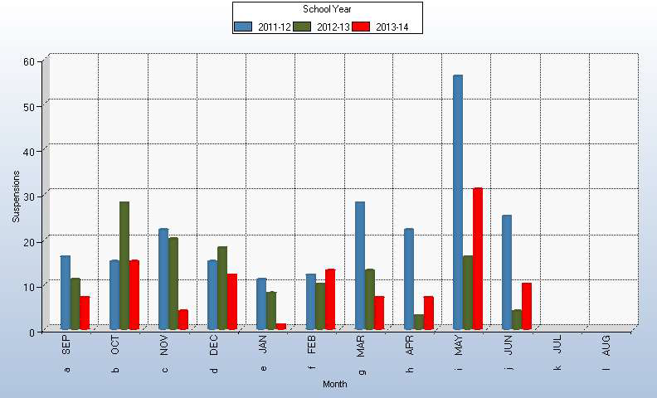
Separation of PBIS & Discipline
Suspensions 11-14

Slide 20
Separation of PBIS & Discipline
Reports Guide Building Decisions & Tier 2
  Containing aggressive behavior during the middle of the day continues to be our focus based on the data.
  Tier 2 & 3 students are identified in part by tracking “Number of Referrals by Student” data.

Slide 21

Separation of PBIS & Discipline
Alternatives to Suspension
Repeat offenders of East’s Focus Card (minor infractions) are typically put on an Individualized Behavior Plan.
Automatic suspensions only for illegal activity.
All attempts are made to work with parents to keep students in school.

Slide 22





Remarkable Rockets
•200 RR’s Handed Out Quarterly Goal
•Teacher Stamps
•Business Partners

Slide 23

Business
Partnerships

Slide 24

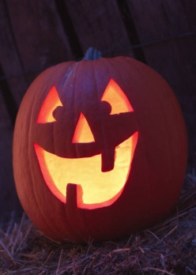

School Store
Cash only for everything from Spirit Gear to School Supplies
  Run by parents during lunches
  Three themed stores 14-15
    Halloween
    Holidays
    Spring Break

Slide 25

Calendar
PBIS Calendar 2014-15 First Quarter
September 2 – PBIS Meeting (2 PM in library)
September 3-11- Expectations Review in Homeroom
September 10 – PBIS Kickoff
September 19 – Electronics Reward Day
September 26 – Gift Card Drawing
October 7 – PBIS Meeting (3 PM in library)
October 10 – Electronics Reward Day
October 17 – Gift Card Drawing
October 24 – Electronics Reward Day
October 27 – 29 - Halloween School Store during Lunches
October 31 – Gift Card Drawing
November 5 - PBIS Meeting (3 PM in library)
November 7 – 1st Quarter Reward Day

Slide 26
Expectations
Review

Slide 27
Expectations
Review

Slide 28
Expectations
Review

Slide 29
Expectations
Review

Slide 30
Expectations
Review

Slide 31
Expectations
Review

Slide 32
Expectations
Review

Slide 33
PBiS KICKOFF
13-14

Slide 34
Pep Band
Thank you Mr. Karboske!

Slide 35

Business Partners
Penn Station

Slide 36
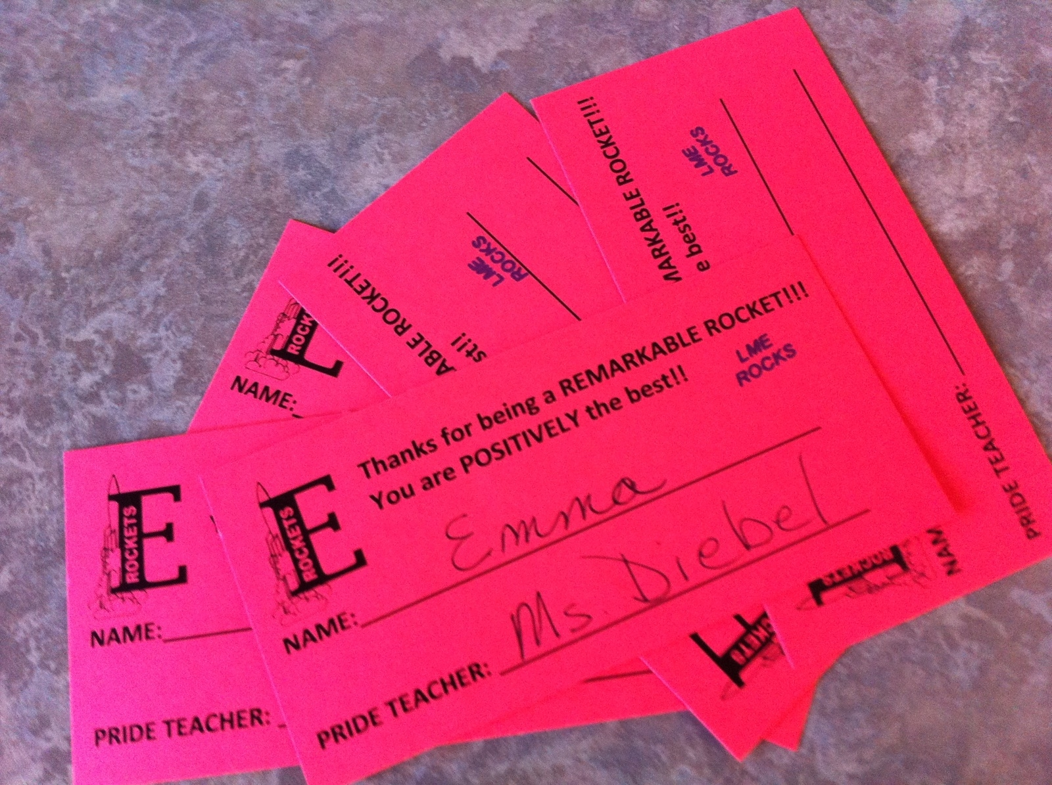
Rewards
Electronics Day – 5 Remarkable Rockets

Slide 37
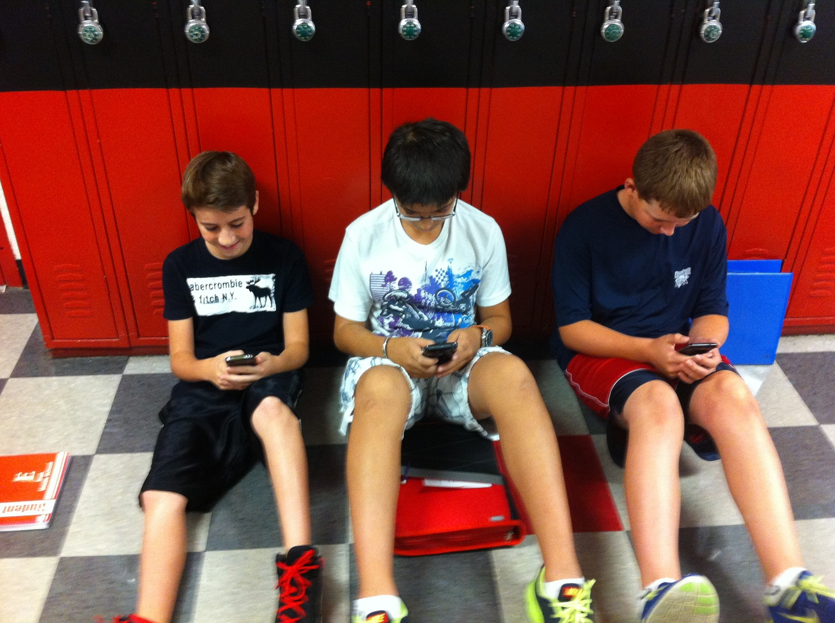
Rewards
Electronics

Slide 38
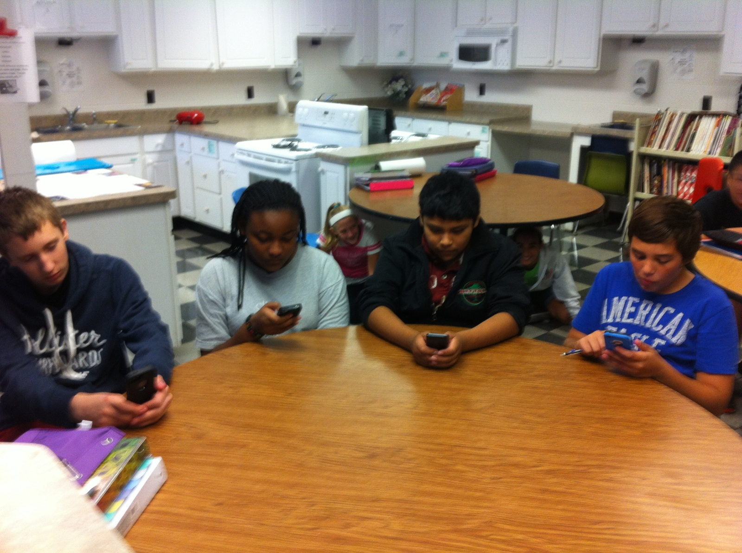
Rewards

Slide 39
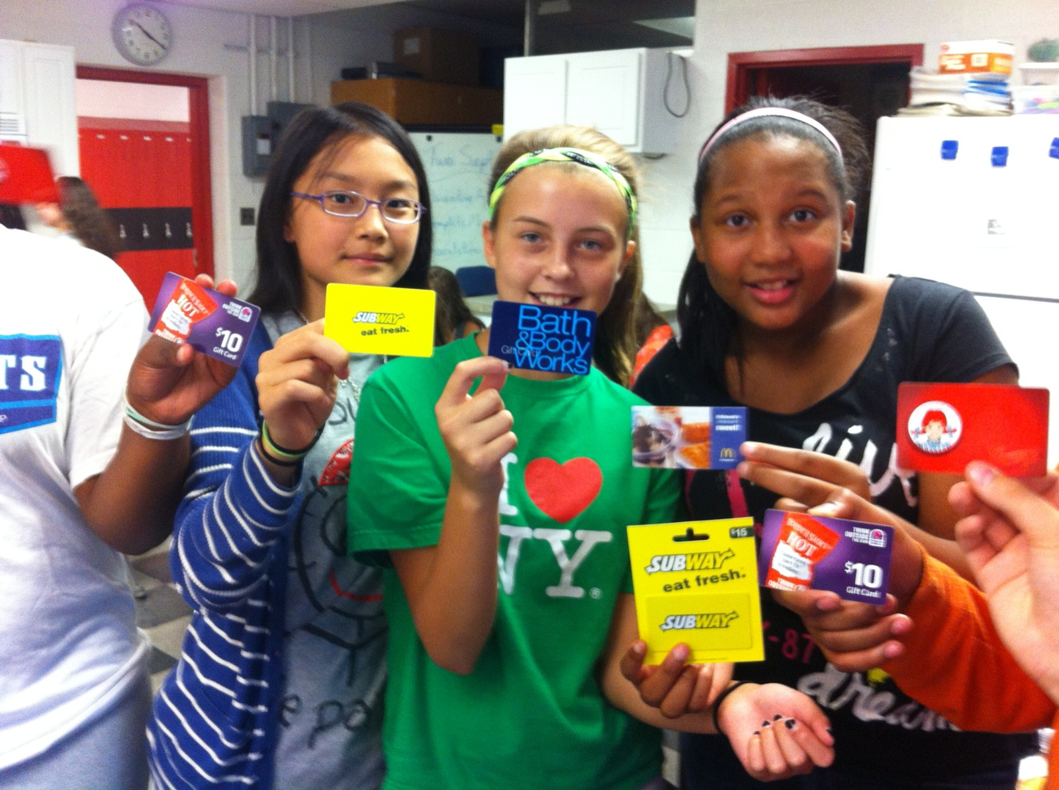
Rewards
Gift Cards

Slide 40
PBiS Jeopardy
www.jeopardylabs.com/play/east-middle-school-pbis-matrix

Slide 41
Quarterly Rewards
1st Q – East Fun Festival
2nd Q – East Hallway Shakeup
3rd Q – East Ice Cream Social
4th Q – East Survivor

Slide 42
Ice Cream Drawing

Slide 43
PBIS Kickoff
PBIS KICKOFF 2014
Classes have been teaching the PBIS Matrix each morning during homeroom. Remember students: these are the expectations for all students at East!
On that note, everyone has been competing in our Electronics Day competition! The grade level with the most days of positive behavior will be allowed to bring their electronics to school on September 19. You can always track your grade’s progress on the bulletin board outside the office. If your grade level wins, you will be able to use them appropriately during lunch and recess!

Slide 44
PBIS Kickoff
Teachers have been handing out Remarkable Rockets to students for being respectful, responsible, and safe. So what can you spend them on?
  Building Rewards: Gift Card Drawings, Electronics Day Make-ups, Building Reward Days, Principal for a Day, and this year’s final activity: East Amazing Race!
  Class Rewards: Many of your teachers offer class rewards as well, including: school supplies, class privileges, oops coupons, and the like. Ask your teacher what they offer!

Slide 45
PBIS Kickoff
PBIS Kickoff 2014
We will also be running the East school store this year in the cafeteria just before Halloween, the Holiday break, and Spring break!
At this time teachers, please hand out two Remarkable Rockets to each student in your first hour. Students, fill there out and give one back to your teacher. When each student has submitted one, you may conduct your drawing!
Teachers, please remember to pass these Rockets back to the owners so they will have some for the drawings at lunch today!

Slide 46
Electronics Competition
Each grade competes over a two week period for the most days without a suspension.
The winning grade gets to bring electronics to use responsibly during lunch/recess.
Students in grades that do not win may buy a wristband for 5 Remarkable Rockets during homeroom if they wish to participate.

Slide 47
Electronics Competition

Slide 48
Remarkable Rockets
Getting them to Students

Slide 49
Making Remarkable Rockets Valuable
Quarterly Rewards
Building excitement through announcements
  Front of lunch line pass
Priority seating at events
Teacher Incentives

Slide 50
Class Rewards
  Oops Coupons
  Change your seat for the day
  Listen to music while working
  Free test question
  Drawings/Raffles
  Class Stores/Purchasing class materials

Slide 51
Building Rewards
Quarterly Rewards
  East Festival: Movie/Bingo/Gym
  East Hallway Shake-up: Games/Art/Electronics/Salon
  Ice Cream Social: Friends, Fun and TOPPINGS!
  East Survivor: Teams of students face challenges to win prizes! Included Selling treats and beverages.
Bi-weekly Rewards
  Electronics Day
  Gift Card Drawing

Slide 52
Easy for Teachers
Make random announcements for Remarkable Rocket give-aways.
  Everyone on time
  Everyone with their planner filled out
  Everyone wearing spirit gear on spirit day
Gift card drawing for teachers at staff meetings

Slide 53
Student Input
Survey students for feedback on building level rewards
  Adjust future rewards based on data
    We decreased the amount of Remarkable Rockets required for East Survivor based on feedback
Select Student Council members will be part of our PBIS team this year.

Slide 54
Tier 2
Building wide Check-In/Check-Out during homeroom and PRIDE.
  Teachers start the day walking around the classroom during homeroom making sure each student is prepared for the day.
    Check for Planner & Focus Card
  Teachers end the day walking around the classroom during PRIDE making sure each student is ready to go home.

Slide 55
Tier 2

Slide 56
Tier 2
Individual CI/CO

Slide 57
Tier 2
Individual Accommodation Plans

Slide 58
Tier 2
Mentorships - Staff
Staff signed up to mentor students who were struggling academically and behaviorally.
Building positive relationships
Checked in one to two times per week

Slide 59
Tier 2
Mentorships - NHS
National Honor Society Students from the high schools paired up with at-risk students
Met twice a week for one hour after school
One day homework
One day mentoring
Students chosen based on academic and behavioral concerns

Slide 60


Acknowledgements
Central Middle School, PCCS
Franklin Middle School, Wayne Westland
Patrick Henry Middle School, Woodhaven/Brownstown
Stevenson Middle School, Wayne Westland
Woodworth Middle School, Dearborn

