Slide 1
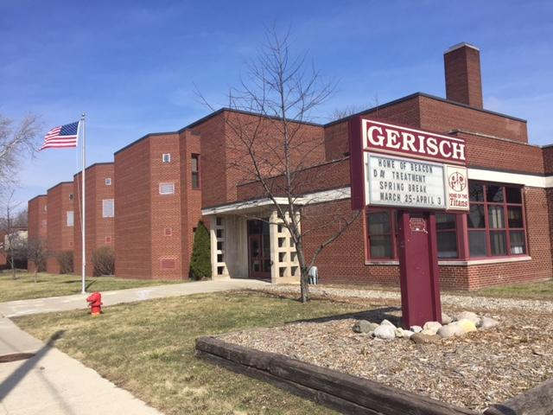
Beacon Day Treatment
12601 McCann St
Southgate,MI 48195
313-551-2790

Slide 2
What is Beacon Day Treatment?
Beacon Day Treatment is a comprehensive program for Students with Emotional Impairments who have exhausted alternatives in the continuum of special services available in community programs.
Beacon has been around for over 30 years, in various different buildings, throughout Wayne County

Slide 3
PBIS and Social Learning
Beacon’s school-wide Positive Behavioral Interventions Support (PBIS) and Social Learning Program is a proactive approach which teaches new behaviors to students based on the values of :
-Responsibility for self
-Respect for self and others
-A safe environment that provides a consistent, predictable and fair school environment for all

Slide 4
How the Program Works
The school wide PBIS and Social Learning Program is designed to facilitate the development of responsible social behavior and to promote a school experience that is rewarding and enriching. The long term goals for all students who participate in the program include:
To incrementally develop behavioral skills which are consistent with the expectations of the referring community school
To incrementally develop behavioral skills which are conducive to learning
To incrementally generalize the above mentioned skills and behavioral skills to classrooms in the community schools
Notes:
To develop responsible social behavior
Long term goal: develop appropriate behavioral and social skills to help the student be successful in home district and in society in general

Slide 5
Services Provided
-A five step Social Learning Program provides a positive framework for presentation of school expectations and individual behavioral goals
-Weekly Individual Counseling sessions provide students with the opportunity to develop a positive relationship with an adult in the program. Students learn to set realistic goals and evaluate them, as well as develop social, problem solving and decision making skills
-Students meet daily in small Affective Groups to discuss concerns, develop age-appropriate relationships, learn social skills and proactive various problem-solving and decision making strategies
Notes:
Step Program
Individuals
Group

Slide 6
Who can attend Beacon Day Treatment?
List of districts we provide services for:
Allen Park Huron Southgate Wyandotte
Dearborn Lincoln Park Taylor Woodhaven
Dearborn Heights #7 Melvindale Trenton Grosse Ile
Ecorse River Rouge Van Buren Romulus
Gibraltar Riverview Westwood 6 other Academies
Flat Rock
**Transportation provided by Community School District**

Slide 7
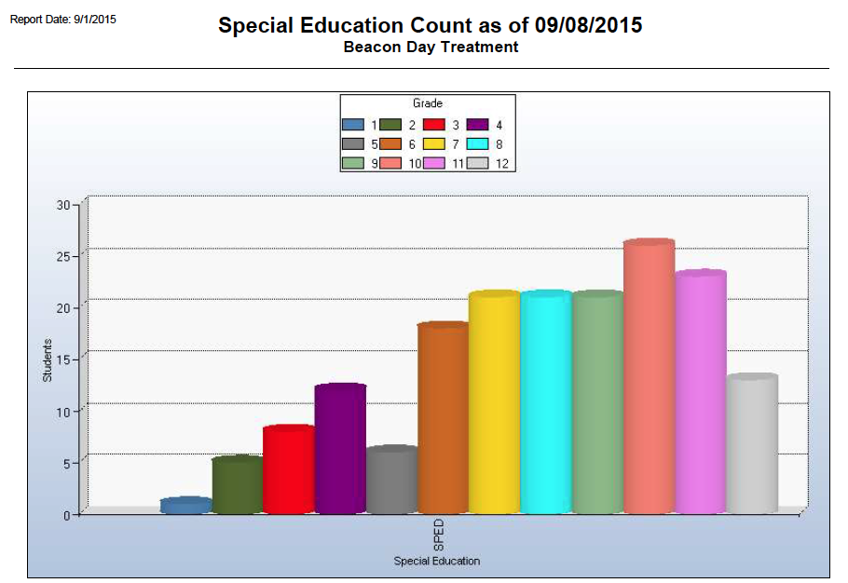
Demographics by Grade Level
Notes:
Grade 7 8 and 9 most referrals

Slide 8
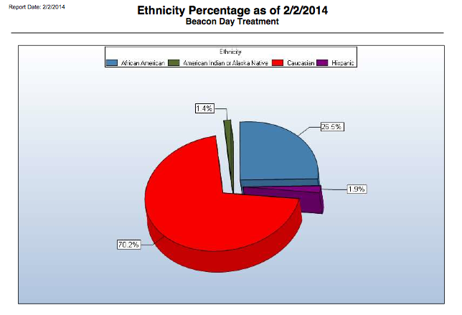
Demographics by Ethnicity
Notes:
African American: 25% Caucasian 70% Hispanic: 2% American Indian 1%

Slide 9
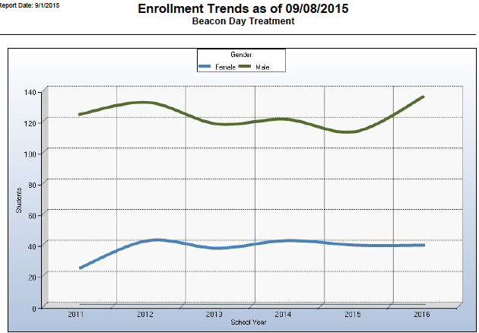
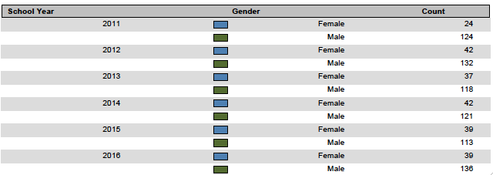
Enrollment Trends by Gender
Notes:
The Older the students are when they come to us, the longer they tend to stay

Slide 10
Academic Instruction
Academic Instruction is provided in small groups:10 students per classroom with one teacher and one program assistant
Classes include: Reading, English, Social Studies, Math, Science and various electives
All credits obtained are transferable to the local school district
Eligible to earn high school diploma through the Michigan Merit Curriculum and Individual Districts
Notes:
Electives: Computers, Family Consumer Science, Spanish, Art, Gym
Diplomas are given by sending District, not Beacon

Slide 11
Staff to Student Ratio 5:1
Beacon is a K-12 building, ages 5- 19 years old, which includes 4 elementary classrooms, 5 middle school classrooms and 10 secondary classrooms, which totals a max amount of 190 students.
Each classroom has a Special Education Teacher as well as a Program Assistant present.
There are a total of 11 Social Workers that average 18-20 students on their caseloads.
Each student has an “individual” that meets with them once a week for 30-45 minutes as well as other times to work on individualized behavior goals.

Slide 12
Support Staff
Principal and Vice Principal Behavioral Specialist
Social Workers School Psychiatrist
Speech Pathologist Special Education Teachers
Teacher Consultants Math Interventionist
Reading Interventionist Program Assistants
Intake coordinator/Clinical Consultant Building Subs

Slide 13
Behavior Management Interventions
Behavior Management Interventions are an integral part of the program. When a student becomes disruptive to the learning process, a series of time-out interventions, both in and out of the classrooms are implemented. During each intervention the student is given the opportunity to regain behavioral control through life space counseling on problem solving or decision making steps to secure a successful return to the classroom. All staff are trained in Crisis Intervention Prevention (CPI).
Sample Point Sheet

Slide 14
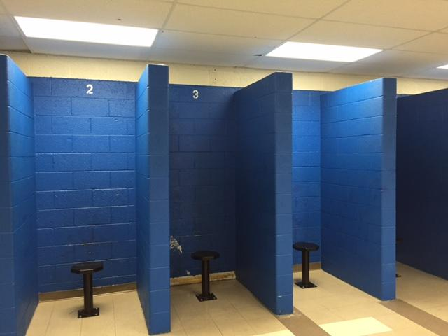
Centers
There are 4 Behavioral Centers (El, MS and 2 in the Secondary) in the building with 2 Behavioral Specialist in each center
The Goal of each center is for the students to take responsibility for their actions as well as practice corrective behaviors
Notes:
Practice corrective behavior

Slide 15
How are we working on implementing PBIS?
PBIS newsletter
Lesson plans that teach specific skills we are addressing that are age specific, taken from the Michigan Model
Refocus plan
Matrix 1
Matrix 2
Focused on areas of Bussing and Transportation as our first step
Notes:
Group time for lesson plans and teaching areas of concern

Slide 16
Bus Issues
Increase in write ups and “Dismissals”
Factors:
Length of time on the bus: 20 minutes to 2 hours
Age ranges of each bus: K-12
Some busses have 3 students, others have 20 students

Slide 17
Bus meets PBIS
PBIS matrix related to the bus with input from Drivers and Aides
Bus Bucks
Bus Breakfasts
Bus Checklist
Refocus plan
Notes:
bucks= 5 points in bank towards school store
Semester bus b fast: bus drivers, aides and students that receive less than 3 write ups in sem: raffles, breakfast

Slide 18
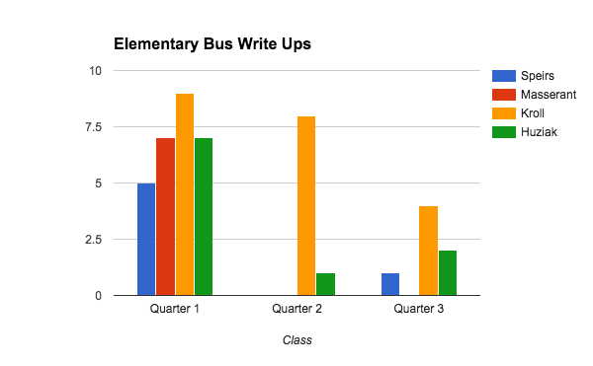
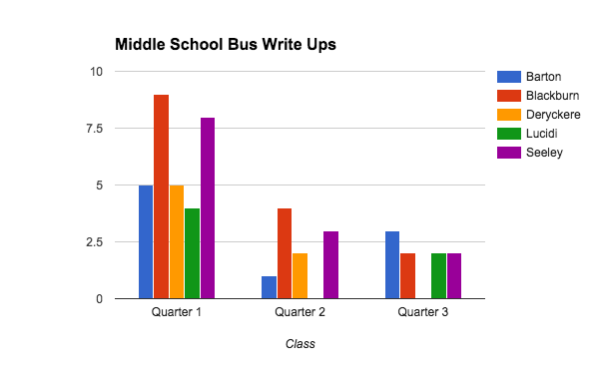
Bus Write Up Data: Elementary and Middle School

Slide 19
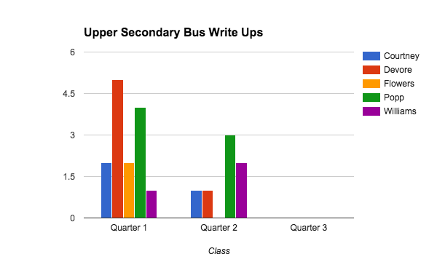
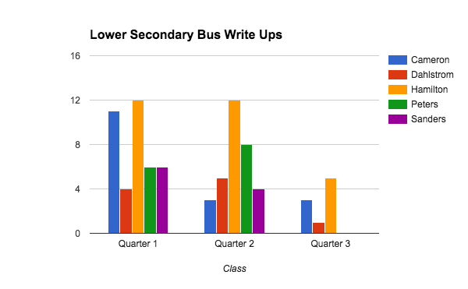
Bus Write Up Data: Secondary (High School)

Slide 20
Challenges of Implementing PBIS
Change in Administration midway implementation of PBIS
Staff buy in: Concerns- “We already had a system in place (Social Learning), why are we changing it?”
Social Learning + PBIS= Cheat Sheet
Lack of training time for all staff (New and Older staff)
Staff Turnover

Slide 21
Contact Information
Kate Ortiz
ortizk@sgate.k12.mi.us
Deanna Devore
devored@sgate.k12.mi.us
313-551-2790

