Slide 1
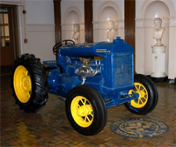
Fordson High School
PBIS Forum 2015
Angela Burley, Nadia Moussa, Marwan Salamey, Julia Martin, and Maymon Mustafa

Slide 2
STATEMENT OF PURPOSE
The main purpose of PBIS is to:
Provide and maintain a school-wide consistent, positive, and fair behavior plan.
Promote and encourage a philosophy that encompasses the entire school population and establishes a “community” where everyone is engaged, active, and invested in the process.
Create a positive learning and working climate, provide a unified teaching focus and maximize efficiency of instructional time.
Foster improved communication among students, faculty, staff, parents and other community members, and efficiently provide extra support for at-risk student populations.
Teach, teach, teach expectations!
6 years strong!

Slide 3
Demographics
Total Students: 2475
Males: 1282
Females: 1193
Out of Country: Over 80 this year; Yemen, Syria, Libya, Lebanon, Egypt, Iraq
Breakdown:
Grade Level Assistant Principals
Grade Level Parent Liaisons
Dual Enrollment
Certificate of Completion Principal
Notes:
Demographics
Senior class size 448
Two year college 45%
4 yr. college/university 35%
Hispanic/Latin 1%
A.I. or Alaskan .08%
Asian .76%
Black/African 1.52%
Native American .76%
White 96.54%
1st generation 40%
US Citizens 90%
Non US Citizens 10%
Free/ Reduced Lunch 82%
School setting Suburban

Slide 4
Demographics
Hispanic/Latin 1%
A.I. or Alaskan .08%
Asian .76%
Black/African 1.52%
Native American .76%
White 96.54%
1st generation 40%
US Citizens 90%
Non US Citizens 10%
Free/ Reduced Lunch 82%
Notes:
Demographics
Senior class size 448
Two year college 45%
4 yr. college/university 35%
Hispanic/Latin 1%
A.I. or Alaskan .08%
Asian .76%
Black/African 1.52%
Native American .76%
White 96.54%
1st generation 40%
US Citizens 90%
Non US Citizens 10%
Free/ Reduced Lunch 82%
School setting Suburban

Slide 5
After Fordson?
2 Year College: 45%
4 Year College or University: 35%
U of M Ann Arbor: 8-10 students on average per year
Brehm Scholarship
Harvard: 1-3 Students accepted per year
Notes:
Demographics
Senior class size 448
Two year college 45%
4 yr. college/university 35%
Hispanic/Latin 1%
A.I. or Alaskan .08%
Asian .76%
Black/African 1.52%
Native American .76%
White 96.54%
1st generation 40%
US Citizens 90%
Non US Citizens 10%
Free/ Reduced Lunch 82%
School setting Suburban

Slide 6
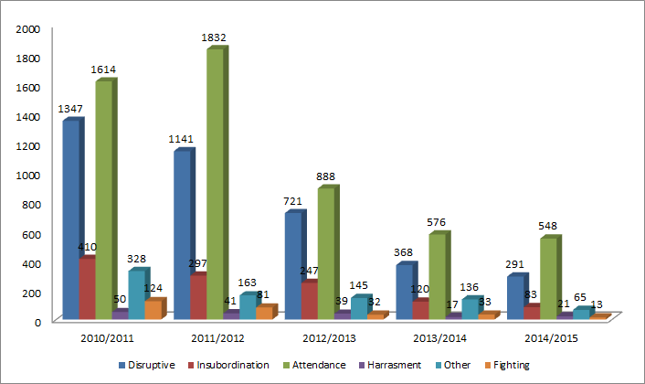
Office Discipline Referrals

Slide 7
Absences by Hour
Fordson High School
Year | Attendance
2010/2011 | 1614
2011/2012 | 1832
2012/2013 | 888
2013/2014 | 576
2014/2015 | 548

Slide 9
Acknowledging and Rewarding Positive Behavior
As part of Fordson High School’s educational philosophy, students will be recognized for exhibiting positive behaviors. Reinforcement of positive behavior can be awarded in a number of ways. All staff members are encouraged to reward students with positive comments or some other form of recognition and/or acknowledgement when a student displays appropriate behavior.
Positive Acknowledgments and Climates (Tier I):
Tractor Ticket
Most Improved Party
Tardy Party
Movie Night
Cocoa and Cram
Tailgate
Ice Cream Social
Link Crew

Slide 10
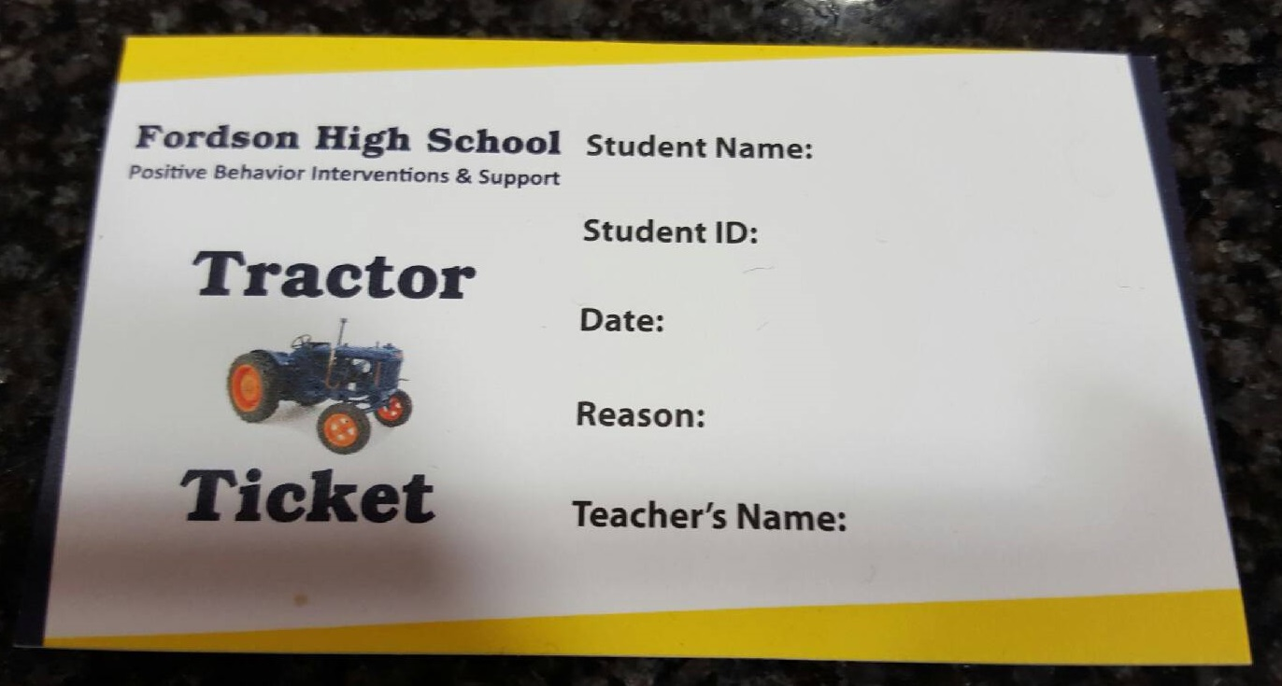
Tractor Ticket
When a staff member observes a student’s positive behavior they will recognize it with verbal praise/recognition/acknowledgement. In addition, the staff member may present a “Tractor Ticket” to the student. Tractor Tickets can be used in two different ways. It may be used as a homework pass. The second option is to enter their Tractor Ticket into various raffles.

Slide 11
Most Improved Party/Ice Cream Social
This party takes place closer to the end of the second card marking or could be done during the third card marking. Student grades are generated and compared to recognize the efforts of students academics. Teachers could also make recommendations for students to attend.
Depending on the number of students attending, this could be a pizza party or ice cream social.

Slide 12
Tardy Party and Movie Night
Tardy Party: A report is generated on attendance. This occurs twice a year. Once during each semester. Students with four or less tardies will receive an invitation to a celebratory event, for instance, an ice cream social party. Students with zero tardies will additionally be recognized in various ways. For example, Tractor Tickets or gift card drawings.
Movie Night: Students focus cards are tallied. Students are invited to a movie night if they have 3 or less infractions for the semester.

Slide 13
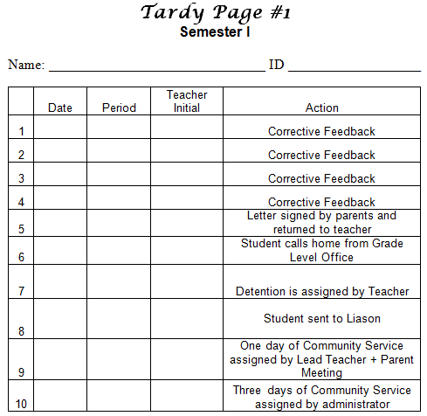
Tardy Page

Slide 14
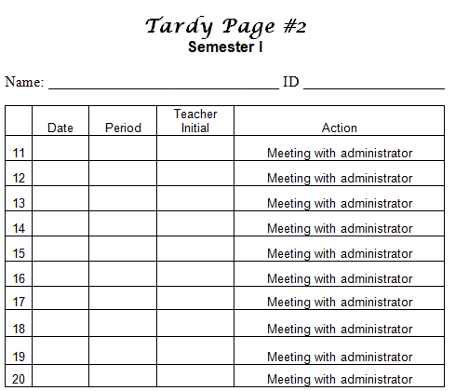
Tardy Page cont.

Slide 15
Focus Card/Infractions
The Focus Card is a tool used for behavior management. It will help teach the student what behavior is expected while simultaneously teaching the student that certain behavior should be changed.
It is used to empower students to take control toward personal responsibility. This allows them to reflect on the incident(s), what happened, what they can change, and to look at patterns in their behavior. It’s an additional opportunity to reteach matrix expectations.

Slide 16
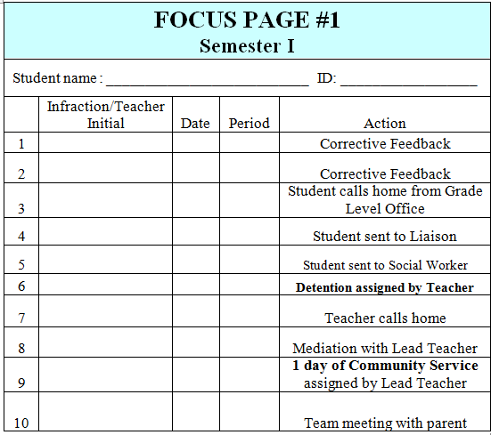
Focus Page

Slide 17
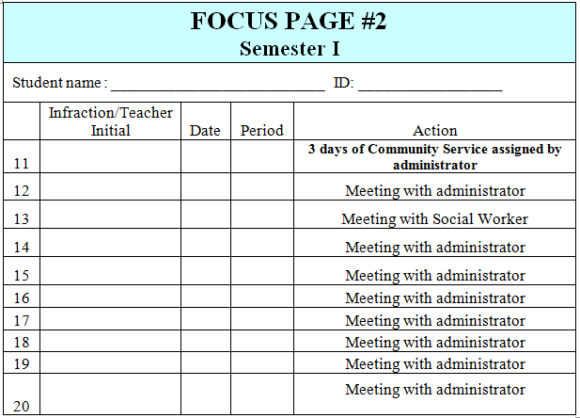
Focus Page

Slide 18
Focus Page Infractions

Slide 19
Cocoa and Cram
Teachers volunteer to commit to
tutoring times before a final exam. Students will sign up for sessions in different content areas that they need assistance in. Sessions run for an hour and students may float from one session to another.
Link Crew members serve cocoa to the freshmen during these sessions.

Slide 20
Link Crew
Link Crew is a high school transition program that welcomes freshmen and makes them feel comfortable throughout the first year of their high school experience. Built on the belief that students can help students succeed by training juniors and seniors to be mentors.
As positive role models, Link Crew Leaders are mentors and student leaders who guide the freshmen to discover what it takes to be successful during the transition to high school and help facilitate freshman success.
Link Crew provides the structure for freshmen to receive support and guidance from juniors and seniors who have been through the challenges that high school poses, and understand that the transition to a larger school can sometimes be overwhelming.

Slide 21
Acknowledging and Rewarding Positive Behavior
Positive Acknowledgments and Climates (Tier II):
Link Crew
Link Alert
Link Applause
Restorative Practices
9th Grade Lead Teacher
Parent Liaison
Social Responsibility Technicians
Cohort List Assignments
Circle of Friends
Alternatives to Suspension
Community Service
Targeted Suspension
After school detention
Conference between administration and social worker
Case Conference - Simple behavior plans
Cool Down
Peer to Peer mediation

Slide 22
Link Crew
Link Alert: This is a way teachers can get academic follow ups through link leaders. It positively impacts the student to student relationship along with a means of getting the student to improve on academics and/or behavior in class.
Link Applause: A way to celebrate positive behavior and for the student to be recognized for it. for example: the student may have had a rough start but after a few weeks has improved by participating/volunteering, performing better on exams, or simply working harder in class.

Slide 23
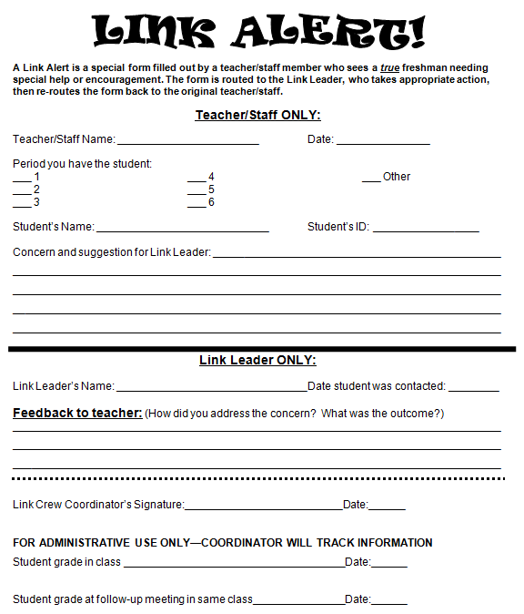

Slide 24
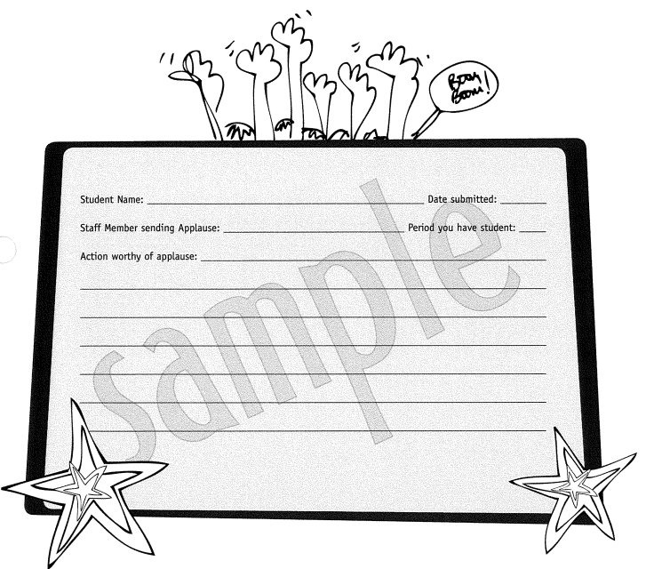
Link Applause

Slide 25
Restorative Practices
In the process of training all staff; started with co-teaching staff
Motto: Start Small and Build
Circles: Builds community, develops relationships (Tier 1, Tier 2)

Slide 26
Restorative Practices: Circles
Sequential:
Circle facilitator raises the topics and the questions
Forbids back and forth argument.
Maximizes opportunity for more quiet voices.
Permission is granted to speak.
Listen more, talk less
Non-Sequential:
Freely Structured
conversation may proceed from one to another without a fixed order.
Fish-Bowl:
Inner-circle of active participants who may discuss an issue.
Outside the circle are the observers.
Empty Chair
Problem Solving

Slide 27
Additional Interventions and Supports
9th Grade Lead Teacher
Parent Liaisons: Cohort support; parent support; translation
Student Services Liaison: Community resources; link between parent, school, and student services office
Social Responsibility Technicians: At-risk student support
Cohort List Assignments
Administration conference with social worker if suspensions are considered
Administrative support

Slide 28
PBIS VERTICAL ARTICULATION
Reinforce positive behavior
Acknowledge positive behavior
Encourage positive working environment
Maximize instructional time
Increase student accountability
Activate communication

Slide 29
PBIS Vertical Articulation
Create a common language between middle schools and high school
Create a positive school culture
Involve stakeholders to ensure that all 9th grade students successfully transition from middle school to high school

Slide 30
Contact Info:
Angela Burley:
burleya@dearbornschools.org
Nadia Moussa:
moussan@dearbornschools.org
Marwan Salamey:
salamem@dearbornschools.org
Julia Martin:
martinj1@dearbornschools.org
Maymon Mustafa:
mustafm1@dearbornschools.org

Slide 31
QUESTIONS?

