Slide 1
Schweitzer Elementary
Blending PBIS and Leader in Me

Slide 2
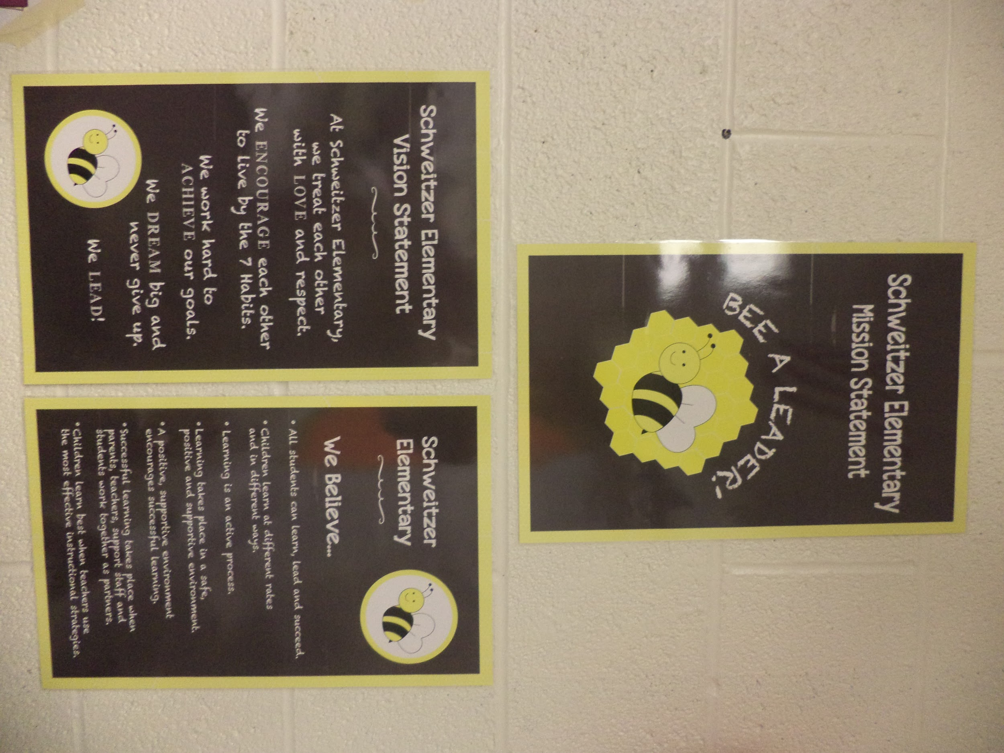
Schweitzer’s History
PBIS School since 2010-2011 school year
Leader in Me School since 2013-2014 school year
70% Free and Reduced Lunch
Identified as a Priority School August 2013 (based on data from fall 2012)
Previously had a negative school culture

Slide 3
Schweitzer ODR History-Total ODRs by year
2011-2012: 322
2012-2013: 358
2013-2014: 109
2014-2015: 102

Slide 4
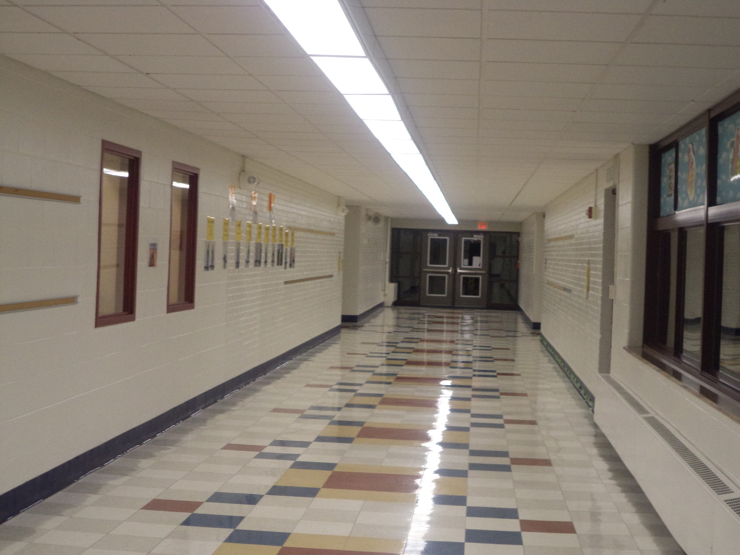
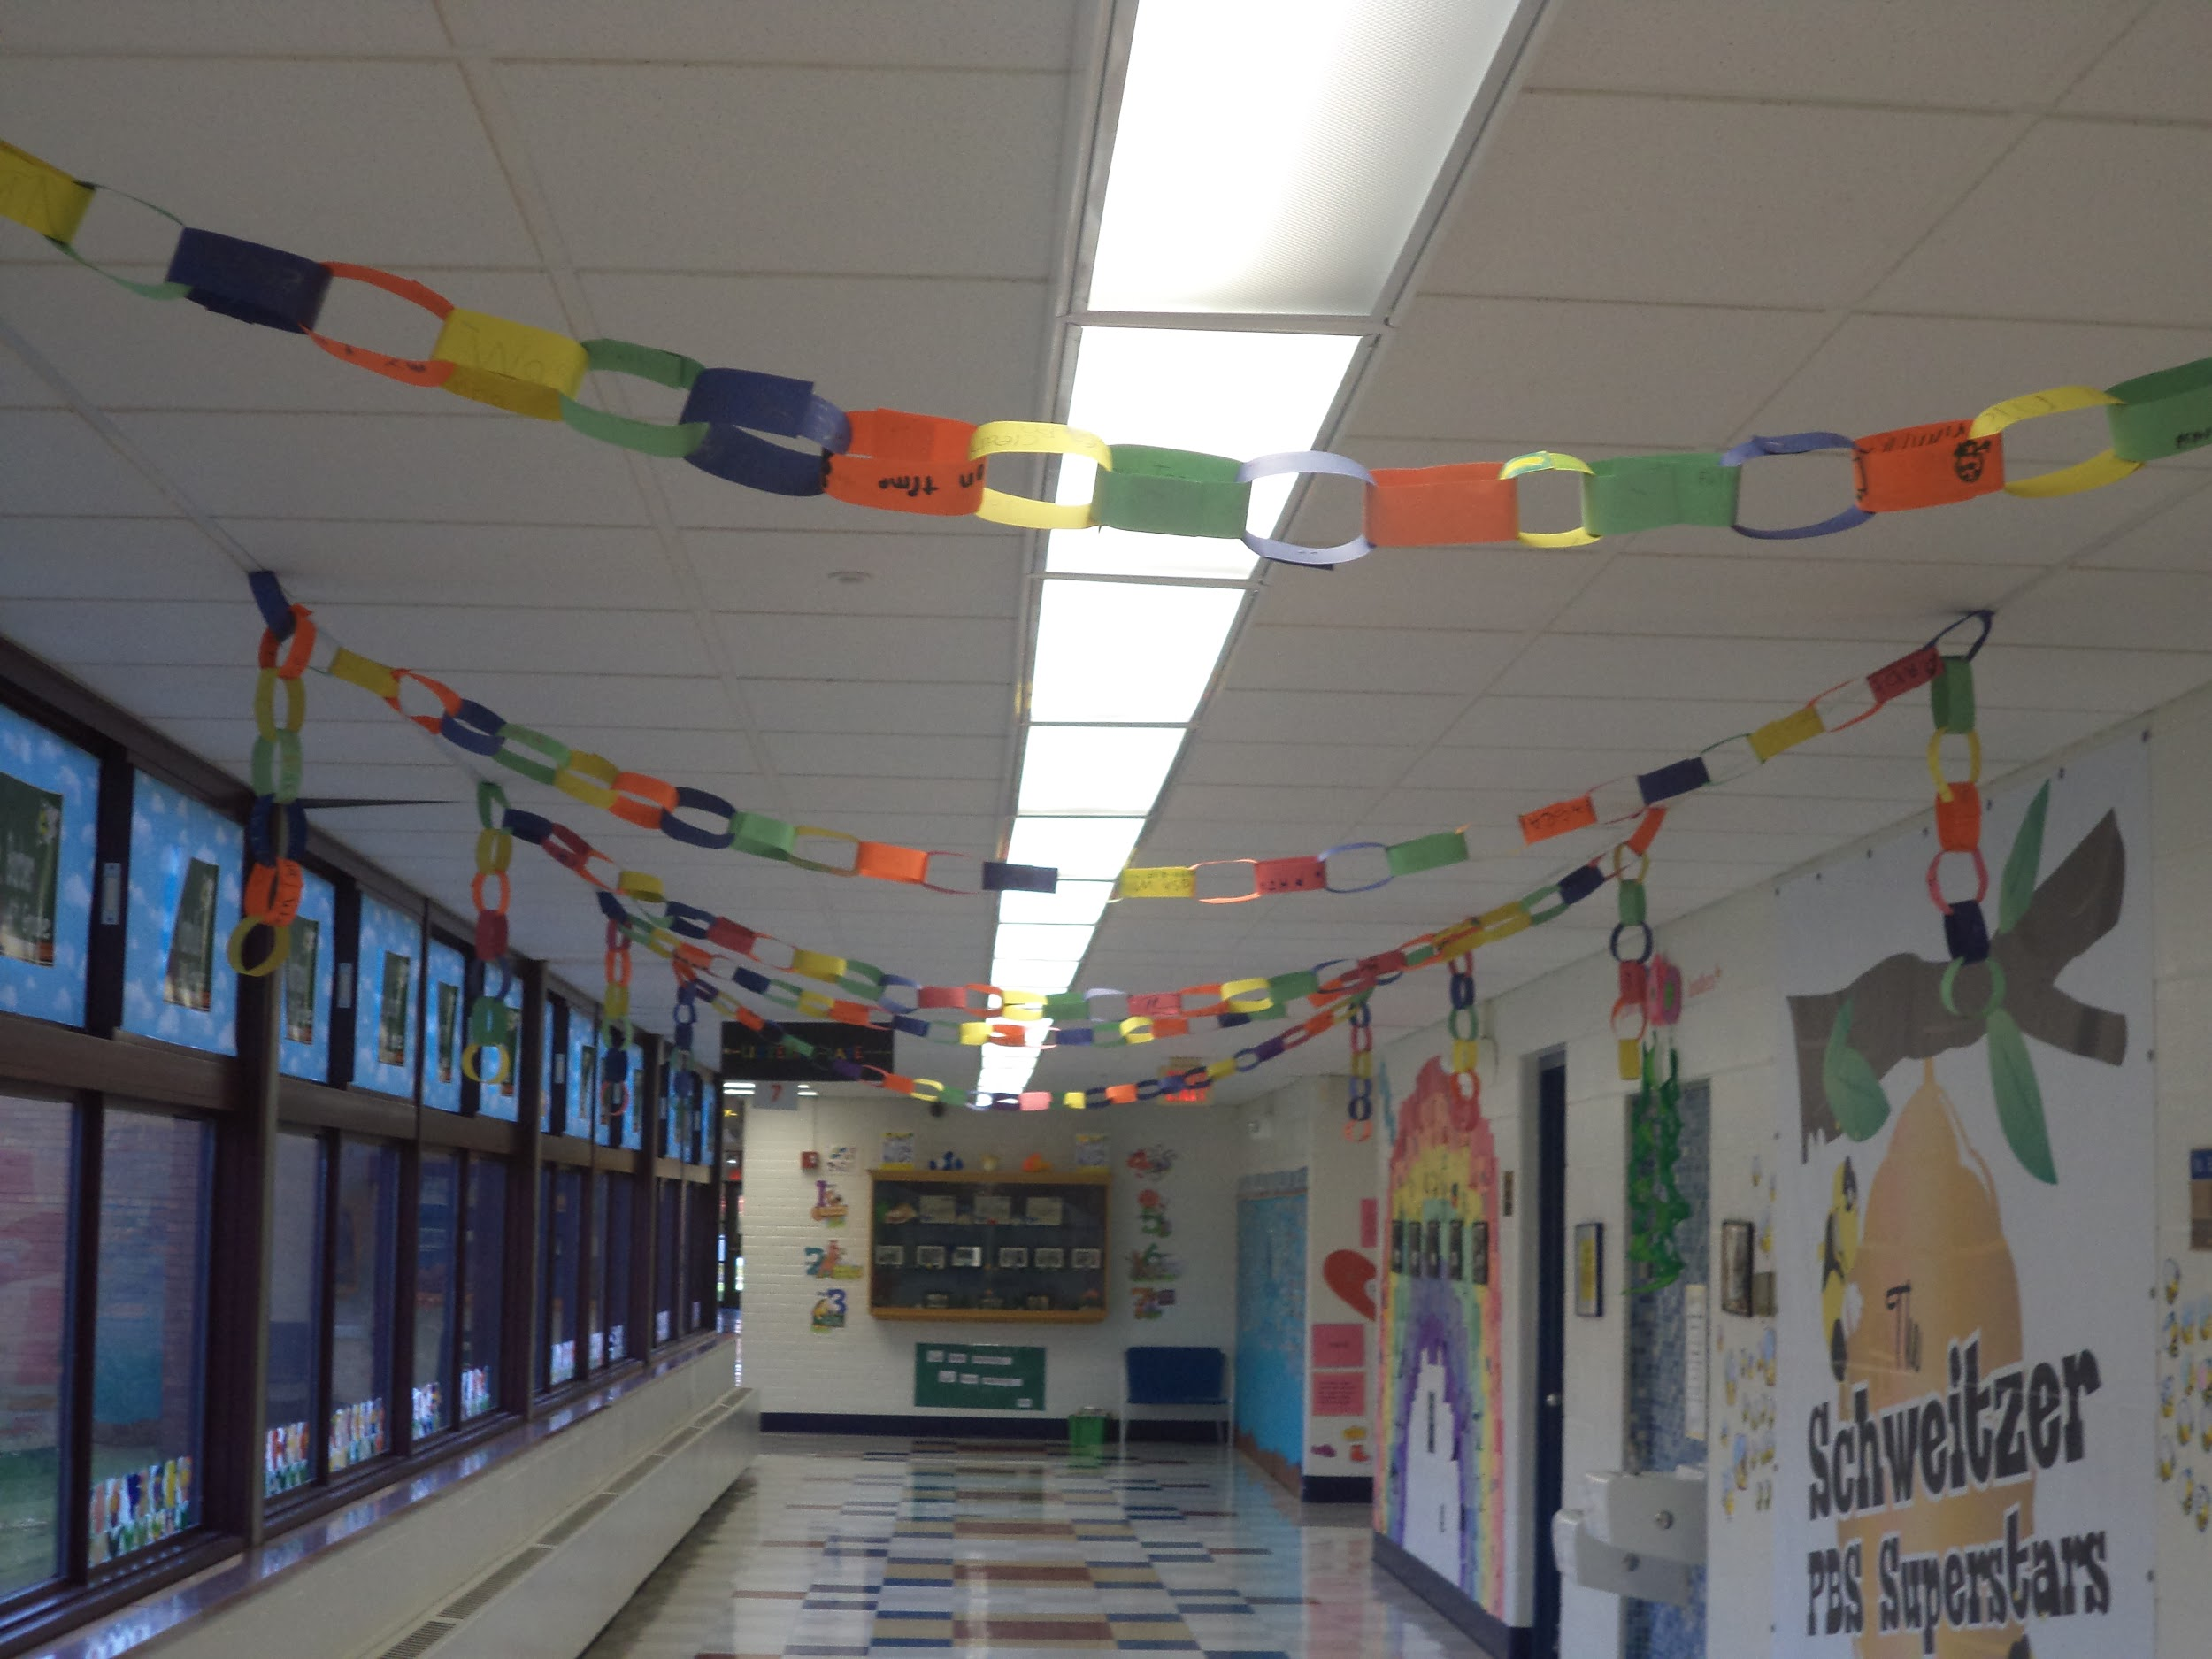
School Culture
Changes to school environment
Sharpen the Saw staff breakfasts
Awareness of how far we’ve come
Staff Calming Caddies
Staff Member of the Month
Increase of staff social outings
Celebrations
Collaborate school-wide
All staff take on leadership roles

Slide 5
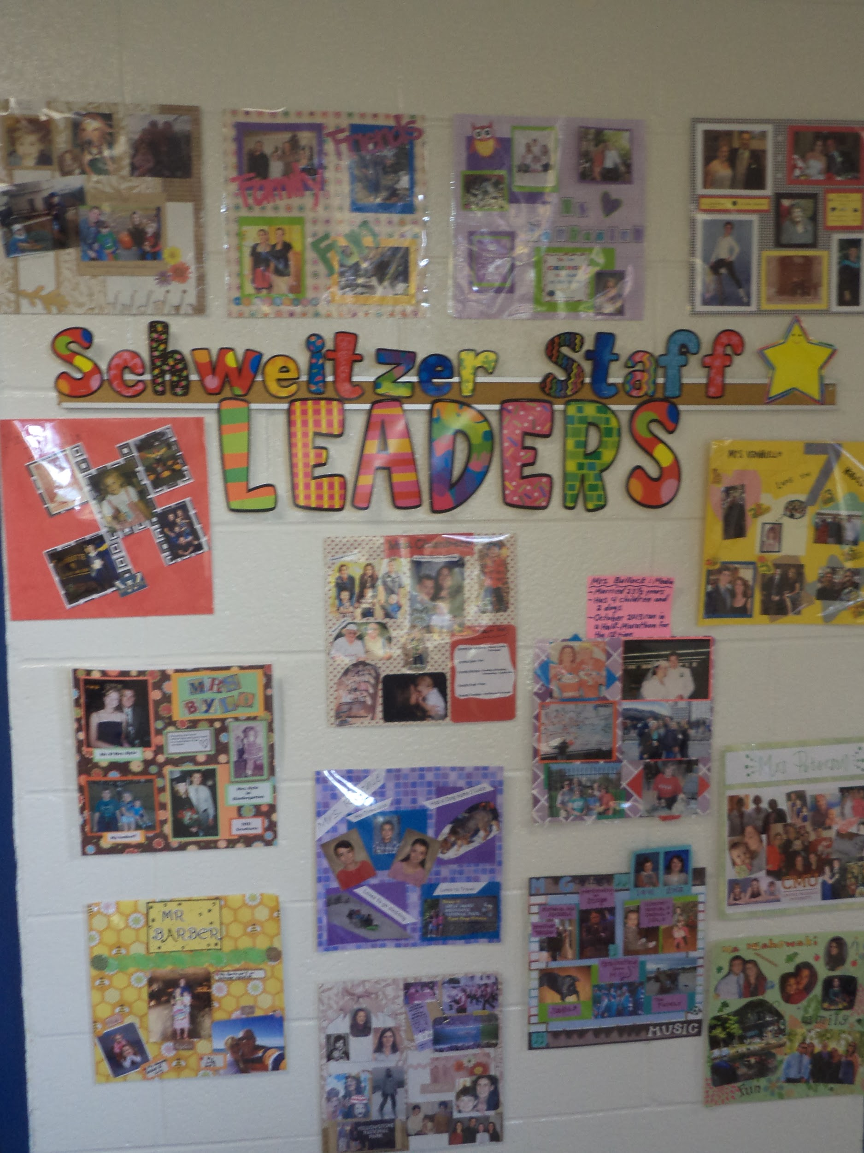
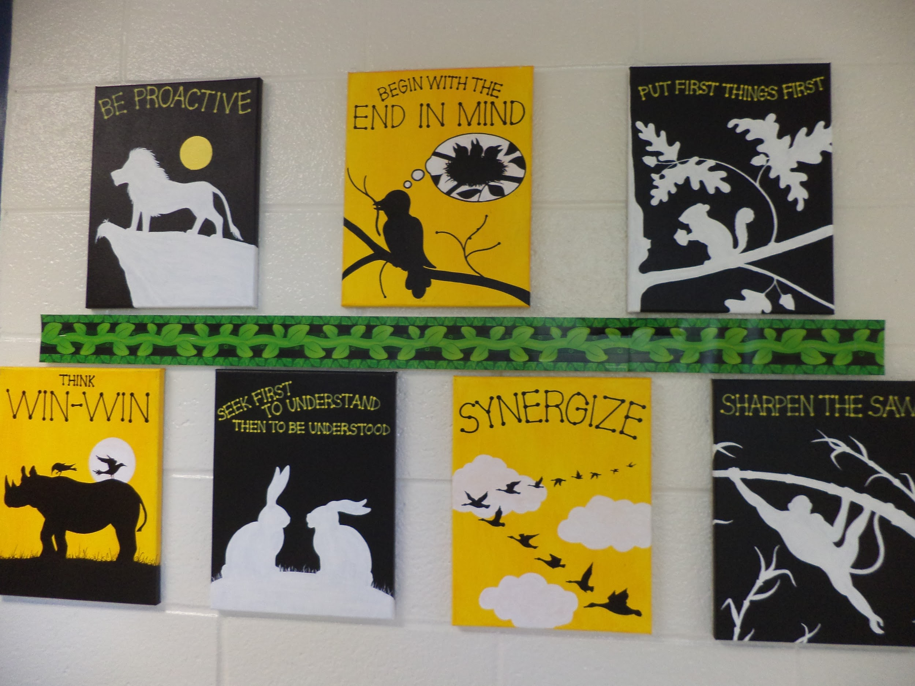
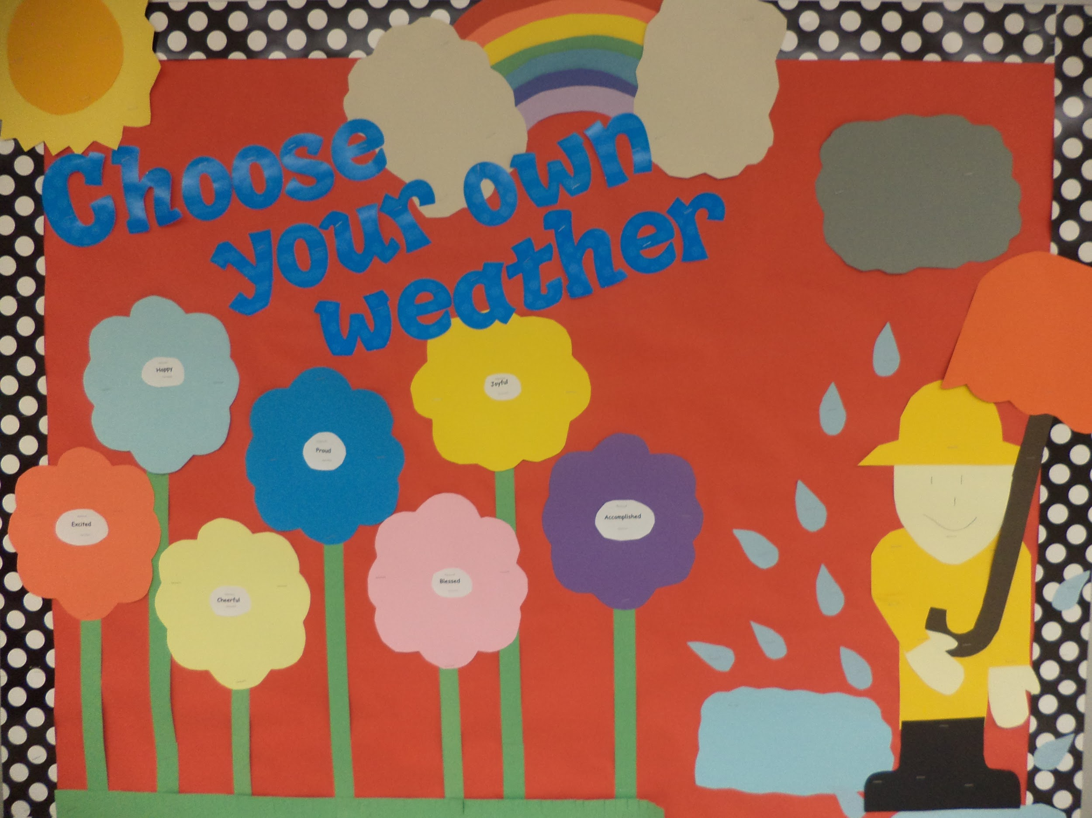

Slide 6
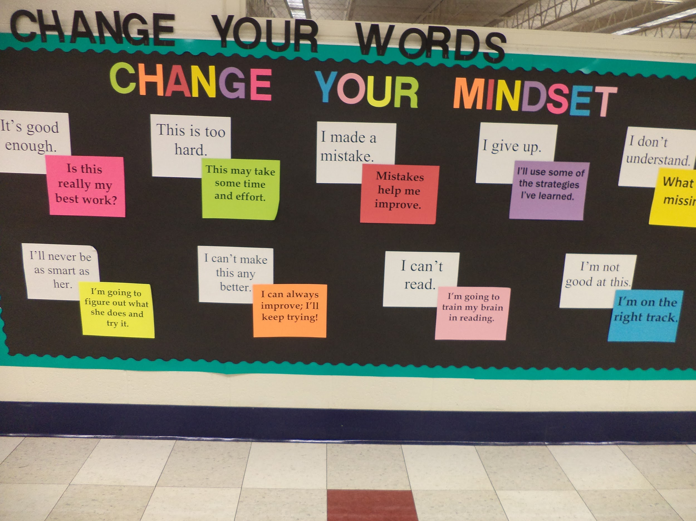

Slide 7
School-wide Projects
To improve our school environment and teach students about school expectations, 7 habits, and anti-bullying we do weekly school-wide projects for the first couple months of school.
This helps provide school community, provides a good review after coming back from the summer, and ensures all students are knowledgeable in school-wide initiatives.
Fundraisers go along with the topics being taught to raise money for PBIS and LIM programs (hat day, stuffed animal day, PJ day).

Slide 8
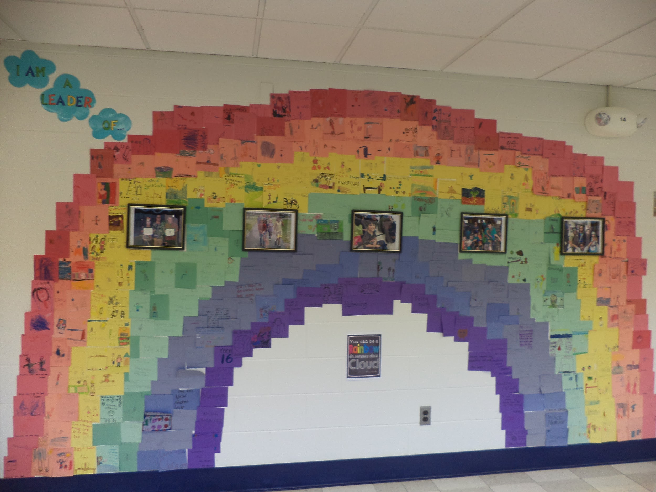
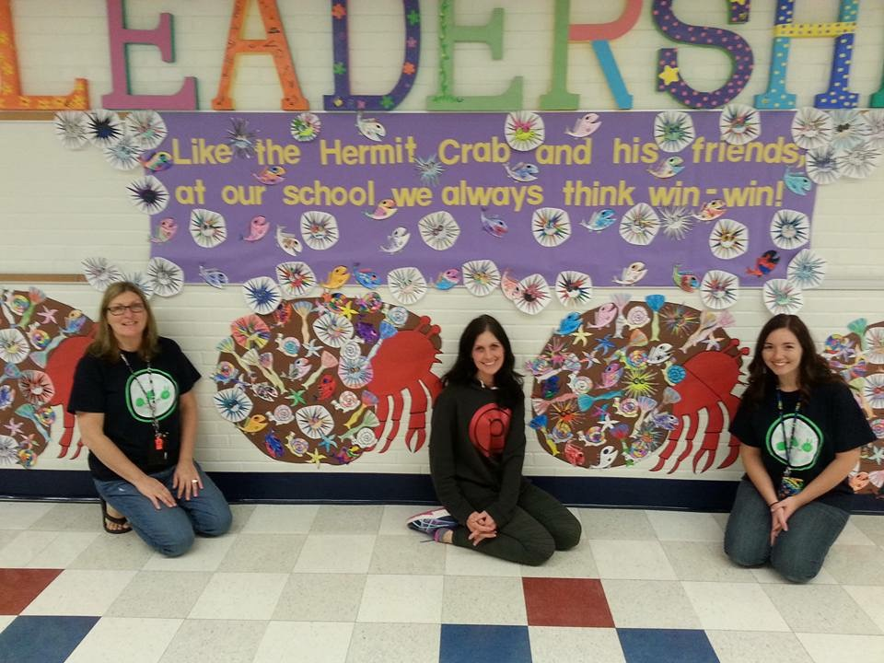
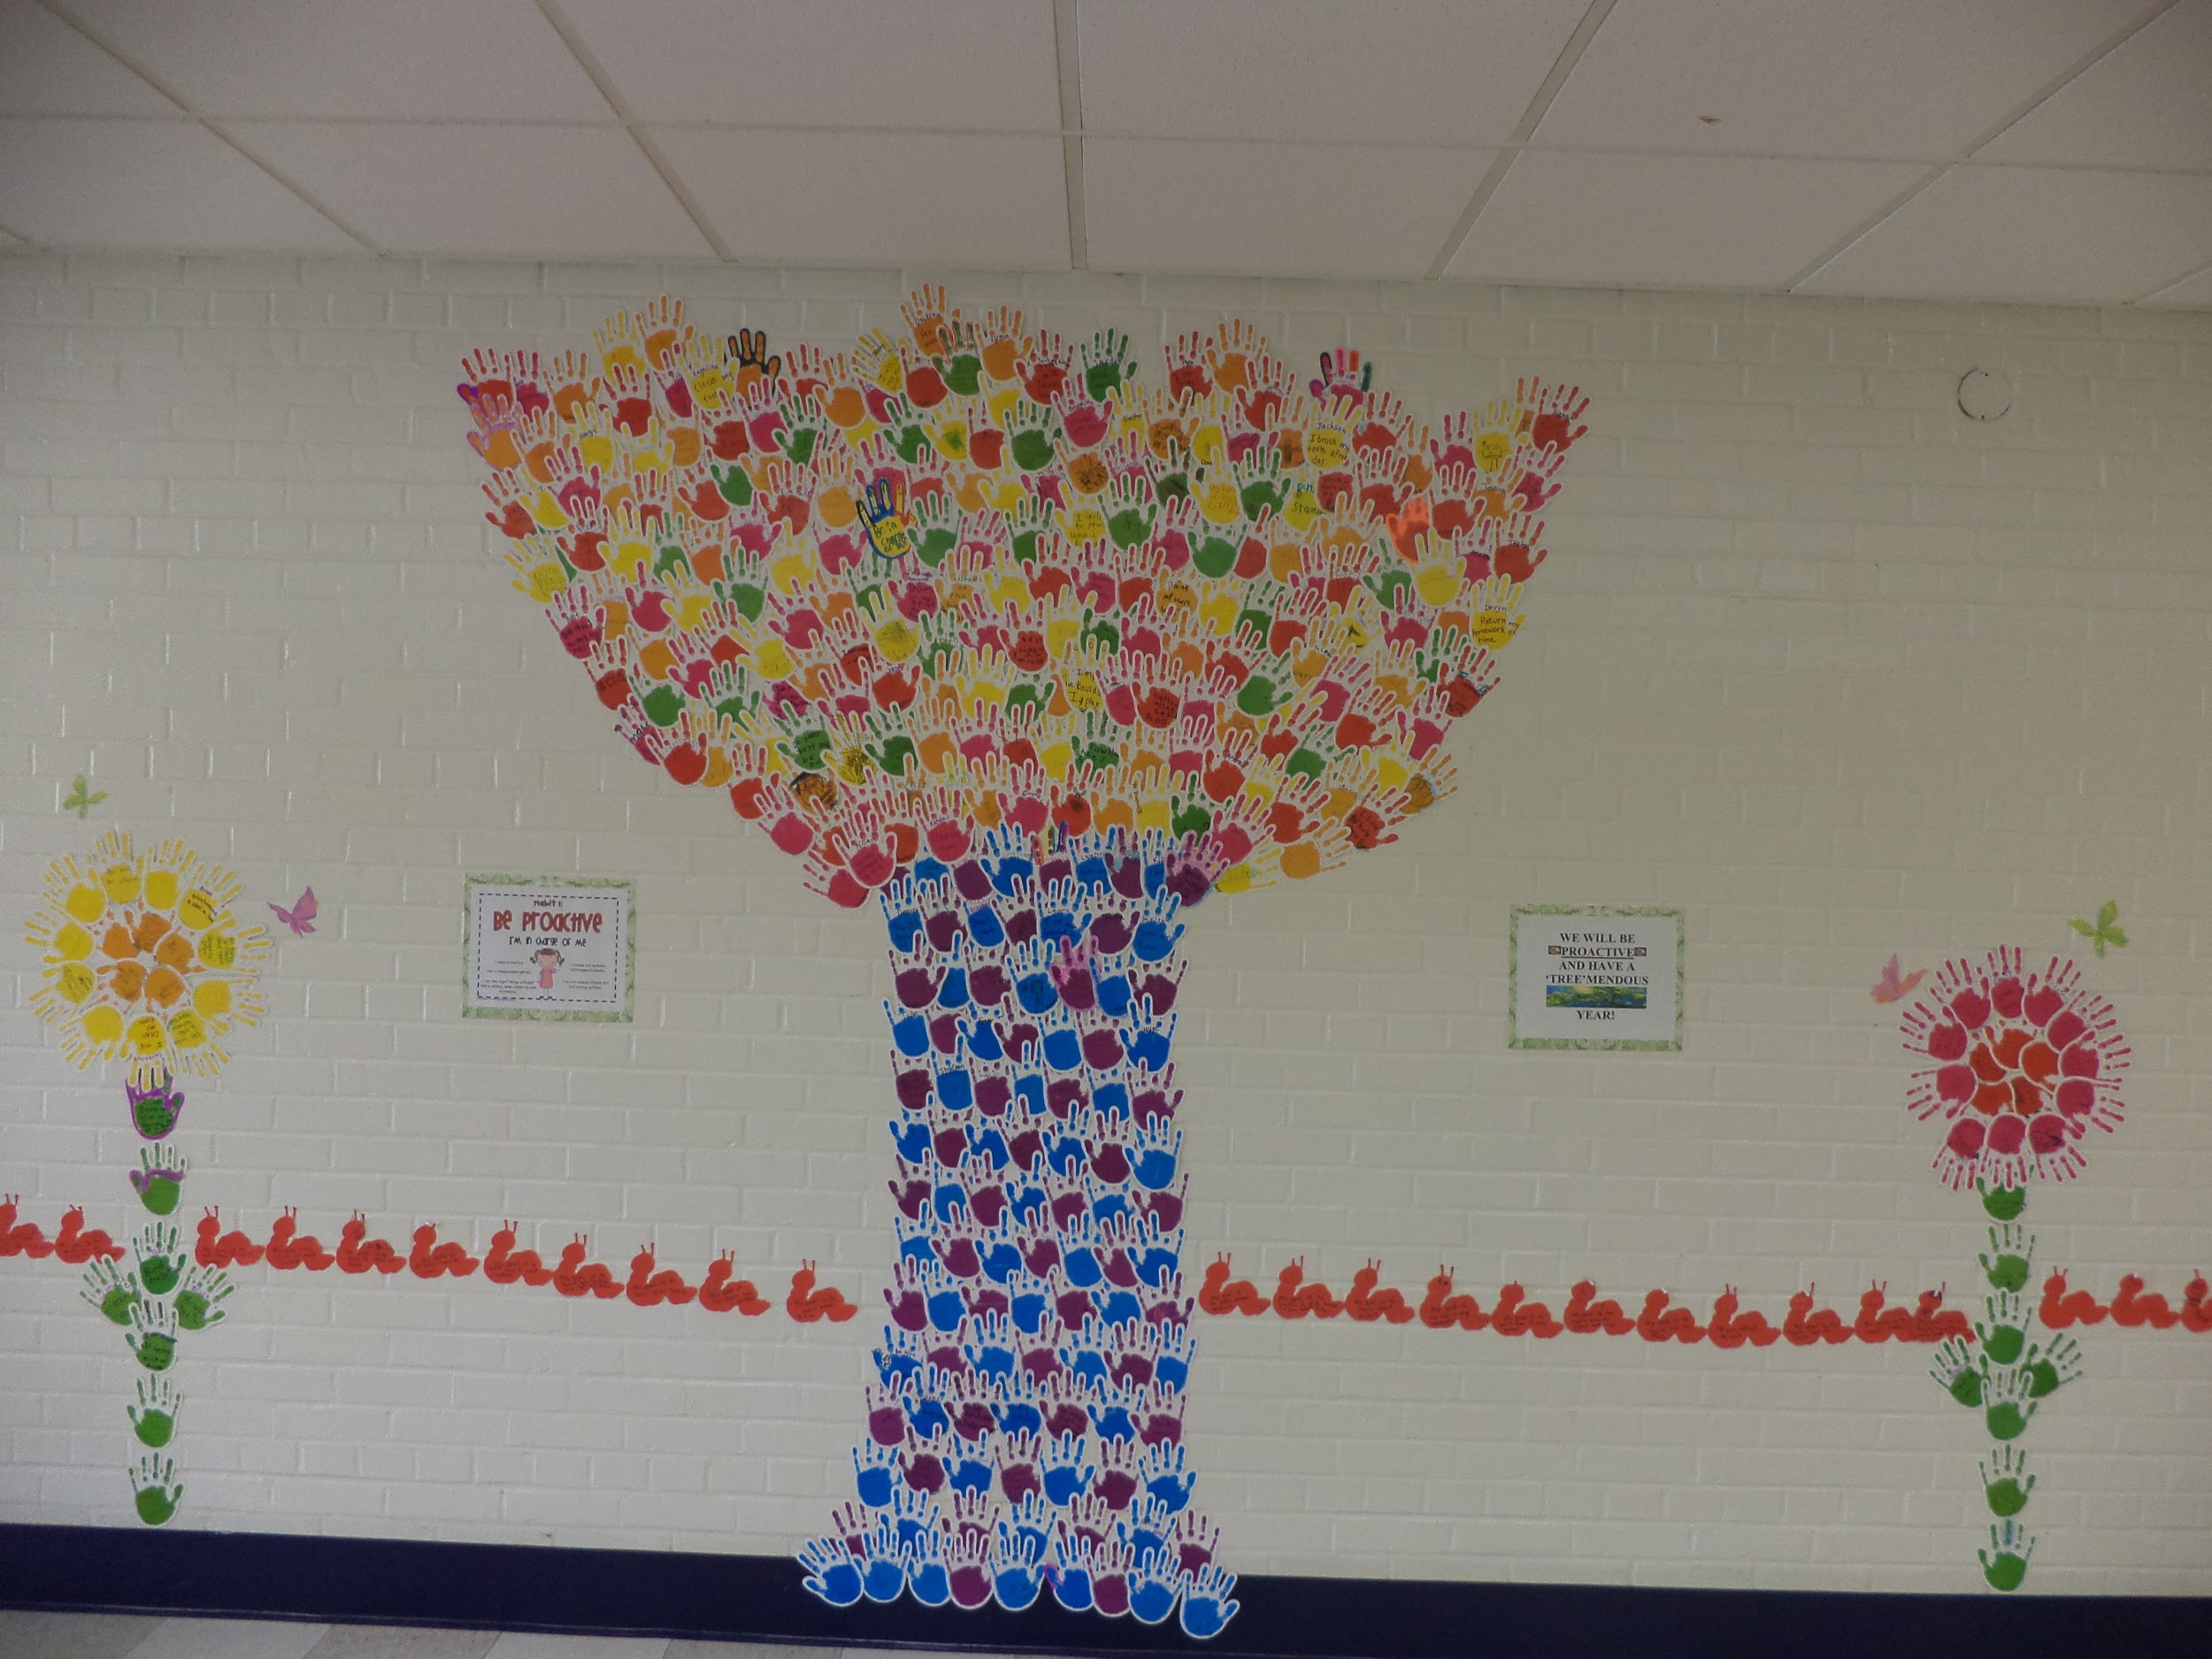

Slide 9
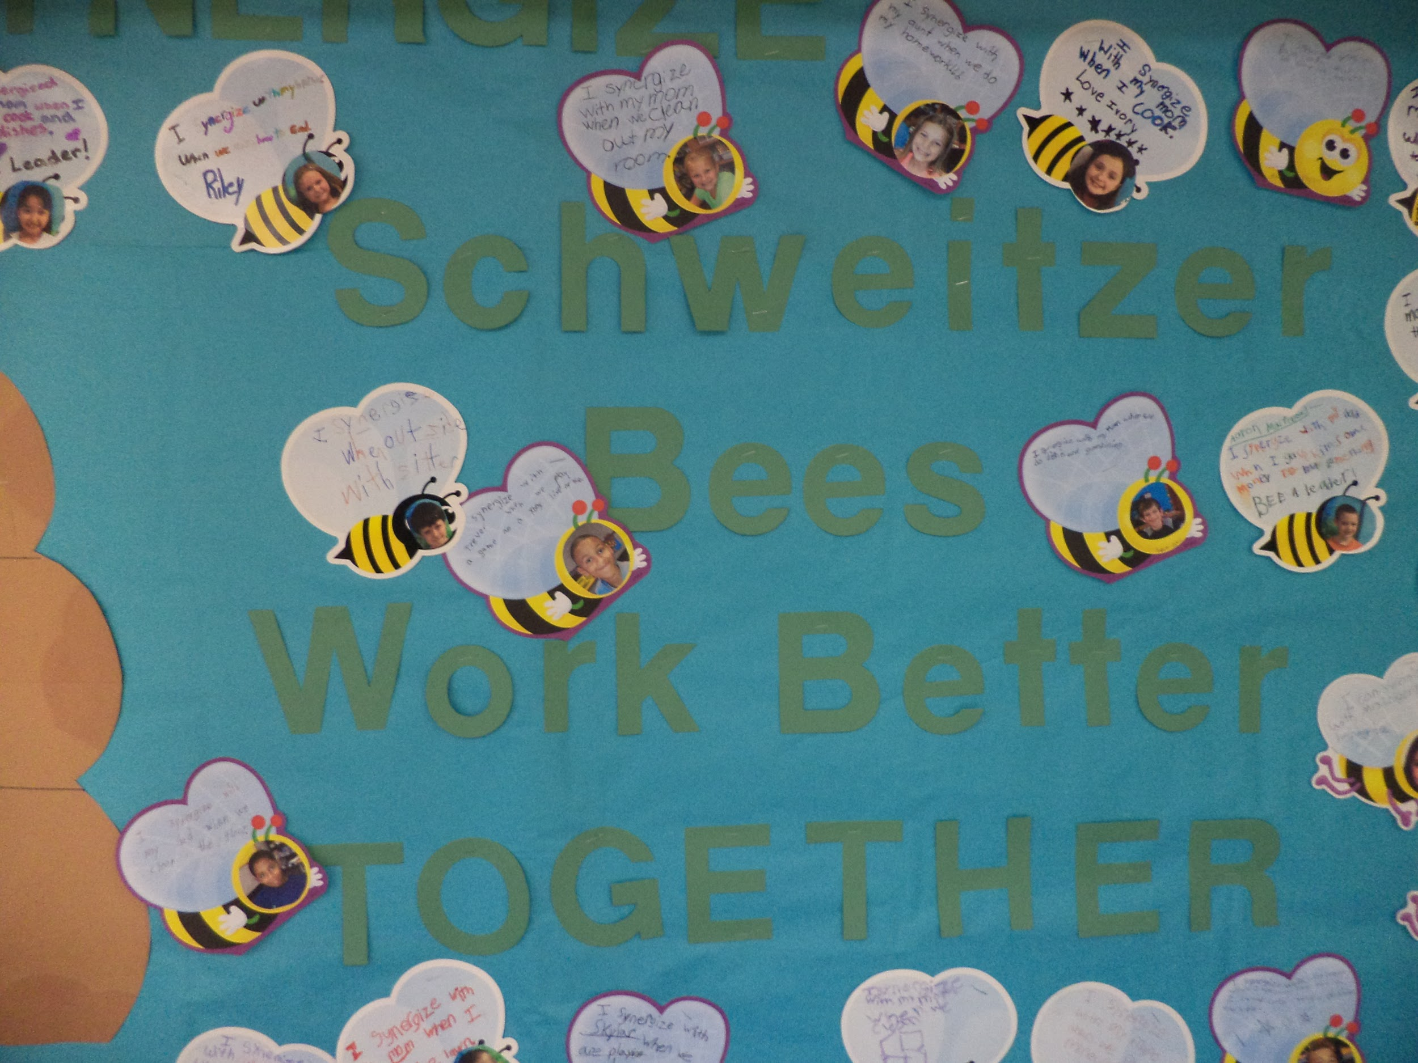
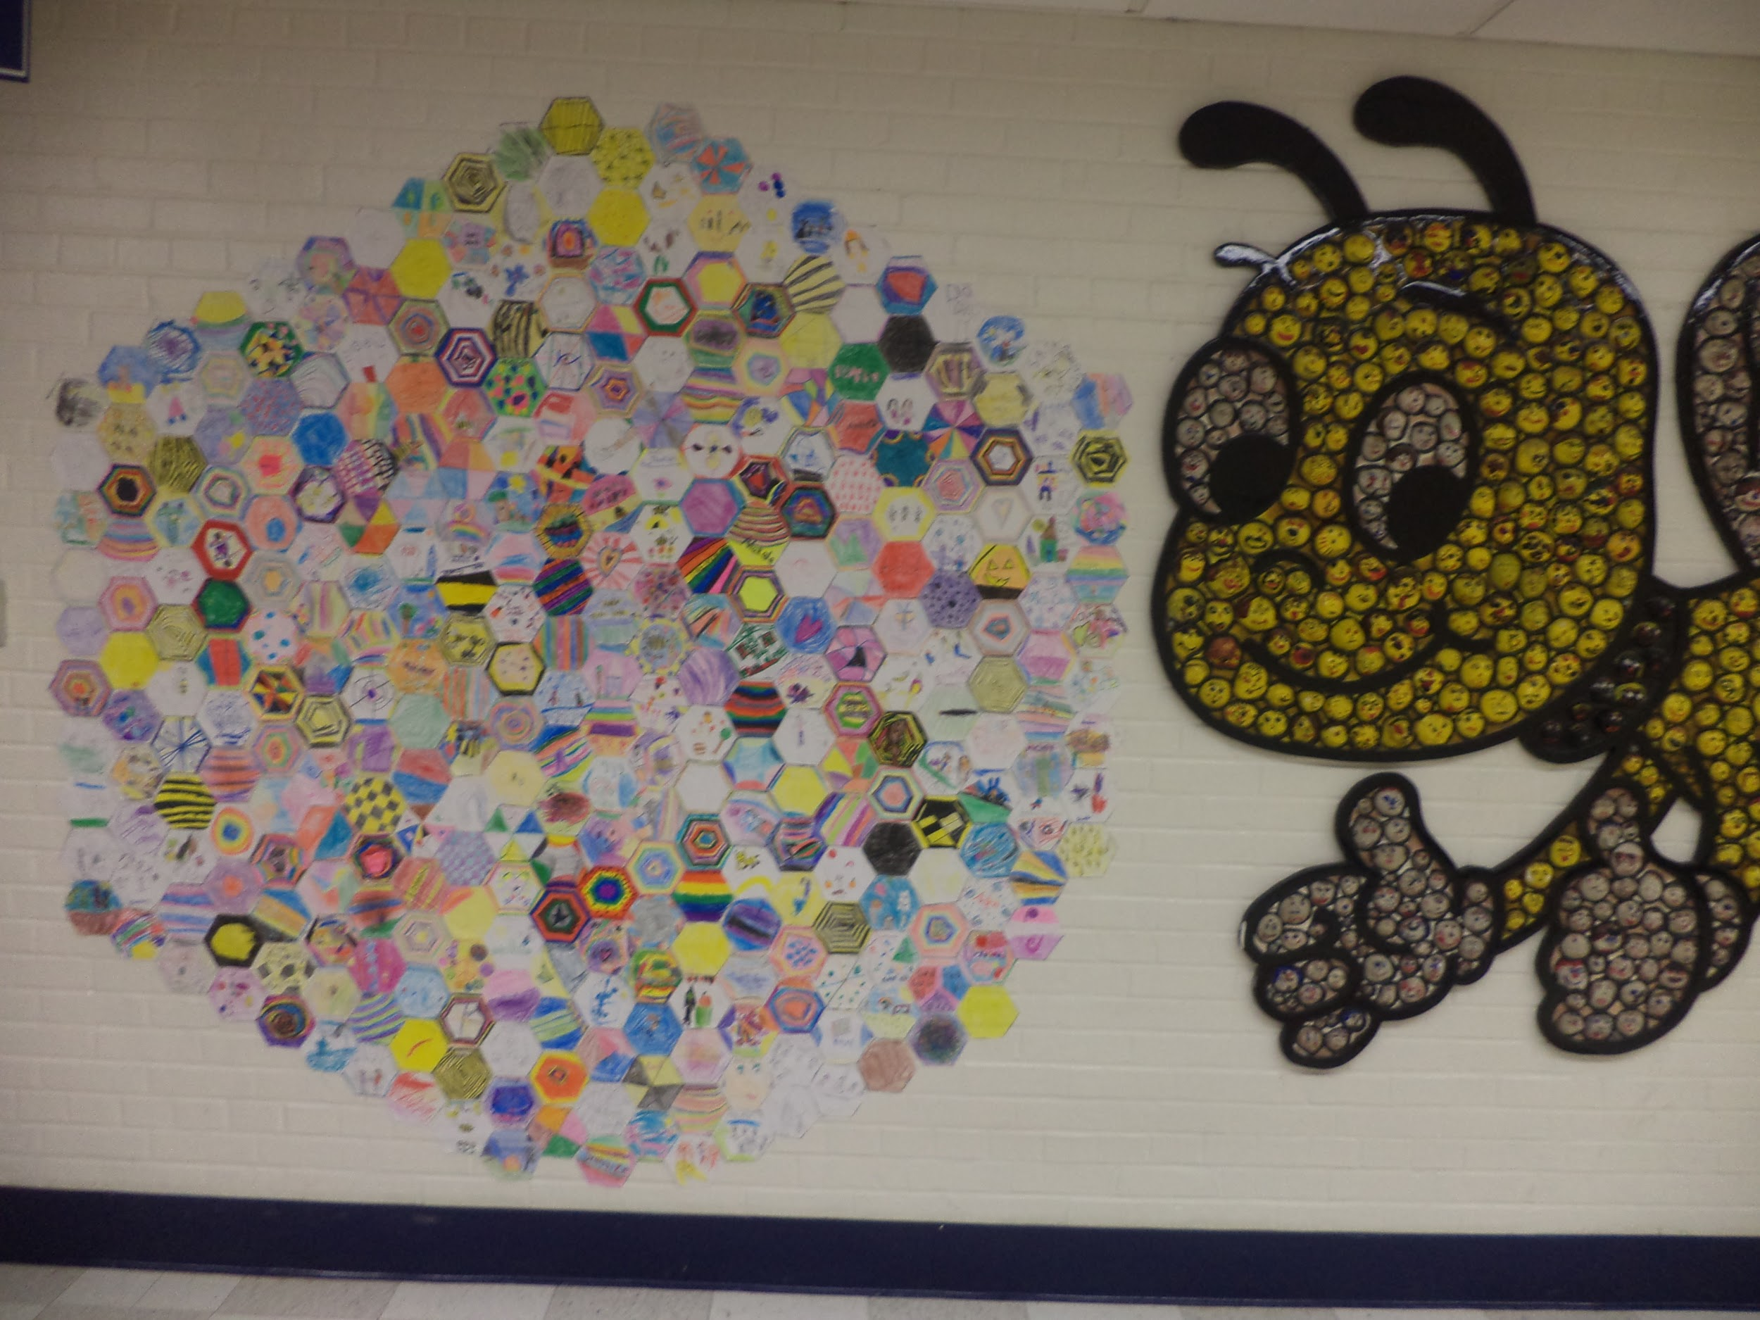
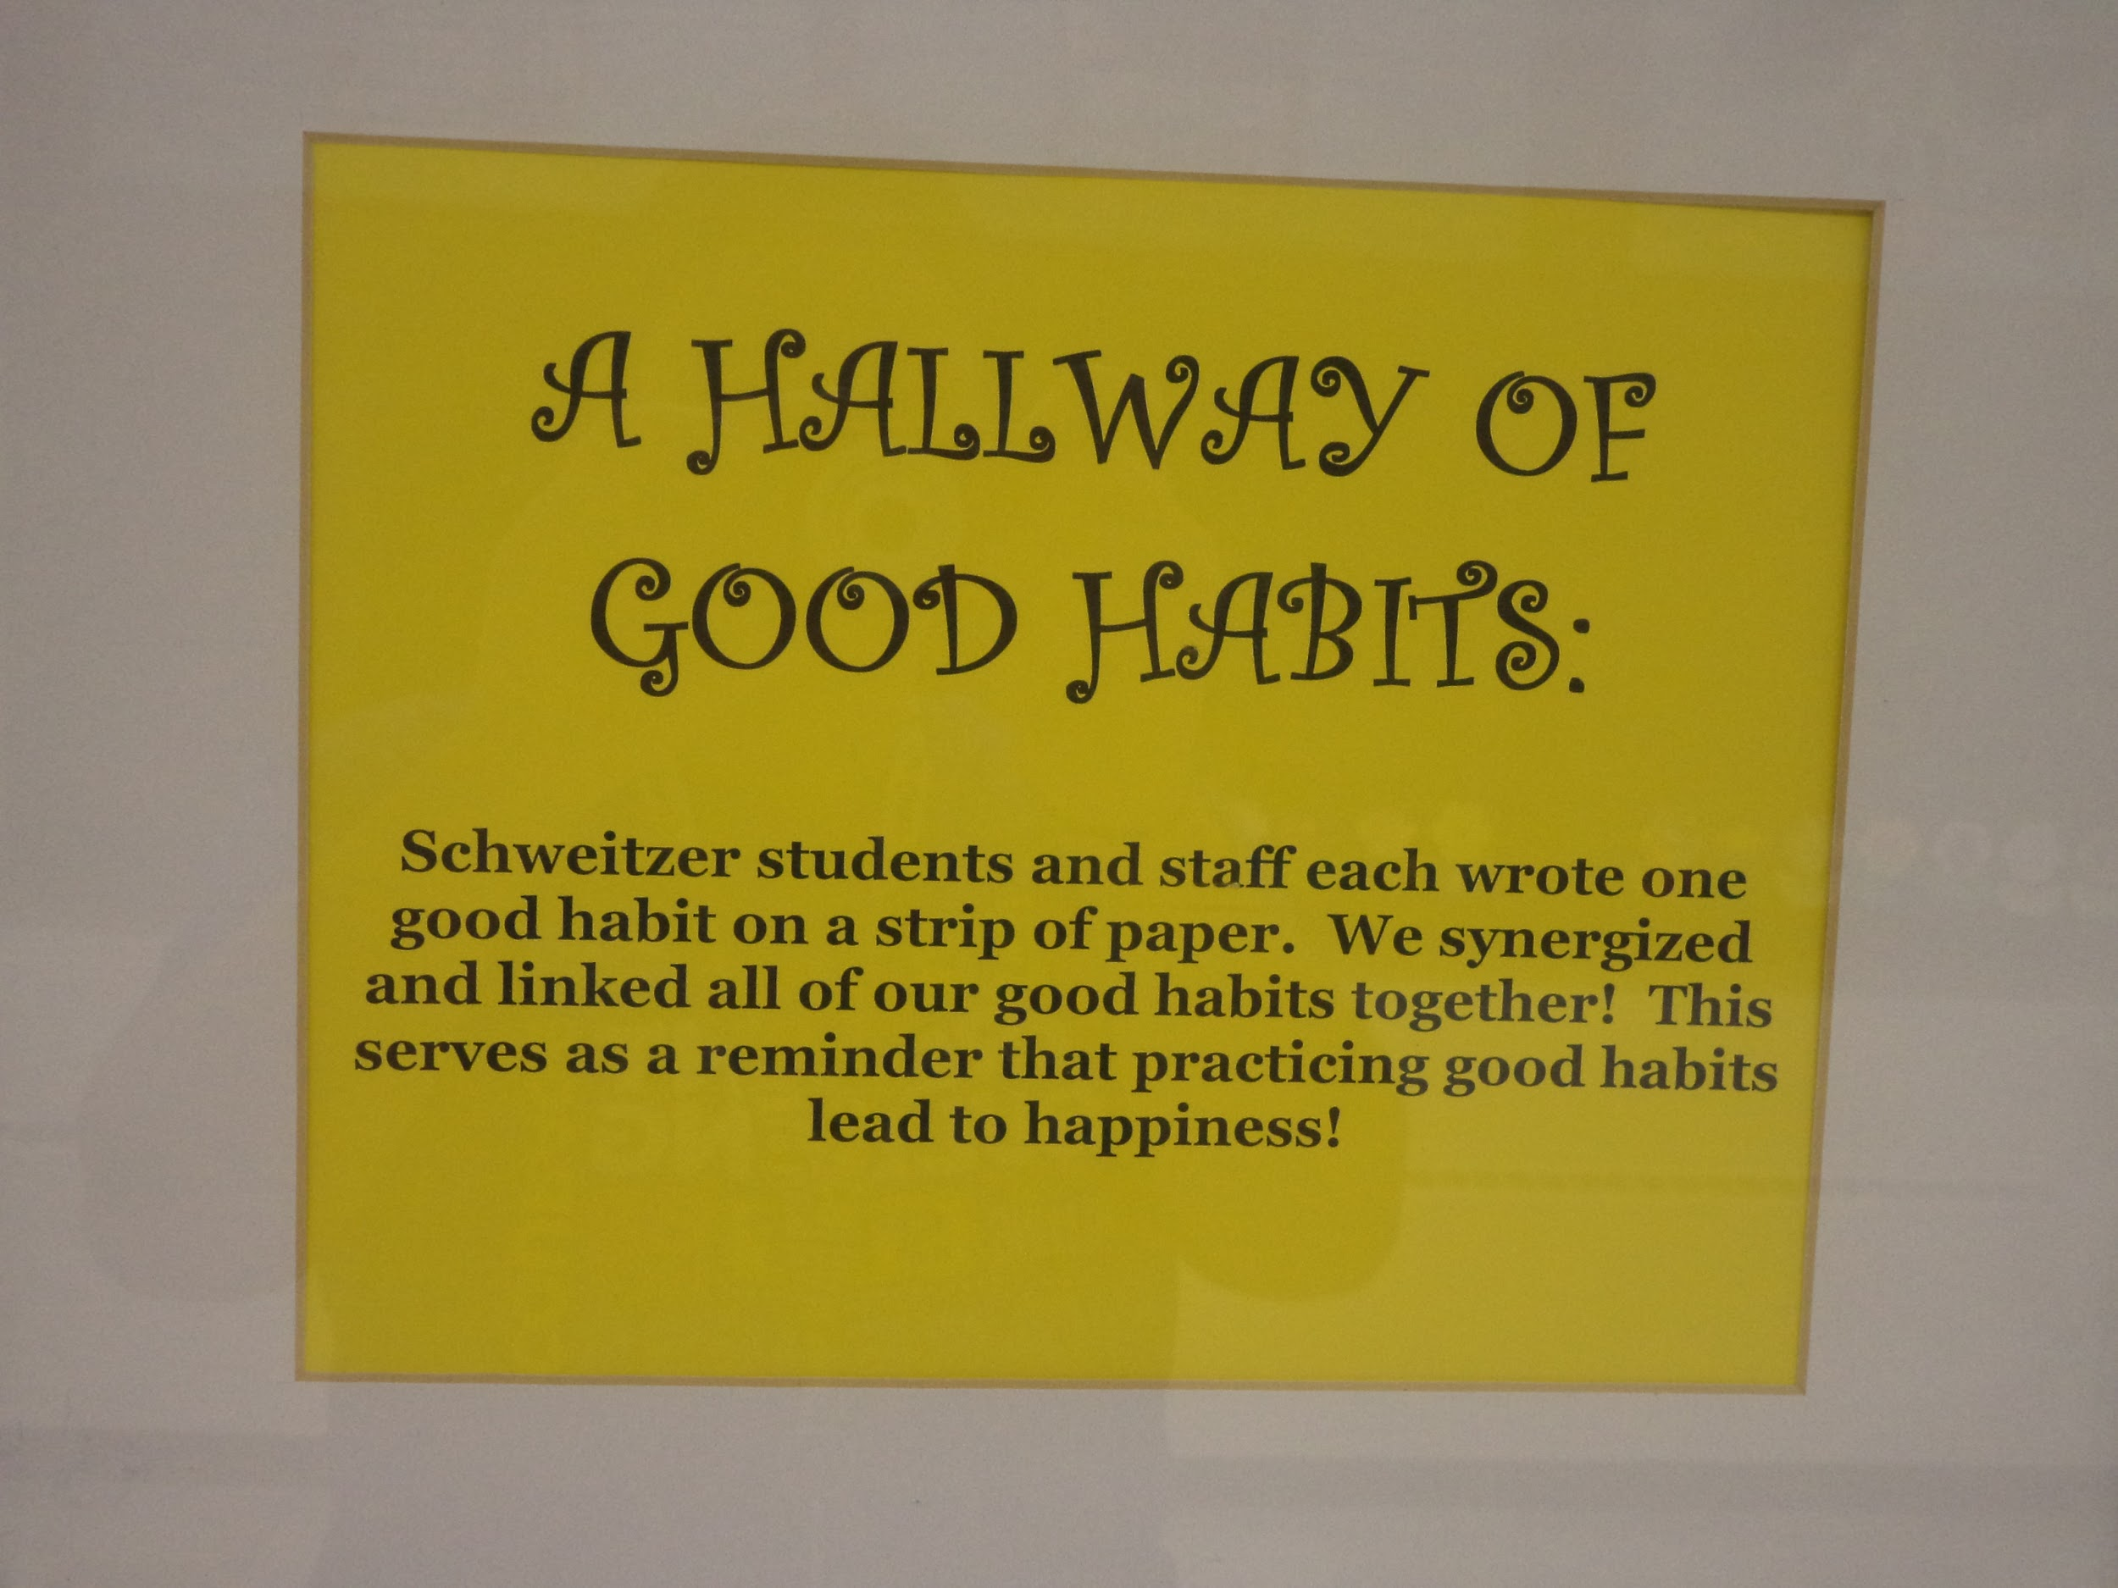

Slide 10
4:1
Positive Contact Logs 2x a year
Greet all students at the door (student leadership position in some classes)
Purple Superstar
-teachers track their superstar data
Groups and clubs (Upstander Association, Student Newspaper, Morning Announcements, Student Lighthouse Team, Environment Club, Service and Safety Squad, School Play, Talent Show, Classroom Leadership Roles, Leadership Day Roles)
Staff Mentors (Tier II Intervention)

Slide 11
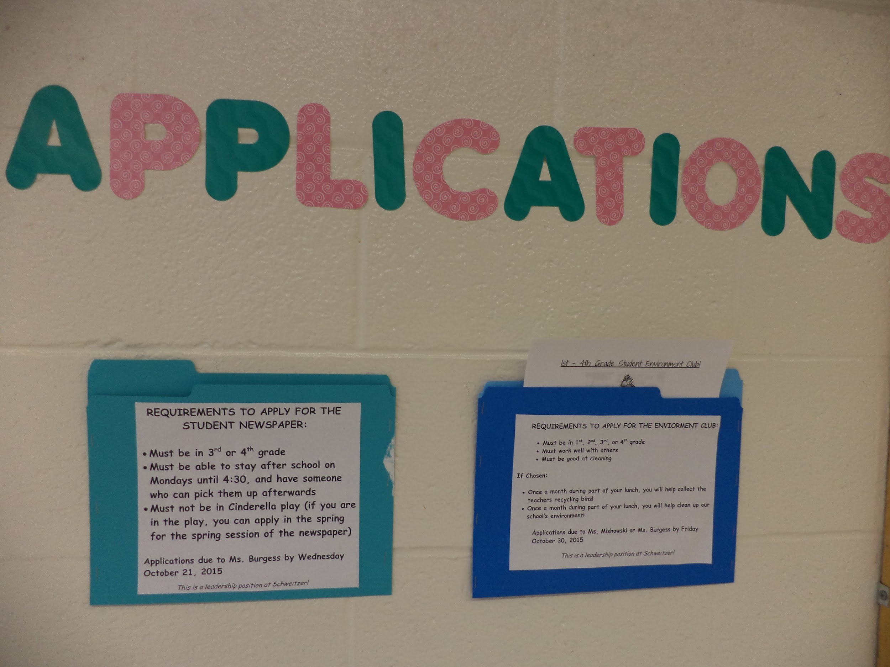
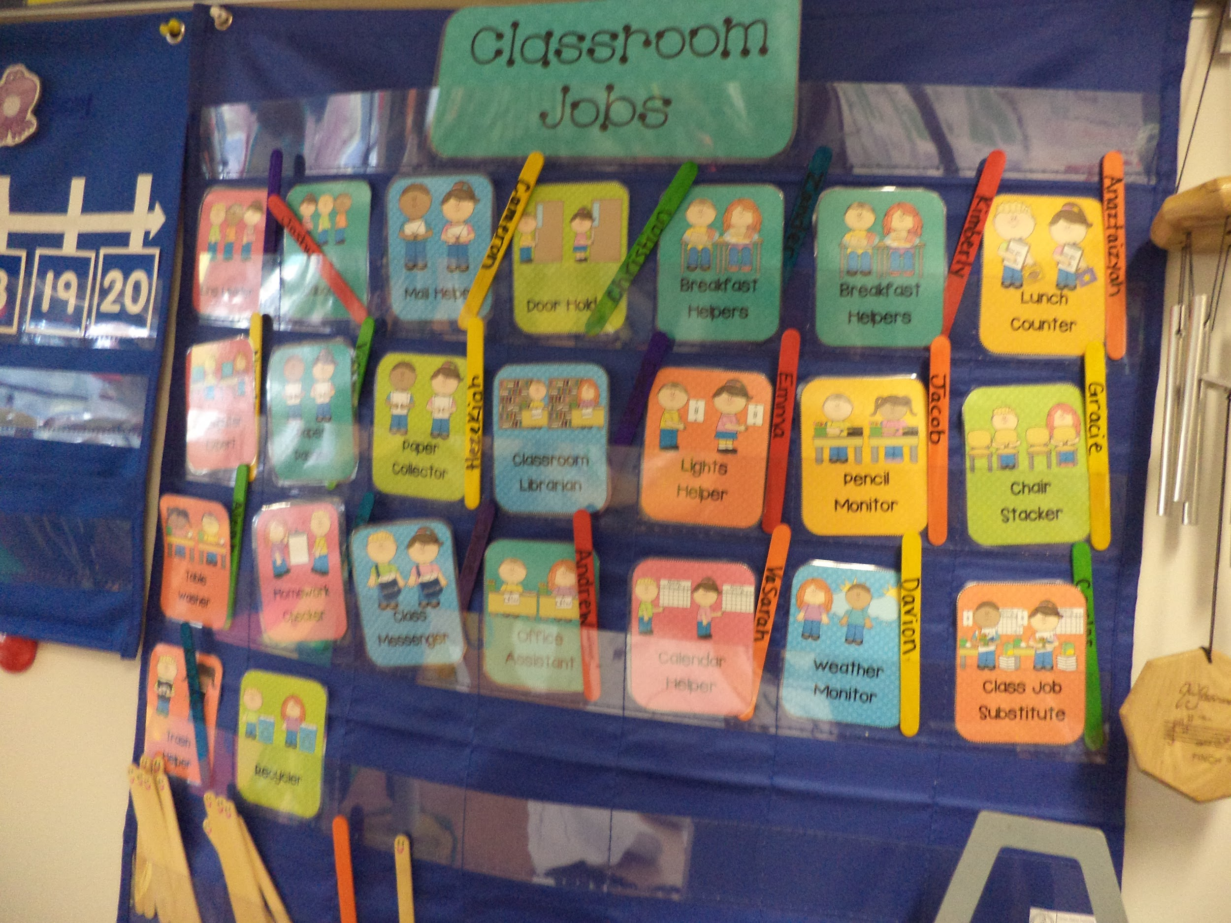
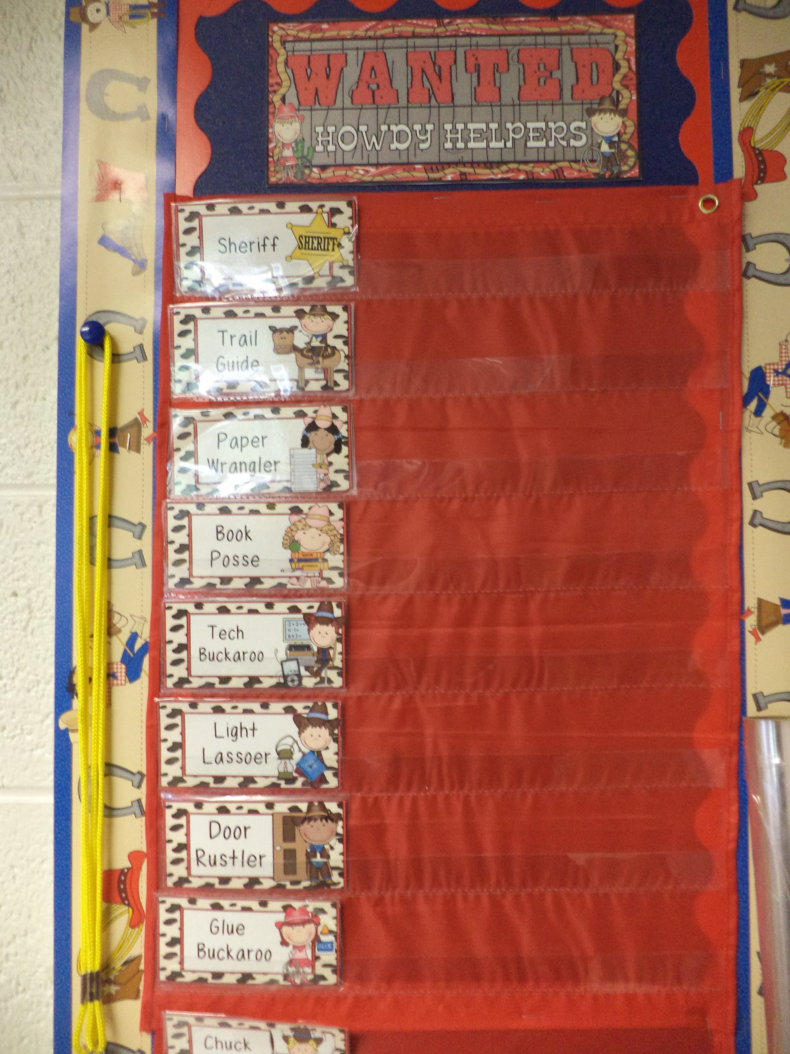
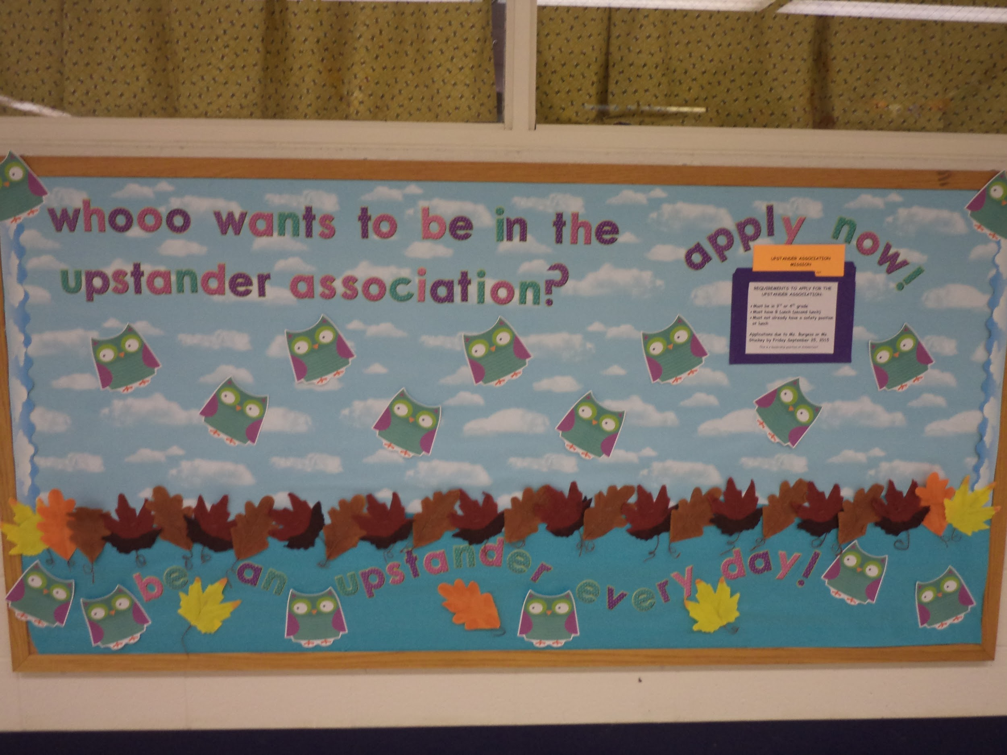
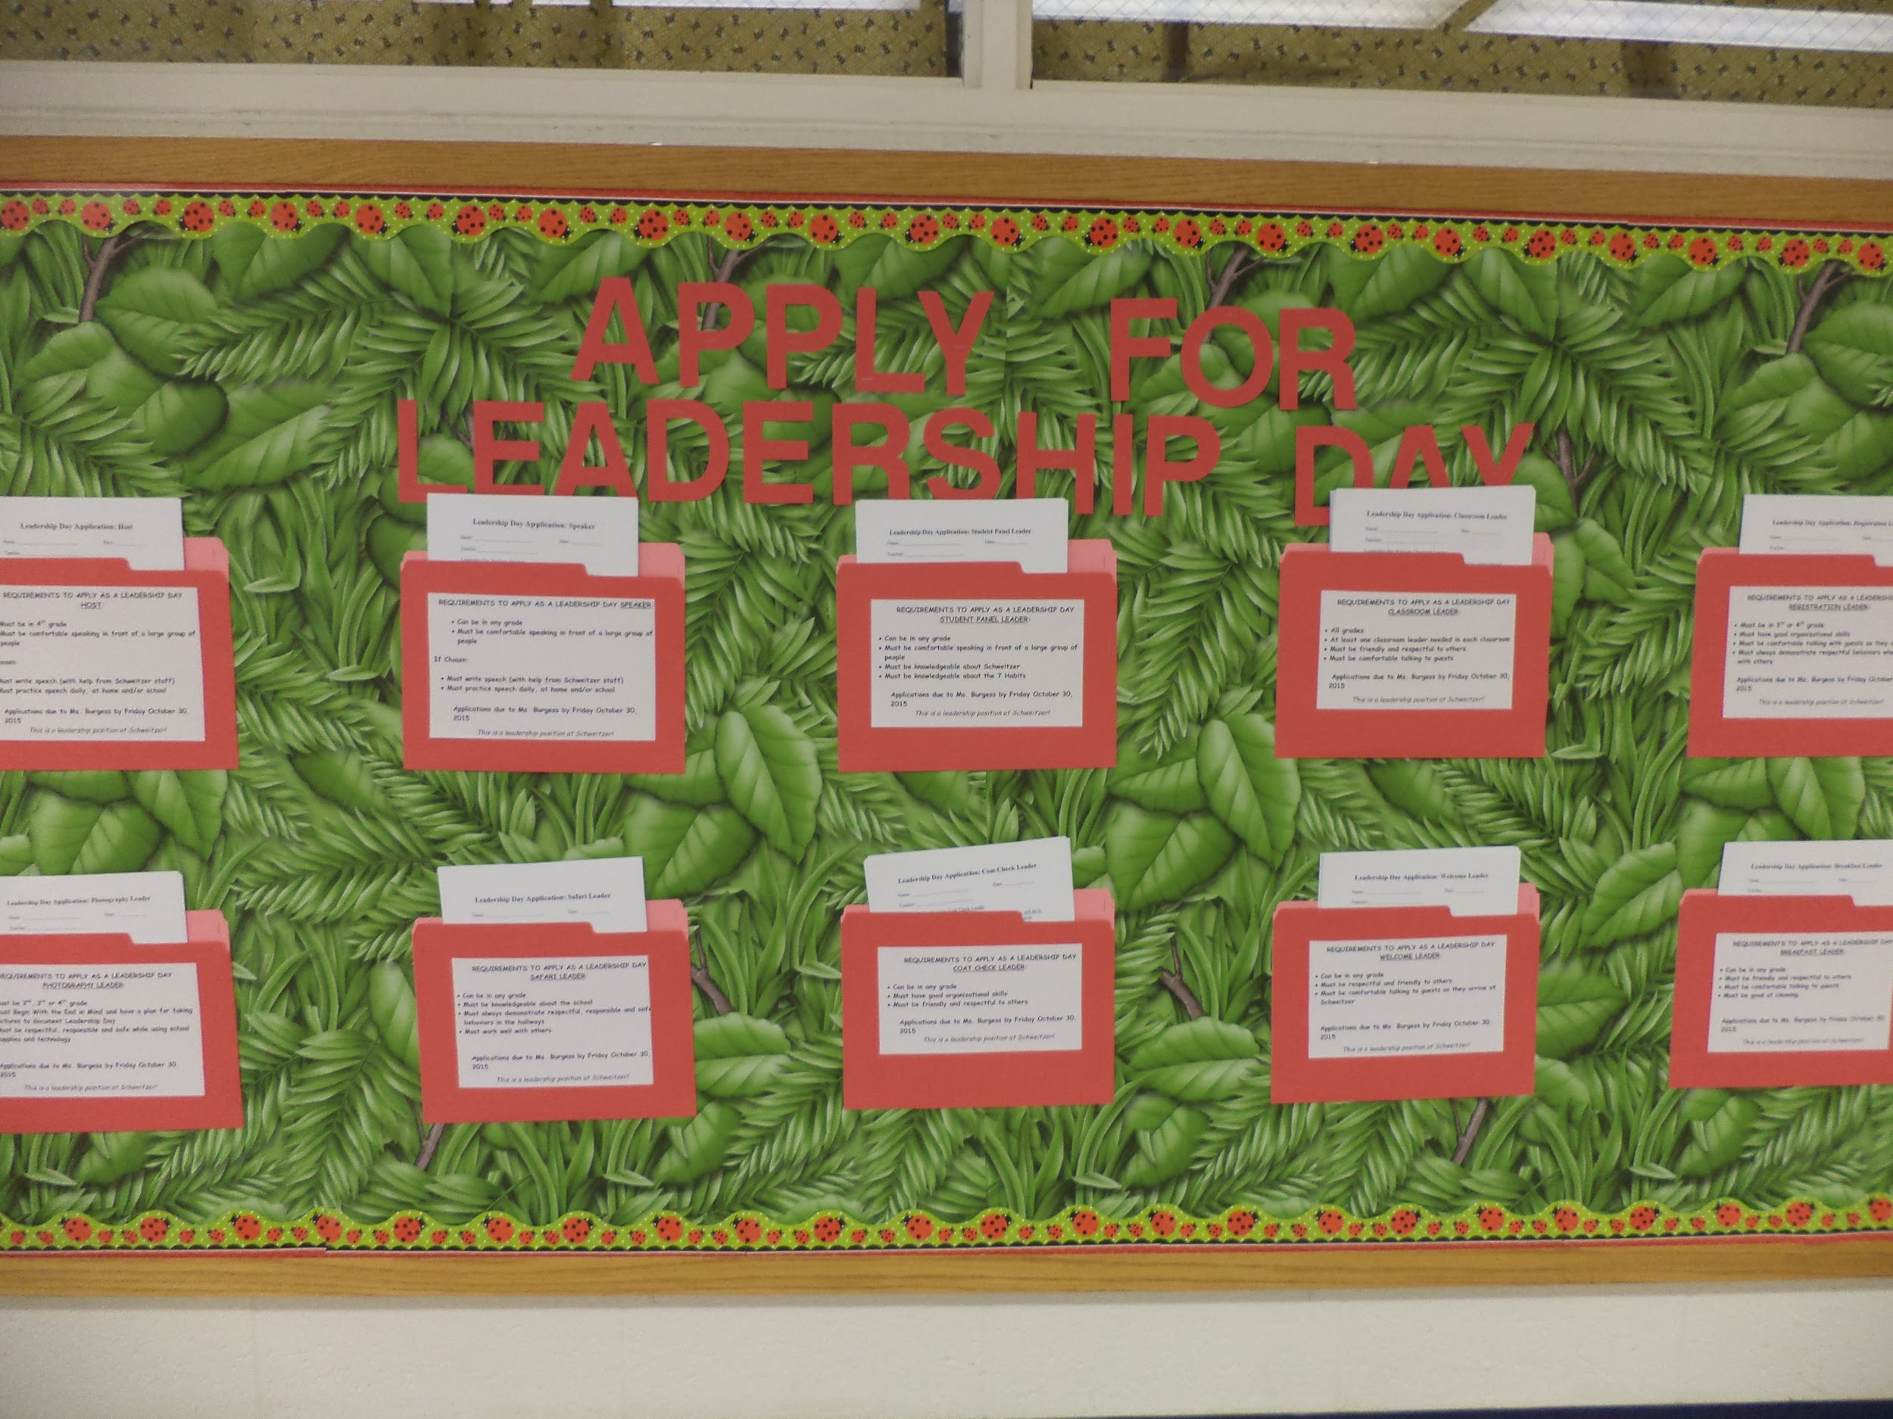
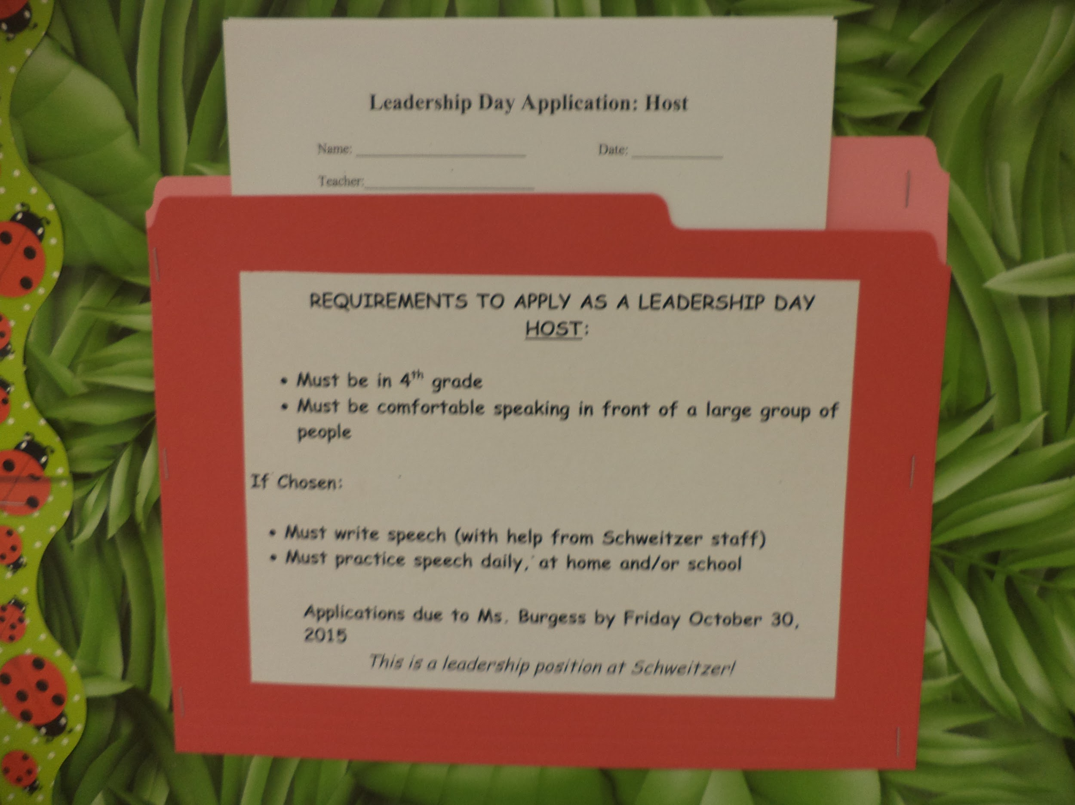

Slide 12
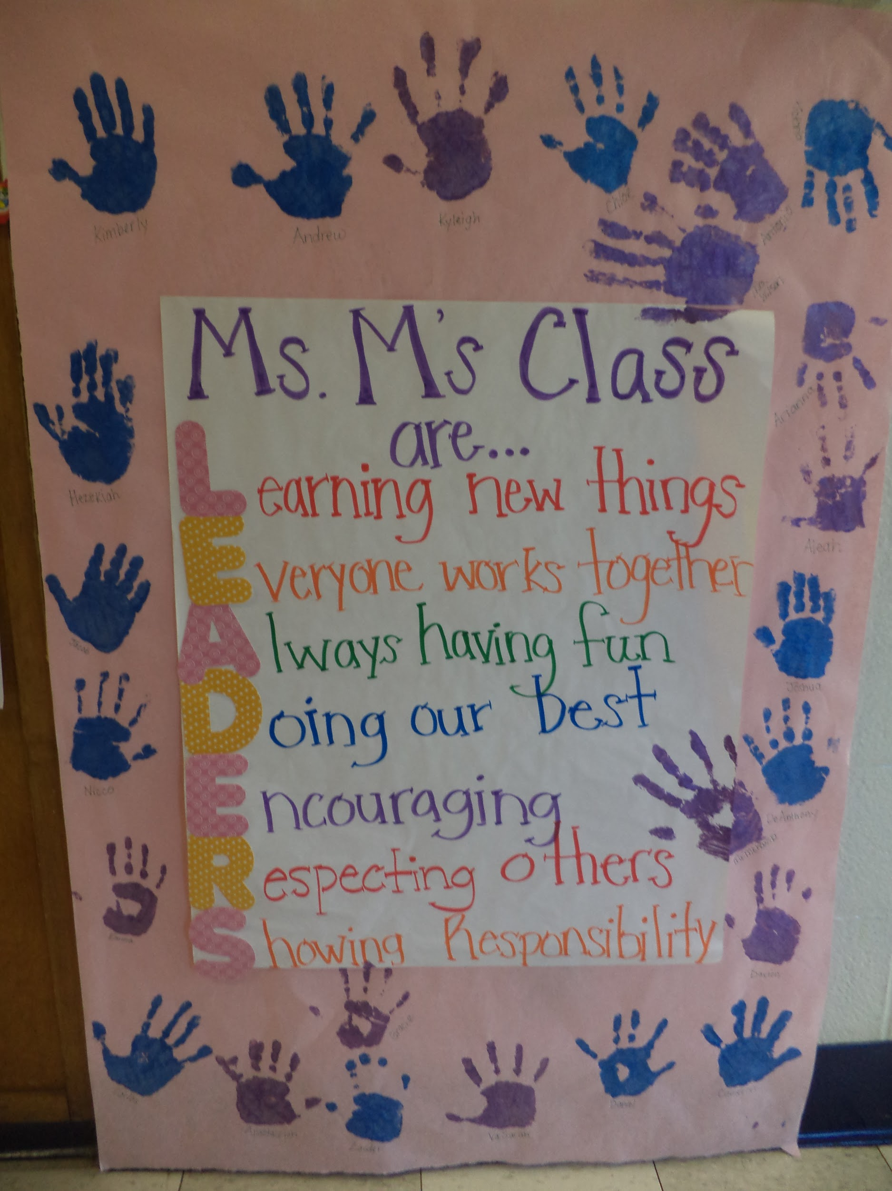
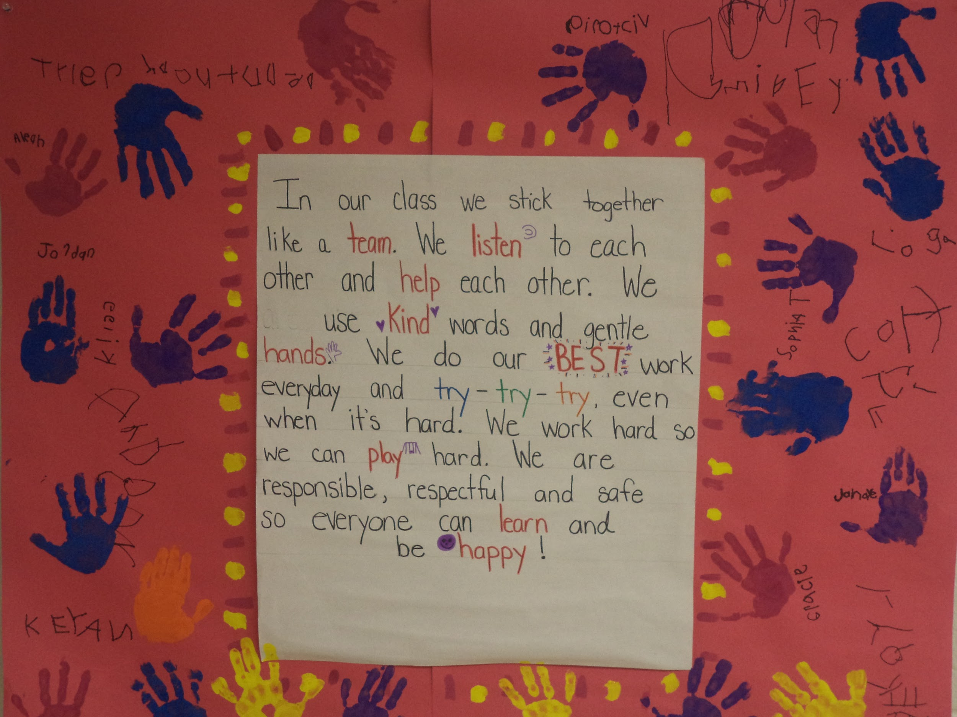
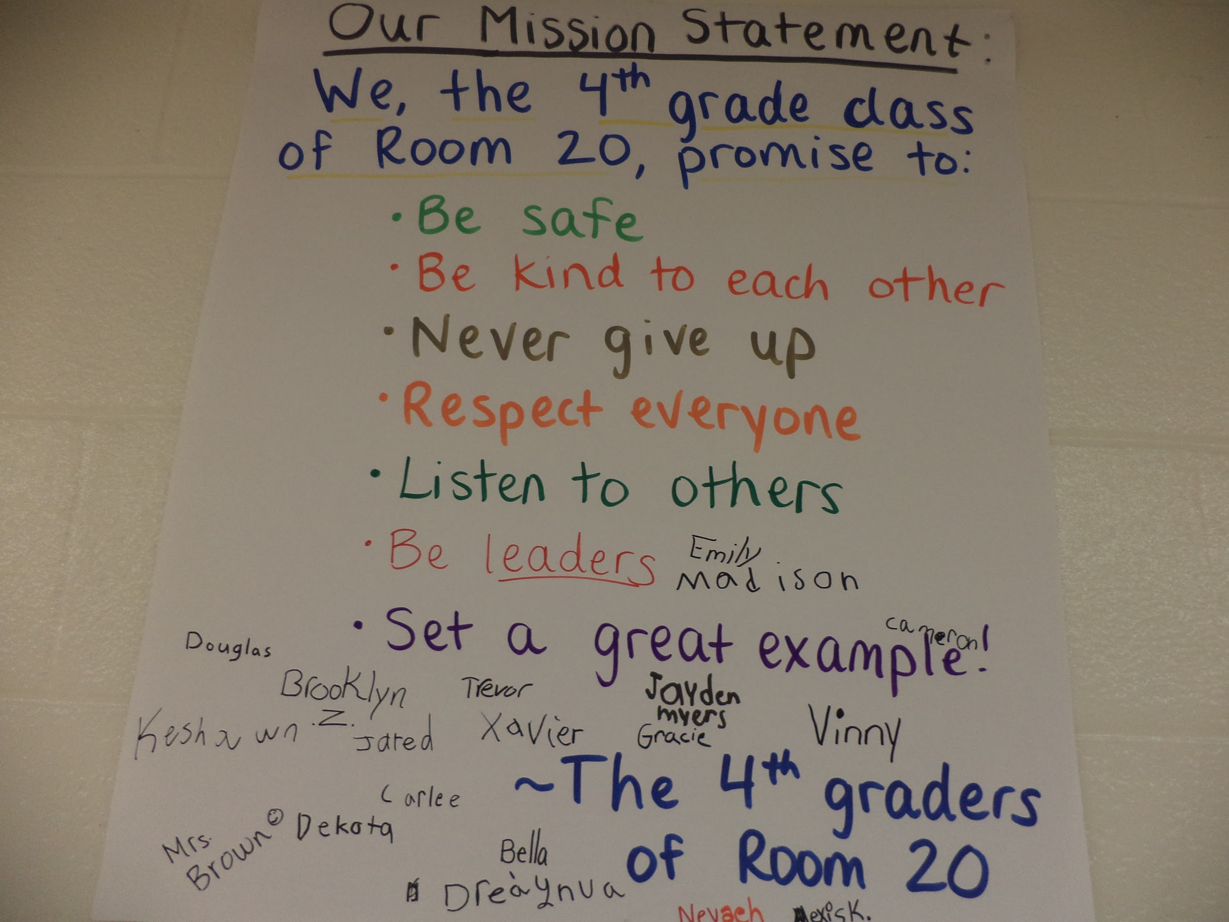
Class Mission Statements
Every class creates a class mission statement in September and posts a copy both inside the classroom and in the hallway outside their classroom.
Every student signs.
Uses PBIS and LIM Language.
Classes recite daily.

Slide 13
Class Meetings: Here’s what the kids had to say
We sit in a circle
We talk about situations or problems and we brainstorm ideas to help one another
“Accomplish” our issues together
We share good compliments (celebrations and “yeahs”)
Looking ahead (planning)
New procedures
Awards (attendance, positive notes, etc.)

Slide 14
PBIS/LIM Kick-Off Assembly
In previous years, staff had planned, led and presented
Completely student led this year
Student Host
Speeches
-written by students with the help of staff
Songs
Performances

Slide 15
Leadership Notebooks and Goal Setting
Students track their WIGs (Wildly Important Goals)
Attendance
2012-2013 school year 36% of students with 10 or more absences
2013-2014 school year 35% of students with 10 or more absences
2014-2015 school year 16% of students with 10 or more absences
Behavior- Reduction in ODRS
Reading- Track using BAS and NWEA scores
Math- Track using NWEA scores
Staff model by setting their own goals

Slide 16
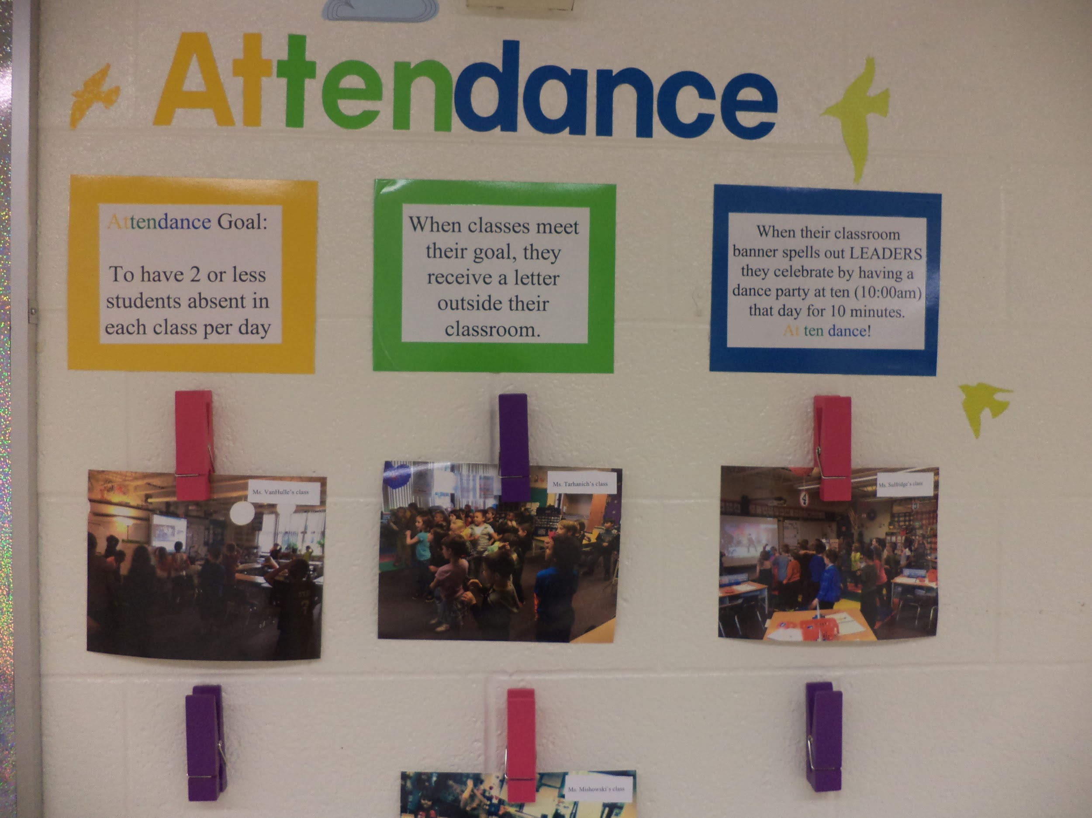
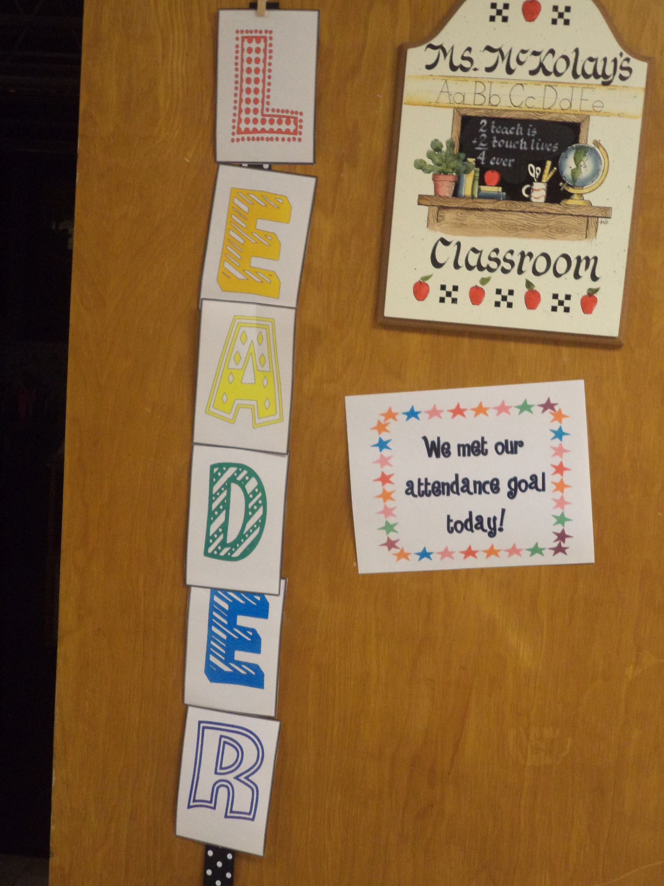
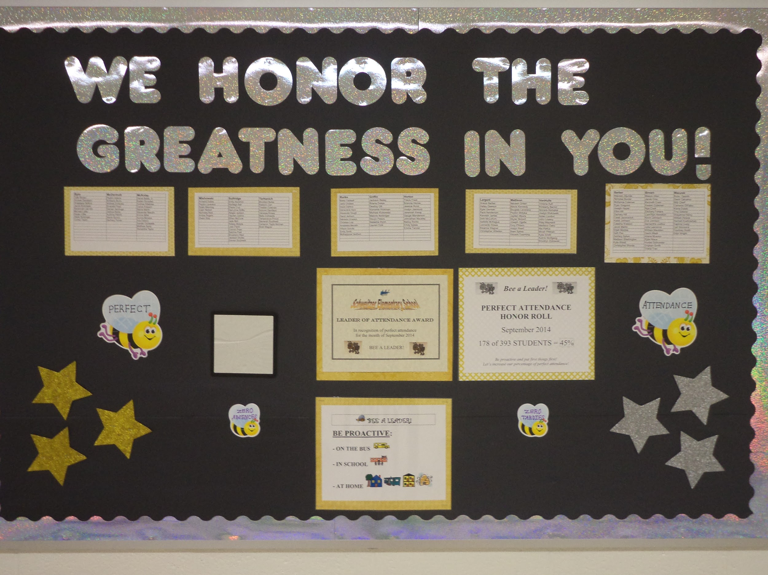

Slide 17
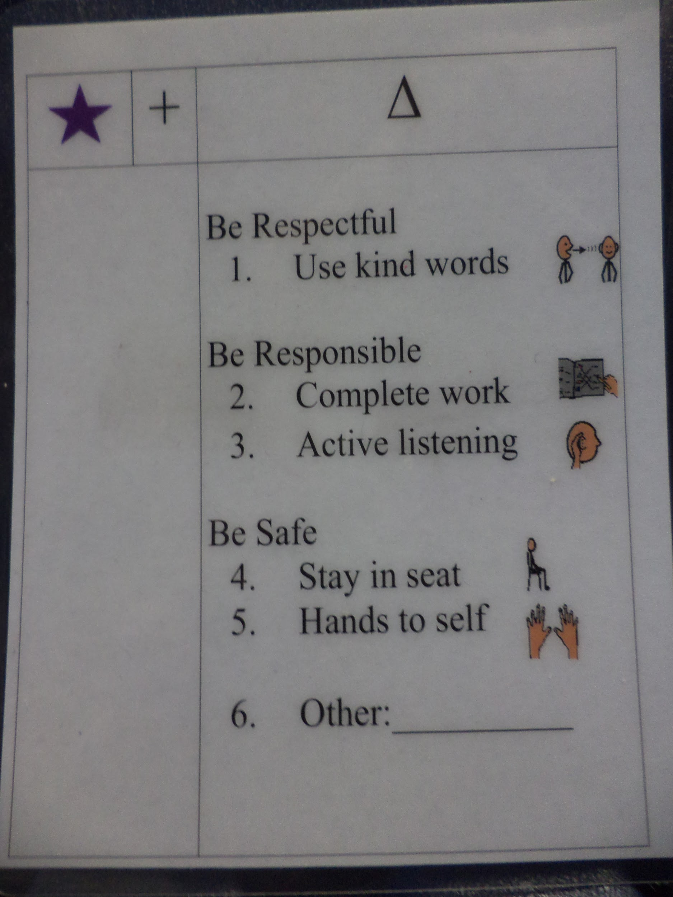
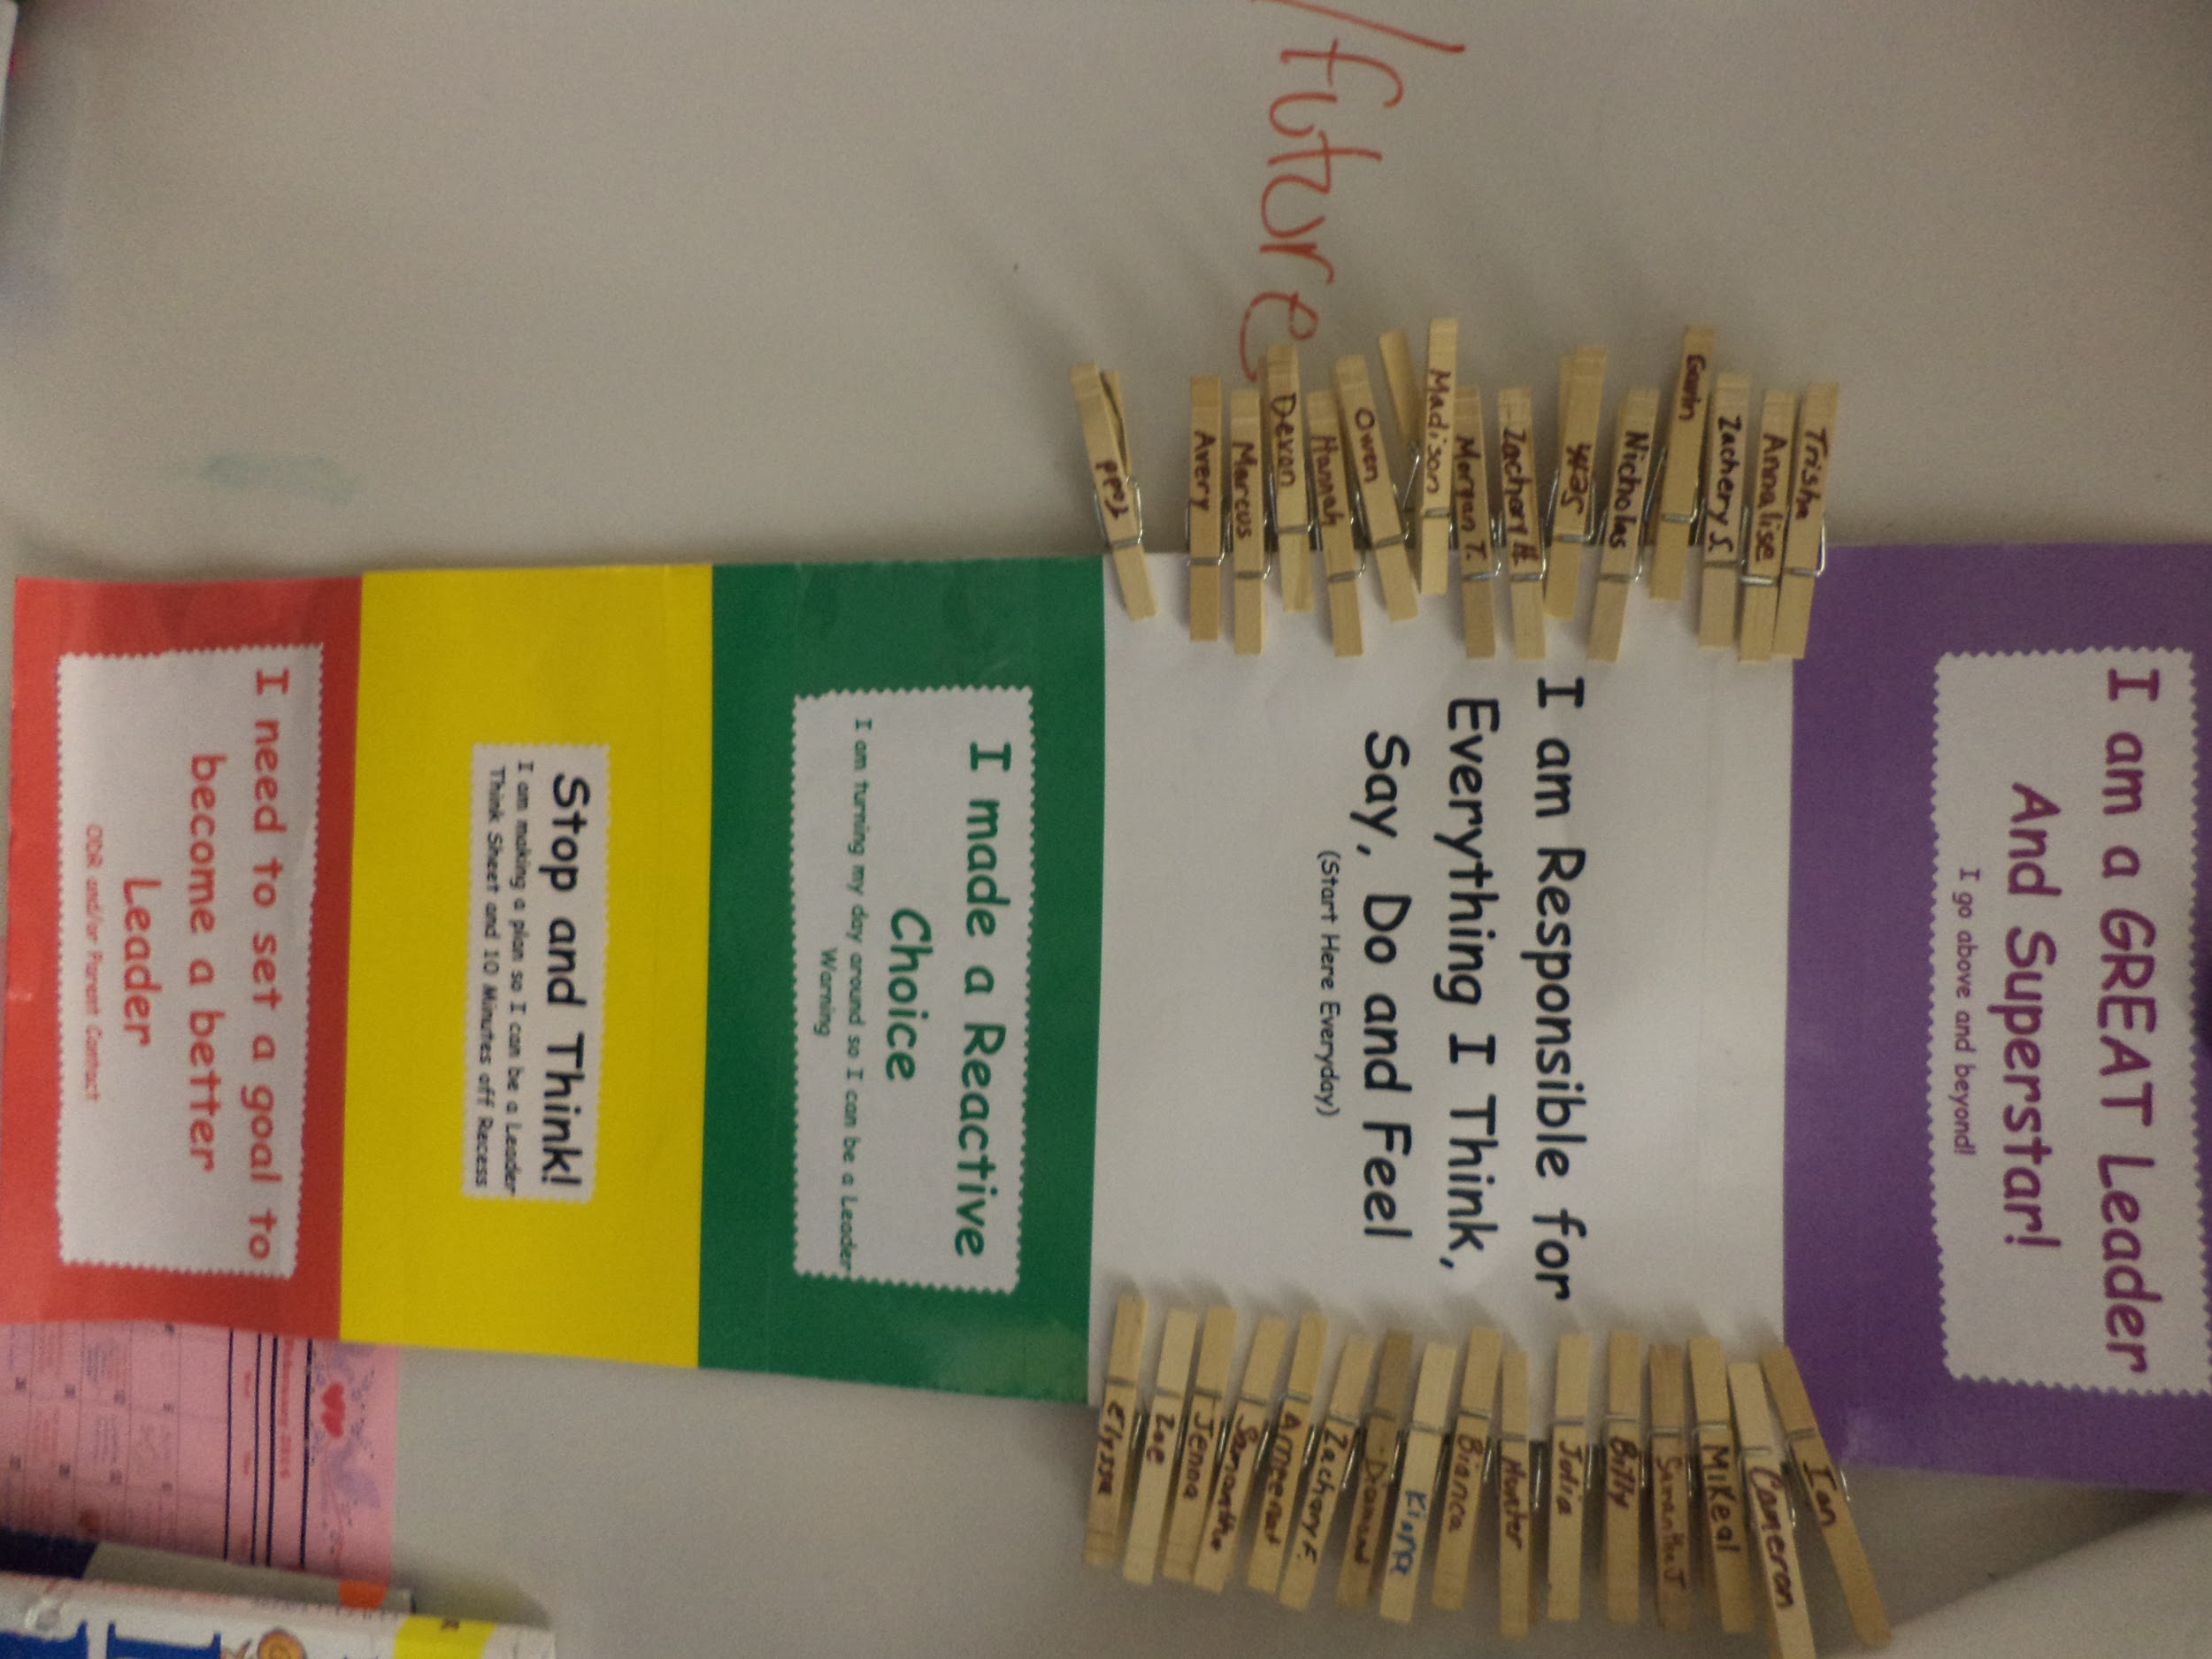
Changes to PBIS and LIM program for 2015-2016 School Year
Anonymous vote at staff meeting in spring favored changing from zone chart to plus delta charts
Summer collaboration to make changes to program

Slide 18
Individual Student Plus/Delta Charts
Private Physical managing of the charts
More dialogue Remembering to change back to plus
Less punitive Feeling of no outlined consequences
Visual Student dishonesty
More opportunity for teaching
Goal is to change behavior
Reduce meltdowns over zone changes
Delta Dialogues
Specials and support staff can use

Slide 19
Possible Solutions Based on Deltas
Brainstormed ideas on how to attach charts to desks
Only have charts on desk when on delta
Reminder that PBIS is about teaching rather than consequences/punishment
Conversations of interventions that can be utilized with students struggling to stay on plus or change their behavior once they are on delta
Reminder that this is a continuous improvement process
Being open to change

Slide 20
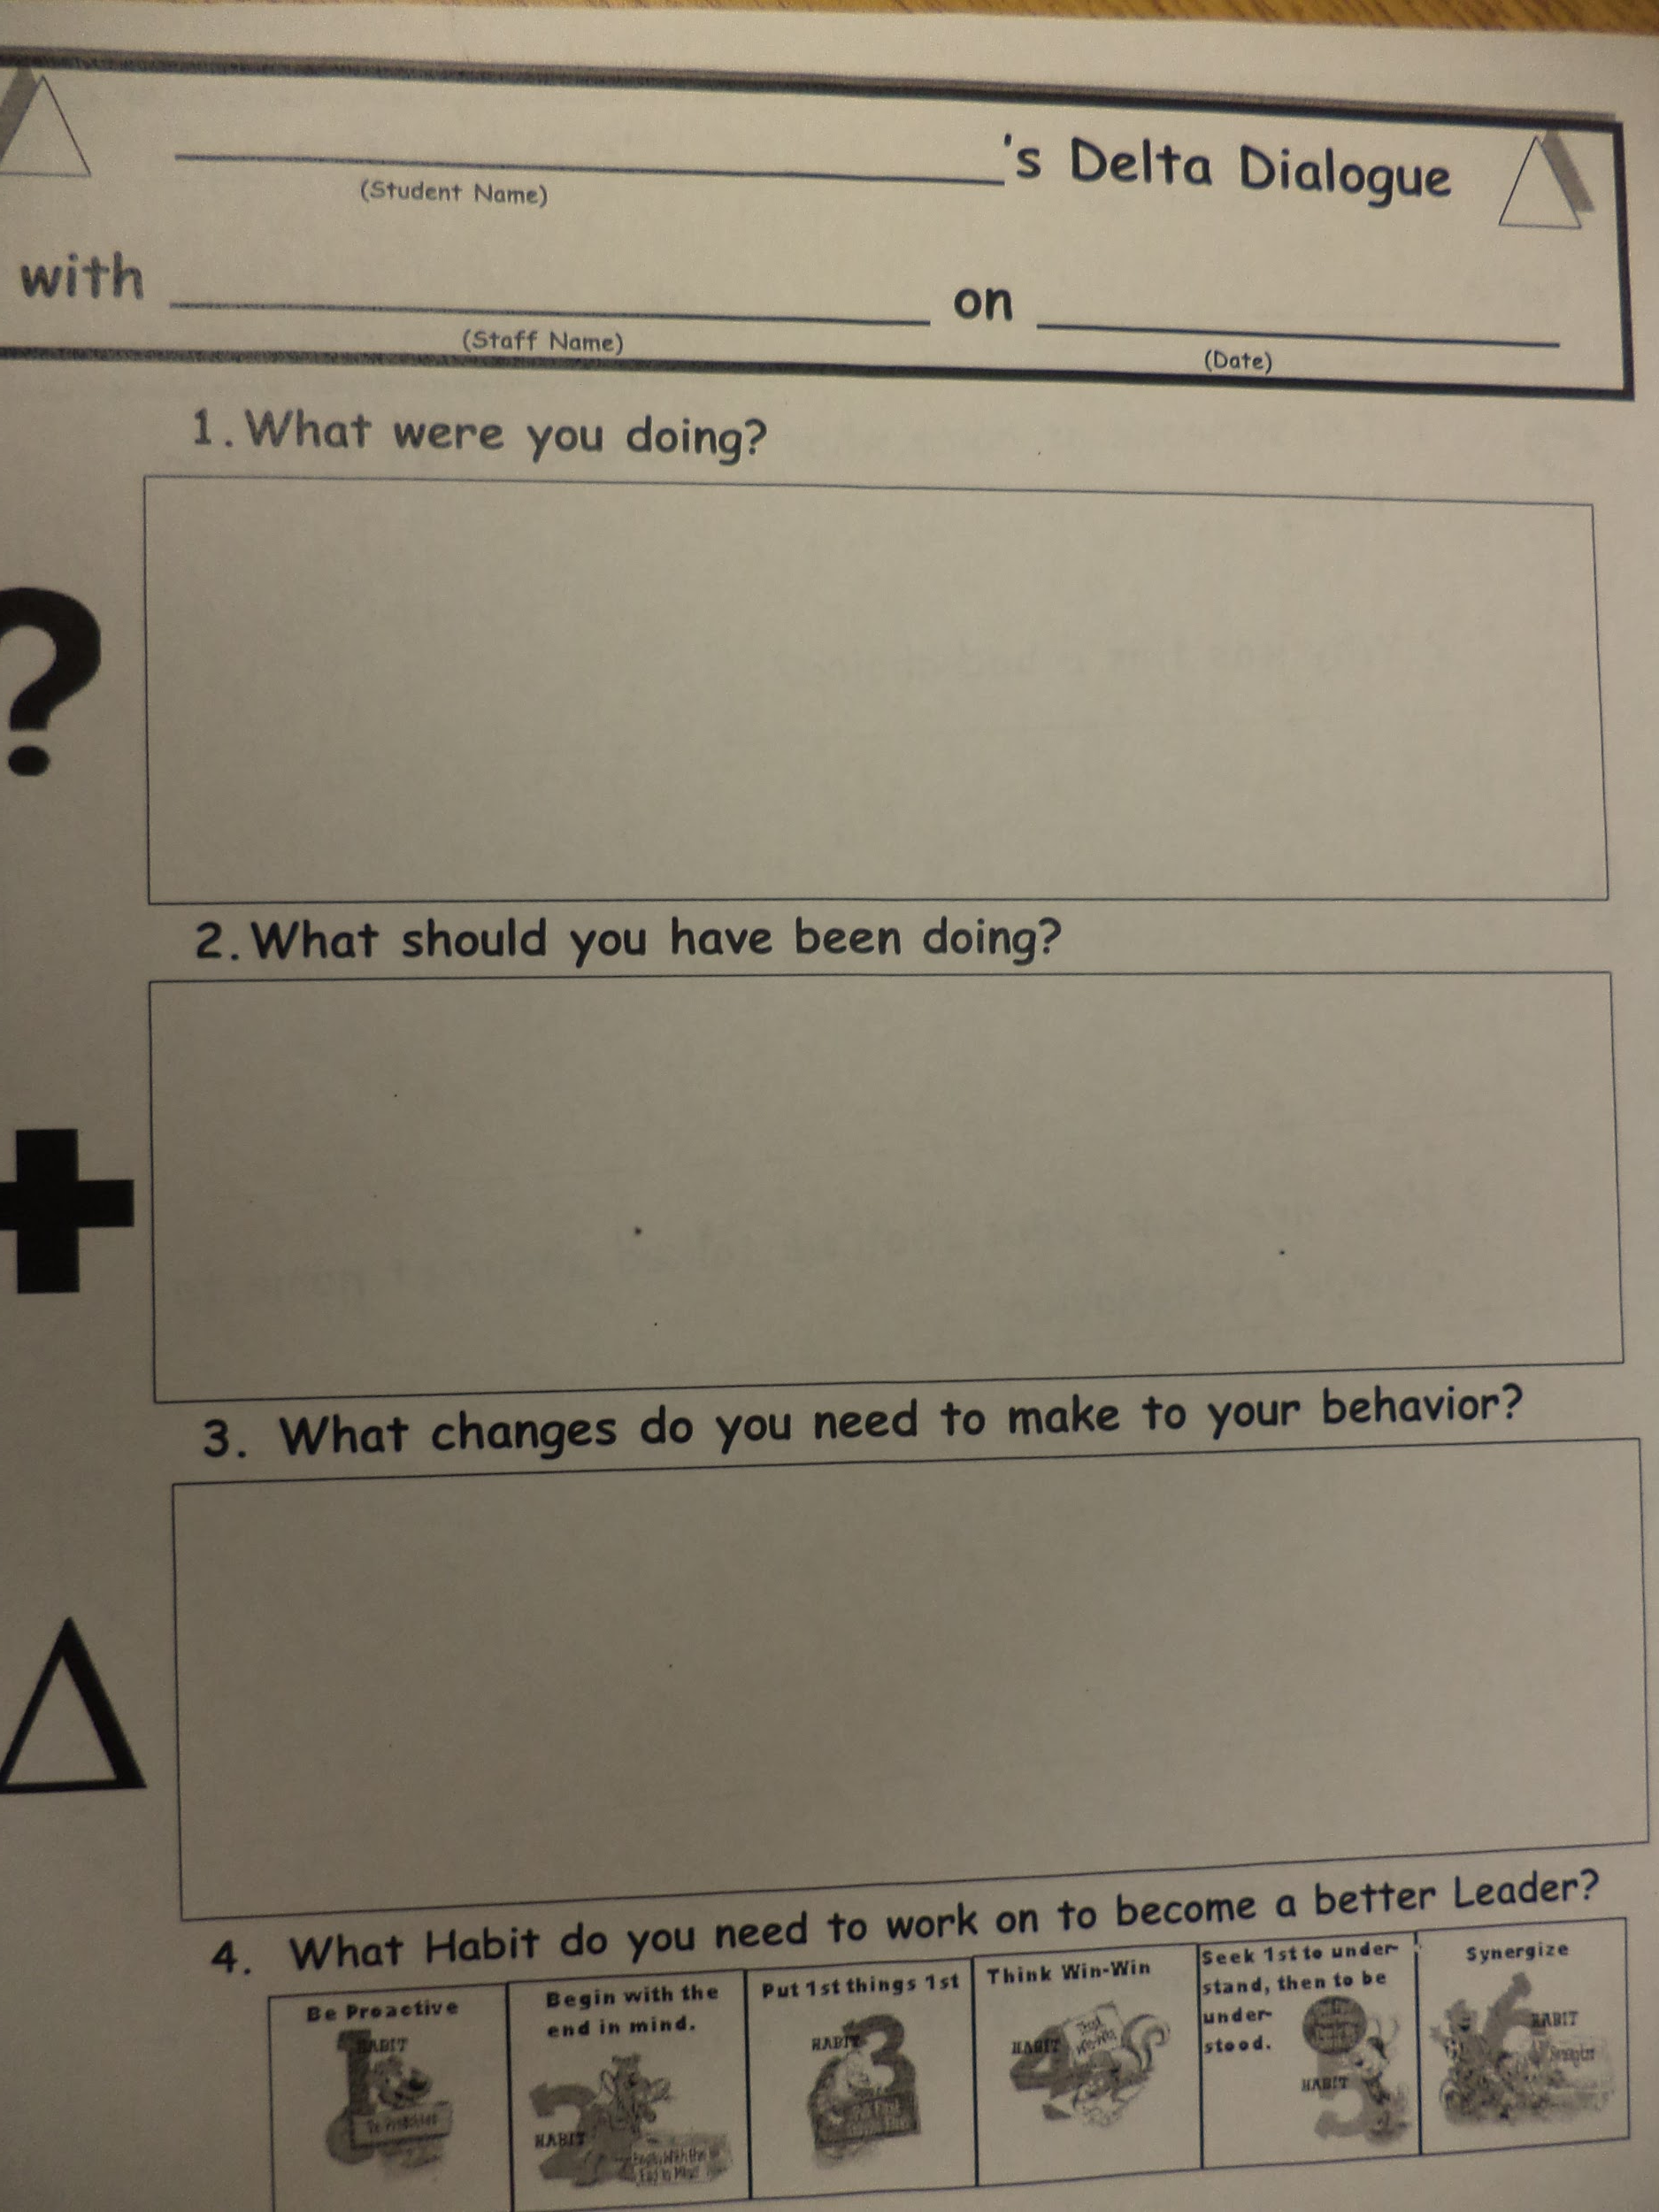
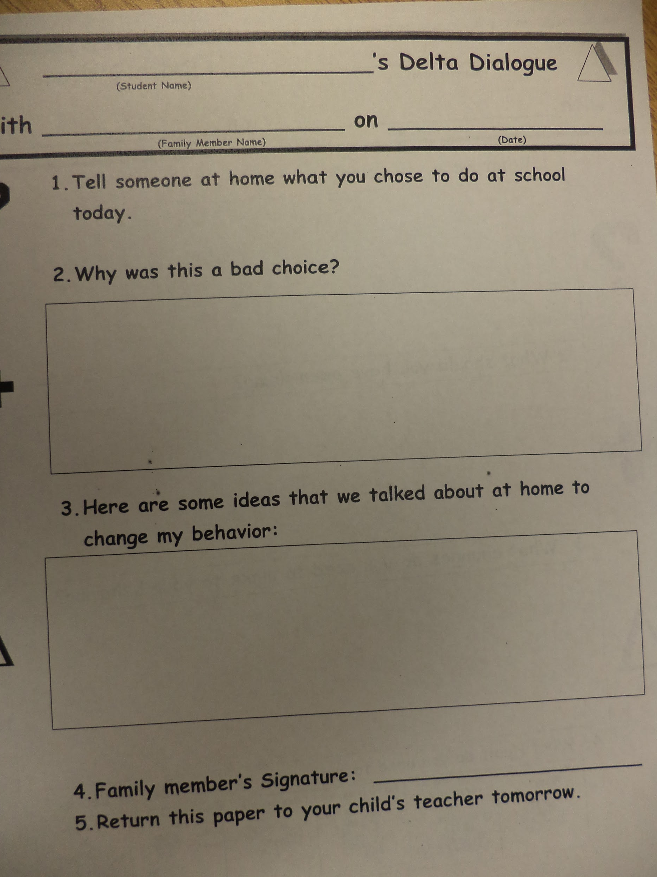
Delta Dialogue

Slide 21
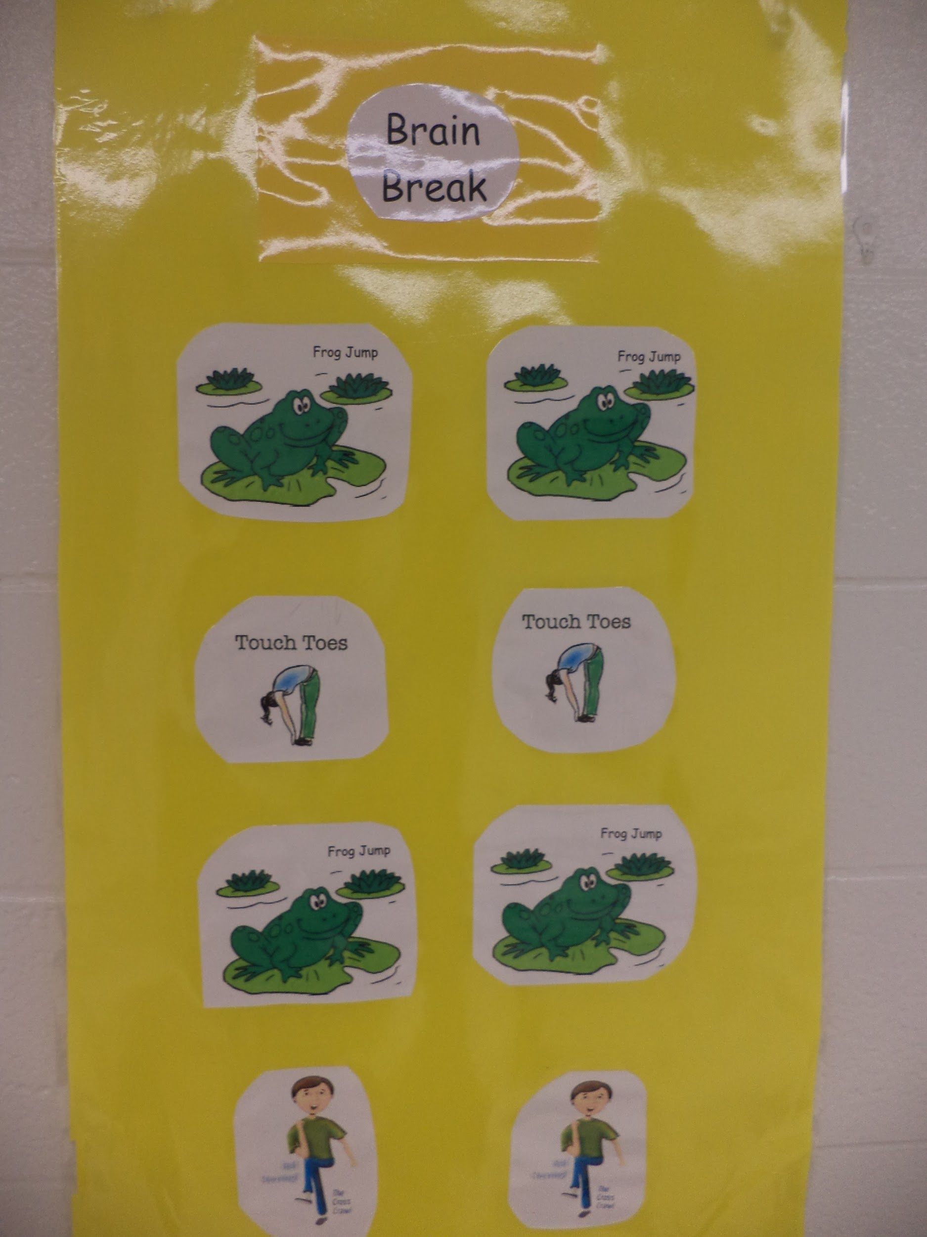
Tier 1 Interventions
Calming Caddy
Brain Fitness Trail
Brain Break Stations
Buddy classroom
Thinking chair
Whole class goals
Leadership jobs
Class meetings
Second Step

Slide 22
Interventions cont.
Use of timers to complete work
Use Plus/Delta for teaching expectations
Natural consequences
clean up mess, give a compliment
Seek First to Understand, Then to be Understood
problem solve with teacher or peer
Preferential seating
near teacher
bumpy seat
stability ball
Changes to schedule
computer time after independent work

Slide 23
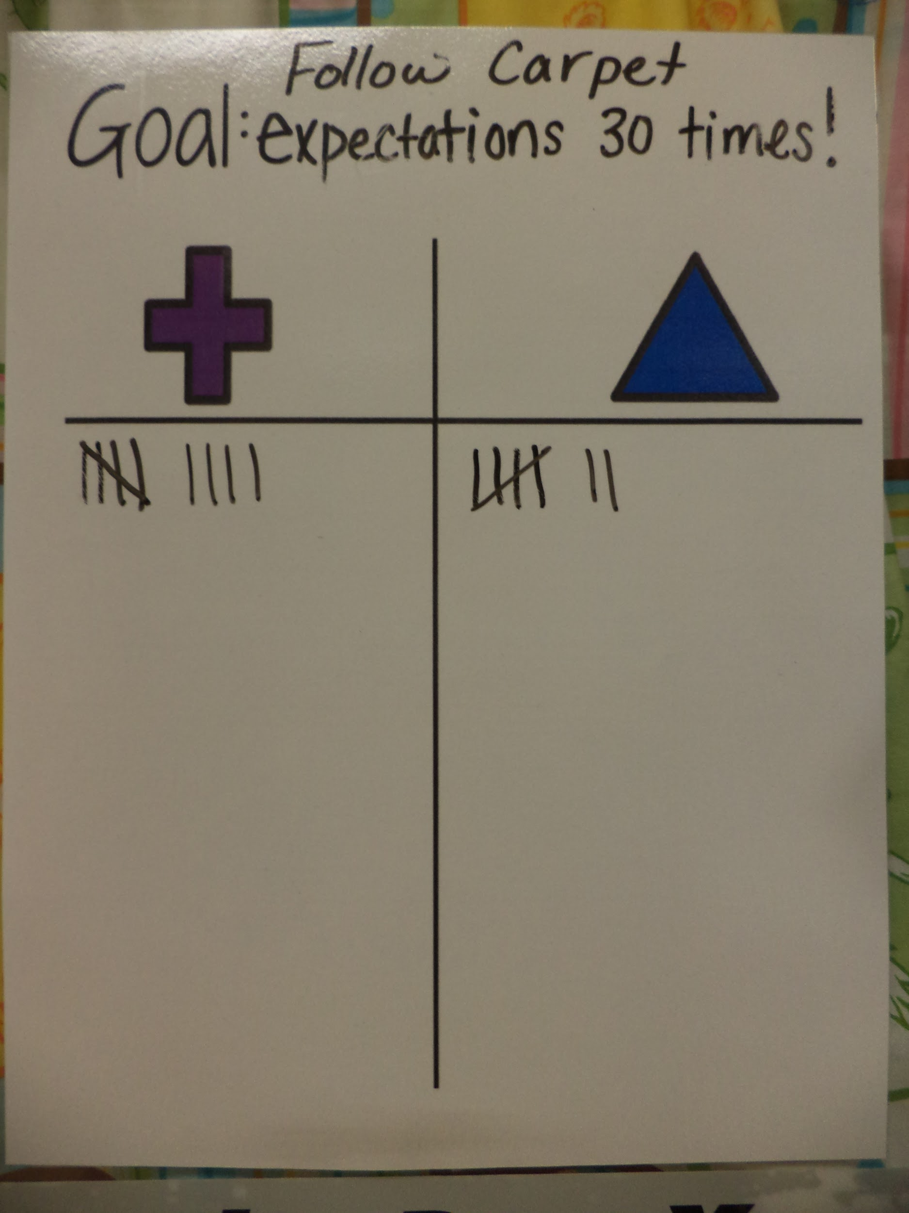
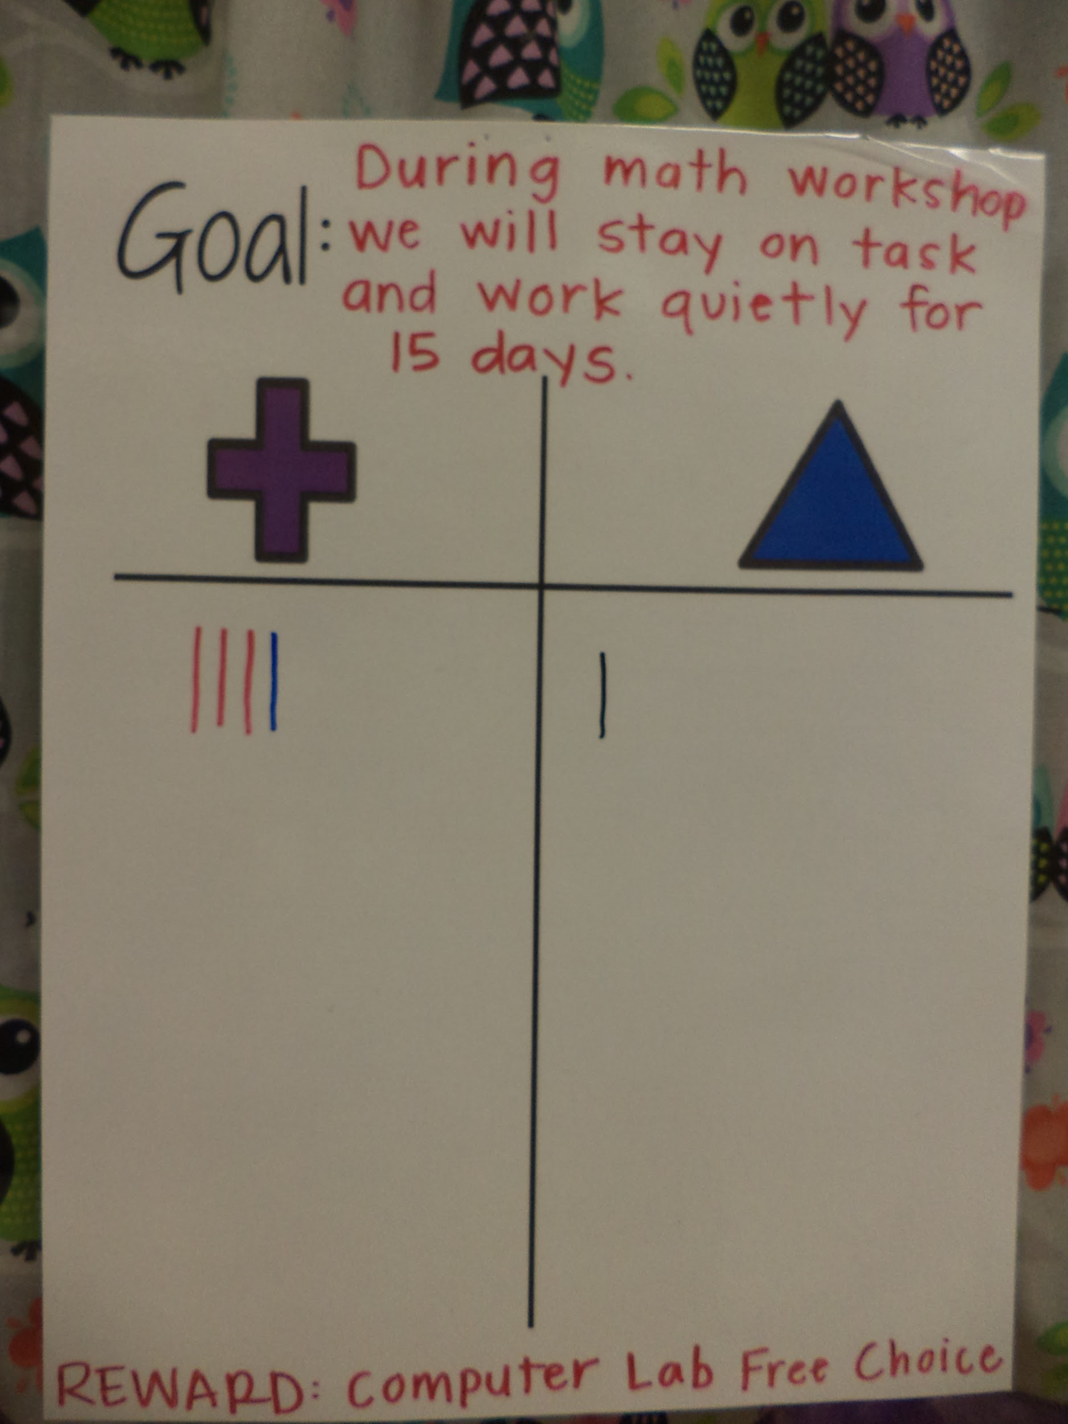
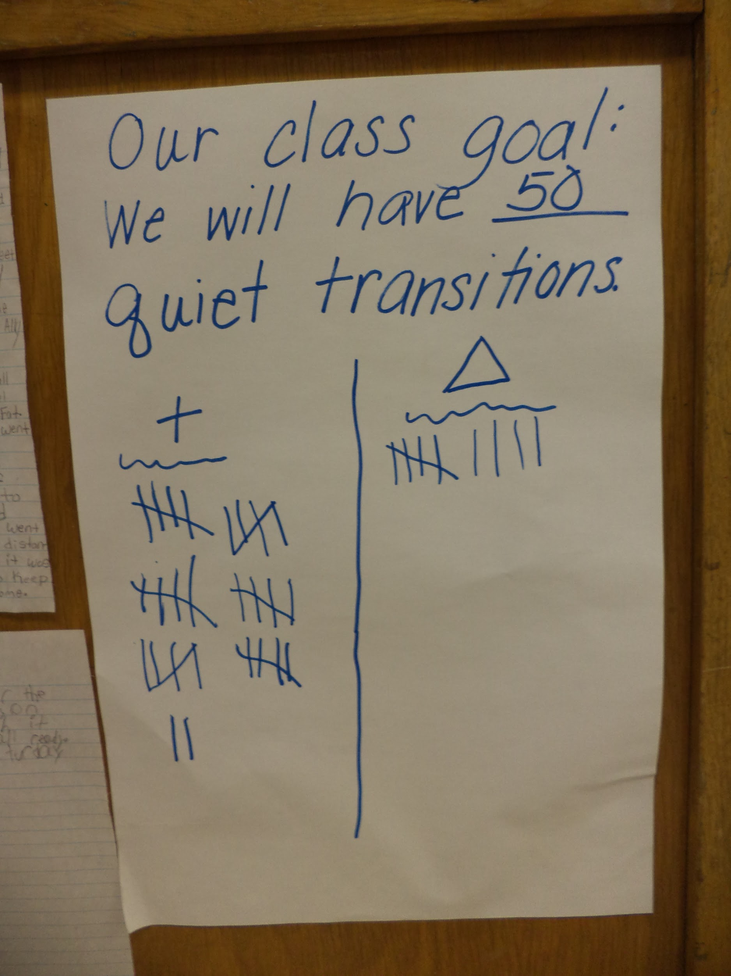
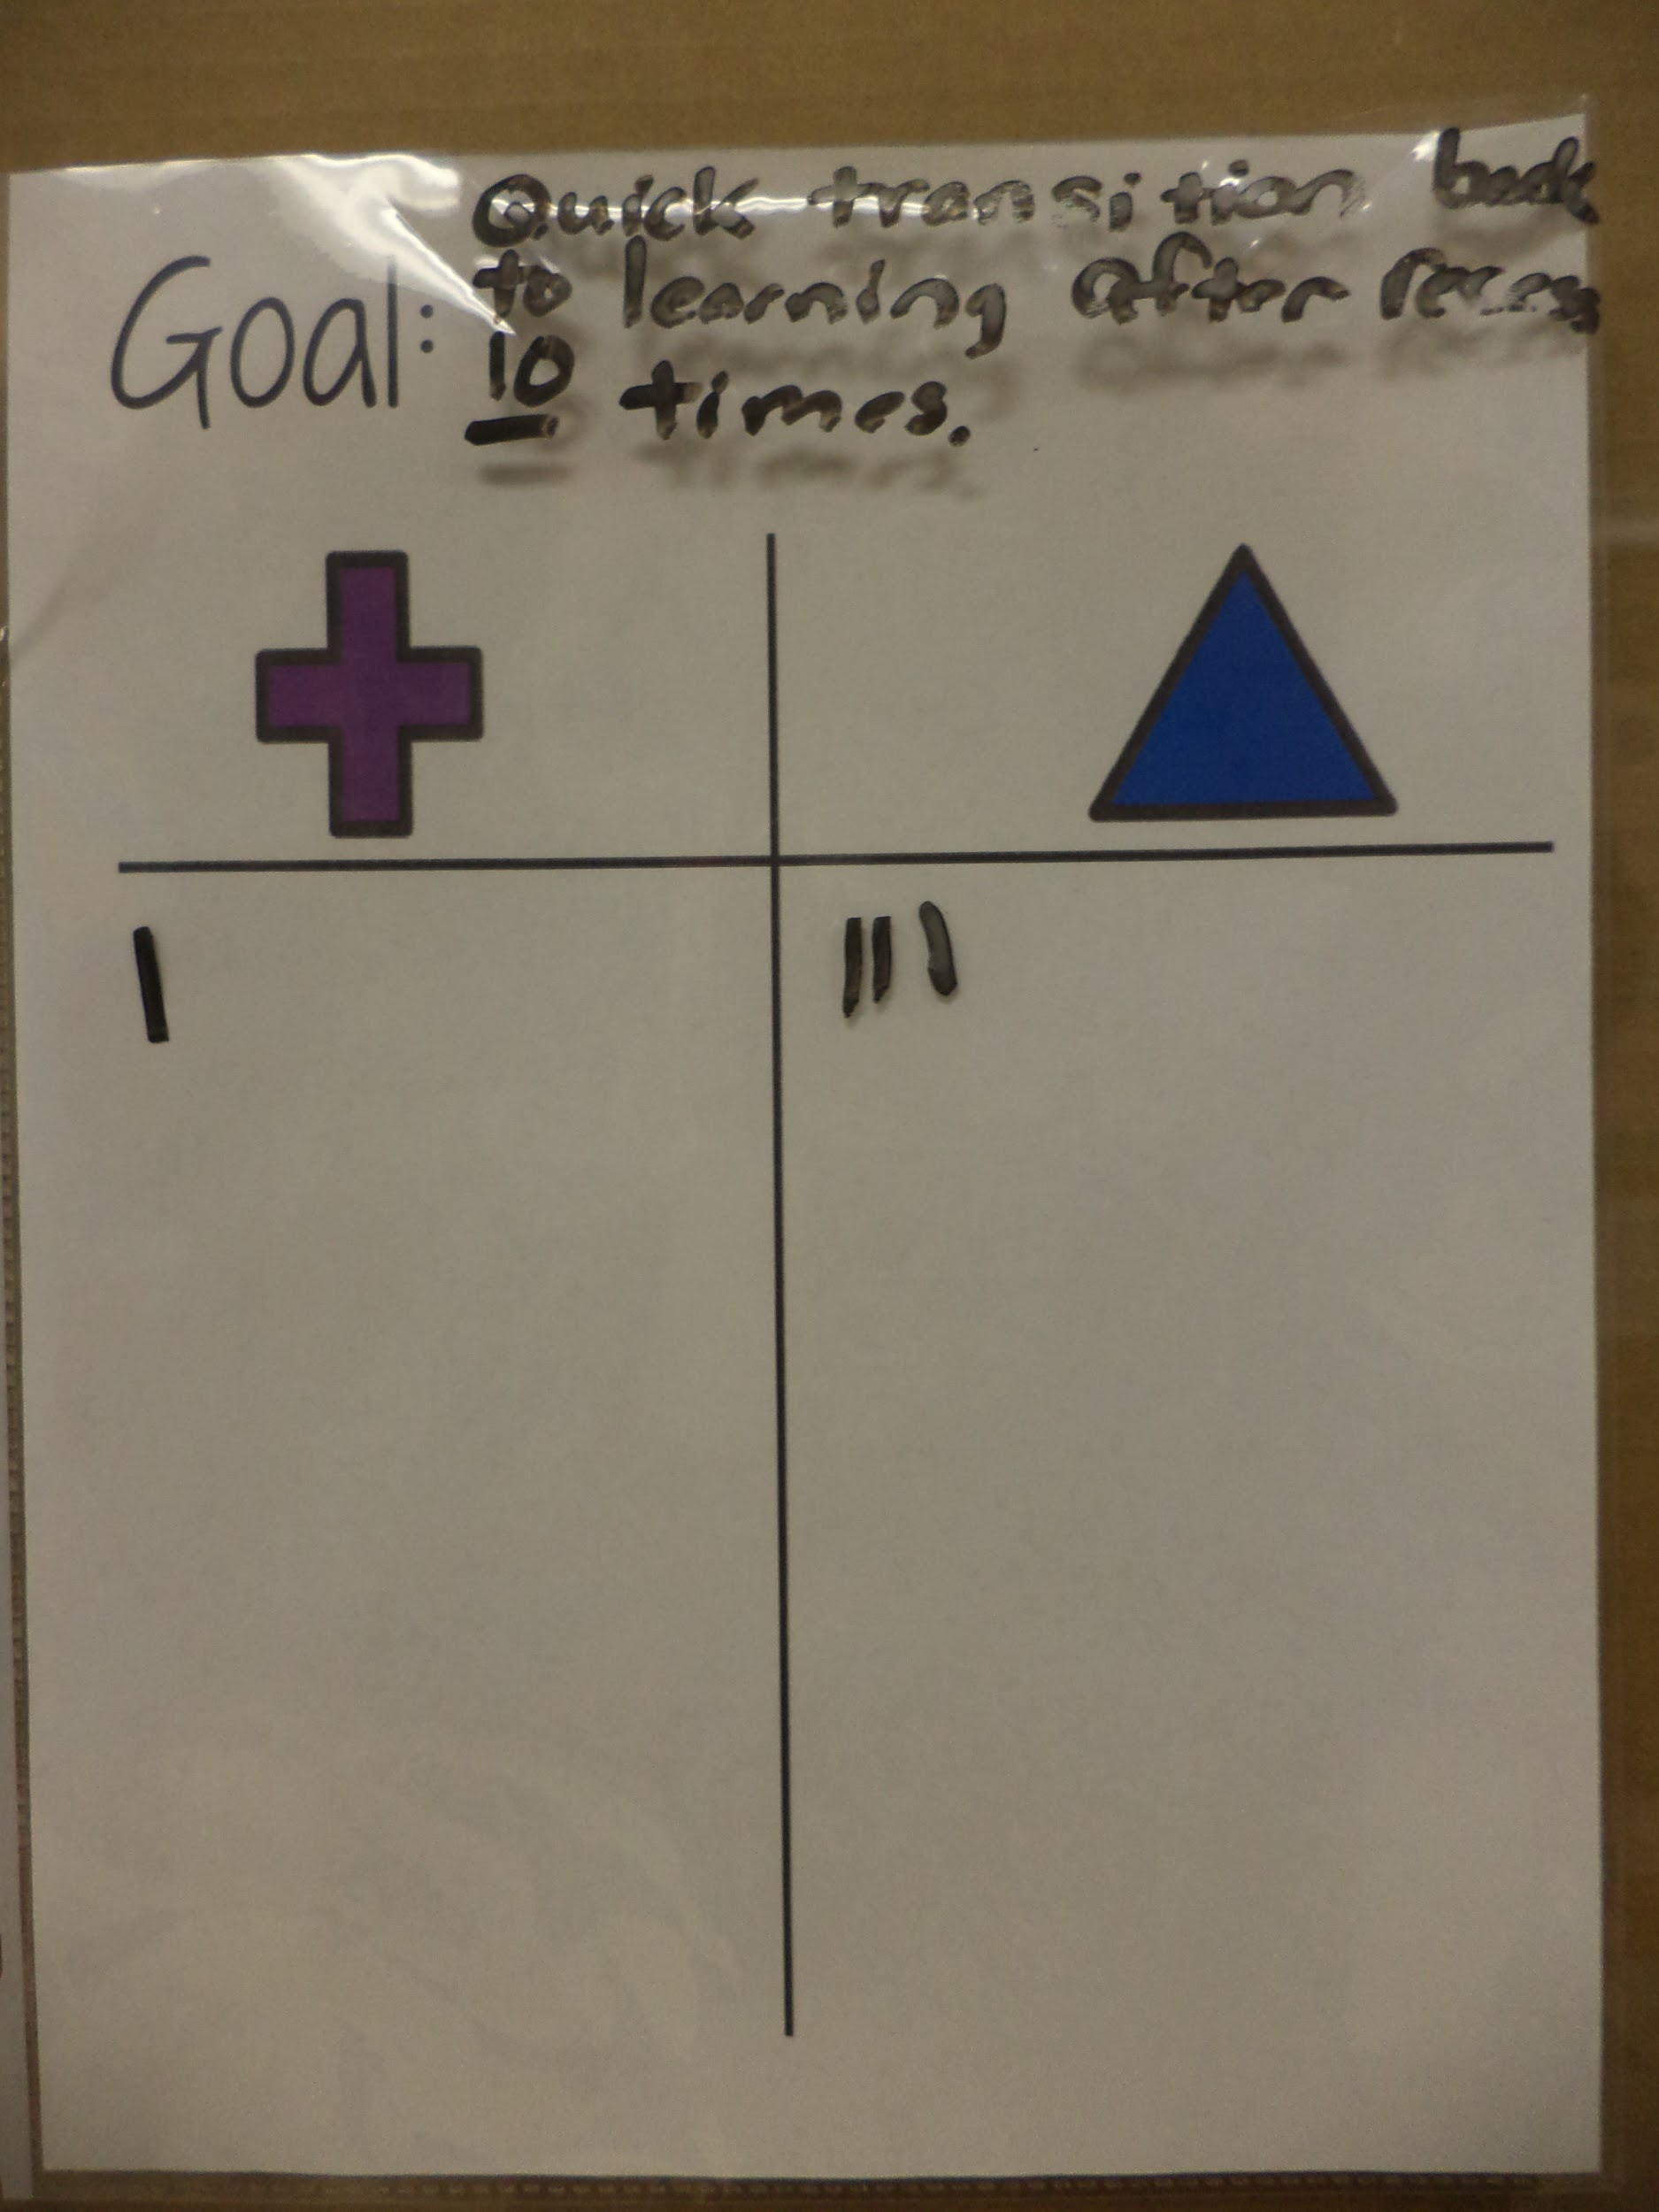
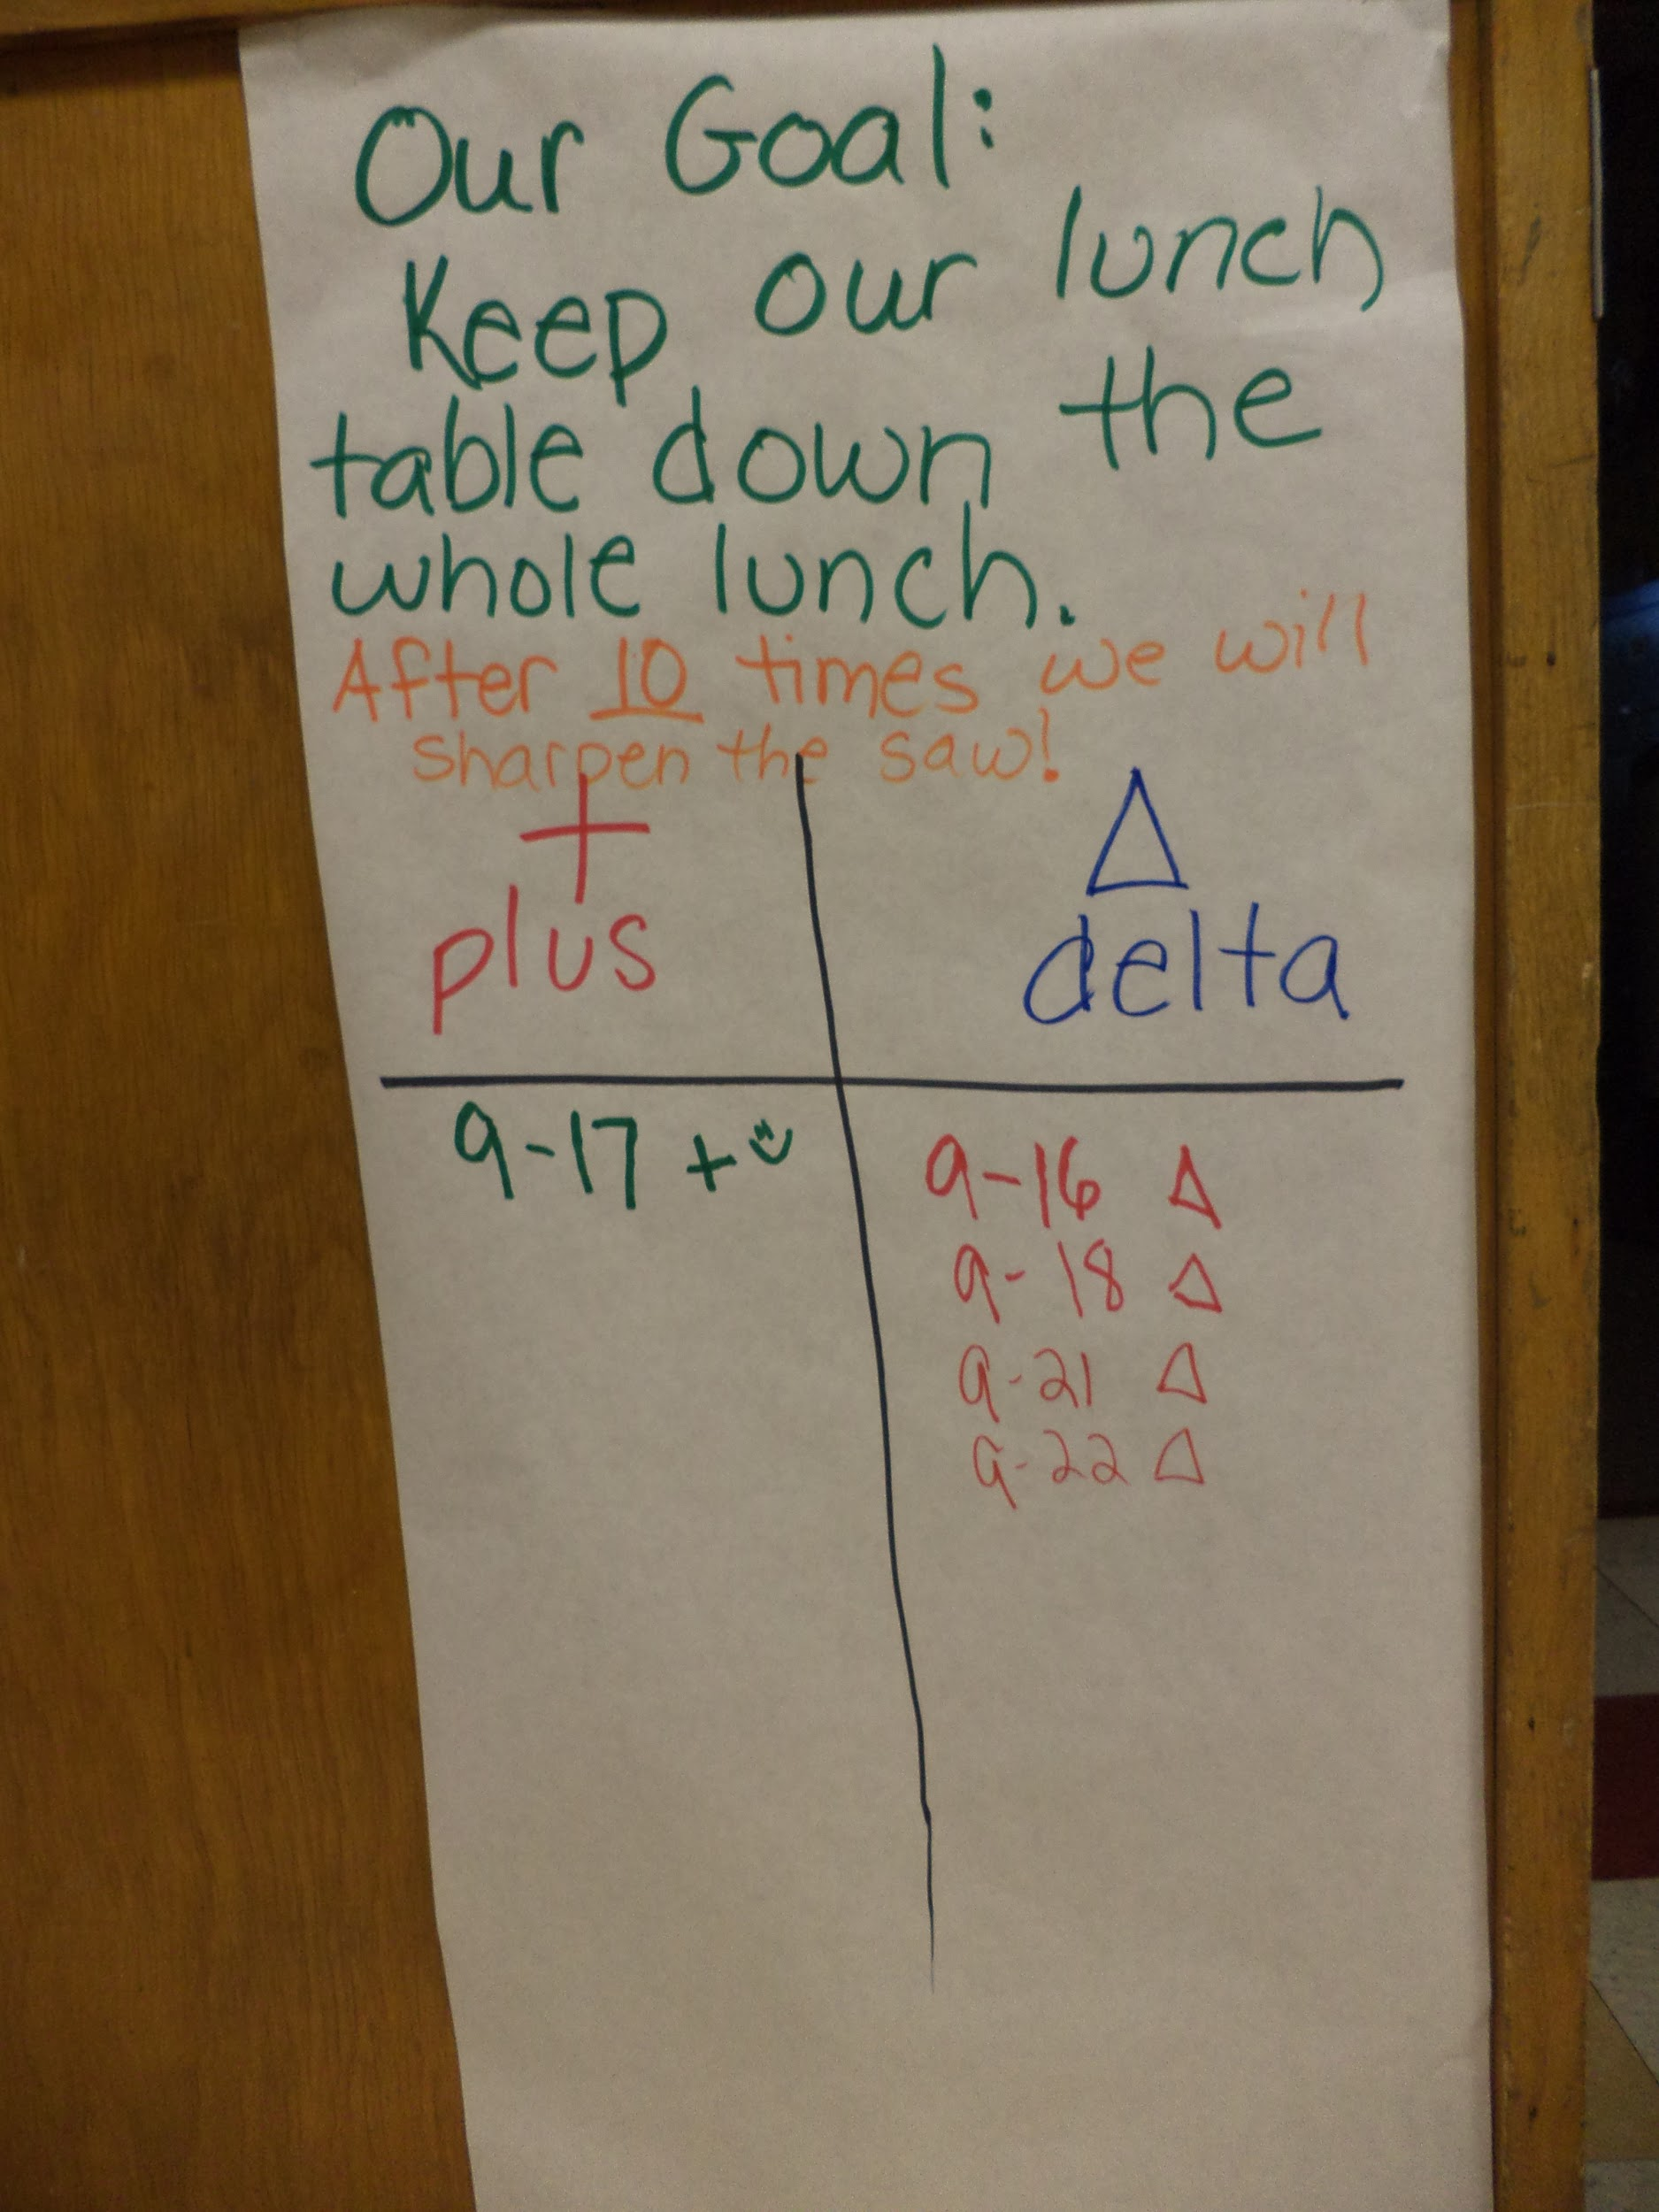
Class Goals
Formally Bucket Filling Parties for earning class compliments
Each class chooses their own goal based on their class need. Then earn a Synergy Celebration or Sharpen the Saw Party once they meet their goal.
Allows classes extra teaching and practice at expectations their class has difficulty with.

Slide 24
Plus/Delta for Bus Behavior
October 2014: 18 bus referrals (4th highest in our district)
October 2015: 0 bus referrals
Focus on things within our circle of control: keeping students calm before getting on the bus
More active supervision in bus lines (each grade level responsible for one bus)
Changed configuration of how we line students up to go to bus at end of day
Tracking behavior of each bus. Each bus receives a plus or delta for their behavior in the bus line and the walk to the bus. Bus with the most days on plus receives a small reward at the end of the month.

Slide 25
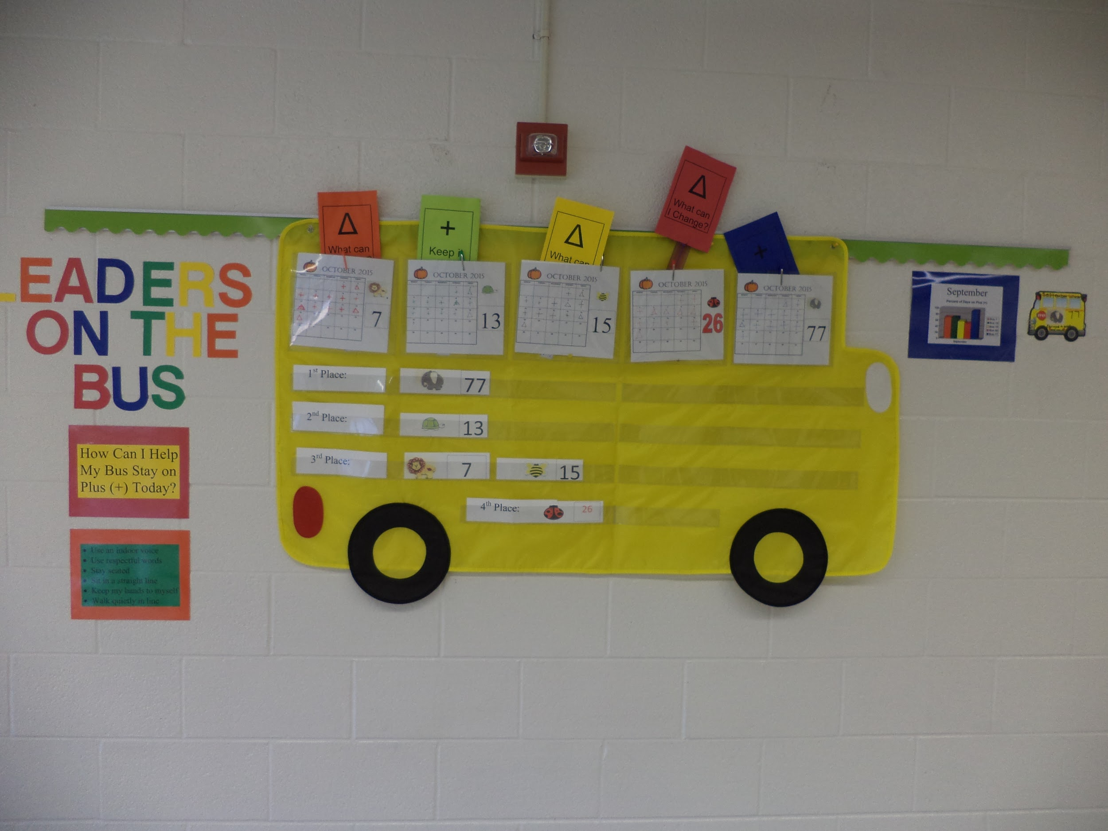

Slide 26
Attend Schweitzer’s Second Leadership Day on December 11th!
Contact us with questions or if you’d like to register for Leadership Day!
Jennifer Chambers (principal): chambersj@wwcs.k12.mi.us
Beth Burgess (school social worker): burgesse@wwcsd.net
Jennifer Sulfridge (first grade teacher): sulfridgej@wwcsd.net
Maureen VanHulle (third grade teacher): vanhullem@wwcsd.net

