Slide 1
Jane Addams Elementary
Pam Nelson MSW, MA, LPC
School Social Worker
South Redford School District Pbis Coach
Doctoral Student
(313) 532- 8064 x1386
Pam.Nelson@southredford.org

Slide 2
Demographics
317 students
25 % Caucasian
71% African American
2% Latino
2% Asian
54% Free lunch
8% Reduced lunch

Slide 3
Staff PBIS 2014-15 Survey Results
The following responses helped drive the direction for changes

Slide 4
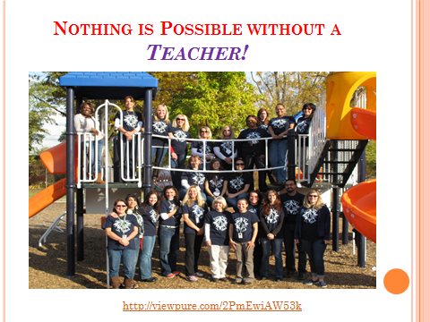

Slide 5
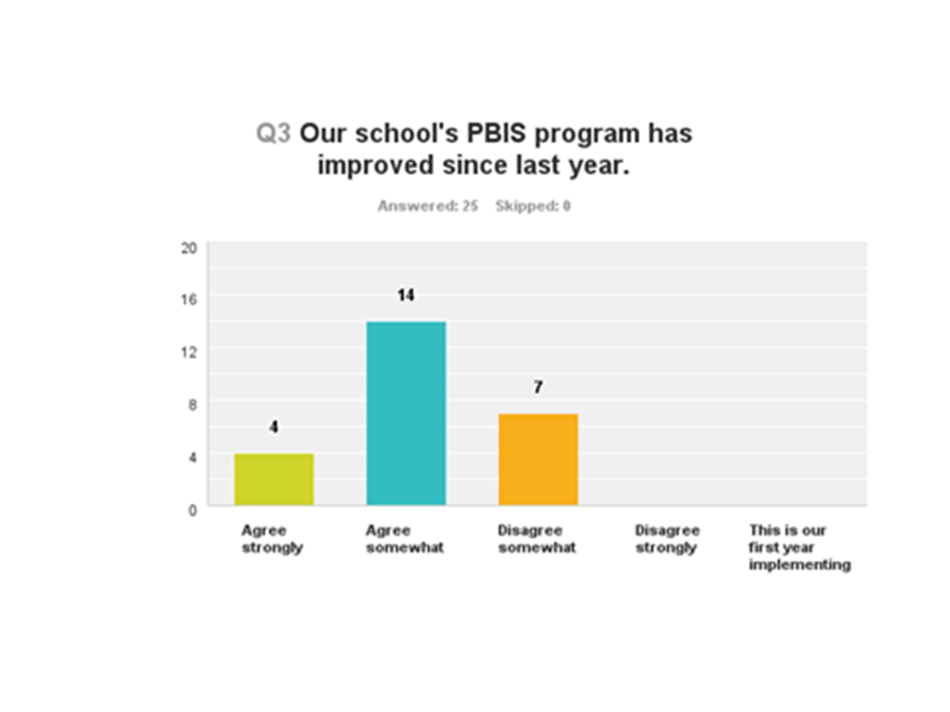

Slide 6
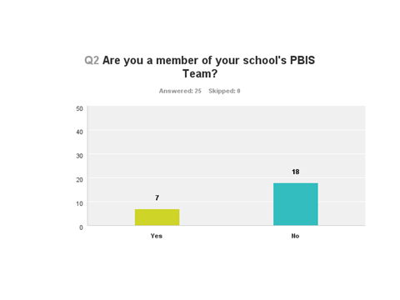

Slide 7
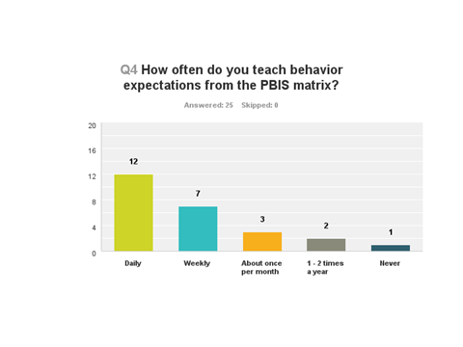

Slide 8

1. Re establish consistency
…Along with the fact that ODR’s had become unmanageable

Slide 9
Recruited New Team Members
BRAINSTORMED with Staff
Teachers were clear that they needed help with how to address behaviors.

Slide 10
Re-Boot
Pbis implementation begin in 2007
After years of success
Chair person driven
Leadership, staff and role changes

Slide 11
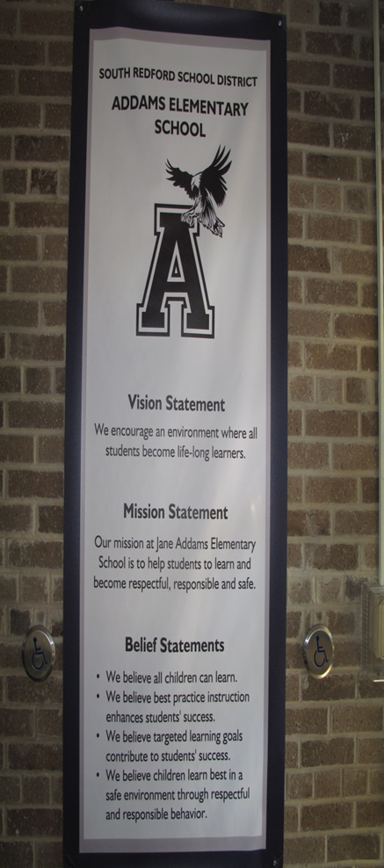
Re-Vamped
Vision Statement
Beliefs Statement
We encourage an environment where all students become life-long learners.
We envision students that demonstrate respect for others and show responsible behaviors in order to create a safe and engaging place for learning.
We believe that ALL students can learn.
We believe that targeted learning goals contribute to student success.
We believe that children learn best in a safe environment through respectful, and responsible behavior.

Slide 12
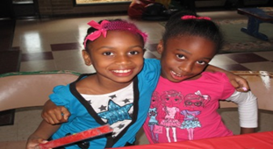
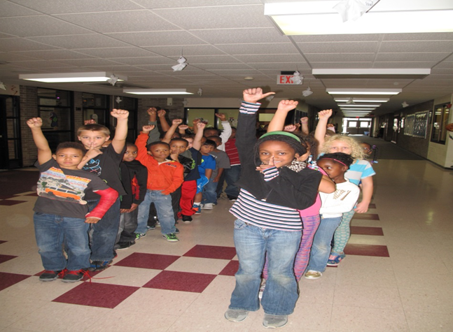

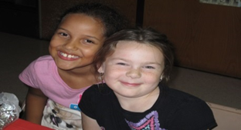
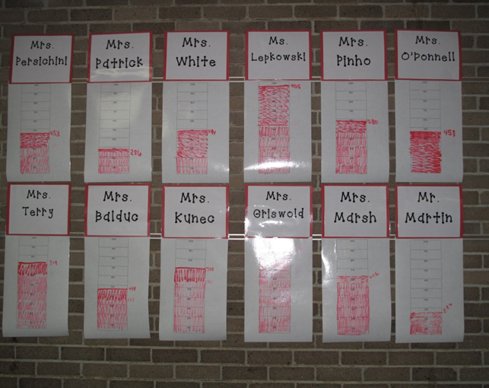

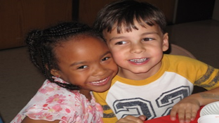
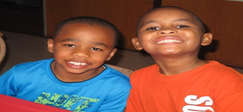
Classroom Rewards
Monthly Rewards
VIP Lunches
Pride on 5
Booster Days
Booster Assemblies
Positive Note Cards
PBIS

Slide 13
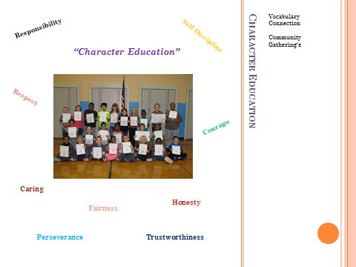

Slide 15
New ODR criteria Established
This student has had problems:
Being Safe
Being Respectful
Being Responsible
Specific problems include:
Computer Use Violation
Continual Disruption of Learning
(Send documentation of incidents and contacts made)
Defiance/Disrespect
Destruction of School Property
Fight/Severe Physical Aggression
Obscene/Indecent Behavior
Sexual Harassment
Theft
Threat/Bullying

Slide 16
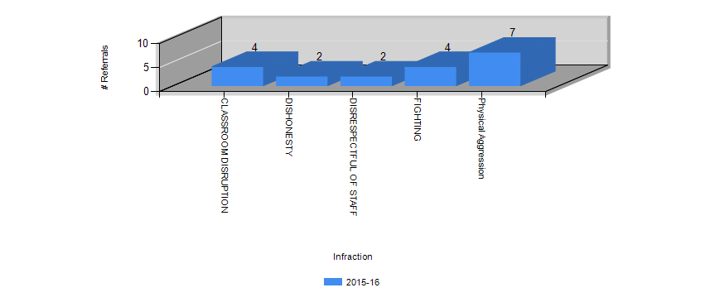
Sept Data

Slide 17
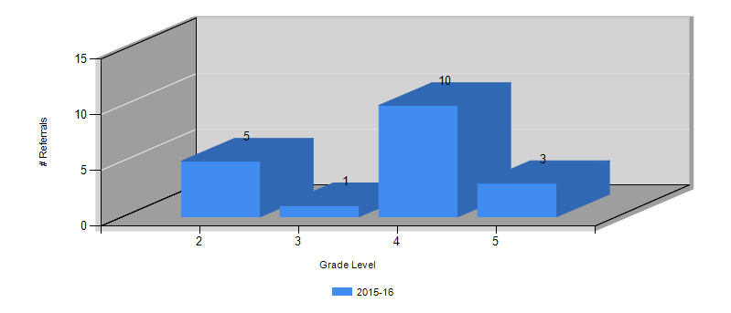
Addams Elementary
ODRs by Grade Level from 09/09/2015 to 11/12/2015
All Students

Slide 18
FUTURE DIRECTIONS For District
Continue building consistent pbis norms within district
District wide parent sessions on how to implement pbis at home
District wide data driven pbis dialogue
Incorporate Trauma informed pbis practices

Slide 19
2015 PBIS Conference Highlights
Session (A15) Exemplar Districts of PBIS Implementation
www.http://flpbs.fmhi.usf.edu/
(Click Resources)
>Family: pbis behavior is a family affair
http://flpbs.fmhi.usf.edu/revision07/family/Colorado_Parent_Trainings/reno.ppt
>Parent Trainings: community buy in
http://flpbs.fmhi.usf.edu/parent_community.cfm
>Parent Engagement 35 ways: http://flpbs.fmhi.usf.edu/revision07/family/Colorado_Parent_Trainings/parentengagement_35ways.pdf

Slide 20
Session (D14)
Early Childhood: Integrating the Research practices of the pyramid model into school wide pbis
Download Colorful handouts from conference website
http://www.pbis.org/presentations/chicago-forum-15
5 Mind Shifts required to create positive early learning climates (handout 1)
Creating High Quality Supportive Environments (handout 3)
Provide targeted social/emotional supports (handout 4)

Slide 21
Session (RDQ 14)
Embedding Mental Health into schoolwide systems of pbis
My Passion: Creating Trauma Sensitive Schools
Free book download-Volume 1 & 2 Available
http://traumasensitiveschools.org
Deals with the impact of trauma on learning
Not asking teachers to become therapists
Understand the symptoms of trauma
But understand how a positive/healthy response to an intense reaction can reduce the severity of the trauma symptom

Slide 22
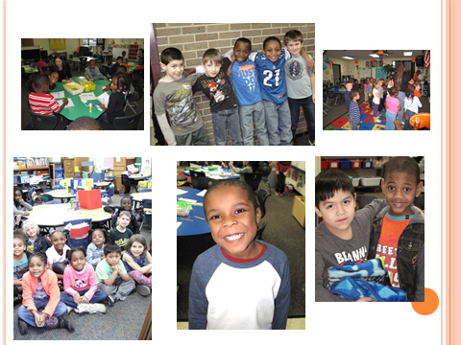
Our Future
Deserves our Best

