Slide 1
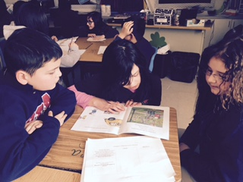
Cesar Chavez Academy Intermediate

Slide 2
Cesar Chavez Academy Intermediate
Upper Elementary building with 437 students in grade 3-5. 91% of our students are of Hispanic descent with 83% of students are considered Limited English Proficient.
13% of our students are in the Special Education Program.
13% are considered homeless
9% are new to our district
99% of our students receive free/reduced lunch

Slide 3
Cesar Chavez Academy
17 classroom teachers; 6 of 3rd grade, 5 of 4th grade, 6 of 5th grade.
1 teacher for each special class; music, P.E. and art.
1 certified reading interventionist, 2 highly-qualified aides for reading, 3 certified math interventionist, 3 special education teachers, 3 Least Restrictive Environment Aides and 5 one-on-one aids.

Slide 4
Tier 1-Basic Structure
School procedures and behavior expectations.
Behavior matrix…. consistency

Slide 5
Behavior Matrix

Slide 6
Behavior Matrix

Slide 7
Tier 1 School- Wide Expectations
89% of students in Tier 1
PBIS Staff Handbook
Matrix in classrooms and behavior expectations are posted in every area of the school
School pledge and anti-bullying pledges are recited each morning
School-wide PBIS kick-off assembly with mock party
Focus on facts and matrix when dealing with behavior
Office referral and think-sheet (orange) procedures and support

Slide 8
Tier 1 Teacher Expectations
All staff members have a training in August and all new staff attend Wayne RESA training for tier 1
Teachers are required to teach and reinforce appropriate behaviors.
Reviewing of the behavior matrix occurs monthly
DOJO points and a card flipping system are used with fidelity
Data is entered daily in Google Drive

Slide 9
How are DOJO Points and the card flipping system used?
DOJO points are used before you flip a students card for a specific behavior and to reinforce good behavior.
Positive DOJO points can be turned in for rewards such as candy, pencils, computer time, lunch with the teacher etc…
DOJO is used to communicate with parents and parents have access on their phones
Teachers other than the classroom teachers also have access and use the system when students are out of the regular classroom.

Slide 10
Class DOJO Sample
https://teach.classdojo.com/#/classes/562e41c80d07f77c65409817/points

Slide 11
Google Doc Format
http://tinyurl.com/ccauepbisdata

Slide 12
Rewards and Consequences
Monthly green parties!! Electronics day, movie day, Pictionary, minute to win it, craft, extra recess, etc. (about 30 min) Students may only have 3 yellow for the previous month to attend…No oranges or reds
Trimester star parties… Students may only 6 yellows for the entire semester. 1 hour with dancing, cookie decorating, crafts, face painting and fun!

Slide 13
Tier 2 Interventions
8% of students receive Tier 2 interventions
Tier 2 team includes all support staff and administration
Tier 2 meetings are separate from Tier 1
Academic and behavior CICO
Individual Mentoring
MTSS (RTI) monitoring
Criteria: 3 yellows, 1 orange and teacher recommendation

Slide 14
Tier 3
3% of our students are in Tier 3
Social work interventions often with social skills group
Functional Behavior Assessments and Behavioral Intervention Plans are created
Parents go over the plan with staff
In some cases students are referred for Special Education Services.

Slide 15
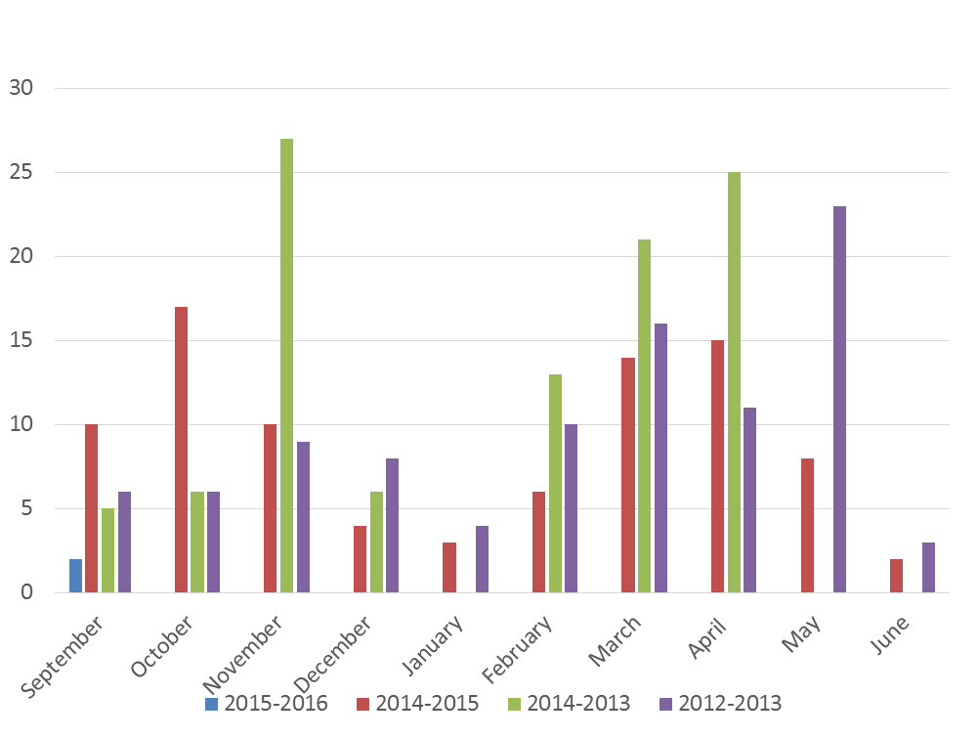
Office Discipline Referrals Year to Year

Slide 16
Suspensions Month to Month 2014-2015

Slide 17
PBIS Leadership Forum Chicago, IL
21,000 schools are now using PBIS
Provides a predictable, positive, consistent and safe environment
Alignment between schools needs to be a district level
Overall it works!

Slide 18
Strengthening Home, School and Community through diverse family partnerships
Adults are self-conscious especially about language usage
Create a support system through the district
Show the Benefits and give them the data (informing the parents empowers them)
Give them the tools to use at home
PTO/PTA – Parent Leadership Institute

Slide 19
Building Tier 2 supports & programs for students with internalizing problems
Behavior is not always referral worthy and can be reflected in grades
When given a targeted assessment they will usually identify themselves as having anxiety(self-report)
Families need to be informed on anxiety and stress
Small group social interventions should be implemented

Slide 20
Small Group Social Skills
Social skills need to be taught tier 1
Must be verbally and physically explicit when going over social skills and behavior expectations
Model and Show them!!
Kids always need to be engaged – Questions need to be set-up for student success

Slide 21
Small Group Social Skills
These are the kids that need more than 4:1 they need 14:1
Schedule 2x’s a week for 20min.
Teach skill repeatedly and use more than 1 trainer
Use real examples
Set a Trap!
Only teacher models the wrong behavior

Slide 22
Elizabeth Bourke – PBIS Chair Elizabeth.bourke@leonagroup.com
Kate Pinkham – Tier 2 Chair
Kate.pinkham@leonagroup.com
Angela Smith – Social Worker/Tier 3
Angela.c.smith@leonagroup.com
Andrea Walley – Instructional Coach
Andrea.walley@leonagroup.com

