Slide 1
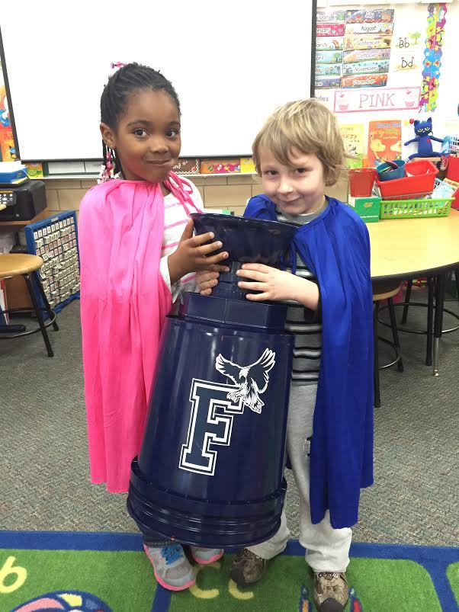
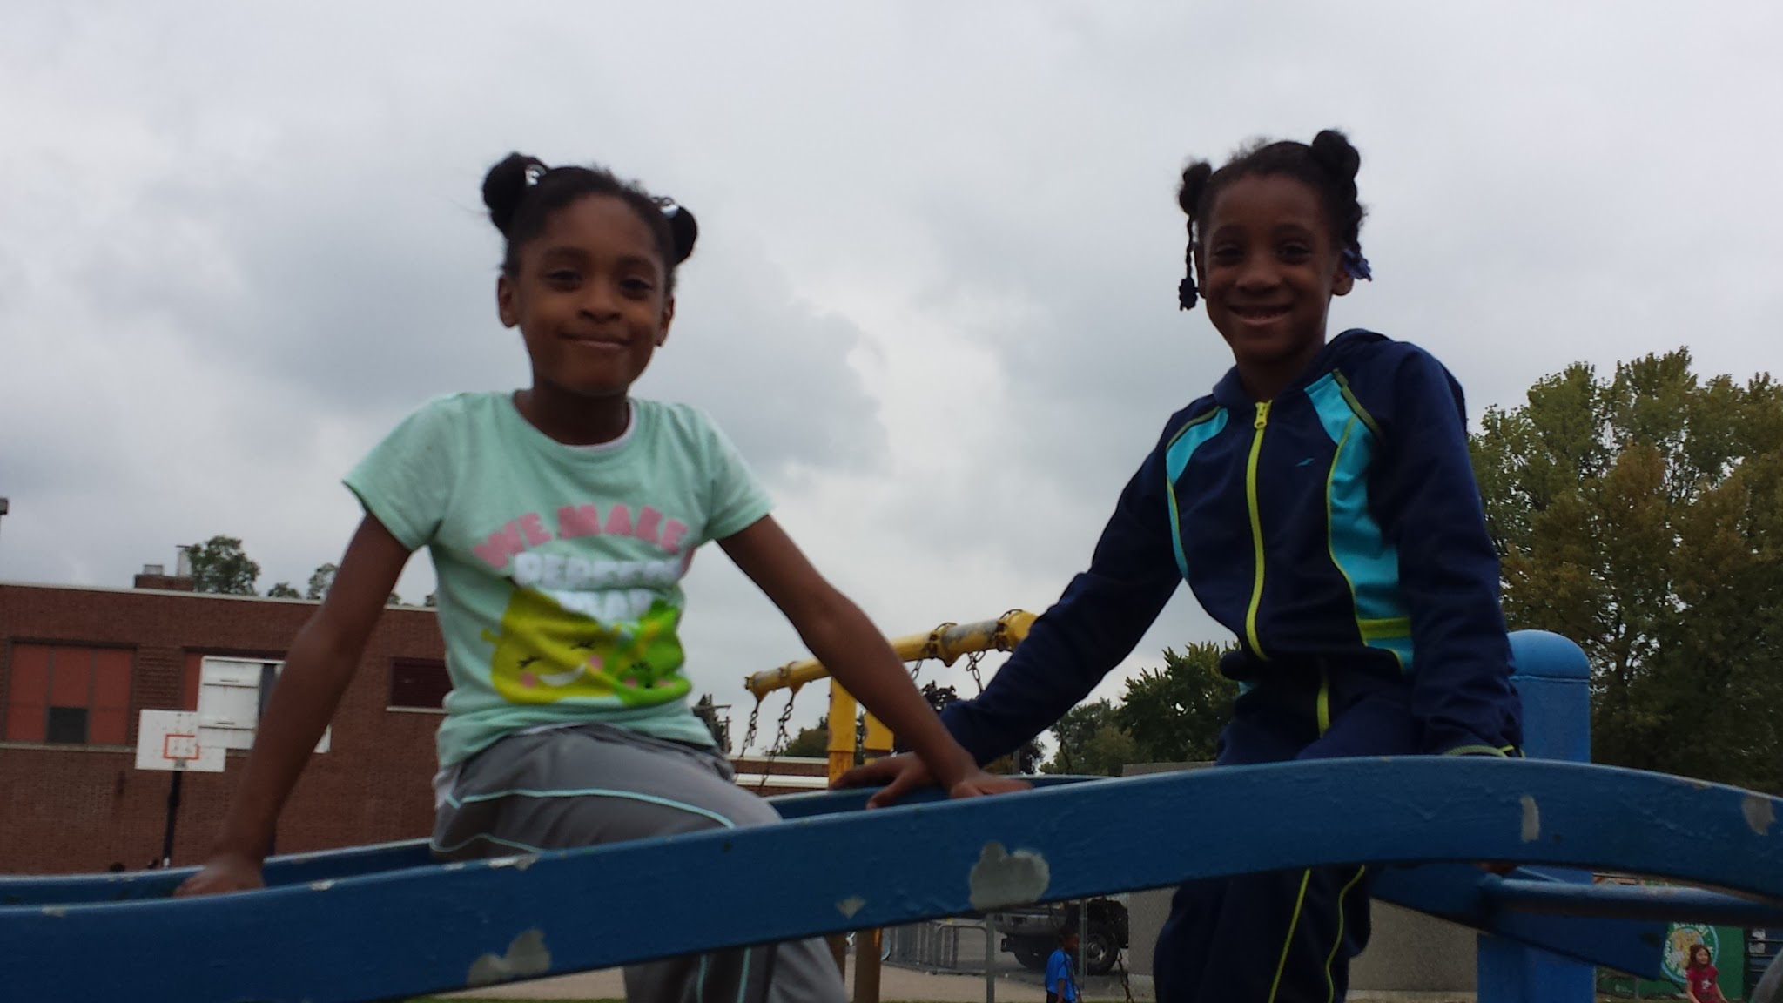
Fisher Elementary
Our Journey in PBIS
(Positive Behavior
Intervention Support)

Slide 2
Fisher Elementary
South Redford
K-5
457 students- 18 classrooms
70.5% meal assistance
78% African American
18% Caucasian
4% Hispanic/Other

Slide 3
Our PBIS Team
Kindergarten
Merrill McArdle
First Grade
Kellee Gourlay
Second Grade
Erin Liptow
Third Grade
Lisa Burke
Fourth Grade
Katie Stevenson
Fifth Grade
Wendi Draper
Social Work
Sally Panci
Secretary
Jackie McGuire
Special Education
Michael Kandah
Principal
Amy Davidson

Slide 4
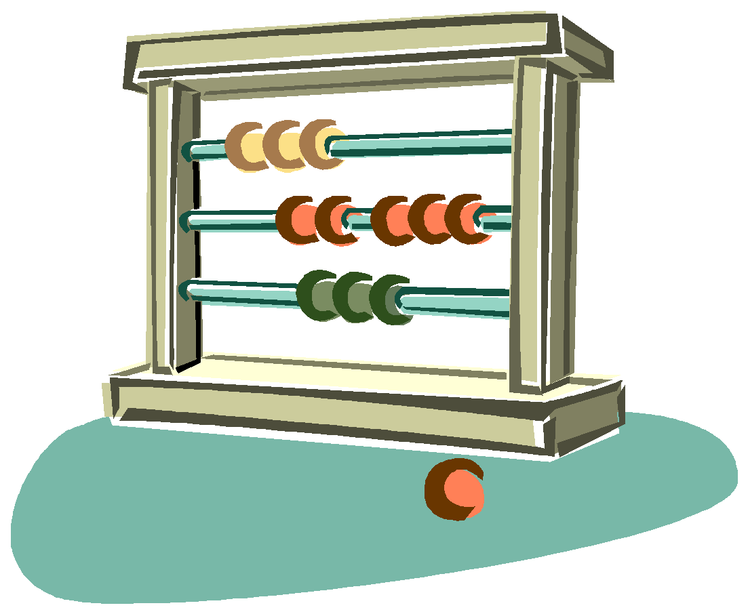
Fisher One Page Plan – Our Big Shifts in…
Math- meet or exceed Common Core expectations
Fluency Strategies
Justifying Why?
Professional Study
Language Arts – meet or exceed Common Core expectations
Reading/ Writing with Evidence
Reading/ Discussing Complex Text
Peer Observation
Climate – respect peers and adults
Peer Respect
Adult Respect
PBIS
Model
behaviors
PBIS
Changing Lives
Student Support
Parental Engagement

Slide 5
Our Mission
Together, we prepare for our future by taking ownership of our learning and behavior.

Slide 6
In the Beginning...
Committee of few in 2009
Grant from Wayne County RESA helped us gather materials, manual and launch the program
Focus on tangible rewards and card flips
Results:
a common classroom and school discipline system
ongoing changes limited and no formal committee

Slide 7
When we started
Only 4 colors (green, yellow, orange, red)
Monthly rewards (kids had to have 3 or less card flips during the month)
Punch cards to earn rewards (ending the day on green was a punch)
Orange tickets in the lunchroom for being caught with good behavior
Pink color ticket for teachers to hand out if they caught someone doing something good (too difficult to keep track of, only lasted a very short while)
Many ODR’s- Reasons for being sent to the office were undefined (teachers sent students for many things that could be dealt with in the classroom)

Slide 8
Then some changes were made... Then, some changes were made…
Larger committee grew to include special areas, upper and lower grades.
Fisher began attending more PBIS training offered by the County.
Friday Community Gathering - classrooms shared what they were working on or wanted to highlight.
Character Education was woven into the program using the Changing Lives words and stories.
At the same time, a school climate goal was established.

Slide 9
For those needs beyond Tier I ...
Peer-to-peer rubric was started with specific behaviors that could be sent to the office. (Teachers interpreted behaviors differently and wasn't as successful as we planned)
Check In/Check Out for individual goals mainly overseen by
the School Social Worker
Social Skills small groups
Some students with a Behavior Intervention Plan

Slide 10
And our most recent changes...
Color System moves from cards to clip scale for room to grow and to make mistakes. Everyone starts on green, but blue and purple were added.
Add Picture of clip chart here

Slide 11
Specific behaviors outlined for ODR’s, consistent school-wide
Buddy Room -
to build relationships in the school
for students on orange to complete Think Sheets

Slide 12
with a focus on the POSITIVE
Classroom rewards
Consistent orange think-sheets for K-2 and 3-5
Opportunity to move back to green if behavior changes
2 added colors above green (blue/purple)
2 star punches for blue/purple
Teachers are now given specific ways to teach the PBiS matrix
Character traits are now specifically taught (same stories shared in each classroom)
Character words are introduced at Community Gathering (sometimes reviewed in daily announcements)
School-Wide end of month celebrations for making good choices
New awards: Fisher Cup, Golden Tennis Shoe, Green Tray, Mona Lisa
Notes:
dance party, treats from the teach,snowman bingo w/cookies, free trach pass, popcorn and movie, popcorn w/ Tiger game

Slide 13
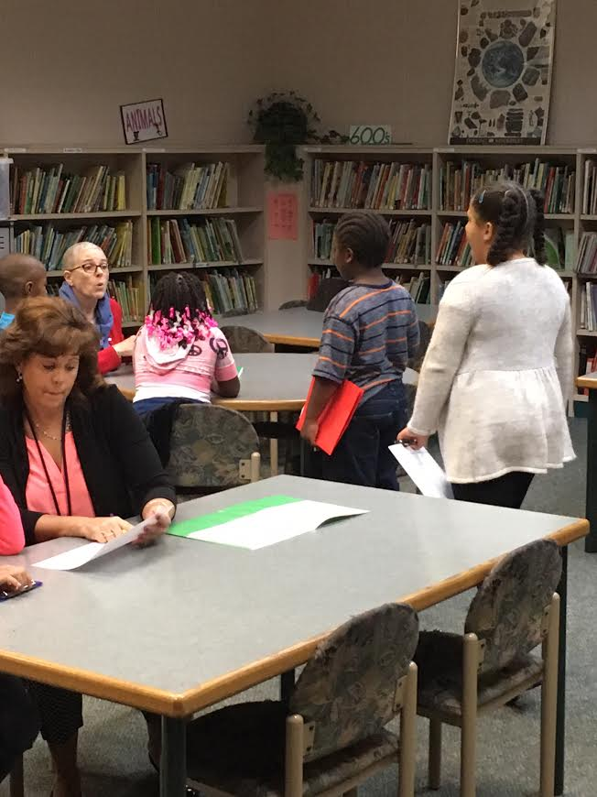
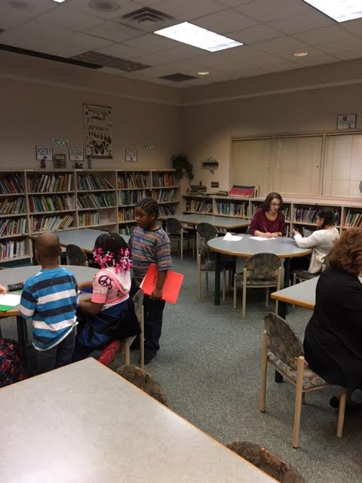
Check in- Check out: All School

Slide 14
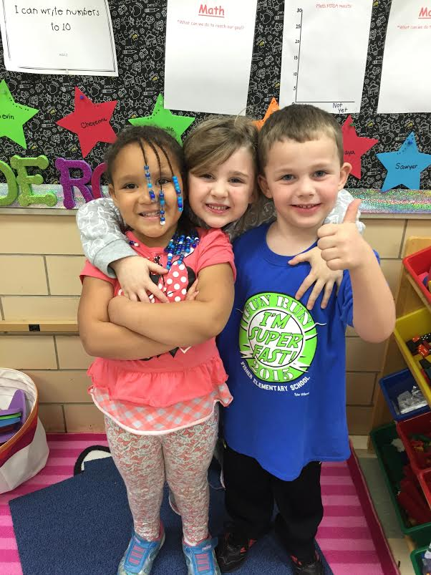
Modeling and Praising (Specifically)
4:1

Slide 15
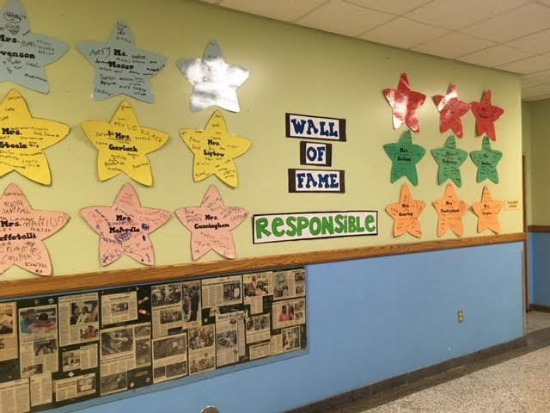
Celebrating Monthly

Slide 16
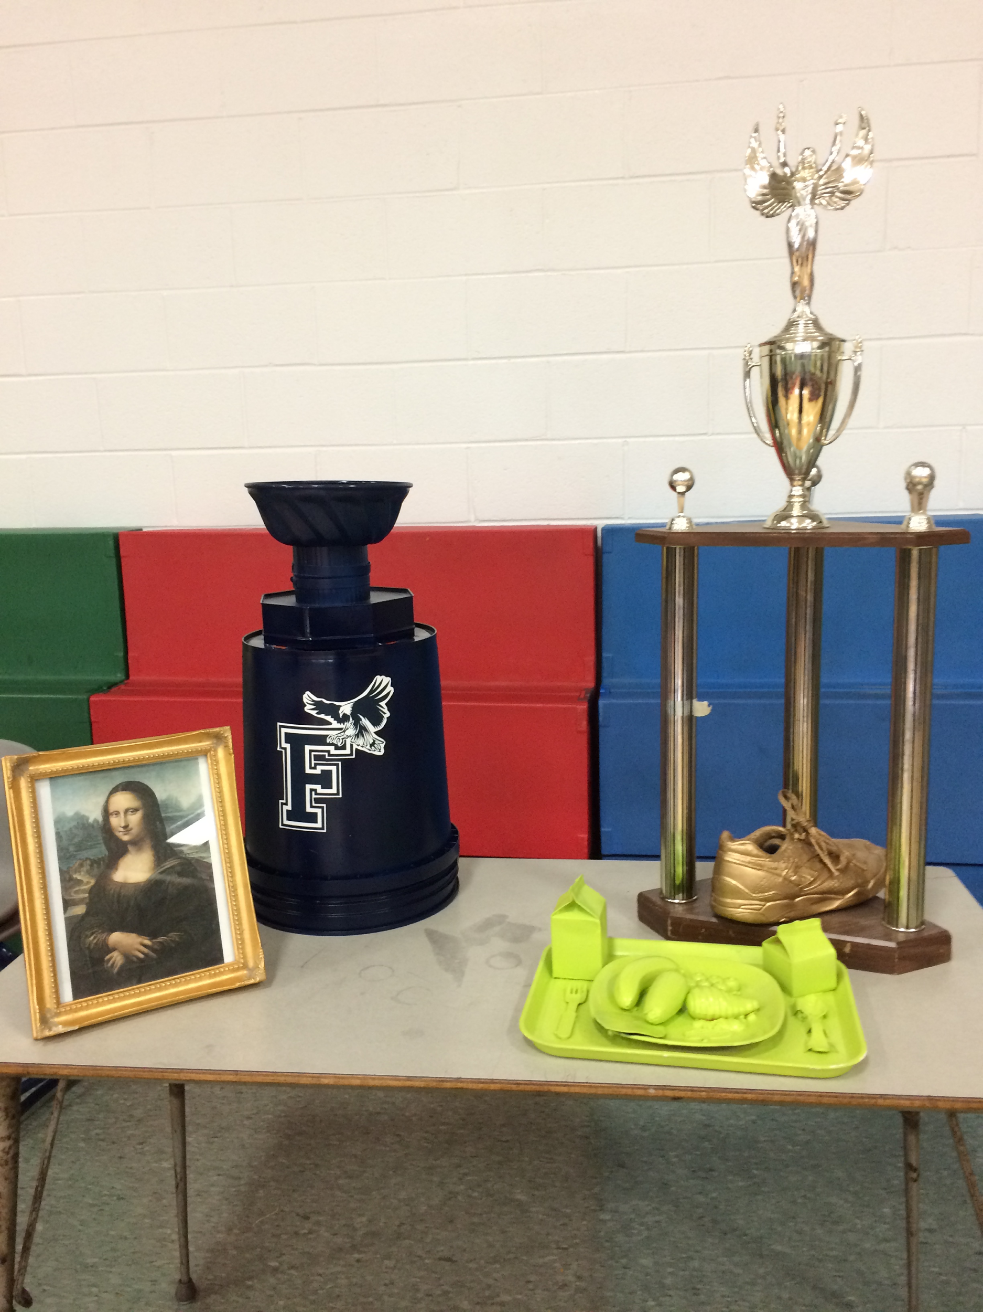
AWARDS
Green Tray
Golden Tennis Shoe

Slide 17
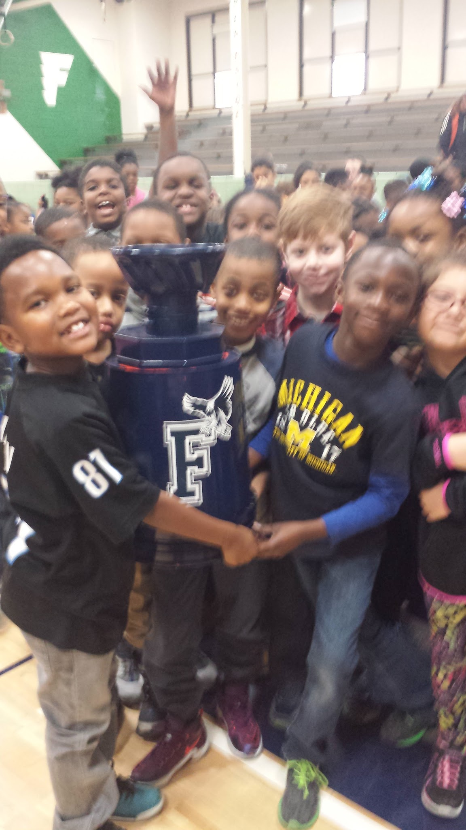
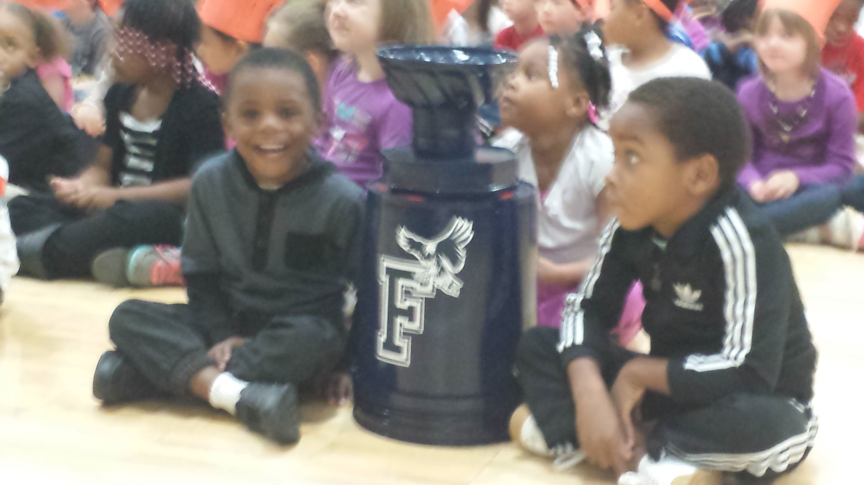
The Fisher Cup

Slide 18
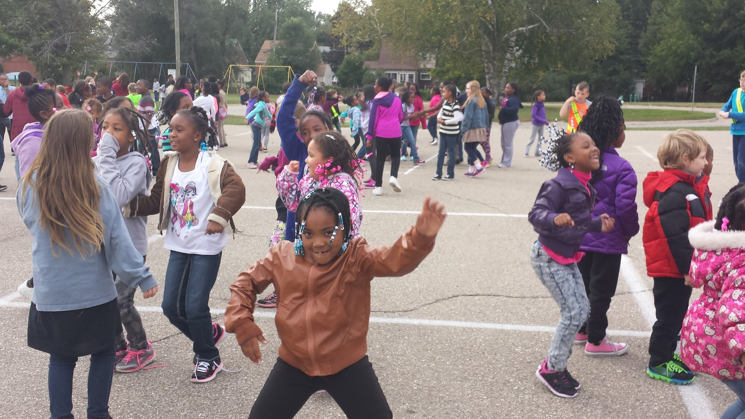
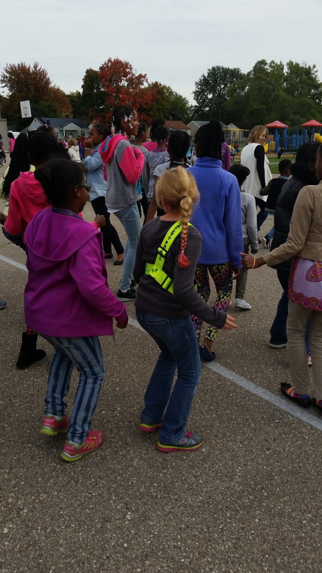
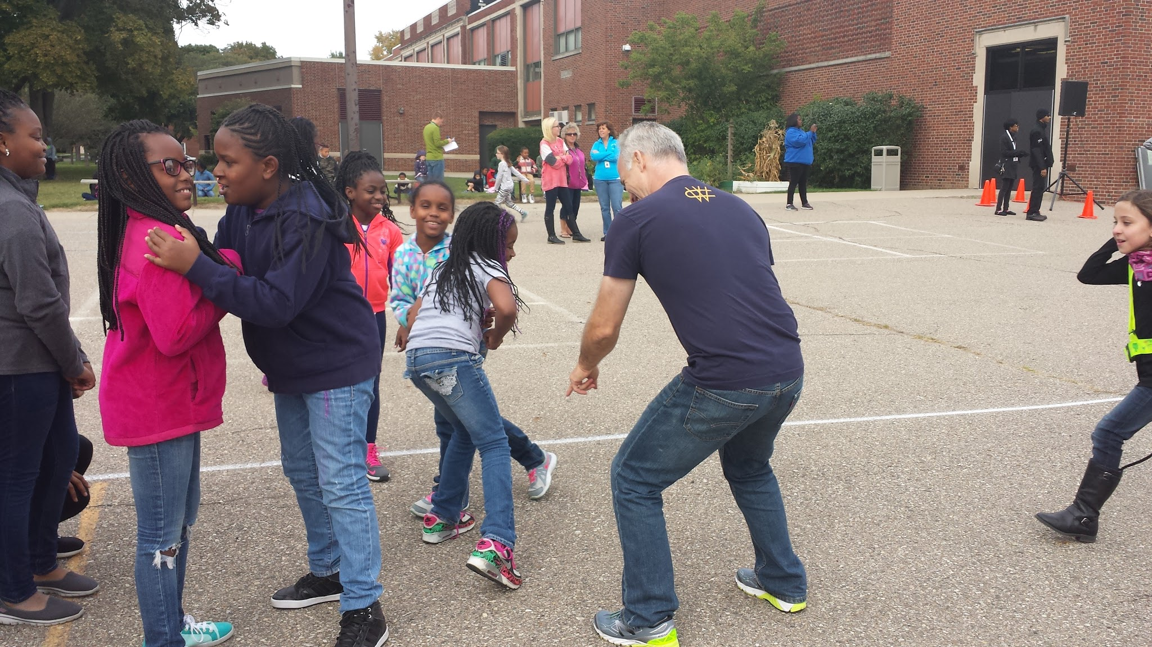
Dance Party!!

Slide 19
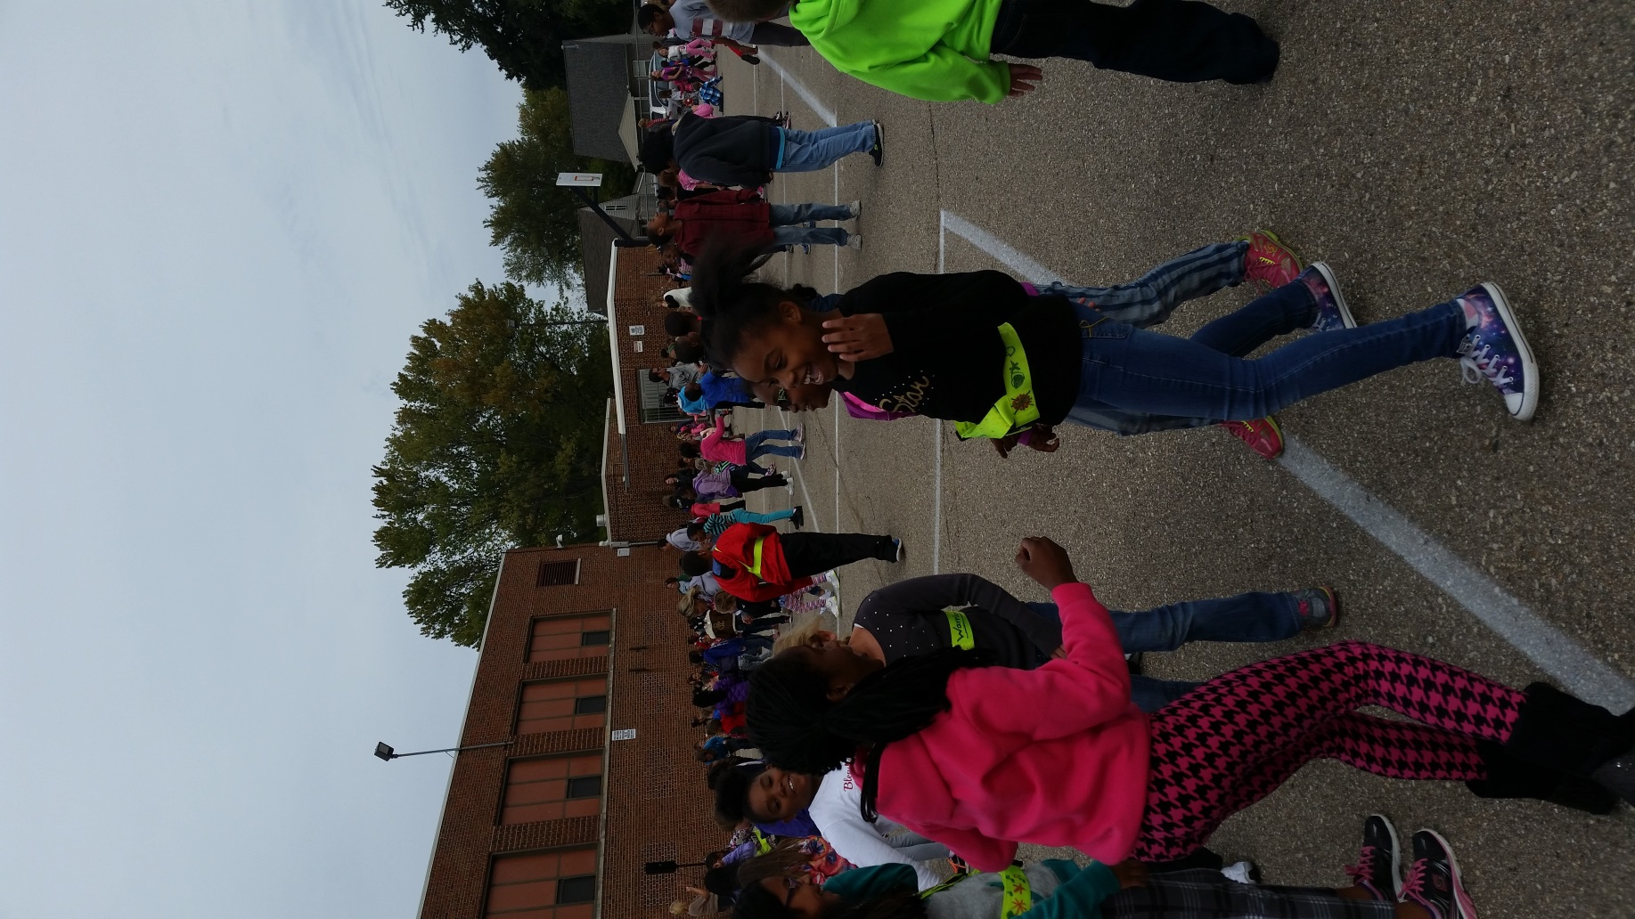
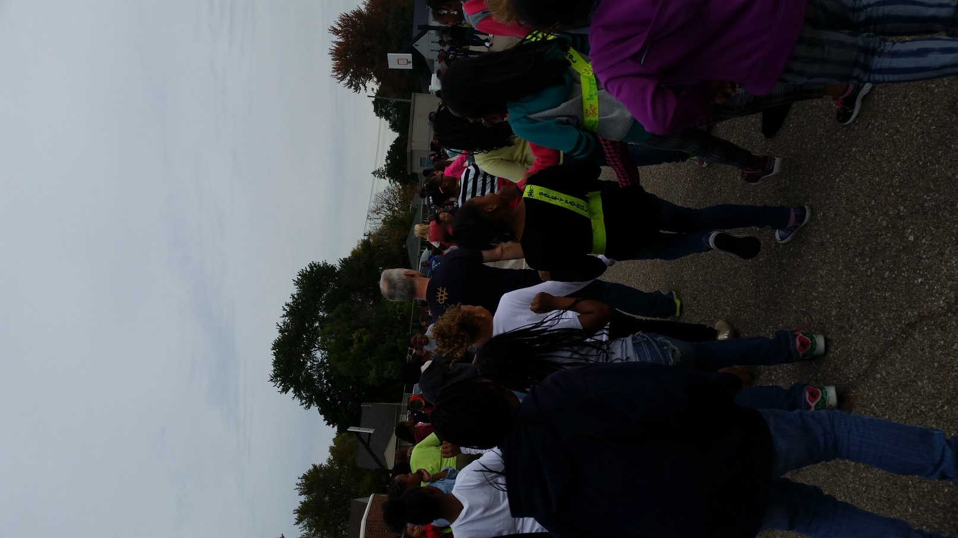

Slide 20
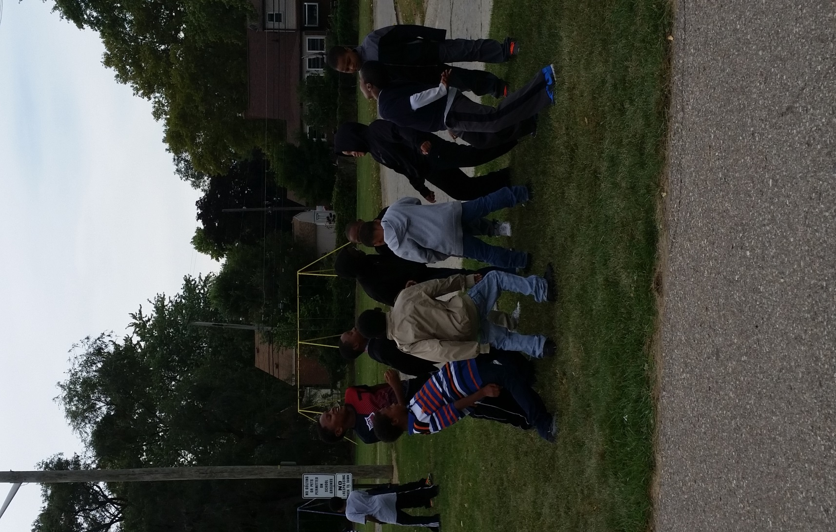
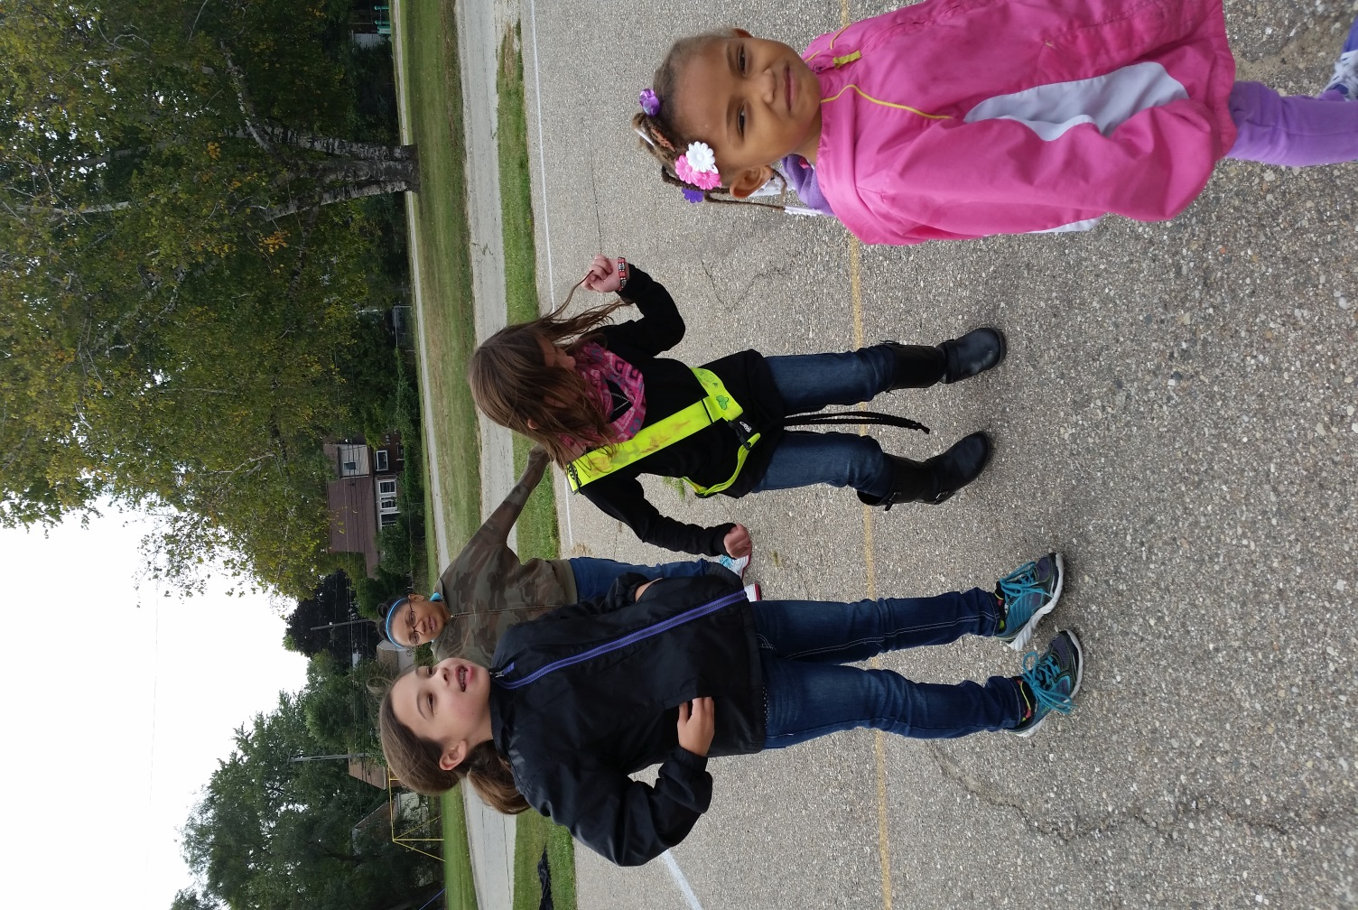

Slide 21
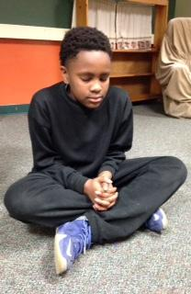
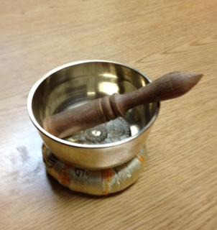
Strategies for
Prevention and Intervention
PBIS
Why Try
Mindfulness

Slide 22
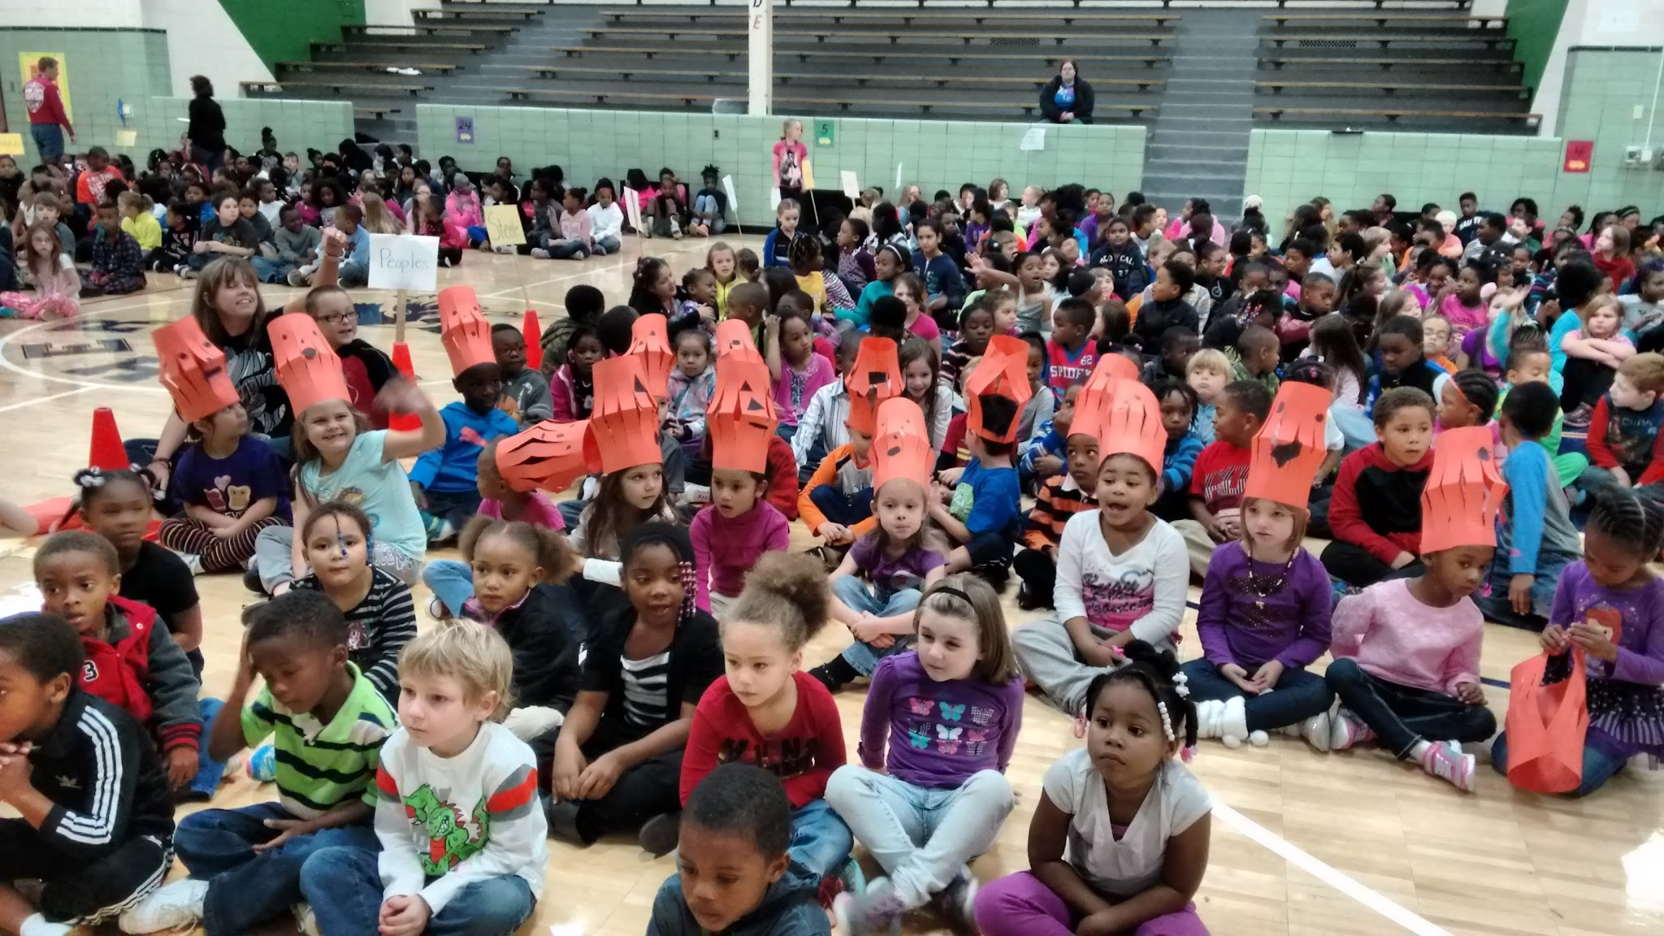
The Community Gathering
https://www.youtube.com/watch?v=PIgJZ4qzzMc&feature=youtu.be

Slide 23
What the Data Shows...
ODRs by Month - Year to Year
ODR’s
September 2009- 17
September 2010- 16
September 2011- 19
September 2012- 21
September 2013- 37
September 2014- 26
September 2015- 2
ODR’s
October 2009- 17
October 2010- 31
October 2011- 27
October 2012- 47
October 2013- 40
October 2014- 32
October 2015- 15

Slide 24
How the students feel
https://www.youtube.com/watch?v=W11a005xUug&feature=youtu.be

Slide 25
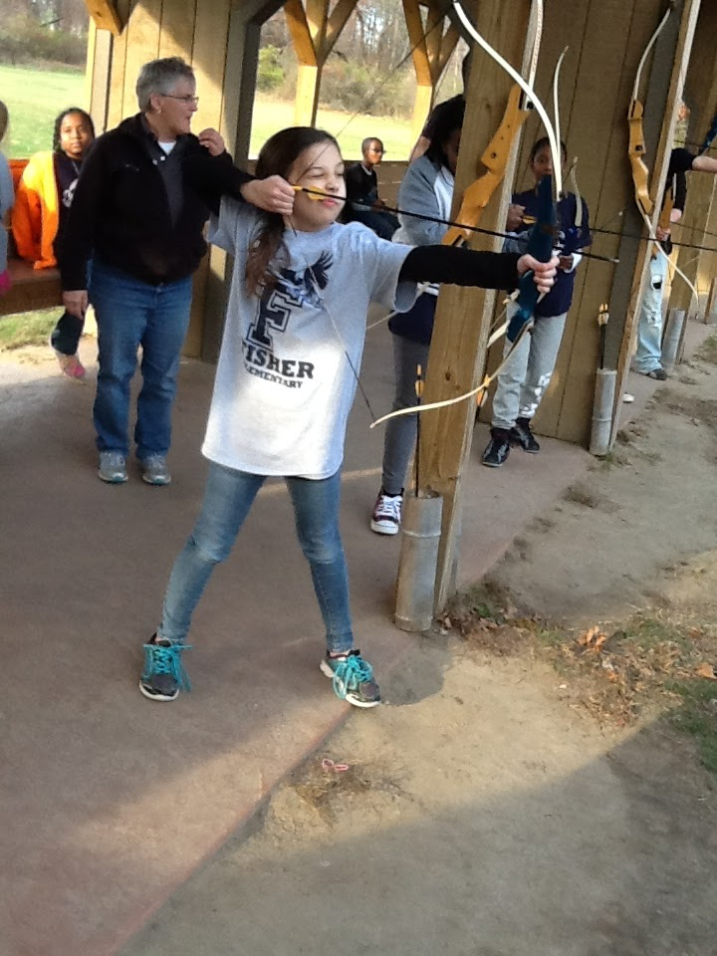
Our Continuous Improvement
Continue to STUDY the data from monthly reports, classroom teacher and student feedback.
ACT on changes through the work of the committee.
Celebrate growth.
Research Tier III and Tier IV solutions through benchmark visits to other schools and training for students with specific behavioral needs.

Slide 26
Fisher Elementary School
Contact us at 313-532-2455 or
Erin Liptow- erin.liptow@southredford.org
Mike Kandah- michael.kandah@southredford.org

