Slide 1
Bennie Elementary PBIS Overview
Sandy Bennett- SSW
Erik Browe- Resource Room
Julie Manor- 4th Grade
Sara Siegwald- 3rd Grade

Slide 2
General Information

Slide 3
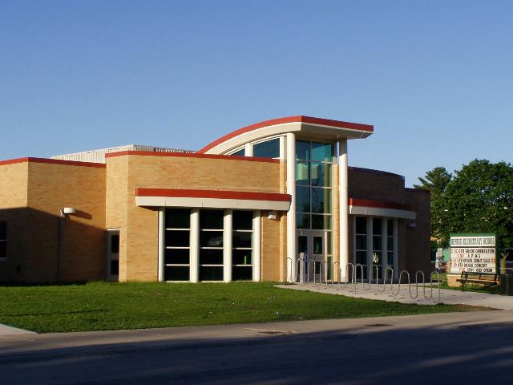
School Size and Demographic
476 Students
Grades K-5
Title I Targeted-Assistance; 35% F&R

Slide 4
Membership and Roles
Administrator Role: Oversee the PBIS program, collect data, reports data to the county, and attempts to implement alternative consequences rather than suspension (if possible).
General Education Teacher Role: Implementation of the PBIS system both school-wide and in their individual classroom.
Support Staff (SSW, Resource Room, Ancillary Staff, etc): Assist with rewards/ consequences and help support the implementation school-wide.

Slide 5
Number of Years Implementing PBIS
PBIS first applied for grant in 2006/2007 school year.
PBIS has been tailored and improved over the past ten years.

Slide 6
Level of PBIS Implementation
Bennie has implemented Tiers 1 through 3.
Within the program, classroom teachers are able to tweak the system to meet their own classroom needs.

Slide 7
Data
Please put in graph for ODR’s either last year or comparison...

Slide 8
Teaching Expectations

Slide 9
Opening of School Year PBIS
Stations- Using teaching support staff and 5th grade “actors” in the following places: Hallway, Bathroom, Bus, Office, Playground, and Cafeteria

Slide 10
Matrix
In all classrooms.
Sent home to families as brochure in opening packet.

Slide 11
W-BEST Student Broadcast
Review Expectations
Focus on Monthly Theme

Slide 12
PBIS Expectations on W-BEST
https://youtu.be/BSu3ZuKSz1w

Slide 13
Student Recognition and Rewards

Slide 14
Funding PBIS at Bennie Elementary
Developed a letter to request donations from community businesses (Jet’s Pizza, Bowling, Sky Zone, Fast Food, Target, Meijer, Tax- ID).
Sold smencils, Bennie spirit wear, candy at after school family events.

Slide 15
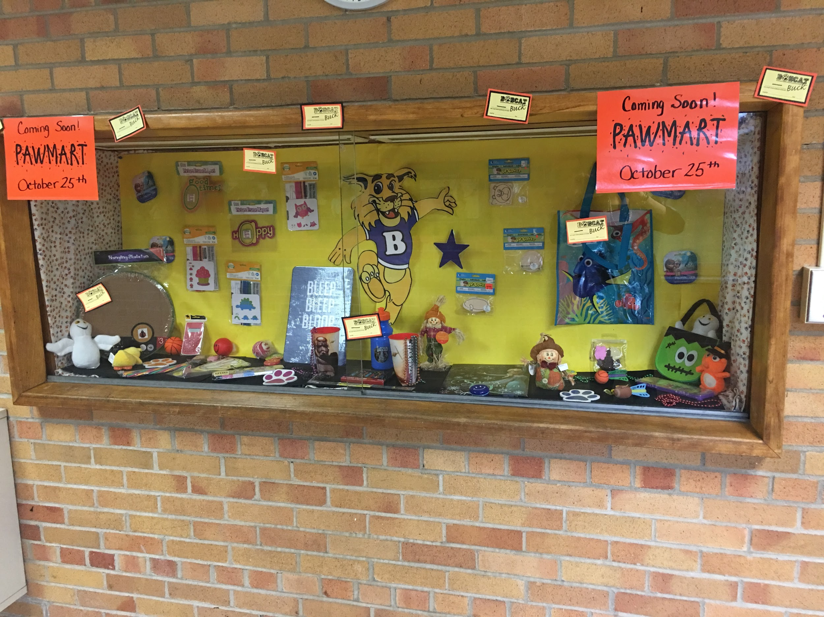
Student Recognition
Weekly Bobcat Buck Recognition
Monthly Rewards/ Charms
Ace Awards
Paw Mart

Slide 16
Weekly Bobcat Buck Recipients
Two students are recognized each week from each class.
The students get their names announced on Friday morning.
Students come down to main office and receive a Bobcat Paw Sticker.

Slide 17
Monthly PBIS Rewards
September: Lunch with class/extra recess
October: Trick-or Treat
November: Electronics Day
December: Pj/sweats with a movie
January: Extra Gym
February: Zumba
March: March Madness
April: Homework Pass
May: Ice Cream Sundae
June: Basket Raffle

Slide 18
Monthly Themes:
Responsibility
Respect
Kindness

Slide 19
Ace Awards
Two per class each month
The students that are picked for the Ace Awards are students that go “above and beyond.”
Students receive a medal and a picture is taken of each winner and placed on a Ace Award bulletin board in the main hallway.
PBIS Team is considering other ways to recognize Ace winners.

Slide 20
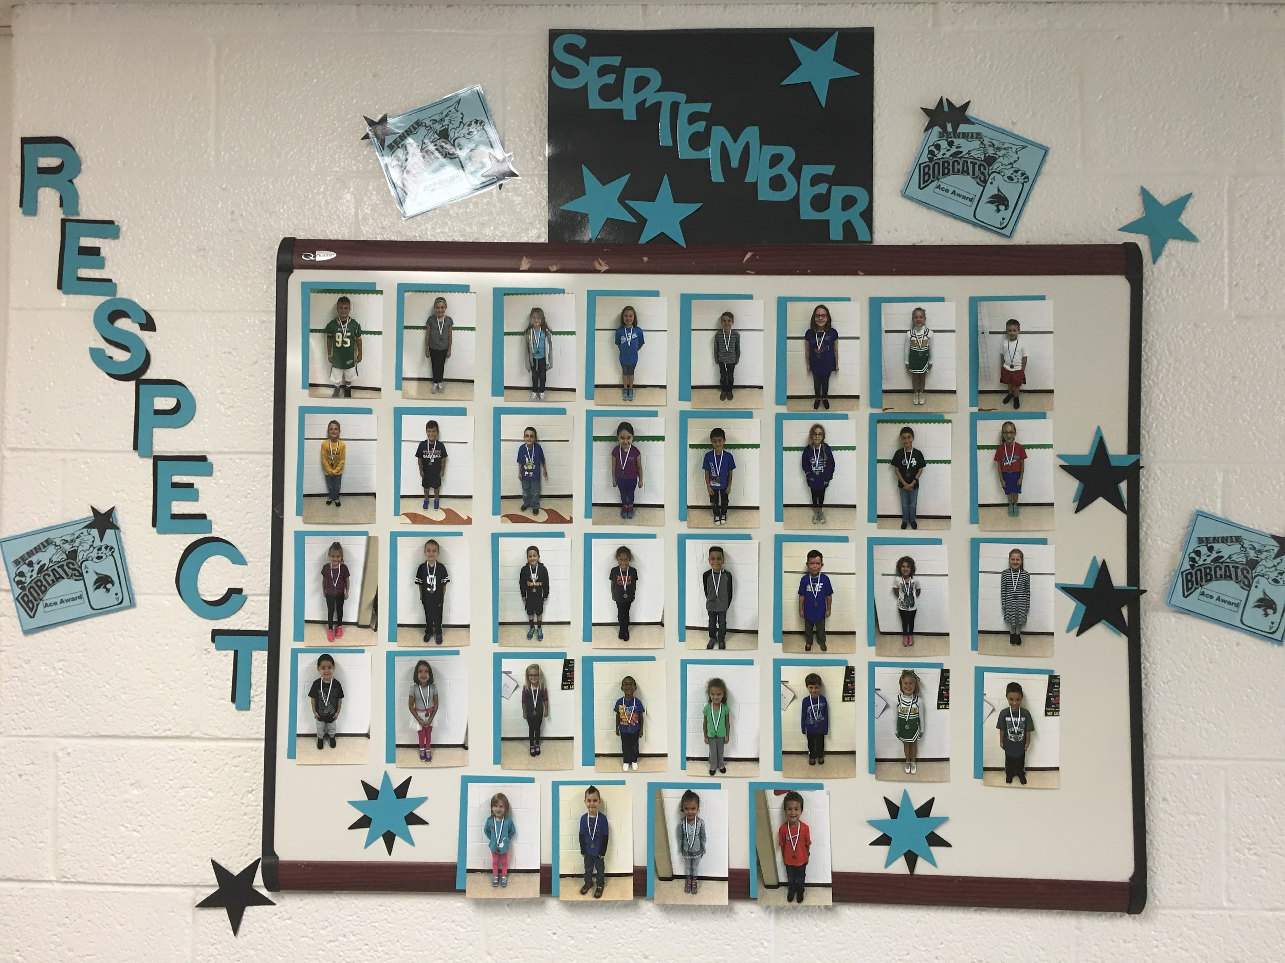
Ace Award Bulletin Board

Slide 21
Paw Mart
3-4 times per year.
Students purchase items with Bobcat Bucks.
Many items donated.
Parent volunteers.
Year-End basket raffle (and special holiday bucks/raffles).

Slide 22
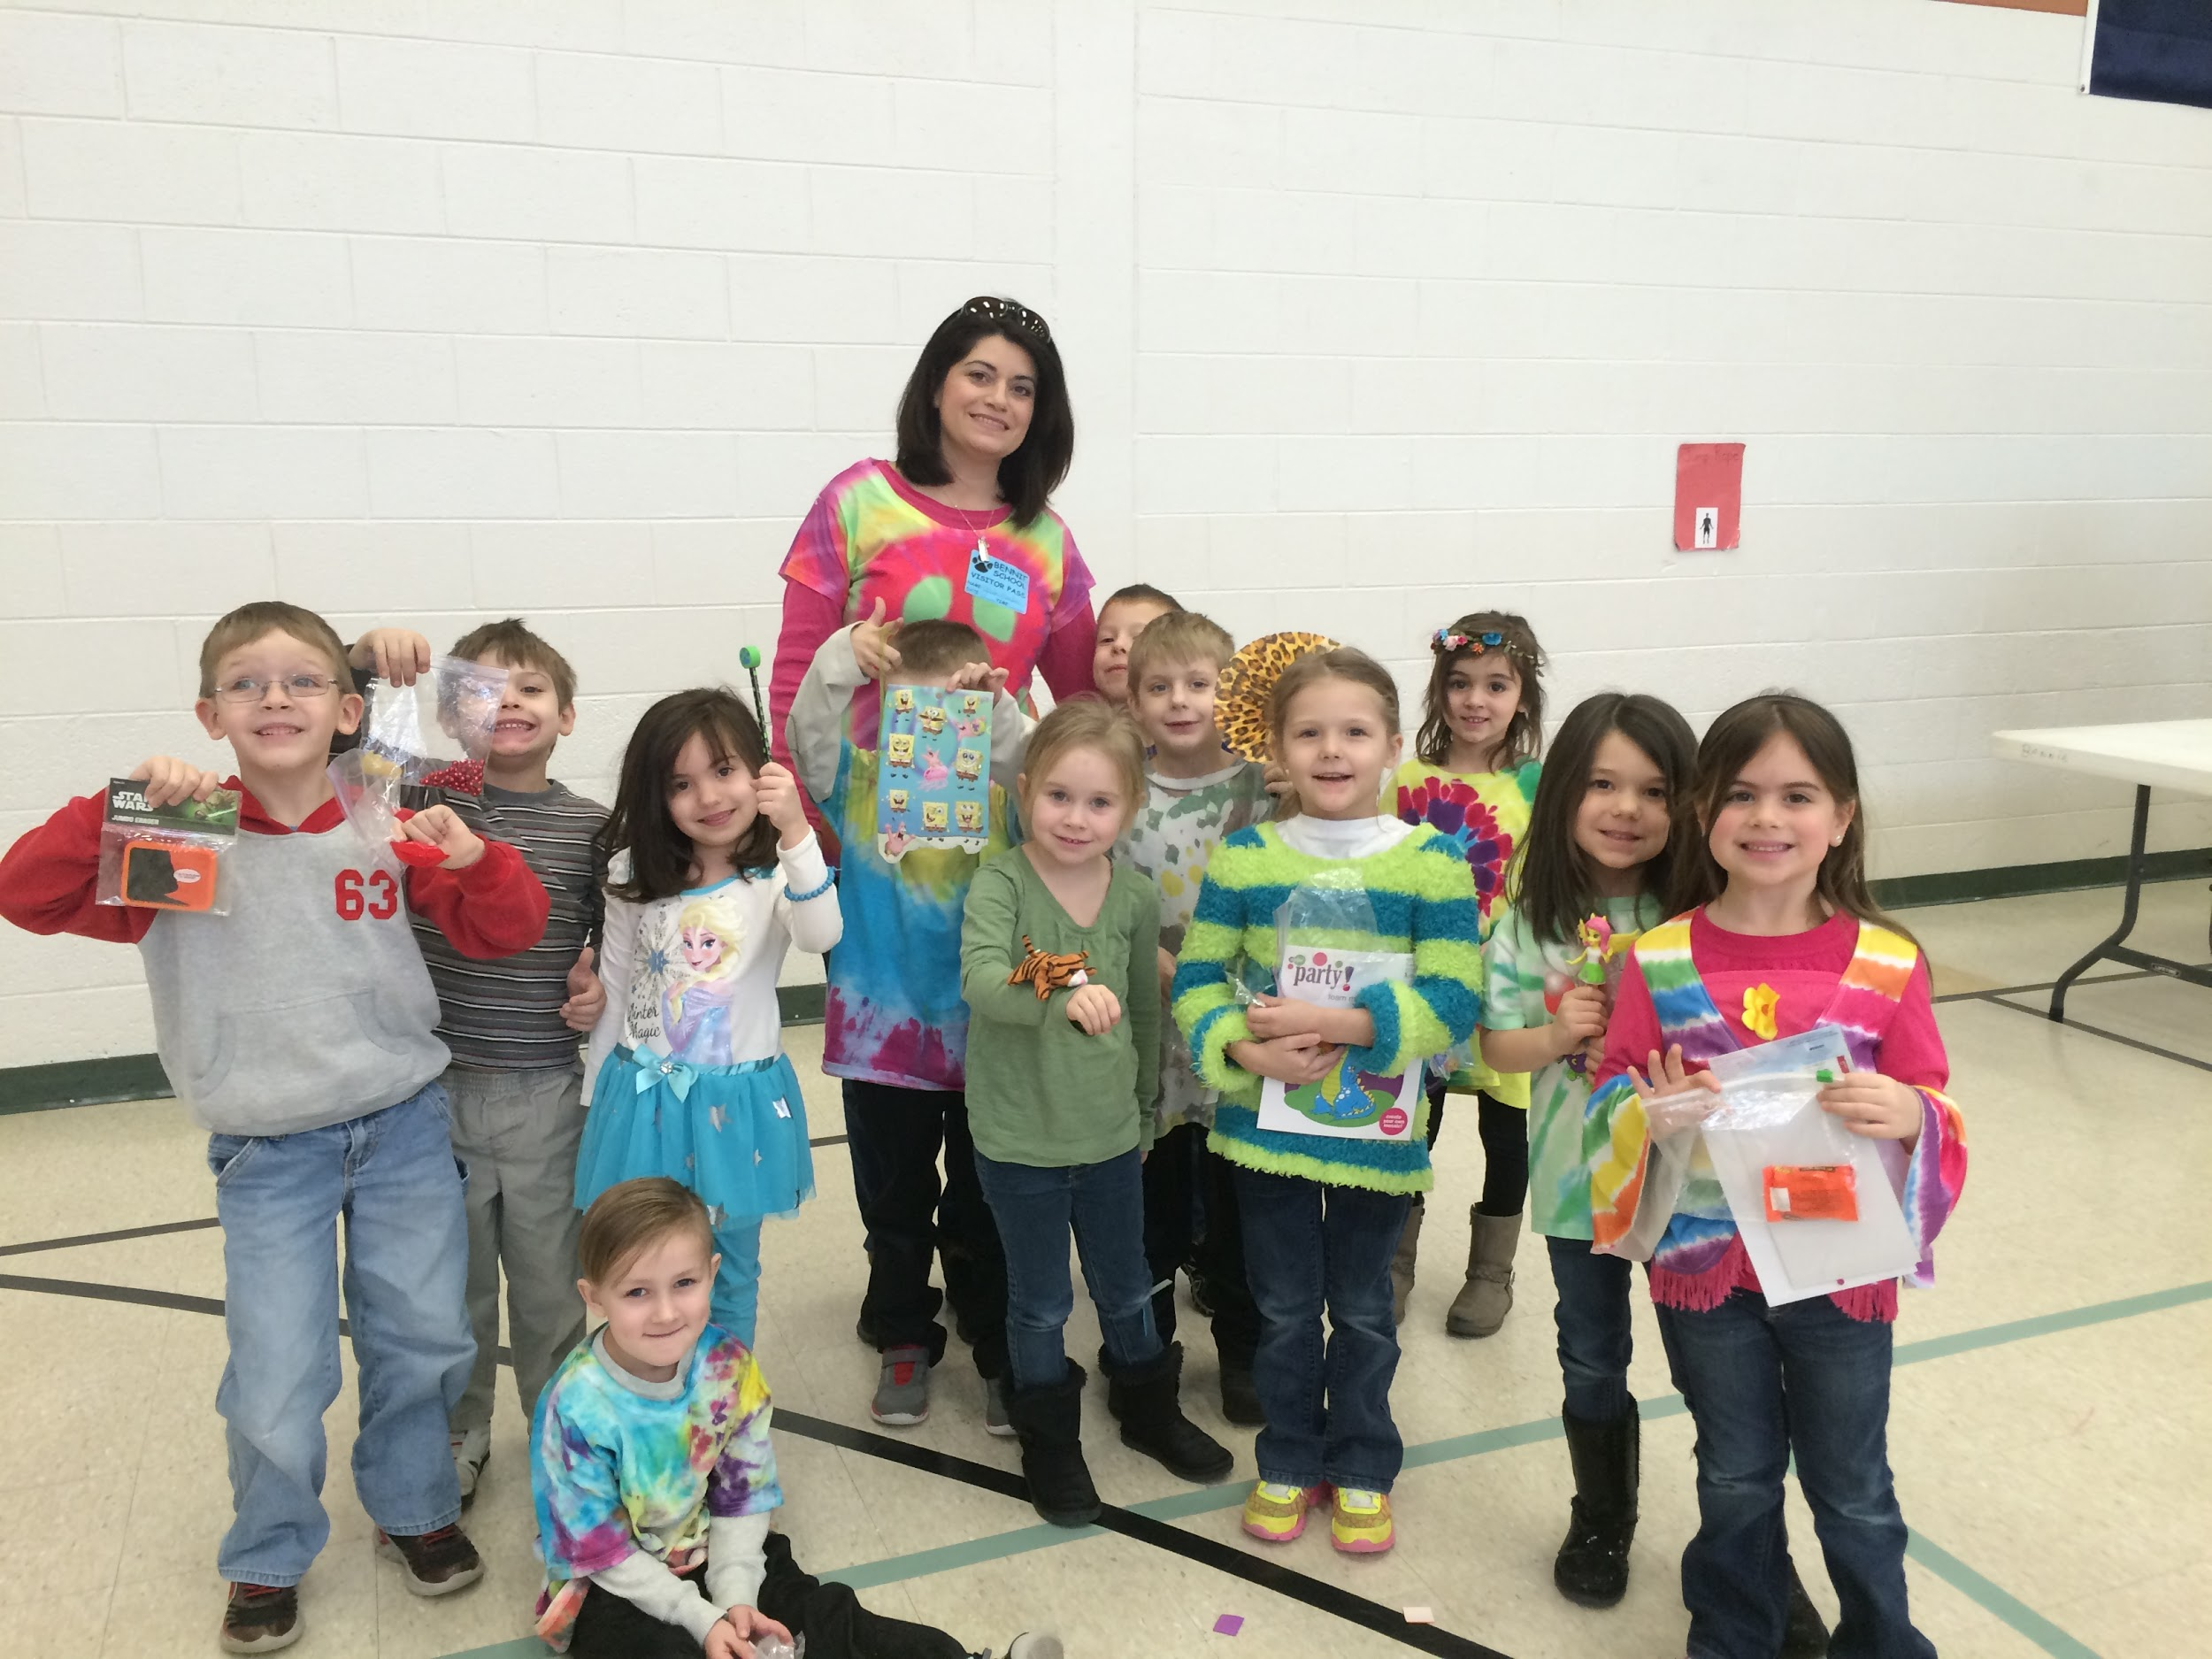
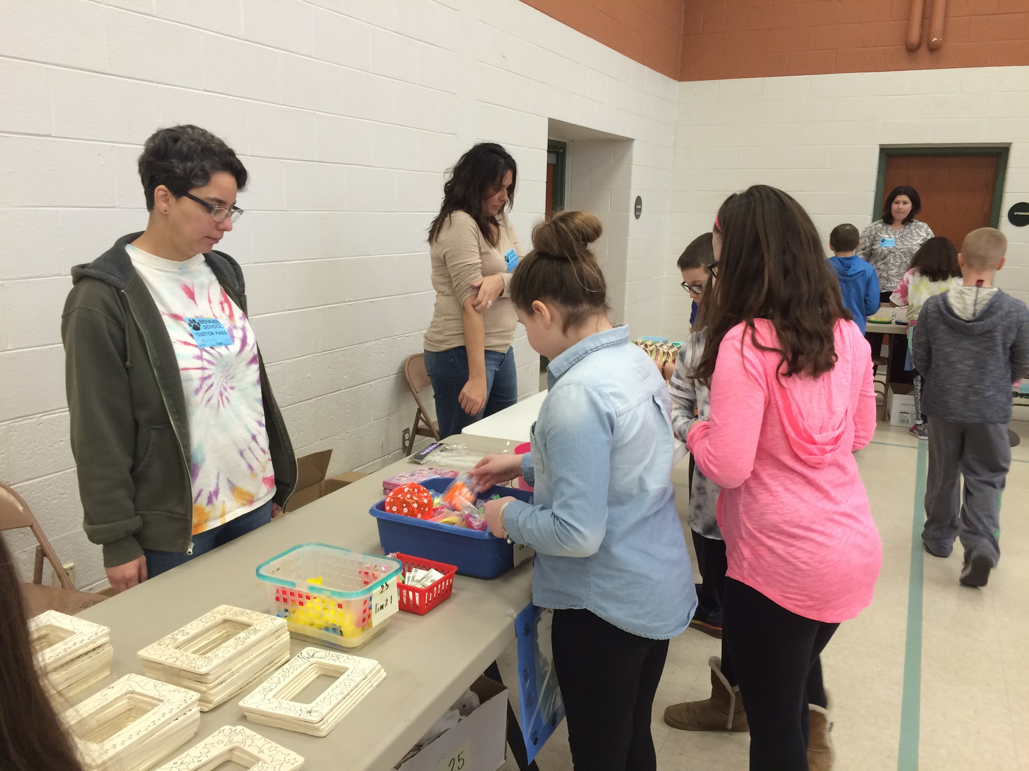
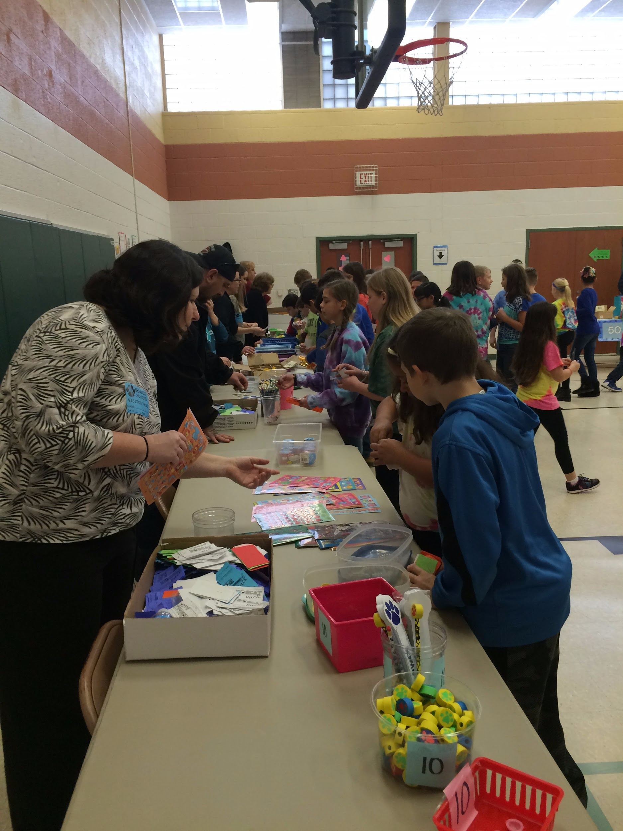
Picture of Paw Mart

Slide 23
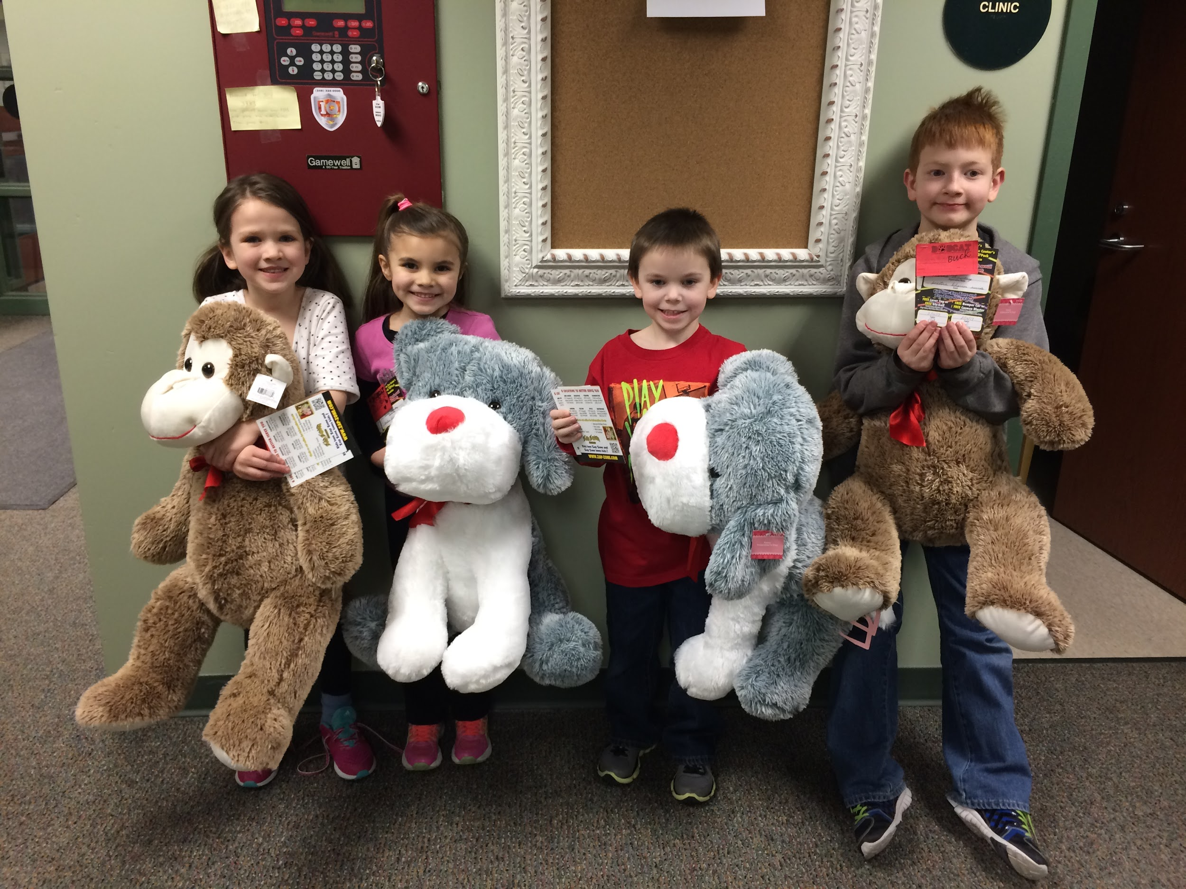
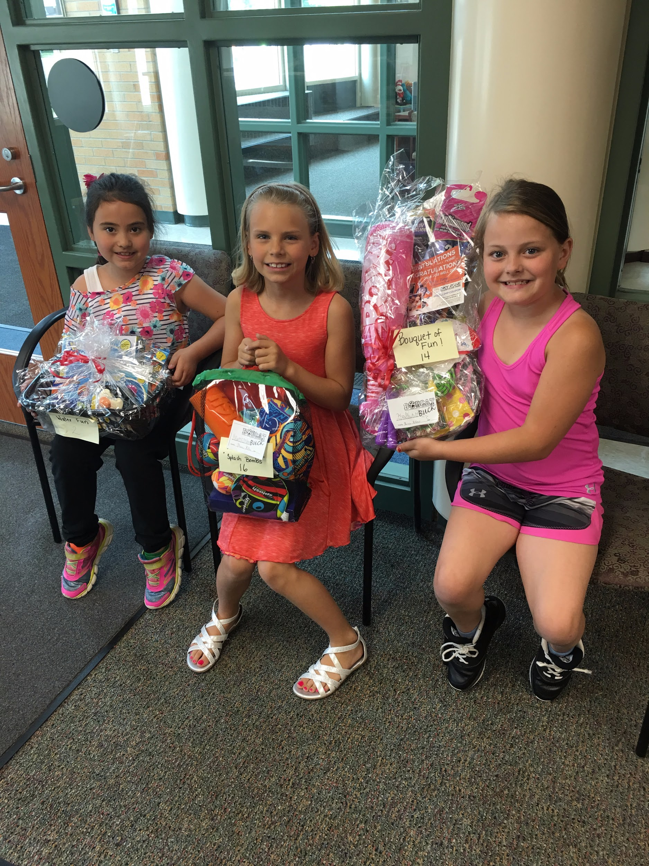
Special Bobcat Bucks/Raffles
Christmas time Santa Bucks
Valentine Bucks given during lunch time.
Bunny Bucks throughout the school day during Spring.
End of the year raffle, all staff donate baskets.

Slide 24
Student Surveys
In the Spring, students grades 3-5 were given an online survey (google form). Survey was done either in the classroom or during media time.
PBIS team reviewed the results in August, which helped us to determine rewards for the present school year.
We plan to survey each month to receive immediate feedback from students. This will help us to determine higher interest rewards.

Slide 25
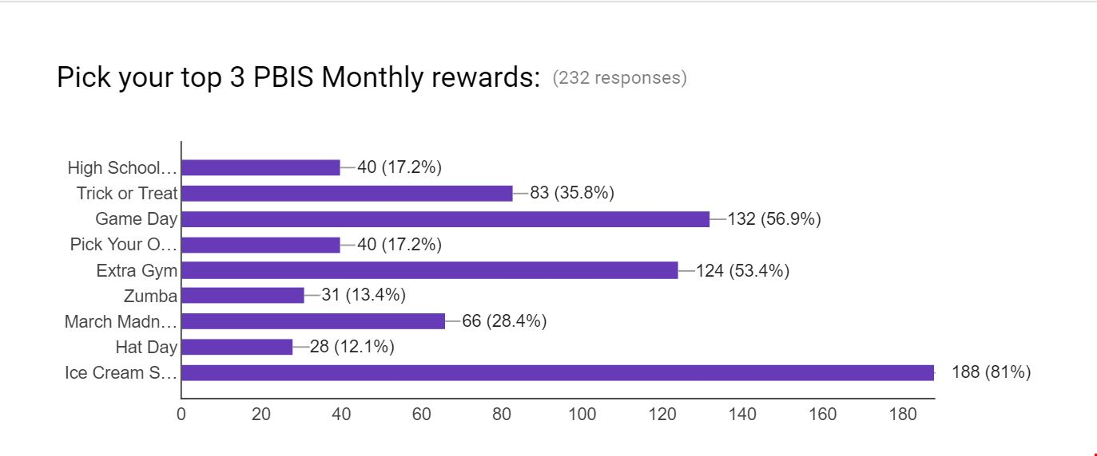

Slide 26
Tier 2/3 Intervention- Mentoring

Slide 27
Tier 2 Intervention- Mentoring
4th/5th graders elect to be on mentoring team as student leadership opportunity.
Training during lunch times with social worker.
Similar to check in/check out.
Use of HS or MS students for upper elementary students needing mentors.
Students selected for mentoring based on PBIS referral data.
Starts as soon as possible with last year’s data.

Slide 28
Examples of Tier 2 Interventions used at Bennie Elementary
Active Supervision
Alternatives to Suspension
Bully Prevention (Classroom Based)
Check-in/ Check-out
Instruction in Behavior Expectations/ Social Skills
Kids Hope Mentors
Take a Break
FBA’s/ BIPS as needed

Slide 29
Tier 3
Always a struggle
Unique to each student
Close communication with family
Specific behaviors identified and monitored (FBA/ BIP/ Data)
Outside agencies if appropriate/available

Slide 30
Contact Information
Sandy Bennett- School Social Worker
bennett@appublicschools.com
Erik Browe- Resource Room Teacher
browe@appublicschools.com
Julie Manor- 4th Grade Teacher
manor@appublicschools.com
Sara Siegwald- 3rd Grade Teacher
siegwald@appublicschools.com

