Slide 1
Pierce Middle School South Redford School District
Christine Hofer, Principal
Christine.hofer@southredford.org
Arietta Papas, PBIS Chairperson
Arietta.papas@southredford.org
Shakel Raiford, Student Responsibility Room (SRC)
Shakel.raiford@southredford.org

Slide 2
Demographics of Pierce MS
Total Number of Students: 702
6th Grade: 248; 7th Grade: 258; 8th Grade: 235
Race:
African American 565 (76%)
White 143 (19%)
Latino 22; Asian 7; Native American 4 (4%)
Gender:
Male: 385; Female: 356

Slide 3
GOALS
Develop and implement a system that will:
Change behavior
Provide specific data regarding problem behaviors
Reward positive behavior
Maximize instructional time
Keep students in class whenever possible
Identify students who need additional support, interventions
Be sustainable long-term

Slide 4
Elements of PBIS
4:1
Lunch Rewards
SRC
Alternatives to Suspensions
Radar List

Slide 5
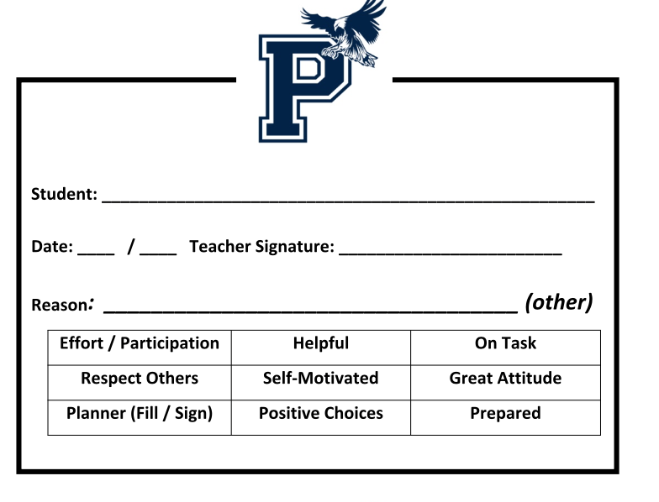
Lunch Rewards
Open gym
Recess
Technology room
Teacher helper
Office helper
Maker Spaces
Read to Virginia (the dog)
Lunch in the courtyard
Lunch at special tables
AP or Principal of the ½ day
and others… (easy to add, subtract, change...FREE)!

Slide 6
Purpose of SRC
Maximize instructional time
Removal of disruptive students to prevent further classroom interruptions
Students are taught the appropriate behavior/response
SRC teacher tracks, calls home, and records the reason the student was sent to the SRC
Student is sent back to class the next hour with a “fresh start”
Data from SRC informs tiers 2 and 3

Slide 7
Student Responsibility Center
What behaviors warrant a trip to the SRC?
Disruptive, disrespectful, insubordination, inappropriate language
What is the process to go to the SRC?
Teacher uses 2-3 interventions prior to referral
Teacher fills out SRC referral form online
Student checks in to the SRC room carrying with them an orange SRC slip

Slide 8
What happens when you reach the SRC?
Student reflects on behavior, receives one-on-one mentoring
Goal is for student to take responsibility for his/her actions
Student does not return to class until the next hour
Parent is contacted

Slide 9
How we use SRC data to determine Tier 2 students
SRC teacher sends out weekly reports of SRC visitors
Staff reviews data looking for students with five visits to the SRC.
Teams determine which intervention the student should receive.

Slide 10
How we use SRC data to determine Tier 3 students
SRC teacher sends out weekly reports of SRC visitors
Teams review data looking for students with ten visits to the SRC.
Teacher Consultant conducts Functional Behavior Assessment on student and helps team to develop a Behavior Intervention Plan with parent and team.

Slide 11
How we use SRC data to build a “Radar List”
End of year SRC and ODR data is used to IDENTIFY students who struggled throughout the year
PROACTIVE APPROACH: These students and their families are asked to participate in school events and activities
GOAL is to connect them to their school; give them positive experiences and be proactive in our approach

Slide 12
2015 / 2016 Radar List
20 students were on the list from 14/15 behavior
14 students (70%) had 0 - 2 infractions
5 students (25%) had slightly less than the previous year
1 student (5%) had more than the previous year

Slide 13
Year to Year Data-SRC
2014- 2015 | 947 Total Referrals 265:Disrespectful 406:Disruptive 276:Insubordinate | Grade: 6th Gr: 159 7th Gr: 404 8th Gr: 384 | Gender: Boys: 724 Girls: 223 | Class Period: 1st: 80 2nd: 102 3rd: 137 4th: 248 5th: 181 6th: 52 | Multiple Referrals: 2: 109 3: 38 4: 19 5+: 13
2015- 2016 | 774 Total Referrals 189: Disrespectful 360: Disruptive 225: Insubordinate | Grade: 6th Gr: 184 7th Gr: 308 8th Gr: 282 | Gender: Boys: 584 Girls: 190 | Class Period: 1st: 77 2nd: 96 3rd: 154 4th: 190 5th: 154 6th: 101 | Multiple Referrals: 2: 132 3: 47 4: 25 5+:14

Slide 14
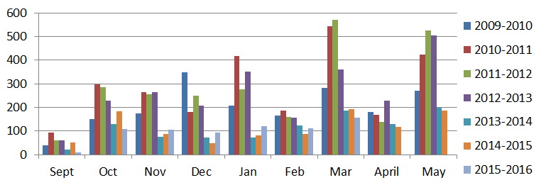
Year to Year Data-ODRs
 | 2009-2010 | 2010-2011 | 2011-2012 | 2012-2013 | 2013-2014 | 2014-2015 | 2015-2016
Sept | 38 | 92 | 61 | 61 | 21 | 50 | 9
Oct | 150 | 298 | 284 | 229 | 128 | 183 | 108
Nov | 174 | 263 | 256 | 265 | 76 | 88 | 104
Dec | 348 | 180 | 249 | 206 | 72 | 48 | 94
Jan | 206 | 417 | 275 | 350 | 72 | 82 | 120
Feb | 164 | 186 | 159 | 156 | 123 | 86 | 111
Mar | 281 | 543 | 569 | 359 | 187 | 191 | 156
April | 179 | 169 | 137 | 227 | 129 | 118 | 186
May | 271 | 424 | 525 | 503 | 199 | 185 | 179

Slide 15
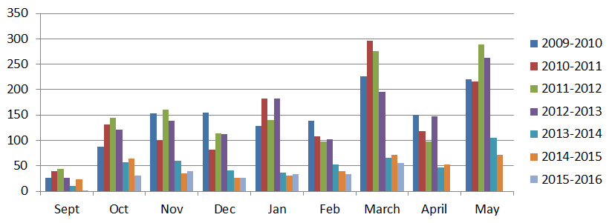
Year to Year Data-Suspensions
 | 2009-2010 | 2010-2011 | 2011-2012 | 2012-2013 | 2013-2014 | 2014-2015 | 2015-2016
Sept | 26 | 39 | 44 | 27 | 10 | 24 | 1
Oct | 87 | 131 | 145 | 121 | 57 | 64 | 30
Nov | 153 | 101 | 161 | 138 | 60 | 35 | 39
Dec | 154 | 82 | 114 | 112 | 41 | 26 | 26
Jan | 129 | 182 | 140 | 182 | 37 | 30 | 34
Feb | 139 | 108 | 98 | 102 | 52 | 40 | 34
March | 226 | 296 | 276 | 195 | 65 | 71 | 55
April | 151 | 118 | 98 | 147 | 46 | 53 | 50
May | 221 | 216 | 289 | 262 | 105 | 71 | 56

Slide 16
2014-15 compared to 2015-16
SRC Referrals: 9.2% DECREASE in SRC Referrals
ODRs: 3% INCREASE in ODRs
Suspensions: 21.5% DECREASE in Suspensions

Slide 17
Alternatives to Suspension
Detention
Brochures
Community Service
Mediation
Lunch/BBall/Games
Restitution
Saturday School
Extra school (skipping)
Mentoring
Contracts
Mini-course (skills)
Counseling / Social Work
Alternative program (time/scheduling/ classes)
Parent monitor
Behavior plan

