Slide 1
PBIS 2016-2017
Amber Wade
Haoura Rizk
Woodworth Middle School
Dearborn Public Schools

Slide 2
Woodworth Middle School
Over 900 Students in 6th -8th Grade
87% Economically Disadvantaged
54% English Language Learners
6th Year Running PBIS- Sustainability
We offer Tier 1,2, and 3 Interventions

Slide 3
How has our Program Improved?
From too many chances, to punitive, to restorative.
A six year journey of reflection and teamwork.

Slide 4
Data Comparison
2011-2012 1st Year PBIS
1,047 ODRs 2011-2012 w/ 750ish Students
Teachers sent in over 10-70 Referrals Each
2015-2016 5th Year PBIS
504 ODRs 2015-2016 w/ 900+ Students
Teachers sent in between 0-12 Referrals Each

Slide 5
What is PBIS?
Always start the year this way!
The premise of PBIS is that continual teaching, combined with acknowledgement or feedback of positive student behavior will reduce unnecessary discipline and promote a climate of greater productivity, safety and learning.

Slide 6
What is PBIS?
Always start the year this way!
REMEMBER:
PBIS is NOT a discipline program.

Slide 7
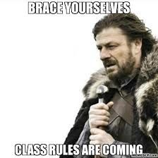
I never knew, Miss!
Each week we send out an e-mail for a PBIS Matrix topic to go over.
Teach. Re-teach. Then teach again!

Slide 8
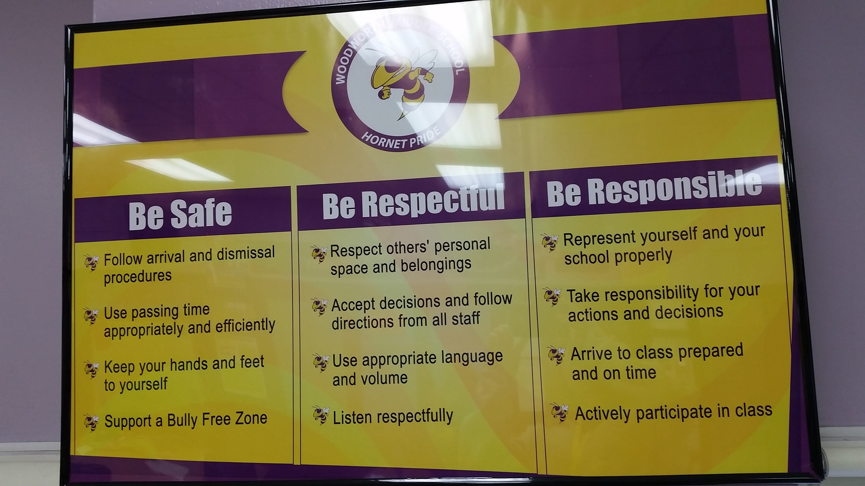
Woodworth PBIS Matrix

Slide 9
Focus/Tardy Cards
No longer in our student planners.
They are combined into one electronic document.
Moving from punitive to restorative. Our goal is to change behavior.

Slide 10
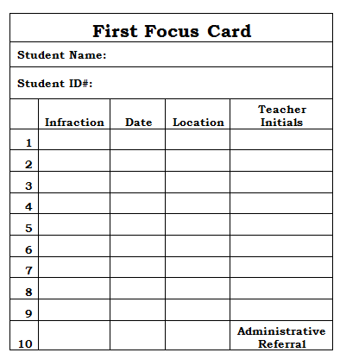
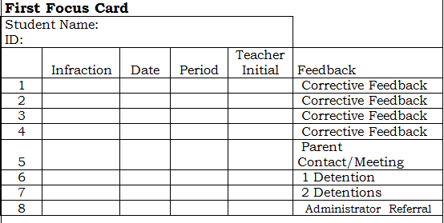
Old Focus Cards
2011-2012
2012-2016

Slide 11
Focus/Tardy Cards- New Progression 16/17
Corrective Feedback
Corrective Feedback
Corrective Feedback with Parent Contact
Referral to either Social Worker, Parent Liaison, Social Responsibility Technician + Call Home
Social Responsibility Class during Elective + Call Home
Parent Meeting
Office Administration Referral

Slide 12
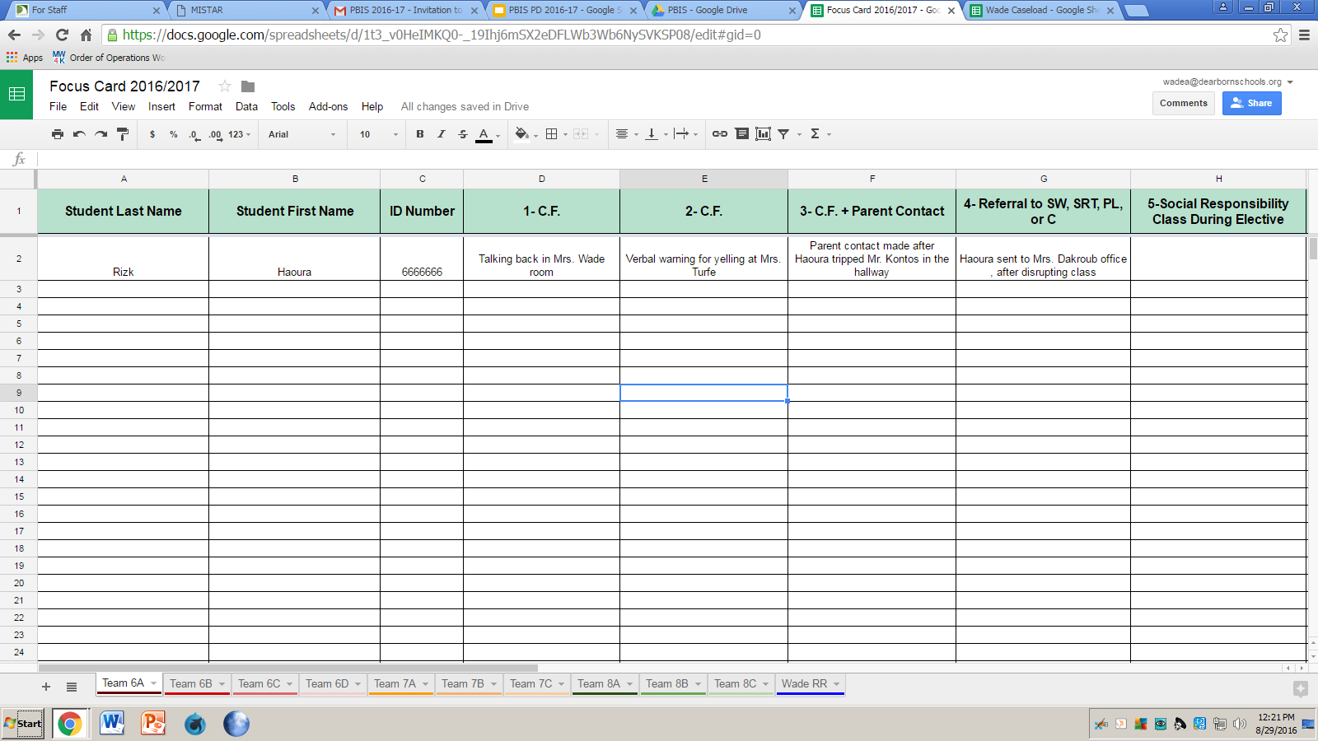
Focus/Tardy Cards

Slide 13
Step 4: Referral to either Social Worker, Parent Liaison, Social Responsibility Technician + Call Home
Students meet with Support staff
Goal is to build skill and emphasizes positive replacement behavior
Extinguish a challenging behavior and replace it with a constructive behavior.
Provide support to improve school wide behavior and decrease punishment based strategies

Slide 14
Restorative Practices
A framework for building community and for responding to challenging behavior through authentic dialogue, coming to understanding, and making things right.
Restorative practices cultivate a culture in which everyone feels like they belong. They build a particular sense of community in which every member--students, teacher, parent volunteers, aides--feel that they are seen, heard, and respected.
Based on respect, responsibility, relationship-building and relationship-repairing. It focuses on mediation and agreement rather than punishment. It aims to keep kids in school and to create a safe environment where learning can flourish.

Slide 15
The basic principles behind restorative practices at Dearborn Public Schools are as follows:
Acknowledge that relationships are central to building community.
Ensure equity of voice among all members of the community. All voices are valued, everyone is heard.
Establish a culture of high expectations with high support, emphasizing doing things “WITH” not “TO” or “FOR”.
Build systems that address misbehavior and harm in a way that strengthens relationships and focuses on the harm done rather than only rule-breaking.
Engage in collaborative problem solving.
Enhance accountability, responsibility and empowers change and growth for all members of the community.
Notes:
Acknowledge that relationships are central to building community.
Ensure equity of voice among all members of the community. All voices are valued,
everyone is heard.
Establish a culture of high expectations with high support, emphasizing doing
things “WITH” not “TO” or “FOR”.
Build systems that address misbehavior and harm in a way that strengthens
relationships and focuses on the harm done rather than only rule-breaking.
Engage in collaborative problem solving.
Enhance accountability, responsibility and empowers change and growth for all
members of the community.

Slide 16
But I don’t have my planner...
No planner equals:
No Hall Passes- No exceptions
No Rewards can be earned
No Snack purchases during Lunch
Students are responsible for keeping track of their planner and “Hornet Pride” Cards.

Slide 17
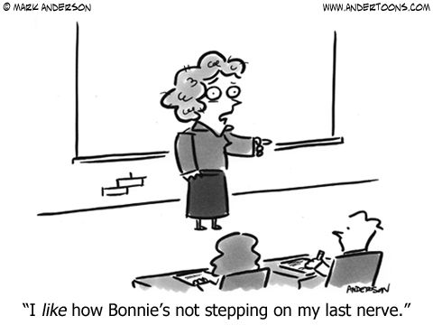
Hornet High Fives to Hornet Pride!
HHF’s are a thing of the past!
We’re saving money by not having the cards printed.
On card stock in the new planner are Hornet Pride cards.
Students now have a Positive Attitude about our Planners.

Slide 18
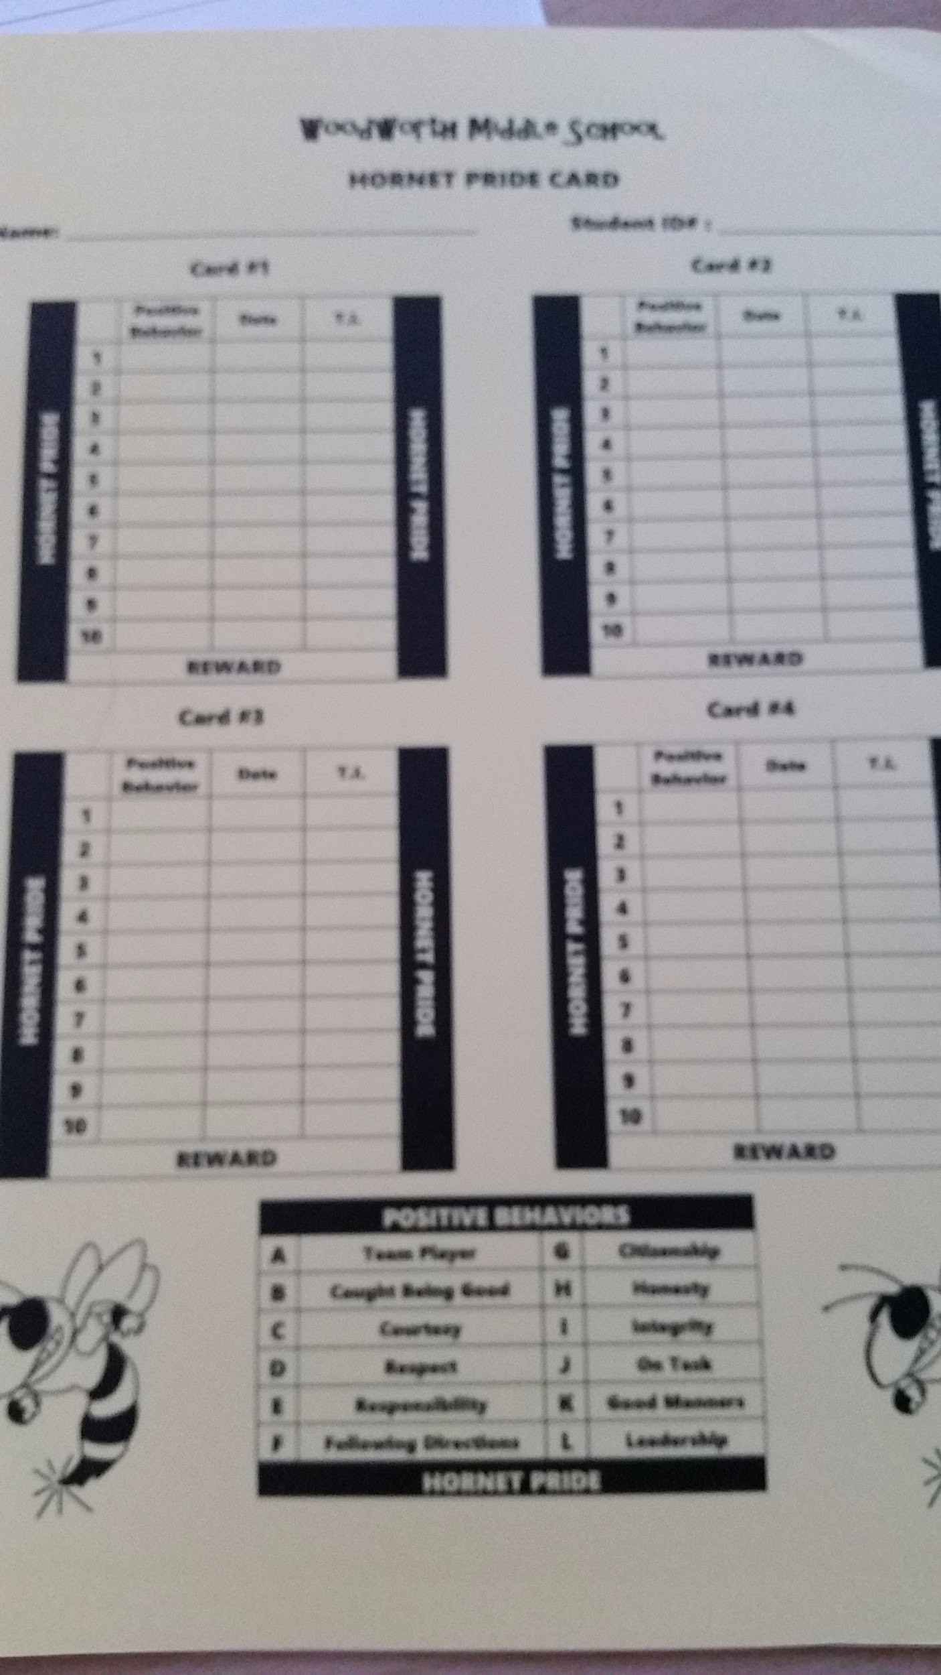
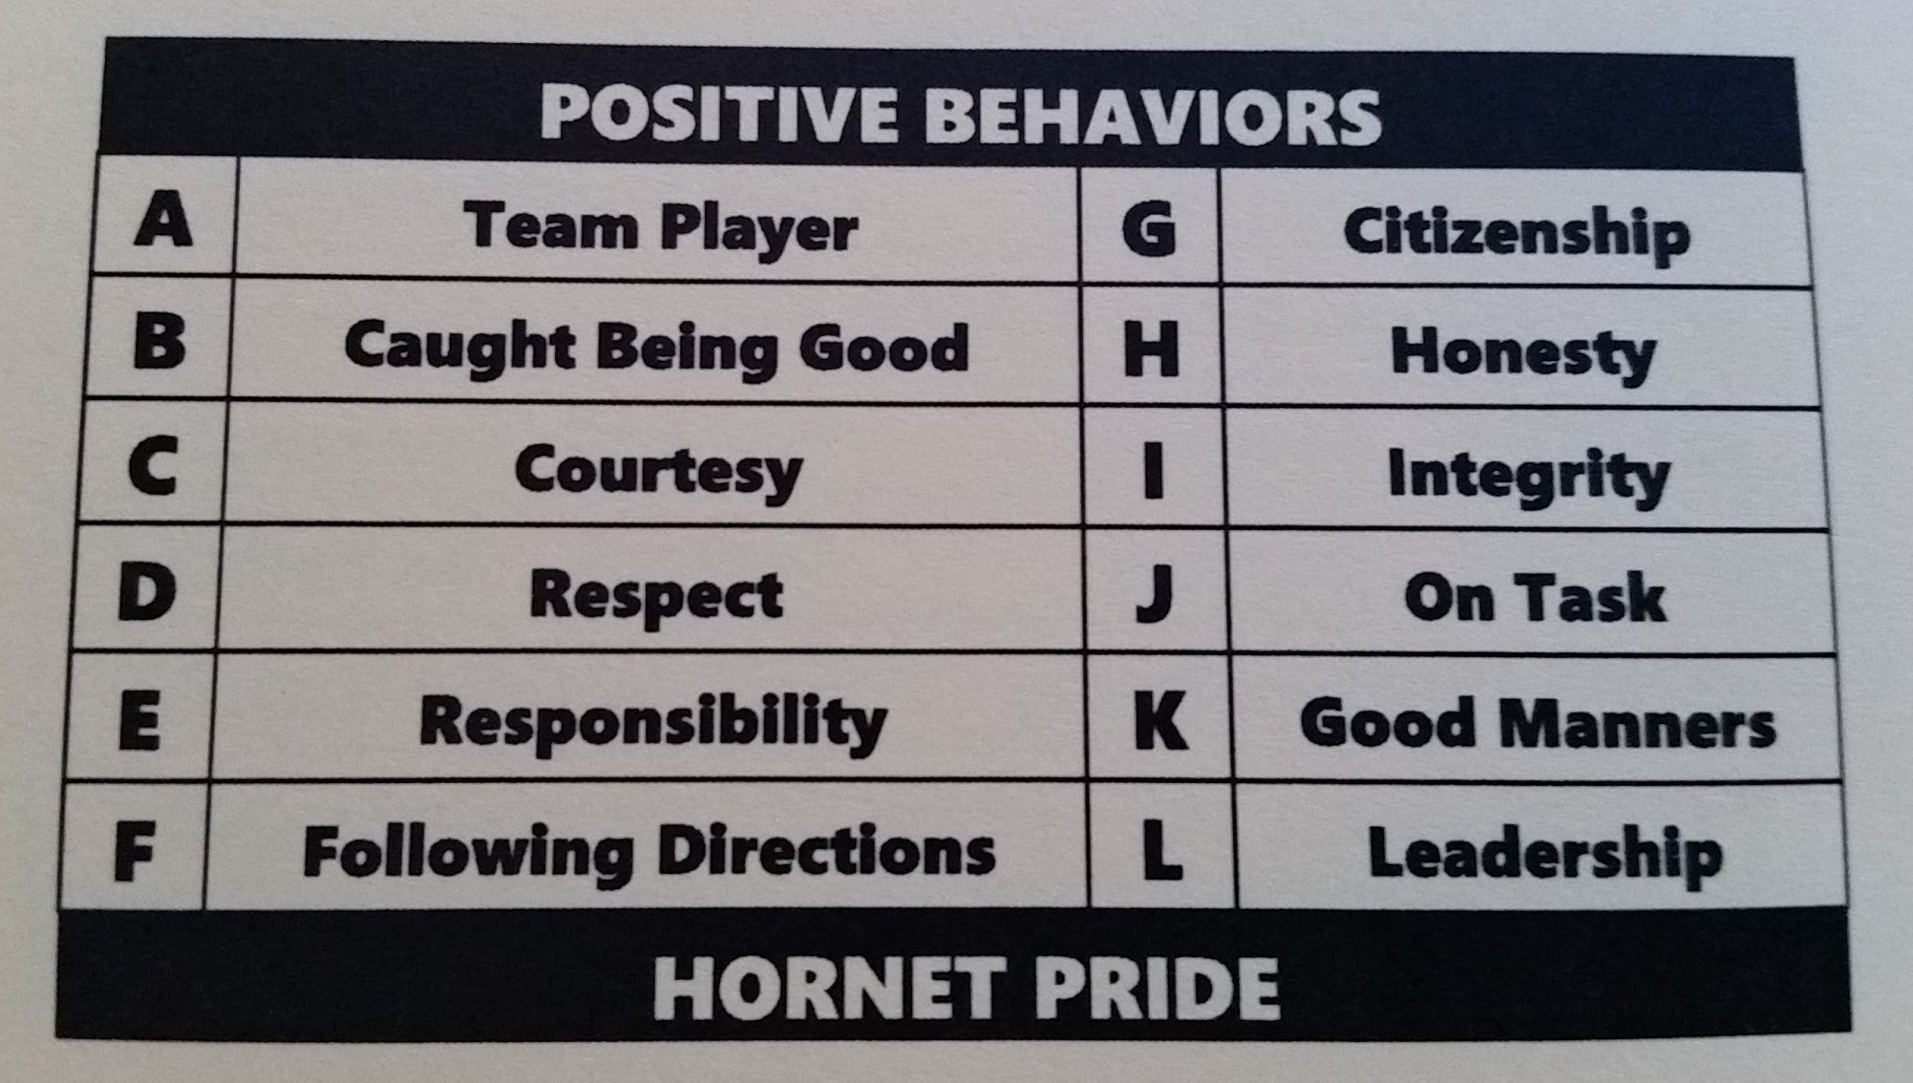
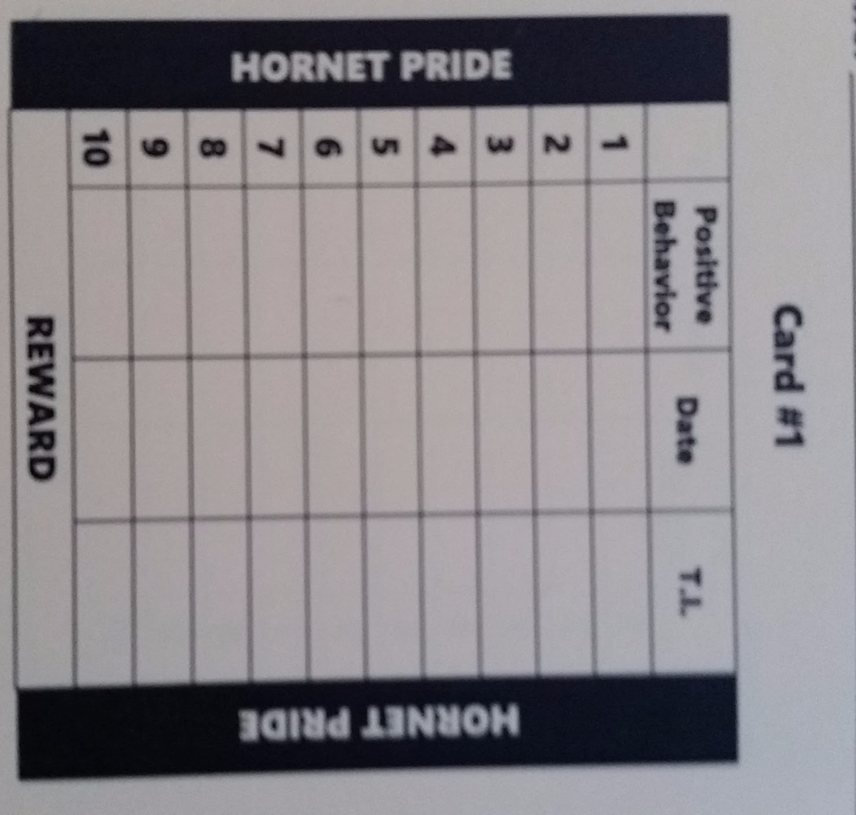
Hornet Pride Card

Slide 19
Hornet Pride by Week 2
Our staff goal: By the end of the 2nd Week of the School Year
Each student should have earned FIVE Hornet Pride Marks
At the 5th mark student earned a small prize (bags of small prizes were provided to staff) (1st card only)
Full cards will earn a Positive Phone Call Home

Slide 20
5:1 “Magic Ratio”
Effective teachers spend more time promoting responsible behavior than responding to irresponsible behavior.
Using a 5:1 ratio, moving toward a ratio of five positive comments to every one negative comment.
Notes:
Acknowledgment of Positive Behavior (praise) is most effective if it is immediate, specific, sincere, varied, student referenced
Immediate
Specific: explicitly describes the desired behavior performed
Sincere: credible and authentic
Varied: varied word choice, varied academic and behavior praise, whole group,
small group and individual
Student referenced: compares student performance to previous performance and
does not compare students to others; acknowledge effort

Slide 21
PBIS Events
September 28- During the Day Team VS Team Kickball
October 28- Cider & Donuts Before School
November -Teacher VS Student Basketball
December- Team Movie Day w/ Treat
January- Teacher VS Student Volleyball

Slide 22
PBIS Kickoff Assembly
First week of School
Grade Level Assembly
Assembly covered:
Student Code of Conduct
PBIS Expectations
RTBB/Upstander Behavior
Social Responsibility Room

Slide 23
PBIS Meetings
Have a suggestion?
Join us during our PBIS meetings.
Always invite entire staff to PBIS meetings!

Slide 24
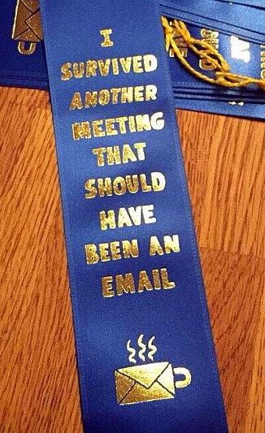
Questions?
Contact us!
wadea@dearbornschools.org
rizkh@dearbornschools.org
Concerns?

