Slide 1
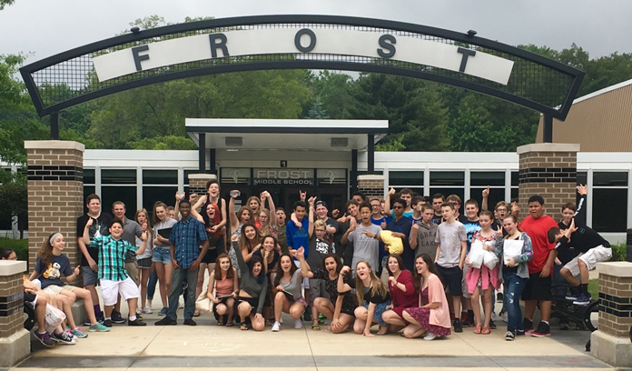
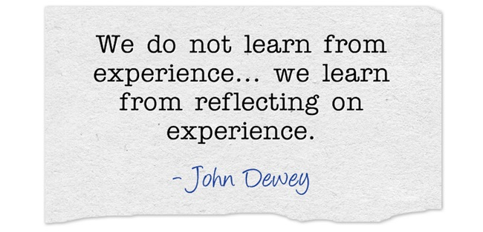
PBIS - Frost Middle School

Slide 2
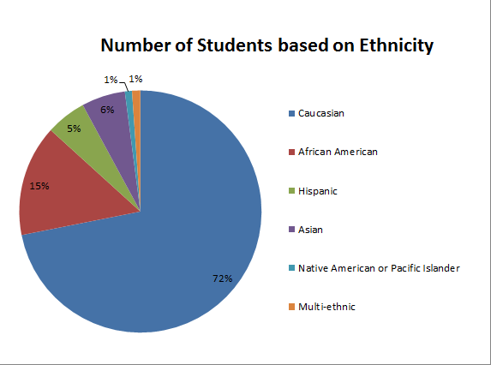
Frost Demographics
Grades 7 &8
633 students
48.50% Female, 51.50% Male
30.17% Free/Reduced Lunch

Slide 3
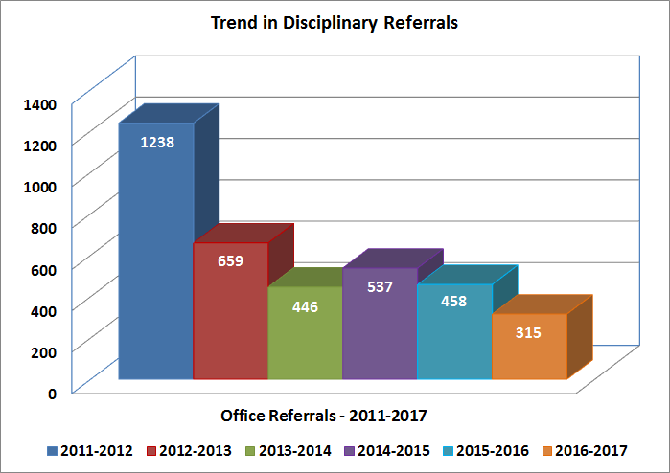
Historical Perspective:
Before PBIS (2011-2012)
After PBIS (2012-2017)

Slide 4
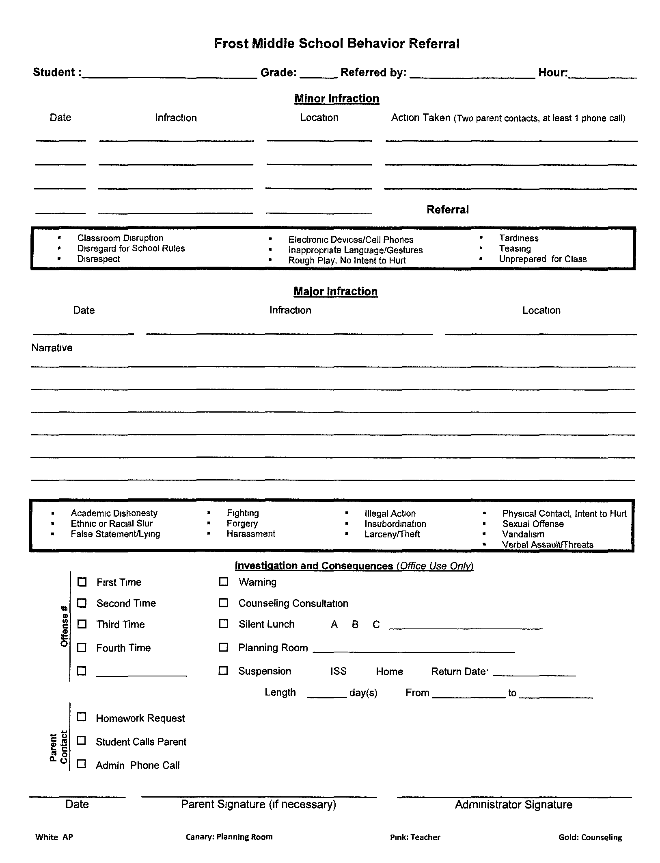
Consequences - Majors vs. Minors
Teachers keep track of the first 3 minor incidents.
Teachers contact parents for minor offenses, at least one phone call home is required.
Major offenses go directly to the main office.

Slide 5
Time to Think
Time to Think - Teacher referral
https://docs.google.com/forms/d/e/1FAIpQLScoEM69TpI_h2Nj3DwRS4IVxd_9H2uWeRJKd29V7GBqRR1iSw/viewform
Time to Think - Student reflection
https://docs.google.com/forms/d/1ZB-fBOROZjhYuJUX8NYCWxzDSngJ9yh-JuySxUYdZwo/edit
Restorative Writing (data based) for:
Disrespect to peers
Disrespect to adults
Classroom disruption

Slide 6
Rewards

Slide 7
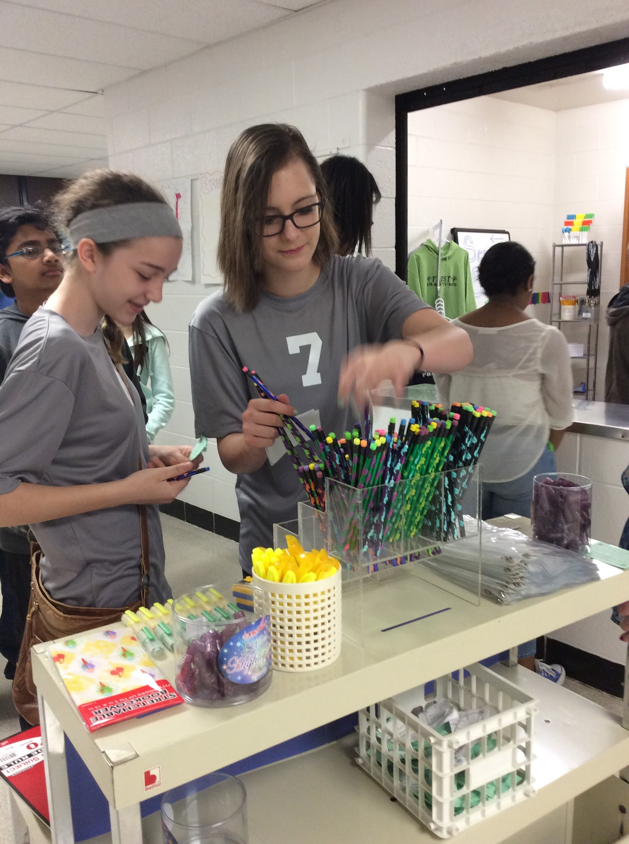
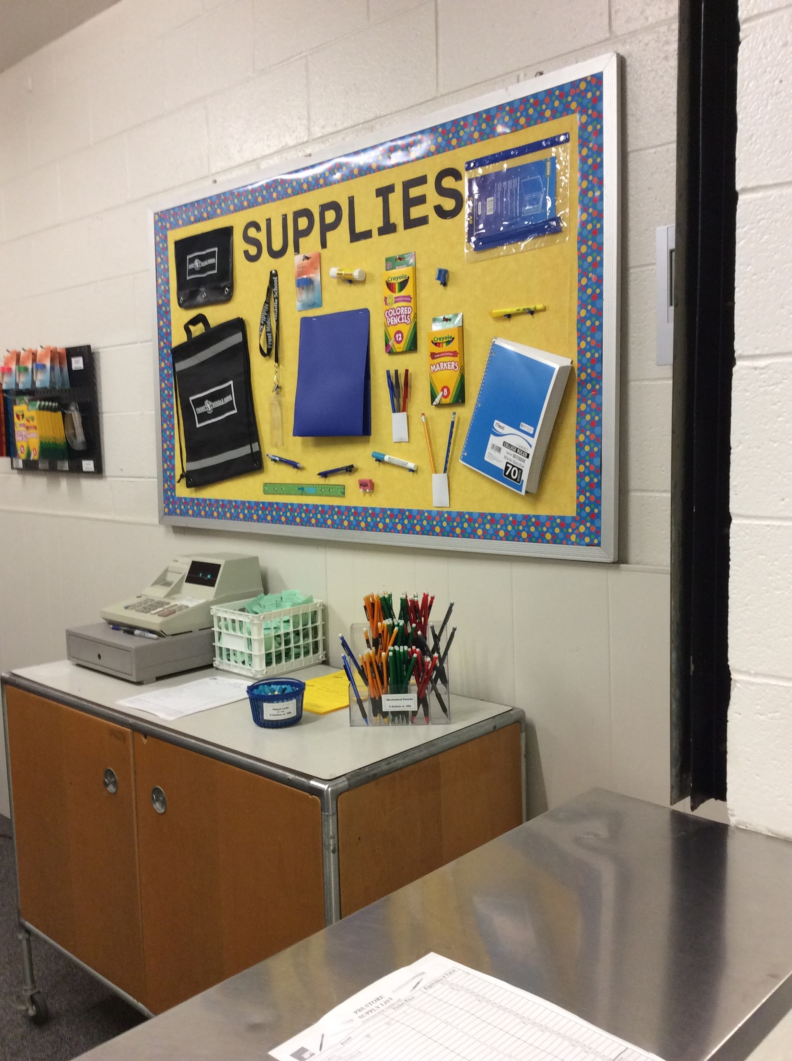
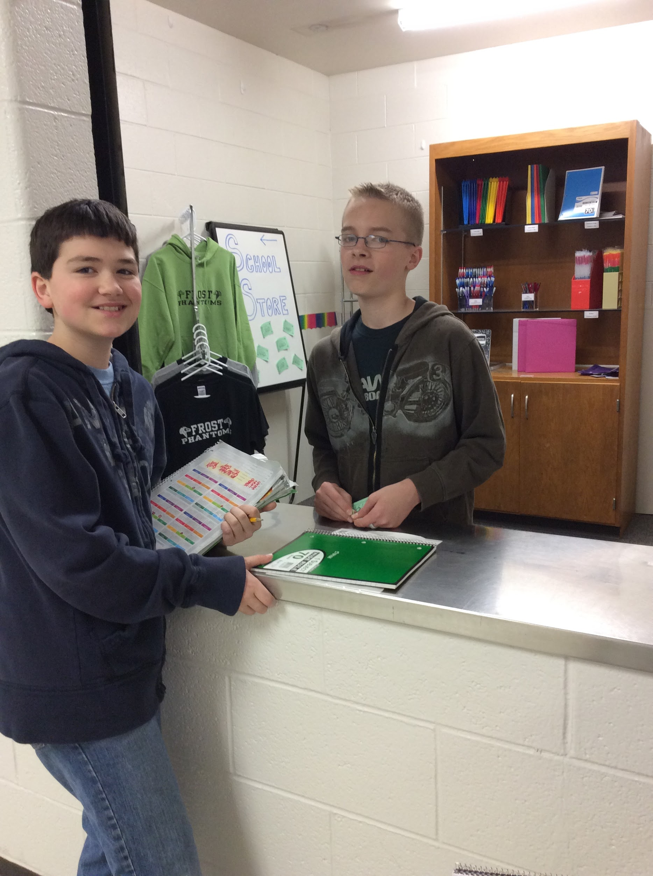
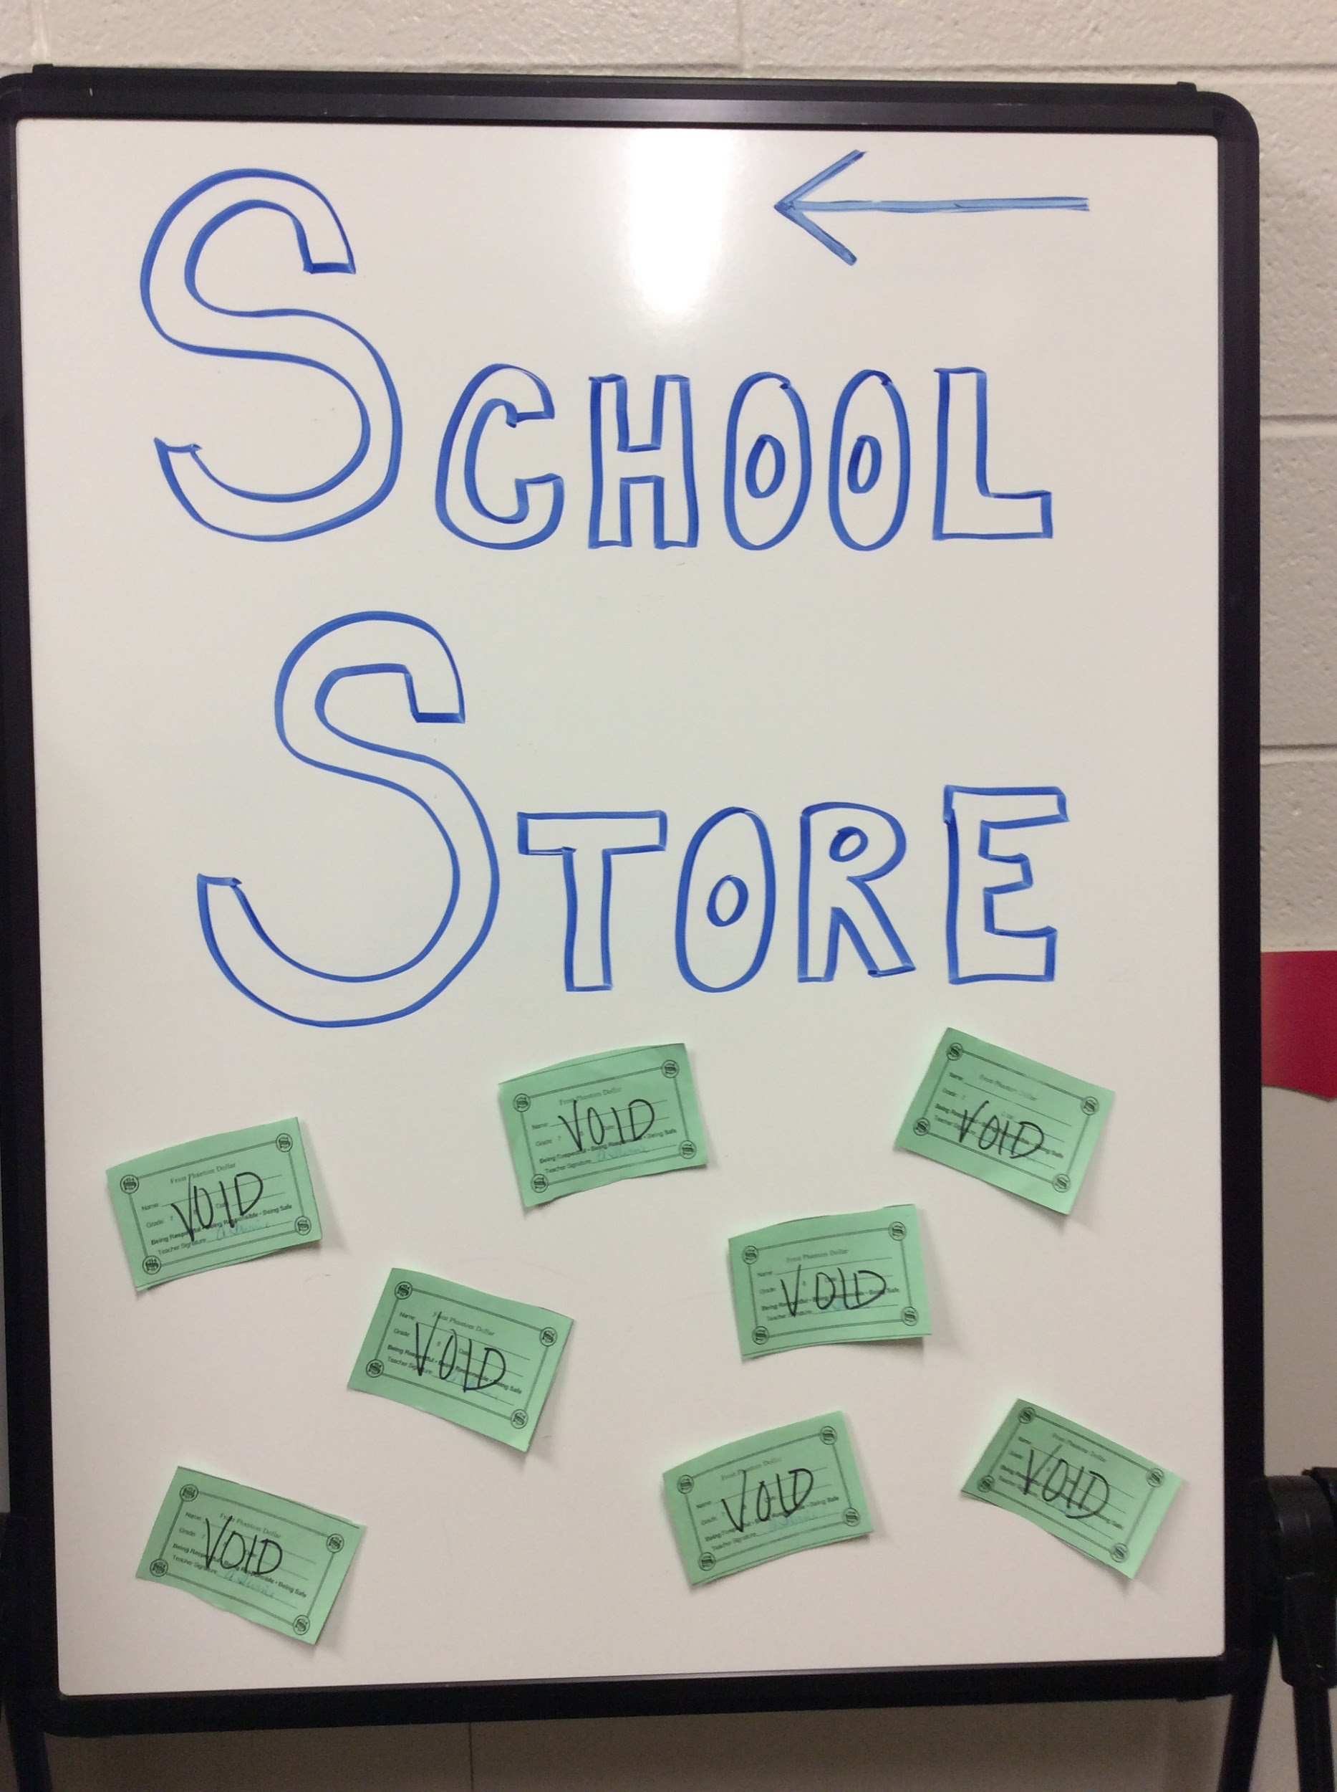
Falcon Dollars

Slide 8
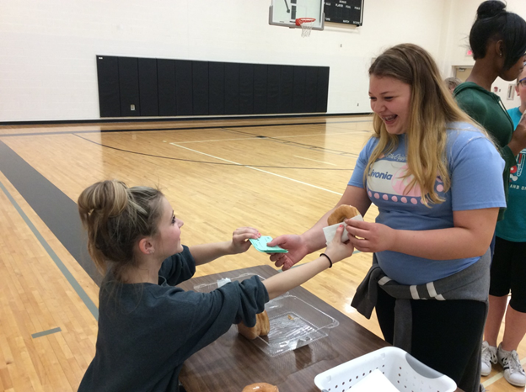
Donut Day

Slide 9
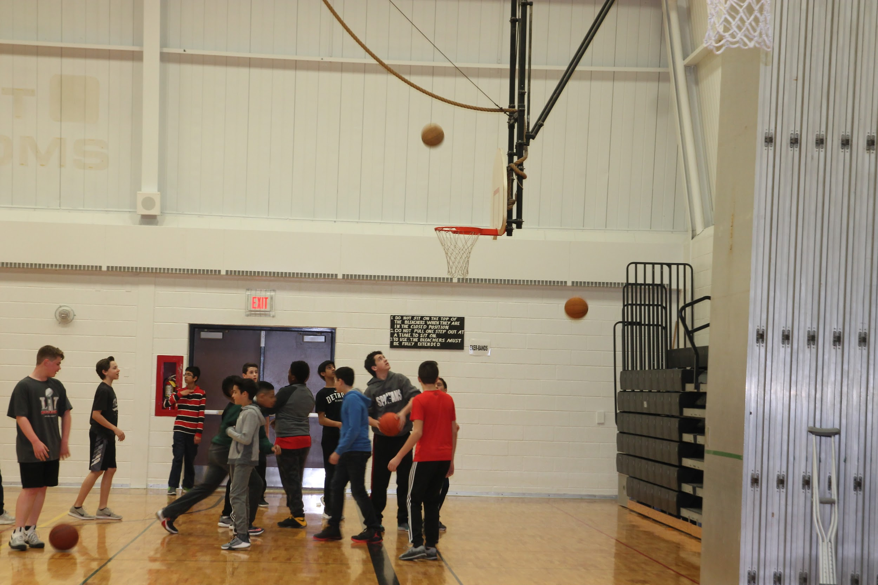
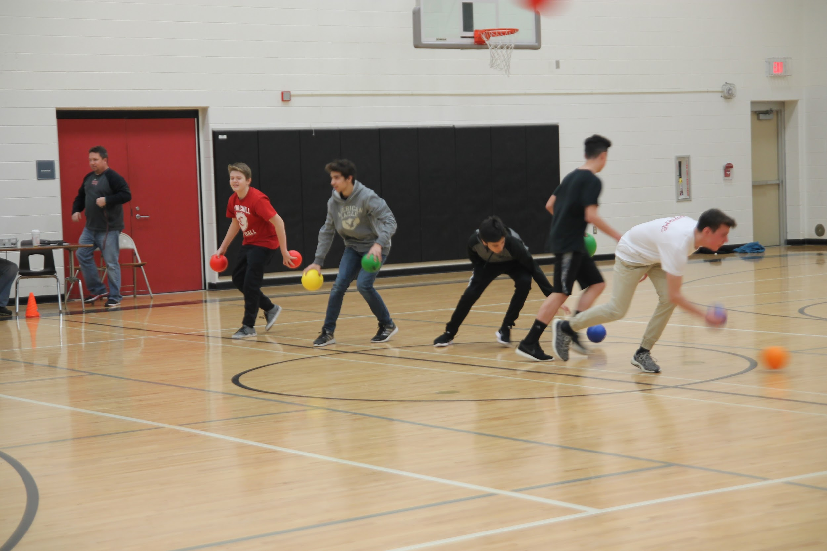
Falcon Time Basketball
Falcon Time Dodgeball

Slide 10
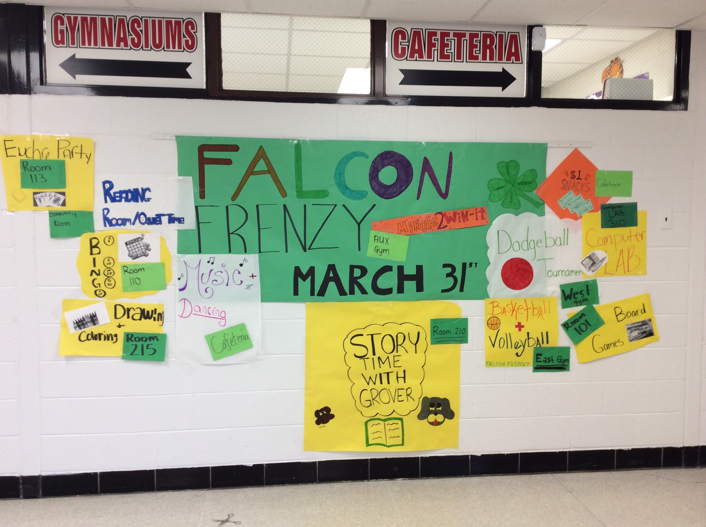

Slide 11
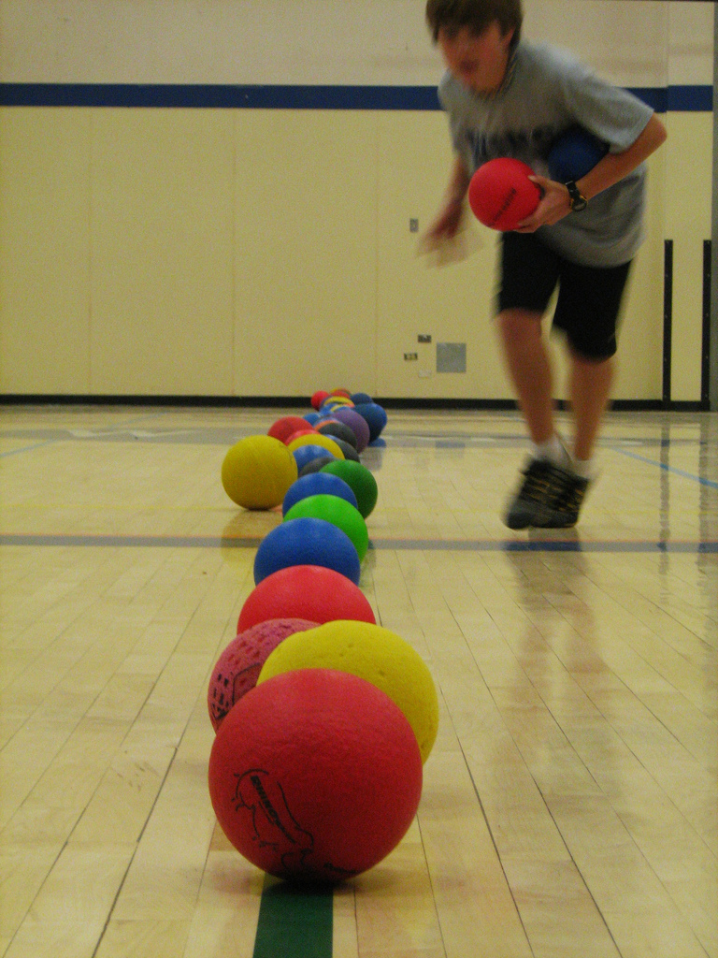
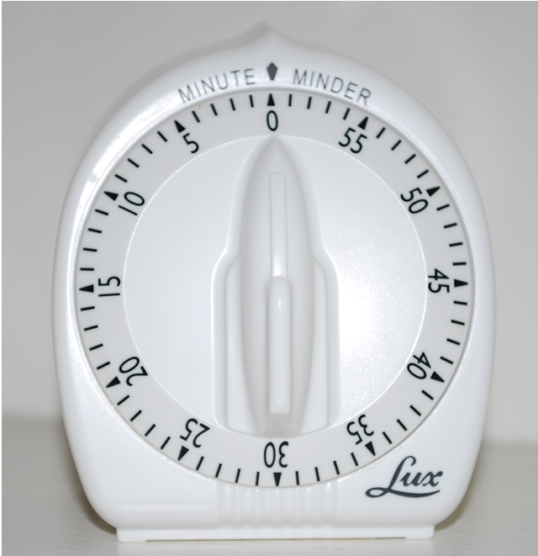
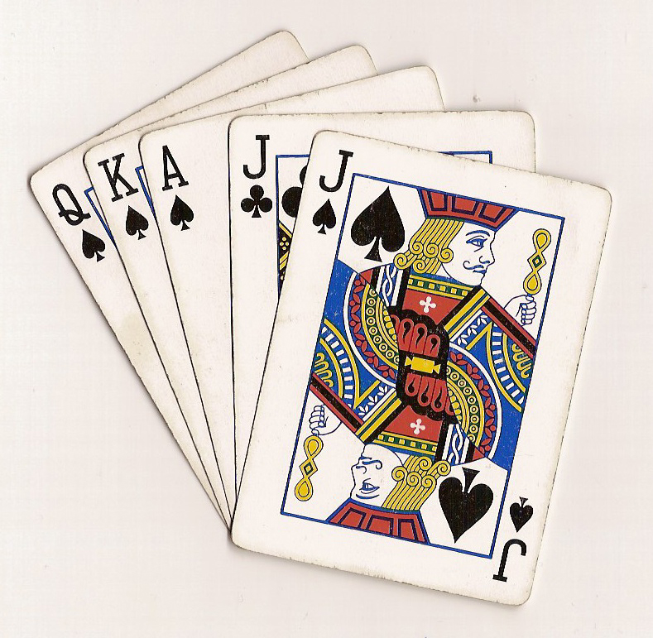
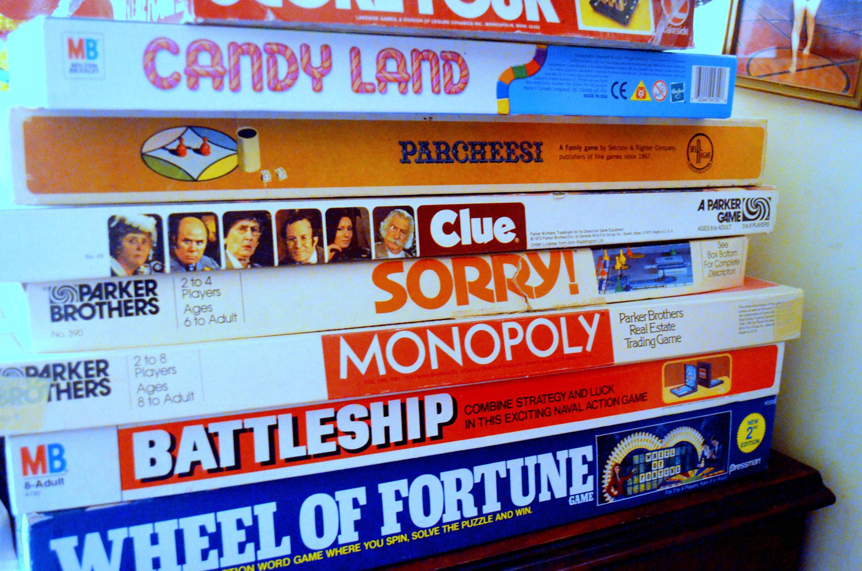
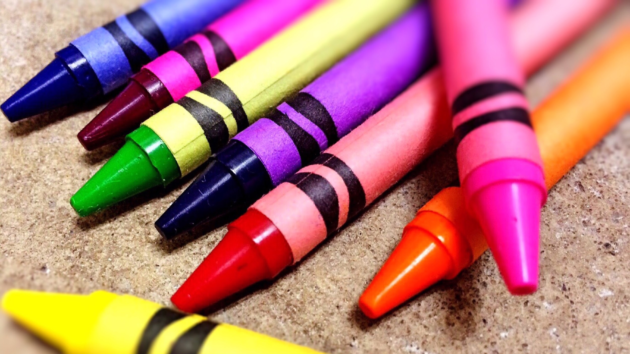
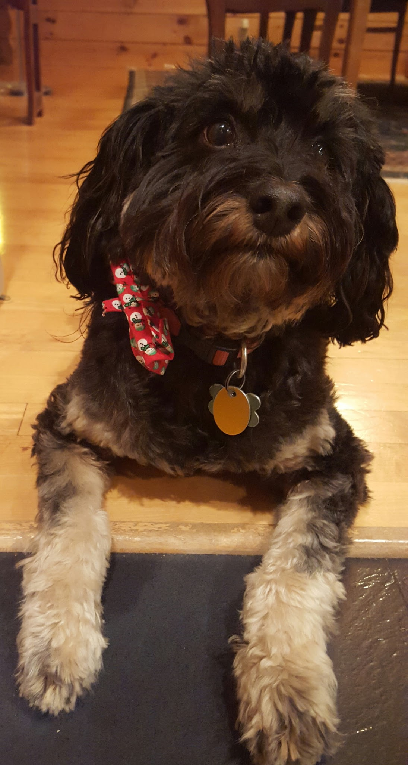
FALCON FRENZY
Friday, March 31st
1:20-2:49
Minute to win it!
AUX GYM
Bingo
Room 110
DODGEBALL
West Gym
Euchre Party
Room 113
Drawing/Coloring
Room 215
Board Games
Room 101
Story Time
(with Grover)
Room 210
music
In in
Cafeteria
Basketball & Volleyball
East
Gym
With
Concessions
Computer Lab 310
in the Community Room
Come read or do quiet work
Bring Falcon Dollars for snacks !

Slide 12
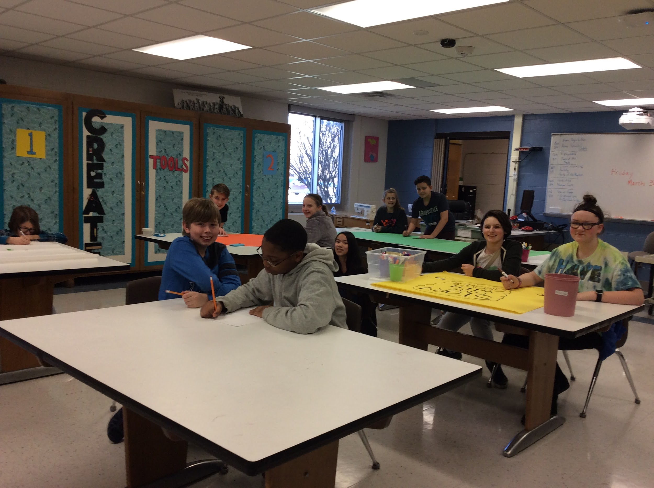
PBIS Student Team
Promotional Video
https://drive.google.com/open?id=0B2EWOBfQal72cmlaS2Utdk01Z2c
Sign making for Frost Frenzy

Slide 13
Staff Support
2016 - 76% of staff favor of continuting PBIS, 2017 - 92% of staff in favor of continuting PBIS!
Teams - Where we’ve been
Consequences
Rewards
Lessons
New Structure
Teacher’s pick two!
Frost Frenzy, all hands on deck
PBIS Teacher sign-up
https://docs.google.com/spreadsheets/d/1qPmdOxLWnF-8agFsGQnQOleUoT-myDwBpXOpJ7ltXwA/edit#gid=0
92% of staff report PBIS makes a positive impact on building climate.

Slide 14
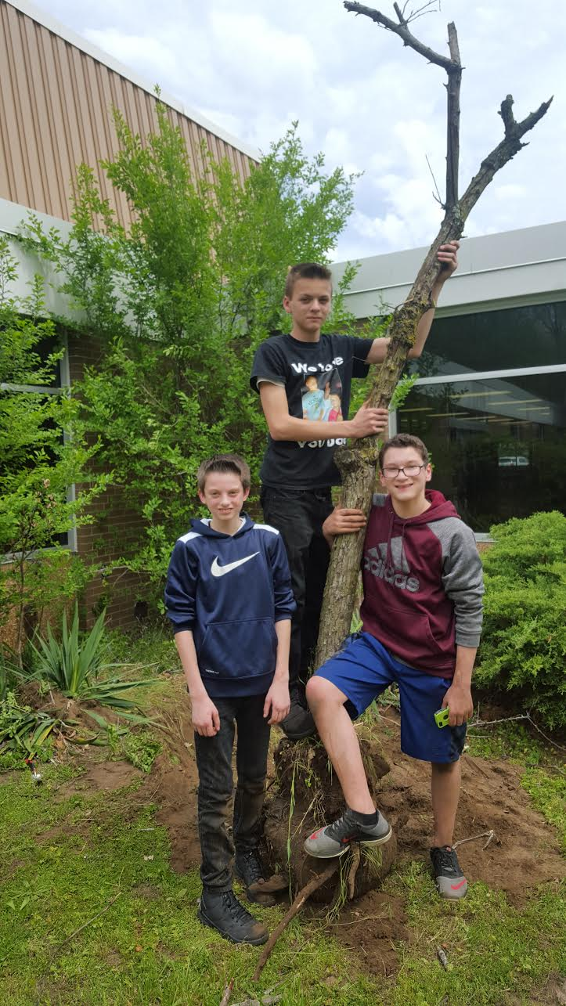
Community Service
Courtyard clean-up
Office tasks
Lost and found
Classroom clean-up

Slide 15
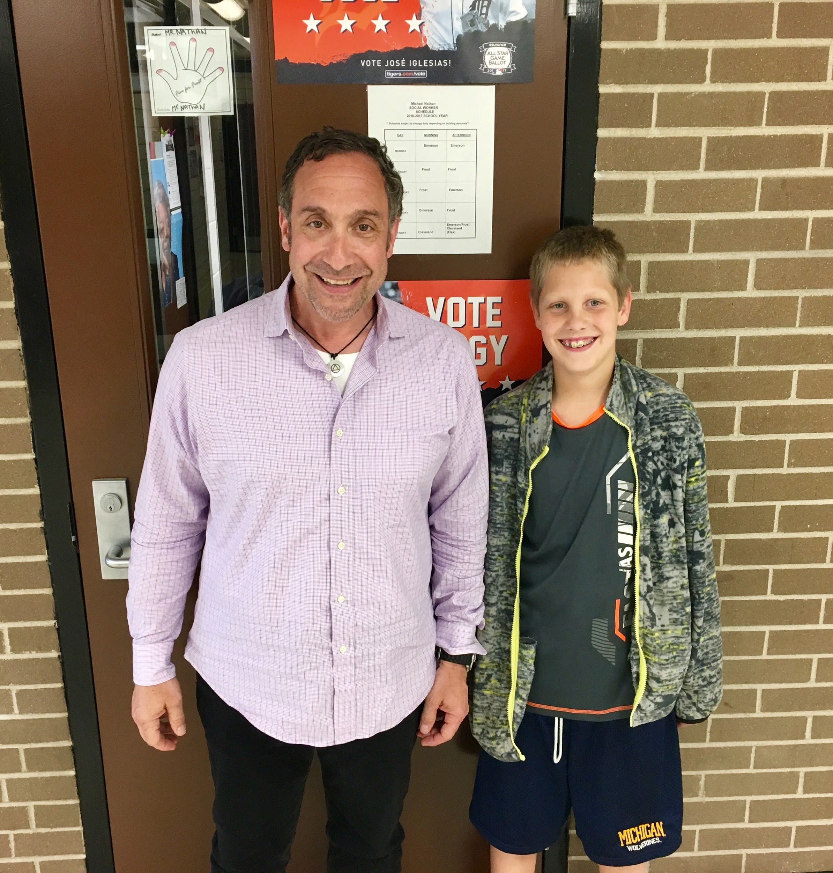
Tier Two Mentoring
Focus - Behaviors, not grades
Criteria - citizenship (3 - 5), prior discipline issues, truancy
Staff volunteers - training, activities

Slide 16
This year’s Plan
Targeted instruction in behavior expectations/social skills
Check in/check out
Professional reading
Increased mentor training/support
Increased staff training
Detailed calendar of events to start the school year
Increased number of rewards
Add PBIS referrals to EPT
Student rewards center

Slide 17
PBIS is what we do!
Supports our district climate goals
Character elements, respectful interactions
Student government/PBIS student team
Alternatives to Suspension
Reflective writing, community service, adult mentors

Slide 18
Team Contact Information
Anthony Abbate, Principal aabbate3@livoniapublicschools.org
Shanan Wheeler, Assistant Principal swheeler2@livoniapublicschools.org
Sherri Brown, Co-Chairperson sbrown14@livoniapublicschools.org
Cathy Burr, District Coach cburr@livoniapublicschools.org
Christy Deskovitz, Student Assistance Provider cdeskovi@livoniapublicschools.org
Renee Melcher, Teacher rmelcher@livoniapublicschools.org
Barb Postel, Co-Chairperson bpostel@livoniapublicschools.org

