Slide 1
Shumate Middle School
Gibraltar, MI

Slide 2
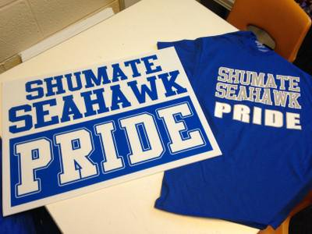
Introduction
Our team…
Principal: Eric Cassie
Assistant Principal: Tracy Richardson
Co-chairpersons: Kathy Gregorich-Filkins, Mandy Gardner
Counselor: Jami Antosiewicz
Data Analyst: Char Kuppe

Slide 3
Shumate Middle School- Demographics
842 Students
6th-258
7th-271
8th-313
Ethnicity Breakdown:
84.1% White 6.6% Black or African American 6.2% Hispanic/Latino
2.6% Asian American 0.6% American Indian

Slide 4
http://www.gibdist.net/shumate-middle

Slide 5
Mission and Vision

Slide 6
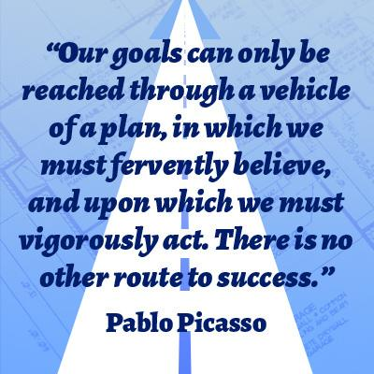
SMS PBIS Program
We are in the 4th year of our PBIS program.
We are currently in the sustainability phrase of our program.
Our matrix has been created and norms are established.
We are adjusting our matrix to reflect the changes in our school.
Posters and expectations
restorative practices
implementation of 1:1 technology

Slide 7
Seahawk Data--Office Referrals
Sample office referral form
Carbon copies, data entered into MiStar by secretarial staff
The form is used for major infractions and repeating minor infractions
Teachers are expected to help out with minor infractions
Warning
Private conversation “The W’s”
Phone call home
Successes
Teachers are using more interventions before “writing up” a student
We have learned to document warnings more efficiently
Challenges
Communication and record keeping of informal interventions
Finding funding for the “NEST”

Slide 8
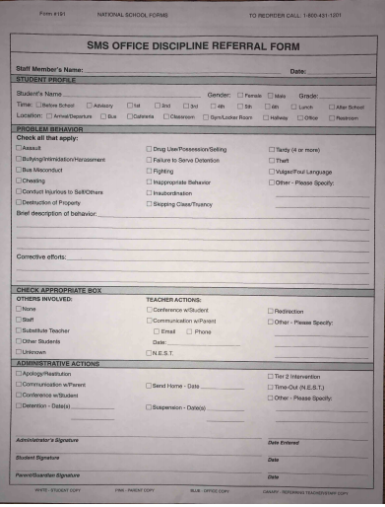
Office Referral Form
ODR form (carbon copies)
Staff completes form and sends it to the office
Administrator speaks with student
Secretary enters data into Mi-star (record minor and major infractions this way
Encourage staff to complete teacher actions:
Conference with a student
Communication with parent
Redirection
Other

Slide 9
Seahawk Data--Check in Check out
Sample CICO form
In the past, students were recommended by a teacher; students were then allowed to choose a staff member to be his or her mentor; now we have an intervention referral program
Staff training
We hold an after school training once per year to train interested staff
Successes
Approximately 50% of students showed improvement either behaviorally or academically
Many students enjoyed the program
Challenges
Our first year, it was difficult to get parent permission, so we changed our slip to an “opt out” form that worked much better.
Finding time to meet to discuss students; this year, we will be using a more formal process with our new interventionist, counselors, and administrative team

Slide 10
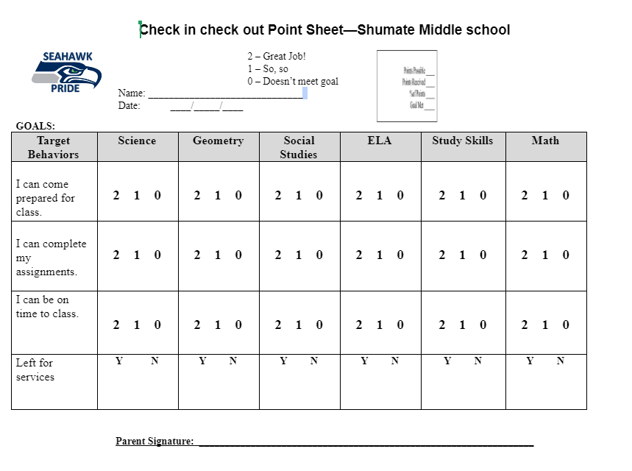

Slide 11
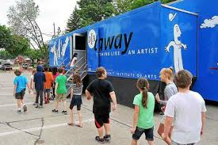
Staff Involvement
Do a brief introduction (30 minutes) to staff at the beginning of the year
Discuss the PBIS Staff Manual
Review rewards
Ask for suggestions & volunteers
Volunteers
We depend on our entire staff to help us with rewards
Lunch in the courtyard
Quarterly rewards (kickball, movies, DIA away)
Lunch with a teacher

Slide 12
Student Voice
Surveys
We gather student data and views of PBIS through student surveys.
Student Suggestions
We allow our students to give suggestions to different rewards that they would like to earn through our Positive Action Tickets.

Slide 13
First Mates--Mentor Program
Two teachers supervise the program
We currently have 70 students (mostly 8th grade, a few 7th to trained the new recruits)
4 students assigned to one “First Mate”
Students have to apply and are screened by teachers, non-academic, based on peer to peer interaction
Help sixth graders with lockers, finding classes, and helping out with general peer problems.

Slide 14
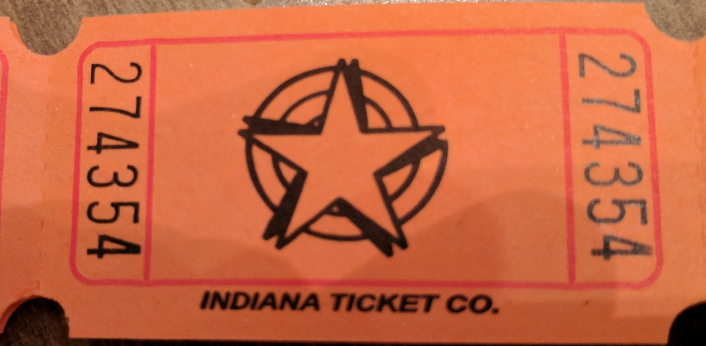
Student Rewards
Positive Action Tickets Opportunities
Weekly Drawings: Two students for each grade
$5 gift cards to stores, restaurants, etc.
Friday Cash-ins:
Students choose from a variety of choices with different ticket values. These are updated throughout the year due to new ideas and the changing seasons.

Slide 15
SMS Positive Action Cash-in Rewards
At lunches, students can cash in their tickets for items or special privileges
Lunch in the courtyard with a friend
Snow cones
Sit at the PRIDE table (games)
Enjoy a piece of candy
School supply items
Computer game hour

Slide 16
Postcards Home

Slide 17
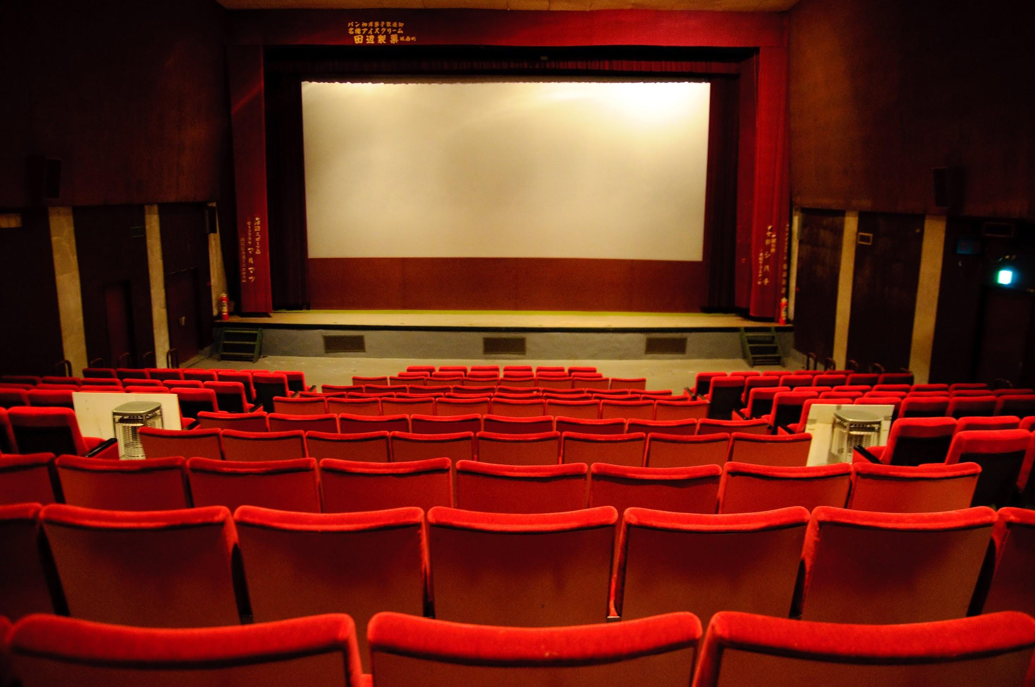
Quarterly Rewards
Each quarter students have an opportunity to earn a special reward.
Last year’s awards were: Mystery Movie Day, DIA Away, Kickball, SMS Lip Sync Battle
Requirements to attend the reward are:
No office referrals
No missing assignments
5 or less absences
Typically the reward is announced ahead of time. However this year we are making them a mystery to increase student participation and suspense.

Slide 18
Fundraising
In School Fundraisers
Hat or Spirit Days
Pencil dispenser
PTO donations
Out of School Fundraisers
MOD Pizza
Chipotle
Stevie B’s
Buffalo Wild Wings
Pips Art Studio

Slide 19
Questions?

Slide 20
Thank you! Contact Information...
Eric Cassie (Principal): cassiee@gibdist.net
Tracy Richardson (Assistant Principal): richart@gibdist.net
Kathryn Gregorich-Filkins (Co-chair): gregork@gibdist.net
Mandy Gardner (Co-chair): gardnem@gibdist.net
Char Kuppe (Data Analysis): kuppec@gibdist.net
Jami Antosiewicz (Counselor): antosij@gibdist.net
School Number: 734-379-7600

