Slide 1
PBIS Lunch Club Presentation
Theodore Roosevelt High School
Wyandotte, Michigan

Slide 2
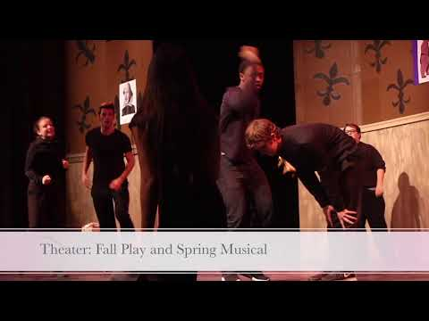

Slide 3
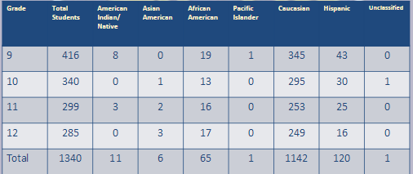
Demographics

Slide 4
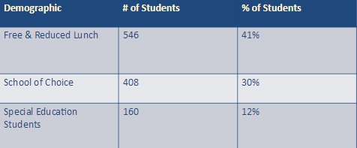
Demographics

Slide 5
PBIS Teacher Group at RHS
10 teachers from various departments represented: Special Education, Counseling, Social Studies, English, World Language
Meet monthly
PBIS sponsored activities:
Lunch Club Virtue Lessons-creation and implementation PBIS Quarterly Reward Virtuous Student of the Month

Slide 6
PBIS Teacher Group at RHS
Fundraising:
Pajama/Hat Day (twice yearly) Holidays for the Homeless
Candy Grams (twice yearly) Food Drive

Slide 7
PBIS Lunch Club-Purpose & Goal
What we were doing was not enough for our incoming 9th graders!
CICO
Graduation Coaches
Tutoring (before & after school)
Lunch CLub was created for an extra support system for struggling 9th graders.

Slide 8
PBIS Lunch Club Through the Ages
Began in 2013-2014
Target Freshmen failing 2-4 classes (core classes).
Each PBIS committee member selected 2-3 students to mentor.
Meet once a month during all three lunches.
Eat lunch
Monitor grades/attendance
Work on study skills

Slide 9
Lunch Club Presentation Example
Getting Focused & Motivated
https://docs.google.com/a/wyandotte.cc/presentation/d/1Fg1TDYyLwm8LN0-sf6OArRoZNgMm5N5QNgTuR7OHDDg/edit?usp=sharing

Slide 10
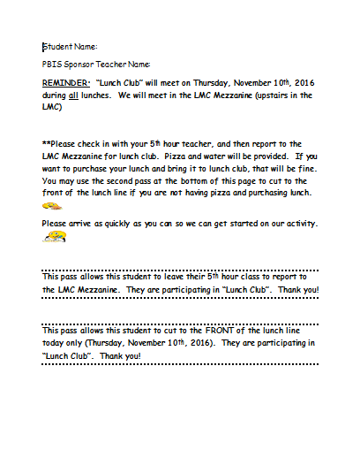
Reminder/Pass

Slide 11
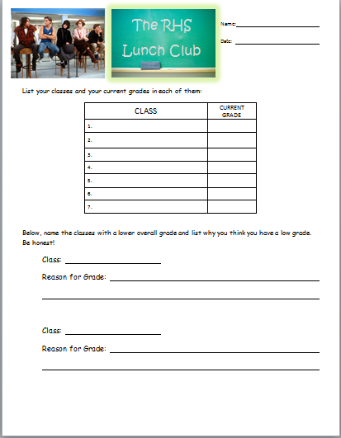
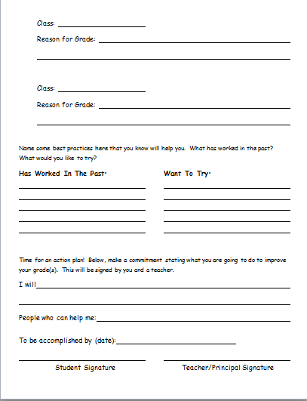
Analysis Worksheet

Slide 12
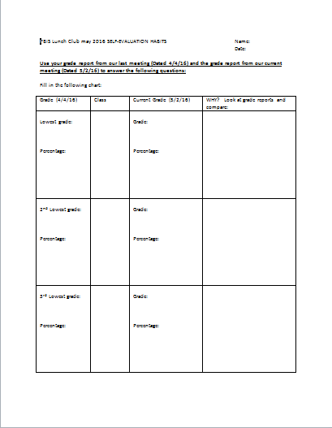
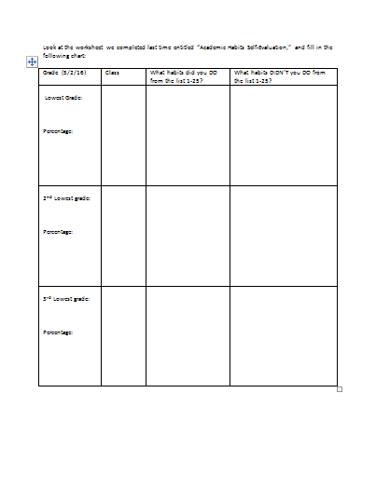
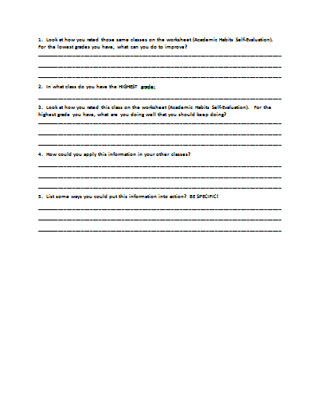
Goal-setting Worksheet

Slide 13
Tweaking Toward Success
⚫ Teacher driven at first ⚫ All lunches vs. One lunch
⚫ Student Mentors vs. Link Crew Leaders ⚫ Google Sharing for the group
⚫ Using Remind ⚫ Evaluating student buy-in
⚫ Providing lunch vs. Bringing a lunch ⚫ Analyzing staff feedback

Slide 14
Where are we now?
Link Crew Leaders as Student Lunch Club Mentors
Staff Mentors
Meet during all 3 lunches
Provide lunch
Create a theme-October was organization

Slide 15
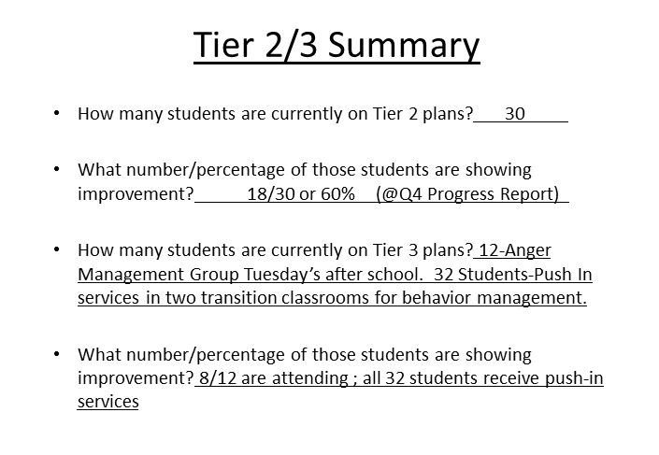
Data Analysis
Data-driven proof of success
May 2017

