Slide 1
Grosse Pointe South High School

Slide 2
Demographics
Grades 9-12
~1,600 students
8.48% African American
86.34% Caucasian
2.83% Hispanic
0.29% Native American/Alaskan Native
2.06% Asian
~100 plus staff members

Slide 3
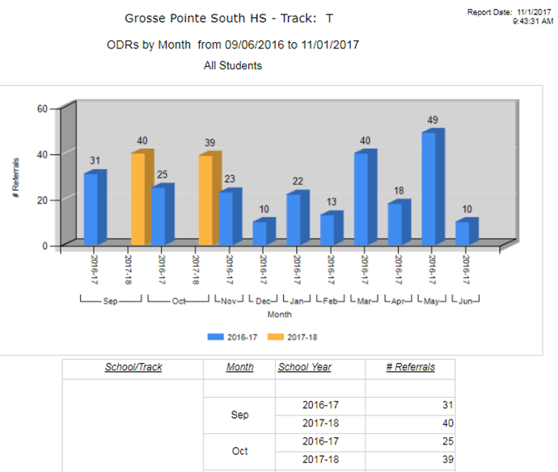
ODRs by Month

Slide 4
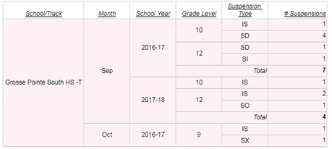
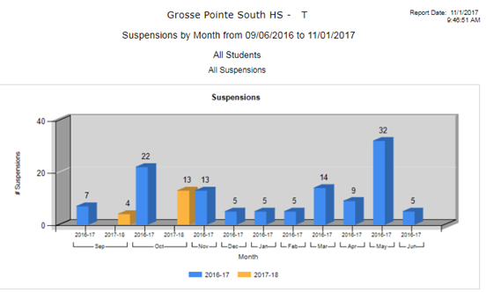
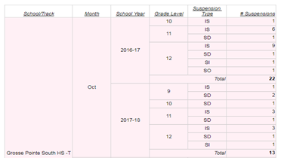
Suspensions by Month

Slide 5
Level of PBIS Implementation
Currently in year 3
Now have a solid tier 1 committee
In year 2 of Tier 2 implementation

Slide 6
Tier 2 Process
Formed Committee
Data Coordinator
Counselors
Social Worker
Psychologist
Administration
Special Education Liaisons

Slide 7
Tier 2 Process
Met monthly
Set criteria
Initially focused on academics
Created data forms/tools

Slide 8
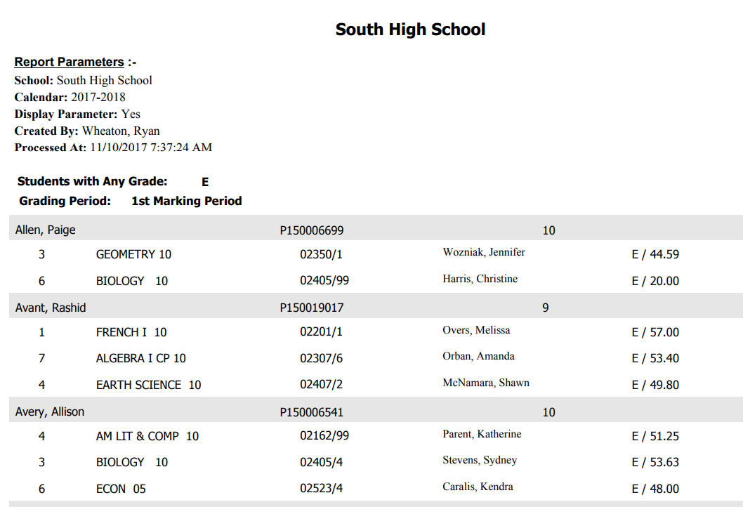
Tier 2 Process
Pinnacle grade report
Pulled at least monthly
Criteria - Keep data on students failing >2 grad requirements

Slide 9
Tier 2 Process
Students currently meeting criteria
Date data was pulled
X = not meeting criteria at time
Yellow = date first met criteria
Number of classes failed
Students that met criteria previously
( ) = number of ODRs

Slide 10
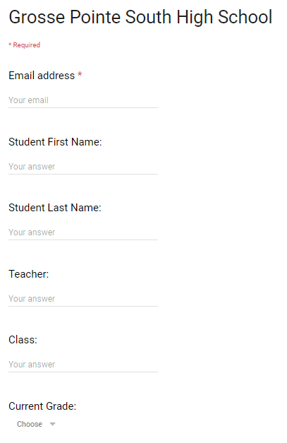
Tier 2 Process
Data collection form from staff

Slide 11
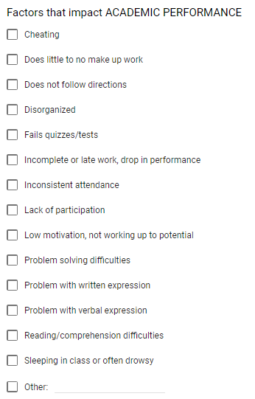
Tier 2 Process
Data collection form from staff

Slide 12
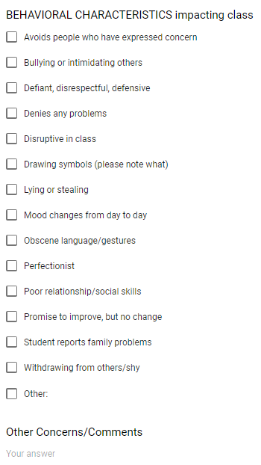
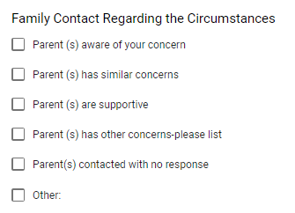
Tier 2 Process
Data collection form from staff

Slide 13
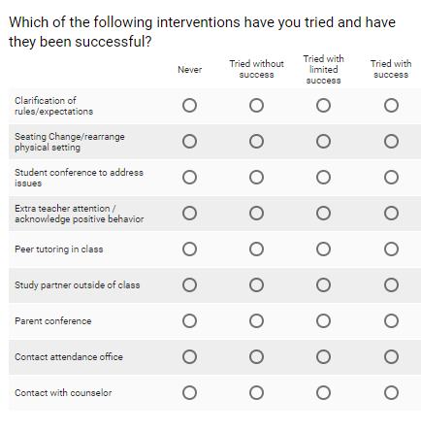
Tier 2 Process
Data collection form from staff

Slide 14
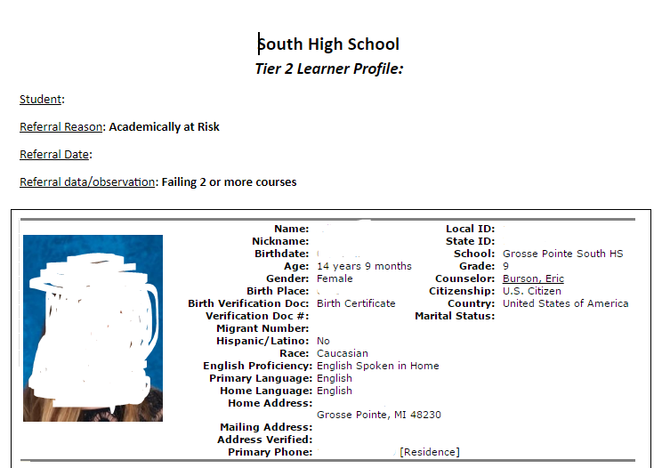
Tier 2 Process - Learner Profiles
Student Photo

Slide 15
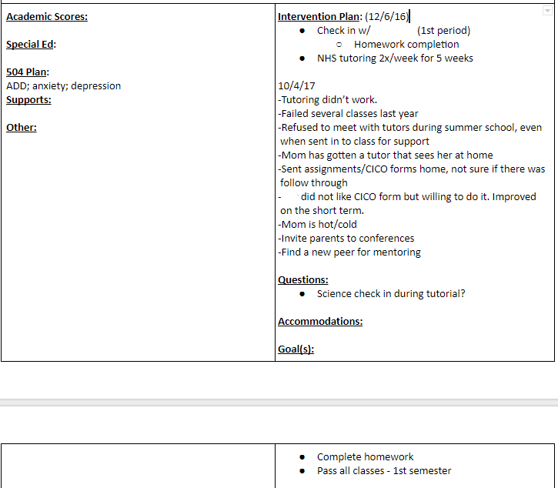
Tier 2 Process - Learner Profiles

Slide 16
Tier 2 Process - Learner Profiles

Slide 17
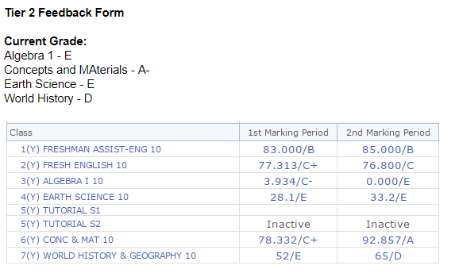
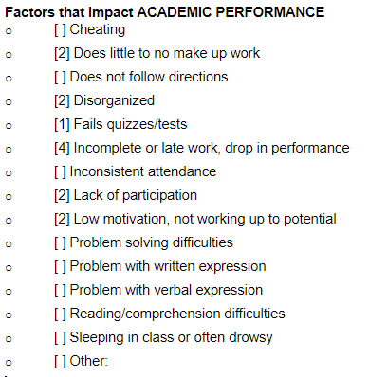
Tier 2 Process - Learner Profiles

Slide 18
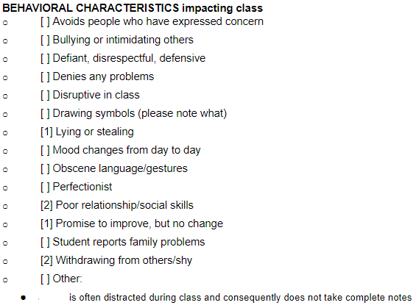
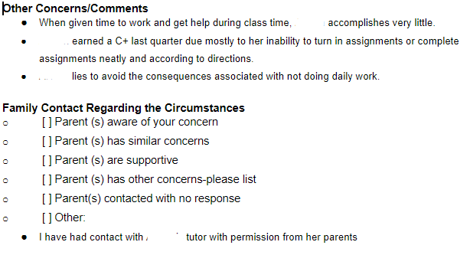
Tier 2 Process - Learner Profiles

Slide 19
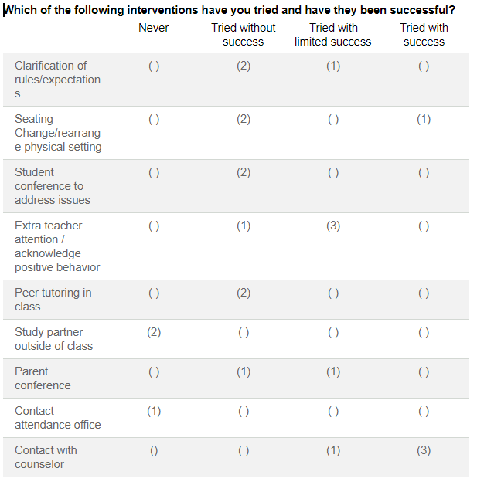
Tier 2 Process - Learner Profiles

Slide 20
Tier 2 Meetings
Year 1
Focused on process
Each counselor chose 2-3 focus students
Attempted to go through entire data
Need to focus on actions
Year 2
Focusing on kids in both academic and behavioral groups
Counselors had opportunity to discuss other students of concern
Action plans - team can modify
May try round robin for counselors

Slide 21
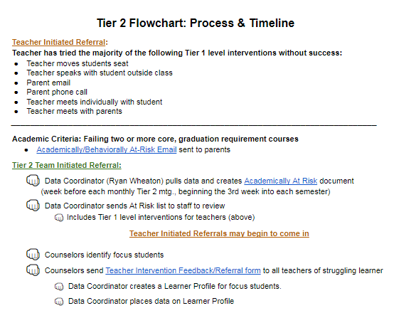
Tier 2 Process

Slide 22
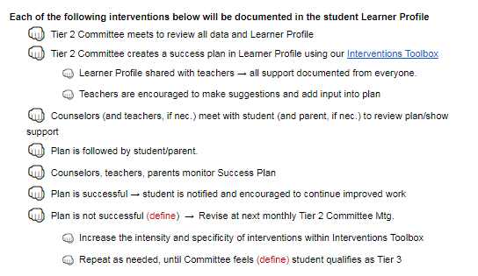
Tier 2 Process

Slide 23
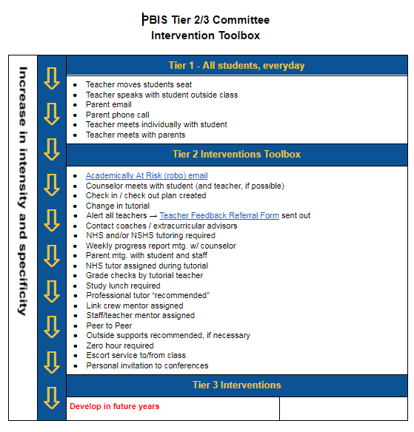
Tier 2 Process

Slide 24
Where we’re headed
Solidify Tier 2 Meeting Functionality
Optimizing staff time
Minimizing an empty counseling office
Communication with Staff
Increase understanding
Staff support for interventions
Transitioning to Tier 3

Slide 25
Grosse Pointe South High School
Aimee Miller - Behavior Specialist/PBIS Coach
millerai@gpschools.org
Ryan Wheaton - Math Teacher/Data Coordinator
wheator@gpschools.org

