Slide 1
How Edsel Ford Married Restorative Practices to PBIS
Presented by:

Slide 2
“Restorative Practices and PBIS are not just more things added to our plate-they are the plate”

Slide 3
What is the difference between a Tier 1, 2, 3 Student?
Tier 2
Tier 1
Tier 3

Slide 4
Edsel Ford’s 9th Grade Academy Tiers 1, 2, 3
Tier 1 | Tier 2 | Tier 3
All of our 9th grade students | 1-2 E’s and/or 16 tardies | 3 or more E’s and/or 24 tardies or has an IEP
Link leader, after school tutoring, SSR, Readers Apprenticeship, Formative Assessment, Orientation, classes mostly in one hallway, teacher trained in RP and circles | Link alert, one on one peer mentoring, lunch time tutoring, Early Start, Parent contact | Adult mentors, check in/out, behavior contracts/plans, parent meetings

Slide 5
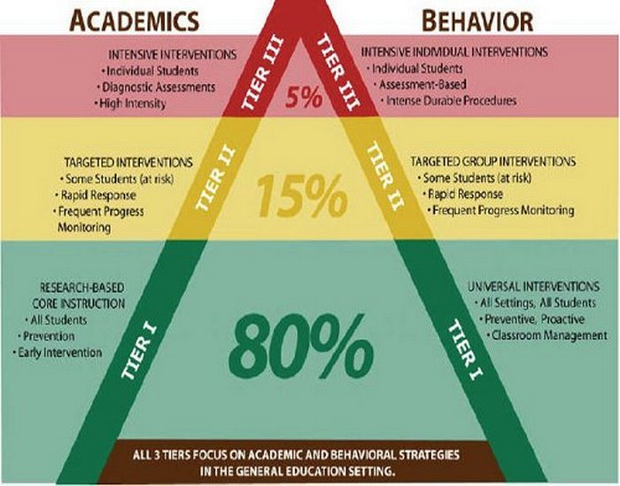

Slide 6
EDSEL FORD’S DEMOGRAPHICS
ETHNICITY | # | %
African Amer. | 90 | 6%
Asian | 24 | 2%
Caucasian | 541 | 36%
Hispanic | 38 | 3%
Middle Eastern | 786 | 53%
Native Amer | 6 | 0%
TOTAL | 1485
STATUS | # | %
ELL | 303 | 20%
SPECIAL ED. | 126 | 8%
ECONOMICALLY DISADVANTAGED | 942 | 63%
IMMIGRANT | 389 | 26%

Slide 7
How Edsel Ford Embeds RP into PBIS….
Incident # Date: | Circle the Unwanted Student Behavior | Circle the Intervention/Reset used:
Incident 1: Date: _________ | Technology Sleeping Missing Work Not prepared Off Task Talking Profanity Eating in class Other: | Requires A Reset Warning Seat Change Proximity change Conference Other:
Incident 2: Date: _________ | Technology Sleeping Missing Work Not prepared Off Task Talking Profanity Eating in class Other: | Requires A Hallway Conversation Hallway Conv. Notes:

Slide 8
Incident 3 Date: _________ | Technology Sleeping Missing Work Not prepared Off Task Talking Profanity Eating in class Other: | Requires a call home Spoke to Whom:_____________________ For translation if needed call Mr. Dakhlallah @ 71535 Notes:
Incident 4: Date: _________ | Technology Sleeping Missing Work Not prepared Off Task Talking Profanity Eating in class Other: | Requires a referral to responsibility room Referral to responsibility room Received Student Reflection Notes:
Incident 5: Date: _________ | Technology sleeping Missing Work Not Prepared Off Task Talking Profanity Eating in Class | Requires a call home, and detention email: Stephanie Salsbury to schedule detention salsbes@dearbornschools.org Detention Date set for:________________ Notified Whom:_______________________

Slide 9
Tardy Policy
**Pete

Slide 10
How RP is embedded into PBIS

Slide 11
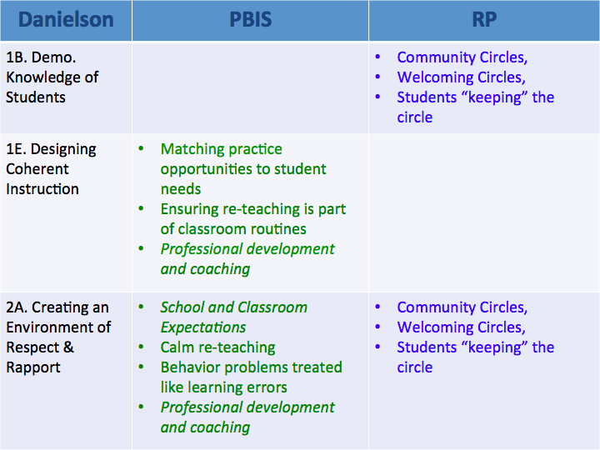

Slide 12
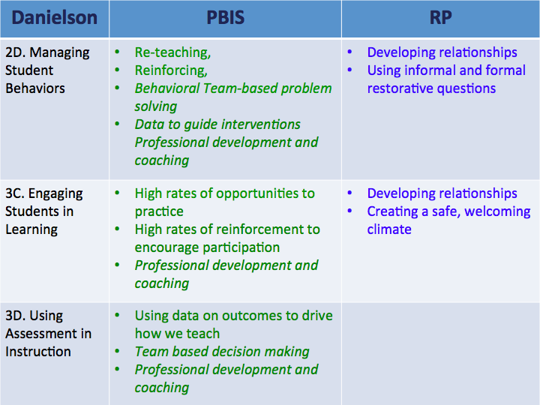

Slide 13
Our Goals for Student Behavior through RP

Slide 16
Edsel Ford’s Commitment to Alternatives to Suspension

Slide 17
School Year | OSS SEM 1 | OSS SEM 2 | TOTAL OSS | OR -
2012-13 | 447 | 526 | 973 | Base
2013-14 | 352 | 435 | 787 | -186
2014-15 | 337 | 292 | 629 | -158
2015-16 | 209 | 277 | 486 | -143
2016-17 | 213 | 210 | 423 | -63
 |  |  |  | -550 | LESS DAYS OSS

Slide 18
School Year | ODR Sem 1 | ODR Sem 2 | ODR Year Total | + or -
2012-13 | 869 | 723 | 1,582
2013-14 | 514 | 633 | 1,147 | -445
2014-15 | 669 | 617 | 1,286 | +139
2015-16 | 594 | 556 | 1,150 | -136
2016-2017 | 426 | 493 | 919 | -231 (-663)less ODR’S

Slide 19
ODR data w/out Truancy Facts
2016-17 EFHS Sem 1 ODR’s= 426
2016-17 EFHS Sem 1 Truancy ODR’s= 179
2016-17 True Sem 1 ODR’s= 247
2016-17 EFHS Sem 2 ODR’s= 493
2016-17 EFHS Sem 2 Truancy ODR’s= 217
2016-17 True Sem 2 ODR’s= 276
2016-17 Total ODR’s= 919
2016-17 Total True Yearlong ODR’s= 523
**Please Note- Baseline 2012-13 ODR data was 1,582

Slide 20
WHAT DOES IT MEAN??
663 ODR’s x ~30 minutes per ODR = 19,890 minutes saved!!!!!
2016-17 staff survey showed 92% favorability to continue SWPBIS.
90% of staff feel SWPBIS contributes positively to the culture of Edsel Ford
We are committed as a whole learning community to reach struggling students and keep them in class while helping them overcome the non-academic barriers to their learning to improve our students academic and behavioral outcomes.

Slide 21
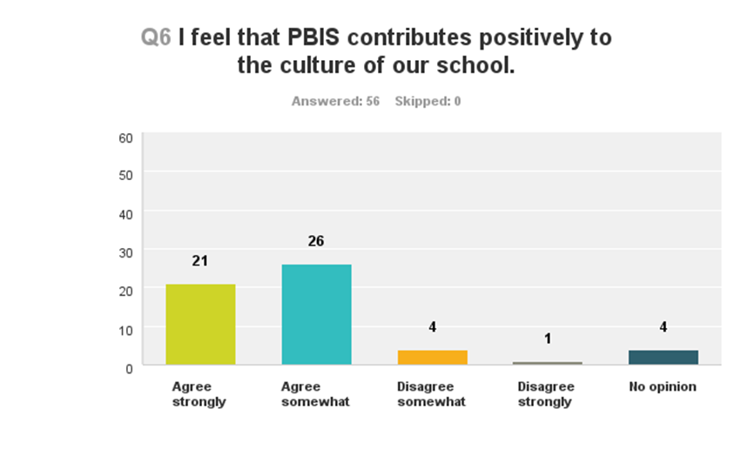
SURVEY SAYS……...

Slide 22
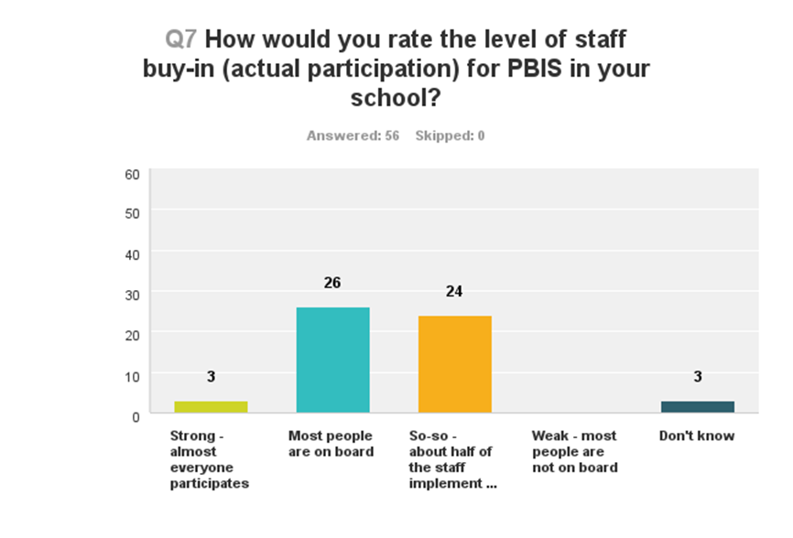

Slide 23
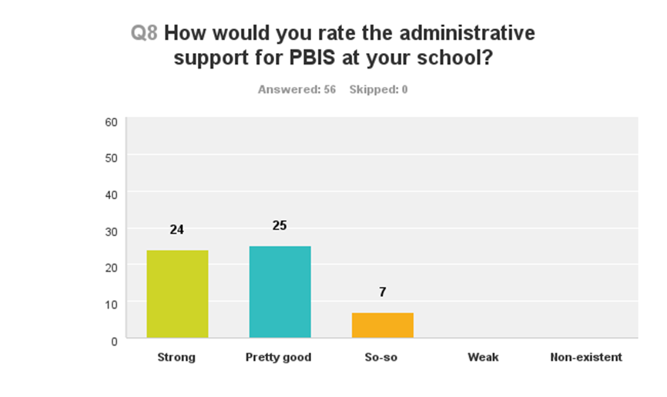

Slide 24
2016-17 TARDY DATA
Students with 40+ tardies | 2015-16 Semester 1 | 2015-16 Semester 2 | 2016-17 Semester 1
Edsel Ford High School | 3 | 9 | 4
DHS | 118 | 162 | 78
FHS | 84 | 118 | 111

Slide 25
GRADUATION RATES
 | 2010 | 2011 | 2012 | 2013 | 2014 | 2015 | 2016
Dearborn City Schools | 79.5% | 76.0% | 82.6% | 86.2% | 87.0% | 89.88% | 92.74%
Dearborn High School | 86.5% | 84.7% | 85.1% | 89.9% | 90.1% | 92.58% | 93.6%
Dearborn Magnet High | 50.0% | 53.3% | 75.0% | 66.7% | 63.2% | 30.00% | 54.55%
Edsel Ford High School | 74.1% | 76.3% | 79.7% | 83.7% | 85.8% | 87.96% | 95.55%
Fordson High School | 82.1% | 77.1% | 84.5% | 89.5% | 88.9% | 93.31% | 94.43%
Henry Ford Early College | --- | --- | 95.6% | 83.0% | 97.3% | 100% | 97.62%
State of Michigan | 75.9% | 74.3% | 76.2% | 77.0% | 78.6% | 79.79% | 79.65%

Slide 26
SUMMARY OF INTERVENTION AT EFHS
The following are the reasons for a reduction in ODRs/OSS
Community Service, Detention, Parent Escort, Restorative Practices, Running club all serve as an alternatives to suspension that helped reduced OSS significantly
Restorative practices lead by our RP Technician (met with 120 students during 1st semester and 110 2nd semester)
School-Wide PBIS implementation
LINK and 9th grade Lead Teacher intervention
At-Risk Advisors
Social Workers
Administrative Team (including interns)
The highest number of OSS were issued because of tardies.

Slide 27
CONTACT INFO
SCOTT CASEBOLT, PRINCIPAL: casebos@dearbornschools.org
KHALID ABDULLA, ASST. PRINCIPAL, 9/10 GRADE: abdullk@dearbornschools.org
PETE KOTSOGIANNIS, ASST. PRINCIPAL, 11/12 GRADE: kotsogp@dearbornschools.org
TARA HADDAD, 9TH GRADE LEAD TEACHER: haddadt@dearbornschools.org

