Slide 1
Pardee PBIS
Dearborn Heights School District #7

Slide 2
Demographics
4th-5th Grade Building
402 students
155 Schools of Choice (39%)
79% Free and Reduced Lunch

Slide 3
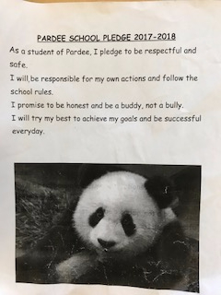
Teaching Tier 1 Expectations
*PBIS is a district wide program in D7 - when the students get to Pardee they are aware of district expectations - Be Respectful, Be Responsible, Be Safe
*At our first PBIS assembly of the year - teachers act out the expectations - the WRONG way and then they come back and show how we expect them to behave
*We say the Pardee School Pledge together every morning
*Teachers are asked to re-teach expectations in their classroom throughout the year

Slide 4
Our Team
Open door meetings
Core team of 7
Added 2 parents to our team this school year (one from 4th grade and one from 5th)
Share information through meeting minutes, late start Monday meetings and emails
5th year of implementation (since we reconfigured into a 4-5 building)

Slide 5
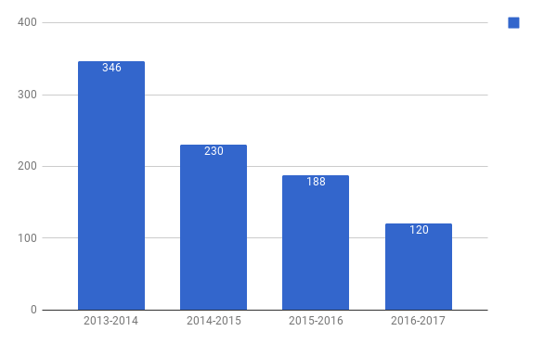
ODR Comparison Data from the last 5 years

Slide 6
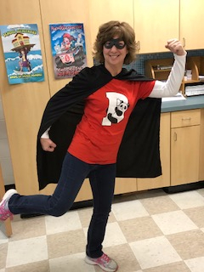
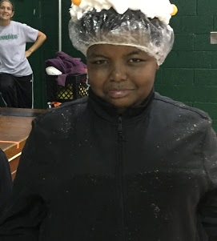
Monthly Assemblies
Classroom Goals
Classroom reports (total - made/missed goal, reward if earned & next month’s goal)
Panda Girl
Game with student participation

Slide 7
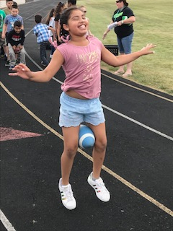
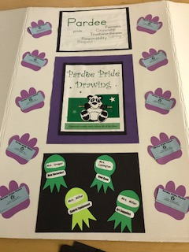
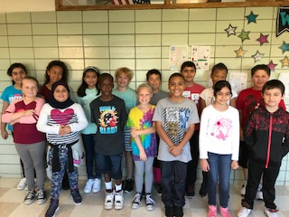
PBIS Rewards
Monthly Rewards
Fun Fridays
Friday Friends
Pardee Pride Tickets

Slide 8
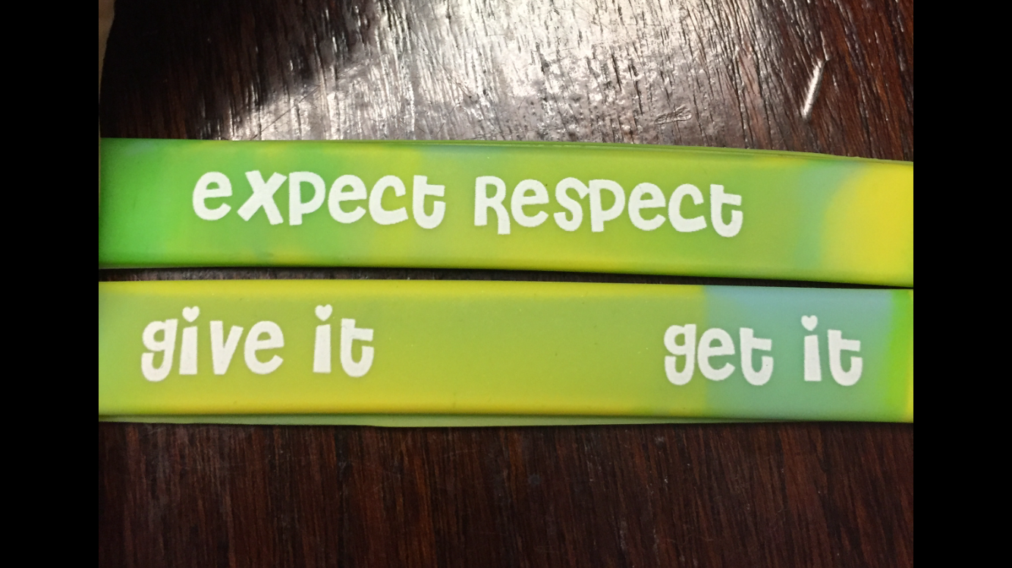
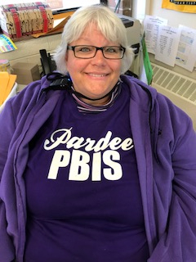
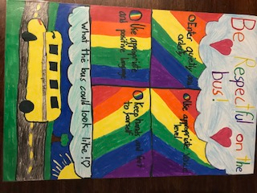
PBIS Around the School
Poster Contest
T-shirts
Expect Respect Club
School wide empathy field trip to see Wonder

Slide 9
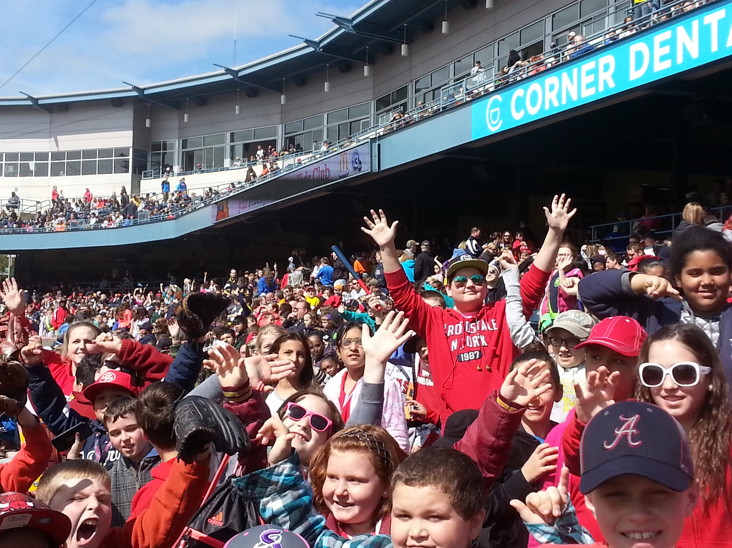
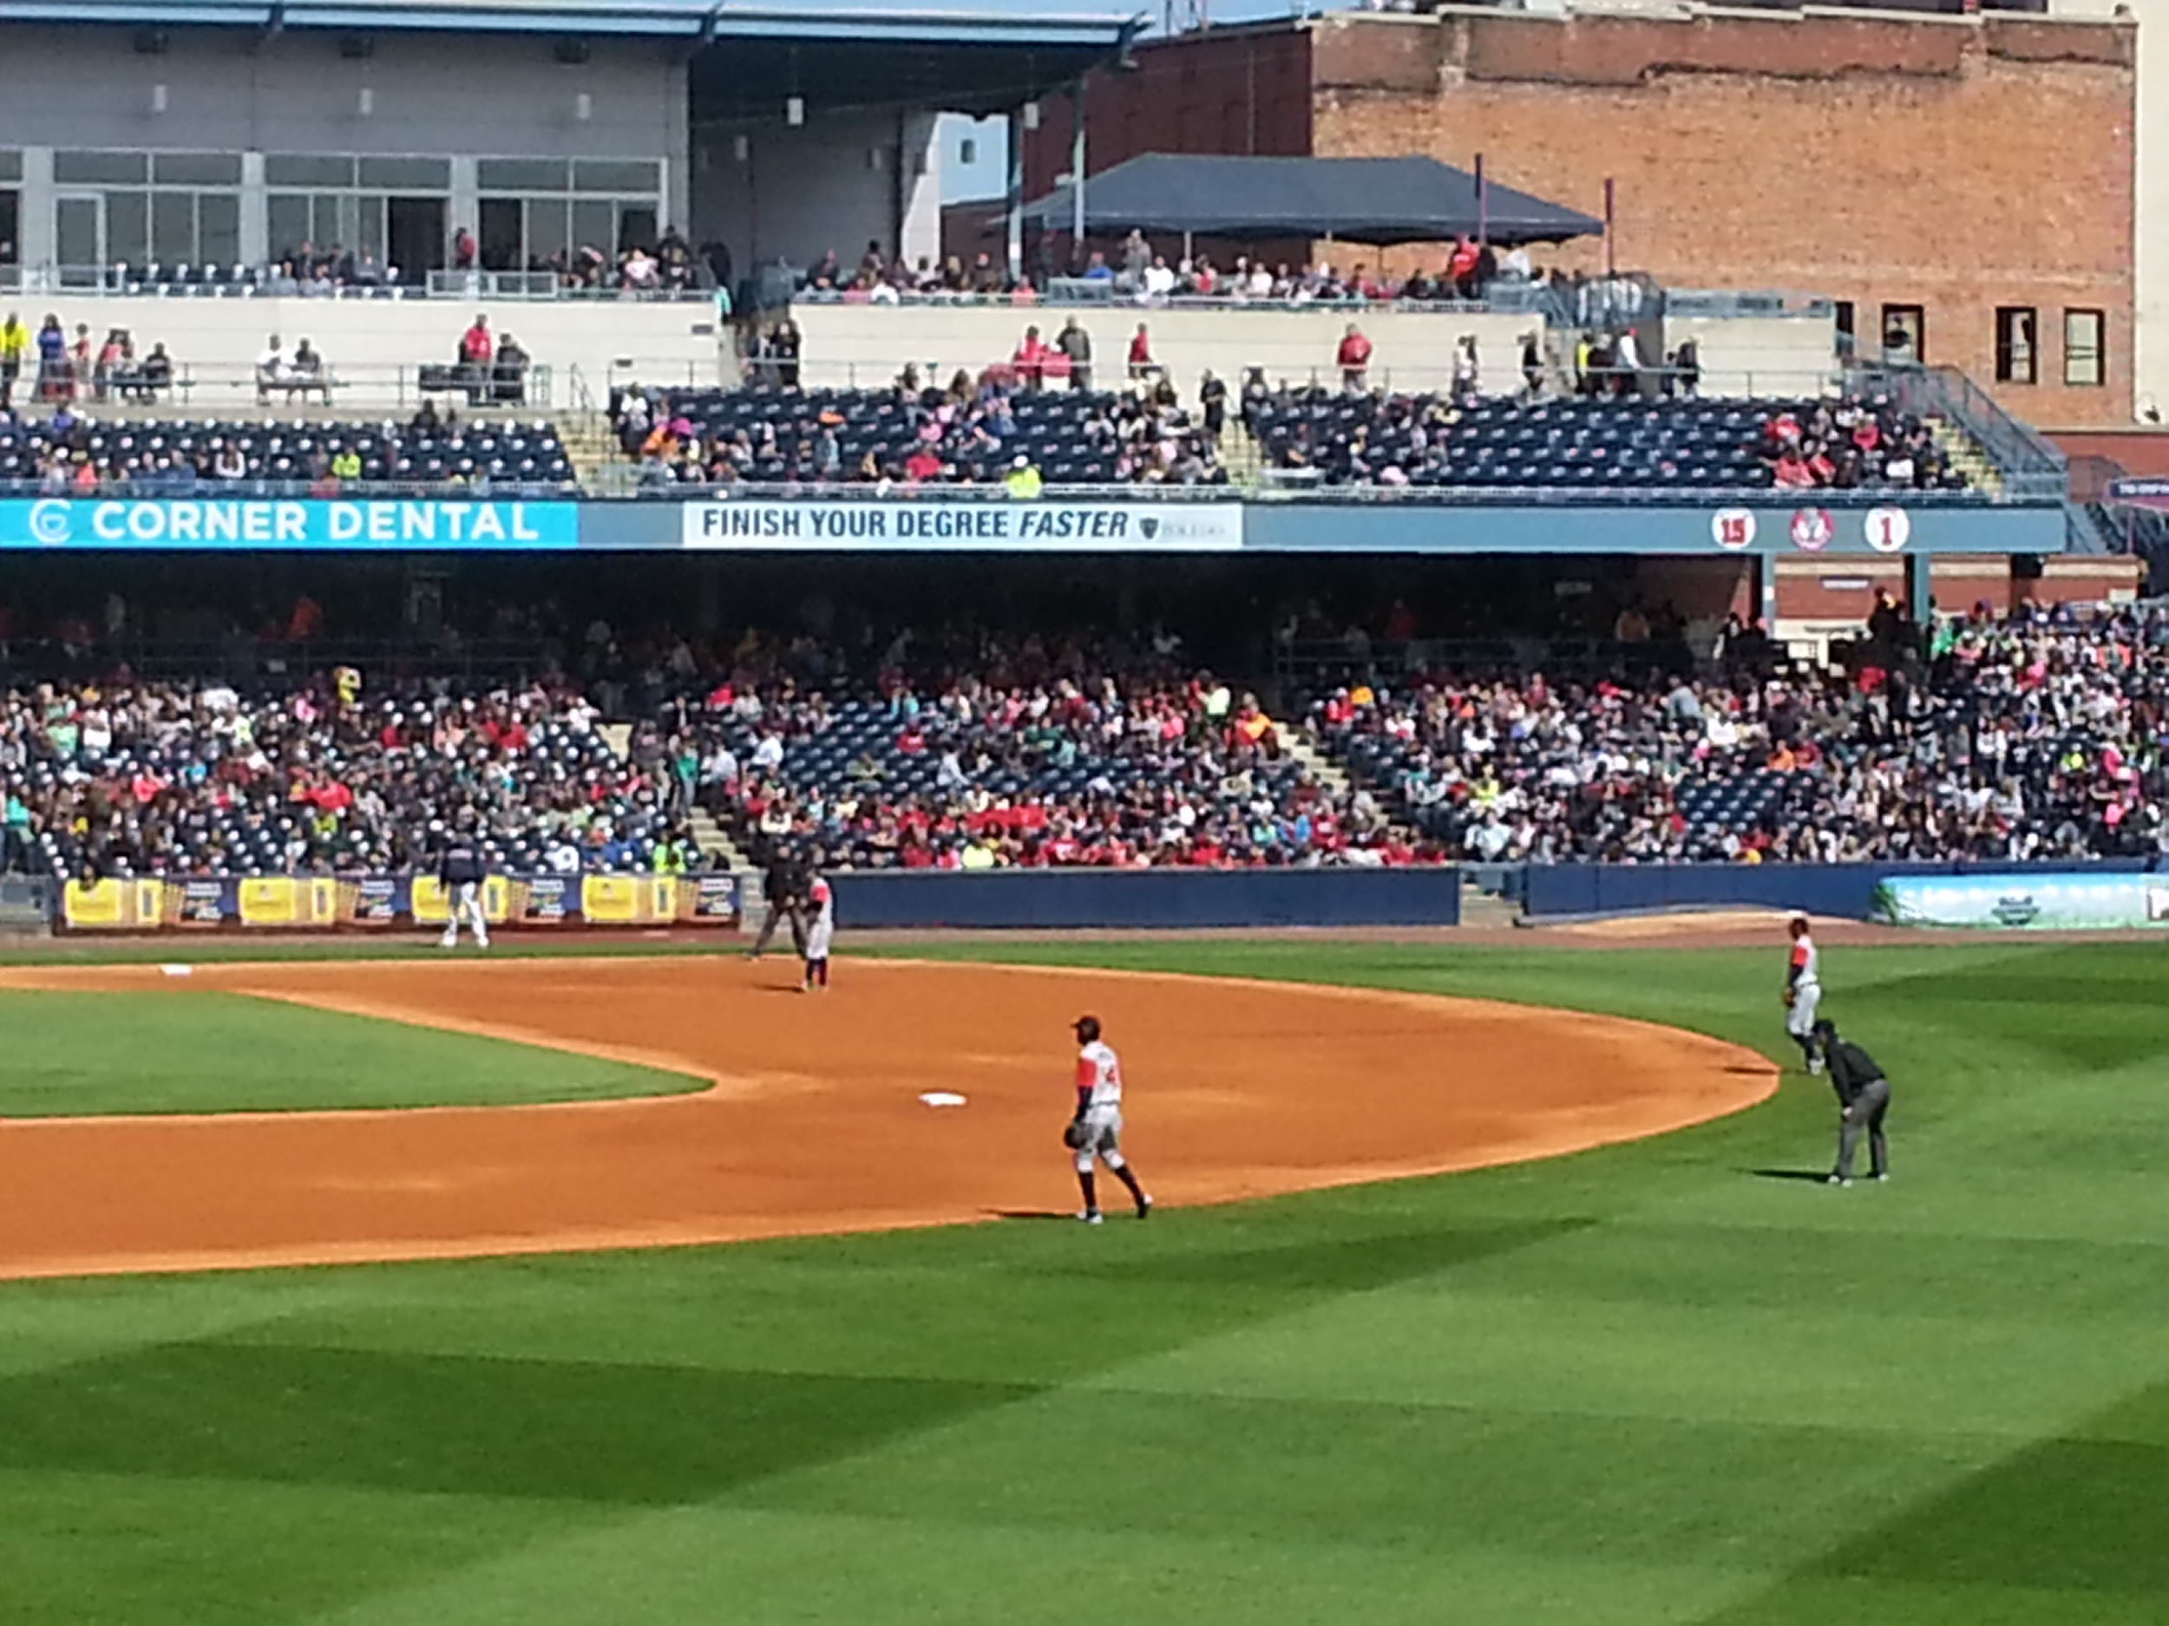
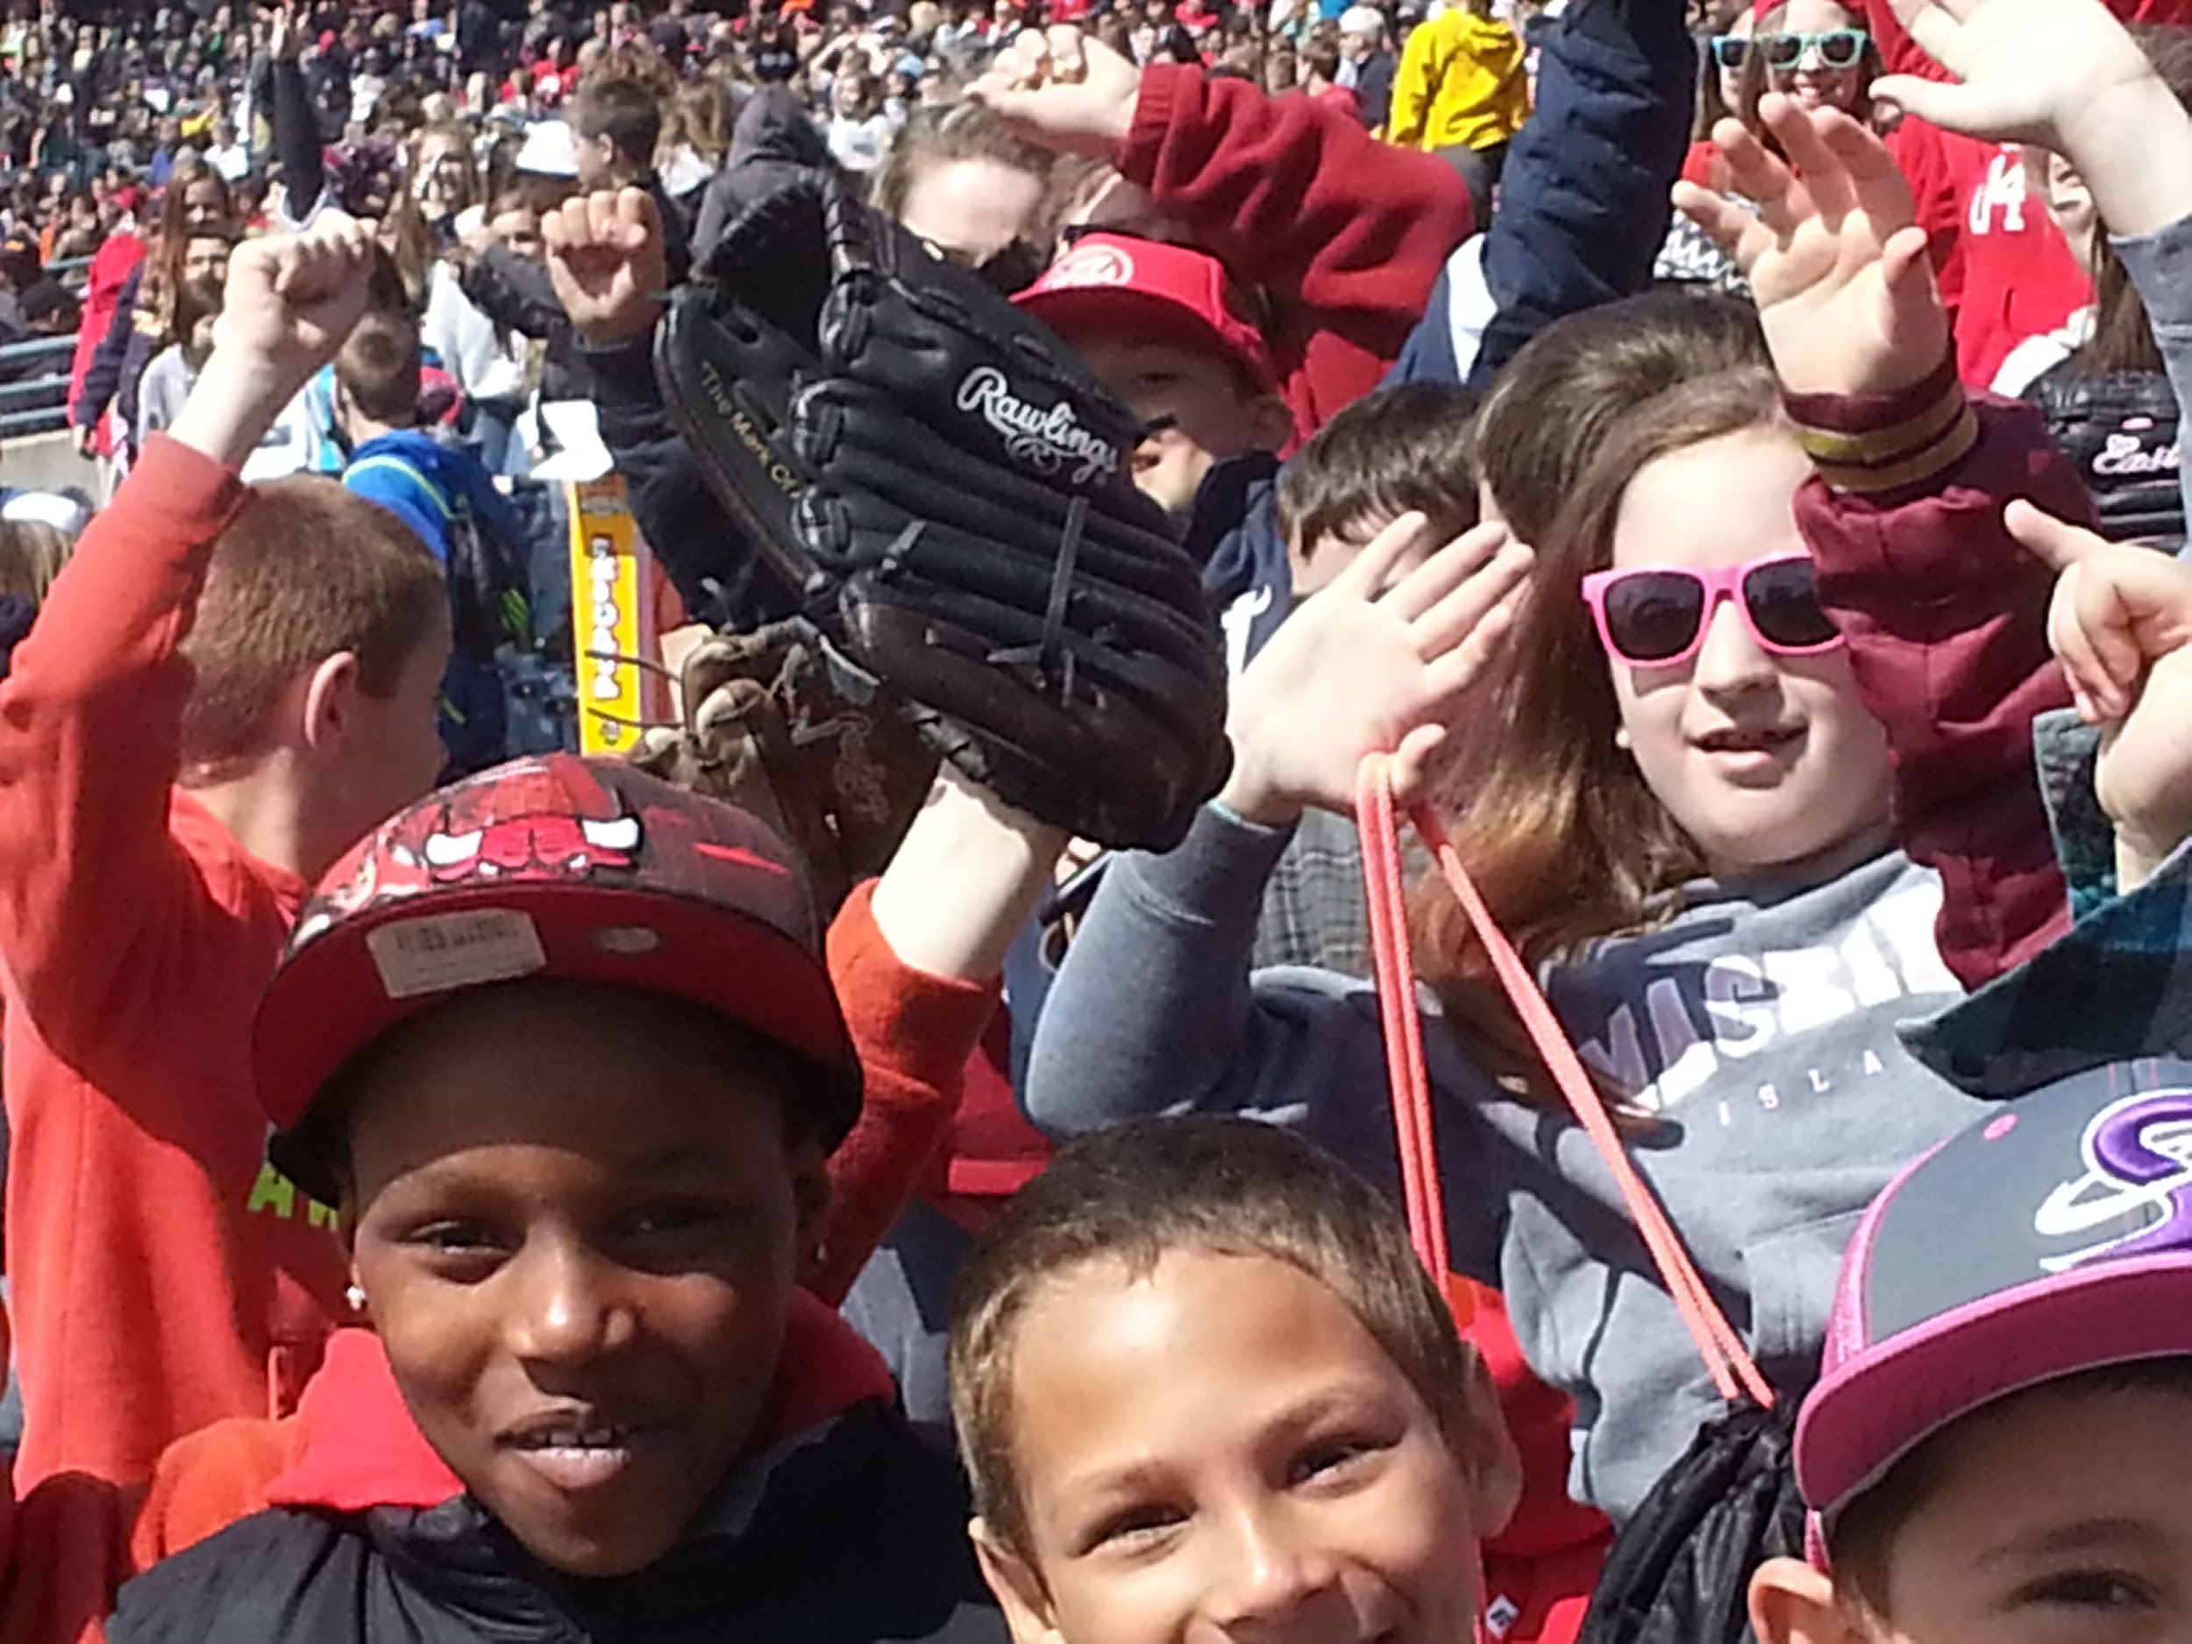
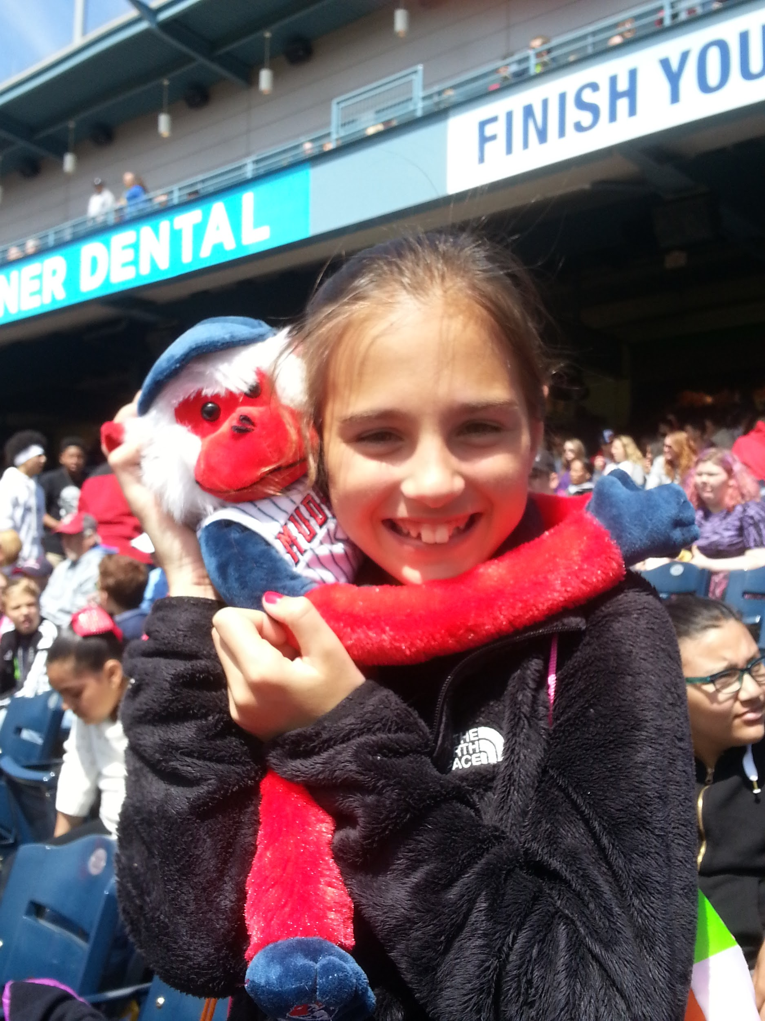
End of the Year Reward
ard
Toledo Mudhens
Baseball Game

Slide 10
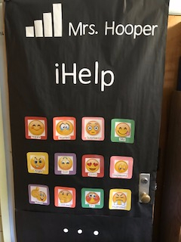
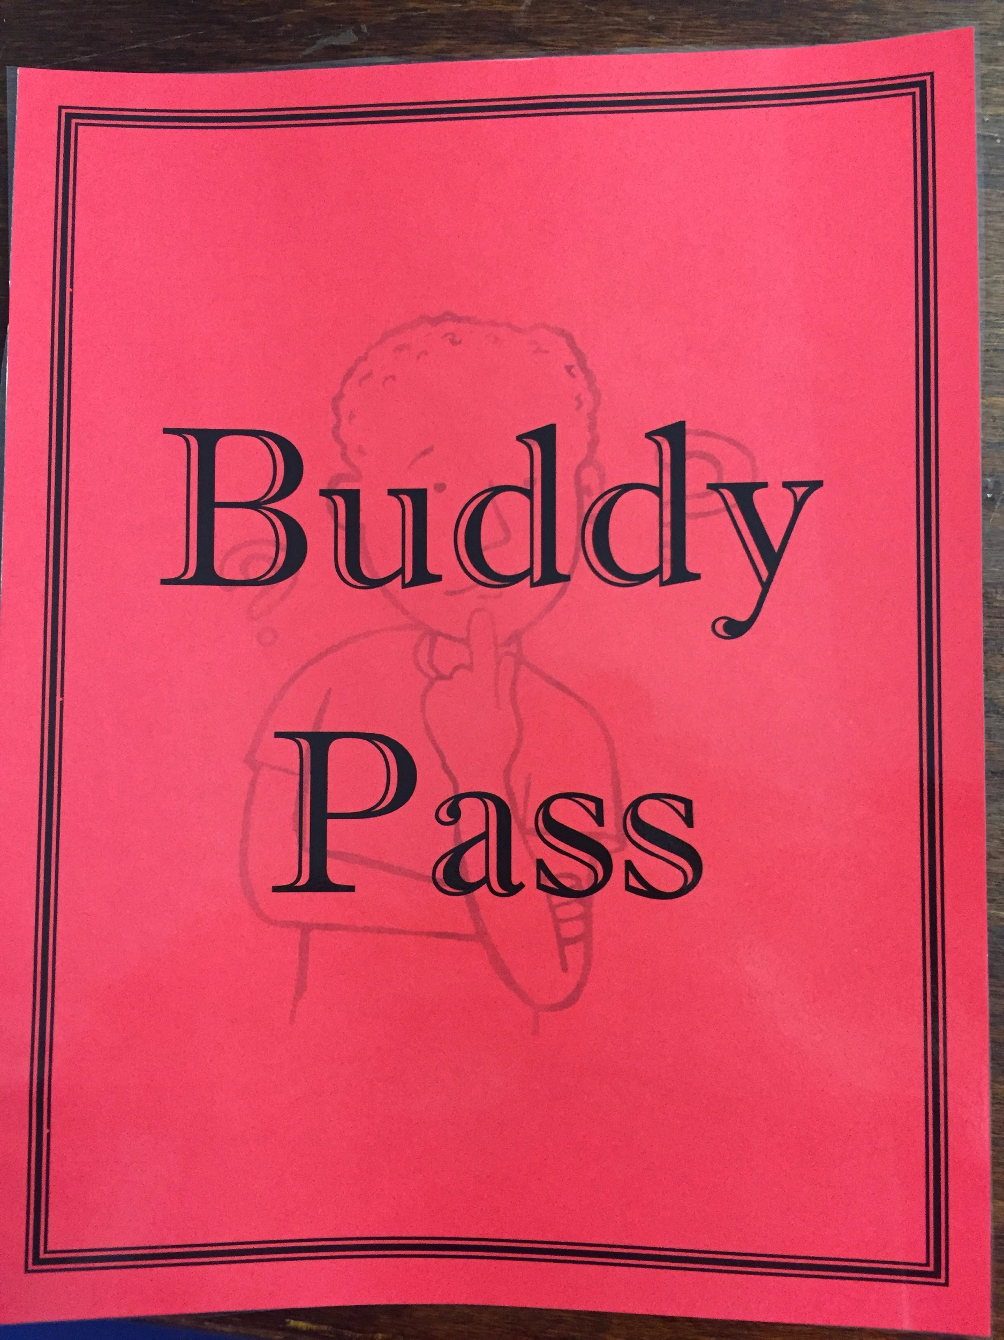
Tier 2 Interventions
Buddy Pass
CICO
Interventionist
Detention

Slide 11
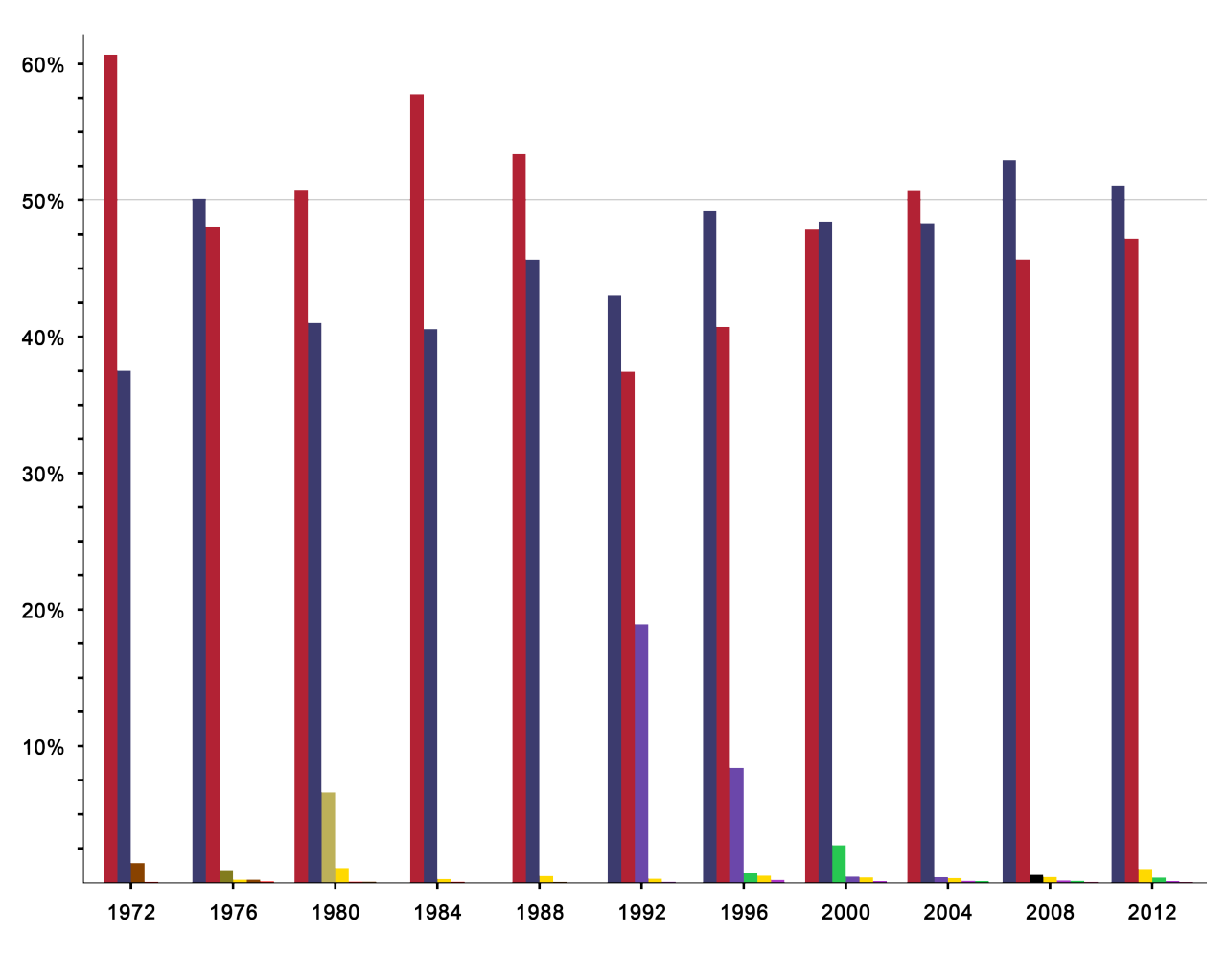
MTSS
Our team meets 4 times a year to discuss academic and behavioral progress and concerns
A member of the PBIS committee sits in on MTSS meetings and documents any Tier 2 or Tier 3 behaviors, what’s being done and if it’s working

Slide 12
Mentoring Program
Started in 2016-2017 school year (only 2 mentors)
Pair students up with community members
Meet twice a month
Expanded this year to 9 mentors

Slide 13
Presented By:
William Murphy - Principal
murphywi@dhsd7.net
Marcy Jouppi - Special Education Teacher
jouppima@dhsd7.net
Shelly Hooper - Interventionist
hoopersh@dhsd7.net
Beth Welkenbach - 4th Grade Teacher
welkenbe@dhsd7.net

