Slide 1
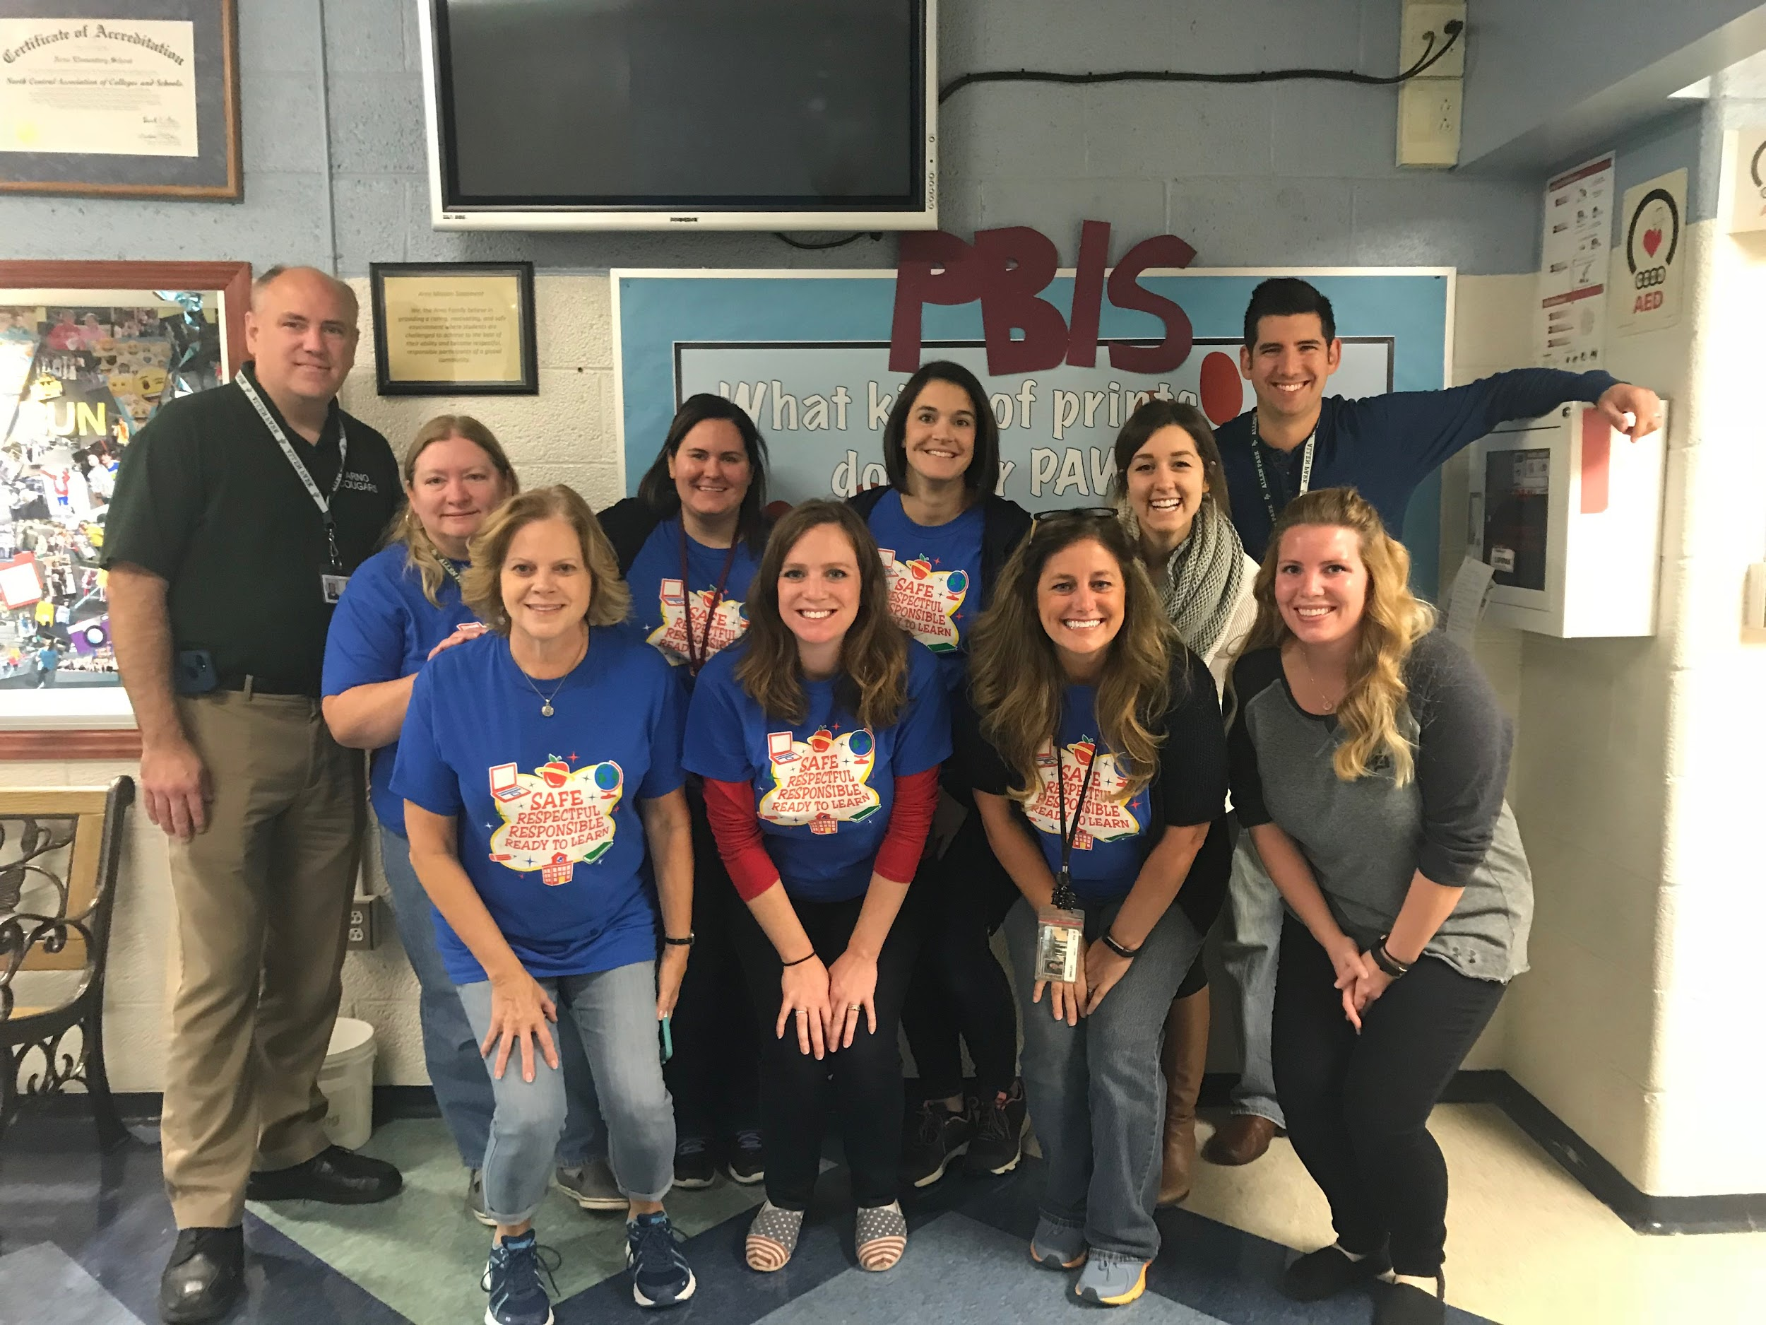
Arno Elementary PBIS Overview
Katie Jensen
Lisa Smalley
Megan Schultz
Steve Zielinski

Slide 2
General Information

Slide 3
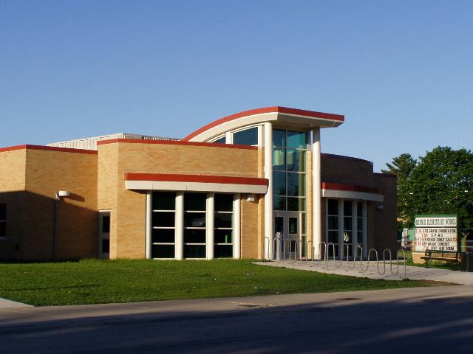
School Size and Demographic
510 Students
Grades K-5
School Wide Title 1; 40% F&R

Slide 4
Membership and Roles
Administrator Role: Oversee the PBIS program, collect data, reports data to the county, restorative justice and attempts to implement alternative consequences rather than suspension (if possible)
Classroom Teacher Role: Implementation of the PBIS system both school-wide and in their individual classroom
Support Staff (SSW, Resource Room, Ancillary Staff, etc): Assist with rewards/ consequences and help support the implementation school-wide

Slide 5
Number of Years Implementing PBIS
PBIS committee first applied for the grant in 2007/2008 school year.
PBIS has been updated and improved over the past ten years, based on building data and student body needs.

Slide 6
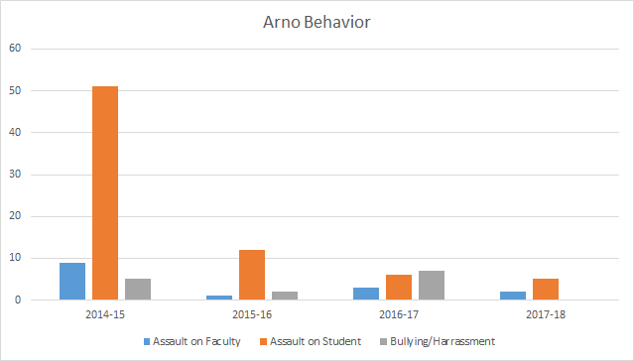
ODR Data

Slide 7
Overview
Arno has fully implemented Tiers 1 and 2.
Implementation is challenging with Tier 3.
Within the program, classroom teachers are able to tweak the system to meet their own classroom needs.

Slide 8
Tier 1 Interventions

Slide 9
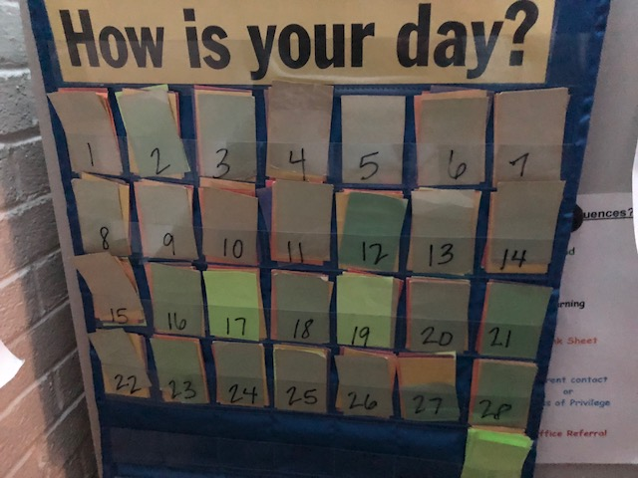
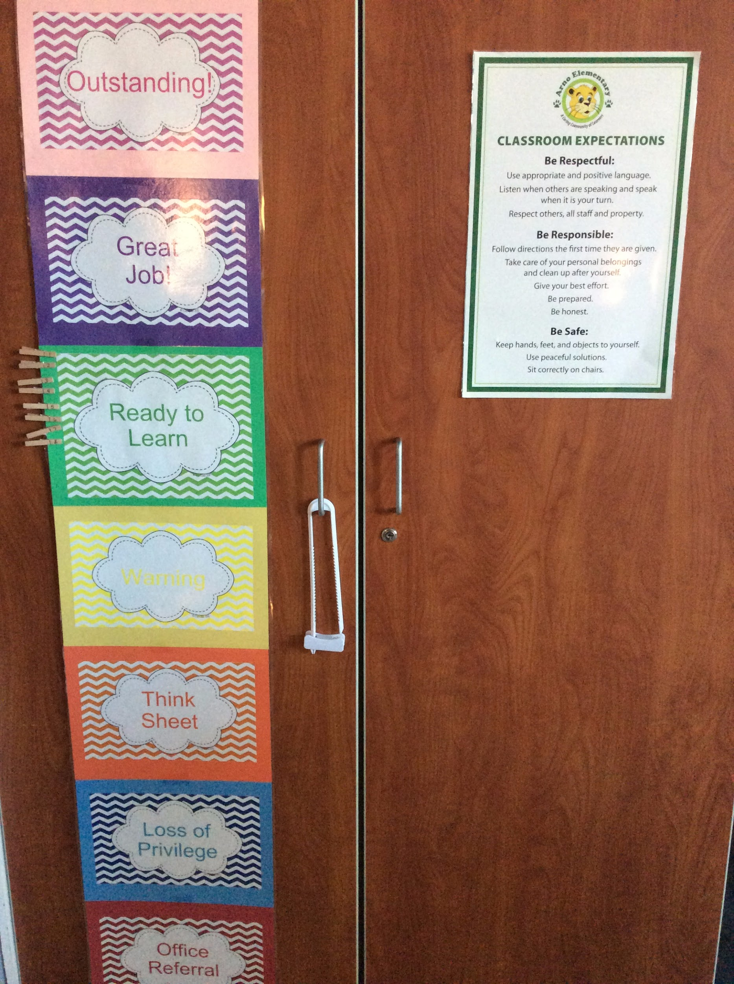
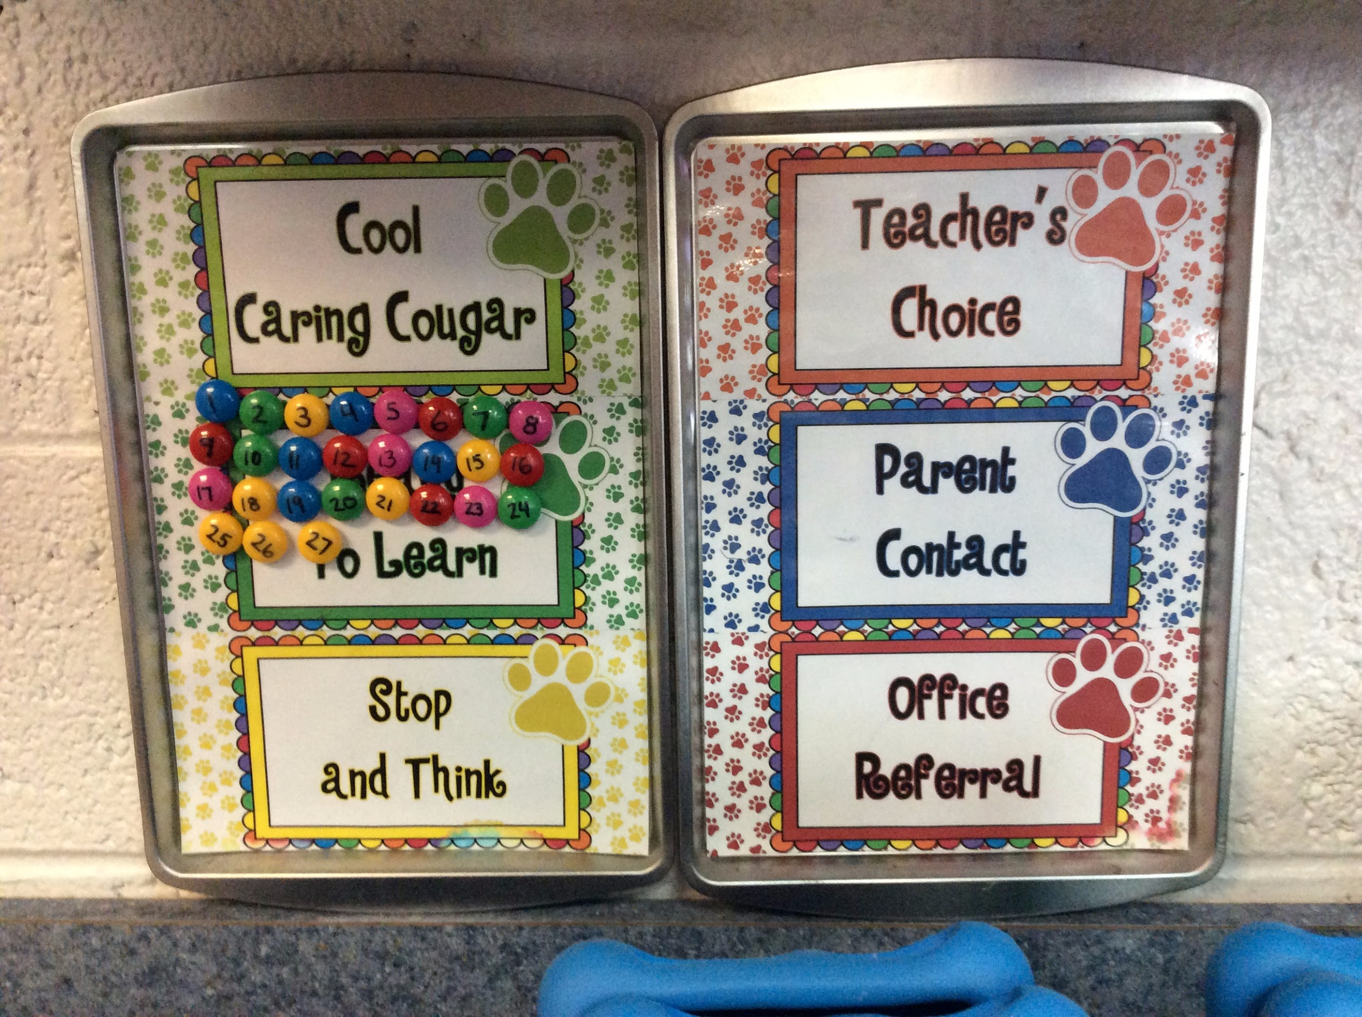
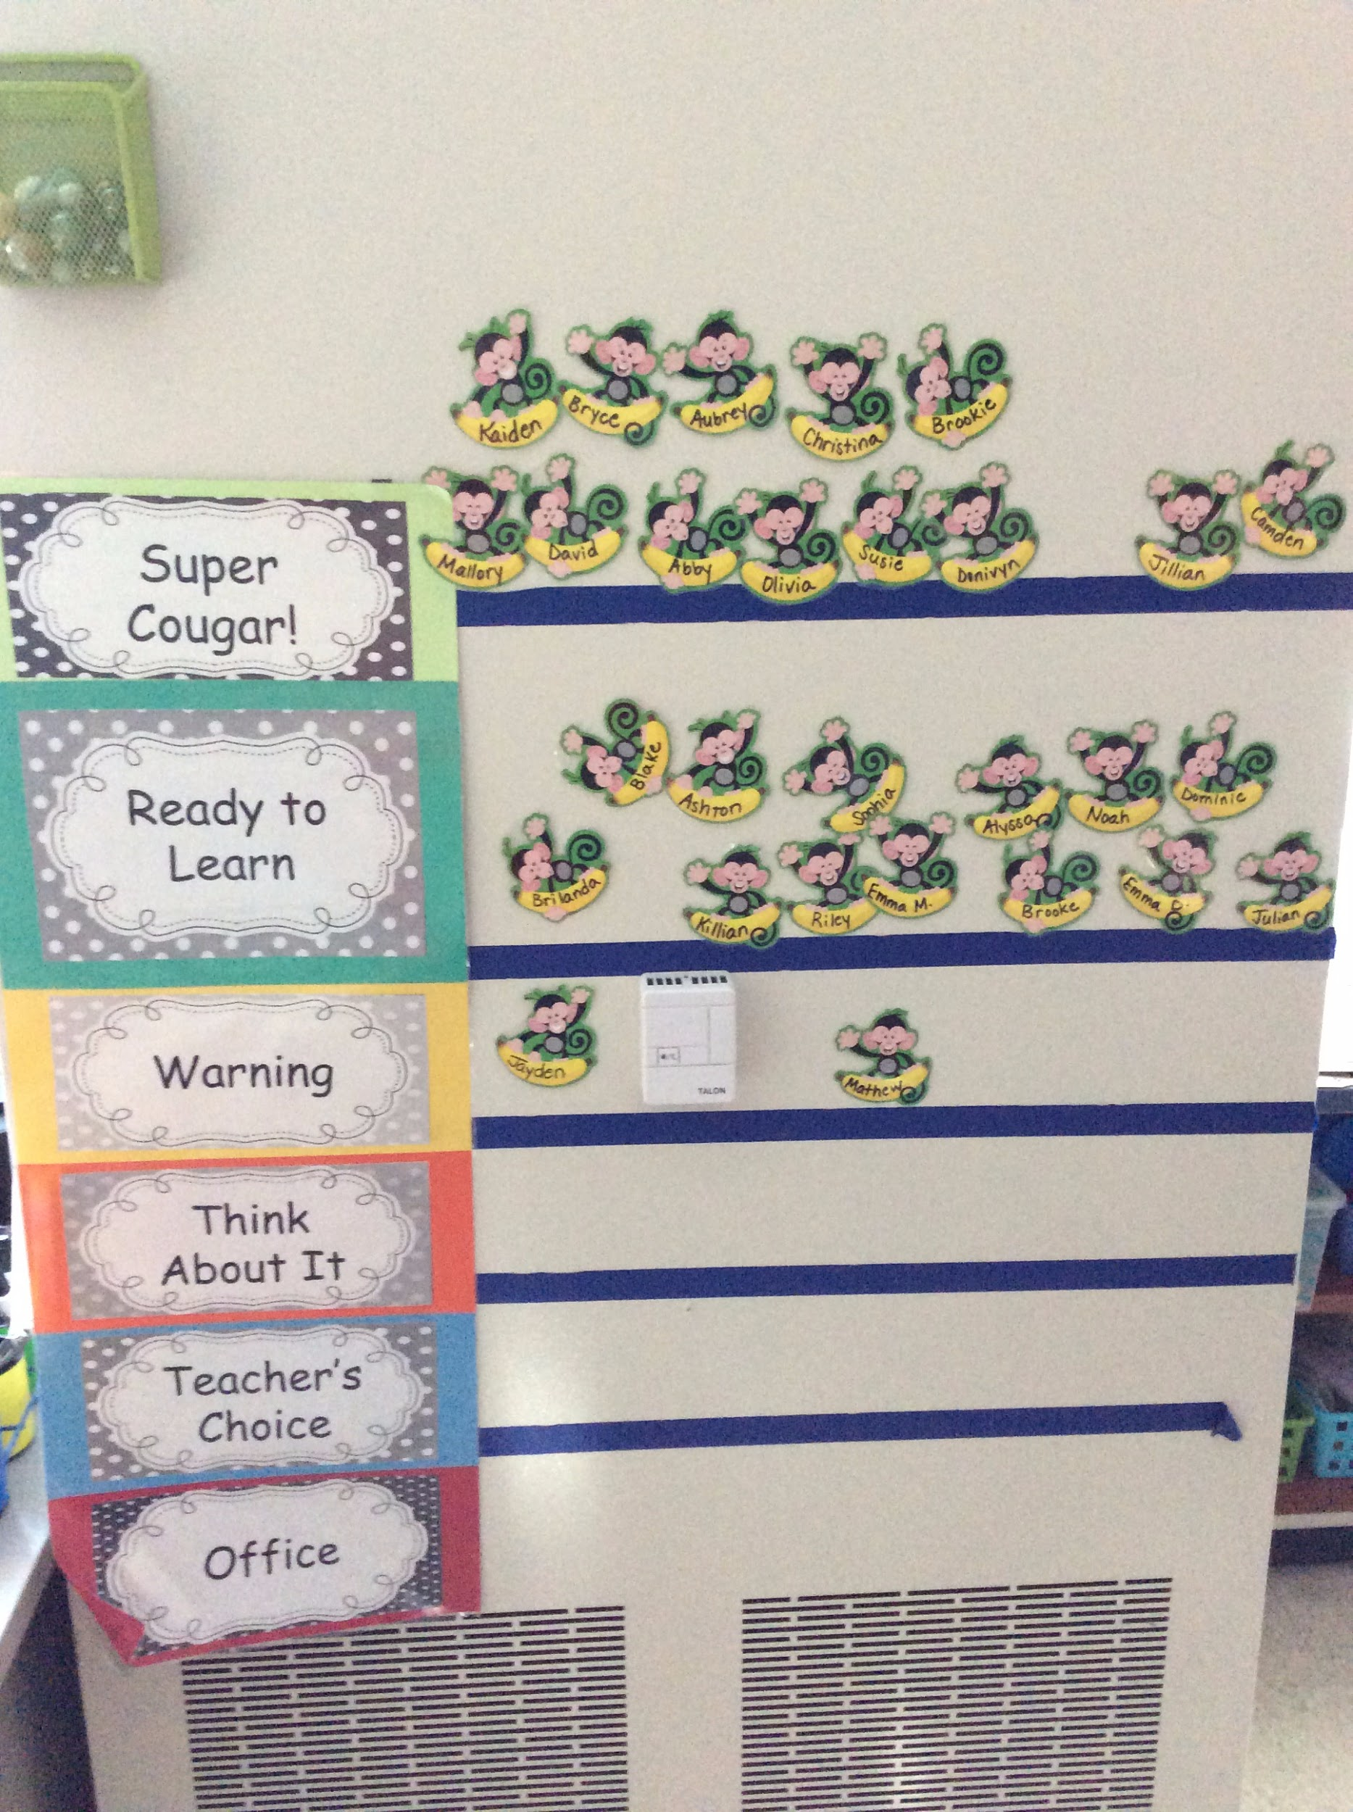
Tier 1 Systems

Slide 10
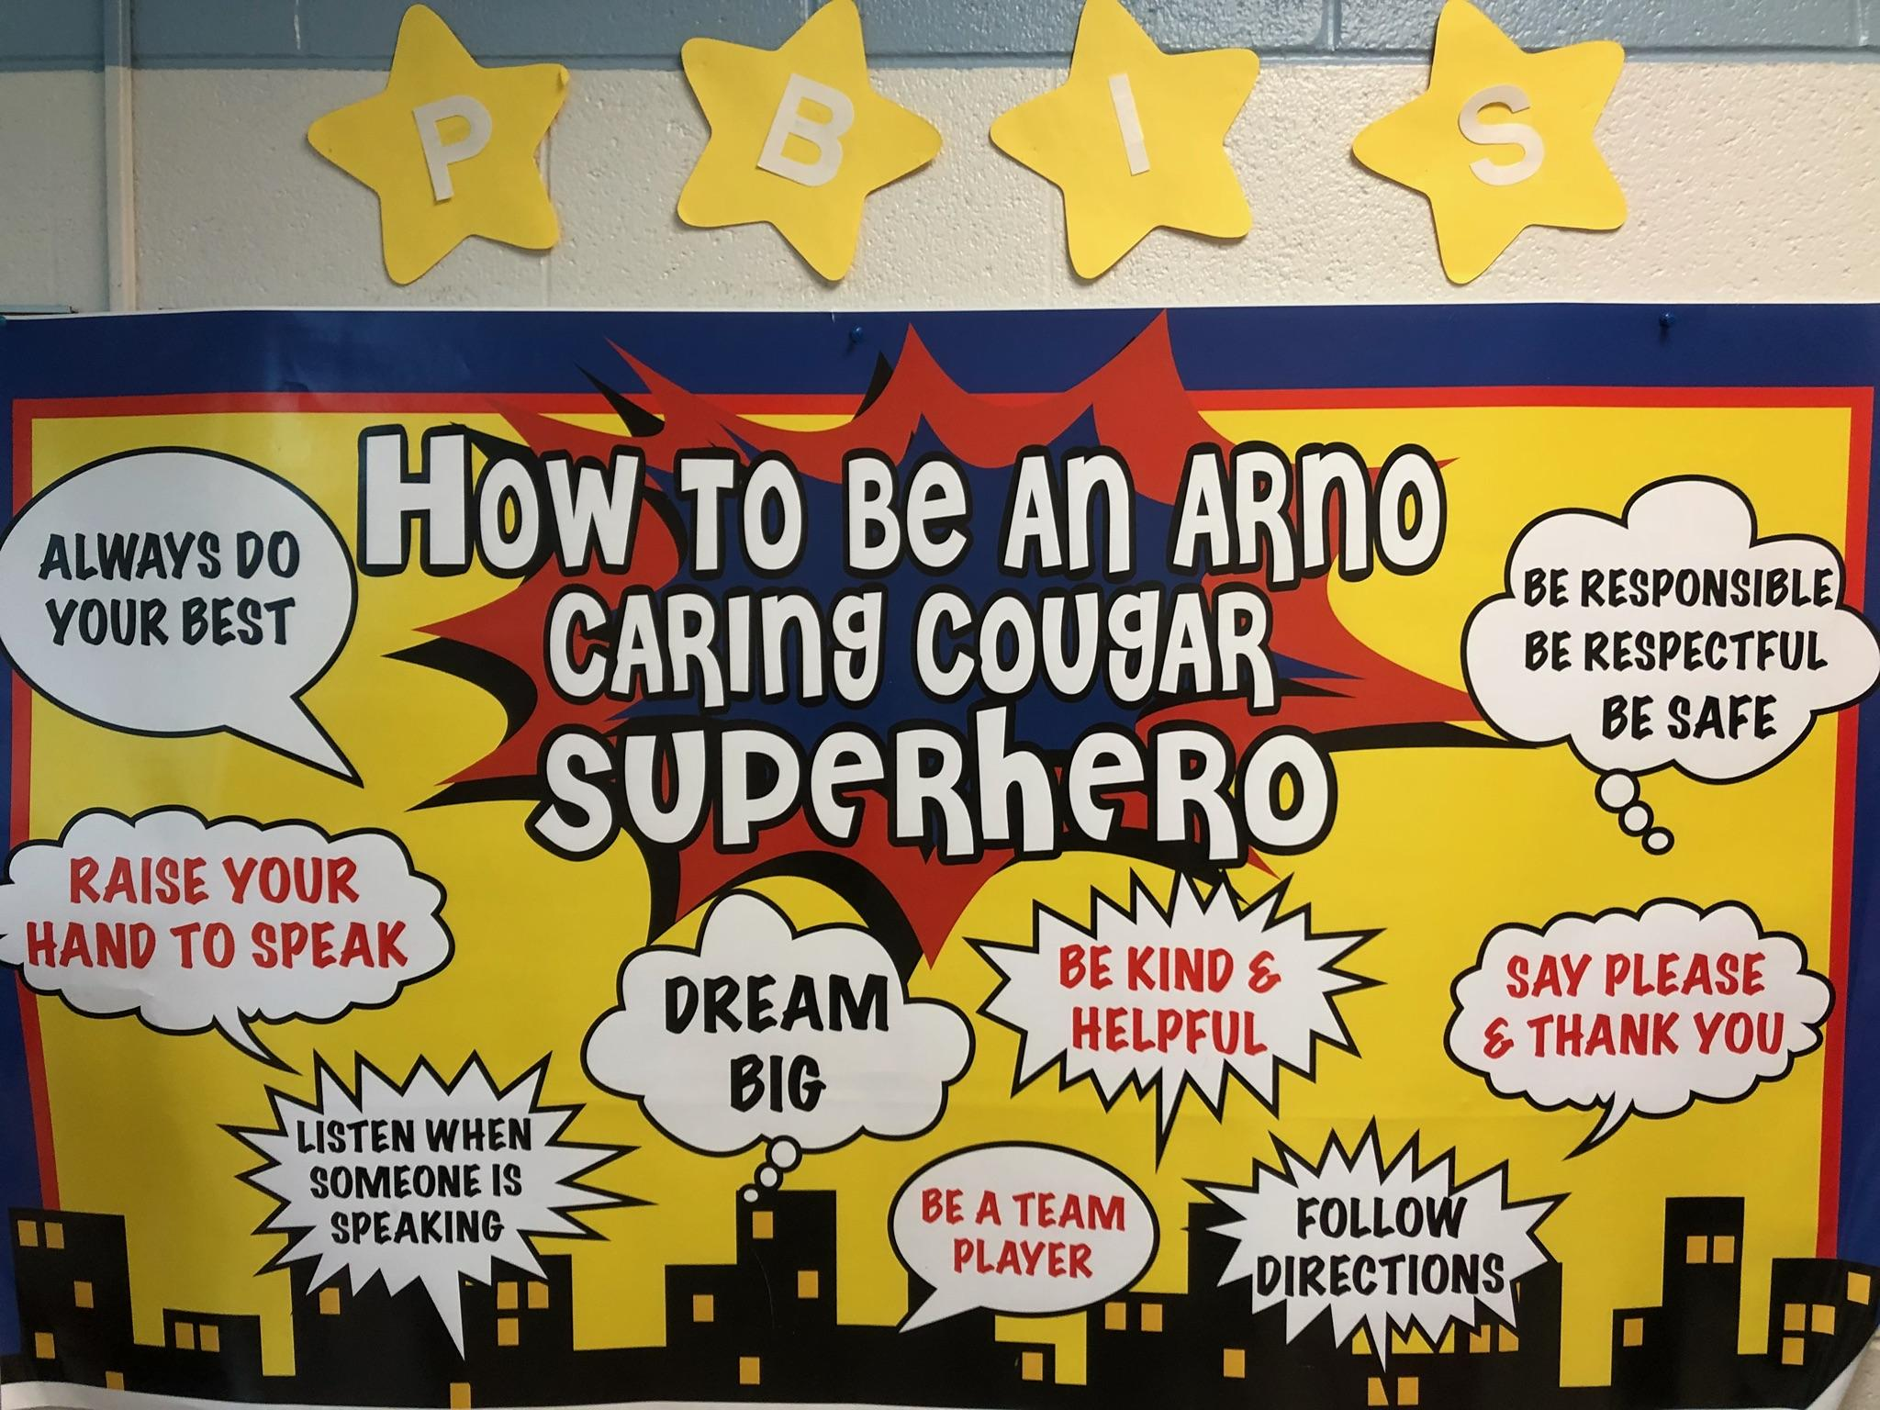
Teaching Expectations

Slide 11
Opening of School Year PBIS
Stations- Using teachers and support staff, students learned about expectations for the Hallway, Assemblies, Bus, Office, and Cafeteria
Previous years’ kick-off include: assembly, Jeopardy, Paws presentation, student role plays

Slide 12
PBIS Stations 2017

Slide 13
Matrix
In all classrooms
Sent home to families as brochure in opening packet
Families sign Parent Agreement

Slide 14
Morning Broadcast
Review Expectations Weekly
Puppet Shows
Student Skits
Review being Respectful, Responsible and Safe
Announce weekly and monthly awards

Slide 15
Student Recognition and Rewards

Slide 16
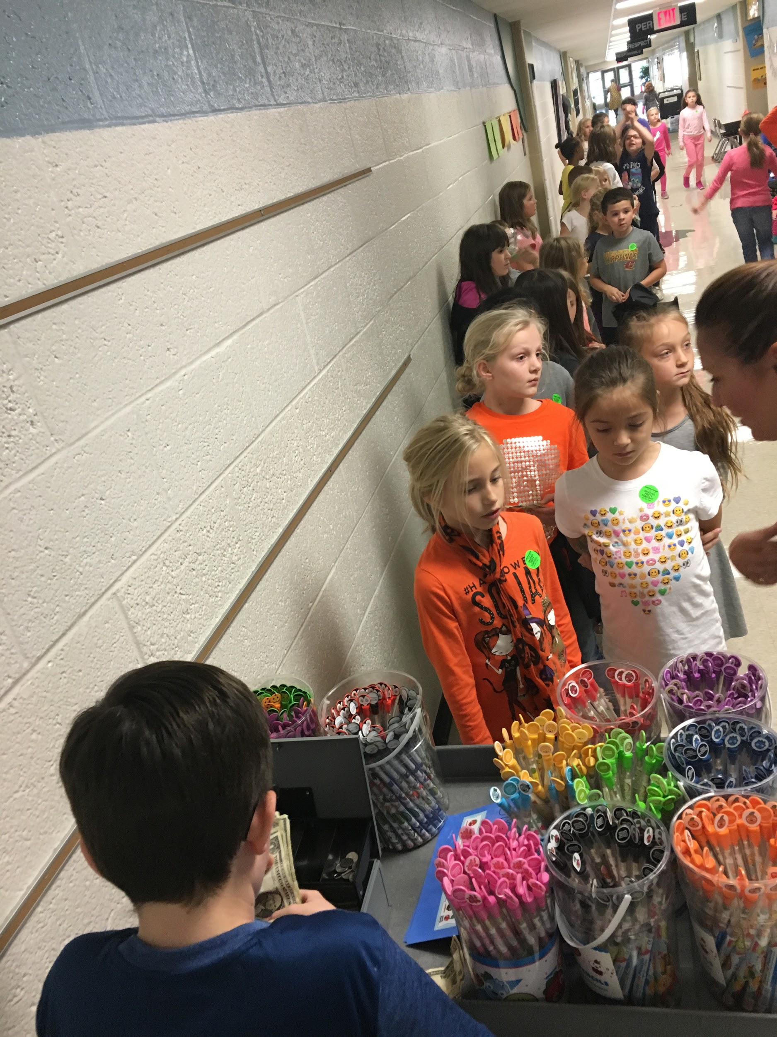
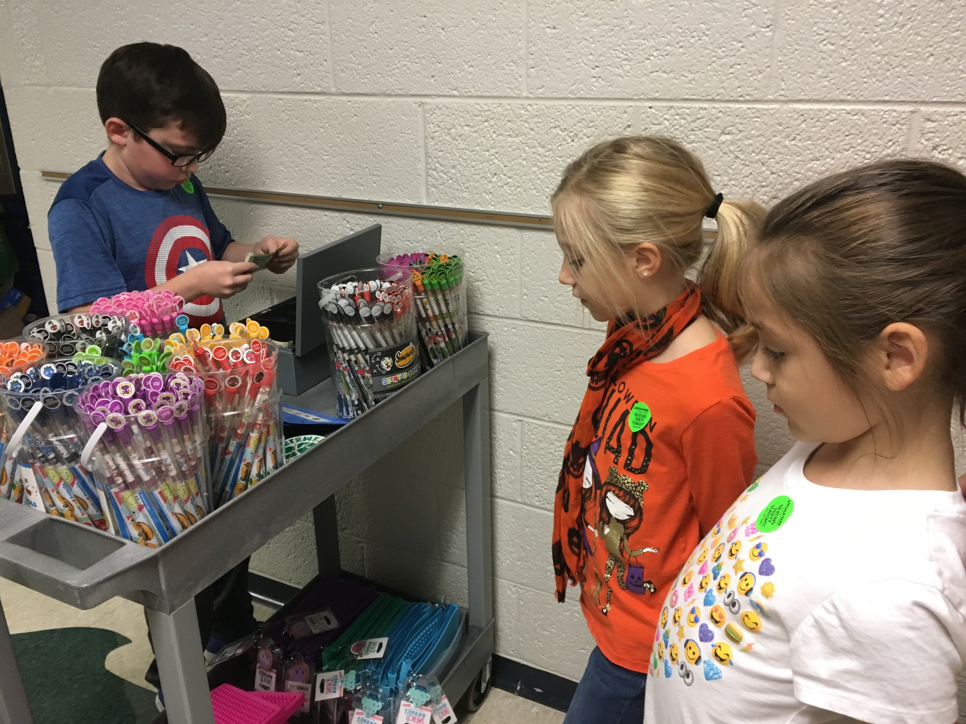
Funding PBIS at Arno Elementary
Smencils, Smens and Pouches sold bi-weekly
Car clings sold at Meet the Teacher Night and Conferences
Shout Outs

Slide 17
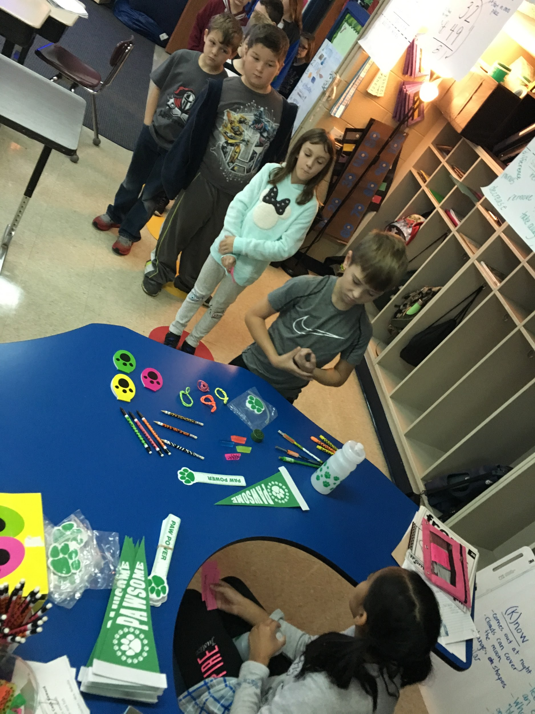
Student Recognition
Weekly Cougar Cash Recognition
Monthly Super Cougar Rewards: pizza party, certificate, and mailed letter
Cougar Cash Store
Monthly Postcards
Spring Celebration
Santa Cash/Spring Shout-Out Flowers
Monthly Celebrations

Slide 18
Monthly PBIS Rewards
September: Extra Recess
October: Bingo
November: PJs and a movie
December: Pick your seat at lunch/hat day
January: Zumba
February: Board Games
March: March Madness
April: Homework Pass/Extra Recess
May: Electronics
June: Extra Recess

Slide 19
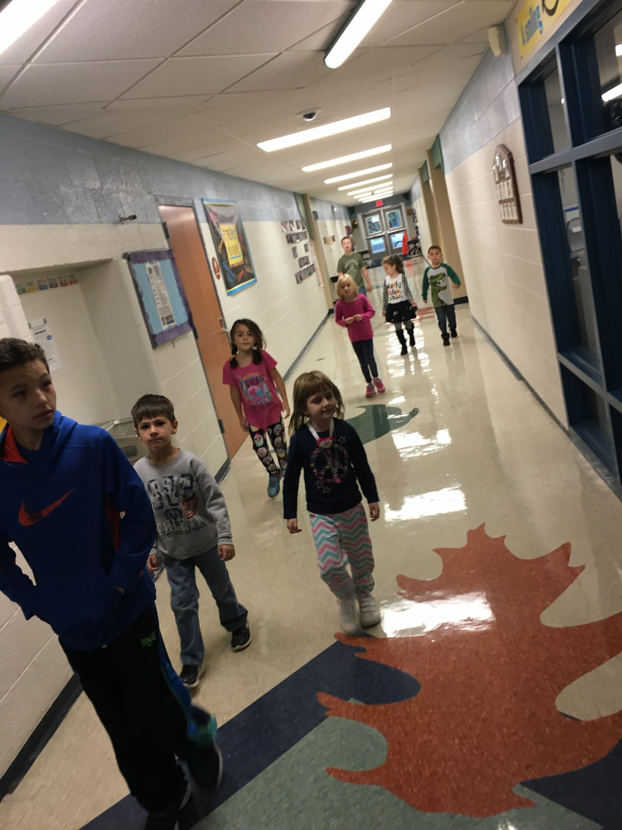
Weekly Cougar Cash Recipients
Two students are recognized each week from each class and their names are announced on Friday morning.
Students walk to Cougar Cash Store to receive prize.

Slide 20
Tier 2/3 Intervention

Slide 21
Examples of Tier 2 Interventions used at Arno Elementary
Active Supervision
Alternatives to Suspension
Bully Prevention (Classroom Based)
Check-in/Check-out
Calming Room-Couch
Instruction in Behavior Expectations/ Social Skills
Kids Hope Mentors
Take a Break
FBA’s/ BIPS, as needed

Slide 22
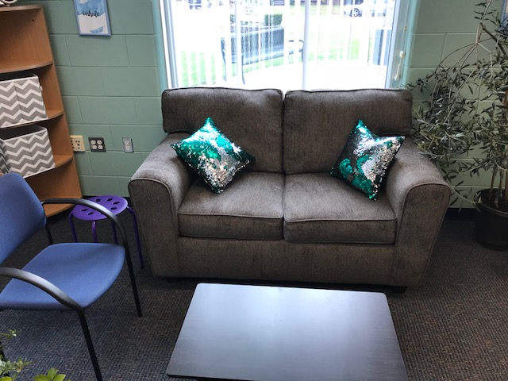
Calming Couch and Kits

Slide 23
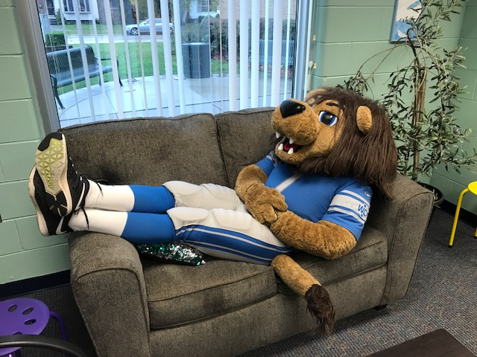
Calming couch in action

Slide 24
Tier 2 Intervention- Mentoring
5th graders elect to be on mentoring team as student leadership opportunity
Training during lunch times with social worker
Students selected for mentoring based on PBIS referral data.
Starts as soon as possible with last year’s data.
Yoga

Slide 25
Tier 3
Always a struggle
Unique to each student
Close communication with family
Specific behaviors identified and monitored (FBA/ BIP/ Data)
Outside agencies if appropriate/available
Attending RESA training in March

Slide 26
Contact Us!
jensen@appublicschools.com
smalley@appublicschools.com
schultz@appublicschools.com
bennett@appublicschools.com
zielinski@appublicschools.com

