Slide 1
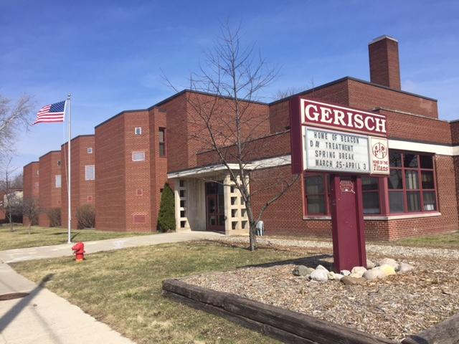
Beacon Day Treatment
12601 McCann St
Southgate,MI 48195
313-551-2790

Slide 2
What is Beacon Day Treatment?
Beacon Day Treatment is a comprehensive program for K-12 grade Students with Emotional Impairments who have exhausted alternatives in the continuum of special services available in community programs.
Beacon has been around for over 30 years, in various different buildings, throughout Wayne County
Notes:
JENN

Slide 3
Who can attend Beacon Day Treatment?
List of districts we provide services for:
Allen Park Huron Southgate Wyandotte
Dearborn Lincoln Park Taylor Woodhaven
Melvindale Trenton Grosse Ile Romulus
Ecorse River Rouge Van Buren Dearborn Heights #7
Gibraltar Riverview Flat Rock
**Transportation provided by Community School District**
Notes:
JENN
SOME districts plus 6 other academies

Slide 4
How the Program Works
The school wide PBIS is designed to facilitate the development of responsible social behavior and to promote a school experience that is rewarding and enriching. The long term goals for all students who participate in the program include:
To incrementally develop behavioral skills which are consistent with the expectations of the referring community school
To incrementally develop behavioral skills which are conducive to learning
To incrementally generalize the above mentioned skills and behavioral skills to classrooms in the community schools
Notes:
JENN
To develop responsible social behavior
Long term goal: develop appropriate behavioral and social skills to help the student be successful in home district and in society in general

Slide 5
Services Provided
-A five step Social Learning Program provides a positive framework for presentation of school expectations and individual behavioral goals
-Weekly Individual Counseling sessions provide students with the opportunity to develop a positive relationship with an adult in the program. Students learn to set realistic goals and evaluate them, as well as develop social, problem solving and decision making skills
-Students meet daily in small Affective Groups to discuss concerns, develop age-appropriate relationships, learn social skills and proactive problem-solving and decision making strategies
Notes:
JENN
Step Program
Individuals
Group

Slide 6
Academic Instruction
Academic Instruction is provided in small groups: 10 students per classroom with one teacher and one program assistant
Classes include: Reading, English, Social Studies, Math, Science and various electives
All credits obtained are transferable to the local school district
Eligible to earn high school diploma through the Michigan Merit Curriculum and Individual Districts
Additionally, for the 2018-19 school year a Certificate of Completion classroom was added
Notes:
JENN
Electives: Family Consumer Science, Spanish, Art, Gym
Diplomas are given by sending District, not Beacon

Slide 7
Staff to Student Ratio 5:1
Beacon is a K-12 building, ages 5- 19 years old, which includes 4 elementary classrooms, 5 middle school classrooms and 10 secondary classrooms, which totals a max amount of 190 students.
Each classroom has a Special Education Teacher as well as a Program Assistant present.
There are a total of 9 Social Workers that average 18-22 students on their caseloads.
Each student has an “individual” that meets with them once a week for 30-45 minutes as well as other times to work on individualized behavior goals.
Notes:
JENN
Individual (SW or assigned staff - higher step students) → use the “check in/check out” approach

Slide 8
Support Staff
Principal and Vice Principal Behavioral Specialists/Center Staff
Social Workers School Psychiatrist
Speech Pathologist Special Education Teachers
Teacher Consultant Math Interventionist
Reading Interventionist Program Assistants
Intake coordinator/Clinical Consultant Building Subs and 1-on-1’s
Notes:
JENN

Slide 9
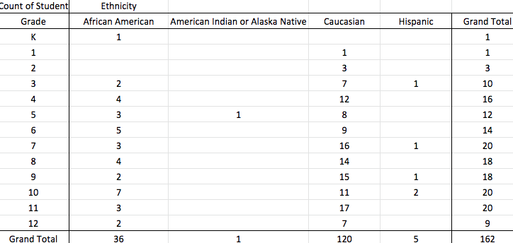
Demographics by Ethnicity
Notes:
DEANNA

Slide 10
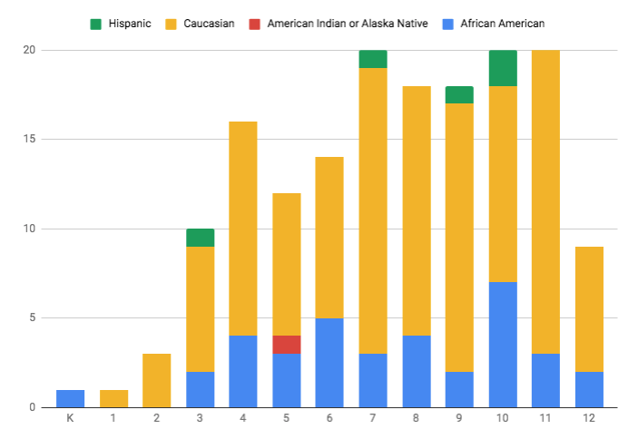
Demographics by Ethnicity
Notes:
DEANNA
African American: 22%
Caucasian 74%
Hispanic: 3%
American Indian 1%
Total 162 students

Slide 11
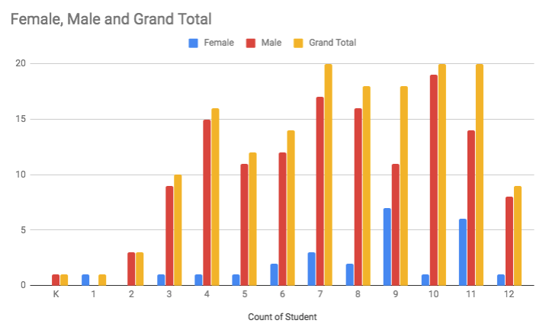
Enrollment Trends by Gender
Notes:
DEANNA- The Older the students are when they come to us, the longer they tend to stay

Slide 12
Behavior Management Interventions
Behavior Management Interventions are an integral part of the program. When a student becomes disruptive to the learning process, a series of time-out interventions, both in and out of the classrooms, are implemented. During each intervention the student is given the opportunity to regain behavioral control through life space counseling on problem solving or decision making steps to secure a successful return to the classroom. All staff are trained in Crisis Prevention Intervention (CPI).
Sample Point Sheet
Notes:
SARAH-
Students EARN points, not taken away- sample point sheet
Level 0- talking in class, redir as reminder of the expectation, break “ for continuing to talk out”- to contemplate or regroup, Center if they can not take responsibility for their actions/ arguing

Slide 13
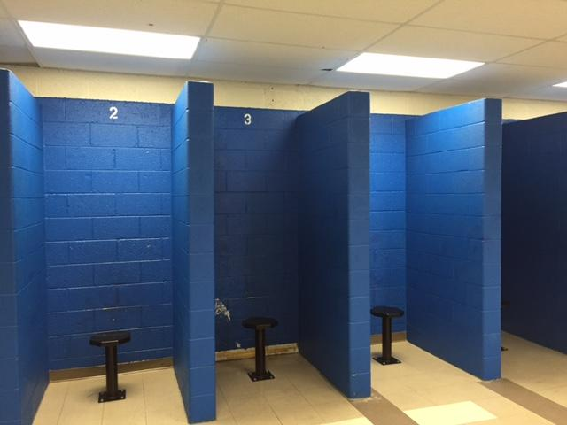
Centers
There are 4 Behavioral Centers in the building (Elementary, MIddle School and 2 in the Secondary/High School) with 2 Behavioral Specialist in each center
The Goal of each center is for the students to take responsibility for their actions as well as practice corrective behaviors and implement problem solving skills
Notes:
SARAH-
Practice corrective behavior

Slide 14
PBIS at Beacon
Beacon’s School-Wide Positive Behavioral Interventions Support (SW-PBIS) is a proactive approach which teaches new behaviors to students based on the values of :
-Responsibility for Self
-Respect for Self and others
-A safe environment that provides a consistent, predictable and fair school environment for all
Notes:
SARAH

Slide 15
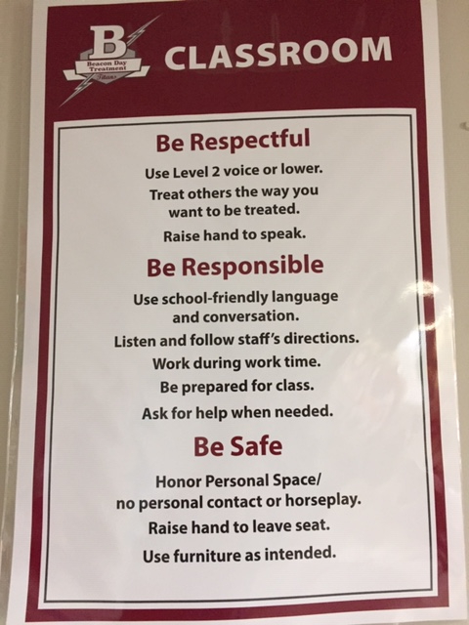
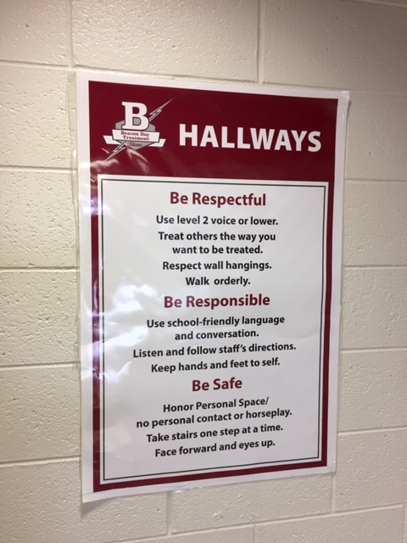
Posters throughout the building and in every classroom
Notes:
SARAH
Elementary - working on different posters

Slide 16
How Are We Working On Implementing PBIS?
Lesson plans that teach specific skills we are addressing that are age specific, taken from the Michigan Model, taught in group throughout school
Refocus plan MS and HS Refocus Elementary
Matrix 1 and Matrix 2
Focused on areas of Bussing and Transportation as our first step, now continuing those areas of focus, as well as Hallway Movement
Notes:
DEANNA- Group time for lesson plans and teaching areas of concern
EACH month we have a different focus of incentives to promote the areas of the matirx

Slide 17
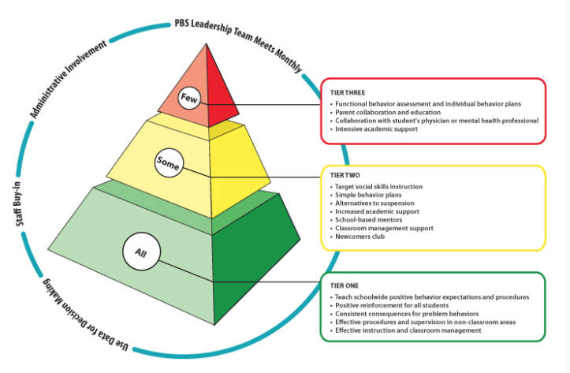
Tiers at Beacon compared to traditional PBIS Tiers
“Traditional” PBIS Tiers
/www.resa.net/curriculum/schoolwide-positive-behavioral-interventions-supports/
Notes:
DEANNA

Slide 18
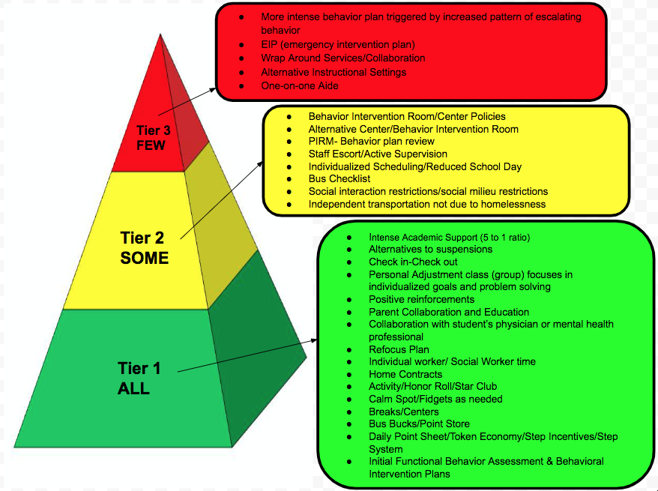
Tiers at
Beacon
Notes:
DEANNA

Slide 19
Challenges of Implementing PBIS
Lack of training time for all staff (New and Older staff)
How we addressed this- Program Coordinator that teaches the expectations to all staff
Staff Turnover
How we addressed this- continued training and committee open to everyone
Staff feel “no idea what is happening with PBIS”
How we addressed- created a website that is updated frequently
Notes:
DEANNA

Slide 20
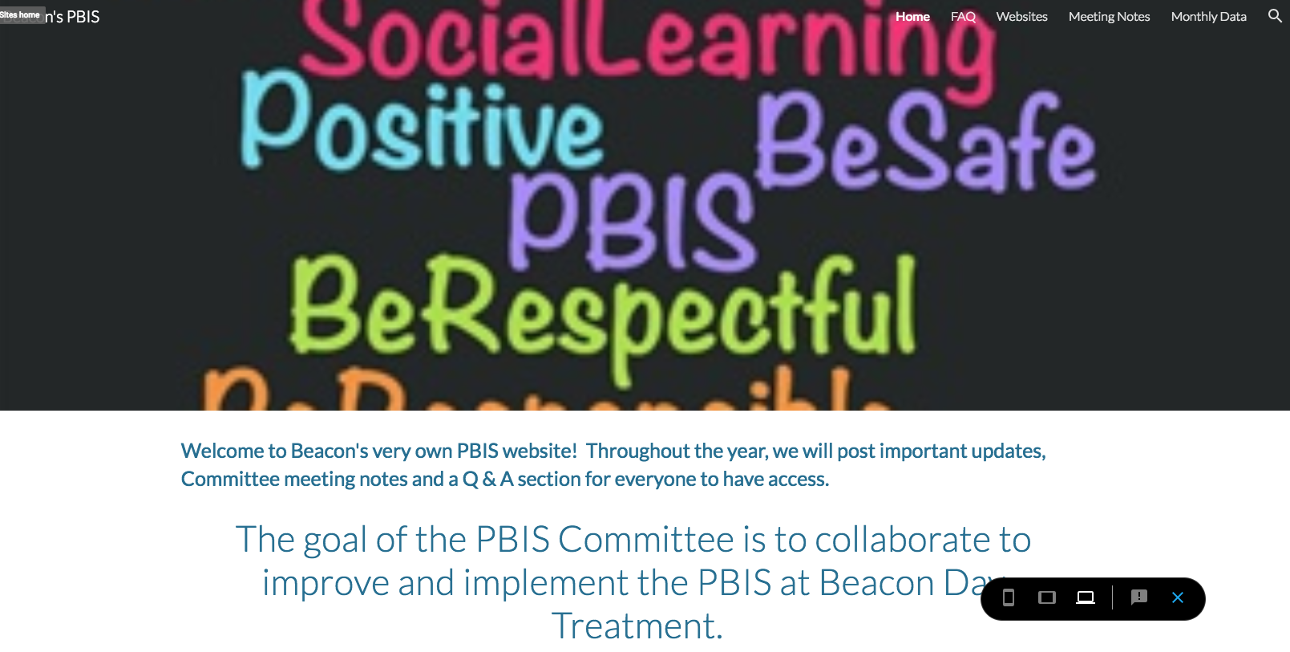
Beacon PBIS Website
Notes:
DEANNA

Slide 21
Wraparound Services
We have around 8-10 intensive Wrap Around Cases/Tier 3
Inventions often include providers outside of Beacon to maximize student growth in less formal process: Outpatient therapy team, Probation Officers, Local District team, Residential treatment team
At Beacon, over 80% of or students are involved in outpatient treatment & often with medical intervention.
Notes:
SARAH
A lot of our students have significant mental health issues and have spent time in intensive outpatient programs (New Oakland Face to Face) and/or in inpatient treatment.
Many students have also had significant contact with the judicial system (regular police contact, JDF, probation)

Slide 22
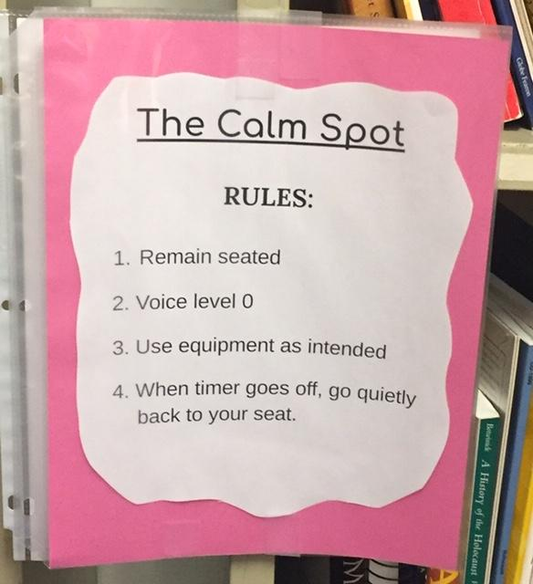
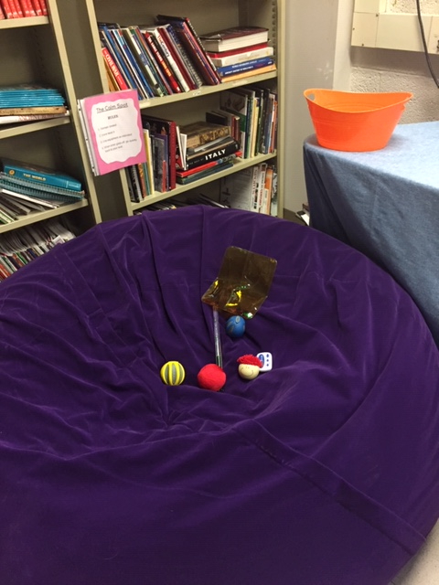
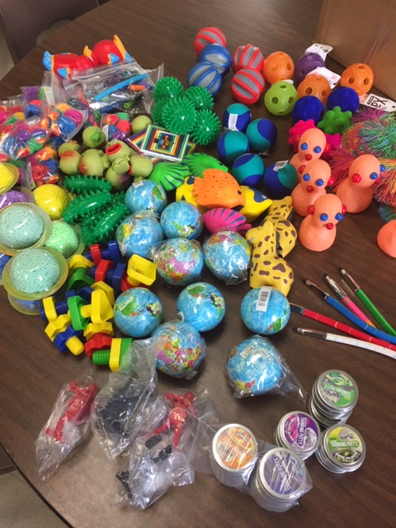
Calm Spot
Notes:
SARAH
What’s in the calm spot/ What’s it look like ---
Guidelines of using calm spot --- 7 min. Anytime aside from when returning from the center, 7 min. of work first.
There have been a variety of responses, differing at grade levels.
Elementary - a lot resistance to use (4th/5th)
(K-3) Hit or miss. ASD kids more so.
Middle - Abuse the calm spot → Work avoidance8th graders use the calm spot the most usually to either work avoid or because they think the work is frustrating so rather than asking for help they will use it up to as many times allowed. My 9th graders hardly ever use it...but...I think that is because I have fidgets in each of the caddies I pass out at the beginning of class, fidget cubes to be exact. The only issue I am finding is that some 8th graders will purposely break items that were given to us so I have had to use alternatives such as squishes or even a coloring book with crayons.
High School - Effective

Slide 23
National Convention
First year we attended the National Convention(2015), we focused more on How to implement PBIS in our unique setting. We also created the “Refocus Plan” which stream lined different interventions that were already being used, so the whole building was on the same page.
This year (2018-19), we focused more on the different alternatives to suspensions, the different tiers we have within our school system and are working on implementing more Trauma Informed Practices and Resiliency into our daily teachings and practices.
Notes:
JENN- talk about how important it is to have principals/superintendents to be involved at the national convention.
For buy in from staff, the district leaders must take the lead and believe in PBIS.

Slide 24
Contact Information
Deanna Devore (Teacher and PBIS Coach)
devored@sgate.k12.mi.us
Sarah Stawowy (Social Worker)
stawowys@sgate.k12.mi.us
Jennifer Hill (Principal)
Hillj@sgate.k12.mi.us

